Slide 1

NCA5 Website: https://nca2023.globalchange.gov
Chapter Website: https://nca2023.globalchange.gov/chapter/appendix-4/
NCA5 Atlas: https://atlas.globalchange.gov
Figure captions can be found in the slide notes of this deck
Social media: @usgcrp, #NCA5

Slide 2
Appendix 4 | Indicators

Slide 3
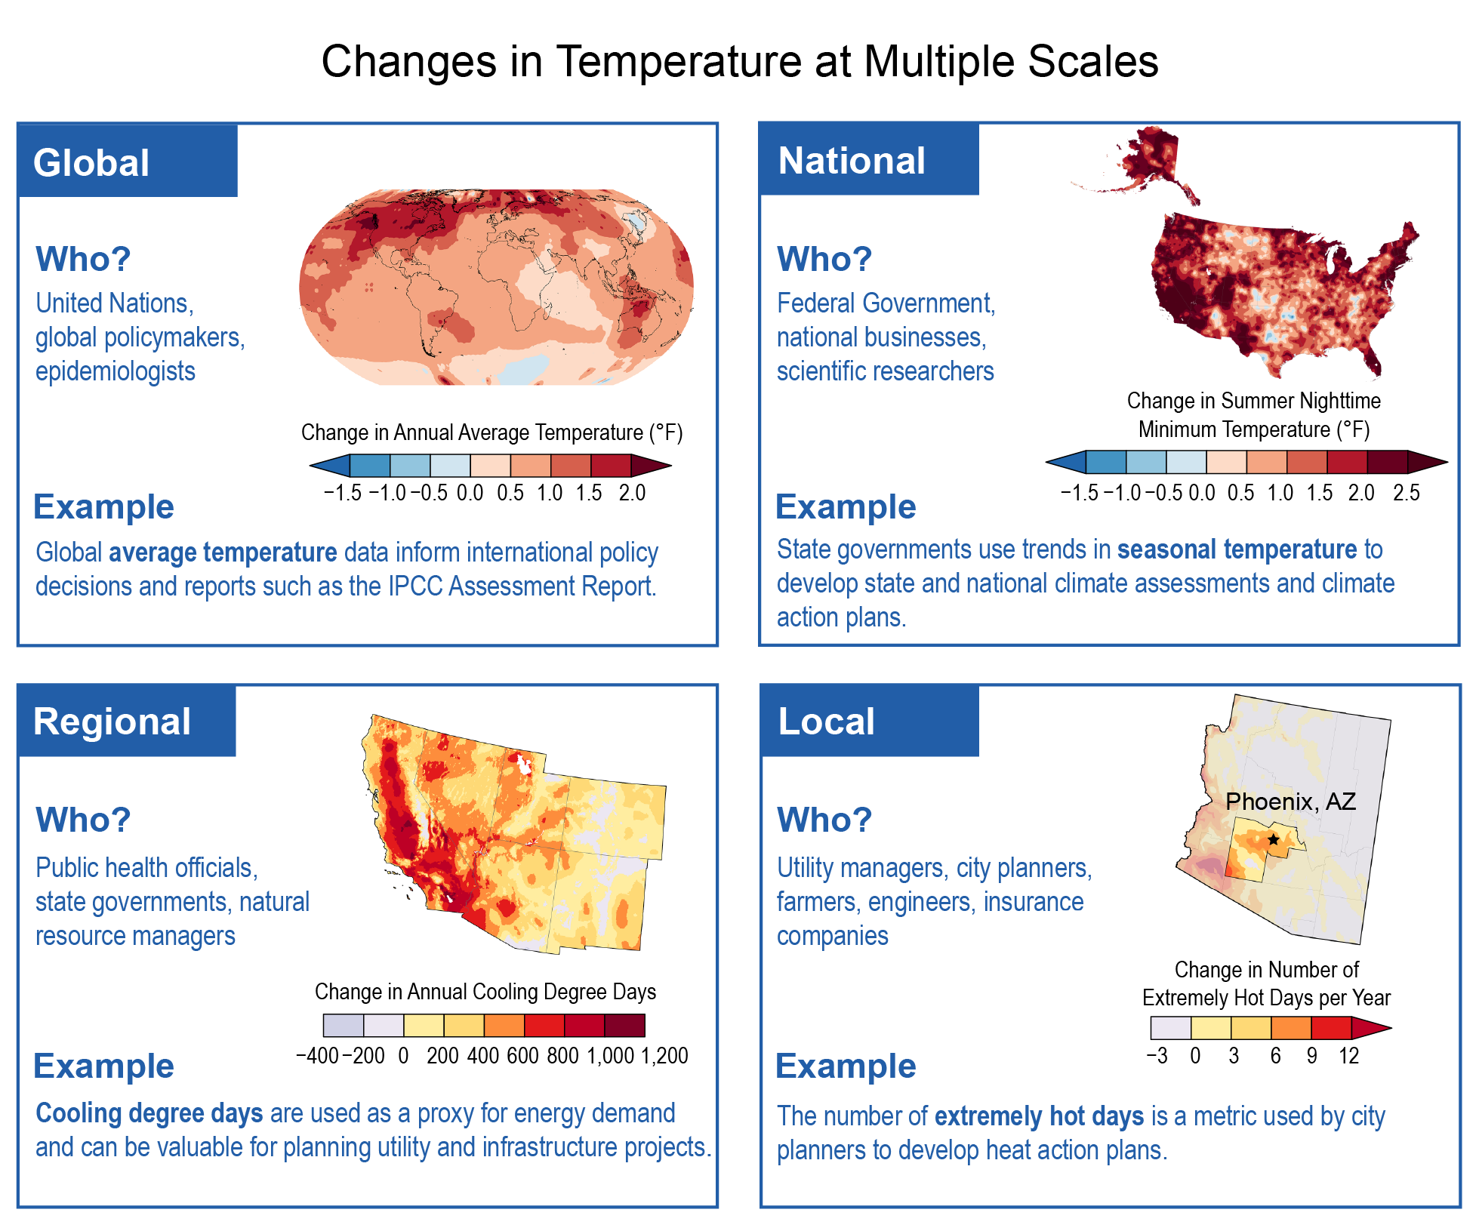
Figure A4.1. Presenting indicators at different scales allows stakeholders to obtain information relevant to their needs.
Notes:
CAPTION: Many people use climate-related indicators for resource and management decisions, from small-scale farmers to global policymakers. Different indicators are relevant at different geographic scales, depending on who uses the information and for what purpose. In this figure, temperature indicators are shown at four scales, with each map depicting spatial patterns in the amount of observed change: (top left) global annual average temperature for the period 1993–2022, relative to 1901–1960; (top right) national (contiguous US and Alaska) summer nighttime minimum temperature for 1993–2022, relative to 1901–1960 (relative to 1926–1960 for Alaska; data are not available for the US Caribbean, Hawaiʻi, or the US-Affiliated Pacific Islands); (bottom left) regional (Southwest region) cooling degree days for 1993–2022, relative to 1951–1980; and (bottom right) local (Maricopa County, Arizona) number of days with maximum temperatures of 110°F or higher for 1993–2022, relative to 1951–1980. Data used for the regional and local indicators are available only from 1951 onwards. In general, increases in each metric have occurred since the start of their respective records, with important variations that are relevant to decision-makers at each scale (see Section A4.2 for additional explanation). Figure credit: North Carolina State University and NOAA NCEI.

Slide 4
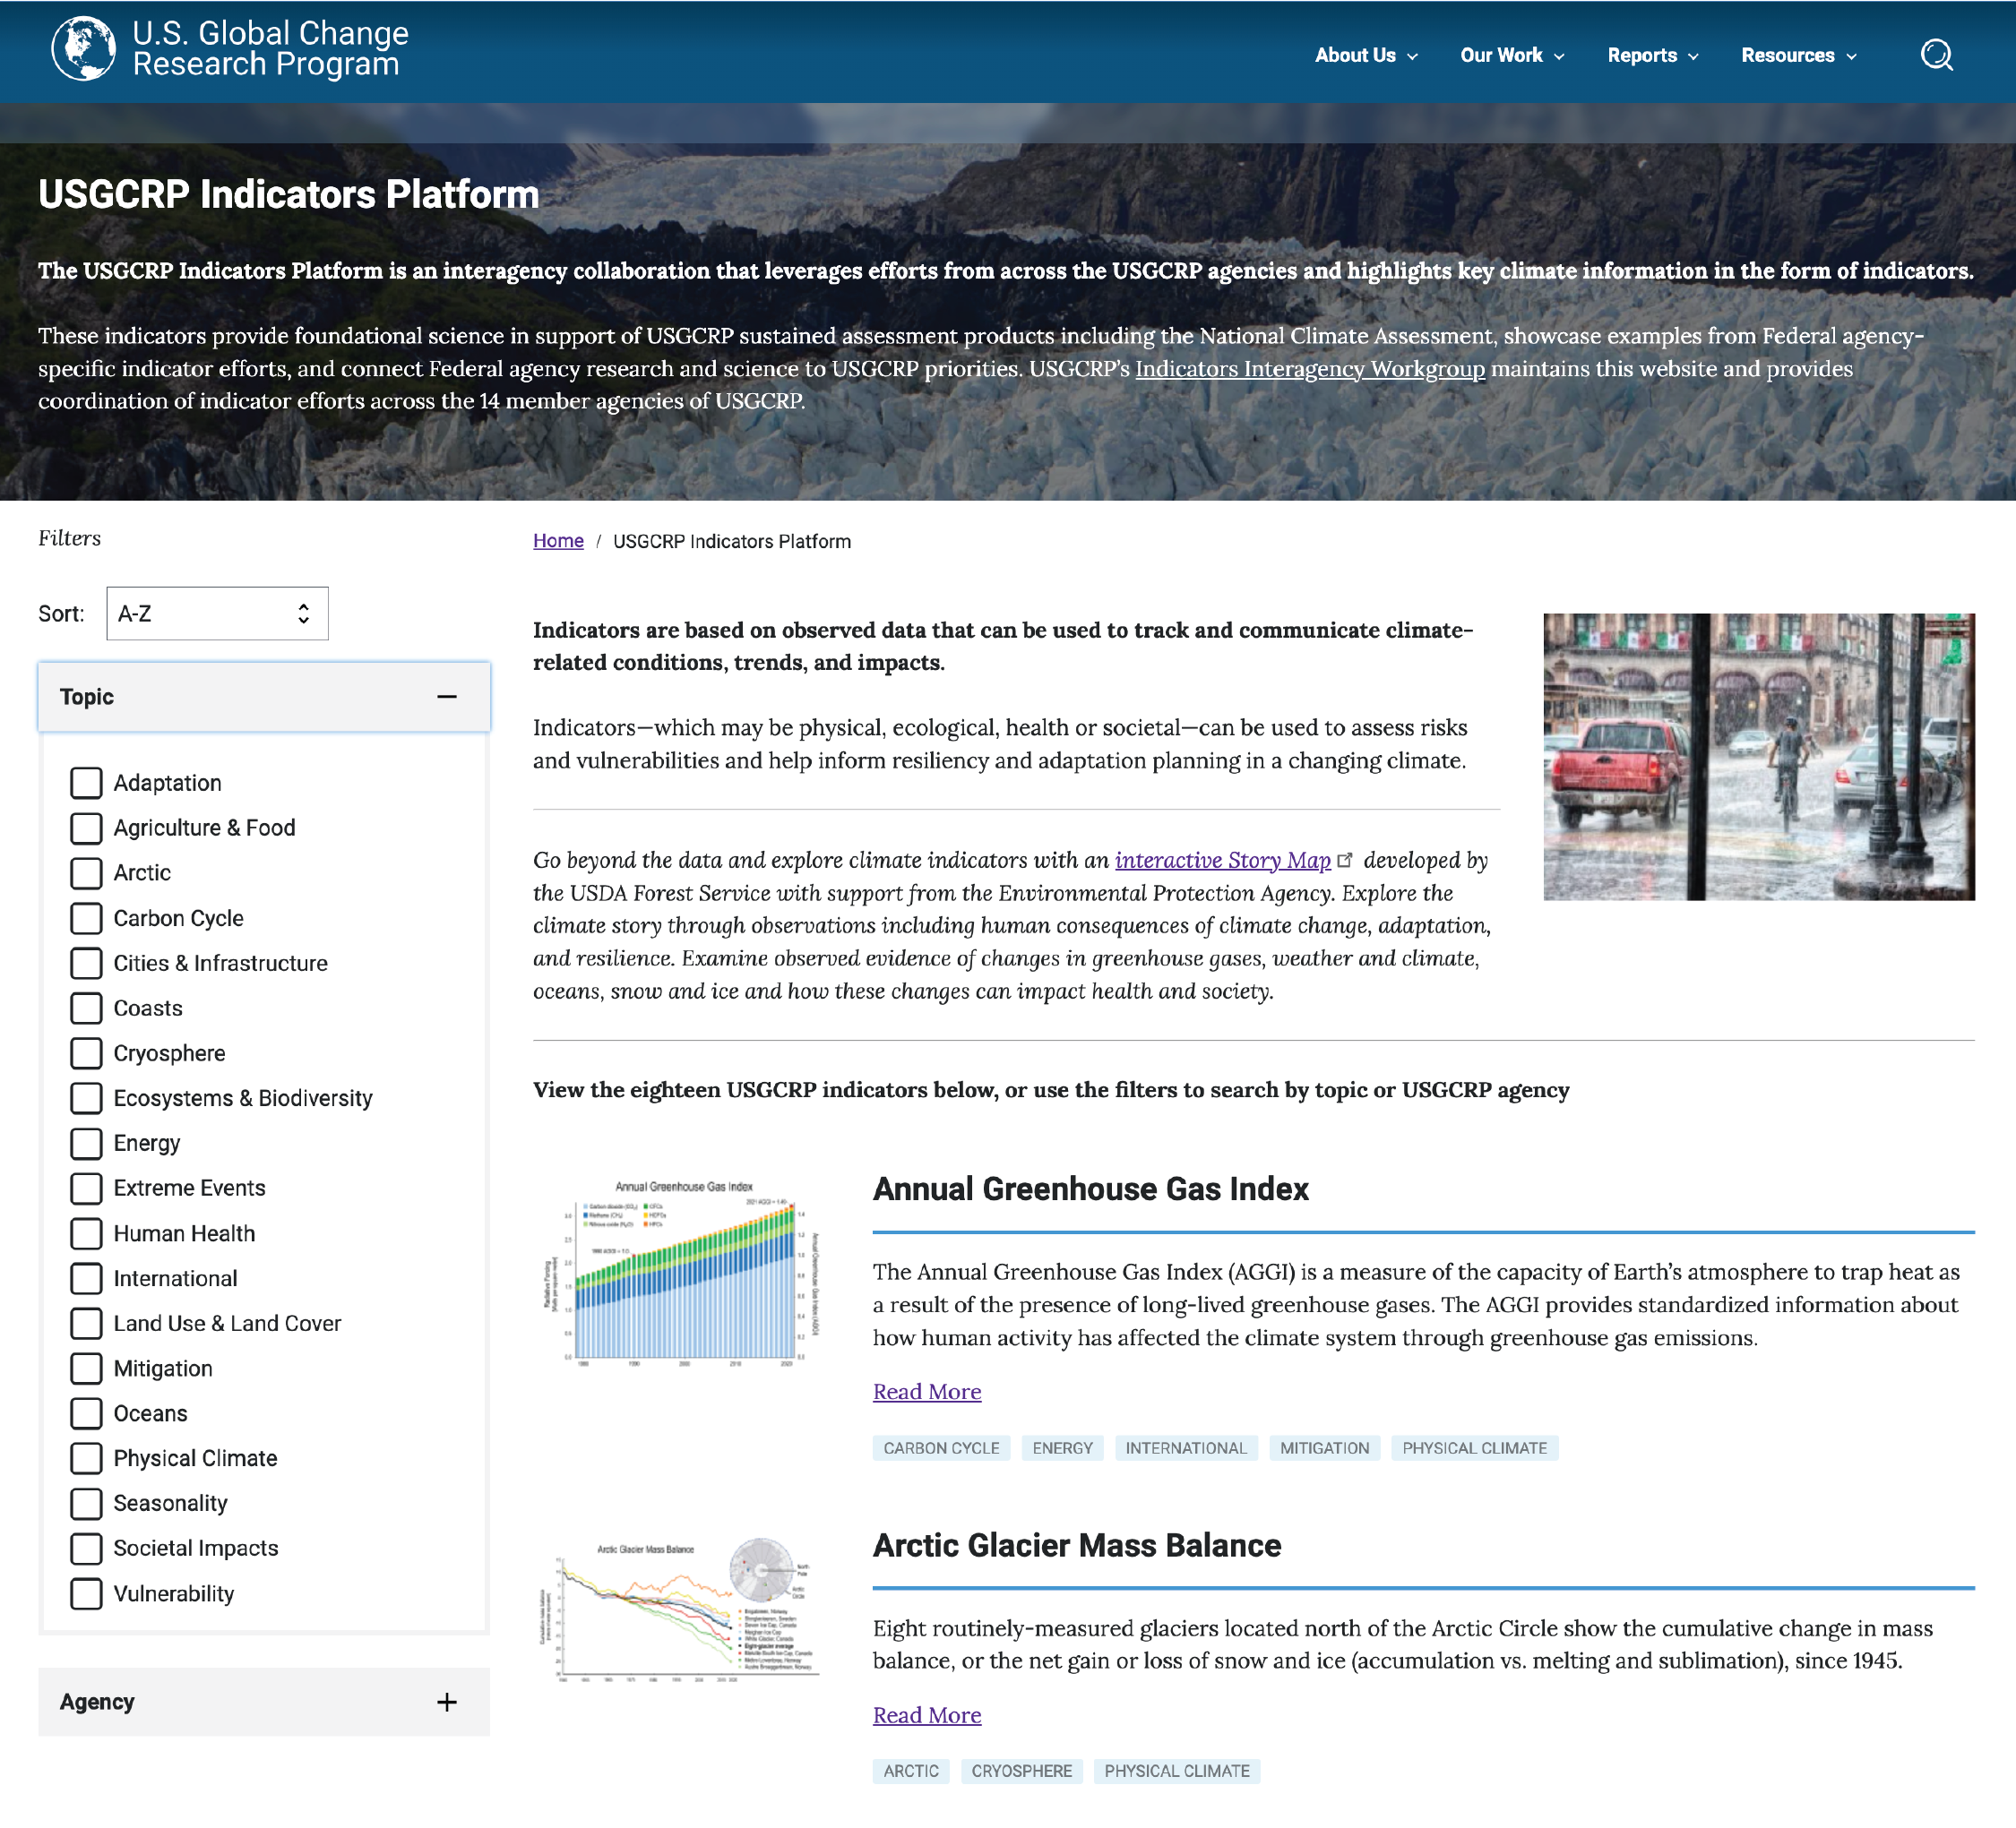
Figure A4.2. The USGCRP Indicators Platform leverages agency-supported science and data to understand how environmental, health, and societal conditions are changing.
Notes:
CAPTION: Screenshot from the USGCRP Indicators Platform: https://www.globalchange.gov/indicators/. Figure credit: USGCRP 2023. (USGCRP 2023)

Slide 5
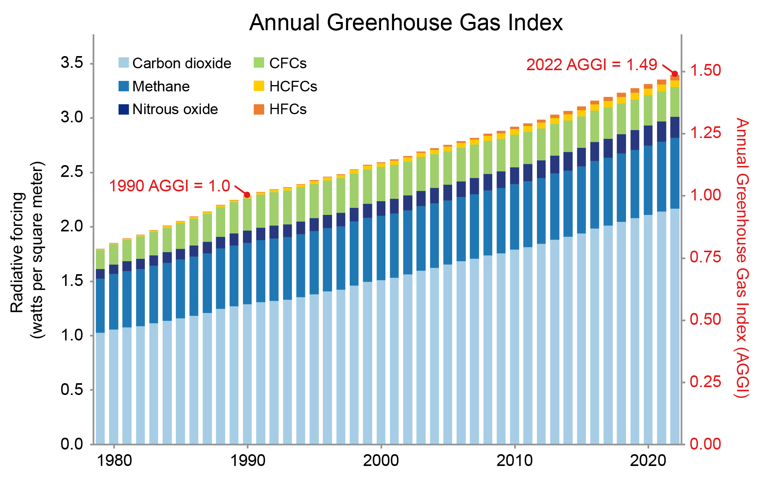
Figure A4.3. The warming effects of greenhouse gases are increasing over time.
Notes:
CAPTION: Radiative forcing (left vertical axis) is the change, either positive or negative, in the amount of energy from the sun that is trapped by Earth’s atmosphere. Increases in the amount of radiative forcing will lead to warming. The Annual Greenhouse Gas Index (AGGI; right vertical axis) compares the total radiative forcing for each year from 1979 to 2022 to the year 1990 (represented by a red dot). The year 1990 was selected as the year for comparison because that is the year the Montreal Protocol(UN Environment Programme n.d.) was signed, so its AGGI value is designated here as 1.0. The 2022 AGGI (also represented by a red dot) was 1.49, indicating that the average warming influence of long-lived greenhouse gases in the atmosphere has increased by a total of 49% since 1990. The increased radiative forcing leads to increasing temperatures, both in the oceans and over land. Indicators of these changes and impacts are found in this appendix and throughout the report. CFCs = chlorofluorocarbons, HFCs = hydrofluorocarbons, HCFCs = hydrochlorofluorocarbons. Adapted from USGCRP 2023. (USGCRP 2023)

Slide 6
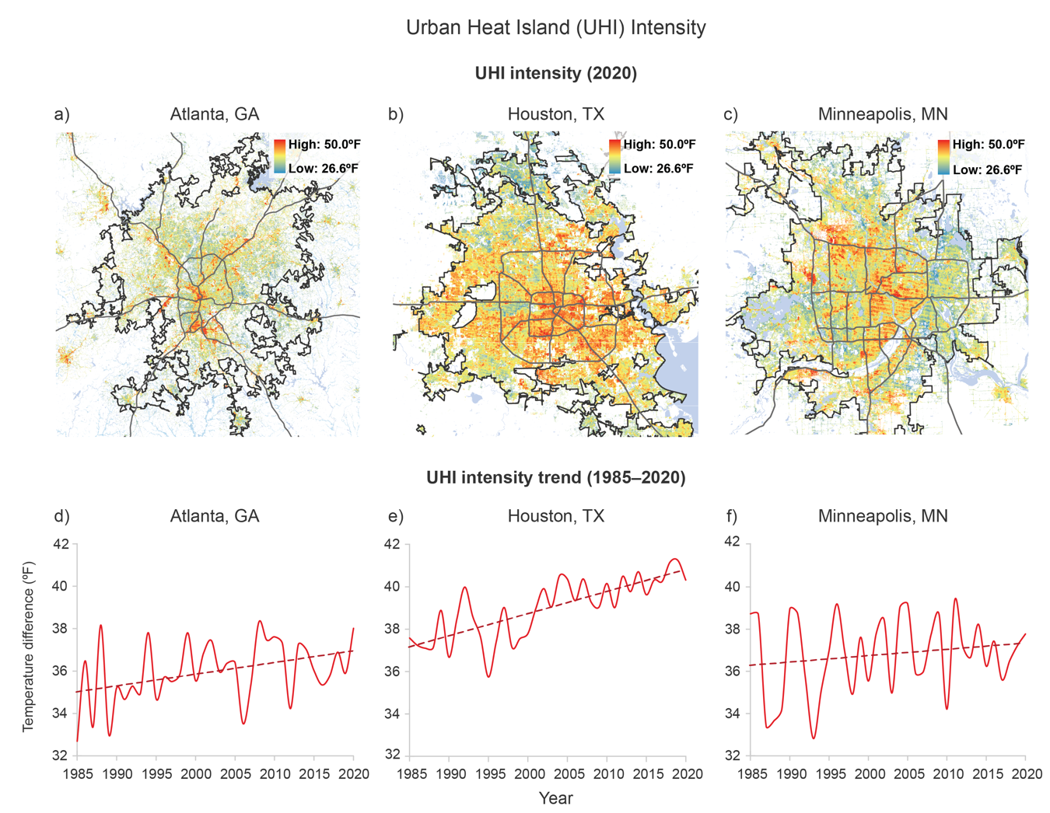
Figure A4.4. Urban heat island intensity is increasing in many US cities due to the combination of urbanization and rising temperatures.
Notes:
CAPTION: Urban heat island (UHI) intensity is defined as the annual difference in average temperature between areas that are urban versus nonurban (within a 5 km, or approximately 3.1-mile, buffer zone of the city boundary). Indicators and maps of UHI intensity can help inform heat-mitigation strategies such as implementing urban vegetation cover.(Xian et al. 2022) Top row: Maps for the year 2020 are presented for (a) Atlanta, (b) Houston, and (c) Minneapolis, showing temperature differences used to determine UHI intensity for that year. Both hotspots and areas of lower temperatures are evident. Bottom row: Trends in average UHI intensity from 1985 to 2020 are presented for (d) Atlanta, (e) Houston, and (f) Minneapolis. Solid lines show observed data, while dashed lines represent the estimated trend for the period of record. Companion figures depicting the relationship between temperature and socioeconomic factors for these same cities can be seen in Figure 12.6. Figure credits: (a, c, d, f) adapted from Xian et al. 2022;(Xian et al. 2022) (b, e) USGS and NIEHS / Kelly Government Solutions.

Slide 7
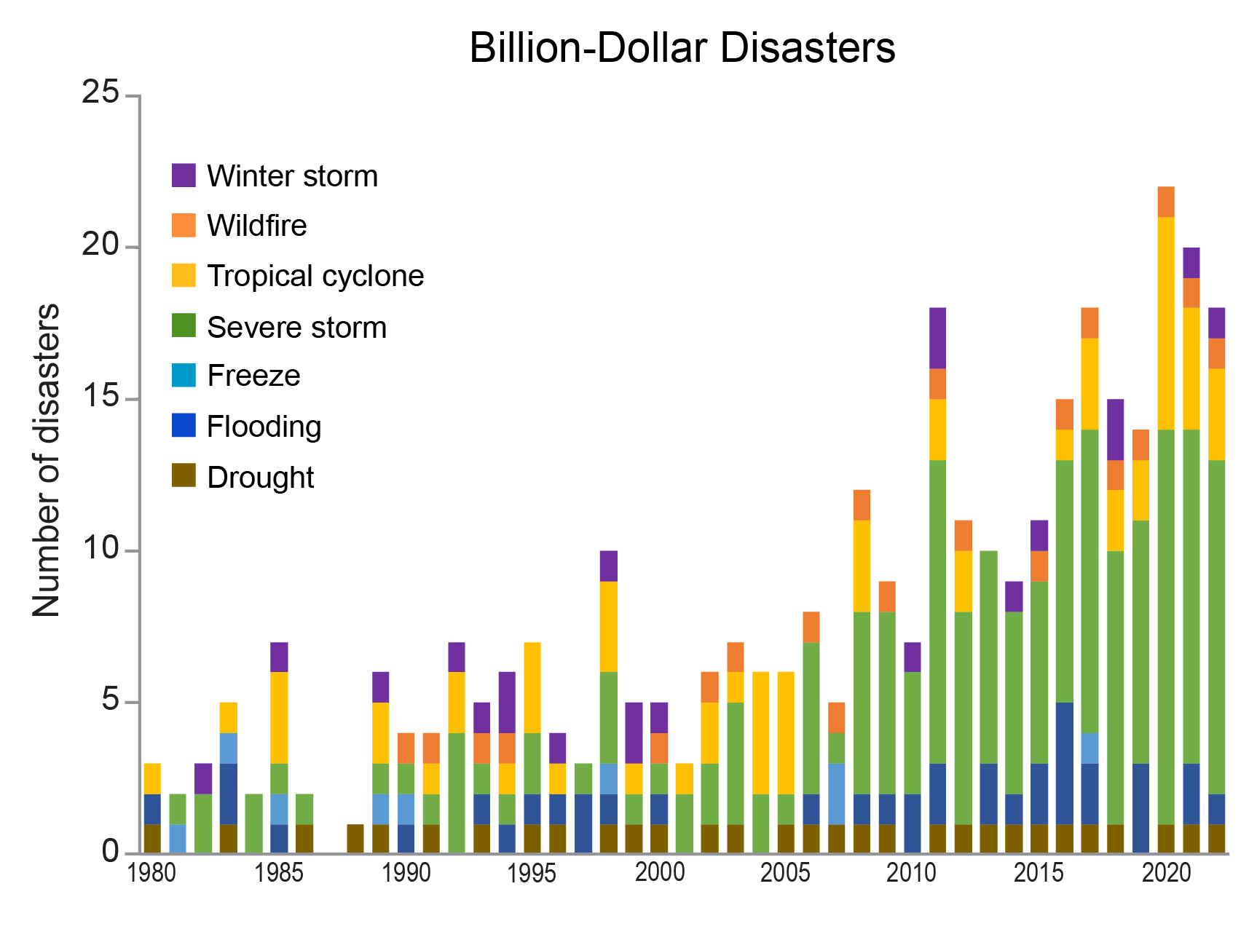
Figure A4.5. The number of weather- and climate-related disasters exceeding $1 billion has substantially increased since 1980.
Notes:
CAPTION: This indicator provides insight into the frequency of events exceeding $1 billion in damages (adjusted for inflation) from 1980 to 2022 across seven disaster types, each represented by its own color. The severe storm category includes events such as tornadoes, hail, and damaging winds but not tropical cyclones or winter storms. The only year with no billion-dollar events was 1987. Since then, the number of events each year has generally increased, with 2020 and 2021 having the two highest number of events on record. The number and cost of these disasters are due to several complex factors. Climate change is leading to increases in the frequency and intensity of extreme events, and, at the same time, there have been continual increases in the numbers of buildings, infrastructure, and people in climate-sensitive areas where these events may occur.(Smith 2022) Economic factors can also play a role. For example, there is potential for property values to increase at rates higher than the Consumer Price Index, which can lead to higher damage assessments compared to previous years. An interactive version of this indicator, including the total annual cost and a breakdown by state and region, can be found at https://www.ncei.noaa.gov/access/billions/time-series/.(NCEI 2023) Adapted from USGCRP 2023. (USGCRP 2023)

Slide 8
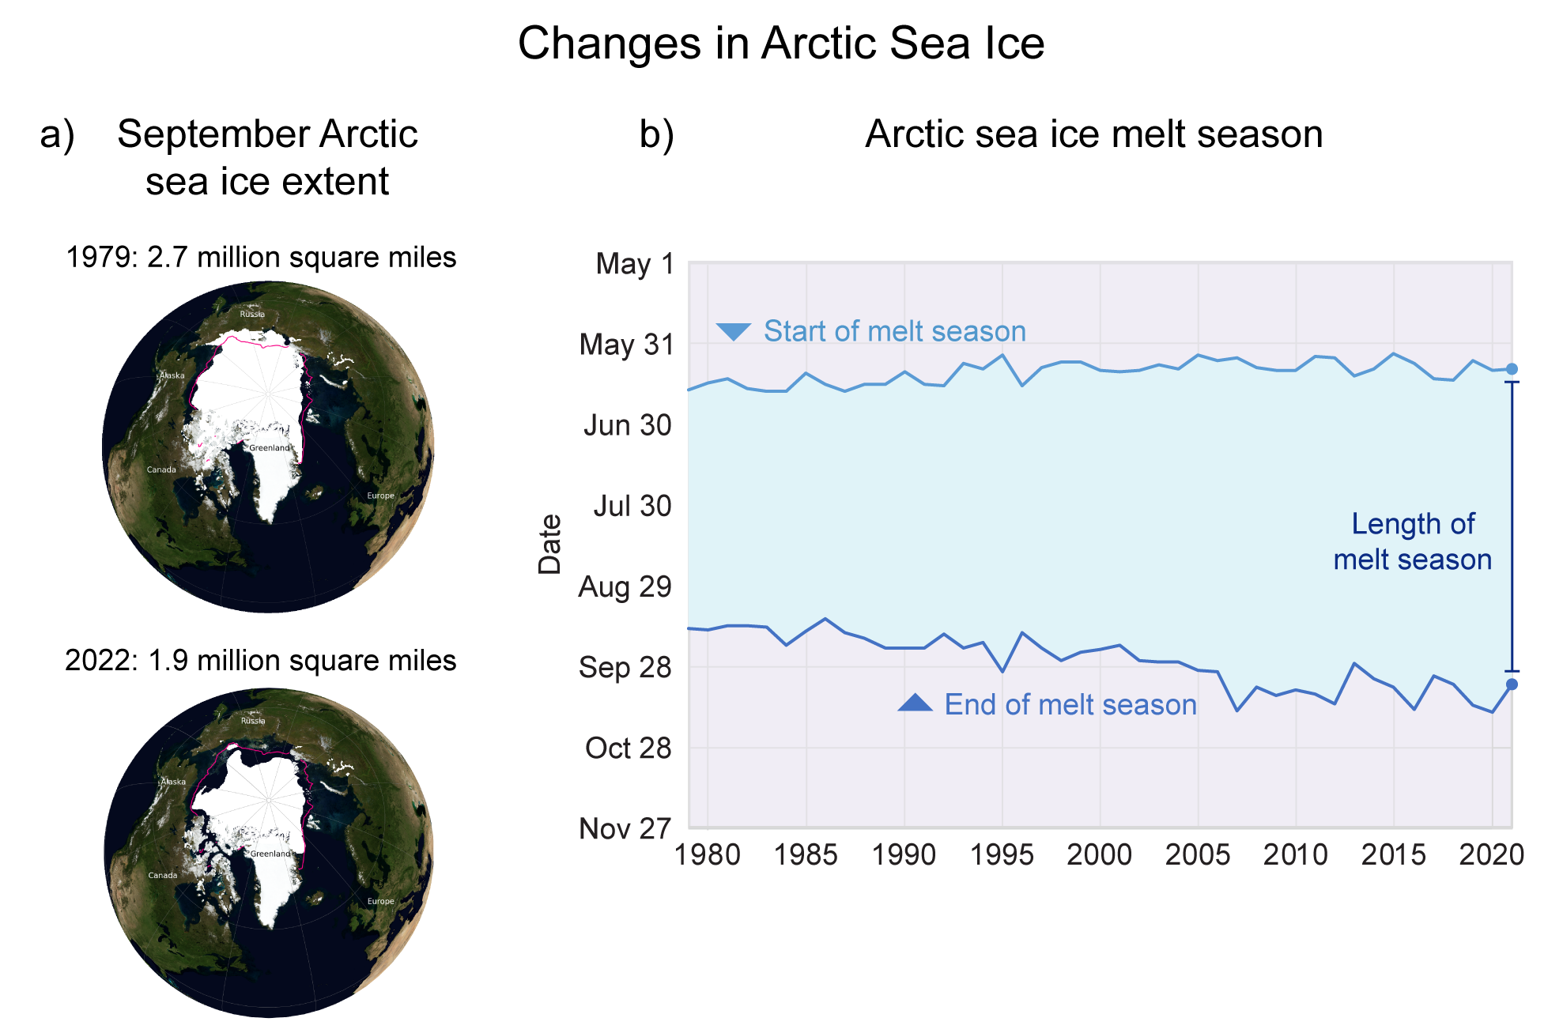
Figure A4.6. Arctic sea ice is shrinking as the melt season grows longer.
Notes:
CAPTION: An increasingly later end to the melt season is the primary contributor to both the longer season and the declining ice extent. (a) This indicator compares the annual minimum sea ice extent—the smallest area of sea ice—measured in the Arctic in 1979 (the beginning of the record) and 2022 (the most recent year of observation). The pink line on each map represents the median ice edge for 1981 to 2010. (b) This indicator shows the annual length of the Arctic sea ice melt season from 1979 to 2021. The blue shaded area represents the amount of time between the date when ice begins to melt consistently (light blue line) and the date when it begins to refreeze (dark blue line). (a) Adapted from NSIDC 2023;(NSIDC 2023) imagery from the Special Sensor Microwave Imager/Sounder (SSMIS) instrument, courtesy of NASA and NSIDC; (b) adapted from EPA 2023. (EPA 2023)

Slide 9
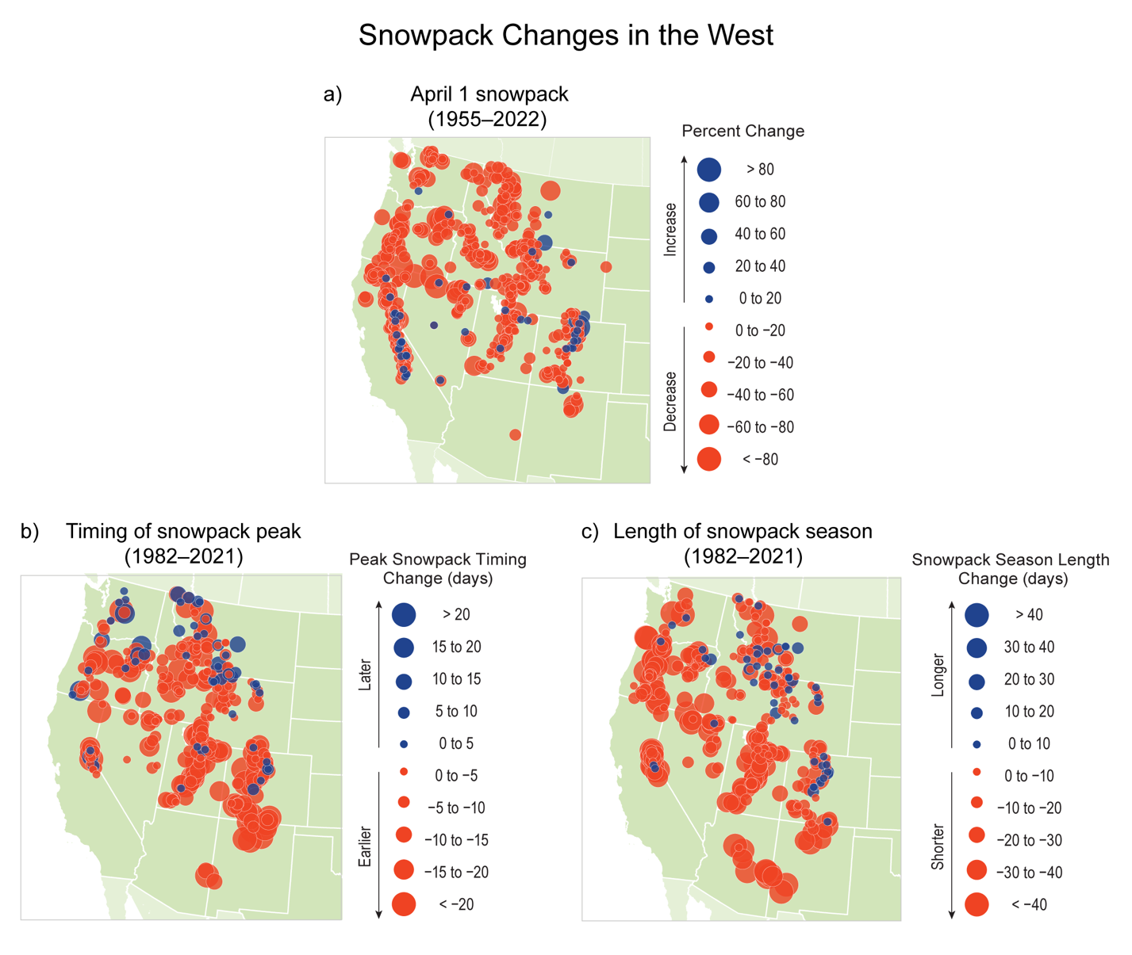
Figure A4.7. Western snowpack is declining, peak snowpack is occurring earlier, and the snowpack season is shortening in length.
Notes:
CAPTION: The overall amount of snow has been declining across the western United States, as shown in three indicators: (a) trends in snowpack on April 1 (percent change) from 1955 to 2022 (red and blue circles represent a decrease and increase, respectively); (b) change in the annual date when snowpack reaches its maximum amount (days) from 1982 to 2021 (red and blue circles represent a shift to earlier and later timing, respectively); and (c) change in snowpack season length (days) from 1982 to 2021 (red and blue circles represent a shortening and lengthening of the snowpack season, respectively). Adapted from EPA 2023. (EPA 2023)

Slide 10
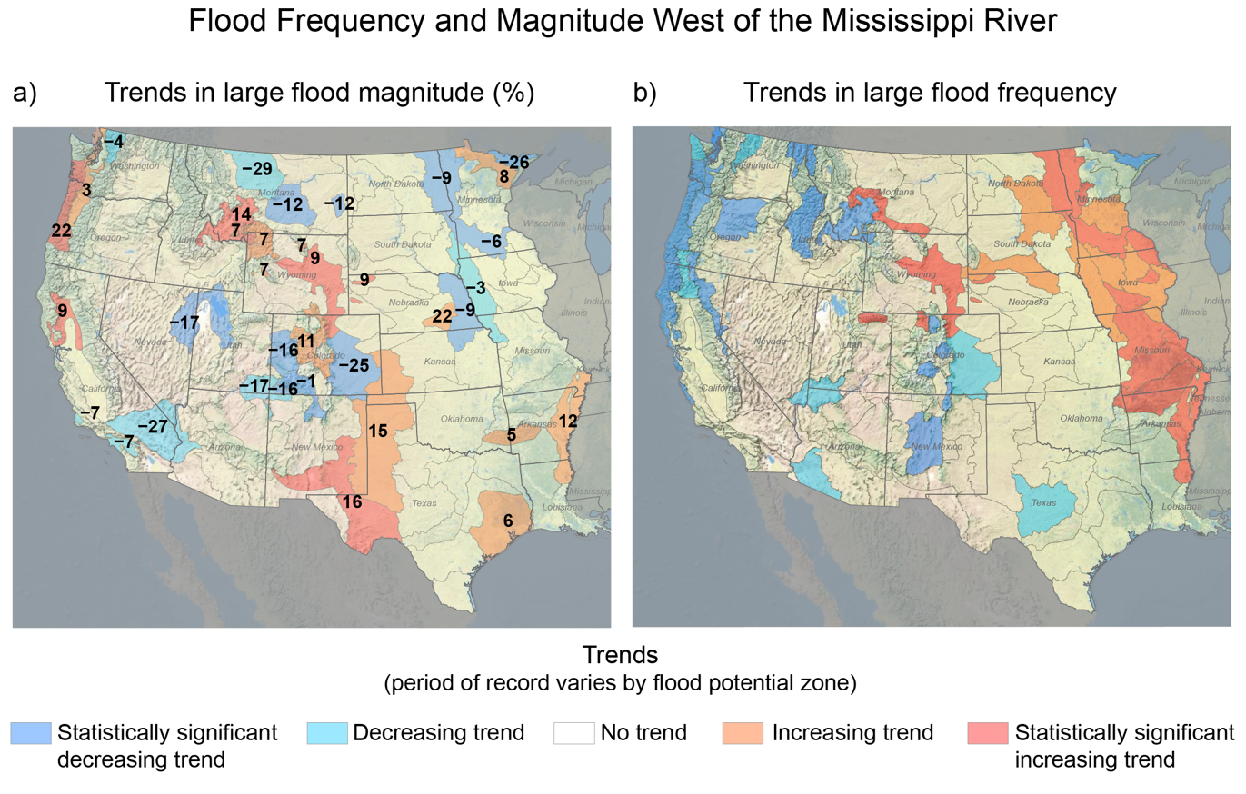
Figure A4.8. Trends in flood magnitude and frequency vary widely across the western US.
Notes:
CAPTION: Flood magnitudes are increasing along the Oregon coastline, throughout large portions of the central Rockies and southern Great Plains, and in parts of the Gulf Coast, whereas flood frequencies are increasing across a large area east of the Rocky Mountain Front.(USFS 2022) This indicator shows trends in (a) magnitude and (b) frequency of large floods in the western US within 117 flood potential zones. Shading in warm colors (reds) represents increasing trends, and shading in cool colors (blues) represents decreasing trends. Darker shades indicate where trends are statistically significant. (a) Percent change in annual flood magnitudes is indicated by black numbering. Trends in magnitudes vary by the available record length (most commonly from the early 1900s through 2020), while (b) trends in frequency are for 1945 to about 2020. Data are not yet available for the US Caribbean, Alaska, or Hawaiʻi and US-Affiliated Pacific Islands regions, as well as the contiguous US east of the Mississippi River. Additional information related to trends in large floods is provided in the Flood Potential Portal at https://floodpotential.erams.com/. Figure credit: USDA Forest Service.

Slide 11
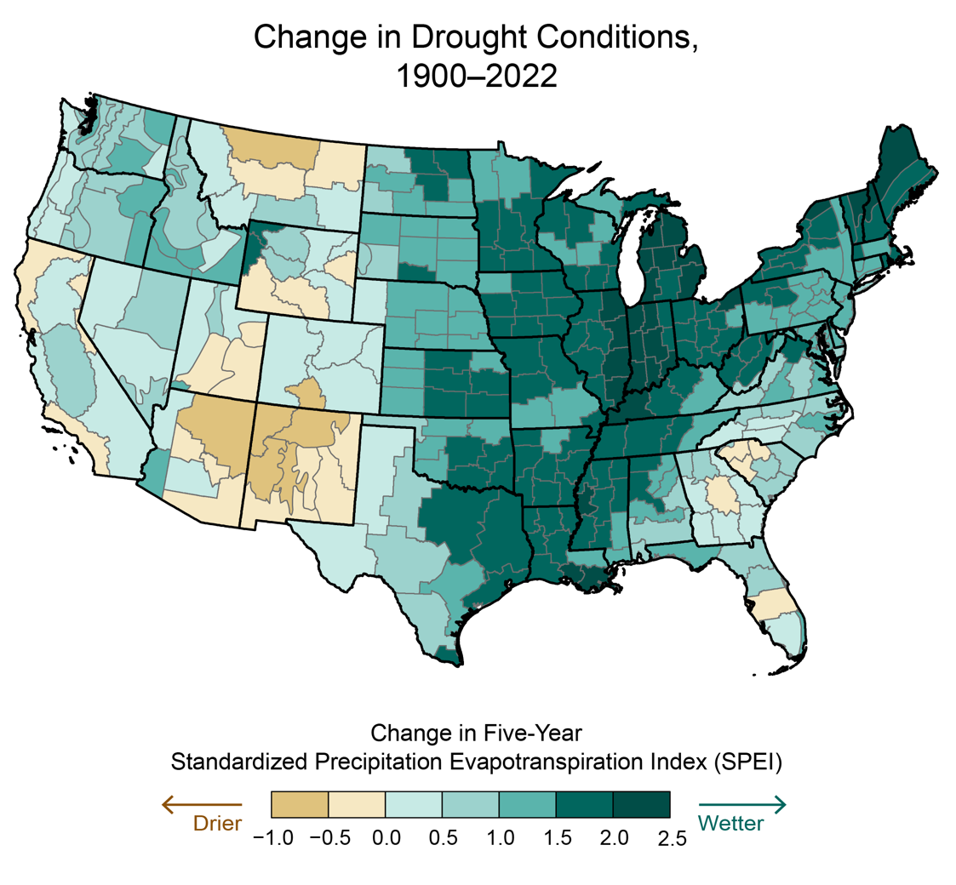
Figure A4.9. Long-term records show conditions are becoming drier in many portions of the West and wetter elsewhere, particularly the East.
Notes:
CAPTION: Since the early 20th century, the eastern US has generally experienced wetter conditions, while portions of the West—especially the Southwest—have experienced drier conditions. This map shows the total change in drought conditions across the contiguous United States, based on the long-term average rate of change in the five-year Standardized Precipitation Evapotranspiration Index (SPEI) from 1900 to 2022. Data are displayed for small regions called climate divisions, as defined by NOAA.(NCEI n.d.) Teal-shaded areas represent wetter conditions, and brown areas represent drier conditions. Data are not available for the US Caribbean, Alaska, or Hawaiʻi and US-Affiliated Pacific Islands regions. Adapted from EPA 2023. (EPA 2023)

Slide 12
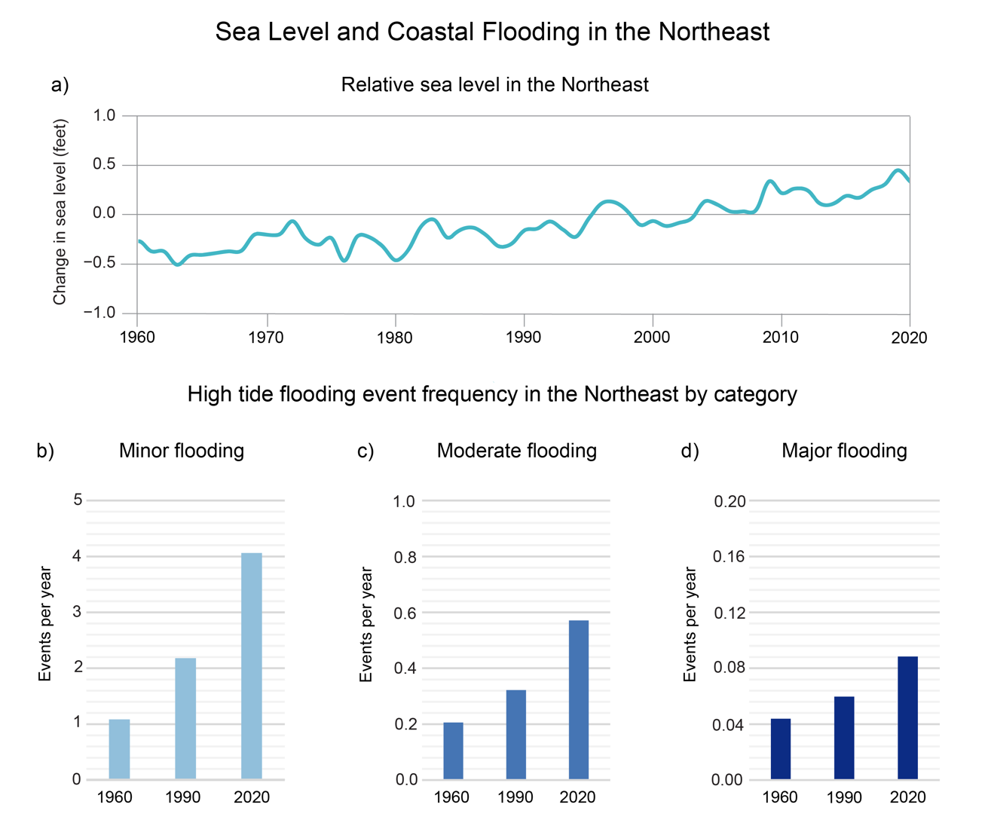
Figure A4.10. The combination of rising sea levels and the increased frequency of coastal flooding events exacerbates risk for coastal communities.
Notes:
CAPTION: (a) The line chart shows the observed changes in relative sea level from 1960 to 2020 (compared to the 1991–2009 average), which is a combination of sea level changes and local uplift or subsidence of land, averaged along the Atlantic coast of the northeastern US. The bar graphs depict the frequency of (b) minor (disruptive), (c) moderate (damaging), and (d) major (destructive) high tide flooding events at 30-year intervals (1960, 1990, and 2020), also for the northeastern US (see Figure 9.3 for definitions of high tide flooding thresholds). The frequency of occurrence is expressed as the number of events per year, where a value of 0.1 is equivalent to a 10% annual chance of experiencing that type of flood event. See Chapter 9 for contiguous US data, including future projections. Figure credits: (a) adapted from Sweet et al. 2022;(Sweet et al. 2022) (b, c, d) NOAA NCEI and NOAA.

Slide 13
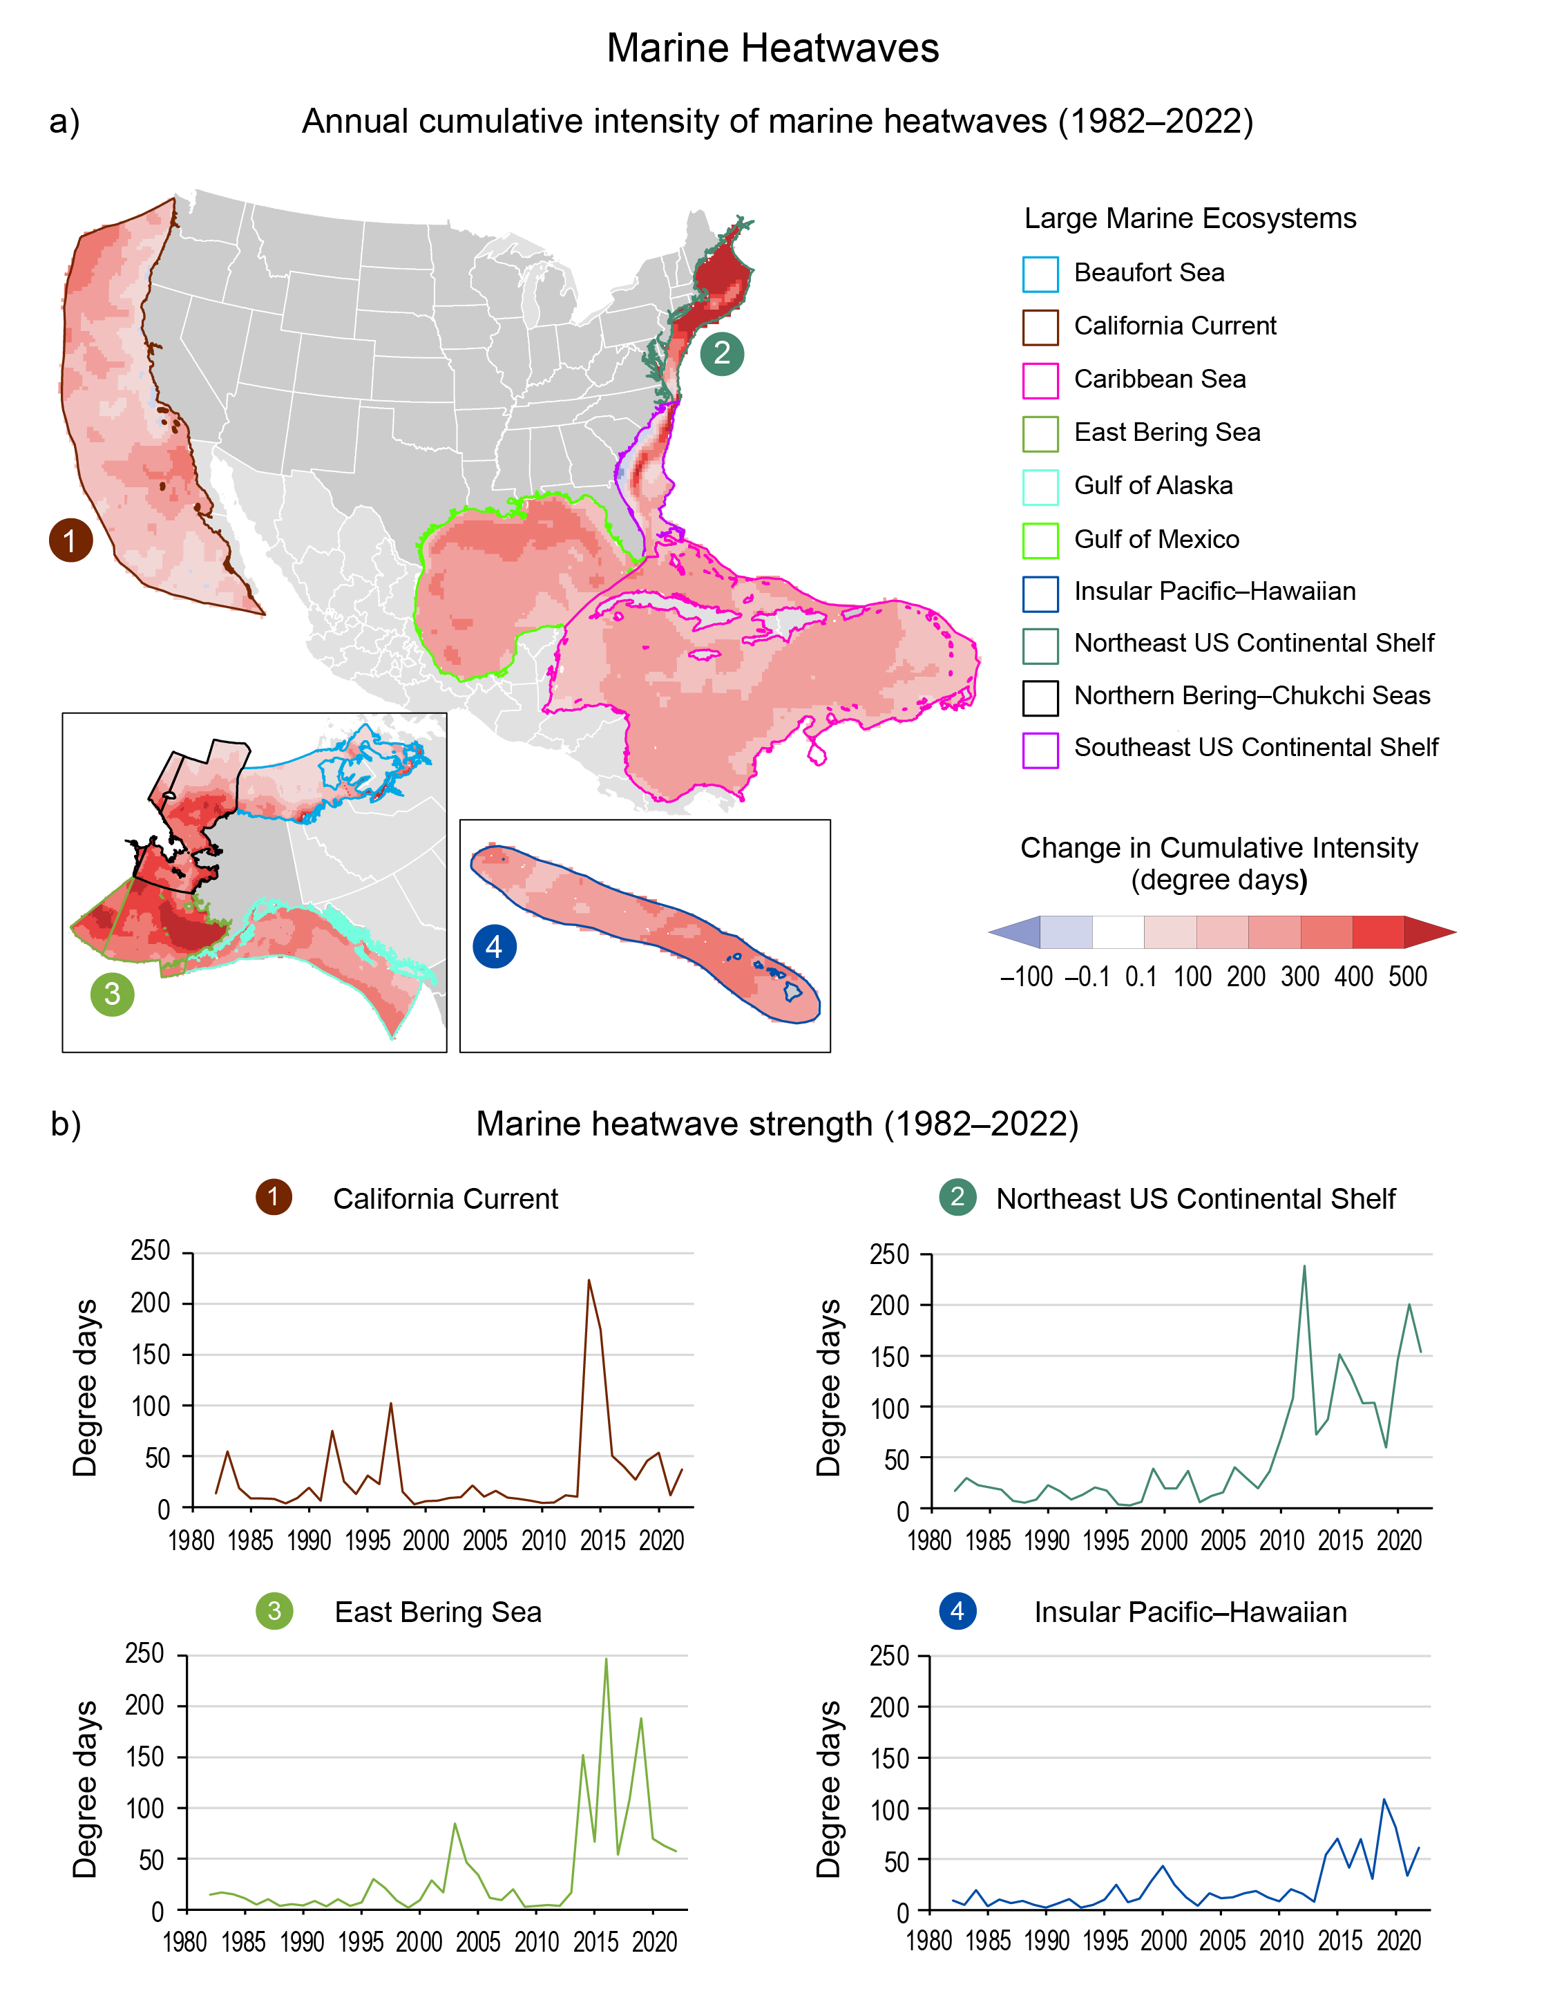
Figure A4.11. Extreme ocean temperatures are more common as ocean temperatures rise.
Notes:
CAPTION: (a) The maps show the change in annual cumulative intensity of marine heatwaves (anomalously warm temperatures lasting five or more days) within large marine ecosystems surrounding the United States from 1982 to 2022. Cumulative intensity, or degree days, is determined by heatwave intensity multiplied by duration, compared to the 1982–2011 average. Areas with increases in cumulative intensity are shown in red, with darker colors indicating greater change. Areas in blue represent a decrease in cumulative intensity over time. (b) Charts show the heatwave strength in total degree days each year from 1982 to 2022 for select large marine ecosystems highlighted in the above maps. Figure credit: NOAA NCEI, University of Miami, DOE, and Eastern Research Group Inc.

Slide 14
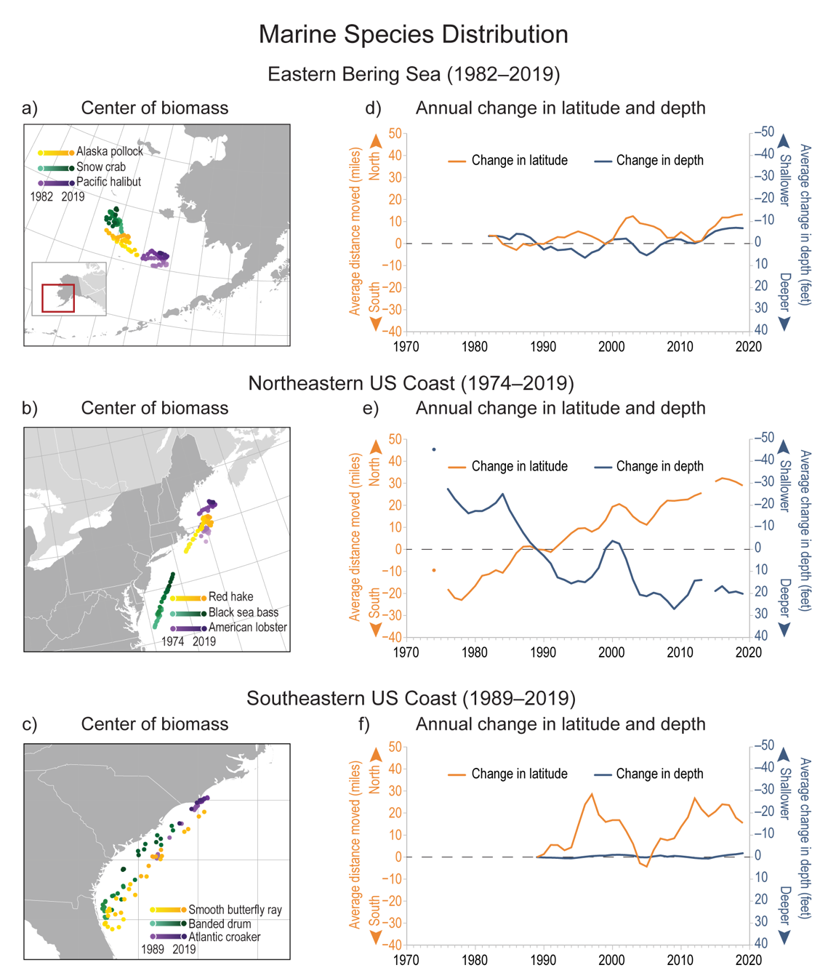
Figure A4.12. Marine species along US coasts are generally shifting northward to cooler waters.
Notes:
CAPTION: (left) Maps show annual centers of biomass for three species in three regions: (a) the eastern Bering Sea (1982–2019) and the (b) northeastern (1974–2019) and (c) southeastern (1989–2019) US coasts. Species were chosen because they represent a variety of habitats and species types and are relatively abundant. Dots are shaded to show how species’ locations have changed over time, with light shading representing earlier years and darker shading representing more recent years. (right) Charts show the annual change in latitude (orange lines; movement in miles) and depth (blue lines; change in feet) of several marine species in (d) the eastern Bering Sea (top; 64 species) and (e) the northeastern (middle; 53 species) and (f) southeastern (bottom; 63 species) US coasts, relative to 1989. Black dashed lines represent no overall change. Data were not available for 1975 or 2014 for the Northeast region. Adapted from EPA 2023. (EPA 2023)

Slide 15
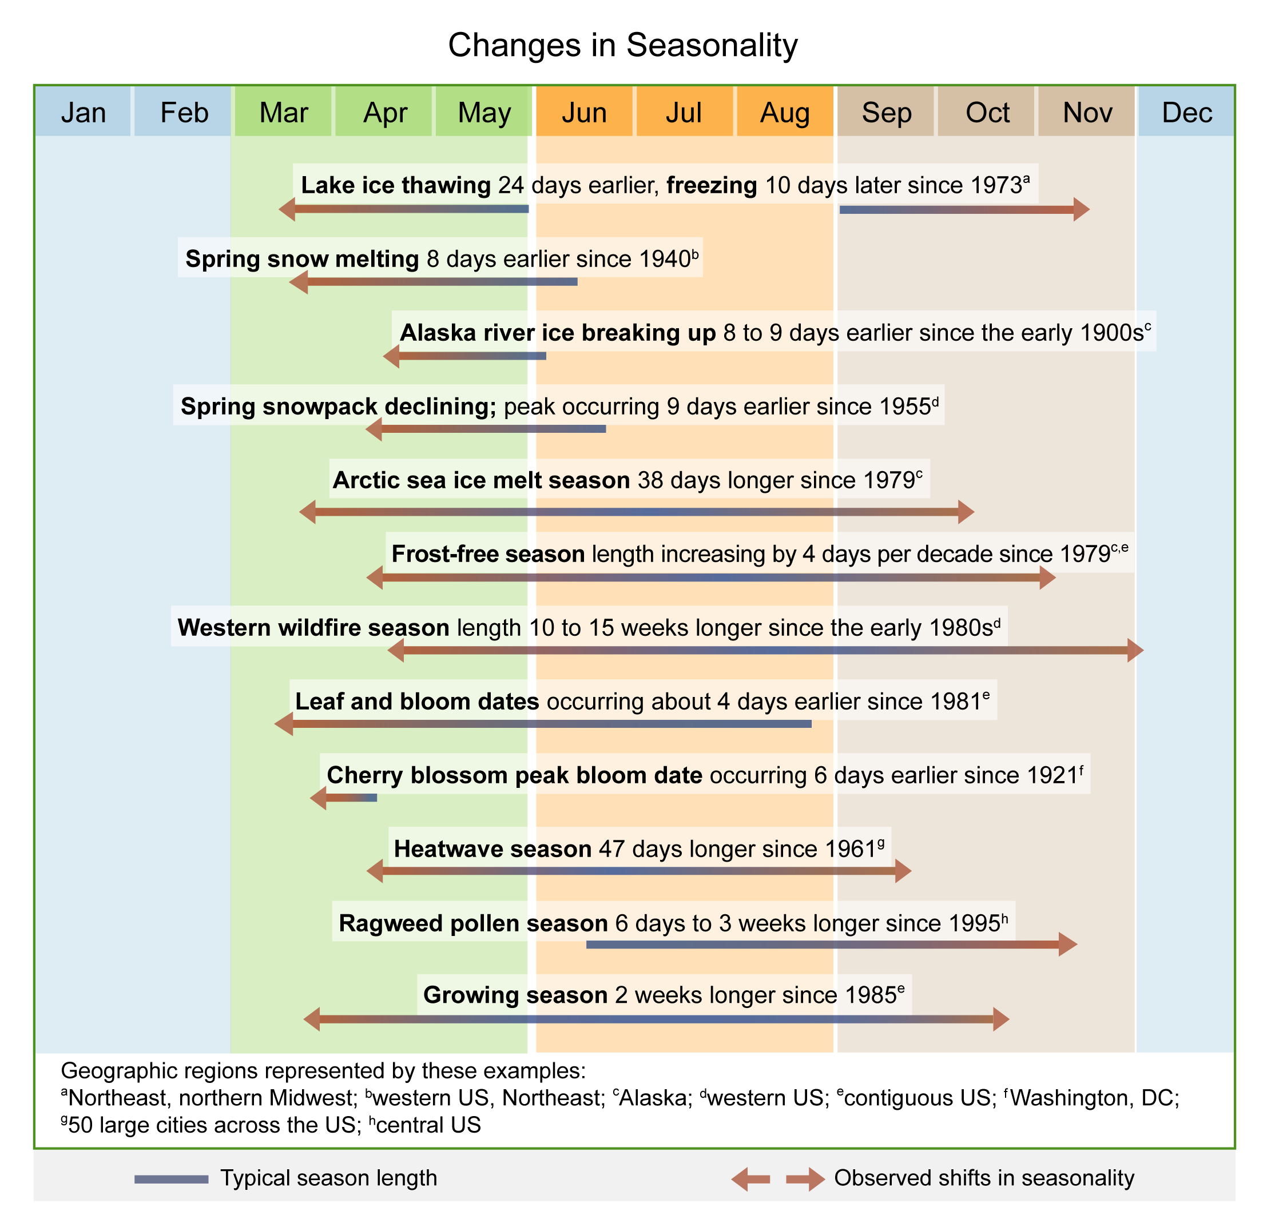
Figure A4.13. Observed evidence of changes in seasonality reflect a warming climate.
Notes:
CAPTION: Many indicators show shifts in timing and duration of seasonal events or processes that are correlated with seasons. The length of the blue lines represents the approximate time of year when these events typically occur, and the direction of the arrows denotes earlier (←) and later (→) shifts in the season. Red line segments portray the observed change for illustrative purposes, whereas the actual observed values are provided as text above each line. Some of these indicators are limited to specific geographic regions. Adapted from EPA 2021. (EPA 2021)

Slide 16
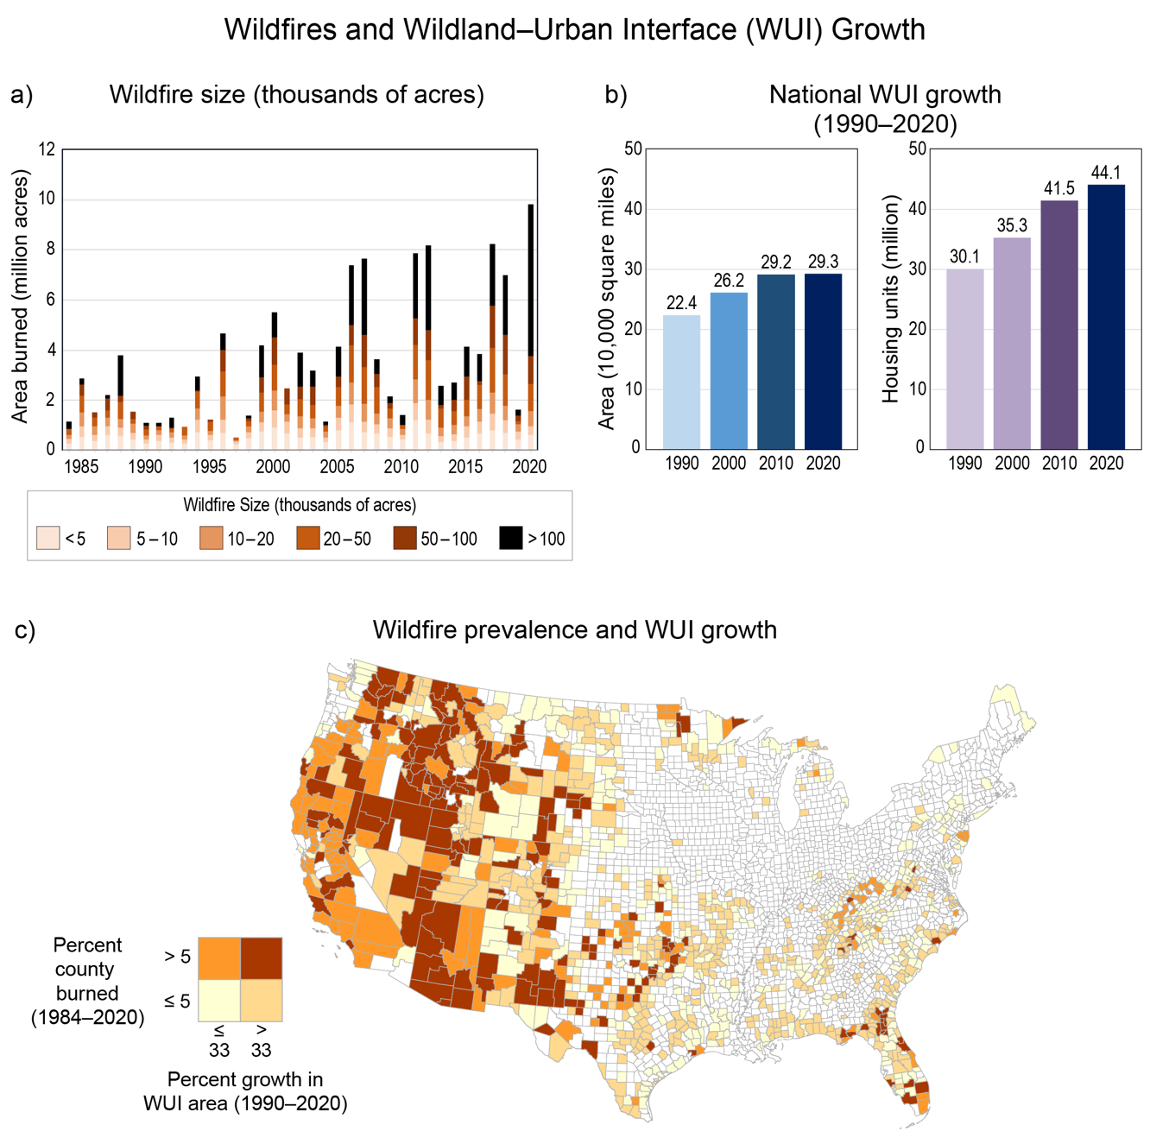
Figure A4.14. Area burned by wildfires is increasing and the wildland–urban interface is expanding in the contiguous US.
Notes:
CAPTION: (a) The chart shows the number of acres burned between 1984 and 2020 for the contiguous US. The different shades within each bar indicate the proportional contribution of different fire size classes to the total for that year. (b) The two charts depict wildland–urban interface (WUI) growth in terms of area and number of housing units from 1990 to 2020 for the contiguous US. (c) The map portrays US counties where WUI growth and wildfires are most prevalent. Counties are categorized by their level of WUI growth between 1990 and 2020 and area burned between 1984 and 2020. Counties are not categorized where wildfires do not meet the minimum size requirements for Monitoring Trends in Burn Severity (MTBS) mapping(Monitoring Trends in Burn Severity 2022) or where percent growth in WUI area is less than zero. WUI data are not available for the US Caribbean, Alaska, or Hawaiʻi and US-Affiliated Pacific Islands regions. In Alaska, wildfires burned over 34 million acres between 1984 and 2020; during this period, eight of the nine wildfire seasons when more than one million acres burned have occurred since 2000. Twenty-one wildfires in Hawaiʻi (more than 103,000 total acres) and four wildfires in Puerto Rico (about 6,300 total acres) were mapped between 1984 and 2020. MTBS wildfire data are not available for other parts of the US Caribbean and US-Affiliated Pacific Islands regions (wildfire data from another source for the US-Affiliated Pacific Islands region is presented in Figure 30.13). Figure credits: (a, c) USDA Forest Service; (b) adapted from Radeloff et al. 2018. (Radeloff et al. 2018)

Slide 17
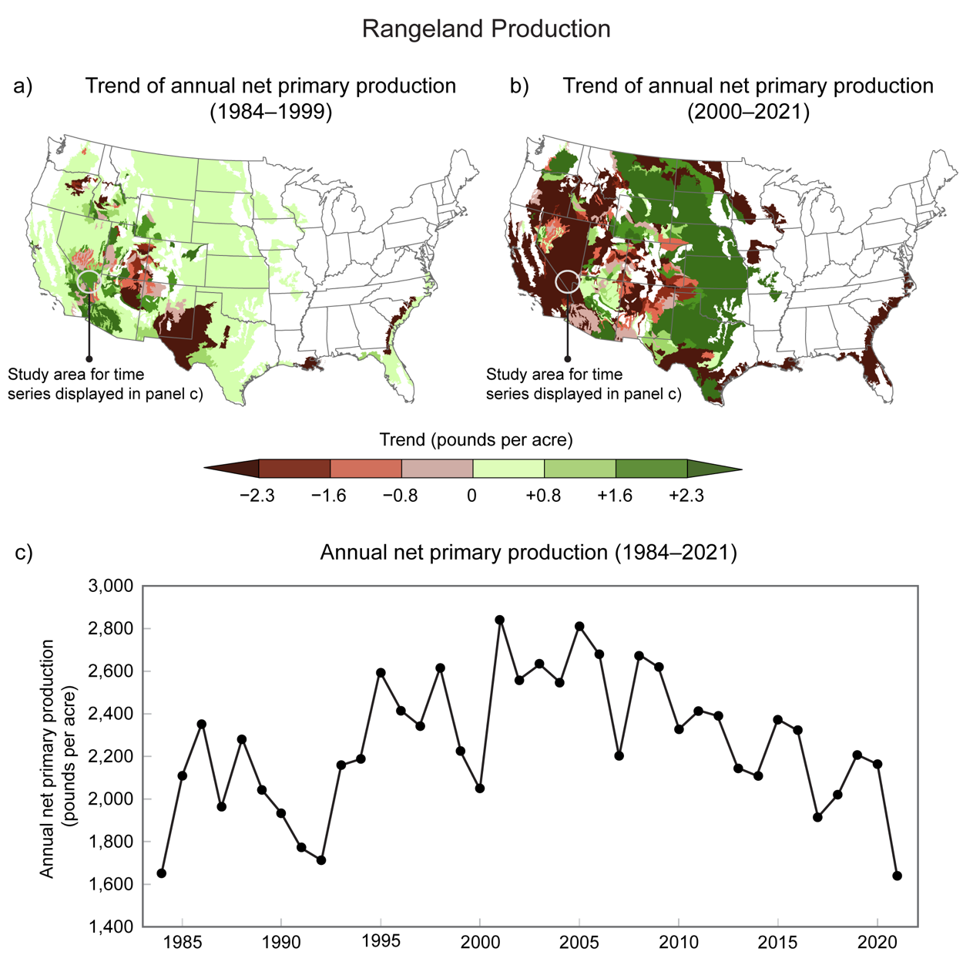
Figure A4.15. Rangeland vegetation production has severely declined in some areas and increased in others.
Notes:
CAPTION: Rangeland annual net primary production (ANPP) measures the annual production of rangeland vegetation, which provides key ecosystem services supporting soil, air, and water quality and billions of dollars in commerce. This figure illustrates ANPP in pounds per acre on rangelands by ecological subsection (see Cleland et al. 2007(Cleland et al. 2007)) during the periods (a) 1984–1999 and (b) 2000–2021. Positive values indicate areas where ANPP has increased over time, and negative values show where it has decreased. Areas in white are not classified as rangeland ecosystems. (c) The time series shows annual values of ANPP from 1984 to 2021 for a select location in the Mojave Desert (indicated by the circle on the maps). ANPP increased in this area over the first half of the time period but has since seen a steady decline. Data are not available for the US Caribbean, Alaska, or Hawaiʻi and US-Affiliated Pacific Islands regions. Adapted with permission from Reeves et al. 2021(Reeves et al. 2021) [CC BY-NC-ND 4.0].

Slide 18
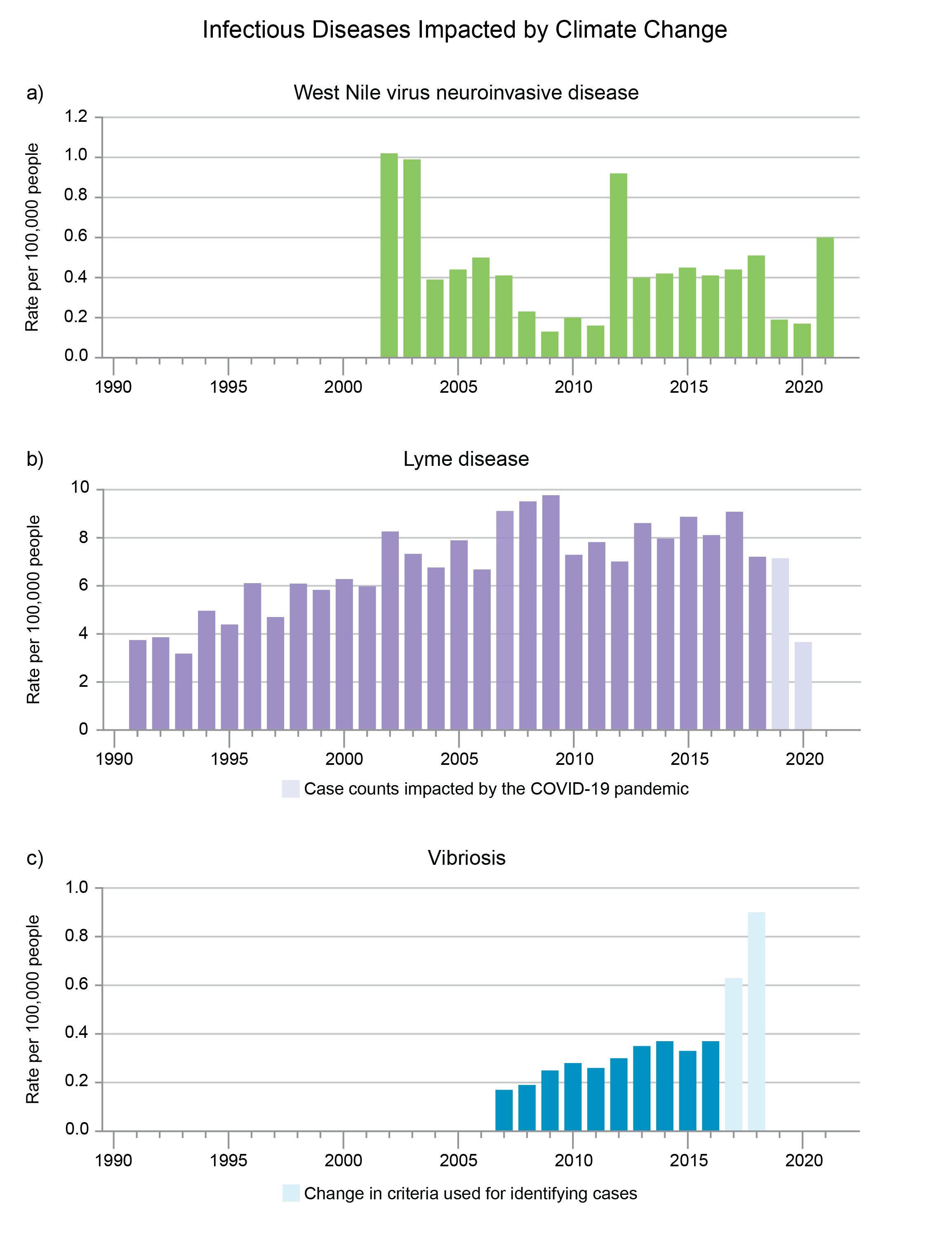
Figure A4.16. Climate, environmental, and social factors influence infectious disease rates.
Notes:
CAPTION: Indicators of diseases widely recognized as being affected by climate change can provide a general gauge of the disease burden and help guide resources and public health actions. Incidence rates of (a) West Nile virus (WNV) neuroinvasive disease, (b) Lyme disease, and (c) vibriosis are presented for the years 2002–2021, 1991–2020, and 2007–2018, respectively. For WNV neuroinvasive disease, the pattern of incidence rates is variable, ranging from 1 per 100,000 people in 2002, when it became a nationally notifiable condition, to 0.6 per 100,000 people in 2021. Lyme disease incidence rates have trended upward from 4 cases per 100,000 people in 1991 to 7 cases per 100,000 in 2018. Similarly, trends in vibriosis have risen since 2007. Confirmed and probable cases are collected by state and local health departments and reported to the National Notifiable Diseases Surveillance System or the COVIS (Cholera and Other Vibrio Illness Surveillance) system. Annual counts and rates for each state are compiled by the CDC. Surveillance data for Lyme disease in 2019 and 2020 were markedly affected by the COVID-19 pandemic (light purple bars). Case definitions are occasionally revised, but because the vibriosis case definition changed significantly in 2017, trends before (dark blue bars) and after (light blue bars) are not comparable. (a) Adapted from EPA 2023;(EPA 2023) (b) adapted from EPA 2023;(EPA 2023) (c) adapted from Sheahan et al. 2022. (Sheahan et al. 2022)

Slide 19
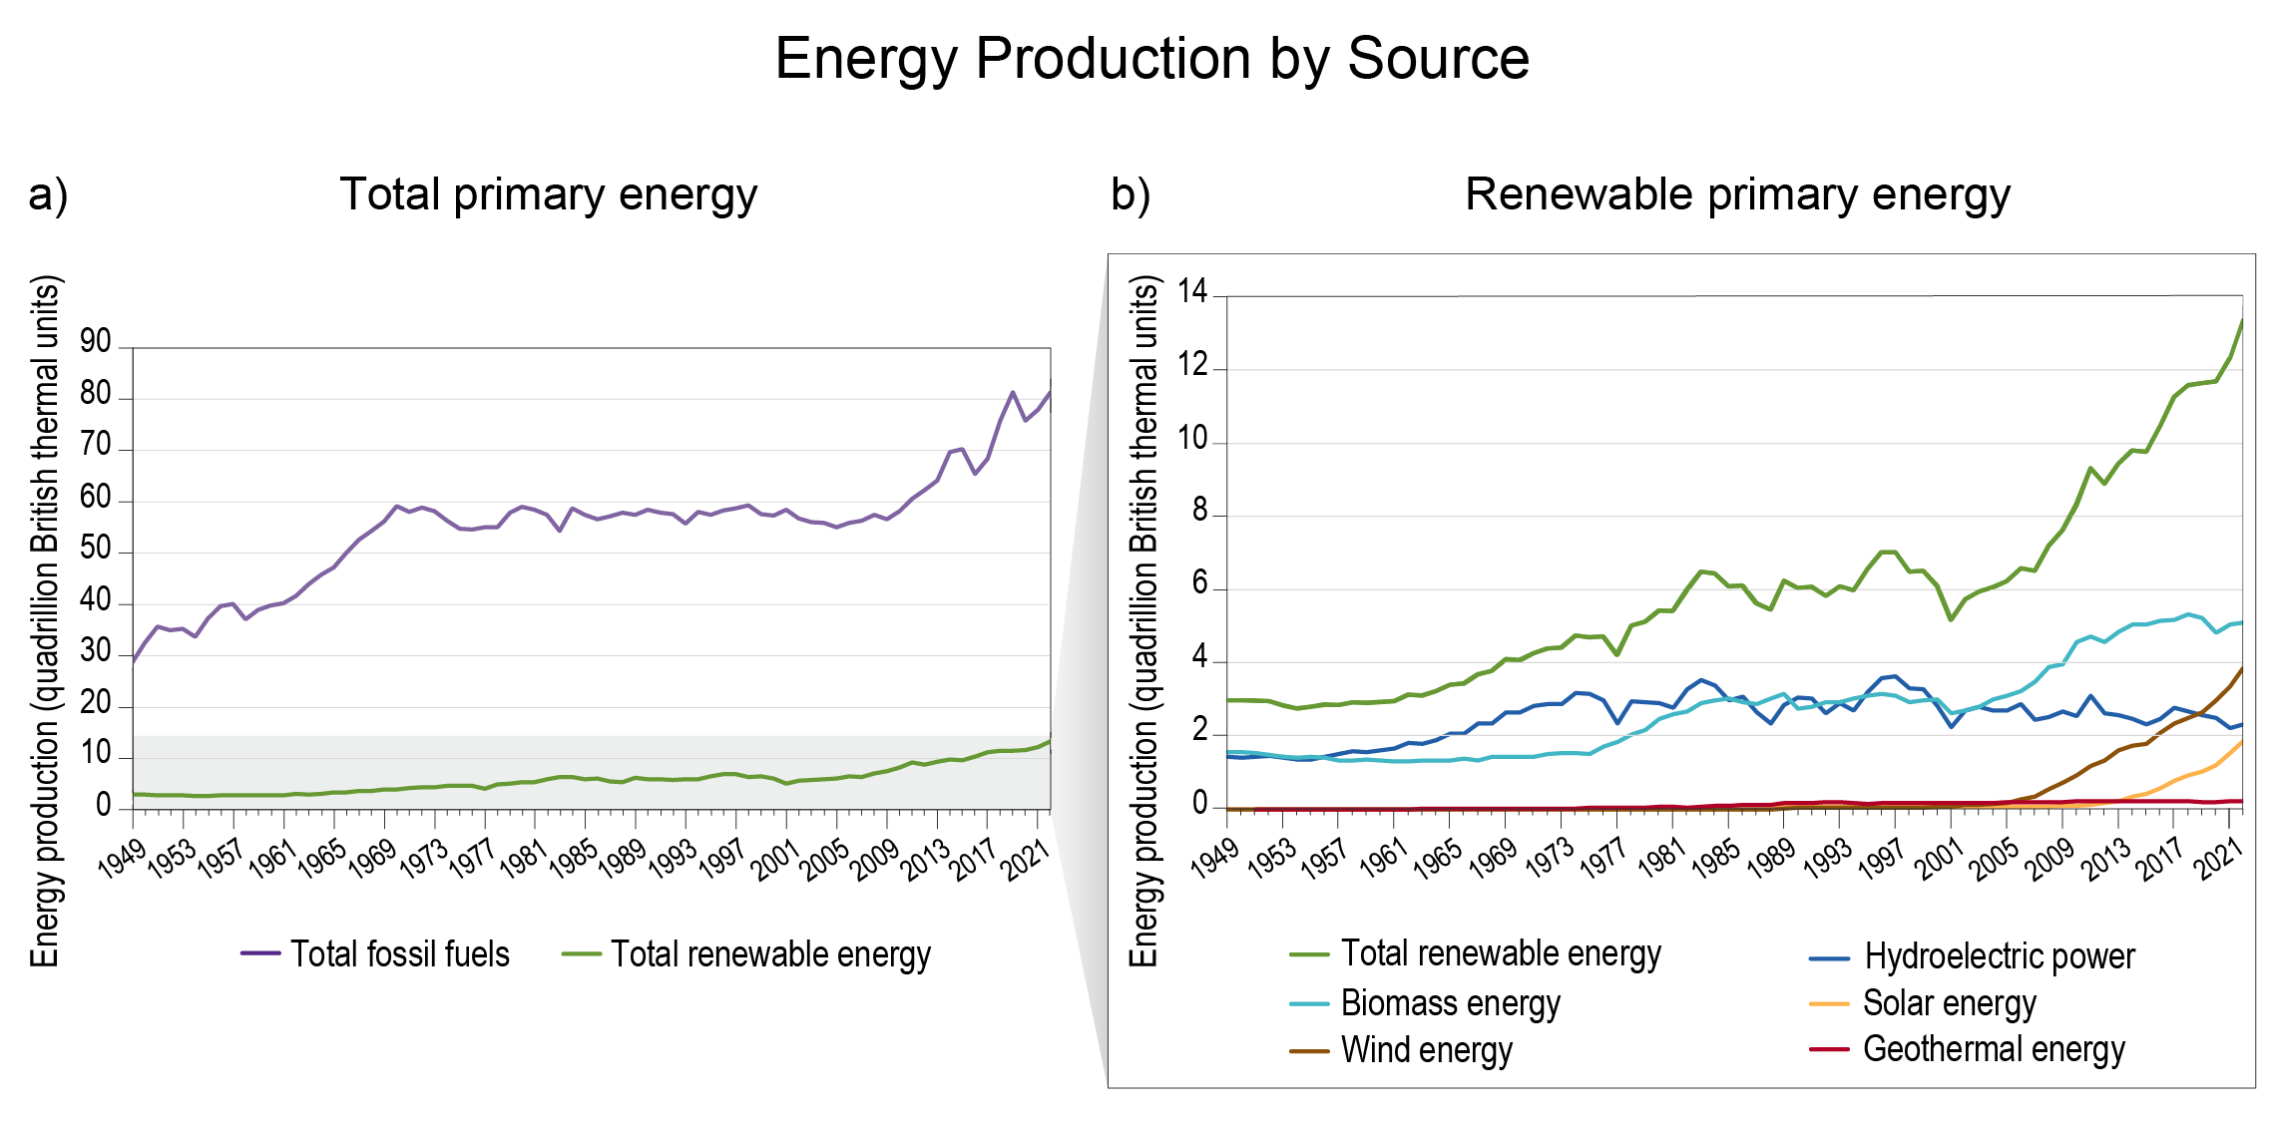
Figure A4.17. US energy production from renewables is increasing.
Notes:
CAPTION: The figure shows annual time series of US energy production for (a) total primary energy (which includes both fossil fuels and renewable energy) and (b) categories of renewable energy (biomass, wind, hydroelectric, solar, and geothermal) for 1949–2022. US energy production from renewable sources (dark green line) has increased since the 1960s, reaching a record high in 2022, primarily due to increases in wind (brown line) and biomass (light blue line) energy. Energy production from fossil fuels (purple line) also increased during this same time period, although with increased use of cleaner fossil fuels (KM 5.3). Adapted from EIA 2023. (EIA 2023)

Slide 20
Federal Coordinating Lead Author
Michael Kolian, US Department of Energy
Chapter Lead
Laura E. Stevens, North Carolina State University
Chapter Authors
Derek Arndt, NOAA National Centers for Environmental Information
Jessica Blunden, NOAA National Centers for Environmental Information
Erik W. Johnson, USDA Forest Service, Office of Sustainability and Climate
Ann Y. Liu, National Institute of Environmental Health Sciences/Kelly Government Solutions
Sheri Spiegal, USDA Agricultural Research Service, Jornada Experimental Range
Technical Contributors
Rebecca L. Achey, University of Colorado
Seth Bogle, USDA Forest Service, Geospatial Technology and Applications Center
Boyin Huang, NOAA National Centers for Environmental Information
Willem Klajbor, University of Miami, Cooperative Institute for Marine and Atmospheric Studies
Jennifer Lecker, USDA Forest Service
AnnaClaire Marley, Eastern Research Group Inc.
Miranda H. Mockrin, USDA Forest Service, Northern Research Station
Matthew C. Reeves, USDA Forest Service
Jared Rennie, NOAA National Centers for Environmental Information
William L. Royer, USDA Forest Service
Hua Shi, US Geological Survey, Earth Resources Observation and Science Center/ASRC Federal Data Solutions
William Sweet, NOAA National Ocean Service
Russell S. Vose, NOAA National Centers for Environmental Information
Steven E. Yochum, USDA Forest Service, National Stream and Aquatic Ecology Center
Review Editor
Azar M. Abadi, University of Alabama at Birmingham
USGCRP Coordinators
Leo Goldsmith, US Global Change Research Program / ICF
Christopher W. Avery, US Global Change Research Program / ICF

Slide 21
Stevens, L.E., M. Kolian, D. Arndt, J. Blunden, E.W. Johnson, A.Y. Liu, and S. Spiegal, 2023: Appendix 4. Indicators. In: Fifth National Climate Assessment. Crimmins, A.R., C.W. Avery, D.R. Easterling, K.E. Kunkel, B.C. Stewart, and T.K. Maycock, Eds. U.S. Global Change Research Program, Washington, DC, USA. https://doi.org/10.7930/NCA5.2023.A4
https://nca2023.globalchange.gov/chapter/appendix-4/

