Slide 1

NCA5 Website: https://nca2023.globalchange.gov
Chapter Website: https://nca2023.globalchange.gov/chapter/11
NCA5 Atlas: https://atlas.globalchange.gov
Figure captions can be found in the slide notes of this deck
Social media: @usgcrp, #NCA5

Slide 2
Chapter 11 | Agriculture, Food Systems, and Rural Communities

Slide 3
1
Agricultural Adaptation Increases Resilience in an Evolving Landscape
Climate change has increased agricultural production risks by disrupting growing zones and growing days, which depend on precipitation, air temperature, and soil moisture (very likely, very high confidence). Growing evidence for positive environmental and economic outcomes of conservation management has led some farmers and ranchers to adopt agroecological practices (very high confidence), which increases the potential for agricultural producers to limit greenhouse gas emissions (likely, medium confidence) and improve agricultural resilience to climate change (high confidence).

Slide 4
2
Climate Change Disrupts Our Food Systems in Uneven Ways
Climate change is projected to disrupt food systems in ways that reduce the availability and affordability of nutritious food, with uneven economic impacts across society (likely, medium confidence). Impacts of climate change on other measures of human well-being are also distributed unevenly, such as worsening heat stress among farmworkers (high confidence) and disruptions to the ability of subsistence-based peoples to access food through hunting, fishing, and foraging (high confidence).

Slide 5
3
Rural Communities Face Unique Challenges and Opportunities
Rural communities steward much of the Nation’s land and natural resources, which provide food, bioproducts, and ecosystem services (high confidence). These crucial roles are at risk as climate change compounds existing stressors such as poverty, unemployment, and depopulation (likely, medium confidence). Opportunities exist for rural communities to increase their resilience to climate change and protect rural livelihoods (high confidence).

Slide 6
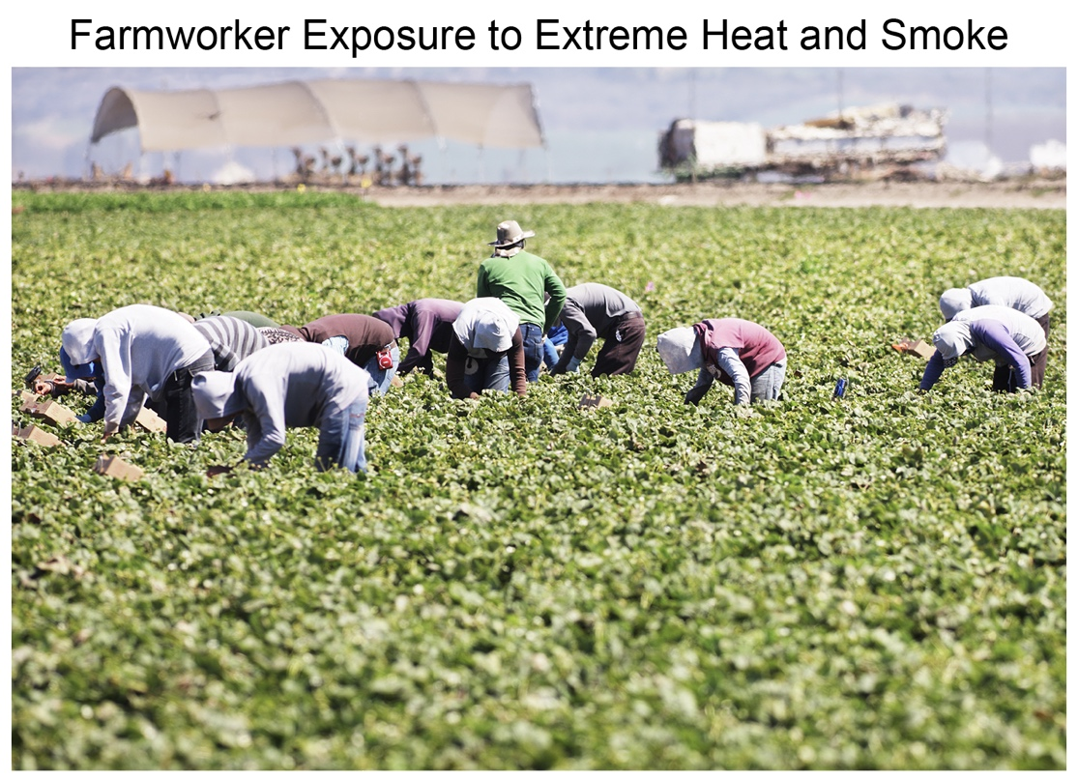
Figure 11.1. Climate change increases farmworker exposure to extreme heat and wildfire smoke.
Notes:
CAPTION: Farmworkers, for example, shown here in Salinas, California, face compounding health risks from extreme heat, wildfire smoke, and COVID-19 (see Ch. 15; KM 28.4; Focus on Western Wildfires; Focus on COVID-19 and Climate Change). Photo credit: ChuckSchugPhotography/iStock via Getty Images.

Slide 7
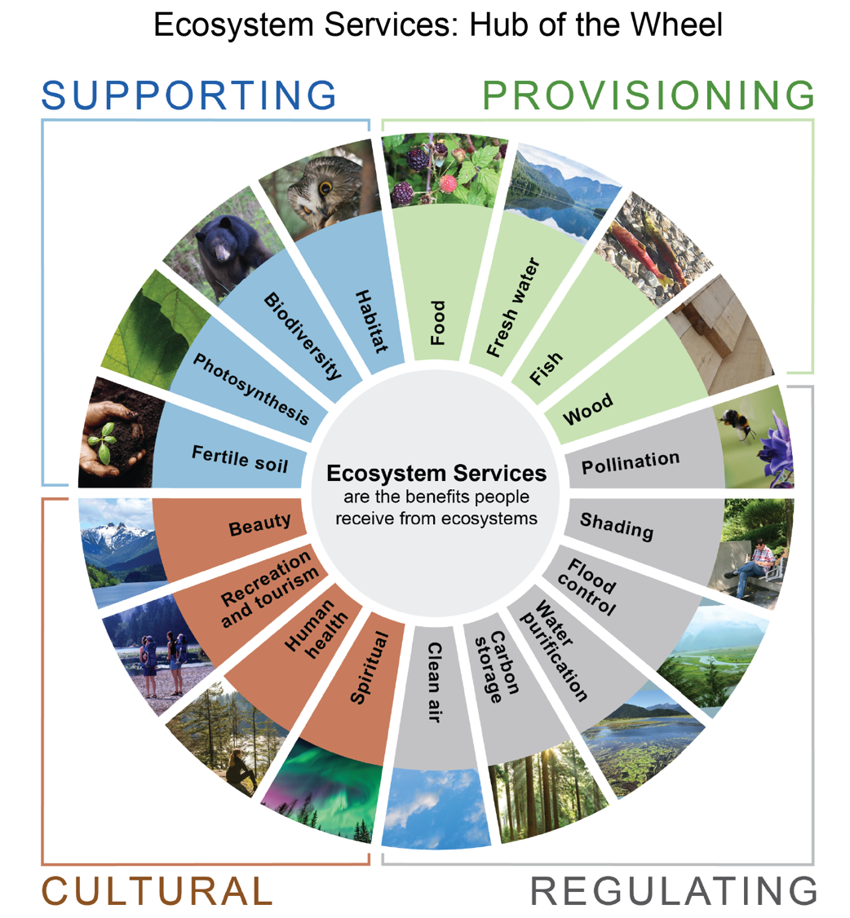
Figure 11.2. Ecosystem services have wide-ranging benefits for plants, animals, and human well-being.
Notes:
CAPTION: People receive many benefits from the ecosystem, including provisioning, regulating, supporting, and cultural services. Adaptive management practices (see Figure 8.1) foster resilience to climate change and related disturbances in these ecosystem services (see Figure 8.18). Adapted with permission from MetroVancouver 2018.(Metro Vancouver 2018)

Slide 8
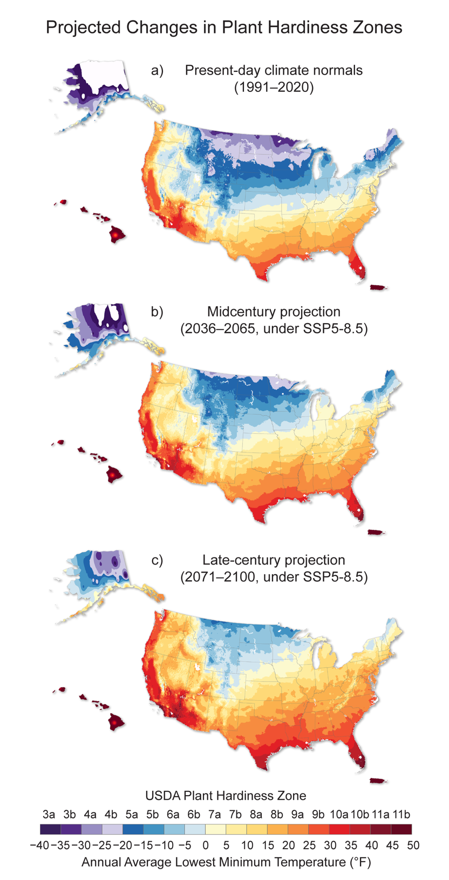
Figure 11.3. Plant hardiness zones are projected to shift northward throughout this century.
Notes:
CAPTION: Plant hardiness zones help local farmers and gardeners identify optimal crops to plant and when to plant them. Hardiness zones are projected to migrate northward as the climate warms. The maps show plant hardiness zones for (a) present-day (1991–2020) climate normals, and (b) midcentury (2036–2065) and (c) late century (2071–2100) under a high emissions scenario (SSP5-8.5). Figure credit: USDA, NOAA NCEI, and CISESS NC.

Slide 9
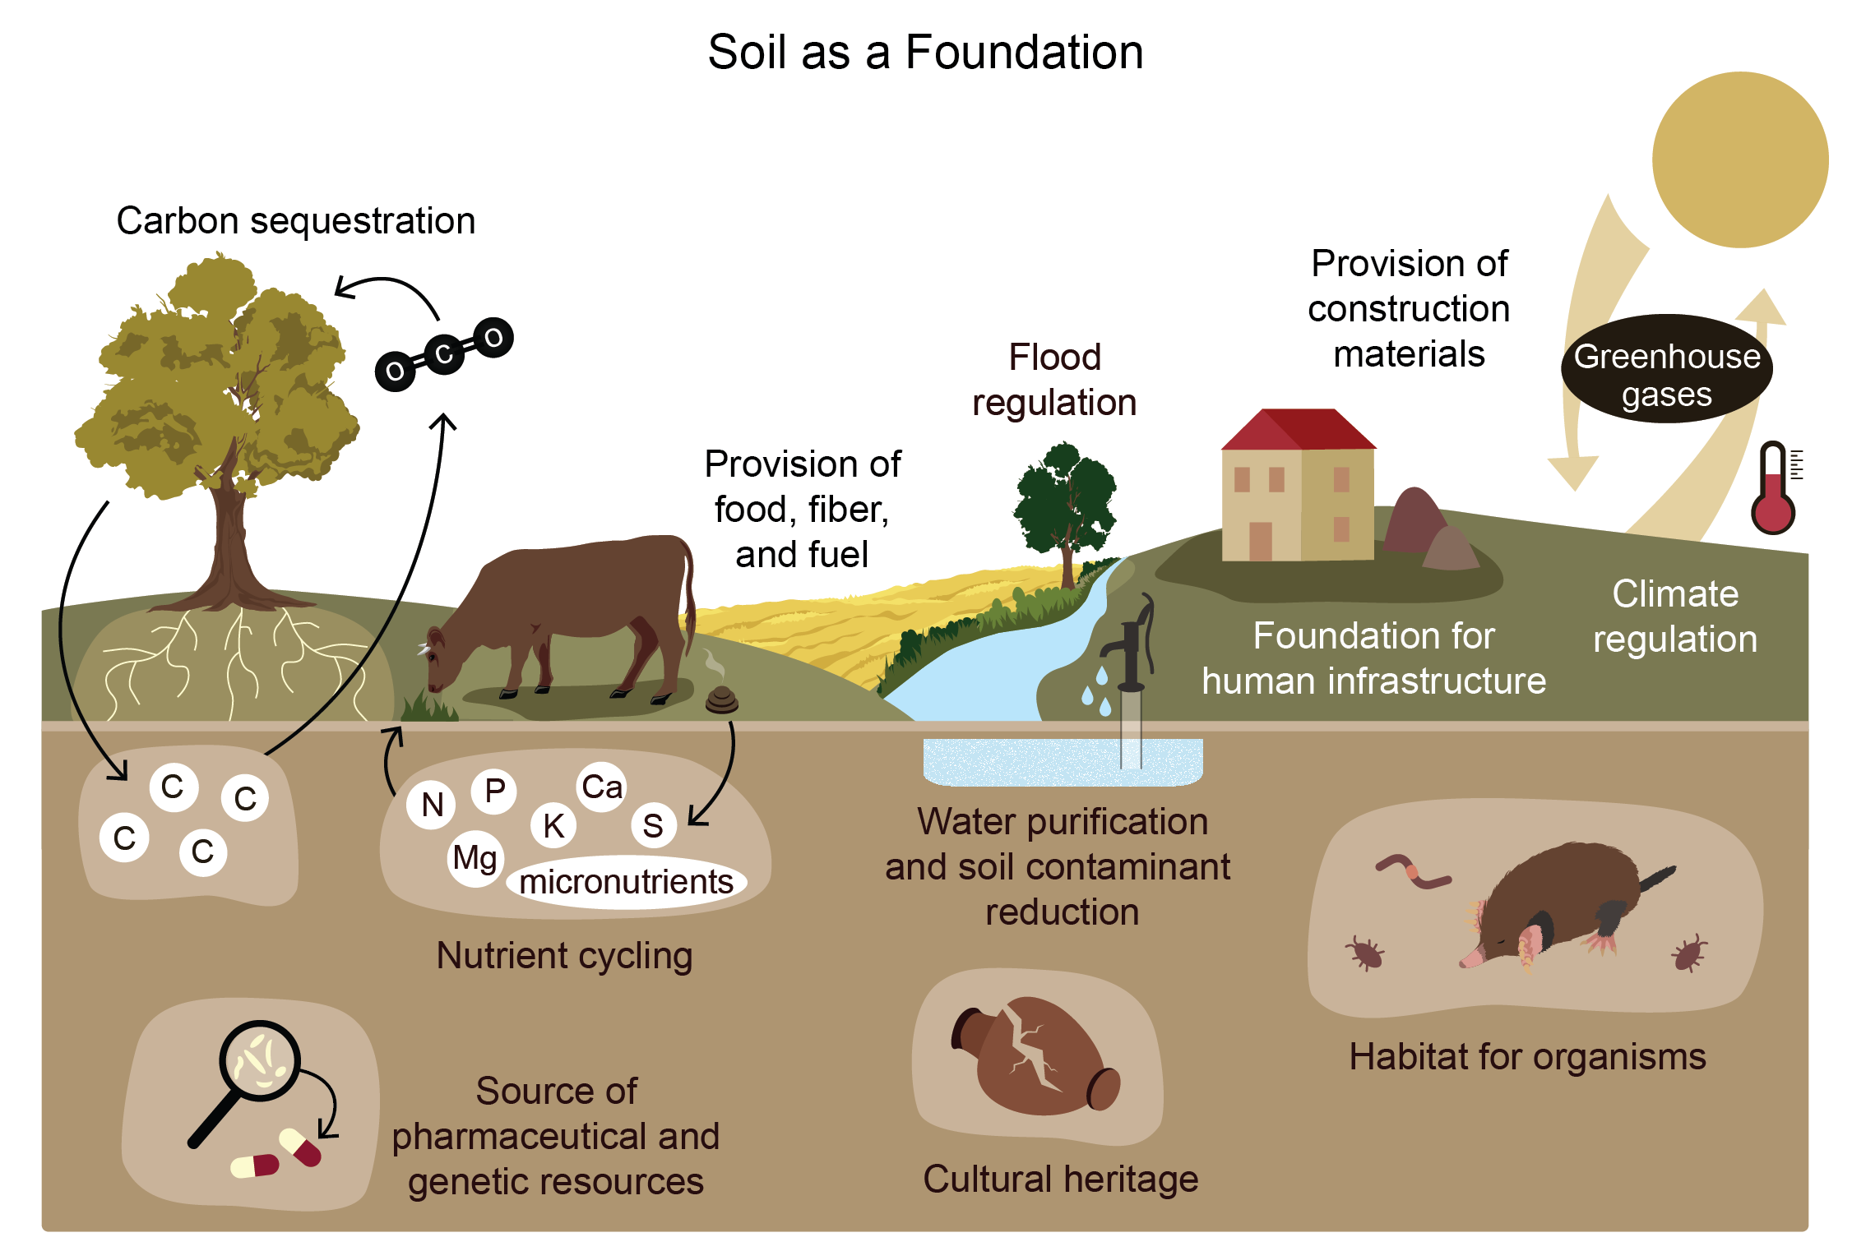
Figure 11.4. Healthy soil plays a foundational role in agriculture, ecosystems, society, and culture.
Notes:
CAPTION: Healthy soil provides the foundation for many agricultural, ecological, microbiological, societal, and cultural activities. Climate change can negatively affect soil health, thus weakening its foundational role. Adapted from Baveye et al. 2016(Baveye et al. 2016) [CC BY 4.0].

Slide 10
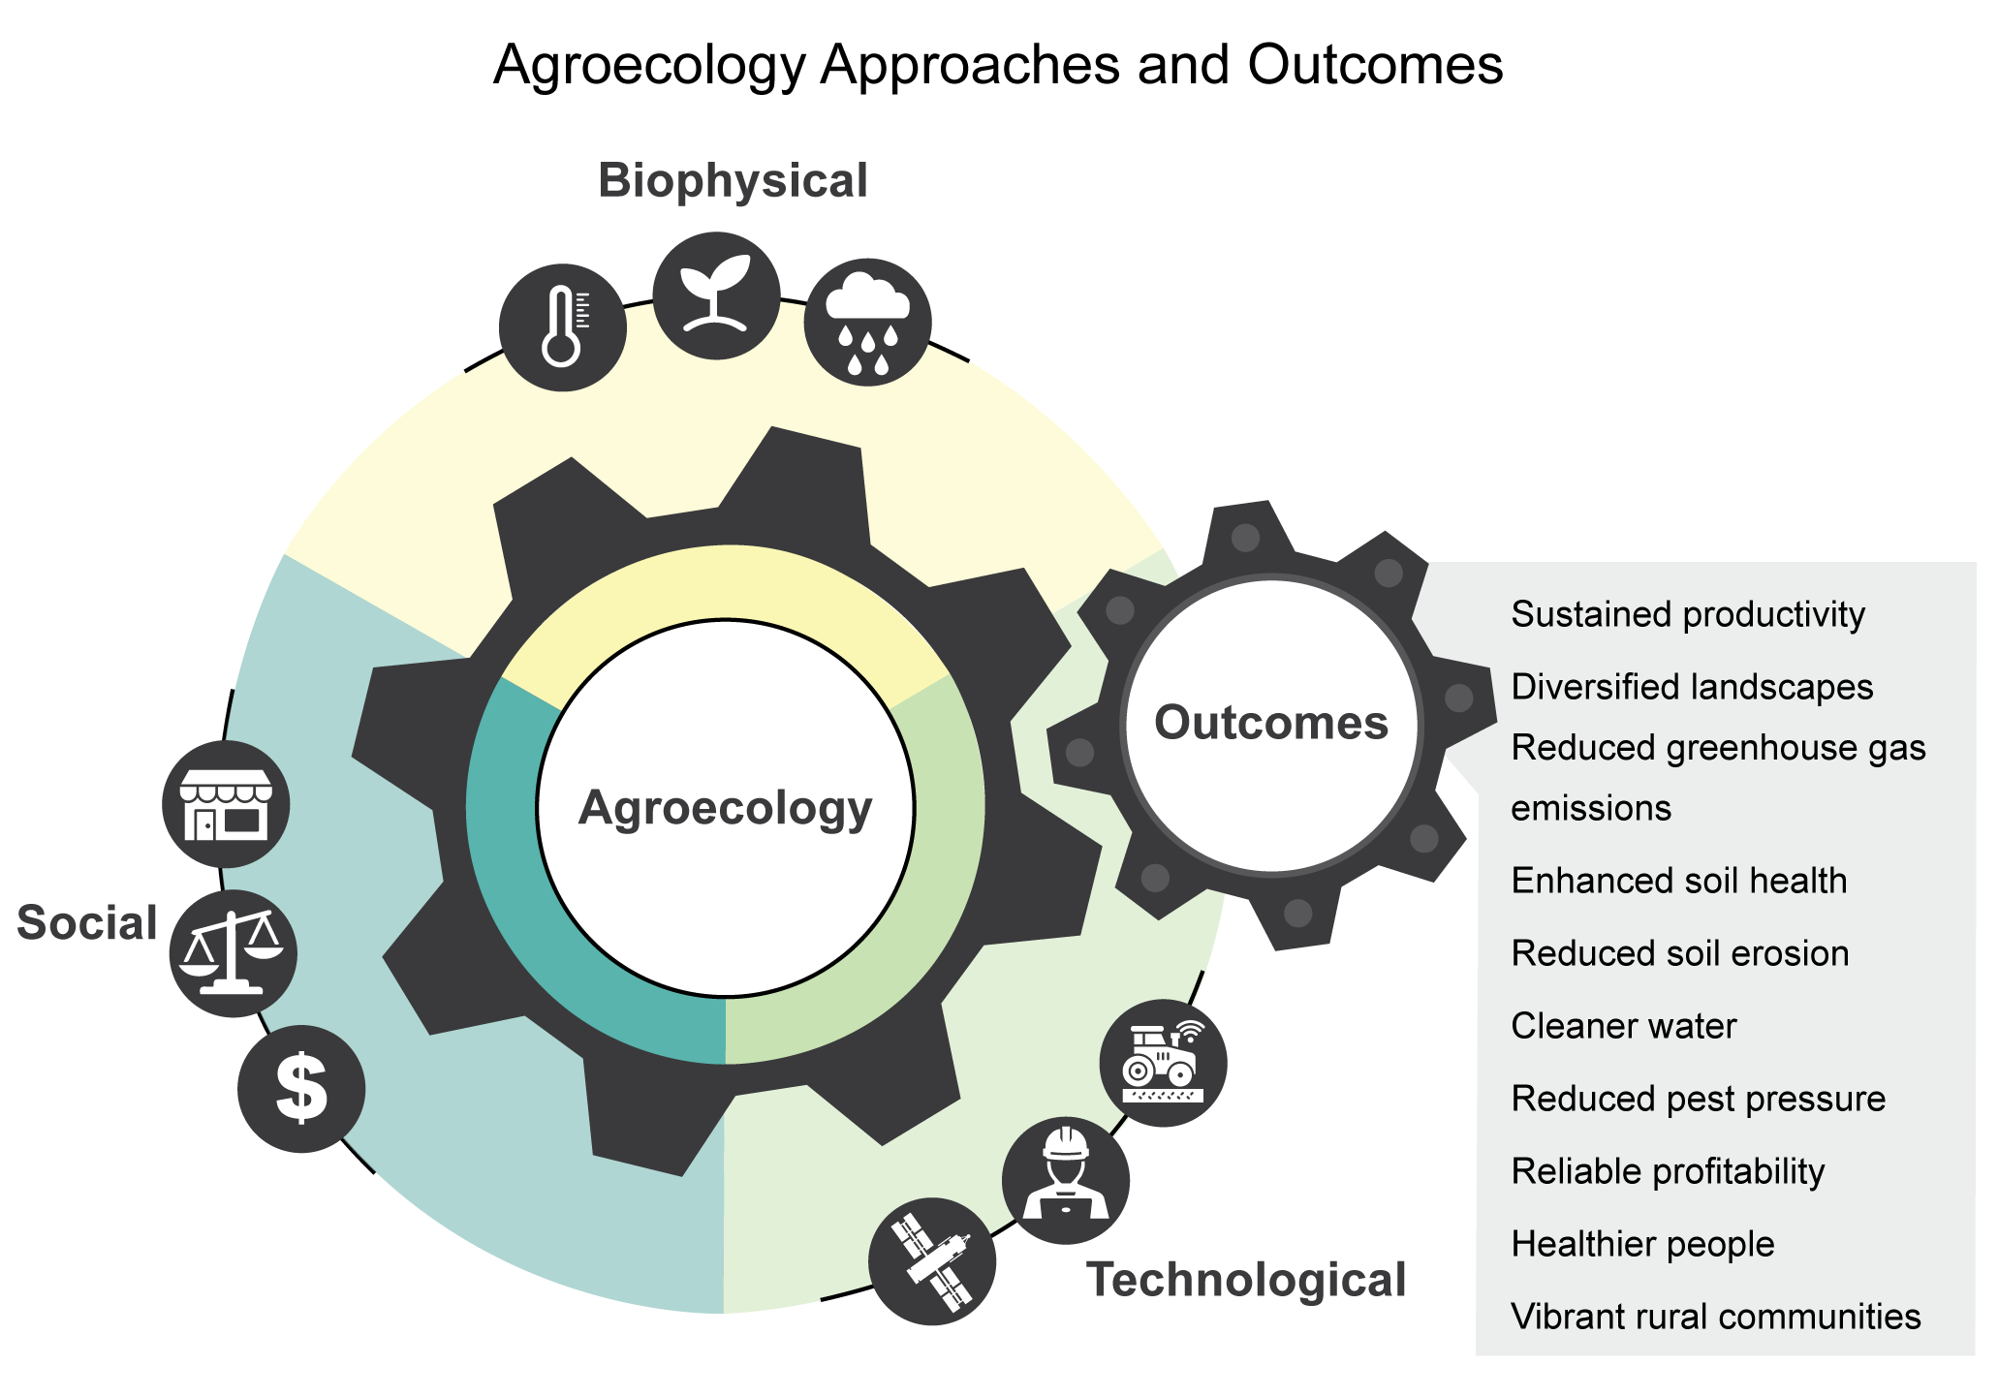
Figure 11.5. Agroecological approaches seek to achieve beneficial agricultural outcomes while promoting ecosystem services and rural livelihoods.
Notes:
CAPTION: Science-based application of agroecological approaches results in outcomes that balance agricultural productivity and profitability with ecosystem services and societal well-being. Figure credit: USDA.

Slide 11
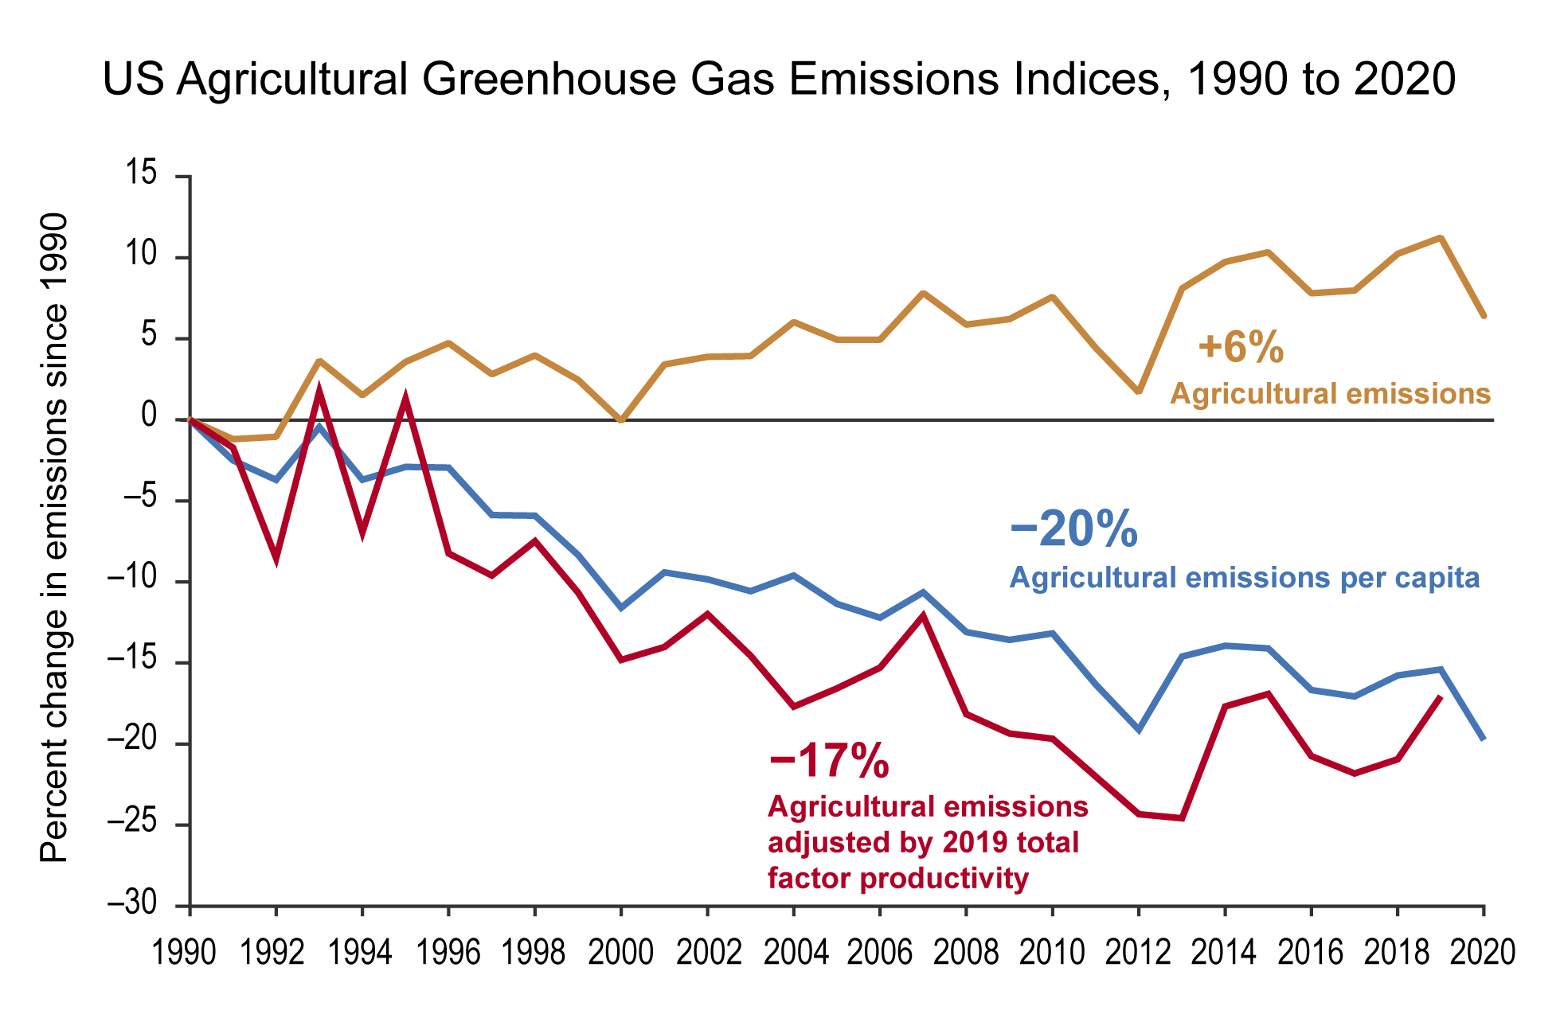
Figure 11.6. While total agricultural greenhouse gas emissions continue to increase, emissions per capita and per unit of total factor productivity (a ratio of agricultural outputs produced to inputs used) have declined over the last 30 years.
Notes:
CAPTION: Over the last 30 years, declines in US agricultural emissions per capita (blue line) and per unit of agricultural productivity (red line) reflect an increasingly efficient US agriculture sector that produces more food, fiber, and renewable fuel with fewer resources. Despite per capita and per unit of productivity improvements, the long-term trajectory of total emissions from US agriculture (yellow line) continues to rise, and mitigation remains a critical priority. Adapted with permission from ©Myers 2022.(Myers 2022)

Slide 12
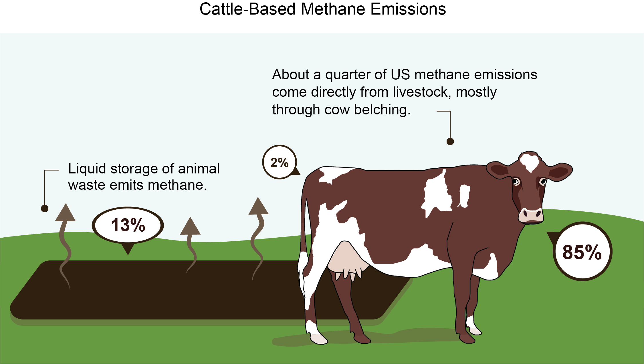
Figure 11.7. Ruminant livestock systems contribute to US methane emissions primarily through belching.
Notes:
CAPTION: Ruminant enteric fermentation via eructation (i.e., belching) contributes most of the methane emissions from US animal production systems (85%), with smaller contributions from manure lagoons (13%) and livestock flatulence (2%). Enteric fermentation contributes approximately 25% of total domestic methane production, making agriculture the largest source of US methane emissions. Figure credit: USDA, NOAA NCEI, and CISESS NC.

Slide 13
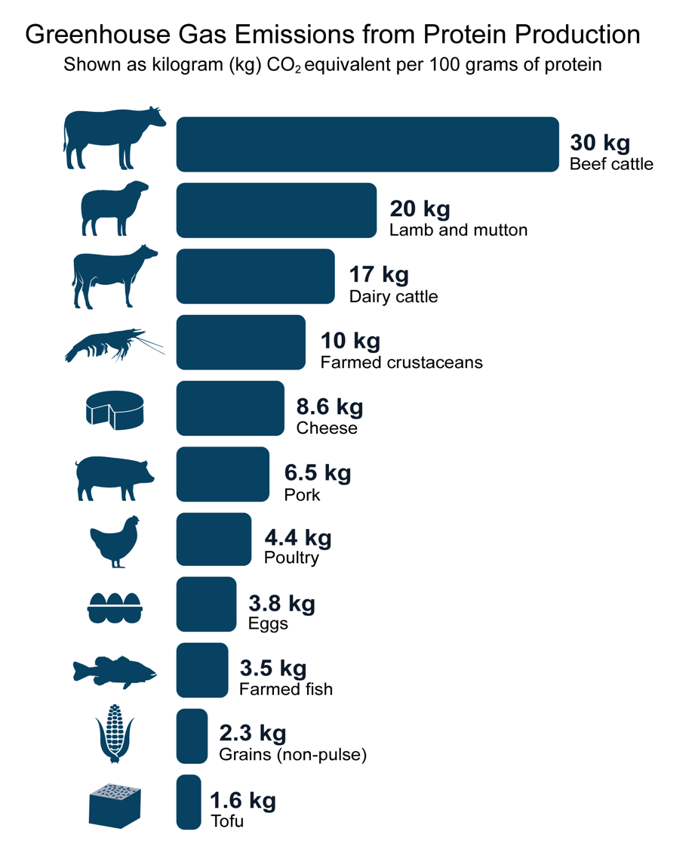
Figure 11.8. Greenhouse gas emissions from protein production vary greatly according to food type.
Notes:
CAPTION: Estimated greenhouse gas (GHG) emissions from protein production vary widely depending on food type. Global median emissions (in kg of carbon dioxide [CO₂] equivalents for every 100 g of protein produced) are shown here for 11 major protein sources. Although cereal grains have lower protein content, they are included here because they contribute 41% to global protein intake. While US emissions values may differ slightly from global values, the relative differences in GHG emissions by protein type are expected to be consistent. Figure credit: USDA, NOAA NCEI, and CISESS NC.

Slide 14
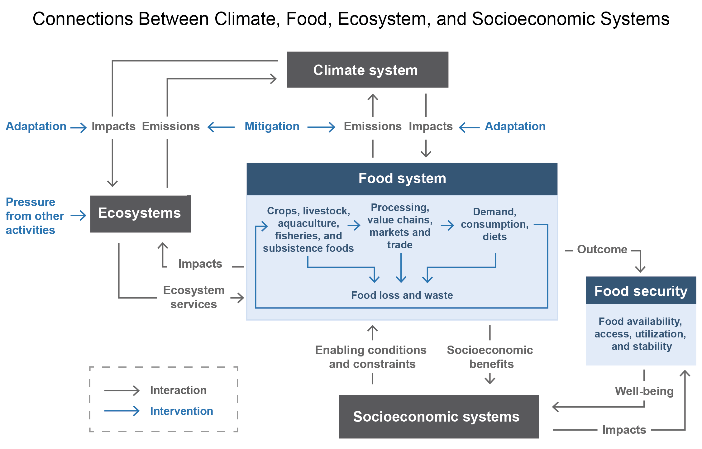
Figure 11.9. Food security is an outcome of the food system, which influences and is influenced by the climate system, ecosystems, and socioeconomic systems.
Notes:
CAPTION: A food system is a complex network that encompasses all inputs and outputs involved in food production, foraging, harvesting, transport, processing, retailing, consumption, and food loss and waste. There can be different types of food systems, each having impacts on and being impacted by climate, ecosystems, and socioeconomic systems. Interactions between these systems influence human well-being through food security outcomes, such as food availability, access, utilization, and stability. Interventions, such as mitigation and adaptation, can reduce risks to food systems, which improves food security and well-being within socioeconomic systems. Adapted with permission from Figure 5.1 in Mbow et al. 2019.(Mbow et al. 2019)

Slide 15
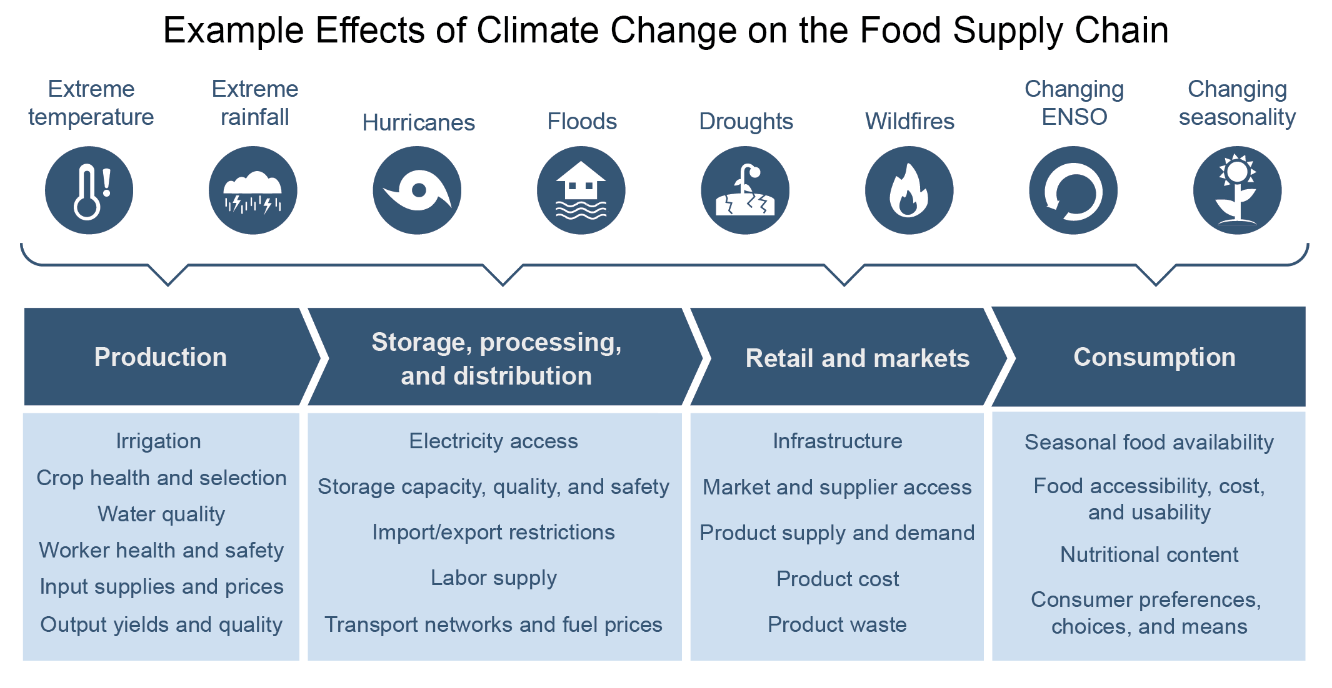
Figure 11.10. Climate change has cascading and compounding effects on all stages of the food supply chain.
Notes:
CAPTION: Extreme events fueled by climate change (first row, icons) can affect each stage of the food supply chain (second row, dark blue), resulting in compounding and cascading effects on the food system (third row, light blue). Adapted with permission from Davis et al. 2021.(Davis et al. 2021)

Slide 16
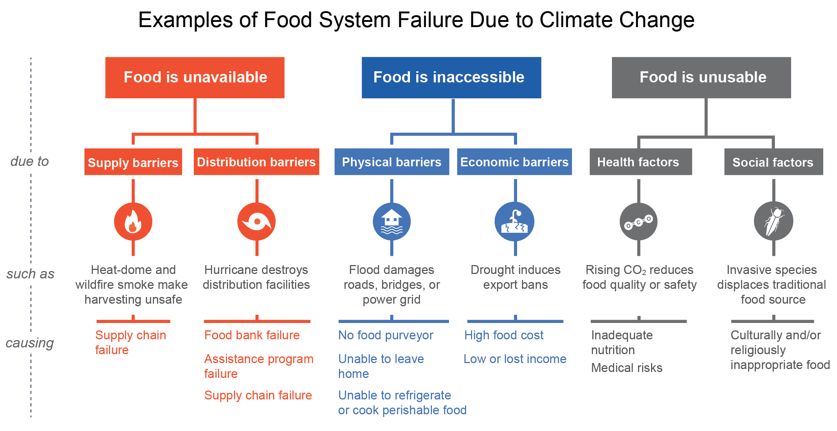
Figure 11.11. Climate change is expected to increase risks to food security in multiple ways.
Notes:
CAPTION: This fault-tree shows some of the many ways that food system failures can occur due to climate change, ultimately making food less accessible, available, or usable. In some cases, food may still be available yet inaccessible or unusable. For example, power outages during extreme heat events or after a hurricane may prevent some consumers from safely refrigerating or cooking perishable foods they have already purchased. Adapted from Chodur et al. (2018)(Chodur et al. 2018) [CC BY 4.0].

Slide 17
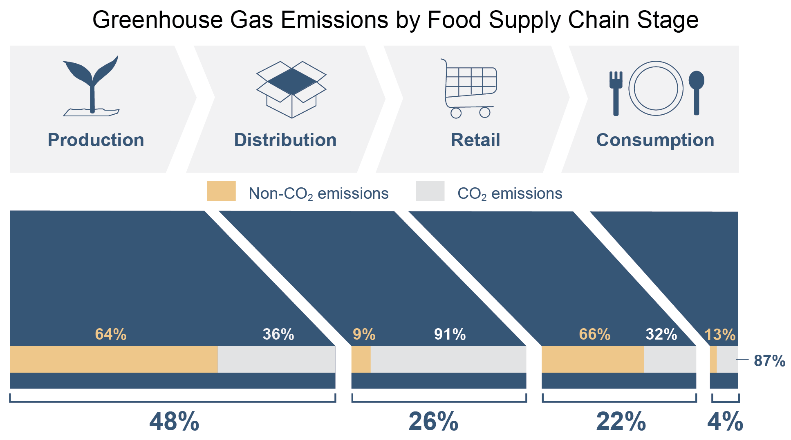
Figure 11.12. Greenhouse gas emissions differ by stage of the food supply chain.
Notes:
CAPTION: Greenhouse gas (GHG) emissions occur at all stages of the food supply chain. Production (i.e., the growth and harvesting of crops and the rearing and slaughter of livestock) represents 48% of the overall GHG emissions from the food supply chain. Non-carbon dioxide (non-CO₂) emissions are largely from nitrous oxide emissions from nitrogen fertilizer and manure management and methane emissions from livestock production in the production stage, along with chlorofluorocarbon emissions at the retail stage. Carbon dioxide emissions in the primary food production stage are from soil and land-use management, fertilizer production, and farm energy use. Energy use is the primary CO₂ emissions contributor to supply chain stages downstream from food production. Adapted from EPA (2021).(EPA 2021)

Slide 18
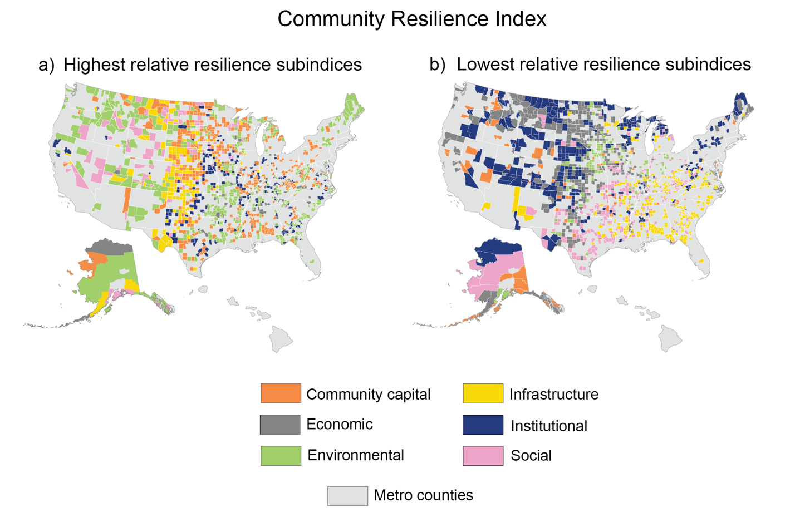
Figure 11.13. Rural communities differ in the categories of the Baseline Resilience Indicators that contribute most substantially to their resilience.
Notes:
CAPTION: Six broad categories (social, economic, community capital, institutional, infrastructure, and environmental) constitute the Baseline Resilience Indicators for Communities (BRIC; see Figure 11.14).(Cutter et al. 2014) The highest (a) and lowest (b) relative category of resilience for communities within nonmetropolitan counties is shown at the county level. There is considerable spatial variability in each category of community resilience. The US Caribbean and US-Affiliated Pacific Islands are not represented on the map because of a lack of data. Discussion of resilience vulnerabilities for these areas can be found in Chapters 23 and 30. Figure credit: USDA, NOAA NCEI, and CISESS NC.

Slide 19
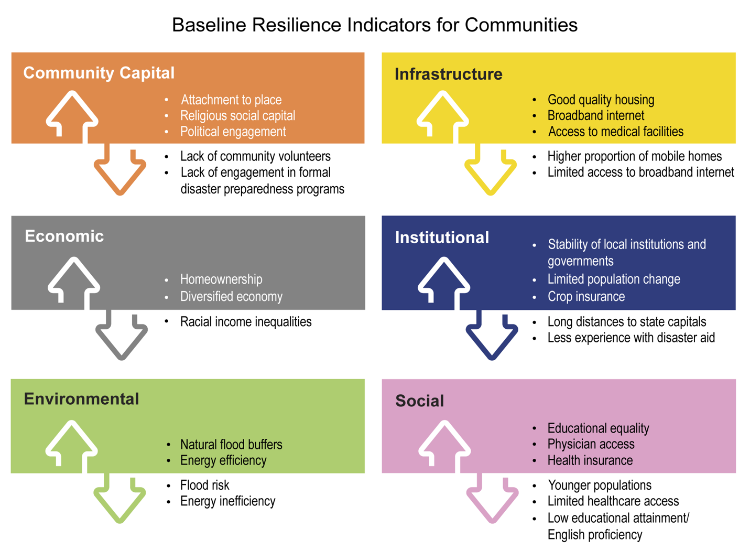
Figure 11.14. Rural community resilience to natural hazards is measured by several broad categories of indicators that affect aspects of resilience (both positively and negatively).
Notes:
CAPTION: The Baseline Resilience Indicators for Communities (BRIC) index is a composite measure of community resilience to natural hazards. It considers 49 indicators of existing attributes of resilience arranged in six broad categories: social, infrastructure, institutional, environmental, economic, and community capital. It can be used to compare community resilience within one county to that of another (see, for example, Figure 11.13). Positive and negative drivers of resilience for rural counties are provided for each category. Figure credit: USDA.

Slide 20
Federal Coordinating Lead Author
Rob Mitchell, USDA Agricultural Research Service
Chapter Lead
Carl H. Bolster, USDA Agricultural Research Service
Agency Chapter Lead Author
Andrew Kitts, NOAA Fisheries, Office of Science and Technology
Chapter Authors
Amber Campbell, USDA National Institute of Food and Agriculture
Michael Cosh, USDA Agricultural Research Service, Hydrology and Remote Sensing Laboratory
Tracey L. Farrigan, USDA Economic Research Service
Alan J. Franzluebbers, USDA Agricultural Research Service
David L. Hoover, USDA Agricultural Research Service
Virginia L. Jin, USDA Agricultural Research Service
Dannele E. Peck, USDA Agricultural Research Service, Northern Plains Climate Hub
Marty R. Schmer, USDA Agricultural Research Service
Michael D. Smith, National Oceanic and Atmospheric Administration
Review Editor
Omanjana Goswami, Union of Concerned Scientists
USGCRP Coordinators
Christopher W. Avery, US Global Change Research Program / ICF
Samantha Basile, US Global Change Research Program / ICF

Slide 21
Bolster, C.H., R. Mitchell, A. Kitts, A. Campbell, M. Cosh, T.L. Farrigan,
A.J. Franzluebbers, D.L. Hoover, V.L. Jin, D.E. Peck, M.R. Schmer, and
M.D. Smith, 2023: Ch. 11. Agriculture, food systems, and rural
communities. In: Fifth National Climate Assessment. Crimmins, A.R.,
C.W. Avery, D.R. Easterling, K.E. Kunkel, B.C. Stewart, and T.K. Maycock,
Eds. U.S. Global Change Research Program, Washington, DC, USA.
https://doi.org/10.7930/NCA5.2023.CH11
https://nca2023.globalchange.gov/chapter/11

