Slide 1

NCA5 Website: https://nca2023.globalchange.gov
Chapter Website: https://nca2023.globalchange.gov/chapter/13
NCA5 Atlas: https://atlas.globalchange.gov
Figure captions can be found in the slide notes of this deck
Social media: @usgcrp, #NCA5

Slide 2
Chapter 13 | Transportation

Slide 3
1
Limiting Transportation Sector Emissions and Integrating Climate Projections Can Reduce Risks
The transportation sector is the largest source of greenhouse gas emissions in the United States, although transportation emissions sources are changing (very high confidence). The sector also faces increasing risk from climate-related extreme weather (very high confidence). Incorporating climate projections and adaptation and resilience best practices into transportation planning, design, operations, and maintenance can reduce such risks to the sector (very high confidence).

Slide 4
2
Climate Change Combined with Other Disruptors Requires New Frameworks and Competencies
Climate action creates an opportunity to address concurrent disruptors, including cyber-technology integration, challenges with the condition of existing assets, and a changing workforce (medium confidence). Climate change has accelerated a transition to the use of more advanced approaches, including updated technologies, tools, and best practices (high confidence). Further recruitment and training of the sector’s workforce is needed to effectively address these fundamental challenges (high confidence).

Slide 5
3
Sustainable Transportation Would Produce Societal Benefits
A carbon-free, sustainable, and resilient transportation system would have co-benefits for human health, environmental justice, the natural environment, and economic development (very high confidence). When these co-benefits are considered, the benefits of greenhouse gas mitigation actions in the transportation sector far outweigh the costs (high confidence).

Slide 6
4
Equitable Distribution of Transportation Trade-Offs and Benefits Requires Community Involvement
Although implementing adaptation and mitigation measures in the transportation sector will produce essential benefits and co-benefits, including addressing existing inequities, additional consideration is needed to avoid or reduce potential adverse consequences associated with these measures (high confidence). Moving toward climate resilience and environmental justice requires that these considerations, as well as current and historic inequities, be assessed through transparent and inclusive processes in order to provide equitable protection from environmental and health hazards and equitable access to transportation benefits (high confidence).

Slide 7
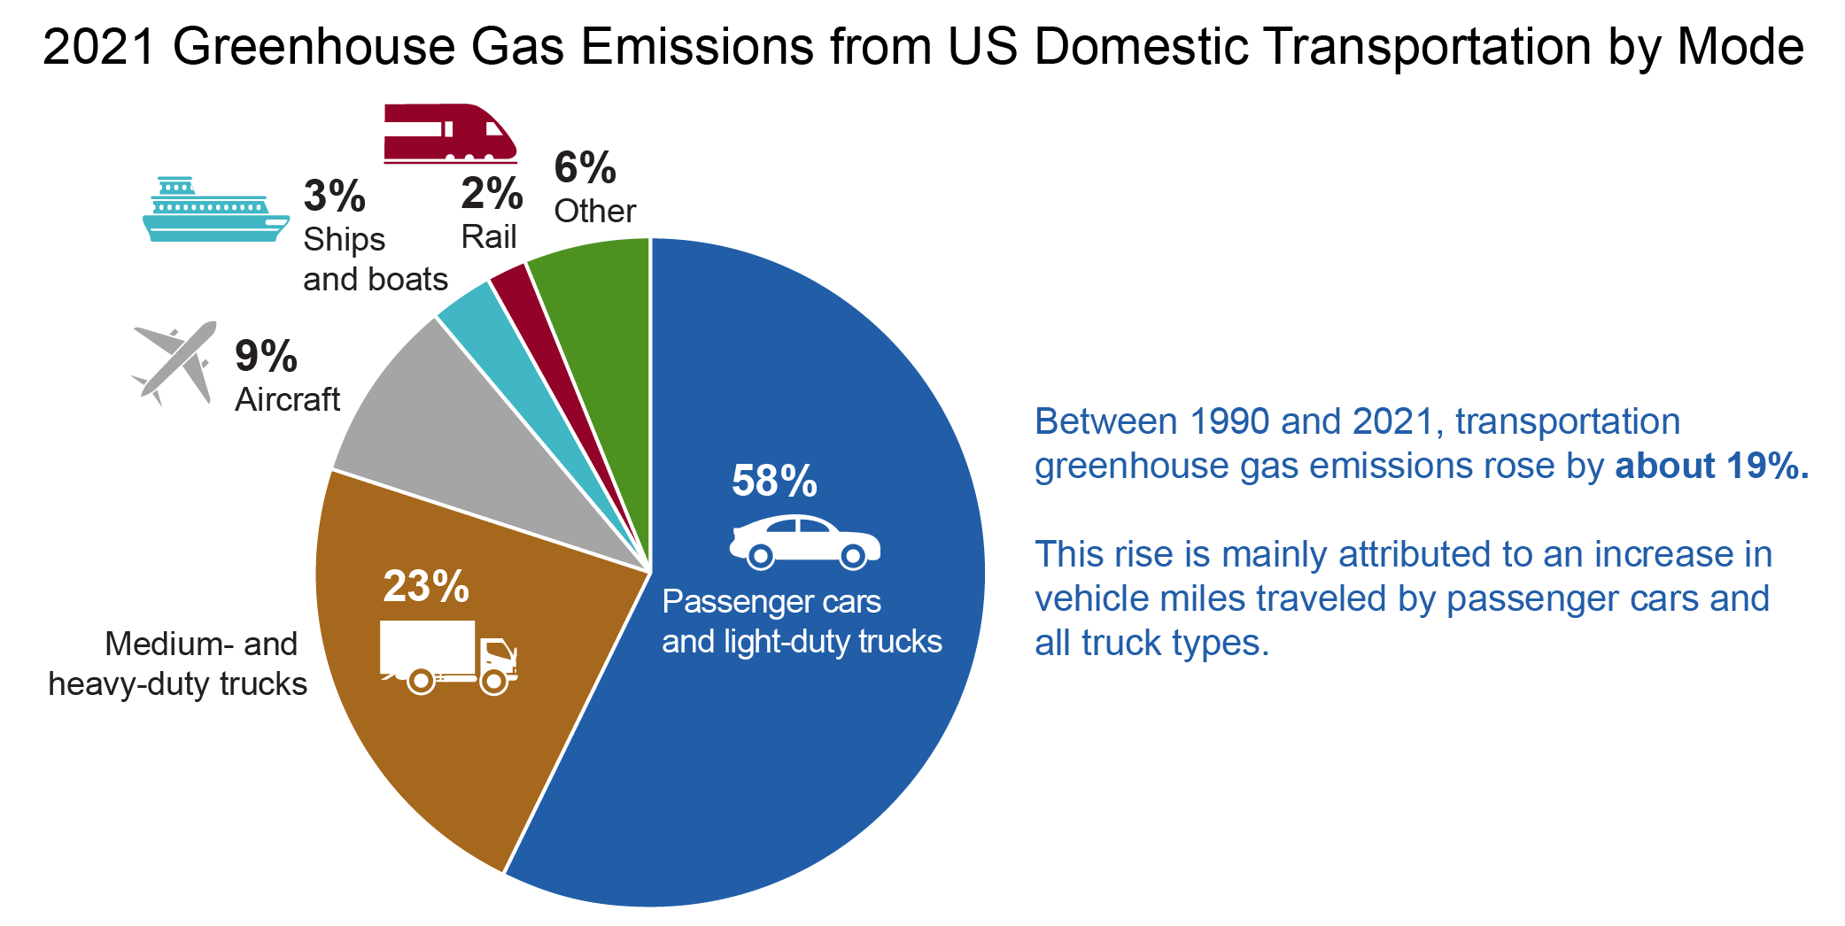
Figure 13.1. Transportation remains the largest source of emissions in the US, with cars and light-duty trucks as the largest contributors.
Notes:
CAPTION: Greenhouse gas (GHG) emissions from the US domestic transportation sector rose by about 19% between 1990 and 2021 and remain the largest source of total national GHG emissions, with passenger cars and all types of trucks being the most significant contributors to the rise in transportation emissions. “Other” refers to buses, motorcycles, pipelines, and lubricants. Numbers do not add up to 100% due to rounding. Figure credit: Arizona State University and Texas Tech University. See figure metadata for additional contributors.

Slide 8
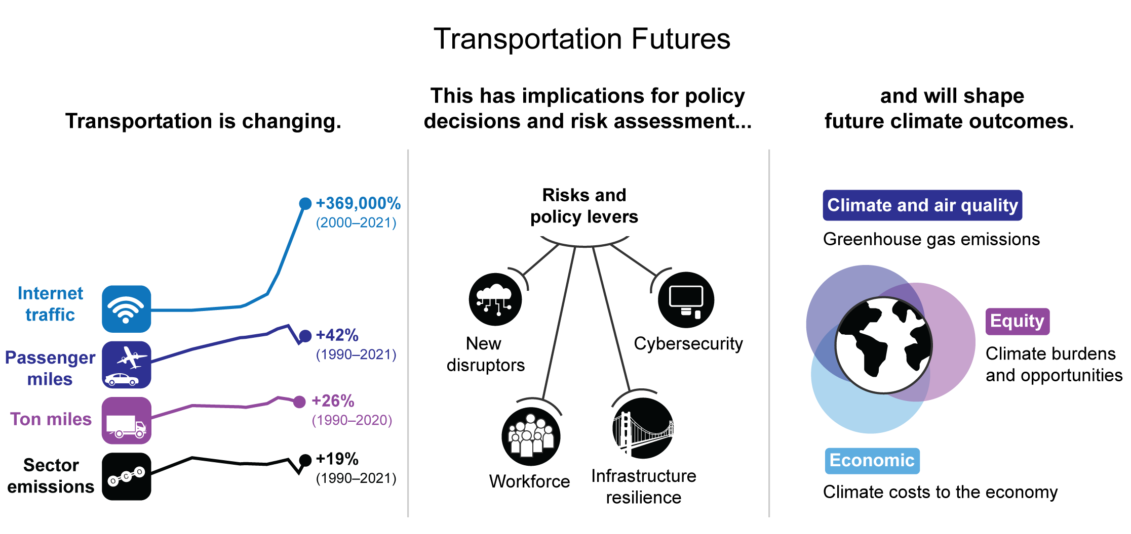
Figure 13.2. A shifting transportation landscape, and how we respond to it, will determine future climate outcomes.
Notes:
CAPTION: The ways people, goods, and services travel have changed since 1990, especially with the dramatic rise of internet traffic. These changes create new challenges, such as cybersecurity impacts, and, coupled with workforce and infrastructure resilience challenges, are increasing the policy decisions in transportation. These decisions will shape future climate outcomes. Figure credit: Open Society Foundations, Introducing Youth to American Infrastructure Inc., NOAA NCEI, and CISESS NC.

Slide 9
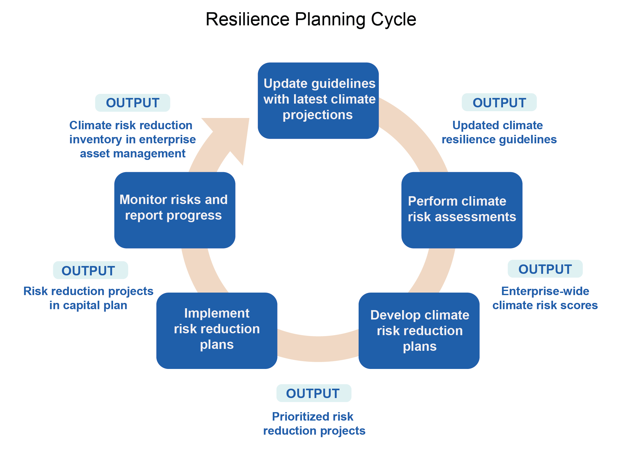
Figure 13.3. Improving transportation resilience requires an iterative approach.
Notes:
CAPTION: This concept demonstrates a potential iterative approach to planning, investing, and building for climate resilience in the transportation sector, starting with 1) integration of updated climate projections into guidelines and workflows and proceeding to 2) assessment of climate change–related risks, 3) prioritization of climate risk-mitigation investments and strategies, 4) implementation of prioritized strategies, and 5) ongoing tracking and reporting of progress, culminating with updates to enterprise asset management (EAM) data—the foundation for the next resilience cycle. This process is underpinned by a strong climate resilience policy. This approach is designed to ensure that the pursuit of resilience is ongoing, adaptable, and both immediately relevant and future focused. Figure credit: Port Authority of New York and New Jersey.

Slide 10
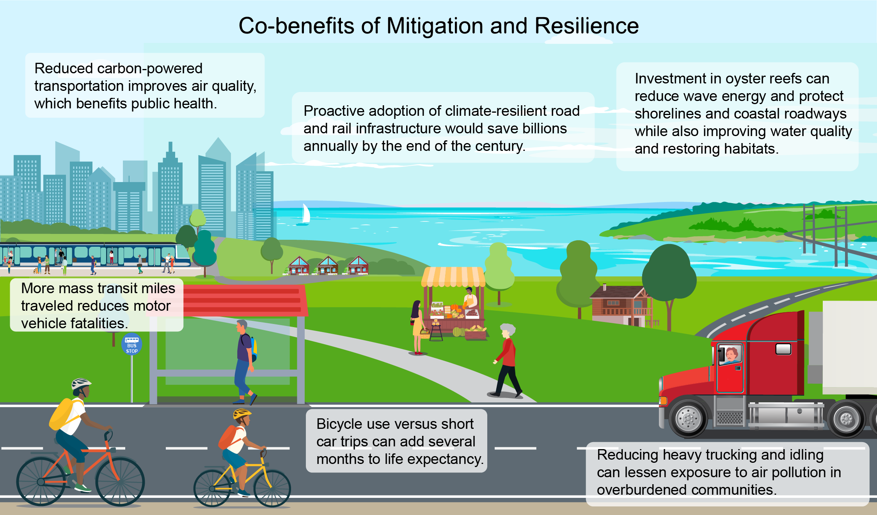
Figure 13.4. Decarbonizing transportation could save money and improve air quality, social equity, and the health of people and ecosystems.
Notes:
CAPTION: Integrating mitigation and resilience into transportation policies and planning at multiple scales leads to improved air quality, enhanced physical fitness from cycling, reduced environmental injustice as a result of decreases in heavy-duty trucking and idling, healthier ecosystems, and more economic opportunities. Figure credit: George Washington University and Jacobs.

Slide 11
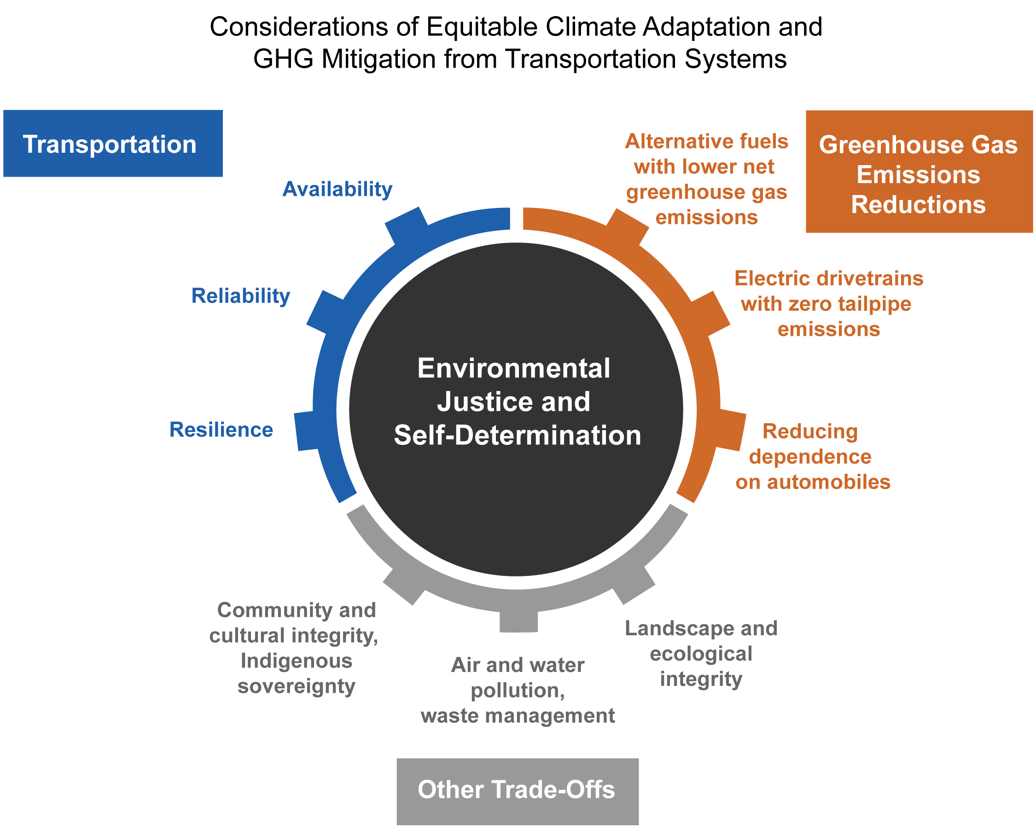
Figure 13.5. Reducing emissions involves trade-offs that have implications for reliability, equity, and environmental quality.
Notes:
CAPTION: This figure shows many of the considerations where risks may arise as changes are made to transportation systems. Each tab on the figure represents a potential trade-off to all of the other factors shown. For example, changing transportation fuels or moving to electric drivetrains can decrease greenhouse gas and air pollutant emissions but may also affect transportation availability (which includes both geographical location and affordability) and reliability in underserved communities or in communities adapting to changing climates. Further, mining of raw materials for those technologies has the potential to damage ecosystems and cultural or sacred landscapes. Accordingly, decisions about climate mitigation and adaptation in transportation systems should be carefully considered through lenses of environmental justice and community self-determination. Figure credit: EPA and University of Idaho.

Slide 12
Federal Coordinating Lead Author
Robert Kafalenos, US Department of Transportation
Chapter Lead
Cris B. Liban, Los Angeles County Metropolitan Transportation Authority
Chapter Authors
Lilian Alessa, University of Idaho
Susan Anenberg, George Washington University
Mikhail Chester, Arizona State University
Joshua DeFlorio, Port Authority of New York & New Jersey
Francisco J. Dóñez, US Environmental Protection Agency
Aimee Flannery, Jacobs
Michael R. Sanio, Institute for Sustainable Infrastructure
Beverly A. Scott, Introducing Youth to American Infrastructure Inc.
Anne Marie K. Stoner, Earth Knowledge Inc.
Technical Contributors
Jack Clark, International Transportation Learning Center
Kristina A. Dahl, Union of Concerned Scientists
Alissa Kendall, University of California, Davis
Samuel A. Markolf, University of California, Merced
Katelyn O'Dell, George Washington University, Department of Environmental and Occupational Health
Steven Olmsted, Arizona Department of Transportation
Laurel Paget-Seekins, Open Society Foundations, Leadership in Government Fellowship
Karen E. Philbrick, Mineta Transportation Institute
Tara L. Ramani, Texas A&M Transportation Institute
Manjit K. Sooch, Alameda-Contra Costa Transit District
Benjamin S. Underwood, North Carolina State University
Madison A. Walker, Arizona State University
Review Editor
John R. Posey, East–West Gateway Council of Governments
USGCRP Coordinators
Joshua Hernandez, US Global Change Research Program / ICF
Reid Sherman, US Global Change Research Program / ICF

Slide 13
Liban, C.B., R. Kafalenos, L. Alessa, S. Anenberg, M. Chester, J.
DeFlorio, F.J. Dóñez, A. Flannery, M.R. Sanio, B.A. Scott, and A.M.K.
Stoner, 2023: Ch. 13. Transportation. In: Fifth National Climate
Assessment. Crimmins, A.R., C.W. Avery, D.R. Easterling, K.E.
Kunkel, B.C. Stewart, and T.K. Maycock, Eds. U.S. Global Change
Research Program, Washington, DC, USA.
https://doi.org/10.7930/NCA5.2023.CH13
https://nca2023.globalchange.gov/chapter/13

