Slide 1

NCA5 Website: https://nca2023.globalchange.gov
Chapter Website: https://nca2023.globalchange.gov/chapter/14
NCA5 Atlas: https://atlas.globalchange.gov
Figure captions: Captions can be found in the slide notes of this deck
Social media: @usgcrp, #NCA5

Slide 2
Chapter 14 | Air Quality

Slide 3
1
Climate Change Will Hamper Efforts to Improve US Air Quality
Climate change is projected to worsen air quality in many US regions (medium confidence), thereby harming human health and increasing premature death (very likely, high confidence). Extreme heat events, which can lead to high concentrations of air pollution, are projected to increase in severity and frequency (very likely, very high confidence), and the risk of exposure to airborne dust and wildfire smoke will increase with warmer and drier conditions in some regions (very likely, high confidence). Reducing air pollution concentrations will unequivocally help protect human health in a changing climate.

Slide 4
2
Increasing Wildfire Smoke Is Harming Human Health and Catalyzing New Protection Strategies
Wildfires emit gases and fine particles that are harmful to human health, contributing to premature mortality, asthma, and other health problems (very high confidence). Climate change is contributing to increases in the frequency and severity of wildfires, thereby worsening air quality in many regions of the contiguous US and Alaska (likely, high confidence). Although large challenges remain, new communication and mitigation measures are reducing a portion of the dangers of wildfire smoke (medium confidence).

Slide 5
3
Air Pollution Is Often Worse in Communities of Color and Low-Income Communities
Communities of color, people with low socioeconomic status, and other
marginalized populations are disproportionately harmed by poor air
quality (very high confidence). In the coming decades, these same
communities will, on average, face worsened cumulative air pollution
burdens from climate change–driven hazards (very likely, high
confidence). Decision-making focused on the fair distribution of air
quality improvements, rather than on overall emissions reductions
alone, is critical for reducing air pollution inequities (high confidence).

Slide 6
4
Climate Change Is Worsening Pollen Exposures and Adversely Impacting Health
Increased allergen exposure damages the health of people who suffer
from allergies, asthma, and chronic obstructive pulmonary disease
(COPD) (very high confidence). Human-caused climate change has
already caused some regions to experience longer pollen seasons and
higher pollen concentrations (very likely, high confidence), and these
trends are expected to continue as climate changes (very likely, high
confidence). Increasing access to allergists, improved diagnosis and
disease management, and allergy early warning systems may counteract
the health impacts of increasing pollen exposure (high confidence).

Slide 7
5
Policies Can Reduce Greenhouse Gas Emissions and Improve Air Quality Simultaneously
Substantial reductions in economy-wide greenhouse gas emissions
would result in improved air quality and significant public health
benefits (very likely, high confidence). For many actions, these benefits
exceed the cost of greenhouse gas emission controls (likely, high
confidence). Through coordinated actions emphasizing reduced fossil
fuel use, improved energy efficiency, and reductions in short-lived
climate pollutants, the US has an opportunity to greatly improve air
quality while substantially reducing its climate impact, approaching net-
zero CO₂ emissions (high confidence).

Slide 8
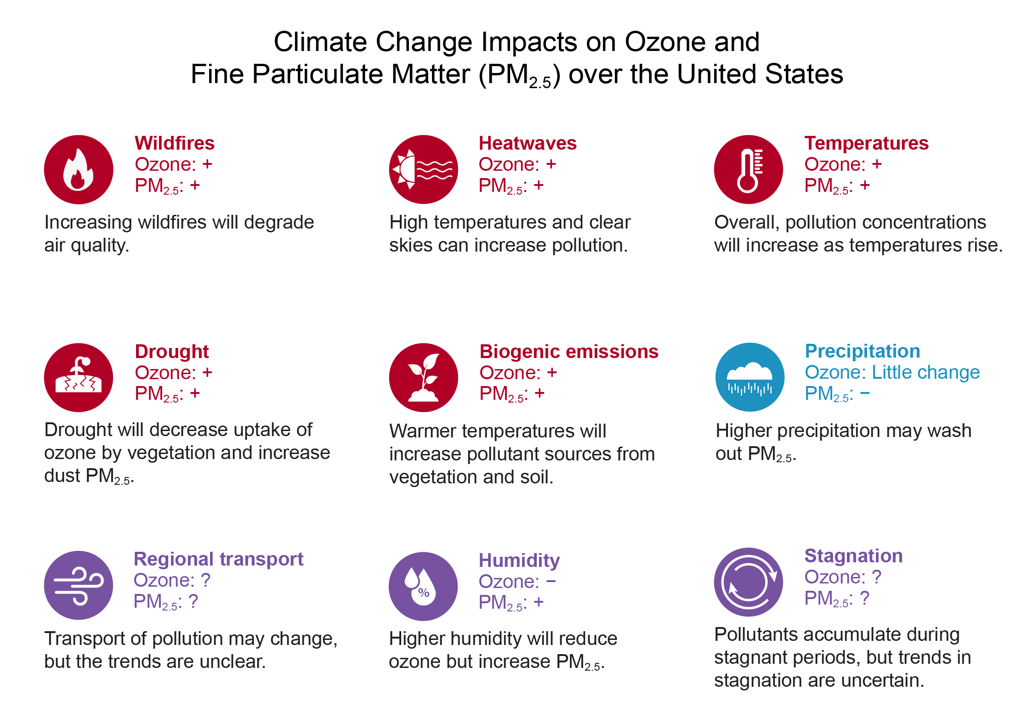
Figure 14.1. Climate change will have varying effects on ozone and fine particulate matter (PM2.5) concentrations, including through impacts on weather-sensitive emissions.
Notes:
CAPTION: Climate change is projected to alter concentrations of two key US air pollutants, ozone and PM_{2.5}, through several processes. Red icons signify increased ozone and PM_{2.5}, and the blue icon denotes decreased PM_{2.5}. Plus and minus signs indicate the expected pollutant response to climate-driven changes in meteorology. Question marks and purple icons denote uncertainty in either the response or in how the meteorological process will change with climate change. Given uncertainties and regional differences in pollution responses, the magnitude of these responses is not presented. Key Messages 14.1 and 14.2 provide more detailed descriptions of the mechanisms involved. Adapted from The Royal Society 2021⁶⁵ [CC BY 4.0].

Slide 9
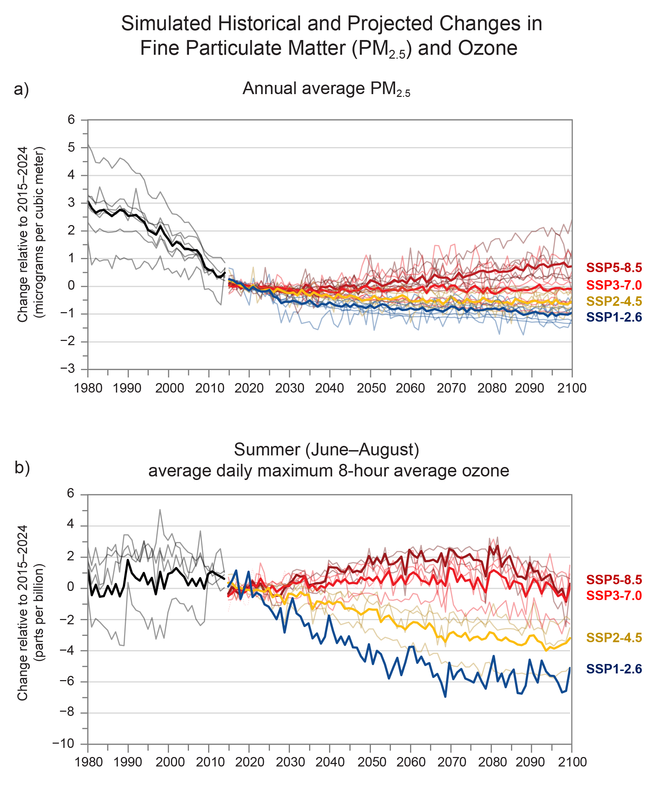
Figure 14.2. Reductions in human-caused emissions that contribute to ozone and fine particulate matter (PM2.5) are expected to improve air quality in a changing climate.
Notes:
CAPTION: Future air quality depends on both air pollution control measures and climate change. Modeled pollutant concentrations are shown averaged over the contiguous US, with the historical period in black and projections in various colors, for (a) annual average PM_{2.5} and (b) summer (June–August) average daily maximum 8-hour average ozone, a metric of ozone pollution. Trends are shown relative to the 2015–2024 average value. Historical air quality improvements reflect clean air policies. Thick lines are multimodel average values. Thin lines show individual model simulations, indicating uncertainties from modeled processes and natural weather variability for each scenario. The focus on the contiguous states reflects the stronger influence from domestic emissions compared to other US regions (Alaska, Hawaiʻi and the US-Affiliated Pacific Islands, and the US Caribbean), where the balance of processes contributing to pollution and responses to climate change are expected to differ. These projections do not include the expected strong influence of climate change on wildfire smoke. Model simulations are described by Turnock et al. 2020.¹⁵ Figure credit: Massachusetts Institute of Technology. See figure metadata for additional contributors.

Slide 10
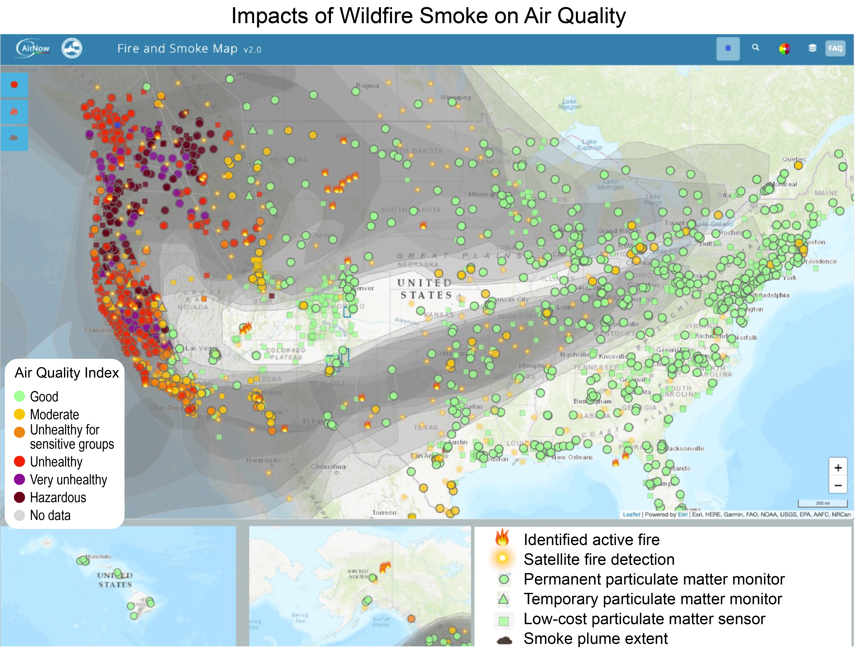
Figure 14.3. Wildfire smoke affects air quality across the country.
Notes:
CAPTION: Wildfire smoke can affect the daily lives of people across the country, as communicated in real time to the public on September 13, 2020, on the AirNow Fire and Smoke Map (https://fire.airnow.gov/). Monitors measuring particulate matter are color-coded by air quality index from green for good air quality to brown for hazardous. Here, unhealthy to hazardous air quality conditions are shown at multiple monitors (circle, triangle, and square icons) across the western US, and satellite imagery (gray) shows smoke extending across much of North America. On this day, the US Caribbean was free of smoke, and monitor or sensor data were not yet available, so the region is not shown. Data are not available for US-affiliated Pacific Islands. Adapted from EPA 2022.¹²⁷ Base map: Copyright © 2022 Esri and its licensors. All rights reserved.

Slide 11
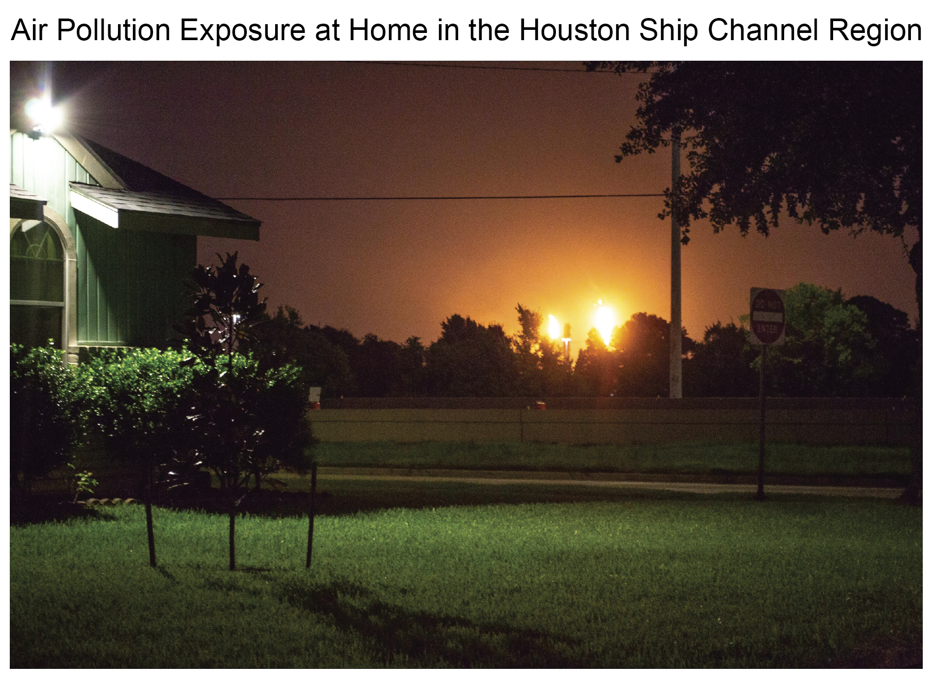
Figure 14.4. Industries expose people living near the Ship Channel—often African American, Latino, and low-income residents—to harmful air pollution.
Notes:
CAPTION: Nighttime industrial flaring exposes residents to air pollution near the Houston Ship Channel in the Deepwater community in Pasadena, Texas, a primarily African American, Latino, and low-income neighborhood. Photo credit: ©Cassandra Casados-Klein, Air Alliance Houston.

Slide 12
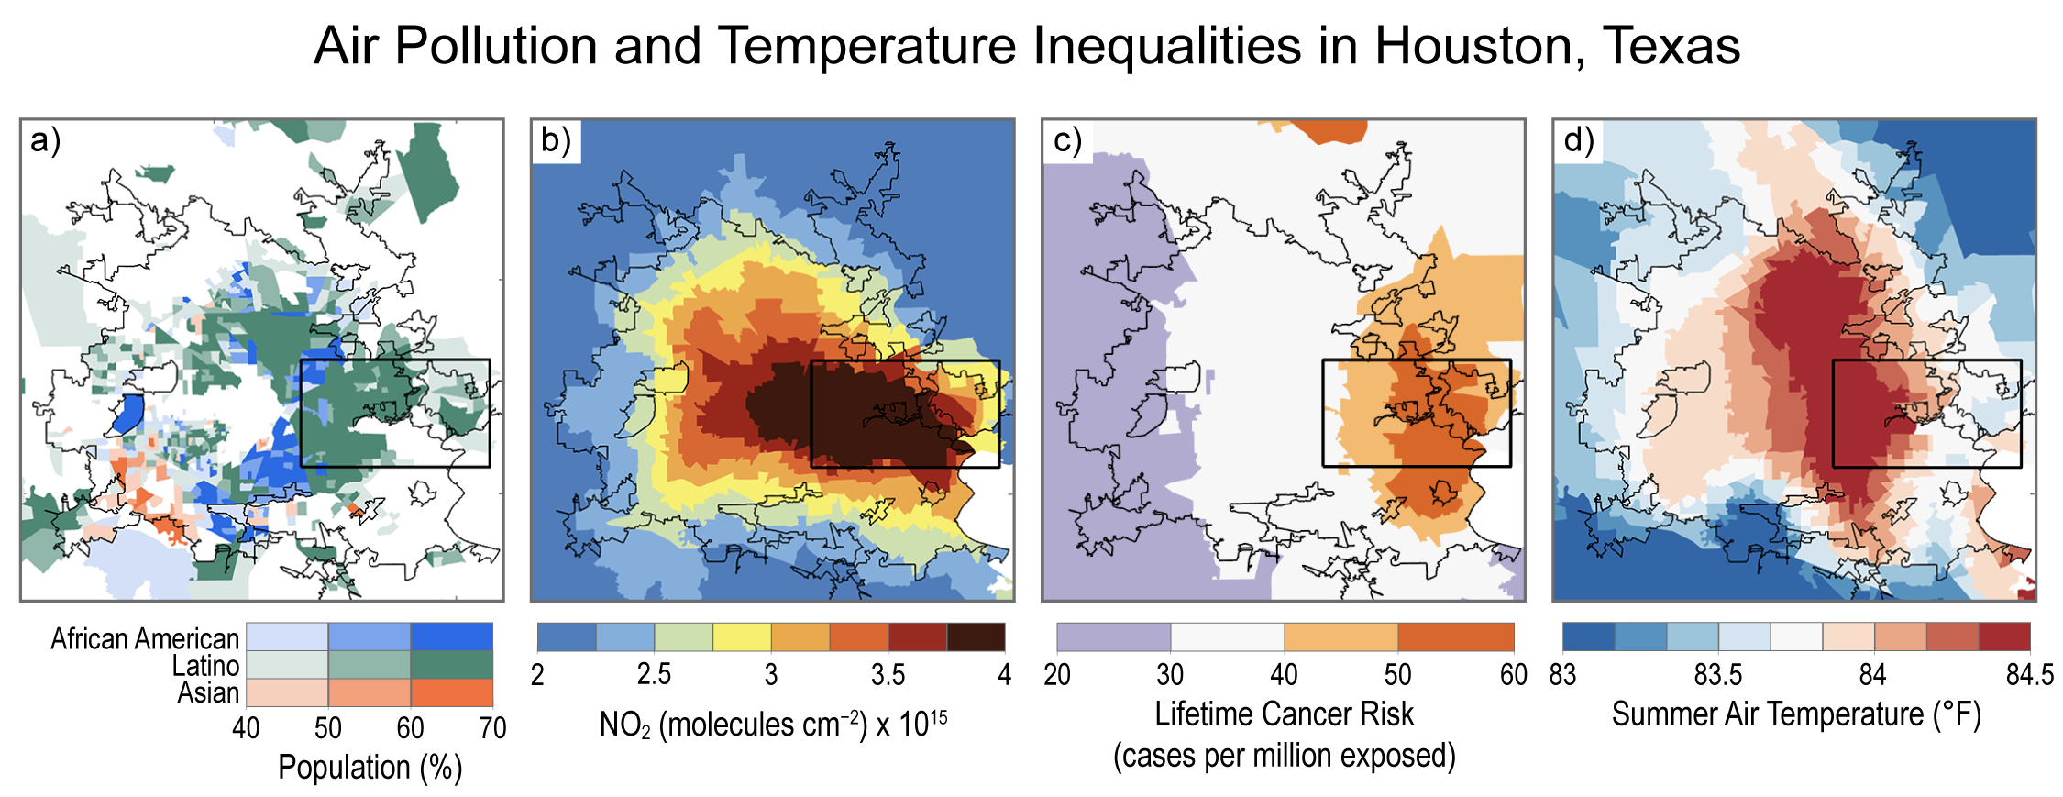
Figure 14.5. Air pollution, its health impacts, and temperatures are unequally distributed across Houston, Texas.
Notes:
CAPTION: Air quality and temperatures vary across Houston, Texas (urbanized area outlined in black). (a) For each neighborhood, the largest racial or ethnic group is shown: African American (blue), Latino (green), and Asian (orange). Higher-than-average levels of (b) nitrogen dioxide (NO₂; in 2019), (c) lifetime cancer risks associated with chronic air pollution exposure per million equally exposed people (2018), and (d) summer (June–August) air temperatures (2020) are found in neighborhoods that are primarily African American and Latino, especially those surrounding the Ship Channel (black box). There is variability in time and at very fine spatial scales that may not be captured here. Figure credit: University of Virginia, Columbia University, and Montana State University.

Slide 13
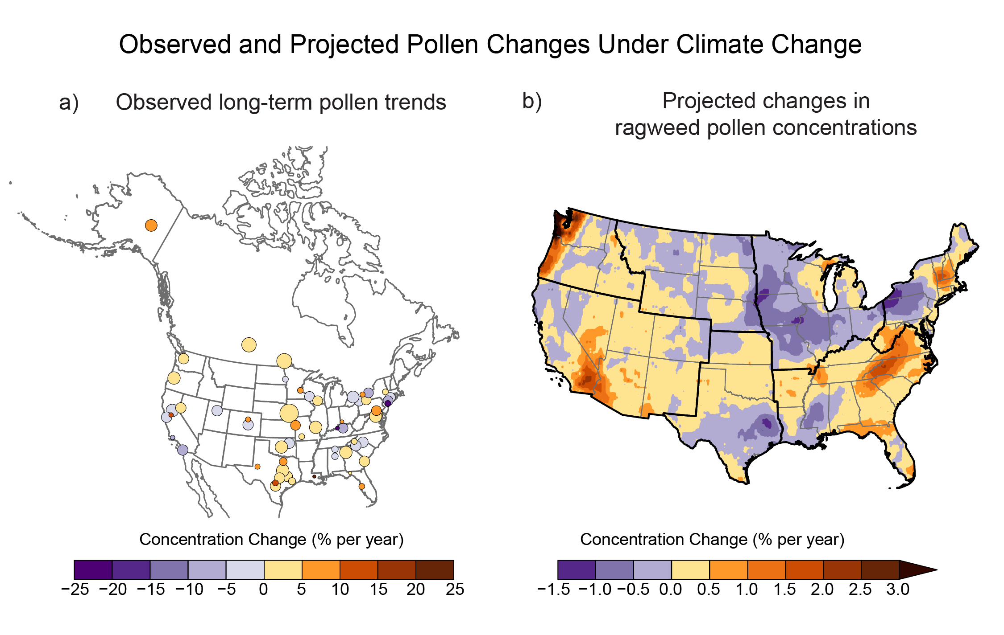
Figure 14.6. Pollen has been increasing in many US regions and is projected to continue to increase as climate changes.
Notes:
CAPTION: (a) Observed long-term pollen increases are shown as the linear trend of total annual pollen at 60 stations (1990–2018). (b) Modeled projected changes in average airborne ragweed pollen concentrations in 2047, relative to 2004, are shown for climate change conditions under a very high scenario (RCP8.5). Yellow and red shades indicate increases in pollen concentrations, and circle size in panel (a) reflects the number of years of data at each station. Observations are not available for many US states and affiliated territories, and the modeled projection does not include non-contiguous US states and territories. There is a net increase in concentration overall, with marked increases in certain areas and declines in others. (a) Adapted from Anderegg et al. 2021¹⁹⁴ [CC BY 4.0]; (b) adapted from Ren et al. 2022²¹⁰ [CC BY 4.0].

Slide 14
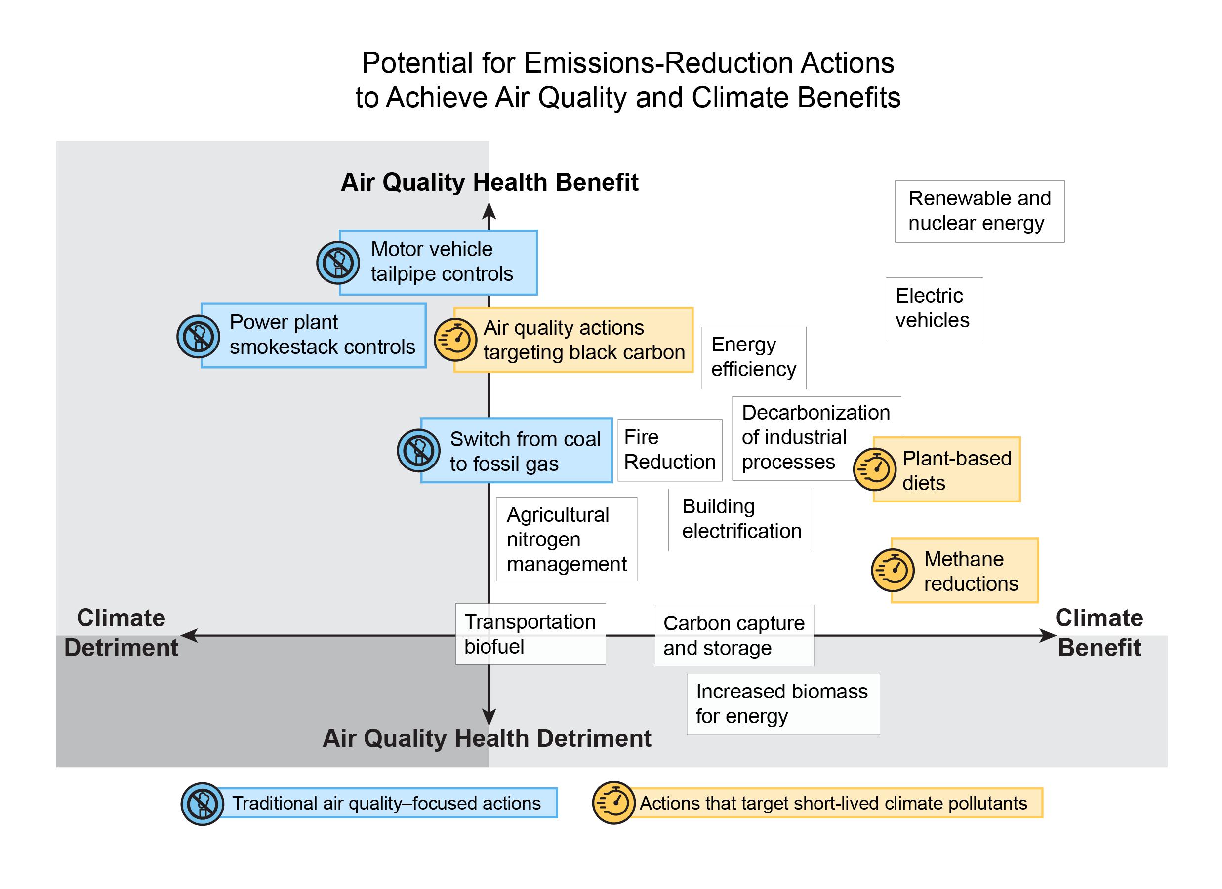
Figure 14.7. Many emissions-reduction actions can achieve multiple benefits for climate, air quality, and health.
Notes:
CAPTION: Environmental policies to mitigate emissions will affect both air quality and climate change, and actions can be coordinated to address both problems simultaneously. Blue boxes show mitigation actions aimed at conventional air pollution controls; orange boxes show actions targeted at short-lived climate pollutants; and white boxes show other types of actions. Emissions-reduction actions in the upper right have greater air quality and climate benefits. Box position indicates the relative potential of actions, from most detrimental to most beneficial, and should not be interpreted quantitatively (e.g., that one action has twice the potential of another). The size of the boxes indicates some uncertainty, with actions in boxes straddling an axis being uncertain in the direction of the effect. Addressing climate change requires moving to the actions on the right-hand side of the figure, where many options simultaneously improve air quality. Figure credit: EPA, University of North Carolina at Chapel Hill, and Duke University.

Slide 15
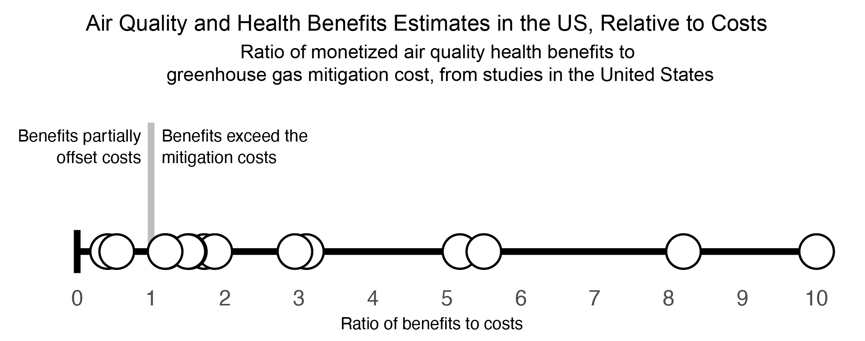
Figure 14.8. Air quality health benefits alone exceed or significantly offset the costs of greenhouse gas reductions.
Notes:
CAPTION: Controls on greenhouse gas (GHG) emissions also reduce air pollutant emissions from the same sources (often fossil fuel combustion), improving air quality and saving lives. Each circle denotes the results from a study in the US during 2013–2022. These studies find that the value of health benefits significantly offset or in most cases exceed the GHG emissions control costs, apart from other benefits of slowing climate change. Figure credit: EPA, University of North Carolina at Chapel Hill, and Duke University.

Slide 16
Federal Coordinating Lead Author
Christopher G. Nolte, US Environmental Protection Agency
Chapter Lead
J. Jason West, University of North Carolina at Chapel Hill
Chapter Authors
Michelle L. Bell, Yale University
Arlene M. Fiore, Massachusetts Institute of Technology, Department of Earth, Atmospheric, and Planetary Sciences
Panos G. Georgopoulos, Rutgers University
Jeremy J. Hess, University of Washington
Loretta J. Mickley, Harvard University
Susan M. O'Neill, USDA Forest Service, Pacific Northwest Research Station
Jeffrey R. Pierce, Colorado State University
Robert W. Pinder, US Environmental Protection Agency
Sally Pusede, University of Virginia
Drew T. Shindell, Duke University
Sacoby M. Wilson, University of Maryland
Technical Contributors
William R. L. Anderegg, University of Utah
Bhargavi Chekuri, University of Colorado School of Medicine
Nina Gabrielle G. Domingo, Yale University
Isabella M. Dressel, University of Virginia
Stuart Illson, University of Washington
Jean-Francois Lamarque, National Center for Atmospheric Research
Yuhao Pan, unaffiliated
Robbie M. Parks, Columbia University
Muye Ru, Morgan Stanley
Cascade Tuholske, Montana State University
Review Editor
Neal Fann, US Environmental Protection Agency
USGCRP Coordinators
Leo Goldsmith, US Global Change Research Program / ICF
Allyza R. Lustig, US Global Change Research Program / ICF

Slide 17
West, J.J., C.G. Nolte, M.L. Bell, A.M. Fiore, P.G. Georgopoulos, J.J. Hess, L.J. Mickley, S.M. O'Neill, J.R. Pierce, R.W. Pinder, S. Pusede, D.T. Shindell, and S.M. Wilson, 2023: Ch. 14. Air quality. In: Fifth National Climate Assessment. Crimmins, A.R., C.W. Avery, D.R. Easterling, K.E. Kunkel, B.C. Stewart, and T.K. Maycock, Eds. U.S. Global Change Research Program, Washington, DC, USA. https://doi.org/10.7930/NCA5.2023.CH14
https://nca2023.globalchange.gov/chapter/14

