Slide 1

NCA5 Website: https://nca2023.globalchange.gov
Chapter Website: https://nca2023.globalchange.gov/chapter/15
NCA5 Atlas: https://atlas.globalchange.gov
Figure captions: Captions can be found in the slide notes of this deck
Social media: @usgcrp, #NCA5

Slide 2
Chapter 15 | Human Health

Slide 3
1
Climate Change Is Harming Human Health
It is an established fact that climate change is harming physical, mental, spiritual, and community health and well-being through the increasing frequency and intensity of extreme events, increasing cases of infectious and vector-borne diseases, and declines in food and water quality and security. Climate-related hazards will continue to grow, increasing morbidity and mortality across all regions of the US (very likely, very high confidence).

Slide 4
2
Systemic Racism and Discrimination Exacerbate Climate Impacts on Human Health
Climate change unequivocally worsens physical, mental, spiritual, and community health and well-being, as well as social inequities. It is an established fact that climate-related impacts disproportionately harm communities and people who have been marginalized. These include BIPOC (Black, Indigenous, and People of Color), individuals and communities with low wealth, women, people with disabilities or chronic diseases, sexual and gender minorities, and children.

Slide 5
3
Timely, Effective, and Culturally Appropriate Adaptation and Mitigation Actions Protect Human Health
In every sector of society, implementing timely, effective, and culturally appropriate adaptation measures (high confidence), creating climate-resilient health systems (high confidence), and preventing the release of greenhouse gases can protect human health and improve health equity (high confidence).

Slide 6
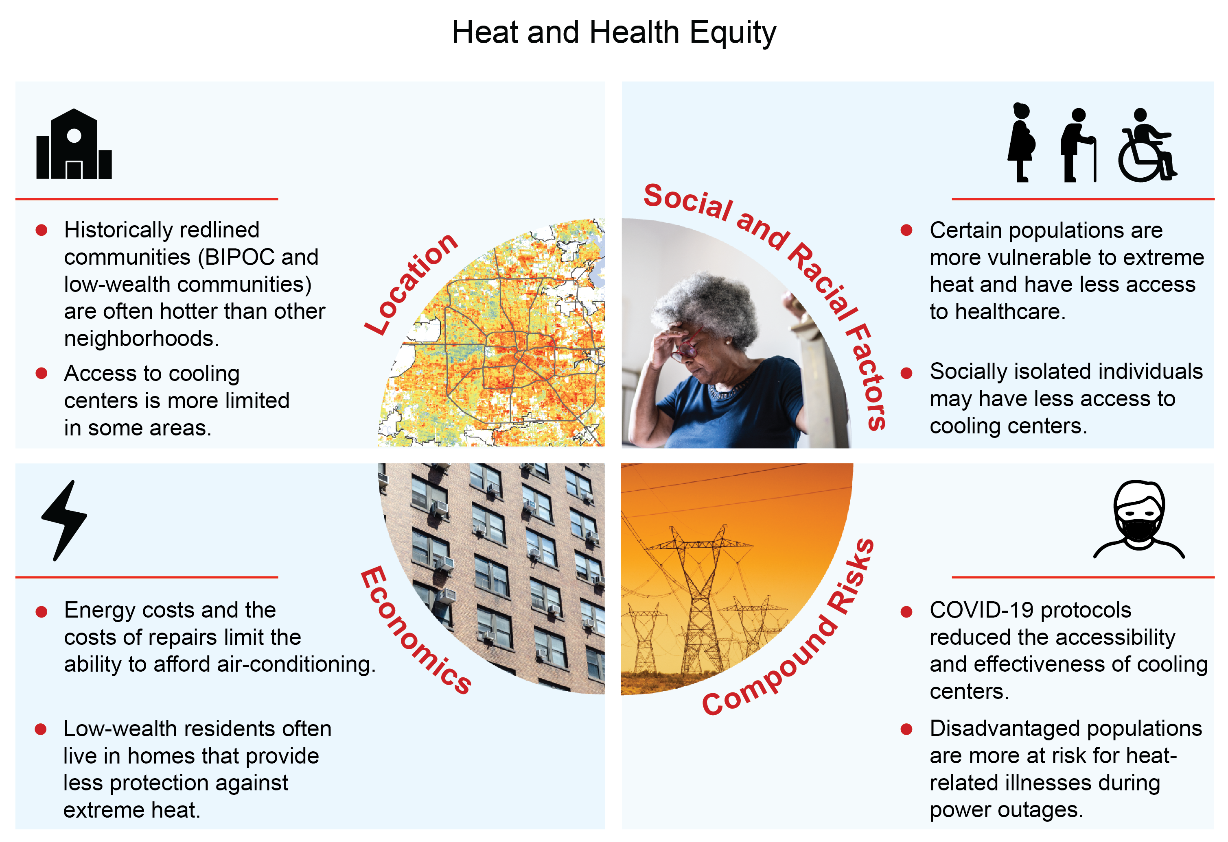
Figure 15.1. Heat does not impact all communities equally.
Notes:
CAPTION: While anyone can be impacted by heat, location, economics, compound risks, and social and racial factors influence who is most at risk. These impacts disproportionately affect BIPOC (Black, Indigenous, and People of Color) communities as well as communities with low wealth. Figure credit: CDC, University of Colorado, NOAA NCEI, and CISESS NC. Image credits (clockwise from top left): NIEHS/Kelly Government Solutions and USGS/ASRC Federal Data Solutions; FG Trade/E+ via Getty Images; YinYang/E+ via Getty Images; Marc Dufresne/iStock via Getty Images.

Slide 7
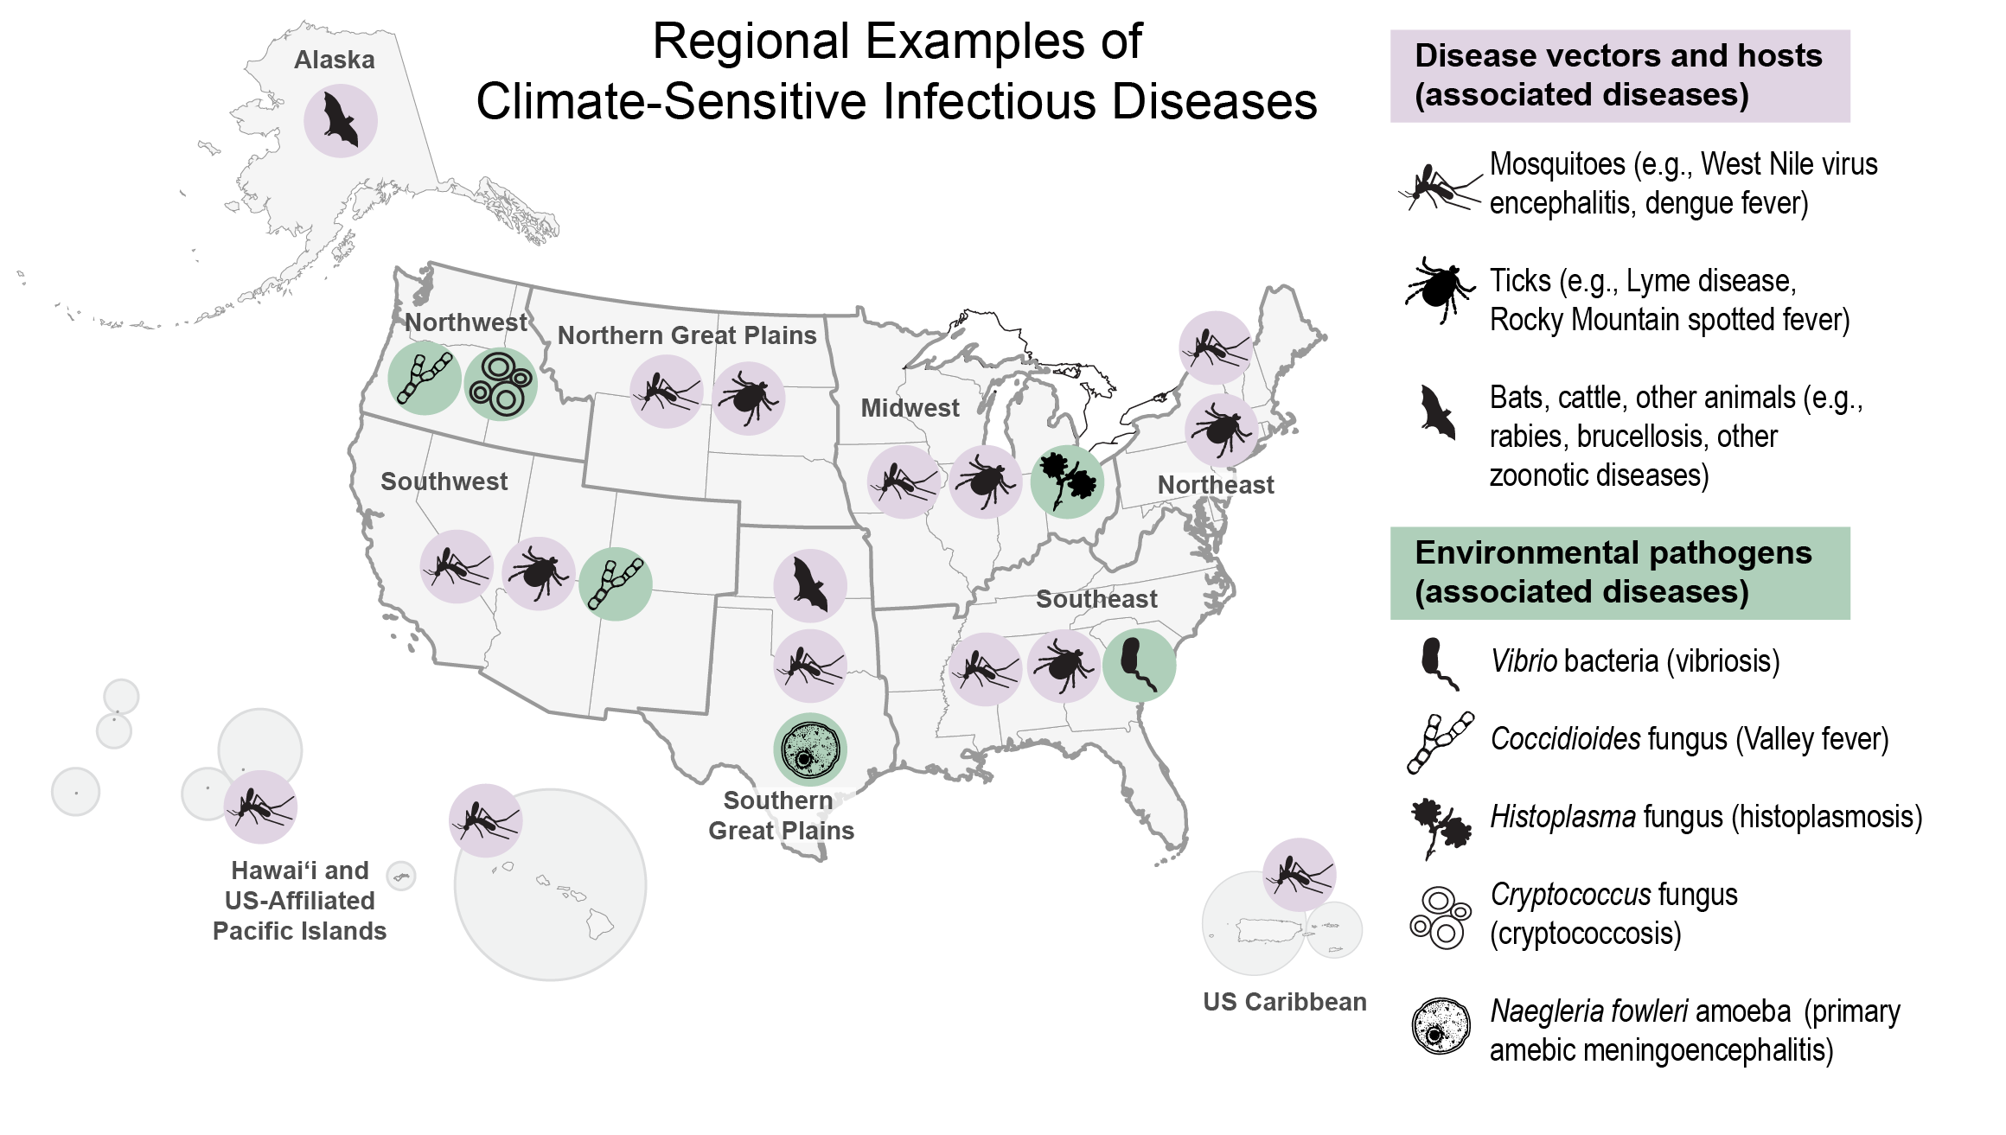
Figure 15.2. Some climate-sensitive infectious diseases are expected to see expanded geographic range and extended seasonality.
Notes:
CAPTION: The map shows select examples of regional climate-sensitive infectious diseases, based on recent changes in geographic range or incidence. Some regions will experience increases in tick- and mosquito-borne diseases, zoonotic diseases, and pathogens, both in geographic area and extended seasonality. Figure credit: Los Alamos National Laboratory, CDC, Columbia University, University of Arizona, and University of Colorado.

Slide 8
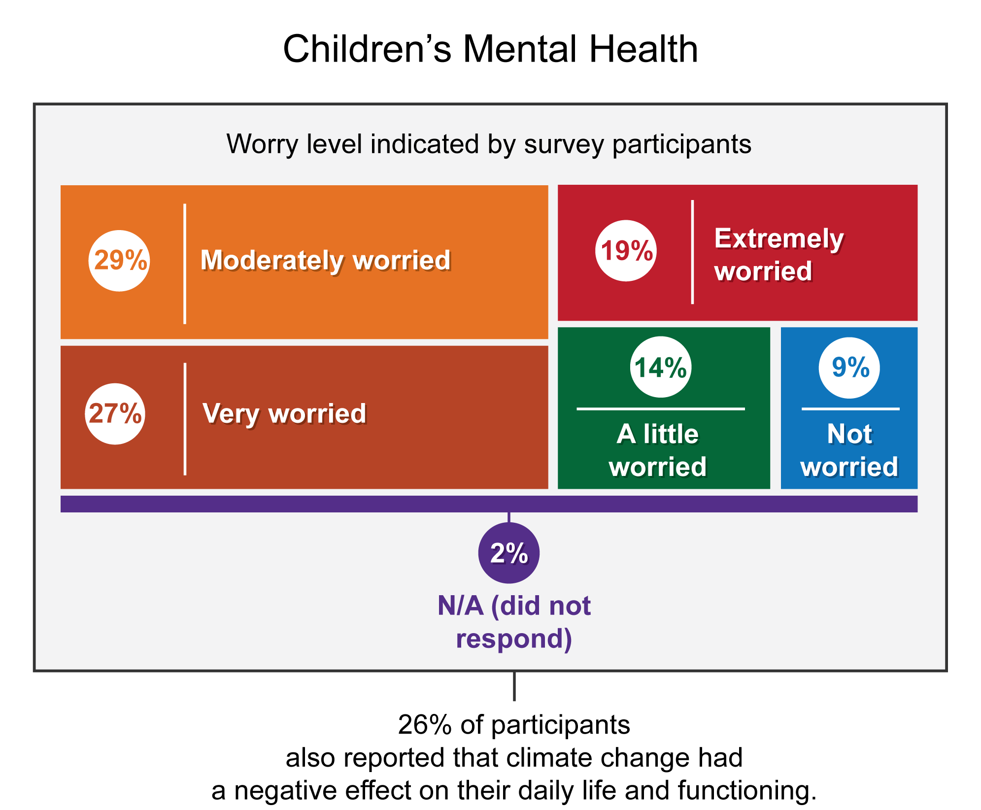
Figure 15.3. Out of 1,000 children and young people surveyed in the US, a majority expressed worry about climate change impacts to people and the planet.
Notes:
CAPTION: The figure shows the level of worry about climate change among young people ages 16–25. In the US, 46% of respondents said they were “very” or “extremely” worried about climate change, and 26% of respondents indicated that their feelings about climate change negatively affected their daily life and functioning, including at least one of the following: eating, concentrating, work, school, sleeping, spending time in nature, playing, having fun, and relationships.¹³² Figure credit: Boston Children’s Hospital, NOAA NCEI, and CISESS NC.

Slide 9
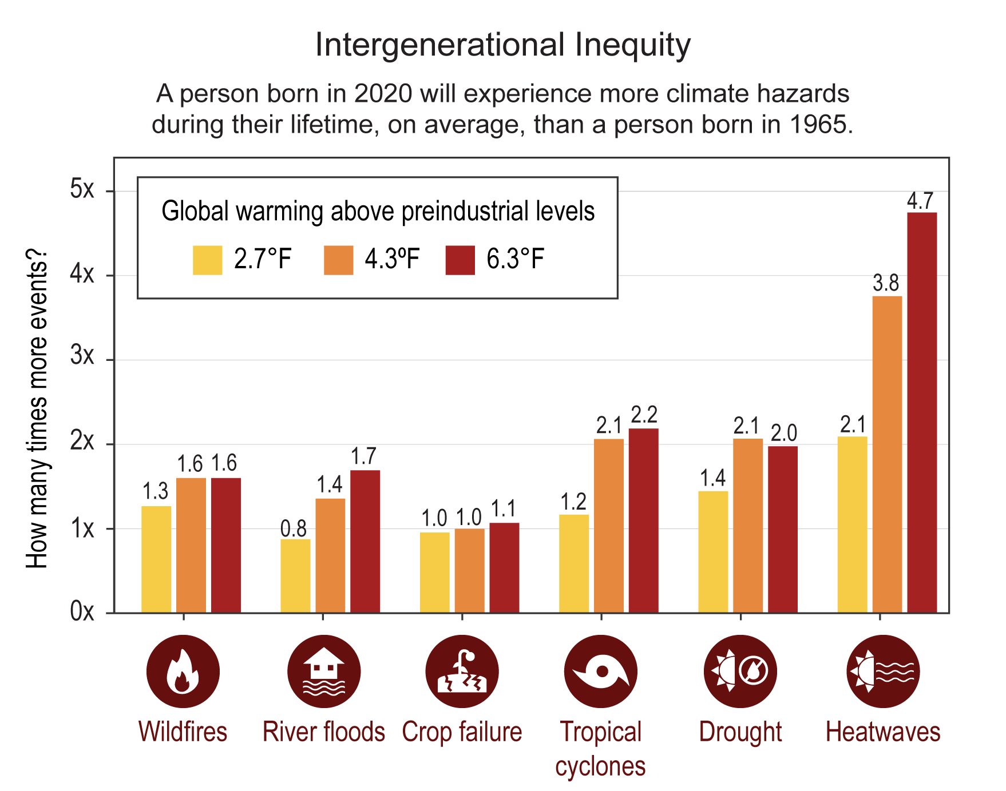
Figure 15.4. The number of climate hazards a person born in North America will experience during their lifetime depends on how much Earth warms above preindustrial levels.
Notes:
CAPTION: People born in North America in 2020, on average, will be exposed to more climate-related hazards compared to people born in 1965, an indication of intergenerational inequity. Figure credit: Boston Children’s Hospital, NOAA NCEI, and CISESS NC.

Slide 10
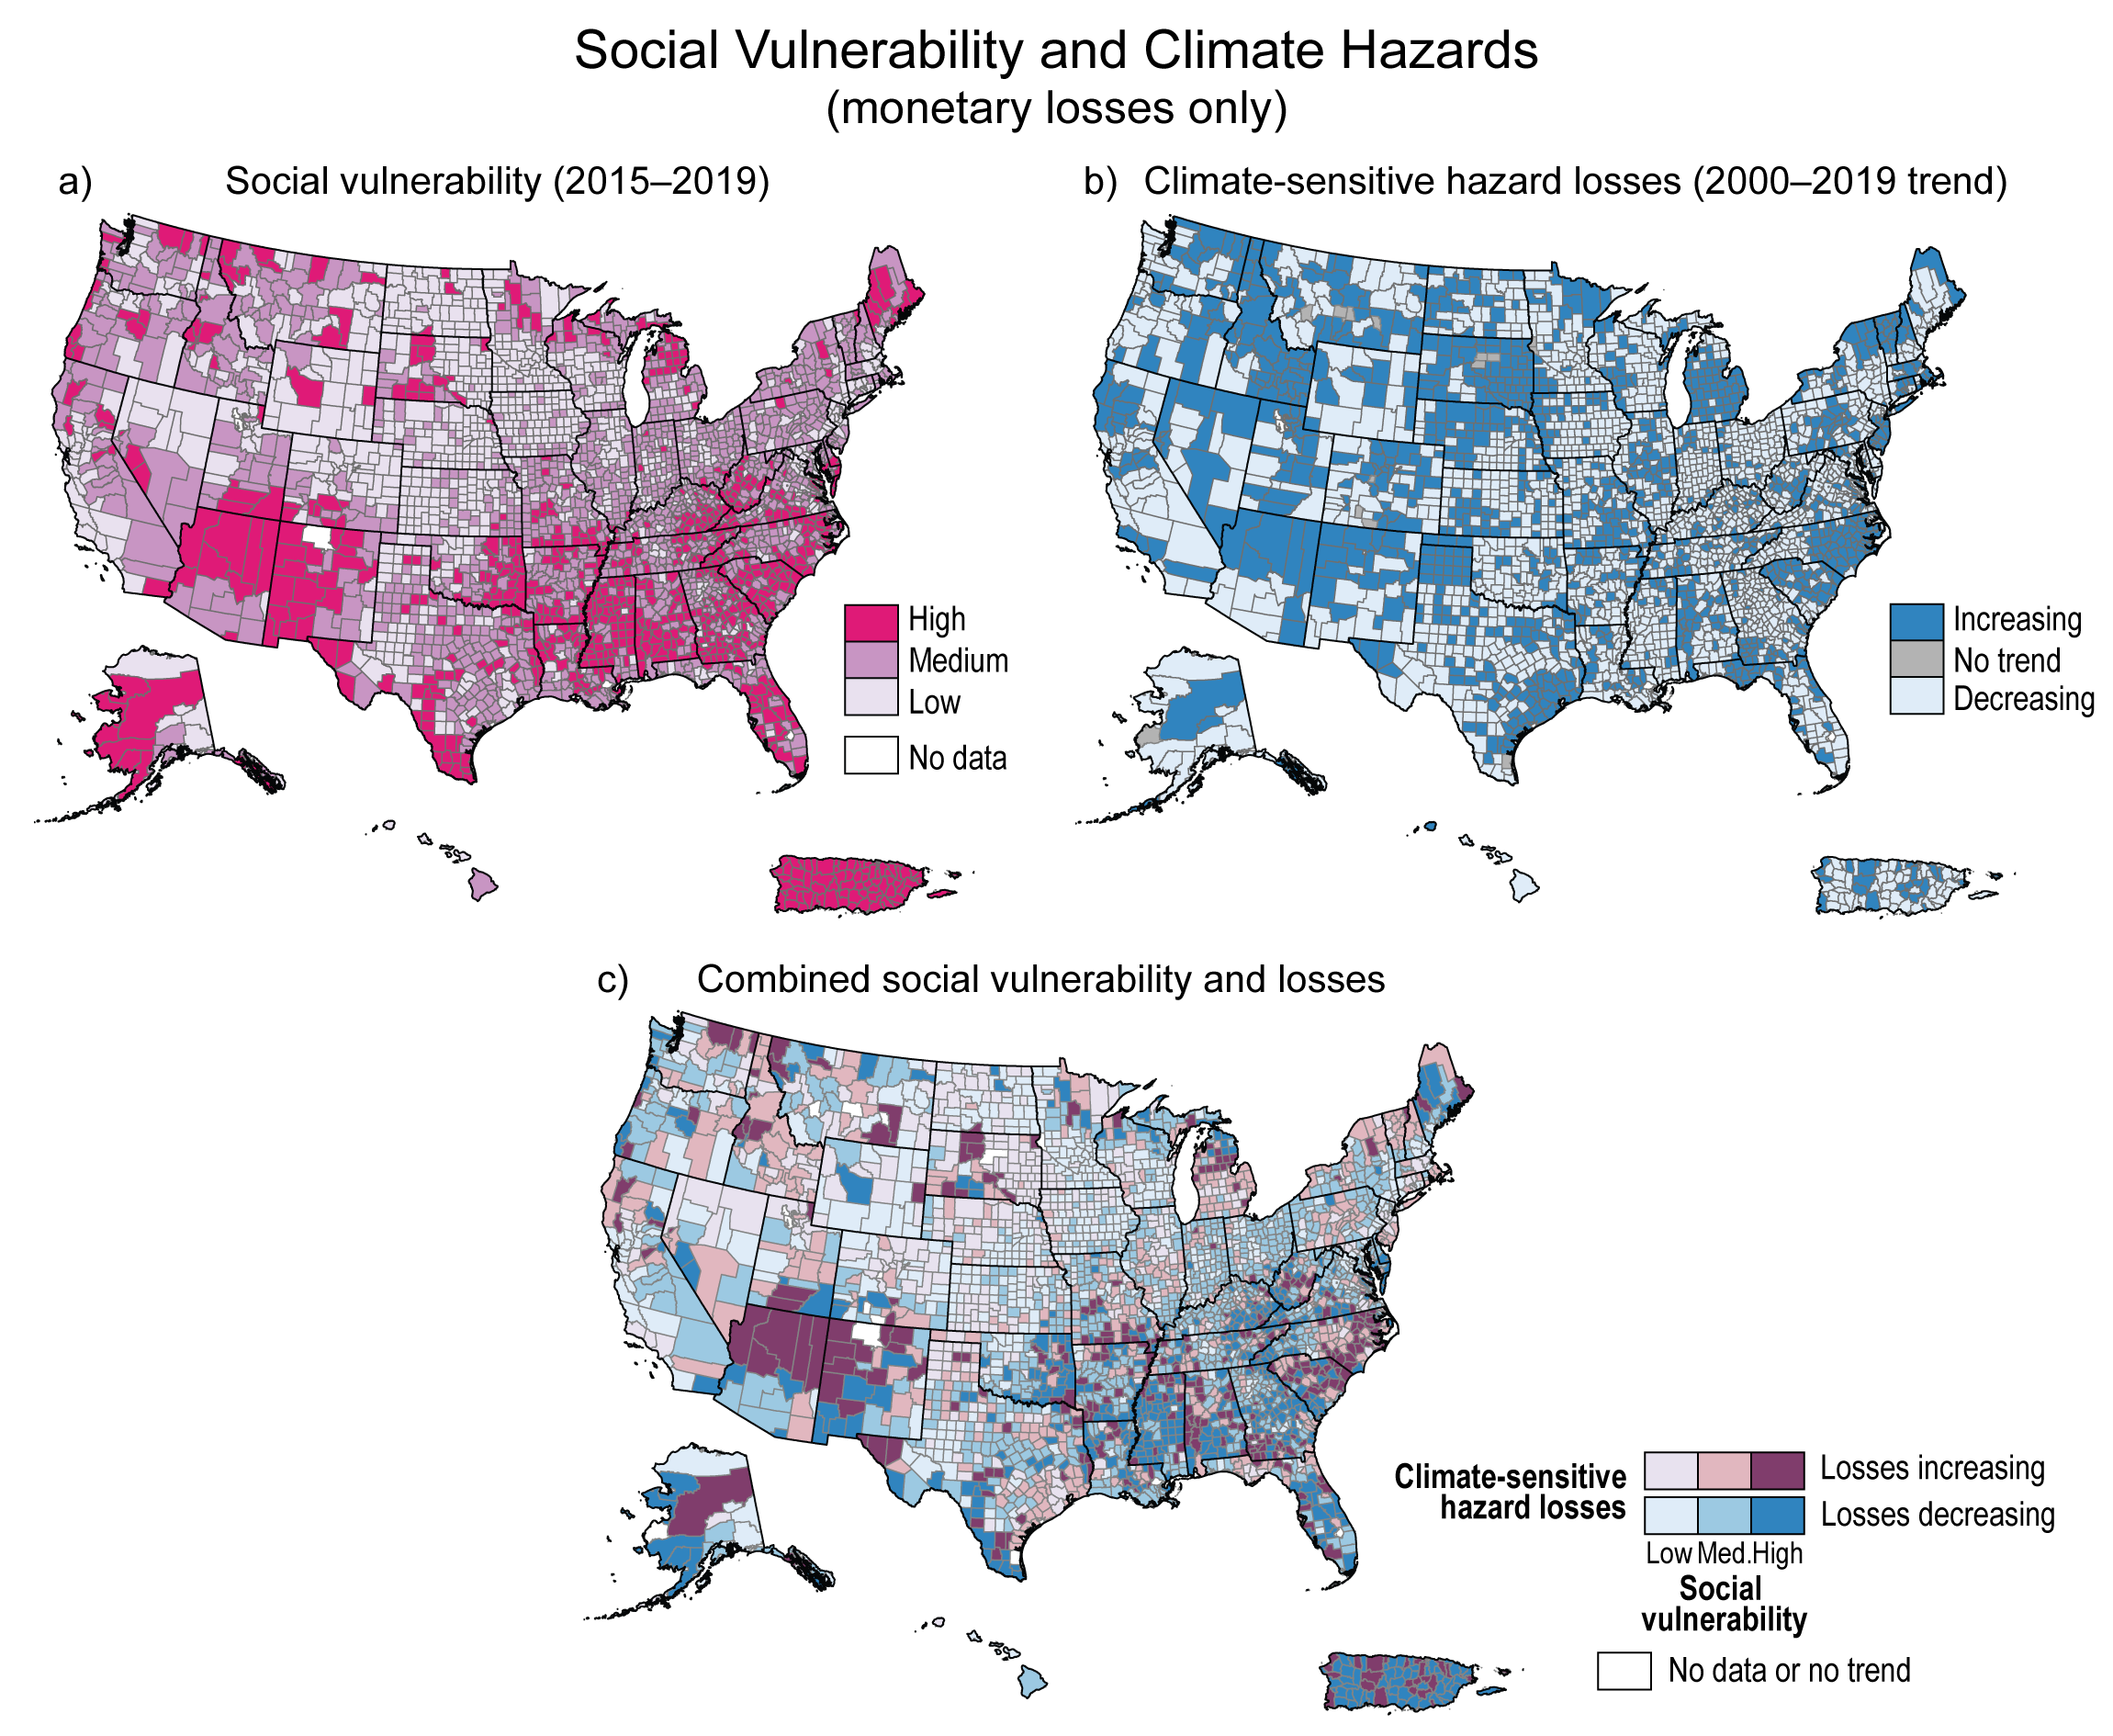
Figure 15.5. Some highly vulnerable areas also have high economic losses from climate hazards.
Notes:
CAPTION: Panel (a) maps counties based on their Social Vulnerability Index (SoVI) scores for the period 2015–2019. SoVI uses 29 different inputs that characterize underlying socioeconomic and demographic factors, and the index is classified (high, medium, low) using standard deviations. Panel (b) shows counties with an increasing trend in climate-sensitive hazard losses (2000–2019) based on data from the Arizona State University/ASU Spatial Hazard Events and Losses Database for the US (SHELDUS). The data is based on property losses and excludes injuries and fatalities from climate-sensitive hazard losses. Exclusion of fatality (especially from heat) explains why some areas of the Southwest appear to have a seemingly decreasing loss trend. The composite map (c) identifies counties with high social vulnerability that have less capacity to prepare for, respond to, and rebound from increasing climate-related losses. SoVI does not fully capture the disproportionate impacts of climate hazards in specific neighborhoods, populations, and cultural groups within a county, nor does it account for risk created by historic marginalization. Figure credit: University of Central Florida, Arizona State University, NOAA NCEI, and CISESS NC.

Slide 11
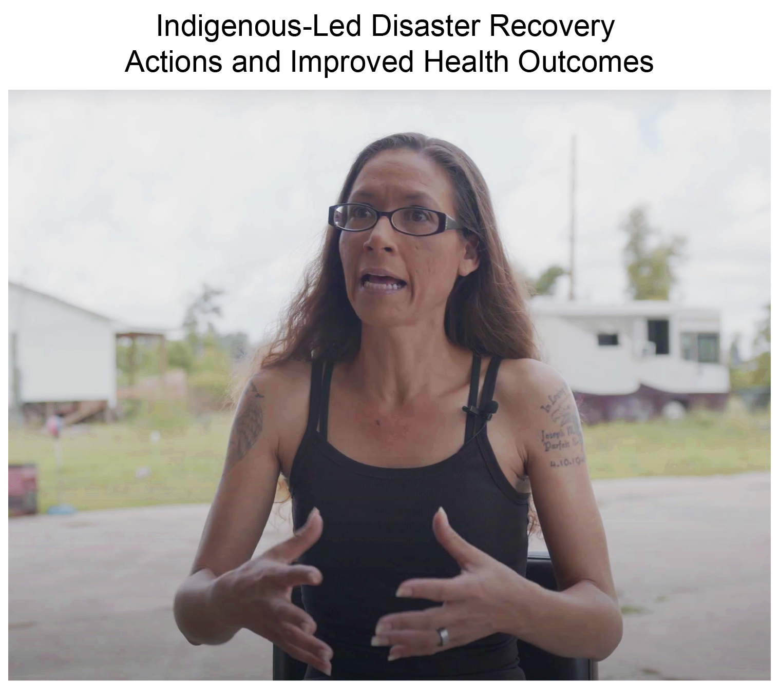
Figure 15.6. Louisiana Tribal leaders are upholding sovereignty and self-determination in their climate adaptation actions following hurricane damage.
Notes:
CAPTION: Tribal leaders from coastal Louisiana shared Indigenous and local knowledge, wisdom, and experiences of the health impacts and resilience-building recovery actions following Hurricane Ida, which made landfall in coastal Louisiana in August 2021. Interviews were recorded during a convening where the Tribal leaders came together to share how Louisiana Tribes are adapting to climate change while upholding sovereignty and working to improve health outcomes. Link to videos. Image credit: ©Craig Richard and Unitarian Universalist Service Committee, in collaboration with the First People's Conservation Council of Louisiana, Lowlander Center, Livelihoods Knowledge Exchange Network, and Disaster Justice Network, July 2022.

Slide 12
Federal Coordinating Lead Author
Paul J. Schramm, Centers for Disease Control and Prevention
Chapter Lead
Mary H. Hayden, University of Colorado, Lyda Hill Institute for Human Resilience
Chapter Authors
Charles B. Beard, Centers for Disease Control and Prevention, Division of Vector-Borne Diseases
Jesse E. Bell, University of Nebraska Medical Center
Aaron S. Bernstein, Boston Children’s Hospital
Ashley Bieniek-Tobasco, Occupational Safety and Health Administration
Nikki Cooley, Institute for Tribal Environmental Professionals, Tribes & Climate Change Program
Maria Diuk-Wasser, Columbia University
Michael K. Dorsey, Club of Rome
Kristie L. Ebi, University of Washington
Kacey C. Ernst, University of Arizona
Morgan E. Gorris, Los Alamos National Laboratory
Peter D. Howe, Utah State University
Ali S. Khan, University of Nebraska Medical Center
Clarita Lefthand-Begay, Navajo Nation and University of Washington
Julie Maldonado, Livelihoods Knowledge Exchange Network
Shubhayu Saha, Centers for Disease Control and Prevention
Fatemeh Shafiei, Spelman College
Ambarish Vaidyanathan, Centers for Disease Control and Prevention
Olga V. Wilhelmi, National Center for Atmospheric Research
Technical Contributors
Rebecca L. Achey, University of Colorado
Bhargavi Chekuri, University of Colorado School of Medicine
Christopher T. Emrich, University of Central Florida
Melanie Gall, Arizona State University
Leo Goldsmith, US Global Change Research Program / ICF
Caitlin A. Gould, US Environmental Protection Agency
Penelope Stein, Harvard Law School Project on Disability
Michael Stein, Harvard Law School Project on Disability
Review Editor
Caroline Anitha Devadason, Harvard University
USGCRP Coordinators
Leo Goldsmith, US Global Change Research Program / ICF
Allyza R. Lustig, US Global Change Research Program / ICF

Slide 13
Hayden, M.H., P.J. Schramm, C.B. Beard, J.E. Bell, A.S. Bernstein, A. Bieniek-Tobasco, N. Cooley, M. Diuk-Wasser, Michael K. Dorsey, K.L. Ebi, K.C. Ernst, M.E. Gorris, P.D. Howe, A.S. Khan, C. Lefthand-Begay, J. Maldonado, S. Saha, F. Shafiei, A. Vaidyanathan, and O.V. Wilhelmi, 2023: Ch. 15. Human health. In: Fifth National Climate Assessment. Crimmins, A.R., C.W. Avery, D.R. Easterling, K.E. Kunkel, B.C. Stewart, and T.K. Maycock, Eds. U.S. Global Change Research Program, Washington, DC, USA. https://doi.org/10.7930/NCA5.2023.CH15
https://nca2023.globalchange.gov/chapter/15

