Slide 1

NCA5 Website: https://nca2023.globalchange.gov
Chapter Website: https://nca2023.globalchange.gov/chapter/16
NCA5 Atlas: https://atlas.globalchange.gov
Figure captions can be found in the slide notes of this deck
Social media: @usgcrp, #NCA5

Slide 2
Chapter 16 | Tribes and Indigenous Peoples

Slide 3
1
Indigenous Peoples Face Risks to Well-Being and Livelihoods from Climate Change and Barriers to Energy Sovereignty
Climate change continues to cause negative effects on critical aspects of Indigenous Peoples’ well-being, including their livelihoods, health, nutrition, and cultural practices, as well as the ecological resilience of their territories (very high confidence). Indigenous Peoples are responding in diverse ways, including through energy sovereignty (very high confidence).

Slide 4
2
Self-Determination Is Key to Indigenous Peoples’ Resilience to Climate Change
By exercising their right to self-determination, Indigenous Peoples can respond to climate change in ways that meet the needs and aspirations of their communities (very high confidence). However, their ability to exercise this right is often undermined by institutions and policies shaped by the impacts of settler colonialism (very high confidence). Expanded support from federal and state governments has the potential to uphold Indigenous rights to self-determination for guiding climate resilience (high confidence).

Slide 5
3
Indigenous Leadership Guides Climate Change Response
Indigenous Peoples lead numerous actions that respond to climate change (high confidence). Indigenous-led organizations, initiatives, and movements have demonstrated diverse strategies for climate adaptation and mitigation that are guided by Indigenous Knowledges and values and by the pursuit of Indigenous rights (high confidence).

Slide 6
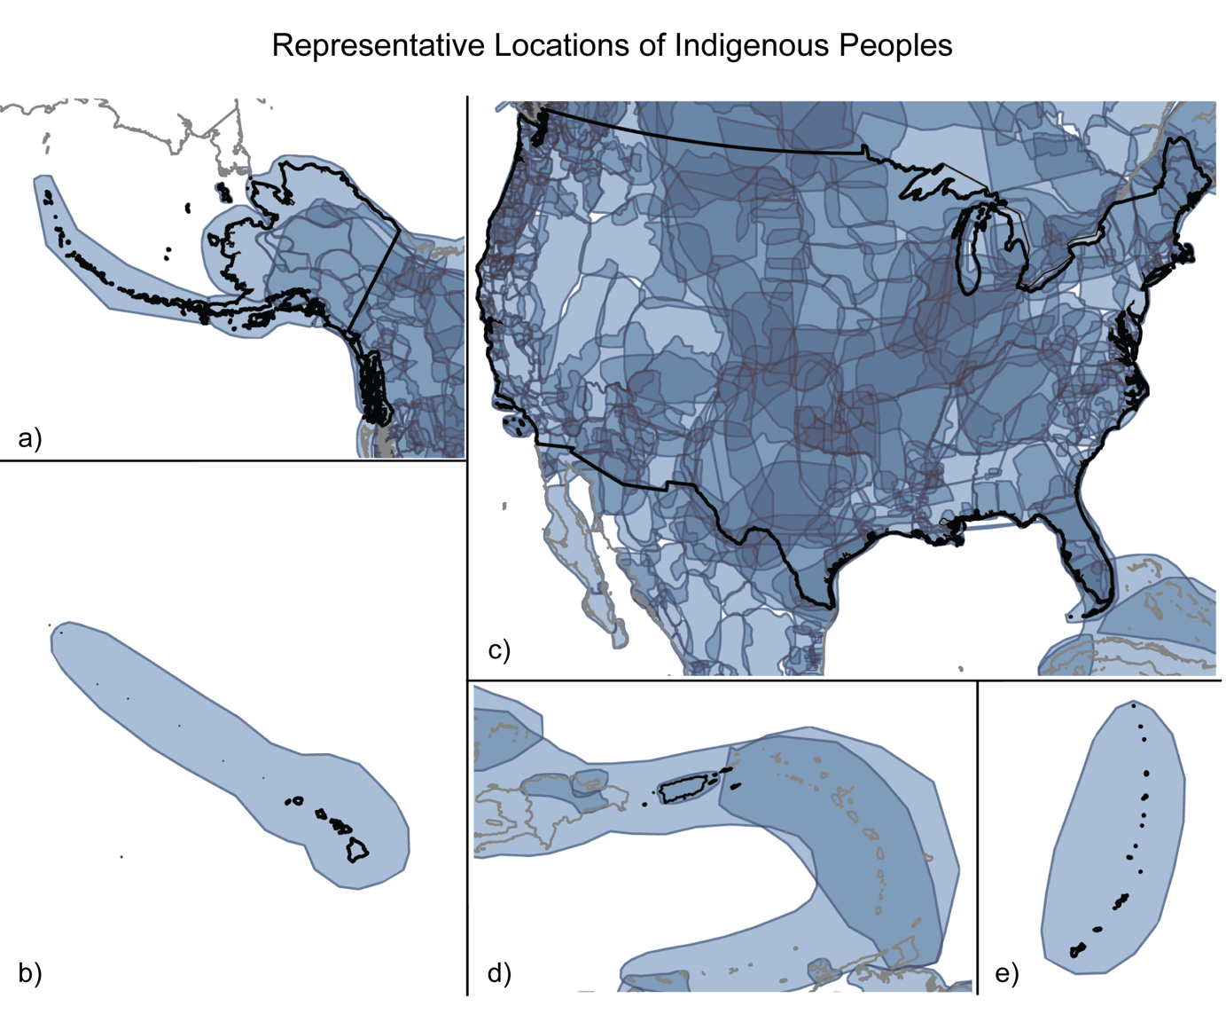
Figure 16.1. Homelands of Indigenous Peoples are located throughout the US and its territories.
Notes:
CAPTION: The maps show pre–United States customary (traditional) homelands and some US-recognized contemporary homelands. The maps represent overlapping territories (approximately represented in outlined, shaded areas, with darker shading representing areas of overlap) in North America (a and c), Hawaiʻi (b), Puerto Rico and the US Virgin Islands (d), and Guam and the Northern Mariana Islands (e). The maps exclude most Indigenous marine territories. Given available data, the maps omit many territories (e.g., in American Sāmoa). Figure credit: Colorado State University, NOAA NCEI, and CISESS NC.

Slide 7
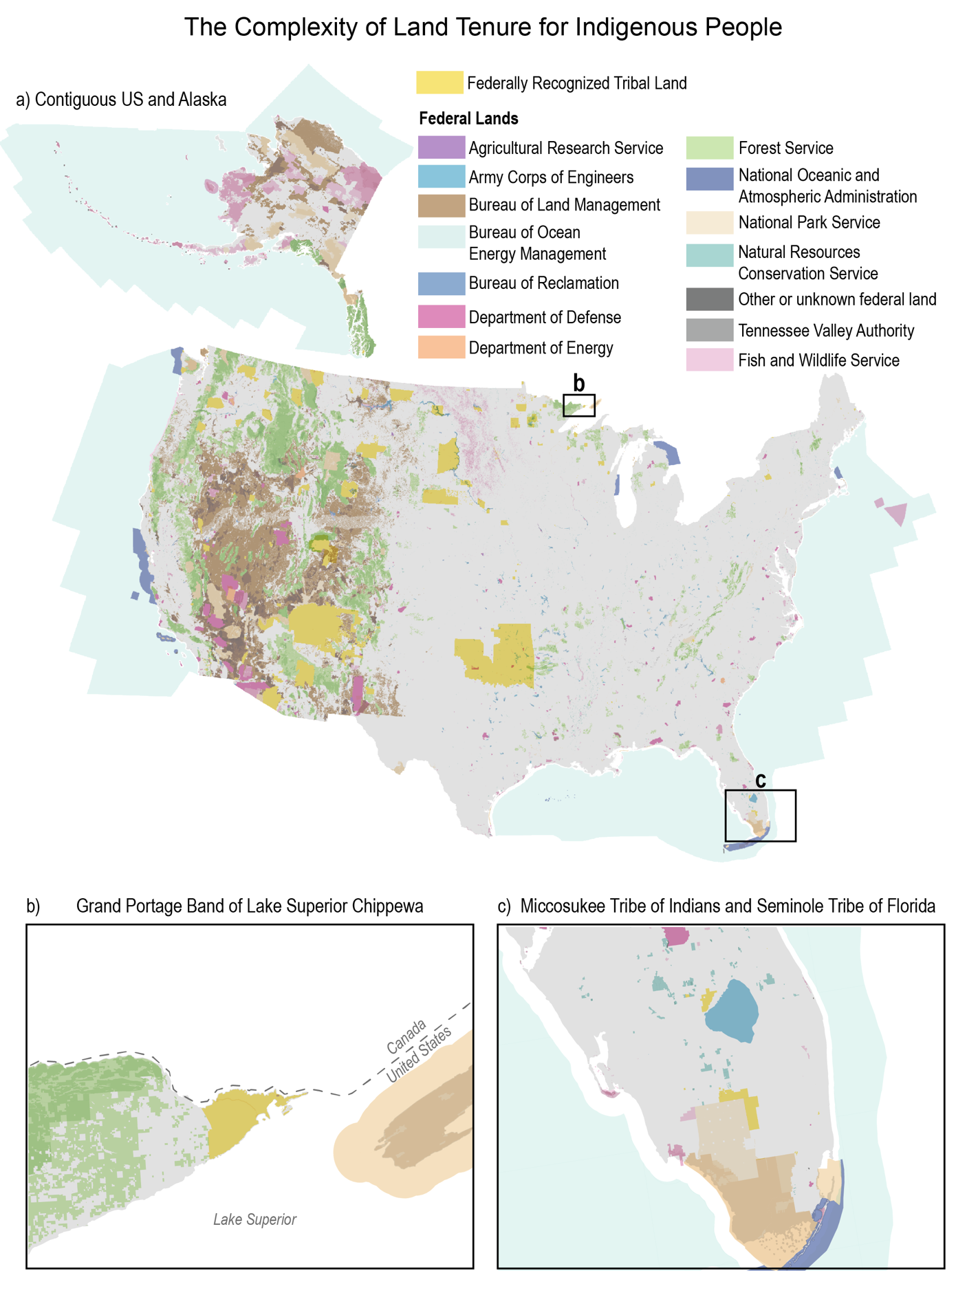
Figure 16.2. Federally Recognized Tribal Lands are often near federal lands, where Indigenous Peoples may have consultation, treaty, or comanagement rights.
Notes:
CAPTION: The maps show many of the current federally recognized reservations in the continental US, including Tribal trust lands (and excluding fee lands and Hawaiʻi, US Caribbean, and US-Affiliated Pacific Islands). Federal lands, including national parks, national forests, and wilderness areas, are shown, as Tribal Nations can have rights to comanage, exercise treaty rights, and consult on land management decisions. Panels (a), (b) and (c) show, in additional detail, the relationship between federal and Tribal lands. The profiles of (b) Grand Portage Band of Lake Superior Chippewa and (c) Miccosukee Tribe of Indians and Seminole Tribe of Florida highlight current and potential comanagement agreements between Federally Recognized Tribes and the Federal Government.(Haaland and Vilsack 2021; Sams III 2022) Figure credit: Citizen Potawatomi Nation, University of Minnesota, and DOI. See figure metadata for additional contributors.

Slide 8
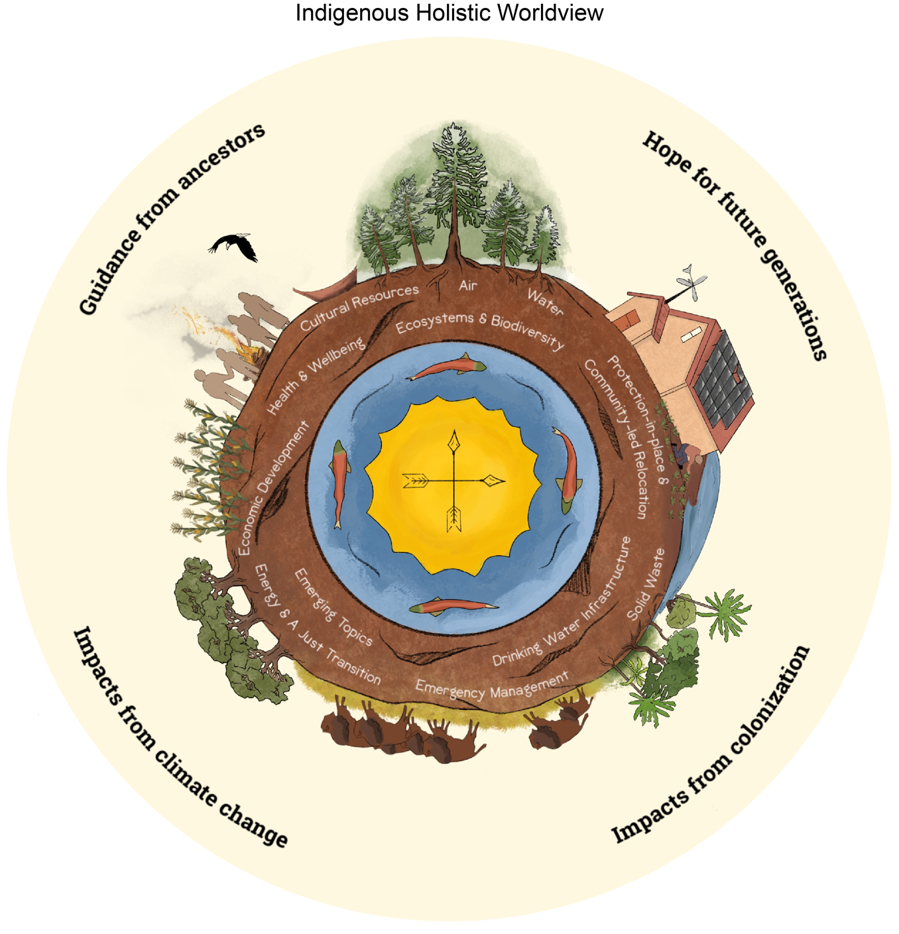
Figure 16.3. Indigenous holistic worldviews offer diverse and complex expressions of climate change.
Notes:
CAPTION: As an intentionally non-exhaustive example by particular Indigenous designers, the “Indigenous holistic worldview” image demonstrates interconnected drivers of sustenance, climate change impacts, and future aspirations. Illustrations connecting human social systems and the environment, including the relationship between social justice (e.g., colonialism, racism) and environmental change (e.g., ecological degradation, pollution), represent certain Indigenous approaches to climate change. Figure credit: ©STACCWG 2021.(STACCWG 2021) Used with permission.

Slide 9
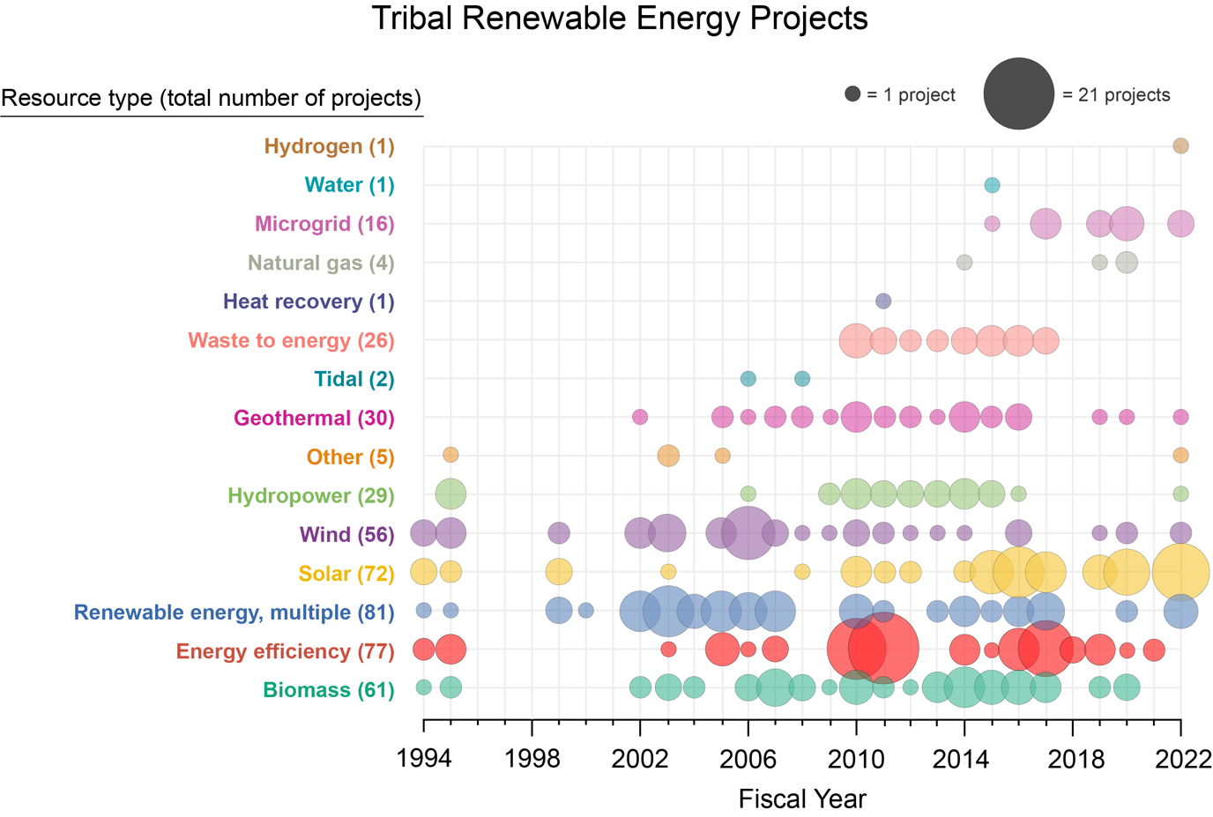
Figure 16.4. The breadth of project type and funding amounts have increased for federally funded renewable energy projects.
Notes:
CAPTION: The figure shows federally funded Tribal renewable energy and energy-efficiency projects between 1994 and 2022. The size of the circles indicates the number of projects: the larger the circle, the more projects of that energy type were funded that year. Historically, projects like retrofitting to improve energy efficiency, as well as renewable energy projects including solar, wind, and biomass, often received funding. The more recent trend toward microgrid and solar projects mirrors efforts to build Tribal energy sovereignty. Figure credit: DOI, NOAA NCEI, and CISESS NC.

Slide 10
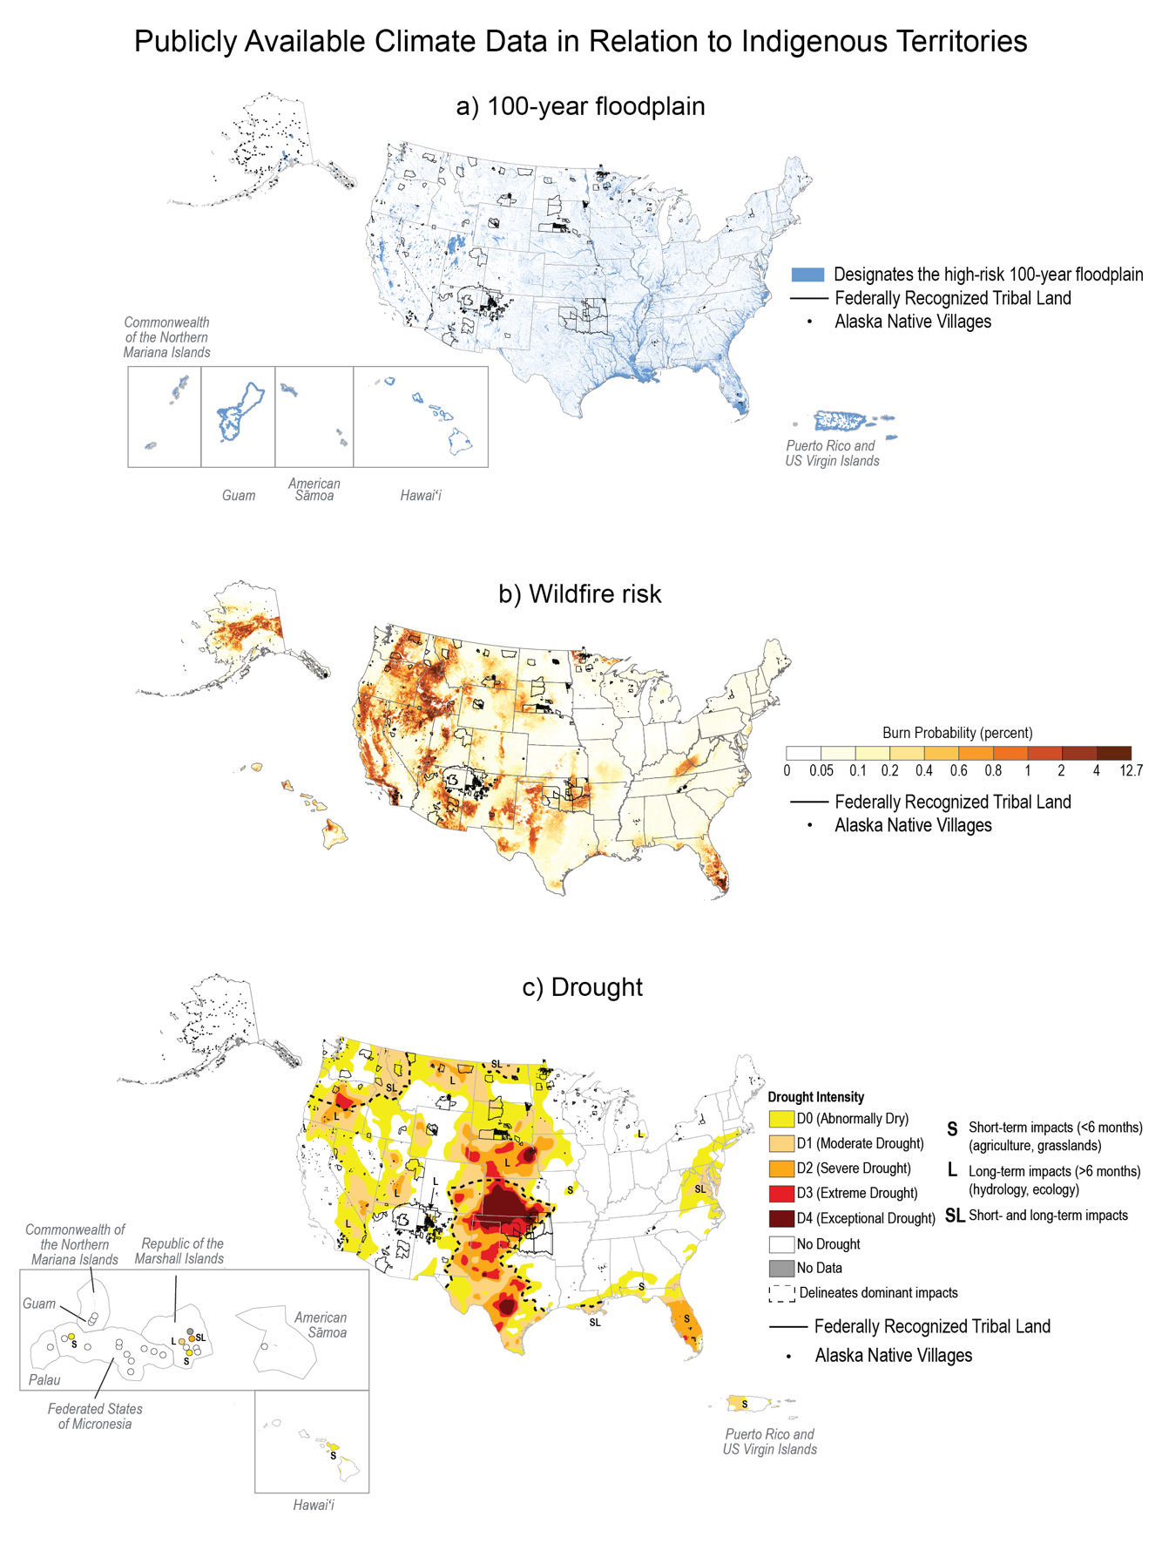
Figure 16.5. Some tribal lands are vulnerable to floods, wildfire, and drought.
Notes:
CAPTION: These maps feature (a) EPA and FEMA’s 100-year floodplain projections; (b) wildfire hazard potential through burn probability, which is the annual probability of wildfire burning in a particular area, also known as wildfire likelihood; and (c) drought intensity and duration of impact. Federally Recognized Tribal Land is outlined in solid black lines, and Alaska Native villages are indicated by black dots. Wildfire risk data were not available for the US Caribbean and US-Affiliated Pacific Islands. Figure credits: (a, b) FEMA, NOAA NCEI, and CISESS NC; (c) adapted from US Drought Monitor 2023.(National Drought Mitigation Center 2023)

Slide 11
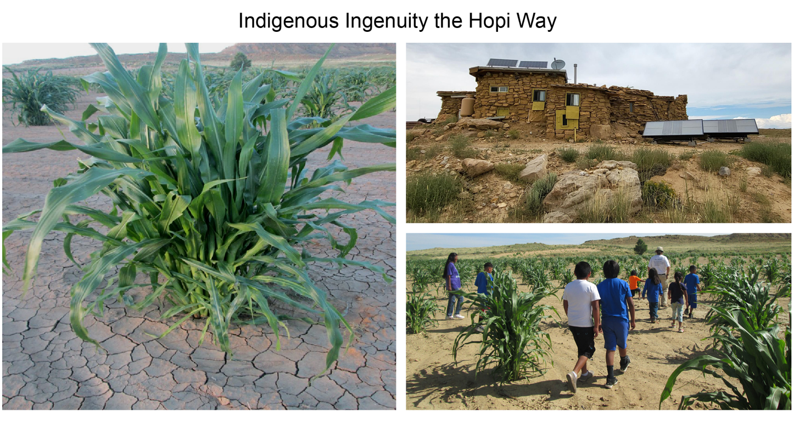
Figure 16.6. Actions on climate change taken by the Hopi people engage science, tradition, and education.
Notes:
CAPTION: For more than 2,000 years, the Hopi have been adapting to an average of 6 to 10 inches of annual precipitation. Seeds from corn, beans, melons, and squash grown in drought years are used again in dry years. Hopi children learn dryland farming and the values, customs, and identities of why they farm. (left) Hopi soil-moisture conservation techniques allow corn plants to adapt to extreme conditions such as drought. (bottom right) Hopi children in a traditional corn field learn about science through a cultural lens. (top right) A traditional Hopi sandstone home incorporates Western science with the use of solar and hydro panels. Photo credits: © Michael K. Johnson, University of Arizona.

Slide 12
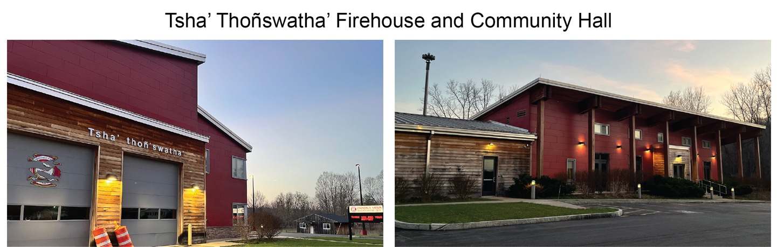
Figure 16.7. The Tsha’ Thoñswatha’ firehouse and community hall in the Onondaga Nation relies on renewable energy and meets a net-zero standard of energy use.
Notes:
CAPTION: The firehouse was designed in collaboration with the community and reflects the Onondaga Nation’s language and culture. Photo credits: © Kelsey Leonard, University of Waterloo.

Slide 13
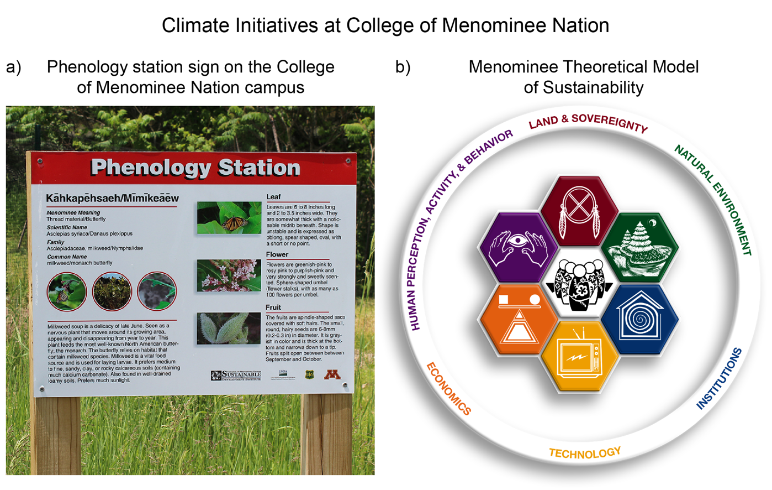
Figure 16.8. At the College of Menominee Nation, Indigenous Knowledge guides climate change response.
Notes:
CAPTION: (a) The photo shows a phenology station sign at the College of Menominee Nation in Keshena, Wisconsin. The phenology project explores the effects of climate change on the reservation forest and community over time. The college has also developed the Menominee Theoretical Model of Sustainability (b), which guides climate change research, education, and community outreach and is an example of Indigenous leadership for climate adaptation. Photo credit: (a) © Thomas R. Kenote, College of Menominee Nation Sustainable Development Institute. Source: (b) The Menominee Theoretical Model of Sustainability (MTMS): 2021 Schwitzer Redesign—3D Version (adapted from Dockry et al. 2016(Dockry et al. 2016)).

Slide 14
Federal Coordinating Lead Author
Rachael Novak, Diné/Navajo Nation, formerly Bureau of Indian Affairs (through August 2023)
Matthew B. Laramie, Colville Confederated Tribes (Sinixt) and Bureau of Indian Affairs
Chapter Lead
Kyle Whyte, Citizen Potawatomi Nation and University of Michigan
Chapter Authors
Nicholas G. Bruscato, US Department of the Interior
Dominique M. David-Chavez, Taíno (Borikén) and Colorado State University
Michael J. Dockry, Citizen Potawatomi Nation and University of Minnesota
Michael Kotutwa Johnson, Hopi Tribe and University of Arizona
Chas E. Jones Jr., Affiliated Tribes of Northwest Indians
Kelsey Leonard, Shinnecock Nation and University of Waterloo
Review Editor
James Rattling Leaf, Rosebud Sioux Tribe and North Central Climate Adaptation Science Center
USGCRP Coordinators
Allyza R. Lustig, US Global Change Research Program / ICF
Joshua Hernandez, US Global Change Research Program / ICF

Slide 15
Whyte, K., R. Novak, M.B. Laramie, N.G. Bruscato, D.M. David-Chavez,
M.J. Dockry, M.K. Johnson, C.E. Jones Jr., and K. Leonard, 2023: Ch. 16.
Tribes and Indigenous Peoples. In: Fifth National Climate Assessment.
Crimmins, A.R., C.W. Avery, D.R. Easterling, K.E. Kunkel, B.C. Stewart,
and T.K. Maycock, Eds. U.S. Global Change Research Program,
Washington, DC, USA. https://doi.org/10.7930/NCA5.2023.CH16
https://nca2023.globalchange.gov/chapter/16

