Slide 1

NCA5 Website: https://nca2023.globalchange.gov
Chapter Website: https://nca2023.globalchange.gov/chapter/17
NCA5 Atlas: https://atlas.globalchange.gov
Figure captions can be found in the slide notes of this deck
Social media: @usgcrp, #NCA5

Slide 2
Chapter 17 | Climate Effects on US International Interests

Slide 3
1
Interdependent, Systemic Climate-Related Risks Increasingly Affect US Interests
In a globally connected world, climate change impacts on US interests are multifaceted, interconnected, and frequently exacerbated by social unrest and environmental degradation (likely, high confidence). The scale and speed of climate-related impacts to US interests are expected to increase, due in part to underlying interdependencies and to the projected intensification of climate change (likely, high confidence). Emerging systems- and scenarios-based approaches to integrative planning are being applied to account for interdependencies and competing priorities (likely, high confidence).

Slide 4
2
Climate Change Exacerbates Risks to National Security
Climate change can contribute to political and social instability and, in some instances, to conflict (likely, high confidence). It impacts the operations and missions of defense, diplomacy, and development agencies critical to US national security (very likely, high confidence). The US Government, bilaterally and in collaboration with international partners, is increasingly addressing these implications through a range of diplomatic, development, and defense responses (very likely, high confidence).

Slide 5
3
Climate Change Presents Risks and Opportunities for US Economics, Trade, and Investments
The physical impacts of climate change are increasingly affecting global and regional economic growth (very likely, high confidence). These impacts have important implications for US economic, trade, and investment interests (likely, medium confidence). Global mitigation and adaptation responses by governments and businesses will likewise impact US economic interests, presenting both risks and potential opportunities for the US economy (likely, medium confidence). Public- and private-sector institutional, regulatory, financial, and market-based frameworks for climate mitigation and adaptation will influence these risks and opportunities (likely, medium confidence).

Slide 6
4
Climate Change Undermines Sustainable Development
Climate change undermines the world’s ability to develop sustainably, reverses development gains, and exacerbates inequities (very likely, high confidence). Climate finance is increasing, but global flows continue to fall short of needs (likely, high confidence). Accelerated deployment of adaptation and mitigation action at scale can yield substantial benefits for sustainable development (likely, medium confidence). Climate action is most effective when co-developed and grounded in equity, local ownership, and inclusive governance (likely, medium confidence).

Slide 7
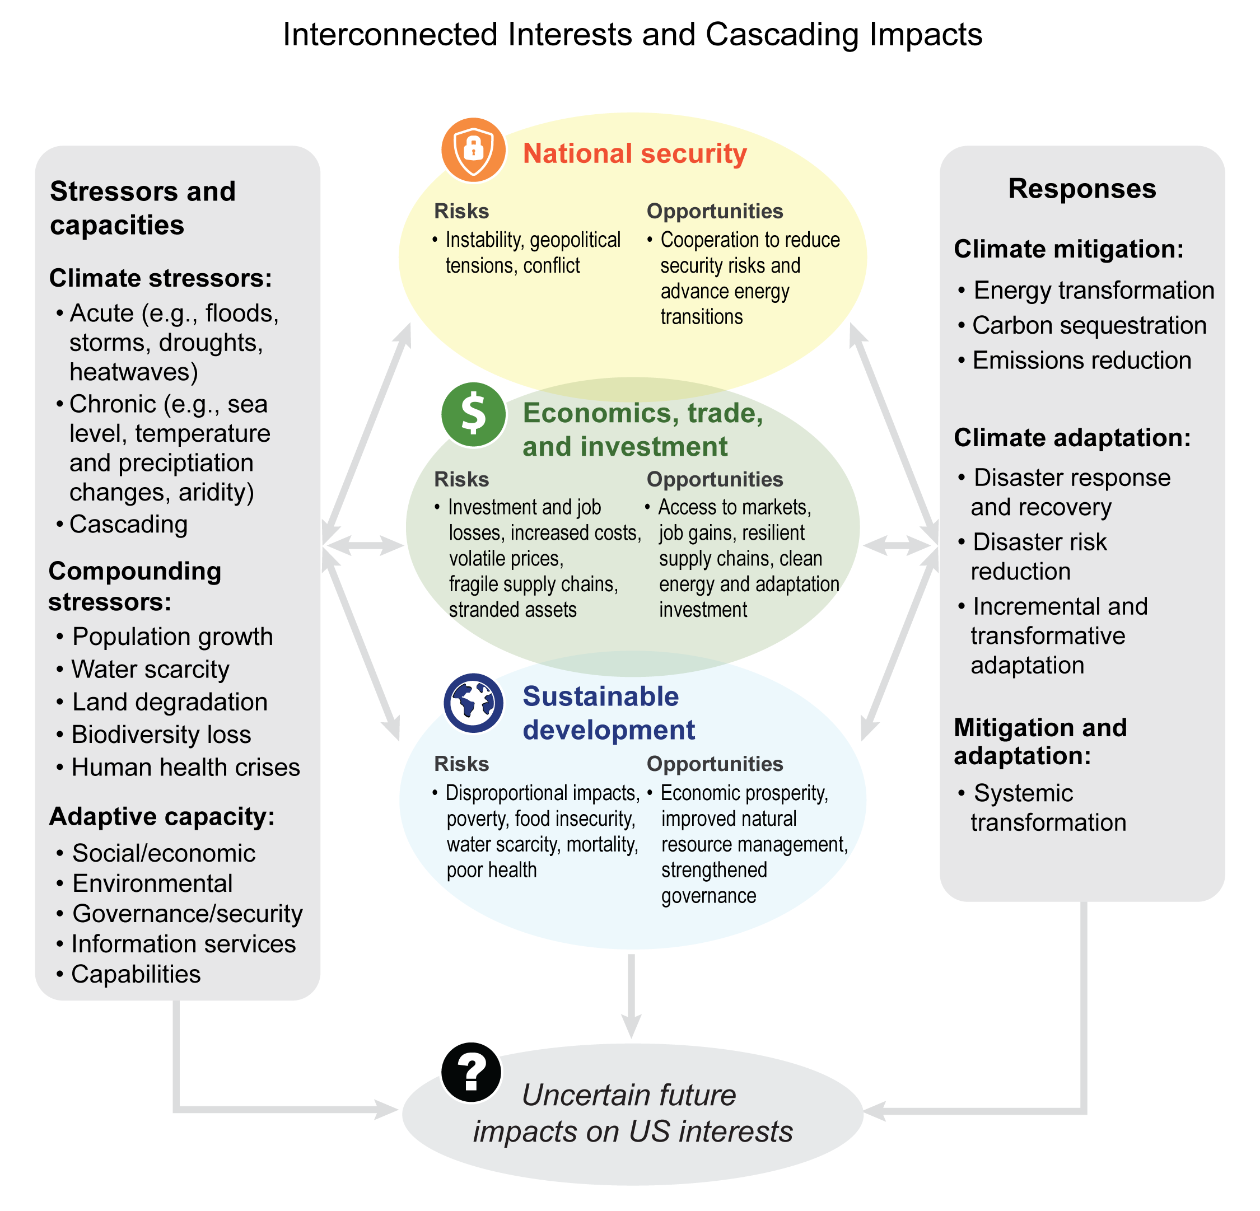
Figure 17.1. Future impacts to US interests are uncertain given complex system interdependencies and interactions between stressors, capacities, and responses.
Notes:
CAPTION: This figure illustrates how system interdependencies and the interconnected nature of climate change stressors and response choices can lead to uncertain future impacts on US interests (e.g., national security; economics, trade, and investment; and sustainable development). Climate and compounding stressors interact and present different degrees of potential impact to US interests given varying levels of adaptive capacity, sensitivity of interest areas, and the effectiveness of responses in addressing systemic risks and taking advantage of opportunities. The complexity of interacting stressors and interdependent systems can lead to cascading impacts, unintended consequences, and increased uncertainty on future impacts to US Interests. Adapted from Ringsmuth et al. 2022(Ringsmuth et al. 2022) [CC BY 4.0].

Slide 8
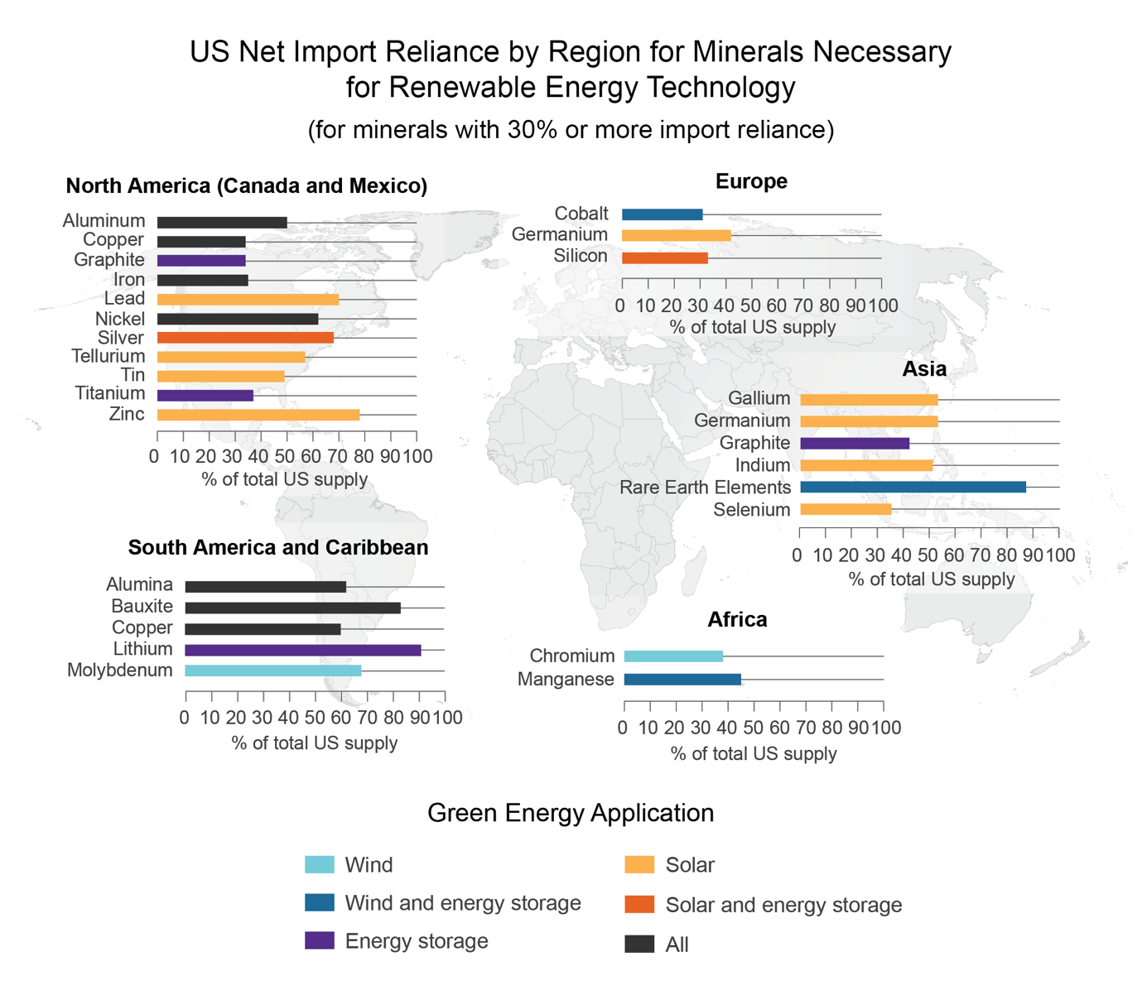
Figure 17.2. US renewable energy technologies rely on imports of critical minerals from around the world.
Notes:
CAPTION: Many mineral inputs critical for renewable energy technologies are imported to the United States. This figure illustrates the diversity of location, mineral type, application, and scale of import reliance.(USGS 2022) Adapted from Humphries 2019.(Humphries 2019)

Slide 9
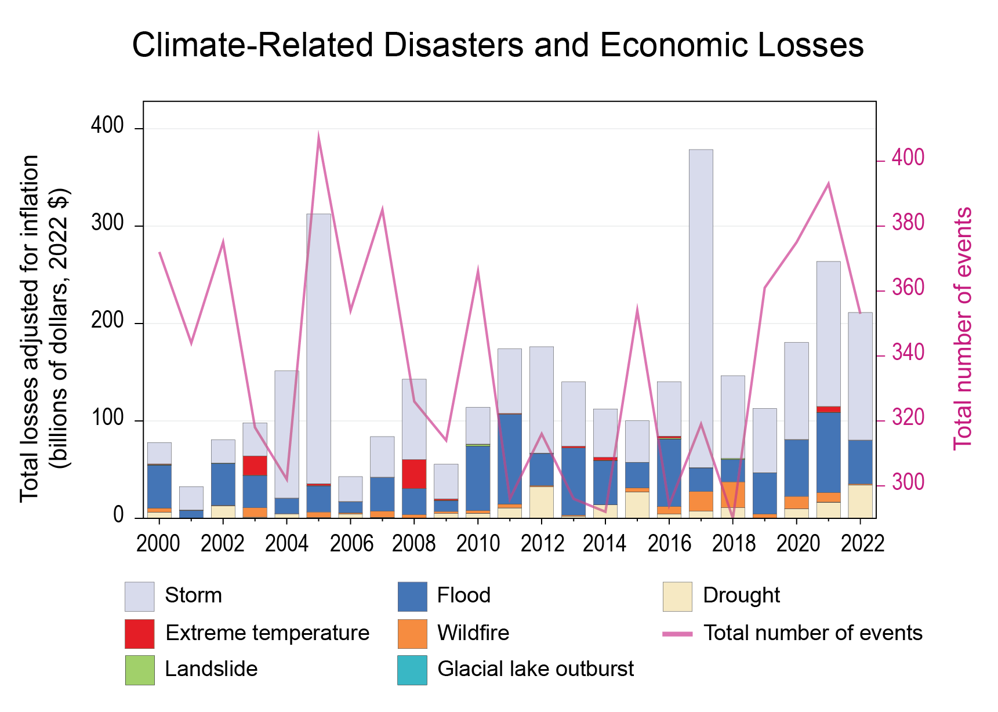
Figure 17.3. This figure shows global trends in the number, growing costs, and increasing diversity of types of climate-related natural disasters since 2000.
Notes:
CAPTION: The total global losses associated with climate-related disasters have risen over the last two decades, with growing diversity in the types of climate-related events that lead to disasters (e.g., drought, wildfires, floods) and some annual spikes in storm-related losses. There is little correlation between losses and total number of disasters (suggesting increased losses may derive from increasing severity of disasters, increased value of assets, reporting discrepancies, or a combination of these). Figure credit: DOI, Winrock International, NOAA NCEI, and CISESS NC.

Slide 10
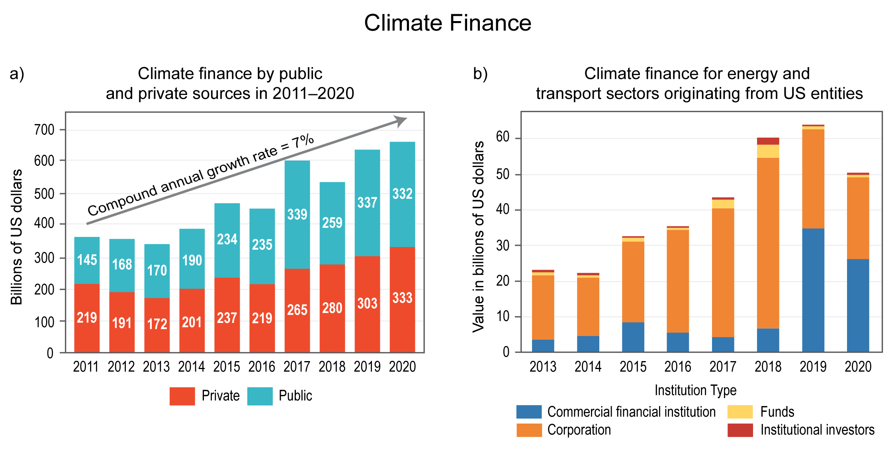
Figure 17.4. Public and private contributions to global climate finance are increasing but not at the pace necessary to avoid the worst impacts of climate change.
Notes:
CAPTION: (a) The public and private sectors provided $4.8 trillion in climate finance in total between 2011 and 2020, with the private sector responsible for about half. (b) Data on private finance flows originating from the US are most comprehensive for the energy and transport sectors. Figure credits: (a) adapted from Naran et al. 2022(Naran et al. 2022) [CC BY-NC-SA 4.0]; (b) DOI, Winrock International, and Climate Policy Initiative.

Slide 11
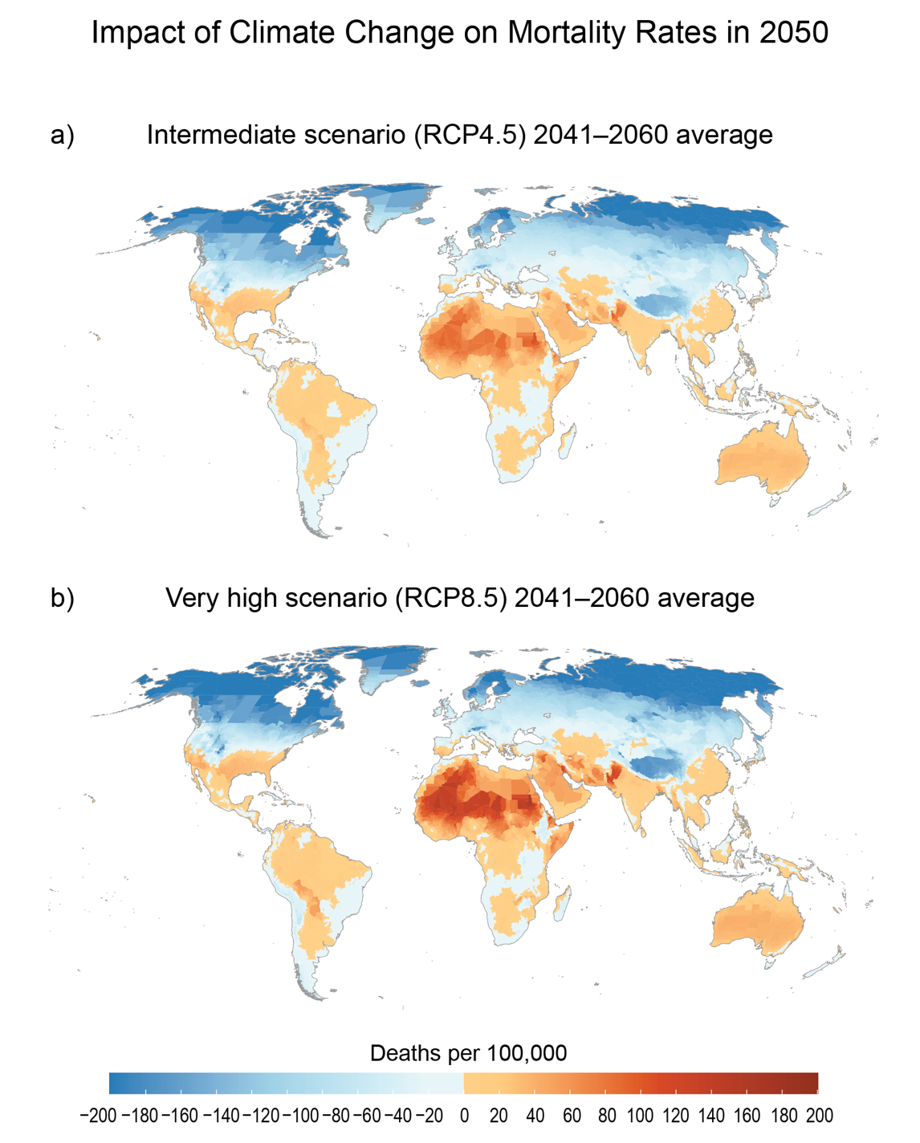
Figure 17.5. Climate change will exacerbate global inequalities in mortality rates.
Notes:
CAPTION: A warmer world will interact with existing differential capacities, shifting mortality patterns. Even when accounting for future adaptation and rising incomes, mortality will significantly increase in the Global South. The maps show projected changes in mortality due to climate change in 2050 (averaged over 2041–2060) for (a) an intermediate scenario (RCP4.5) and (b) a very high scenario (RCP8.5). Adapted with permission from Carleton et al. 2020.(Carleton et al. 2020)

Slide 12
Federal Coordinating Lead Author
Farhan H. Akhtar, US Department of State
Chapter Lead
Molly E. Hellmuth, Winrock International
Chapter Authors
Andrea H. Cameron, US Department of Defense
Caitlin A. Corner-Dolloff, US Agency for International Development
Geoffrey D. Dabelko, Ohio University
Tufa Dinku, Columbia University, International Research Institute for Climate and Society
Jay L. Koh, Lightsmith Group
Douglas Mason, Millennium Challenge Corporation
Roger S. Pulwarty, National Oceanic and Atmospheric Administration
Lawrence I. Sperling, US Department of the Interior
Maria Fernanda Zermoglio, US Agency for International Development
Technical Contributors
Trinetta Chong, University of California, Berkeley, Global Policy Lab
Jake Connolly, Climate Policy Initiative
Margaret Poulos, Duke University
Elizabeth Pruitt, Florida State University
Review Editor
Quentin A. Stubbs, NOAA National Ocean Service
USGCRP Coordinators
Katia Kontar, US Global Change Research Program / ICF
Fredric Lipschultz, US Global Change Research Program / USRA

Slide 13
Hellmuth, M.E., F.H. Akhtar, A.H. Cameron, C.A. Corner-Dolloff, G.D. Dabelko, T. Dinku, J.L. Koh, D. Mason, R.S. Pulwarty, L.I. Sperling, and M.F. Zermoglio, 2023: Ch. 17. Climate effects on US international interests. In: Fifth National Climate Assessment. Crimmins, A.R., C.W. Avery, D.R. Easterling, K.E. Kunkel, B.C. Stewart, and T.K. Maycock, Eds. U.S. Global Change Research Program, Washington, DC, USA. https://doi.org/10.7930/NCA5.2023.CH17
https://nca2023.globalchange.gov/chapter/17

