Slide 1

NCA5 Website: https://nca2023.globalchange.gov
Chapter Website: https://nca2023.globalchange.gov/chapter/21
NCA5 Atlas: https://atlas.globalchange.gov
Figure captions can be found in the slide notes of this deck
Social media: @usgcrp, #NCA5

Slide 2
Chapter 21 | Northeast

Slide 3
1
Chronic Impacts of Extreme Weather Are Shaping Adaptation and Mitigation Efforts
The Northeast continues to be confronted with extreme weather, most notably extreme precipitation—which has caused problematic flooding across the region—and heatwaves (very likely, high confidence). In response, climate adaptation and mitigation efforts, including nature-based solutions, have increased across the region (high confidence), with a focus on emissions reductions, carbon sequestration, and resilience building (medium confidence).

Slide 4
2
Ocean and Coastal Impacts Are Driving Adaptation to Climate Change
The ocean and coastal habitats in the Northeast are experiencing changes that are unprecedented in recorded history, including ocean warming, marine heatwaves, sea level rise, and ocean acidification (high confidence). Changing ocean conditions are causing significant shifts in the distribution, productivity, and seasonal timing of life-cycle events of living marine resources in the Northeast (high confidence). These impacts have spurred adaptation efforts such as coastal wetland restoration and changes in fishing behavior (high confidence).

Slide 5
3
Disproportionate Impacts Highlight the Importance of Equitable Policy Choices
Extreme heat, storms, flooding, and other climate-related hazards are causing disproportionate impacts among certain communities in the Northeast, notably including racial and ethnic minorities, people of lower socioeconomic status, and older adults (very likely, very high confidence). These communities tend to have less access to healthcare, social services, and financial resources and to face higher burdens related to environmental pollution and preexisting health conditions (very likely, high confidence). Social equity objectives are prominent in many local-level adaptation initiatives, but the amount of progress toward equitable outcomes remains uneven (very likely, high confidence).

Slide 6
4
Climate Action Plans Are Now Being Implemented
In recent years, there have been substantial advances in the magnitude and scope of climate action across all jurisdictional scales (high confidence). Almost every state in the region has conducted or updated a climate impact assessment, developed a comprehensive climate action plan, and enacted climate-related laws since 2018 (high confidence). Innovative approaches to transparent, inclusive, and equitable processes around climate action are being embraced by Tribes, municipalities, and states (high confidence). Although ambitious emissions reduction targets have been put forward, meeting these goals is expected to be challenging (medium confidence).

Slide 7
5
Implementation of Climate Plans Depends on Adequate Financing
Options for financing mitigation and adaptation efforts have expanded in recent years, providing households, communities, and businesses with more options for responding to climate change (high confidence). Flood insurance allows individuals and communities to recover following extreme flooding events, but many at-risk homeowners lack adequate coverage (high confidence). Although the public sector remains the primary source of funding for adaptation, private capital has started to invest in a variety of mitigation and adaptation projects, including services for monitoring climate risks and community-based catastrophe insurance (high confidence).

Slide 8
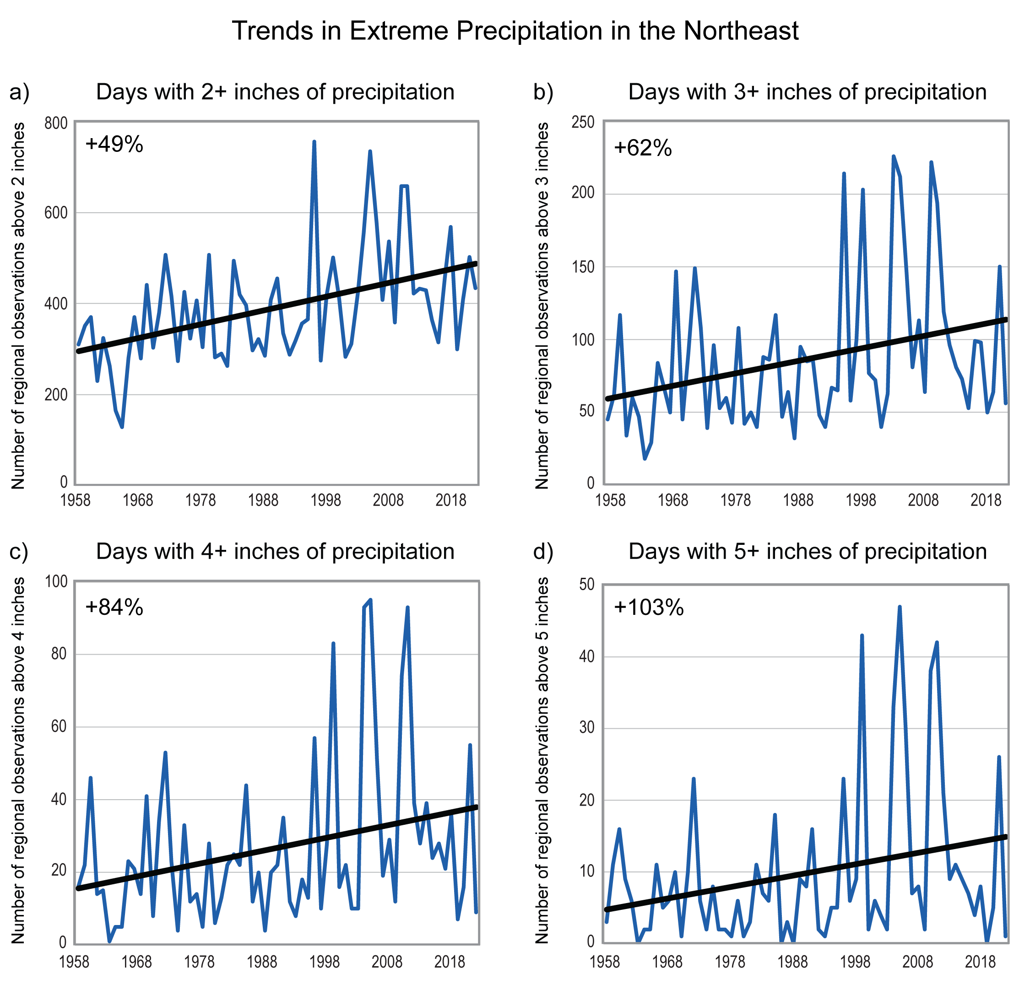
Figure 21.1. The number of days in the Northeast with extreme precipitation has increased.
Notes:
CAPTION: The four charts show the number of daily events per year with precipitation totals equal to or exceeding 2, 3, 4, and 5 inches, respectively (blue lines), from 1958–2022, along with trend lines (black) computed from linear regressions over the full period. Numbers in the top left corner show the percent increase relative to the long-term average, computed as the difference between the end points of the trend lines divided by the 1958–2022 average. The number of daily events is defined as the total number of extreme precipitation accumulations recorded at all stations across the observing network in the Northeast. See the figure metadata for details on the methodology. The trends shown suggest an increase in the frequency of extreme precipitation, with larger increases for the more extreme precipitation events. Figure credit: USDA Forest Service, Drexel University, NOAA NCEI, and CISESS NC.

Slide 9
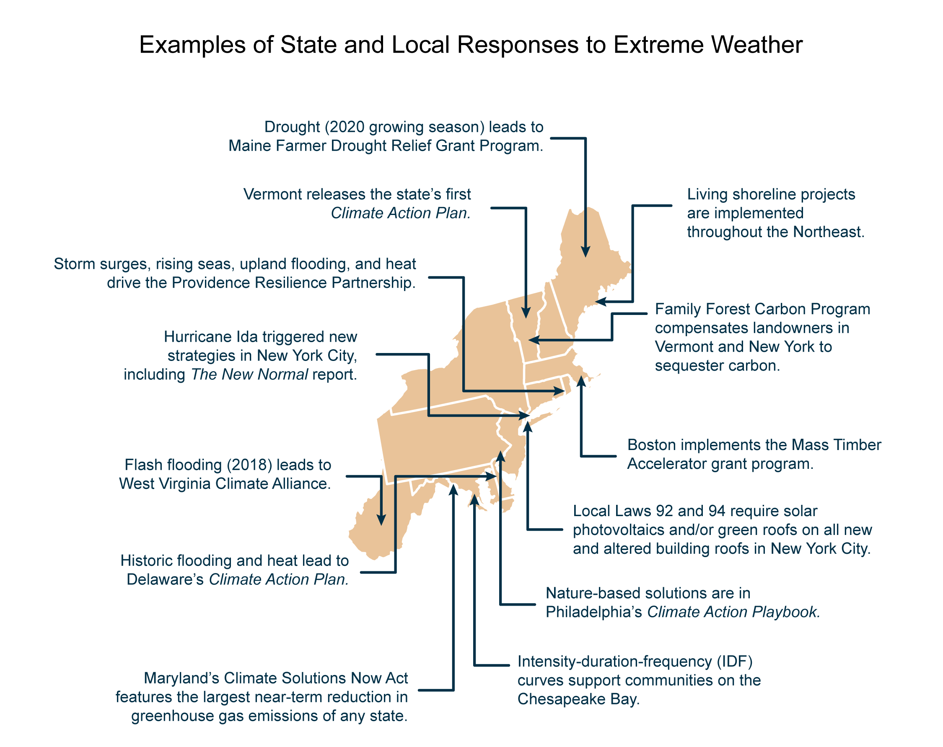
Figure 21.2. Northeastern states and cities have adopted a range of plans, programs, and policies in response to extreme weather, many of which include nature-based strategies.
Notes:
CAPTION: This map highlights efforts, many of which are nature-based, that address climate change impacts by building resilience or promoting mitigation measures. In some cases, these efforts are specific programs or projects, such as the Family Forest Carbon Program in Vermont and New York. In other cases, local and statewide plans include broader attention on natural and nature-based strategies. Figure credit: Drexel University and USDA Forest Service.

Slide 10
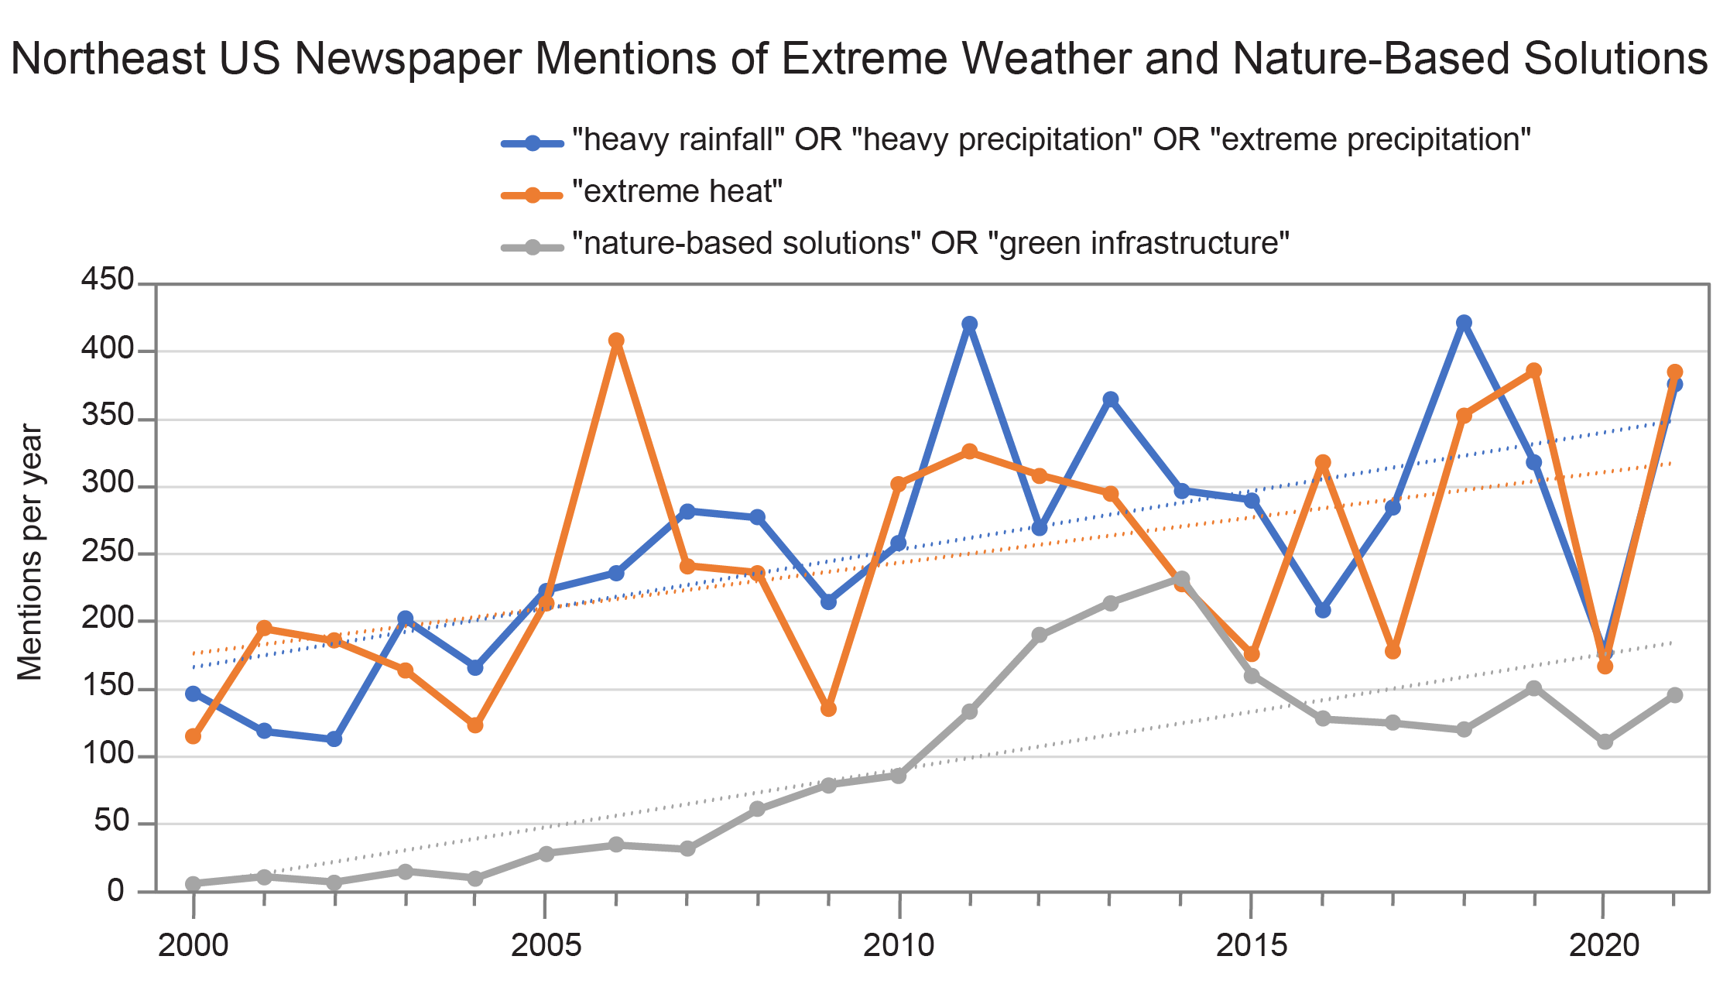
Figure 21.3. Mentions of extreme weather events and nature-based solutions are increasing across Northeast media.
Notes:
CAPTION: As the Northeast continues to experience extreme weather events, news articles highlight the trend in climate action planning. Natural and nature-based features are a common strategy used in these efforts. Solid lines show mentions related to heavy precipitation (blue), extreme heat (orange), and nature-based solutions and green infrastructure (gray) during 2000–2021, with dotted lines showing the estimated trend line for each category. Figure credit: Drexel University and USDA Forest Service.

Slide 11
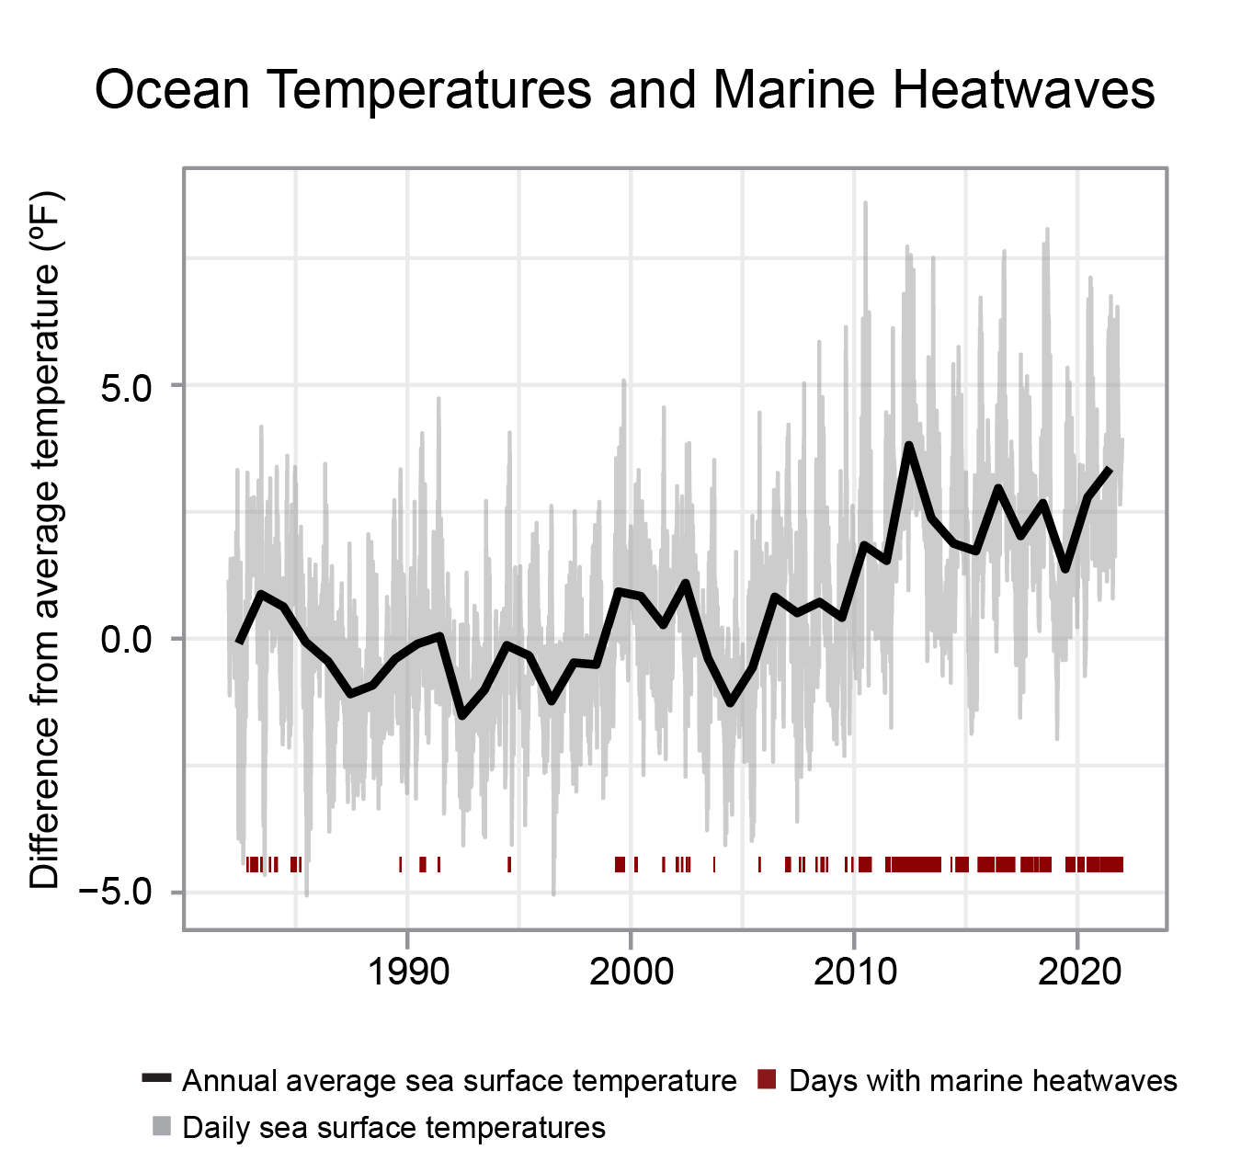
Figure 21.4. Oceans are growing warmer and marine heatwaves are more frequent, which is impacting marine ecosystems in the Northeast.
Notes:
CAPTION: Annual average sea surface temperature (SST) anomalies (solid black line) and daily SST anomalies (light gray line) for the Gulf of Maine (region defined as ecological production unit, an ecologically distinct ecosystem). Differences from the long-term average are estimated using a 30-year climatology reference period of 1982–2011. Days meeting marine heatwave criteria are noted (red tick marks). Marine heatwave status was determined following the methods of Hobday et al. (2016).(Hobday et al. 2016) The figure shows continued warming of the Gulf of Maine, with 2022 among the warmest years on record. In addition to the warming trend, the periodicity of extreme temperature events (i.e., marine heatwaves) has increased in the region. Adapted from Gulf of Maine Research Institute 2022.(GMRI 2022)

Slide 12
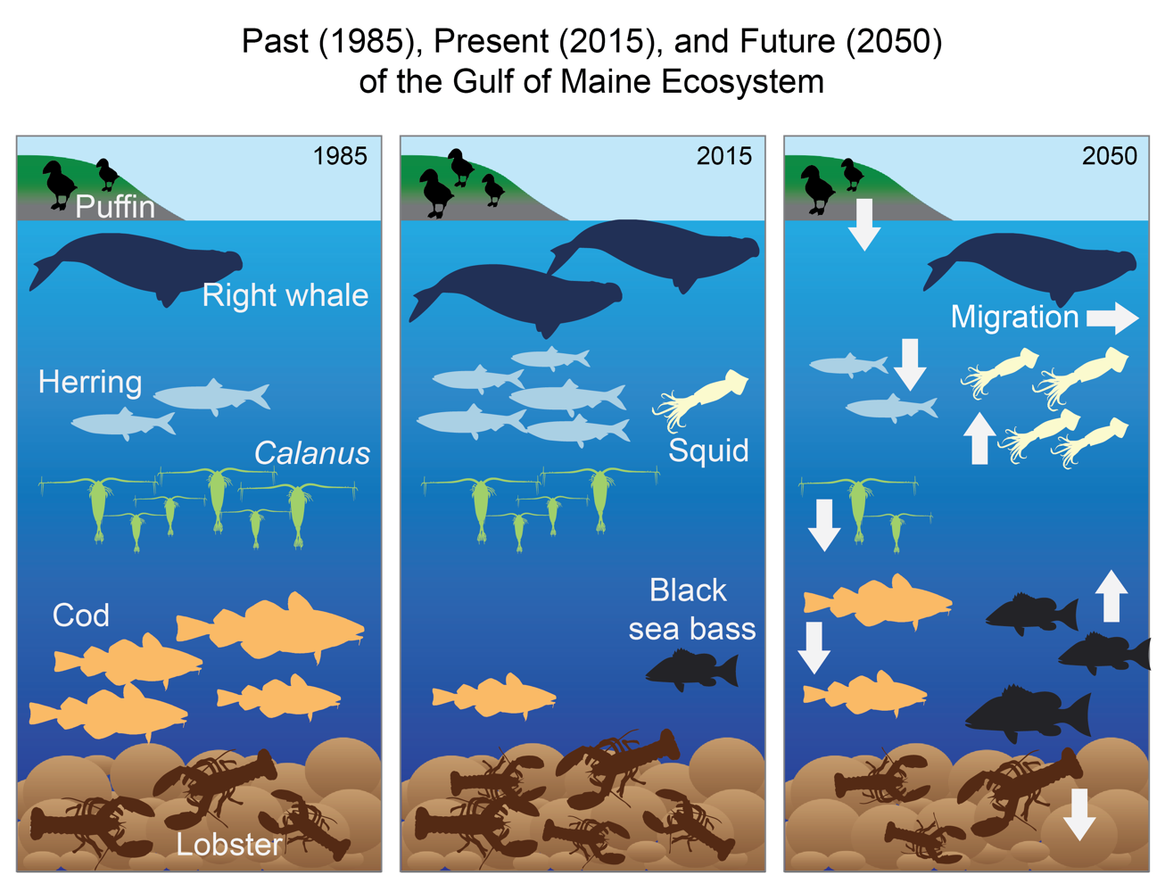
Figure 21.5. Shifts in the abundance and composition of species in the Gulf of Maine are expected to continue with additional warming.
Notes:
CAPTION: In 1985, conditions in the Gulf of Maine ecosystem were cool, and subpolar species (puffin, right whales, and Atlantic herring) were not abundant due to human activities and natural variability. By 2015, Atlantic cod abundance was low due to overfishing and rising temperatures, whereas temperate species (e.g., black sea bass and squid) became prevalent due to warming. Under an intermediate scenario (RCP4.5), by 2050 many subpolar species (e.g., lobster, Atlantic cod, Atlantic herring, and Calanus, a copepod) are expected to decline (down arrows), and temperate species will increase (upward arrows). With better management, Atlantic cod abundance will tend to increase, but it will be counteracted by decreased productivity due to warming. Right whales will increase with better management but are expected to move out of the Gulf of Maine (horizontal arrow) due to the impacts of warming on the distribution and abundance of their prey. Local fishing communities will need to shift effort to harvest species that have become more abundant. Adapted from Pershing et al. 2021(Pershing et al. 2021) [CC BY 4.0].

Slide 13
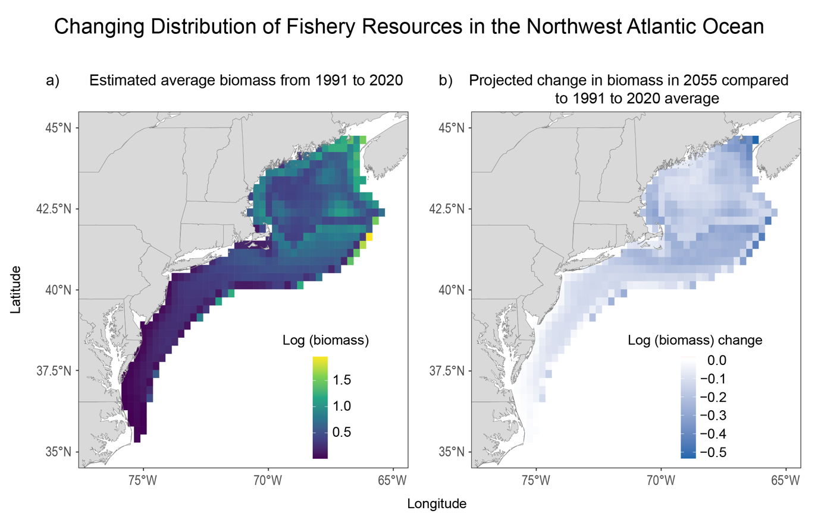
Figure 21.6. The distribution and abundance of American lobster are expected to decrease by midcentury.
Notes:
CAPTION: The figure shows (a) predicted changes in American lobster (Homarus americanus) distribution and abundance based on the estimated baseline biomass (log-transformed scale) from 1991 to 2020 (the color scale ranges from yellow [high biomass] to purple [low biomass]) and (b) future projected change in biomass in 2055 compared to the baseline period (the color scale ranges from no change [white] to a decrease in biomass [darker blue]). Projections suggest a decrease in the future biomass of lobster due to ocean warming. Adapted from Allyn et al. 2020(Allyn et al. 2020) [CC0 1.0].

Slide 14
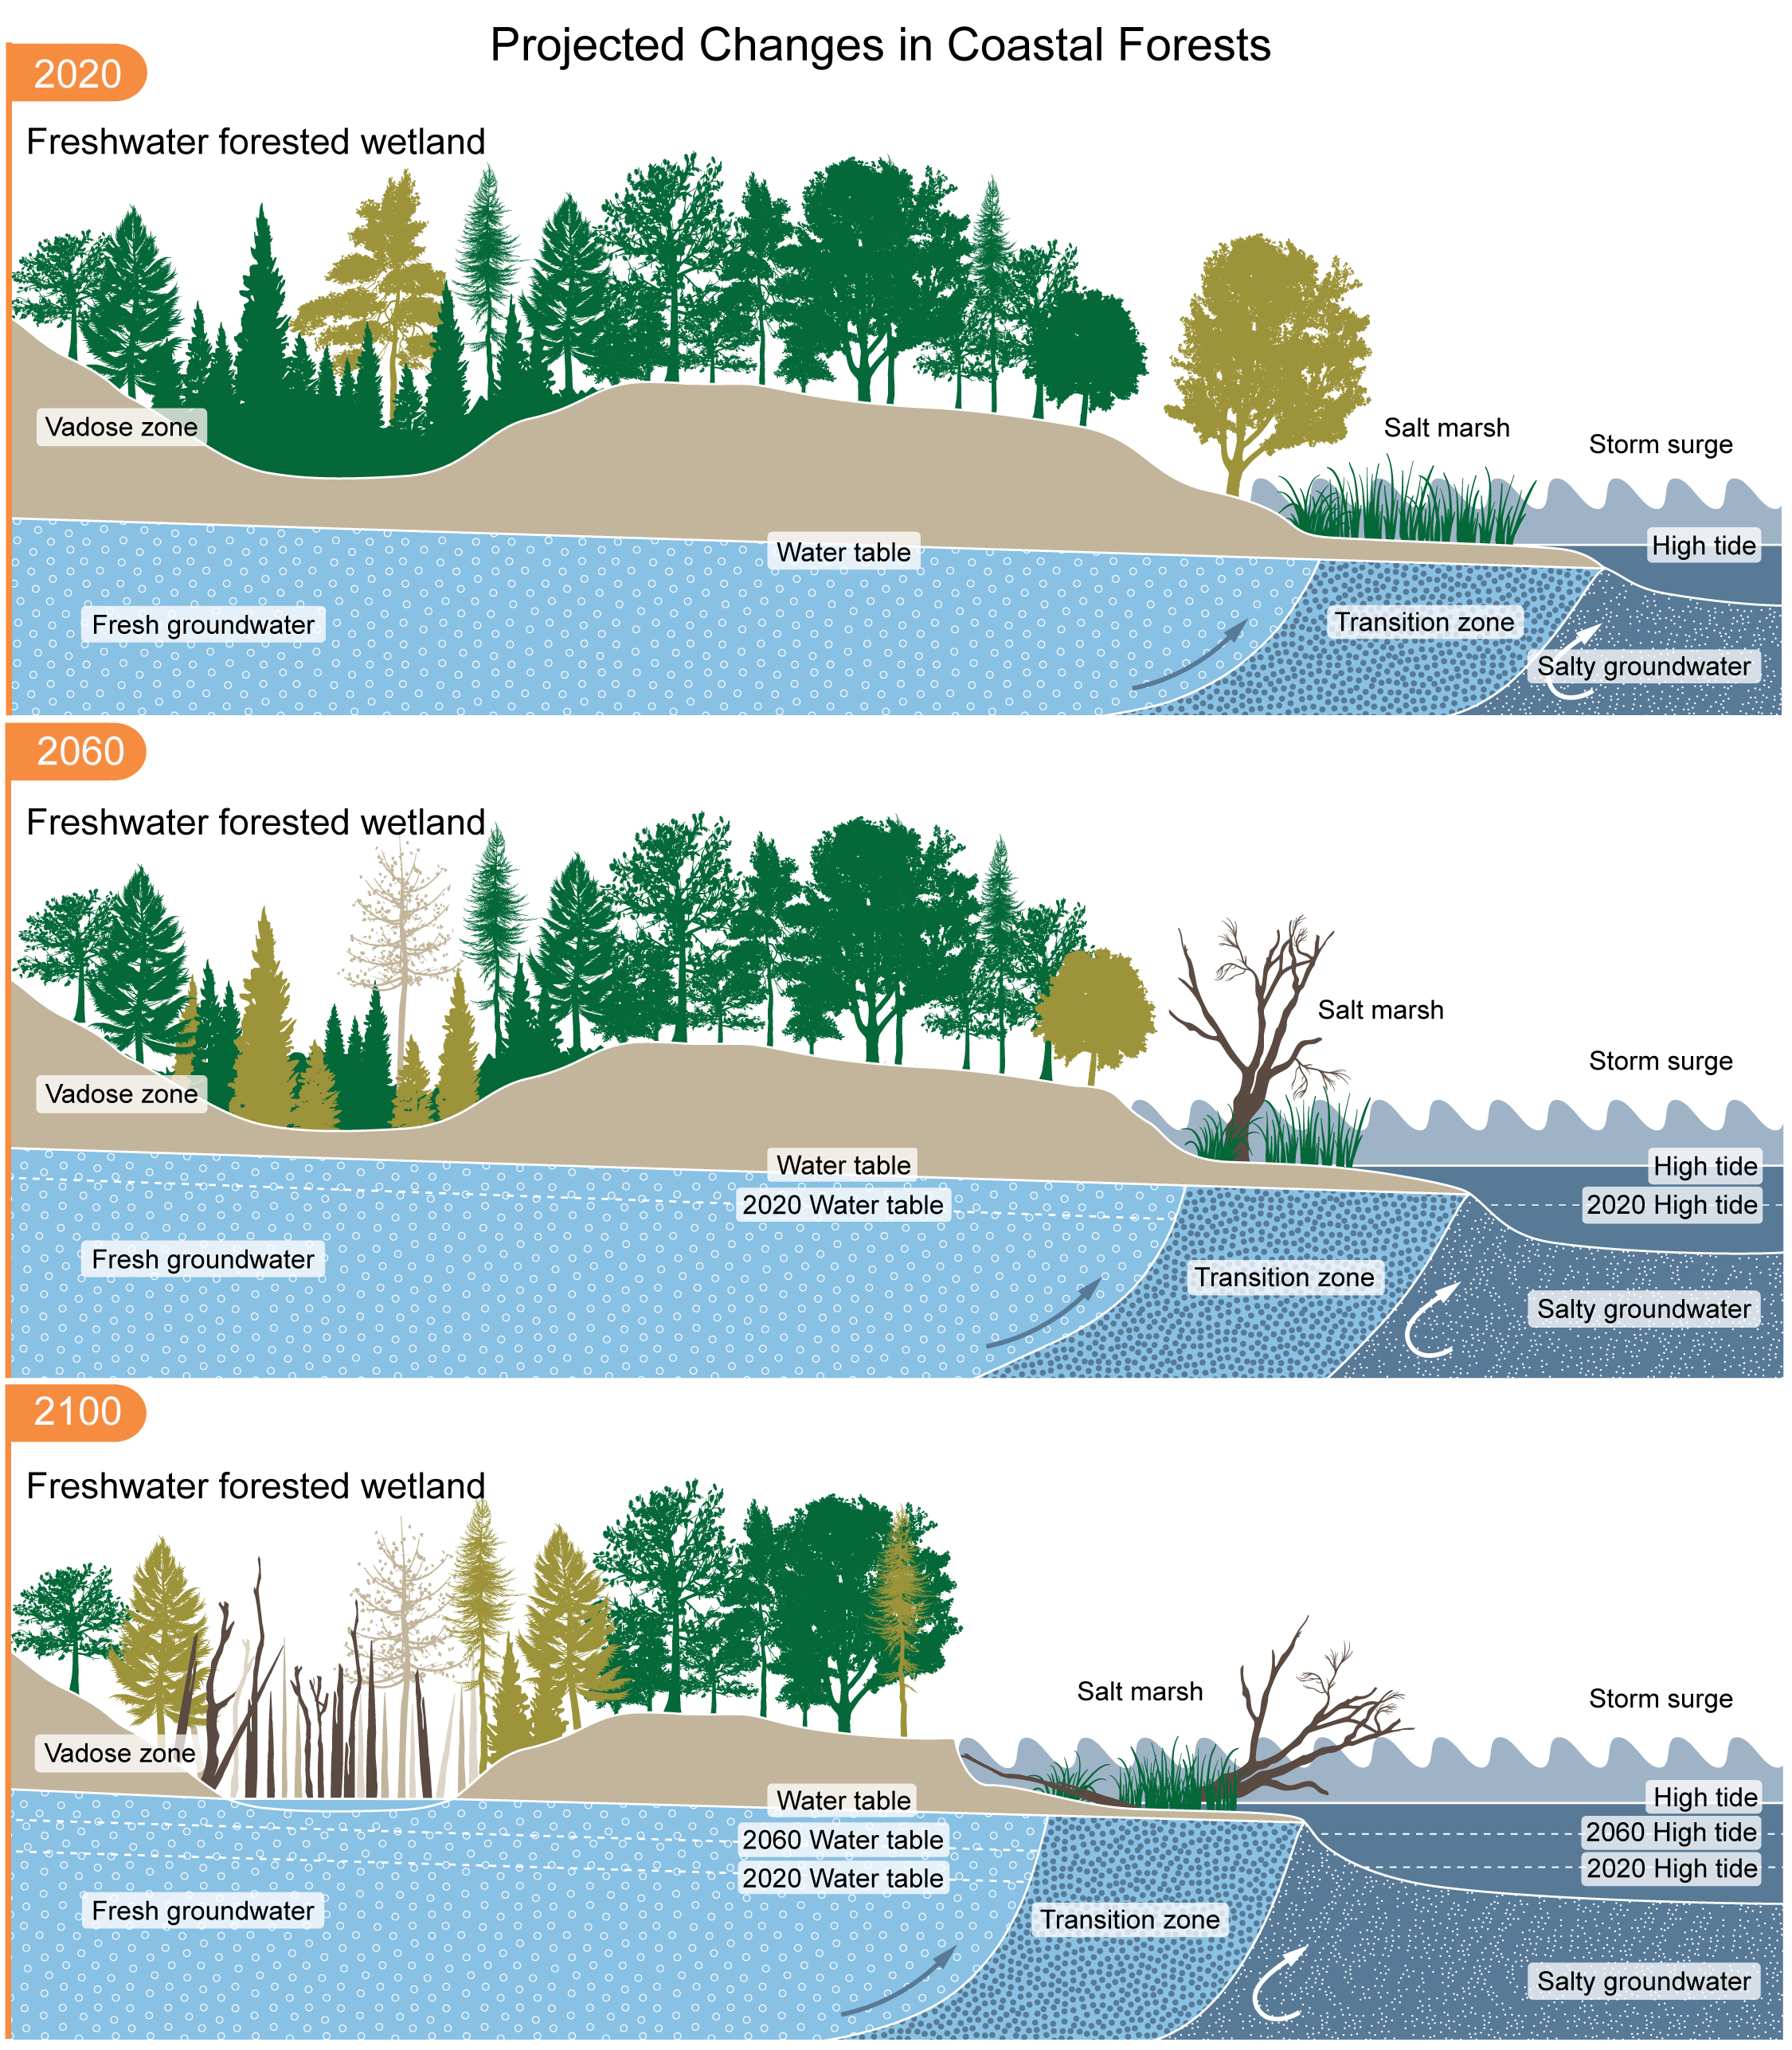
Figure 21.7. Rising sea levels kill trees and transform coastal forests into marshes, damaging vital ecosystems and the services they provide to the community.
Notes:
CAPTION: As sea level rises, the water table also rises; the vadose zone (which is between the ground surface and the groundwater table) becomes thinner, bringing the water table closer to the surface; and tidal flooding and storm surges reach farther inland, resulting in forest dieback and conversion of forested wetlands to standing-water wetlands. Over time, these changes result in permanent habitat shifts. Adapted from Sacatelli et al. 2020.(Sacatelli et al. 2020)

Slide 15
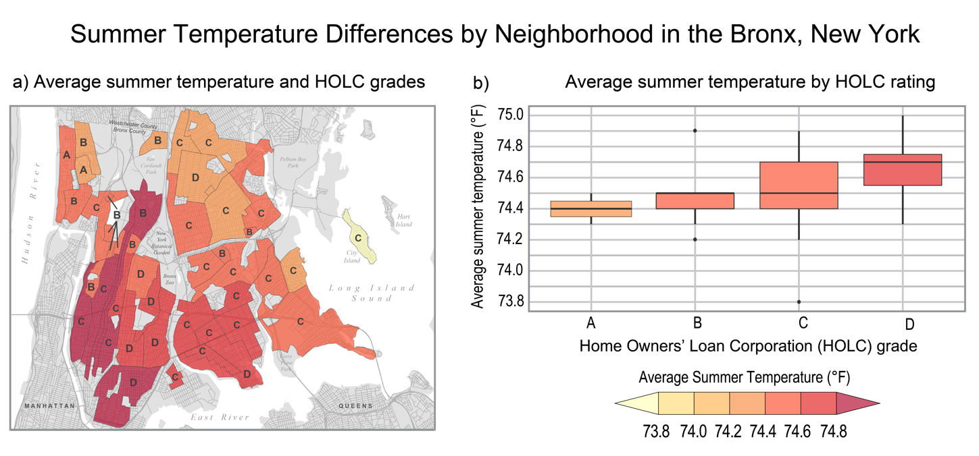
Figure 21.8. Average summer temperatures are generally higher in historically redlined neighborhoods in the Bronx, New York.
Notes:
CAPTION: Historically redlined areas, defined by lower Home Owners’ Loan Corporation (HOLC) grades that deprived certain areas of federal loans and insurance, typically show higher temperatures relative to non-redlined neighborhoods, leading to greater likelihood of heat exposure for areas with lower socioeconomic status and higher percentages of racial and ethnic minorities in the Bronx, New York (1981–2010). The letters A, B, C, and D on the figure correspond to the four categories used by the HOLC: “Type A (Best), Type B (Still Desirable), Type C (Declining), and Type D (Hazardous).”(Hillier 2003) Figure credit: Union of Concerned Scientists, RAND Corporation, Columbia University, NOAA NCEI, and CISESS NC.

Slide 16
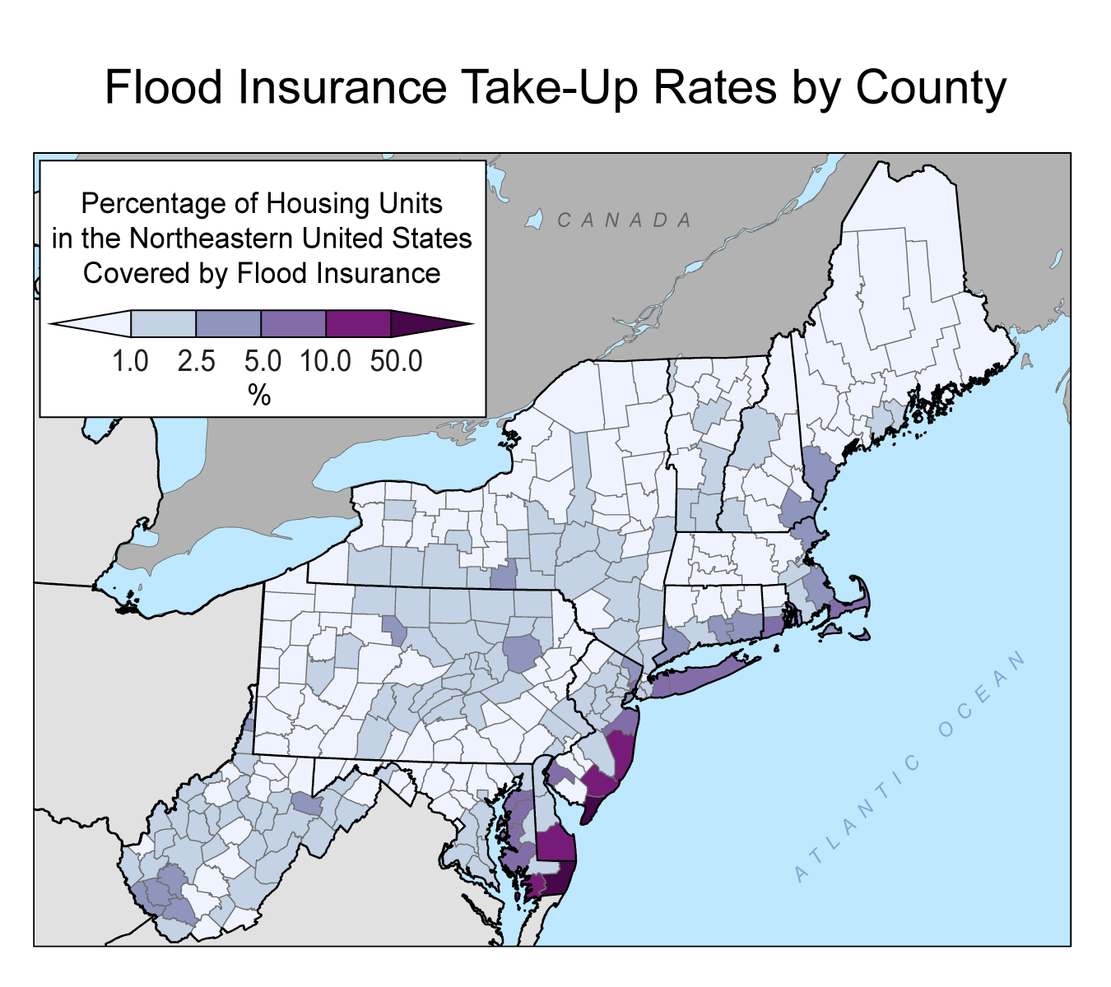
Figure 21.9. Many Northeast households and communities risk financial hardship from a lack of flood insurance coverage.
Notes:
CAPTION: The figure shows flood insurance take-up rates by county in the northeastern United States, based on 2020 Census housing units and active National Flood Insurance Program policy counts at the end of 2021. Almost half of the counties in the region have less than 1% market penetration, while only two counties (Cape May, New Jersey, and Worchester, Maryland) have more than 50% of their housing units insured for flood. The lack of coverage, particularly inland, leaves both individuals and communities at risk of major financial hardship after a flood event. Figure credit: Munich Reinsurance America Inc.

Slide 17
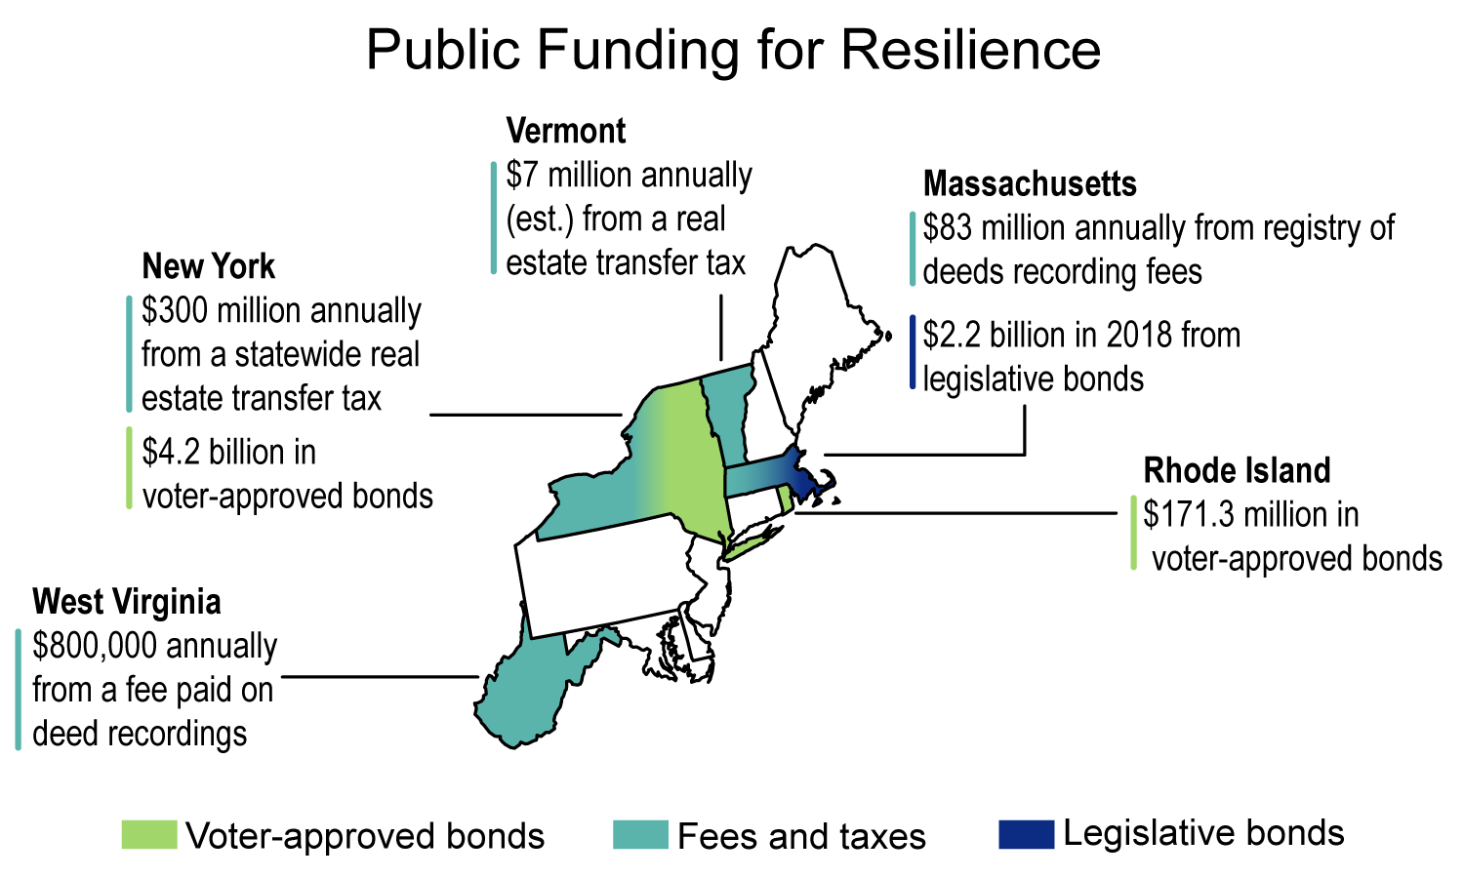
Figure 21.10. Northeastern states provide funding for resilience efforts in a number of ways.
Notes:
CAPTION: Northeastern states fund planning and implementation of resilience projects through multiple public financing mechanisms. Examples of voter approved bonds, taxes and fees, and legislative bonds established and ongoing since 2018 are highlighted. The most common source of state funding originates from annual fees and is largely directed to conservation and natural and working lands. Infrastructure projects and capital investments are most often funded through voter-approved general obligation bonds, with Rhode Island being the most active issuer of bonds for climate-resilience projects. Figure credit: Rhode Island Infrastructure Bank.

Slide 18
Federal Coordinating Lead Author
Ellen L. Mecray, NOAA National Centers for Environmental Information
Chapter Lead
Jessica C. Whitehead, Old Dominion University, Institute for Coastal Adaptation and Resilience
Chapter Authors
Erin D. Lane, USDA Forest Service, Northeast Climate Hub
Lisa Kerr, Gulf of Maine Research Institute
Melissa L. Finucane, Union of Concerned Scientists
David R. Reidmiller, Gulf of Maine Research Institute
Mark C. Bove, Munich Reinsurance America Inc.
Franco A. Montalto, Drexel University, Department of Civil, Architectural, and Environmental Engineering
Shaun O'Rourke, Quantified Ventures
Daniel A. Zarrilli, Columbia University
Paulinus Chigbu, University of Maryland Eastern Shore
Casey C. Thornbrugh, United South and Eastern Tribes Inc., Northeast and Southeast Climate Adaptation Science Centers
Enrique N. Curchitser, Rutgers University
James G. Hunter, Morgan State University
Kevin Law, Marshall University
Technical Contributors
Jay Bhatt, Drexel University
Carlos Calvo-Hernandez, RAND Corporation
Adam A. Kemberling, Gulf of Maine Research Institute
Zhaoxiong Li, Drexel University
Review Editor
Katherine D. Cann, Rutgers University
USGCRP Coordinators
Joshua Hernandez, US Global Change Research Program / ICF
Christopher W. Avery, US Global Change Research Program / ICF

Slide 19
Whitehead, J.C., E.L. Mecray, E.D. Lane, L. Kerr, M.L. Finucane, D.R. Reidmiller, M.C. Bove, F.A. Montalto, S. O'Rourke, D.A. Zarrilli, P. Chigbu, C.C. Thornbrugh, E.N. Curchitser, J.G. Hunter, and K. Law, 2023: Ch. 21. Northeast. In: Fifth National Climate Assessment. Crimmins, A.R., C.W. Avery, D.R. Easterling, K.E. Kunkel, B.C. Stewart, and T.K. Maycock, Eds. U.S. Global Change Research Program, Washington, DC, USA. https://doi.org/10.7930/NCA5.2023.CH21
https://nca2023.globalchange.gov/chapter/21

