Slide 1

NCA5 Website: https://nca2023.globalchange.gov
Chapter Website: https://nca2023.globalchange.gov/chapter/22
NCA5 Atlas: https://atlas.globalchange.gov
Figure captions can be found in the slide notes of this deck
Social media: @usgcrp, #NCA5

Slide 2
Chapter 22 | Southeast

Slide 3
1
Regional Growth Increases Climate Risks
The Southeast’s population has grown and is expected to continue growing, mostly in metropolitan areas and along its coastline (very likely, very high confidence), putting more communities and their assets into harm’s way from increasing risks related to climate and land-use changes (very likely, very high confidence). Conversely, many rural places are facing declining populations with a growing percentage of older residents (very high confidence), making these areas particularly vulnerable to the impacts of a changing climate (likely, high confidence). At the same time, decision-makers frequently use outdated and/or limited information on climate-related risks to inform adaptation plans, which as a result fail to account for worsening future conditions (likely, high confidence). These climate adaptation efforts also tend to be concentrated in wealthier communities, leaving under-resourced and more rural populations, communities of color, and Tribal Nations at growing and disproportionate risk (likely, high confidence).

Slide 4
2
Climate Change Worsens Human Health and Widens Health Inequities
Human health and climate stressors are intimately linked in the Southeast (very high confidence). Community characteristics such as racial and ethnic population, chronic disease prevalence, age, and socioeconomic status can influence how climate change exacerbates, ameliorates, or introduces new health issues (very high confidence). Climate change is already impacting health in the region (very likely, very high confidence). There are effective strategies to address the health impacts of climate change in the Southeast that have multiple benefits across social and environmental contexts (high confidence).

Slide 5
3
Climate Change Disproportionately Damages Southeastern Jobs, Households, and Economic Security
Over the last few decades, economic growth in the Southeast has been concentrated in and around urban centers (high confidence) that depend on climate-sensitive infrastructure and regional connections to thrive (medium confidence). Simultaneously, rural and place-based economies that rely on the region’s ecosystems are particularly at risk from current and future climate changes (very likely, high confidence). Global warming is expected to worsen climate-related impacts on economic systems, labor, and regional supply chains in the Southeast, with disproportionate effects on frontline communities (very likely, high confidence). A coordinated approach that recognizes present-day inequities and the interdependencies between rural and urban communities will be necessary to secure the region’s economic vitality (very likely, high confidence).

Slide 6
4
Agriculture Faces Growing Threats, but Innovations Offer Help
Changes in temperature, drought, extreme rainfall, and sea levels are already threatening the Southeast’s agriculture and other food-related systems (likely, very high confidence). Moreover, these climate-related hazards are expected to worsen with every increment of global warming, disproportionately harm farmers and small-scale operations, and increase the competition between urban and rural communities for valuable resources such as water and land (high confidence, very likely). However, innovative agricultural techniques such as precision farming show promise for adapting to future climate changes in the region (likely, high confidence).

Slide 7
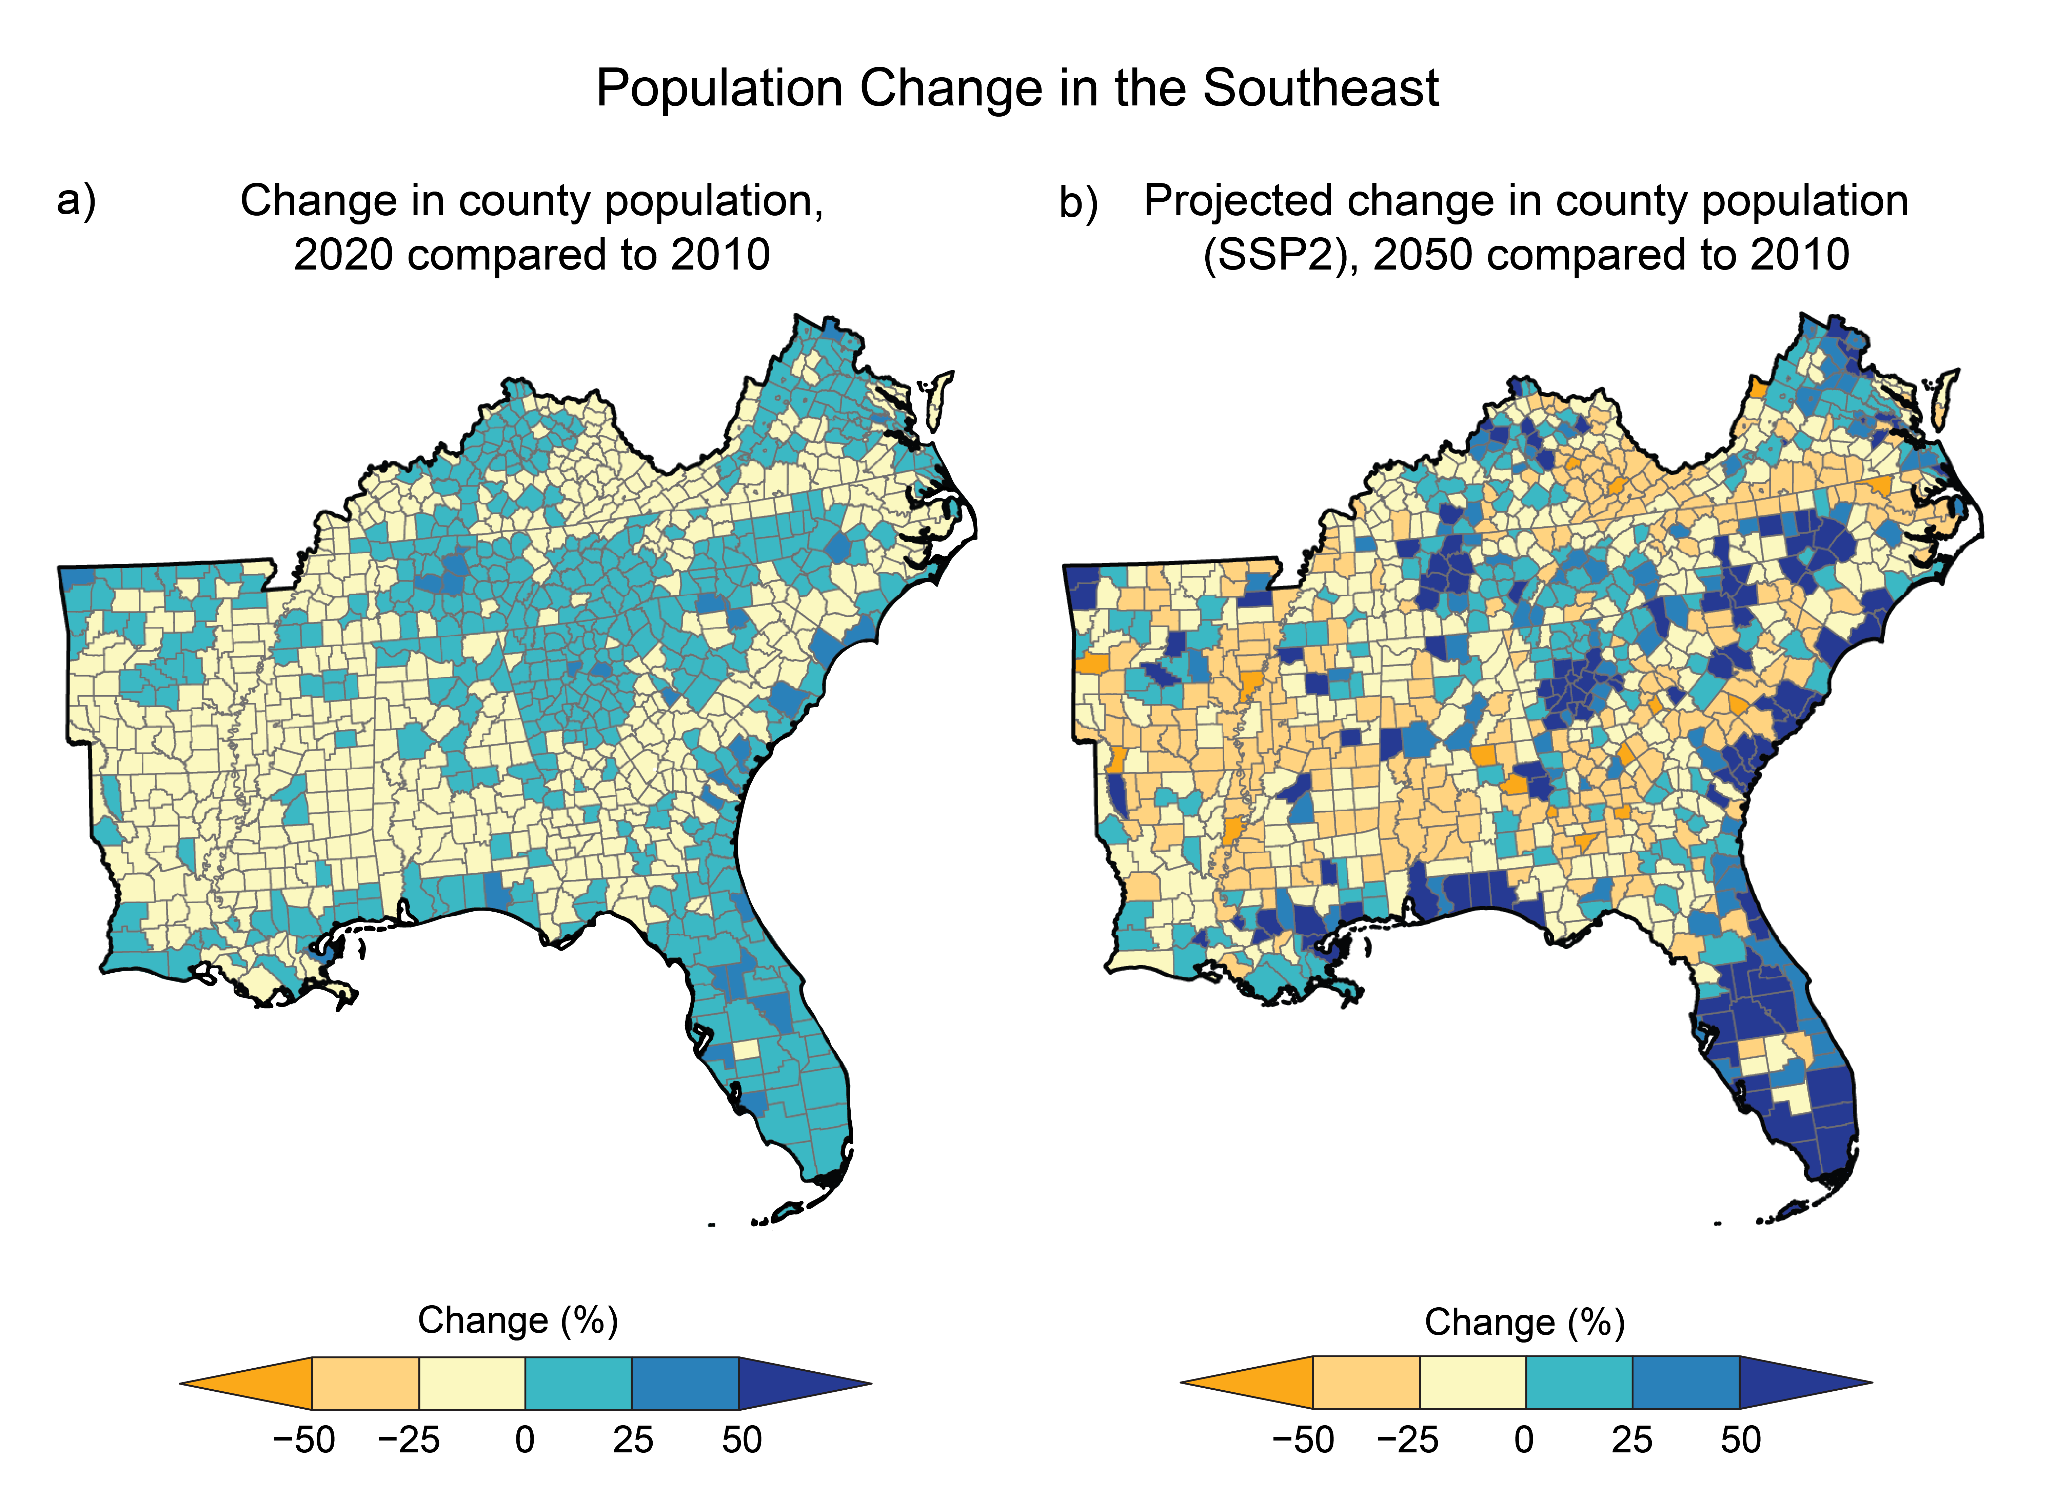
Figure 22.1. Population change in the Southeast exposes more people to climate threats along the coast and in cities while leaving rural areas with limited capacity.
Notes:
CAPTION: (a) Between 2010 and 2020, unequal population change occurred in the Southeast, with coastal and metropolitan counties growing while many rural counties’ populations declined. (b) This pattern is expected to continue through 2050 (under SSP2) and will expose more people to climate threats. Diminishing populations reduce the capacity of rural counties to adapt to climate threats by reducing critical financial and social resources, such as tax bases and community care organizations. Figure credit: Groundwork USA, NOAA NCEI, and CISESS NC.

Slide 8
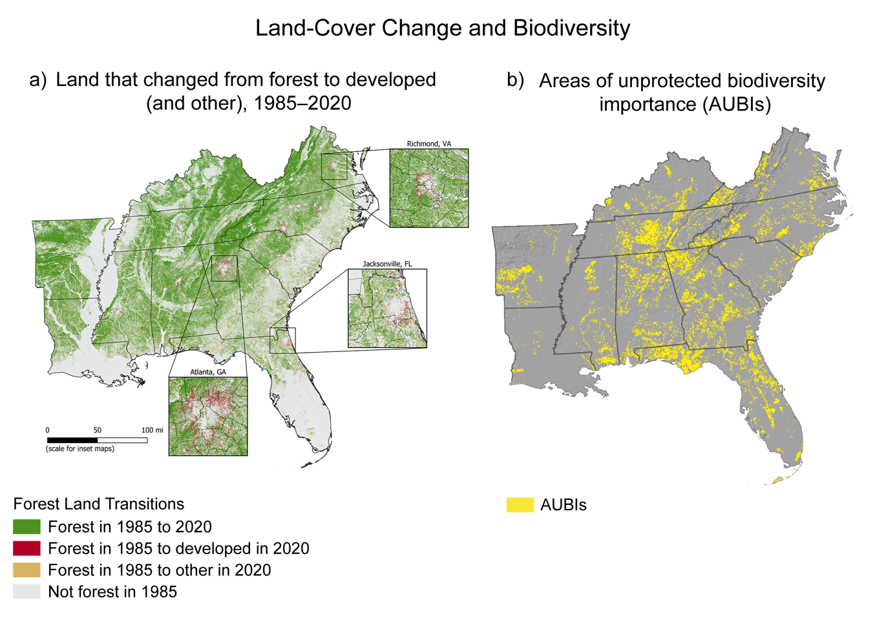
Figure 22.2. Land cover change and sprawling development threaten unprotected biodiversity hotspots in the Southeast.
Notes:
CAPTION: (a) The Southeast has lost more forested area to development and other land uses (cropland, grass/shrub, and water) than any other National Climate Assessment region since 1985. (b) Many of the region’s most biodiverse landscapes remain unprotected, threatening unique species of birds, fish, and amphibians. Future sprawl may threaten these landscapes, known as Areas of Unprotected Biodiversity Importance (AUBIs). Figure credits: (a) Groundwork USA, Oak Ridge National Laboratory, NOAA NCEI, and CISESS NC; (b) adapted with permission from Hamilton et al. 2022.(Hamilton et al. 2022)

Slide 9
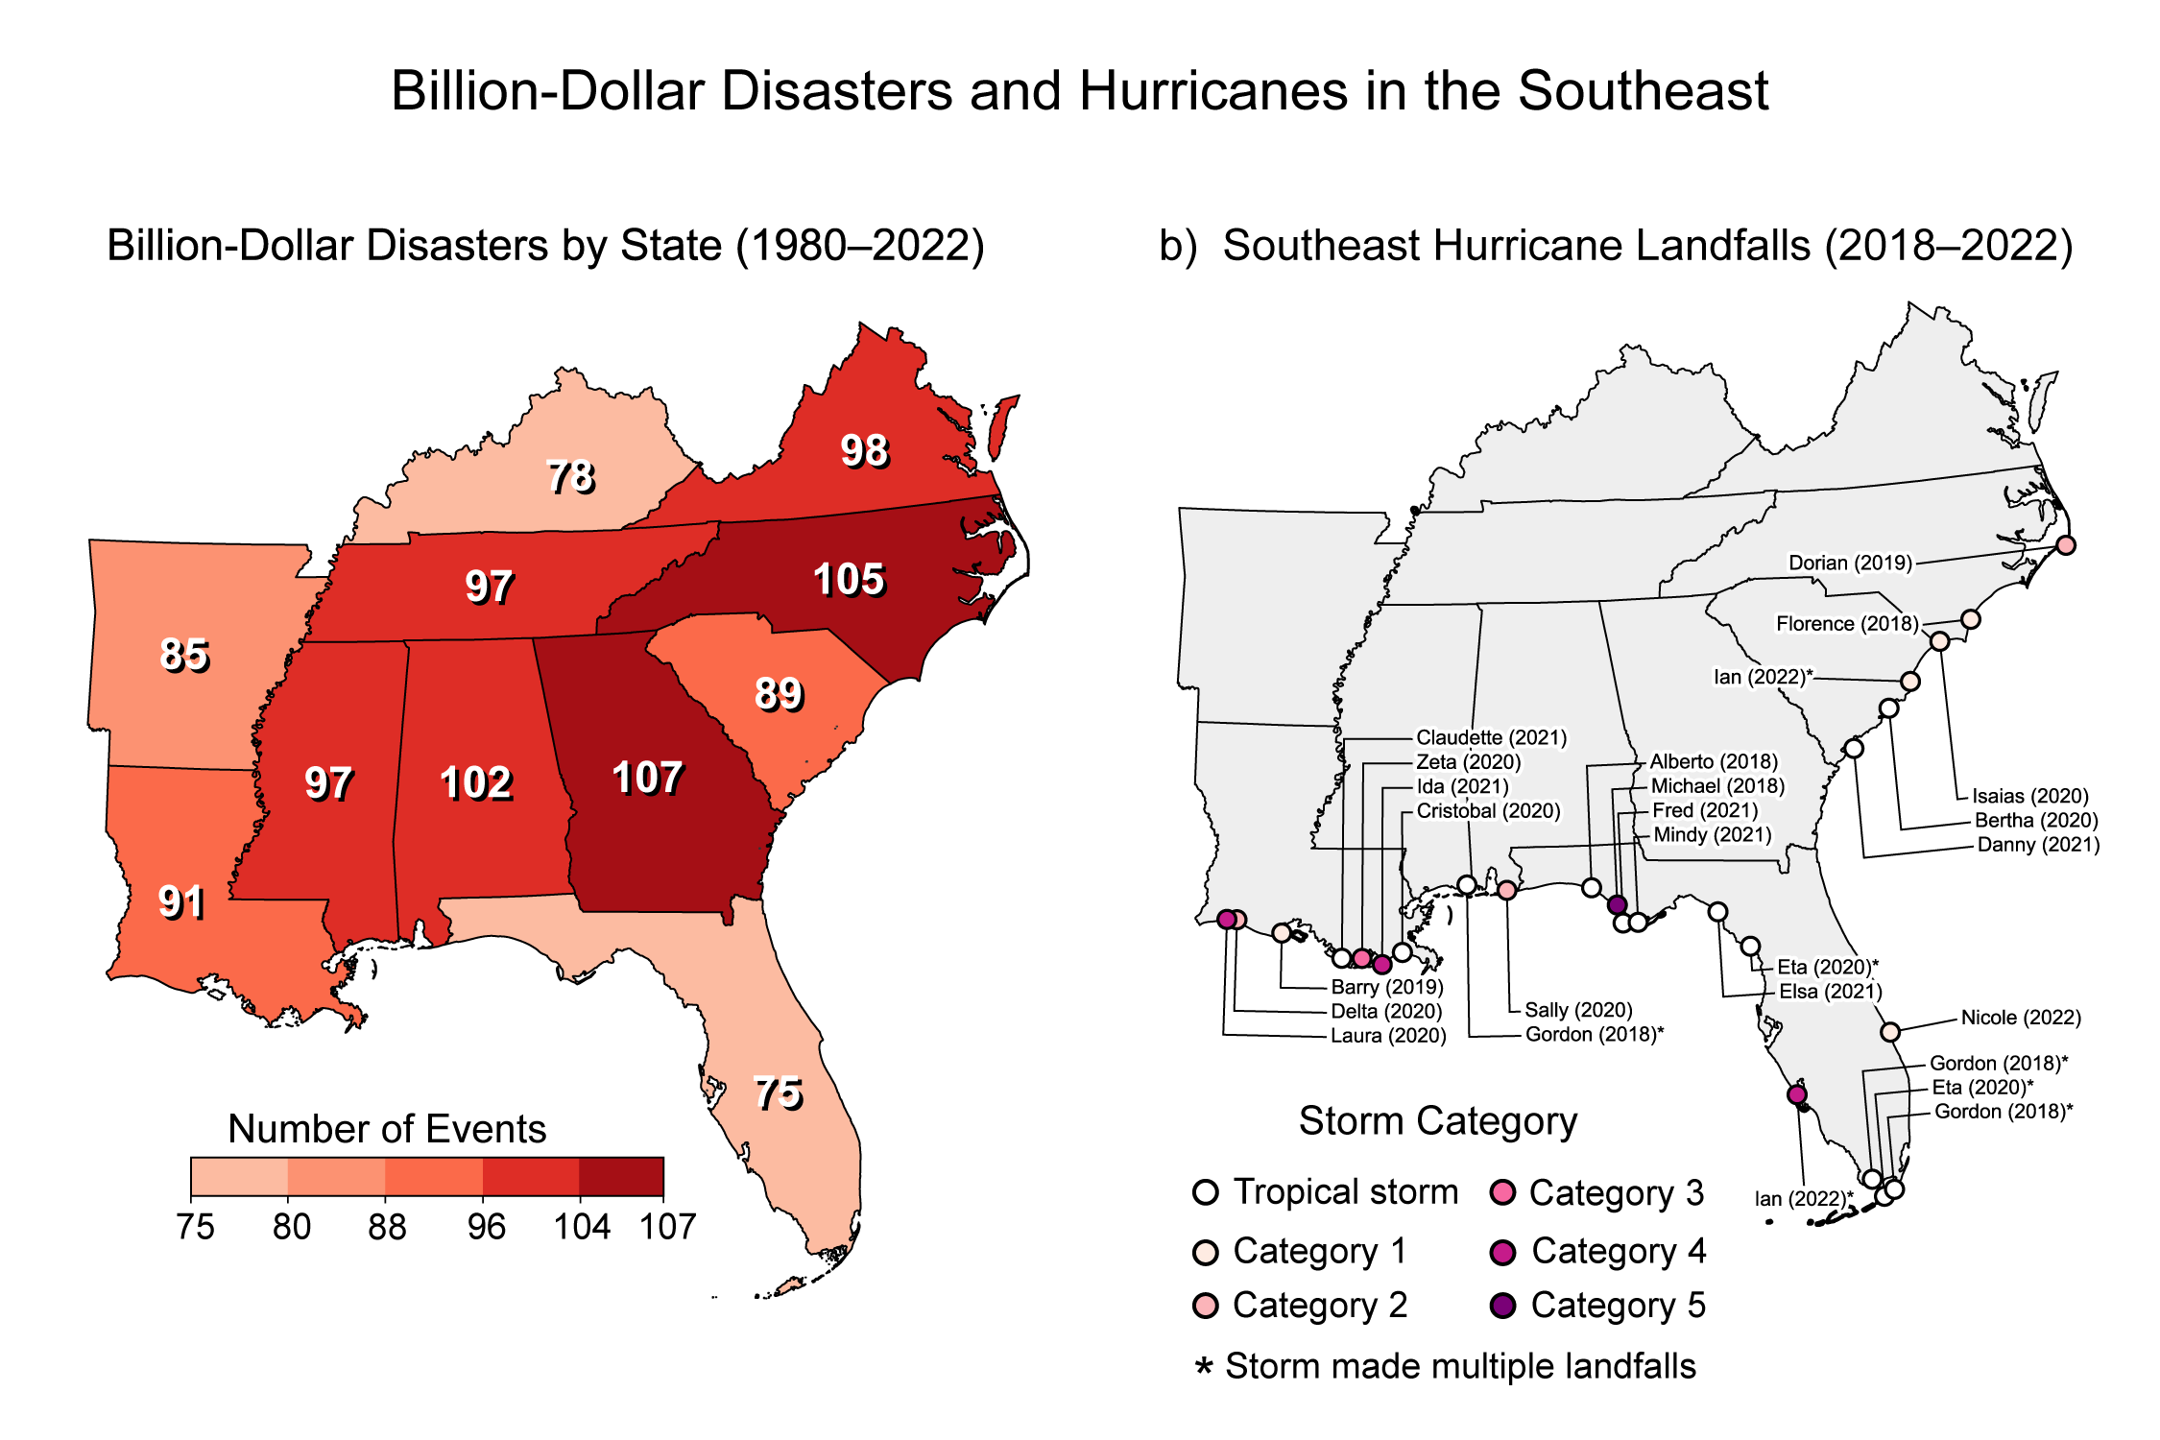
Figure 22.3. The Southeast frequently experiences costly weather-related disasters, which are worsened by climate change.
Notes:
CAPTION: (a) The map shows NOAA billion-dollar disasters by state during 1980–2022 in the Southeast. The map adds up billion-dollar events for each state affected (i.e., it does not mean that each state shown suffered at least $1 billion in losses for each event). (b) The map shows Southeast hurricane landfalls during 2018–2022. Since 1980, the Southeast has had a higher frequency of billion-dollar disasters than other National Climate Assessment regions. Disasters attributed to hurricanes have been particularly damaging. Hurricane impacts can spread far inland and even outside the region, including major flooding, which is not captured in the Saffir–Simpson Scale depicting hurricane landfall intensity (b). Because map (b) is limited to 2018–2022, it excludes prior billion-dollar hurricanes that hit the Southeast, including Hugo (1989), Andrew (1992), Fran (1996), Floyd (1999), Charley (2004), Rita (2005), Katrina (2005), Matthew (2016), and Irma (2017). Figure credit: Mississippi State University.

Slide 10
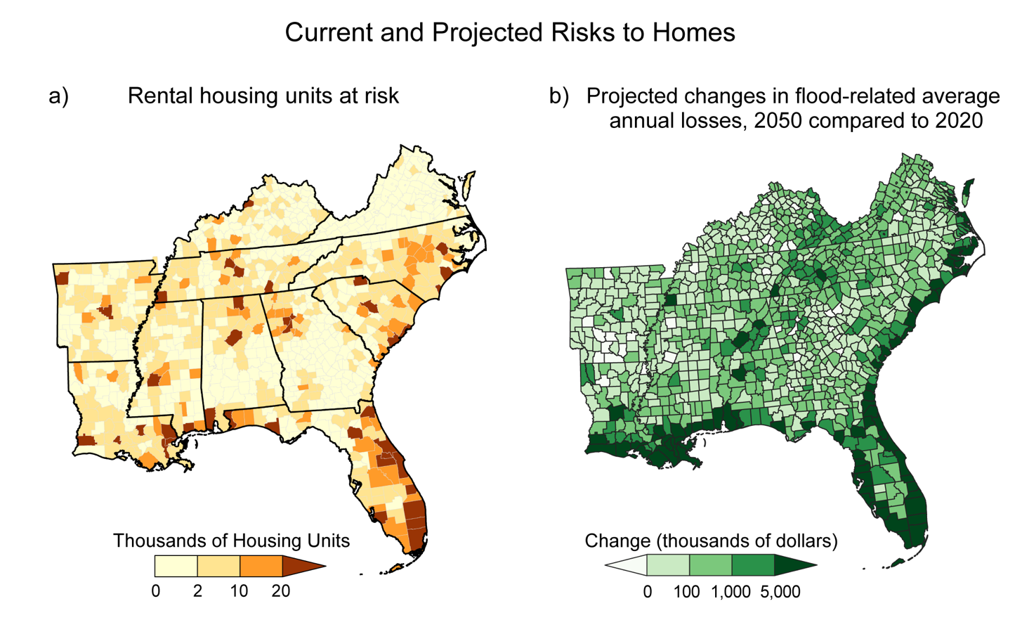
Figure 22.4. Vulnerable homes in the Southeast will face increasing climate threats in the future.
Notes:
CAPTION: (a) Thousands of rental housing units across the Southeast are located in counties with at least a “relatively moderate” Expected Annual Loss score in FEMA’s National Risk Index. (b) Projected future increases to flood-related average annual losses by 2050 compared to 2020 under an intermediate scenario (RCP4.5) disproportionately affect under-resourced populations and communities of color and are amplified by population growth, exposing more people to increased flood risk. (a) Adapted with permission from Harvard Joint Center for Housing Studies, America's Rental Housing, © 2022 by the President and Fellows of Harvard College, www.jchs.harvard.edu. All rights reserved;(Harvard Joint Center for Housing Studies 2022) (b) adapted from Wing et al. 2022(Wing et al. 2022) [CC BY 4.0].

Slide 11
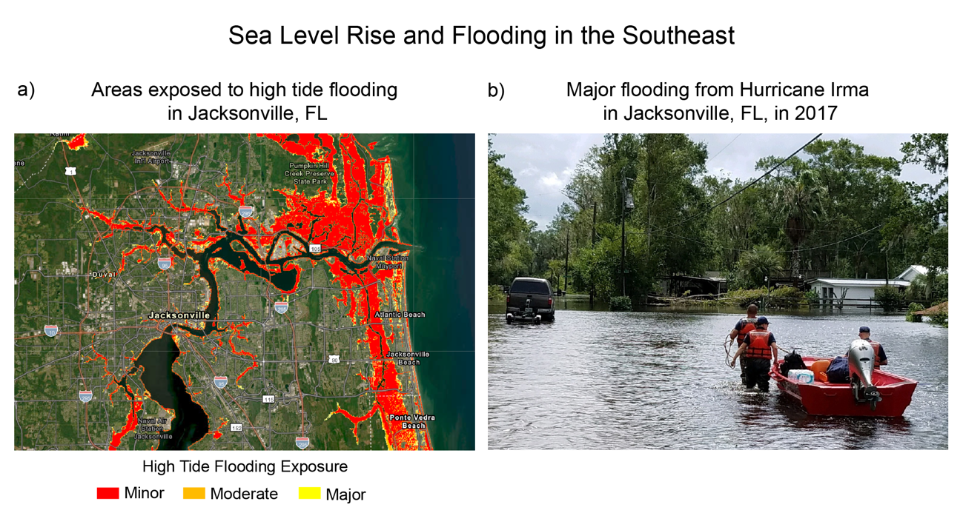
Figure 22.5. Major flood events in Jacksonville, Florida, could become about 5 times more likely by 2050 under an Intermediate-High sea level rise scenario.
Notes:
CAPTION: Sea level rise under an Intermediate-High scenario(Sweet et al. 2022) would drastically increase the likelihood of flood conditions by 2050. For Jacksonville, Florida (a), this would mean that “minor” flood conditions (red colors) will be about 30 times more likely, “moderate” (orange colors) will be about 20 times more likely, and “major” (yellow colors) will be about 5 times more likely. This would translate to more than 250 minor floods, 10–50 moderate floods, and about 1 major flood per decade in 2050. (b) Major flooding impacts would resemble those experienced during Hurricane Irma in 2017, when Jacksonville experienced record-high flooding conditions. (a) Adapted from NOAA/NOS/CO-OPS 2023.(CO-OPS 2023) Data layers provided by © Esri, HERE, Garmin, FAO, NOAA, USGS, © OpenStreetMap contributors, and the GIS User Community. (b) Photo credit: Department of Homeland Security.

Slide 12
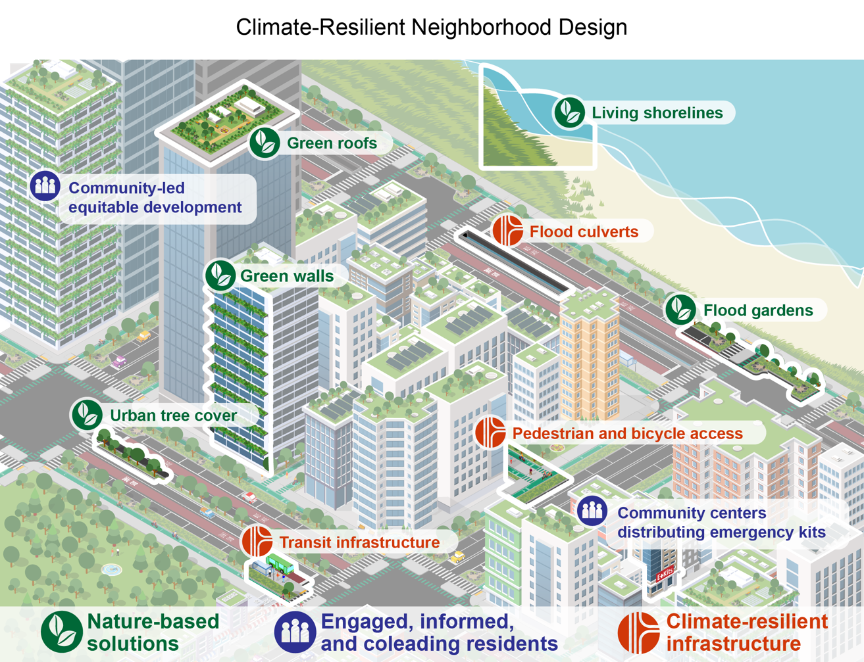
Figure 22.6. Climate-resilient community design can ensure the long-term vitality of cities.
Notes:
CAPTION: Climate-resilient urban design may incorporate nature-based, infrastructural, and community-based solutions to alleviate the harm from climate stressors such as extreme heat and flooding. Participatory processes can foster shared ownership of climate resilience strategies and promote the distribution of resources to where they’re needed most. Equitable reduction of climate risks and ensuring the reliability of critical services can create social benefits. Figure credit: Groundwork USA and North Carolina State University.

Slide 13
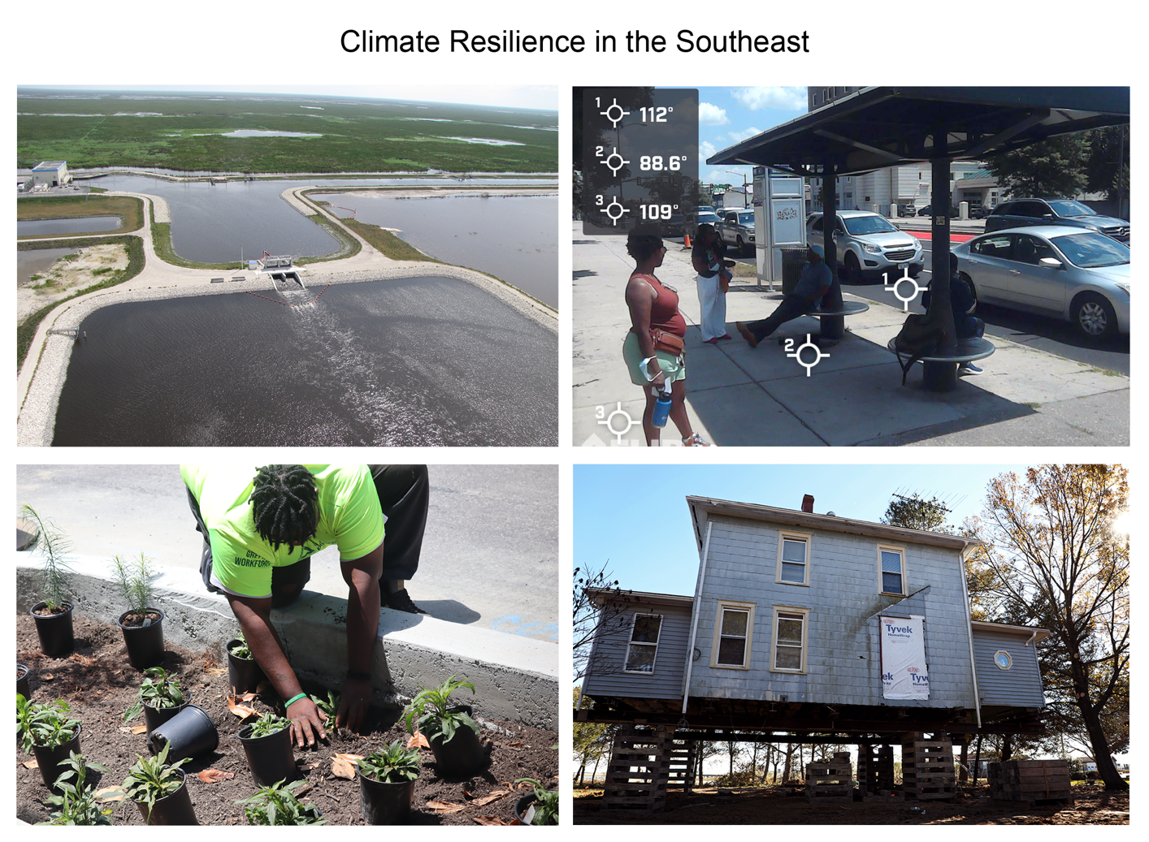
Figure 22.7. Southeast communities are adapting to climate threats in a number of ways.
Notes:
CAPTION: (top left) A 60,000-acre-foot stormwater reservoir in Palm Beach County, Florida, temporarily stores peak stormwater flows. (top right) Transit advocates in Richmond, Virginia, document the cooling efficiency of shade structures at public bus stops. (bottom right) Construction workers prepare to raise a home’s foundation along Virginia’s Eastern Shore. (bottom left) Rain gardens like this one can be highly place- and community-driven projects to absorb excess stormwater and improve green space, while nonprofits like Groundwork RVA build skills for a green economy. Photo credits: (top left) South Florida Water Management District [CC BY-ND 2.0]; (top right) © Jeremy Hoffman, Science Museum of Virginia; (bottom left) © Robert Jones; (bottom right) Aileen Devlin, Virginia Sea Grant [CC BY-ND 2.0].

Slide 14
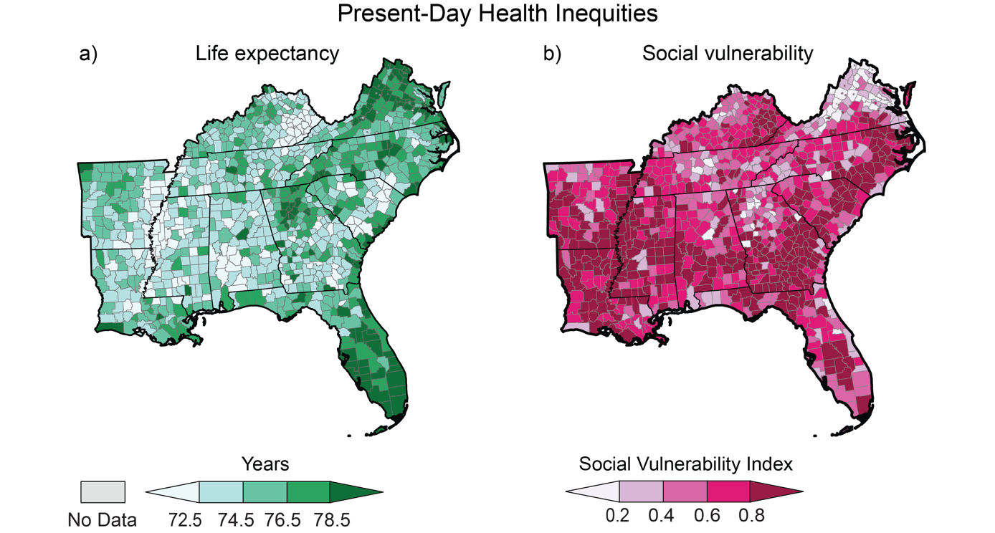
Figure 22.8. Present-day health inequities in the Southeast exacerbate climate-related risks.
Notes:
CAPTION: (left) Southeastern states rank among the lowest in the Nation for life expectancy, although there is considerable variation within the region and within individual states. These patterns in life expectancy are reflected in estimates of social vulnerability (right)—a measure of how societal stressors like poverty, crowded housing, older populations, and lack of access to transportation may diminish a community’s ability to avoid human distress and financial damages in a disaster like those made worse by climate change. Figure credits: (left) Groundwork USA, NOAA NCEI, and CISESS NC; life expectancy data from University of Wisconsin Population Health Institute, County Health Rankings & Roadmaps 2022, www.countyhealthrankings.org; (right) Science Museum of Virginia, NOAA NCEI, and CISESS NC.

Slide 15
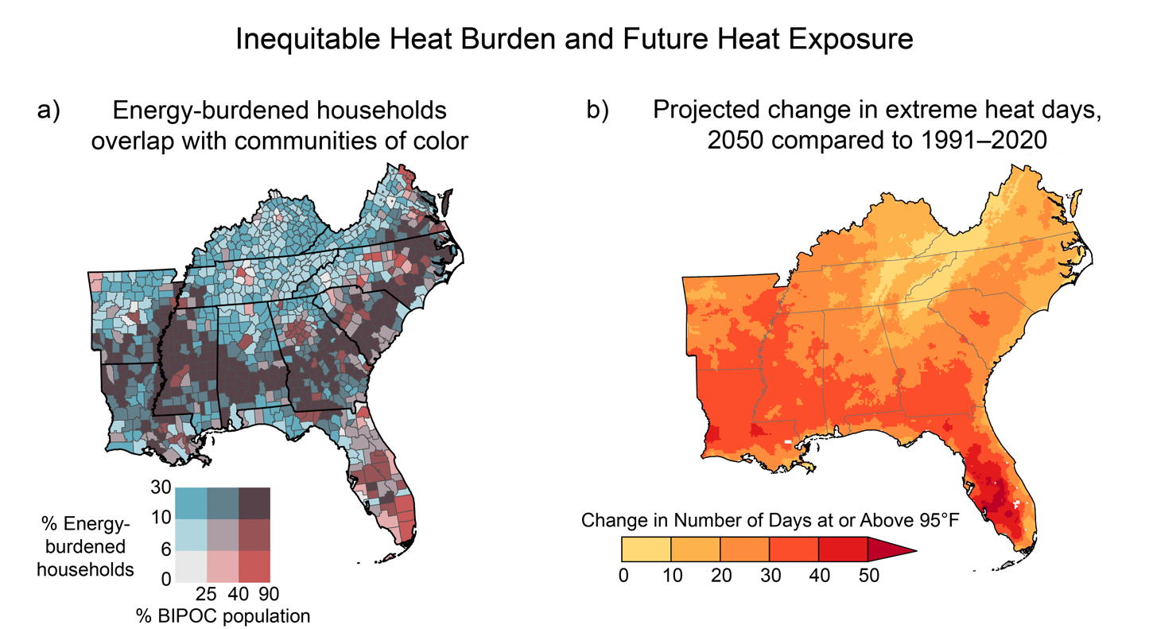
Figure 22.9. Projected increases in heat extremes disproportionately affect communities of color and other energy-burdened groups.
Notes:
CAPTION: Present-day inequities will be amplified by the increased threat of extreme heat in the future. Panel (a) shows overlap between the percentage of the population that is BIPOC (Black, Indigenous, and People of Color) and the percentage of low- and moderate-income households with a high energy burden, or households that spend a disproportionately high amount of money on energy costs relative to their income. The dark purple areas show high overlaps between BIPOC households and high energy burden. Panel (b) shows the projected increase in the number of extreme heat days (maximum temperature at or above 95°F) in 2050 relative to 1991–2020 under a high scenario (SSP3-7.0). Figure credits: (a) adapted from Bryan 2020;(Bryan 2020) (b) NOAA NCEI and CISESS NC.

Slide 16
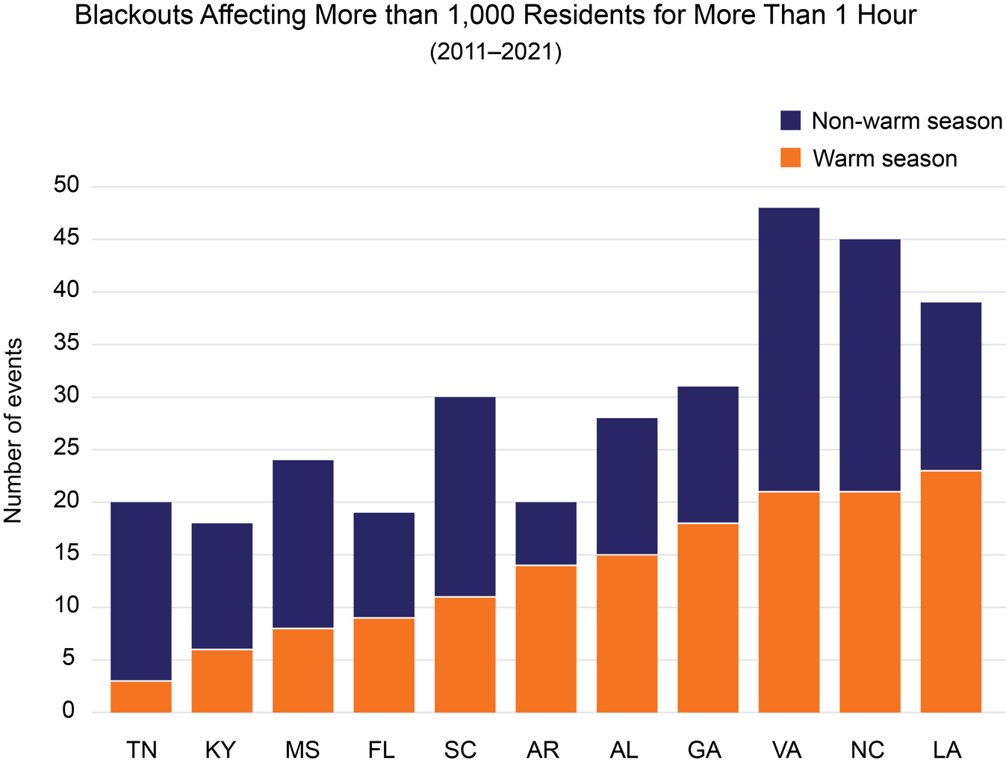
Figure 22.10. Warm-season blackouts add to heat-related risks for residents in Southeast.
Notes:
CAPTION: For several Southeast states, major blackout events occur most often during the warm season (May–September). Major blackouts during the warm season generally occur during heatwaves, placing people at higher risk of heat exposure and heat-related illness because they do not have access to air-conditioning. The figure shows reported major blackout events—defined as electrical grid failures affecting more than 1,000 residents for more than 1 hour—in Southeast states during 2011–2021. Data are presented as warm season (orange, May through September) and non-warm season (blue, October through April). Figure credit: Georgia Institute of Technology, Groundwork USA, CDC, NOAA NCEI, and CISESS NC.

Slide 17
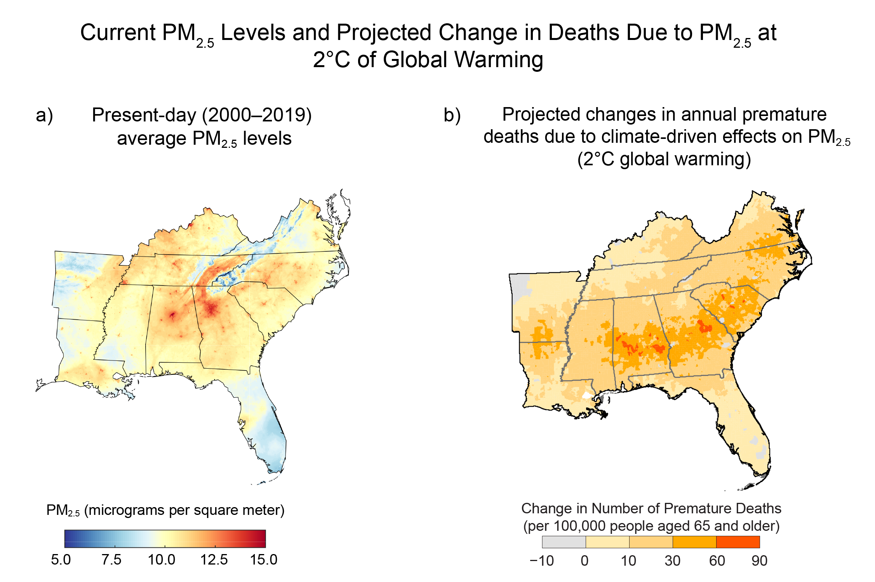
Figure 22.11. Rising levels of air pollution from a warming climate pose profound threats to human health.
Notes:
CAPTION: (a) Present-day (2000–2019) patterns of particulate matter (PM_{2.5}) pollution in the air are associated with excess mortality. (b) Potential future patterns (projected changes at 2°C of global warming relative to the 1986–2005 average) of premature deaths in people aged 65 and older due to PM_{2.5} show that even when accounting for reduced particulate emissions in the future due to developments such as vehicle electrification, the Southeast is particularly sensitive to increases in PM_{2.5} from increased temperature alone. (a) Adapted from van Donkelaar et al. 2019.(van Donkelaar et al. 2019) (This is an unofficial adaptation of an article that appeared in an ACS publication. ACS has not endorsed the content of this adaptation or the context of its use.) (b) Adapted from EPA 2021.(EPA 2021)

Slide 18
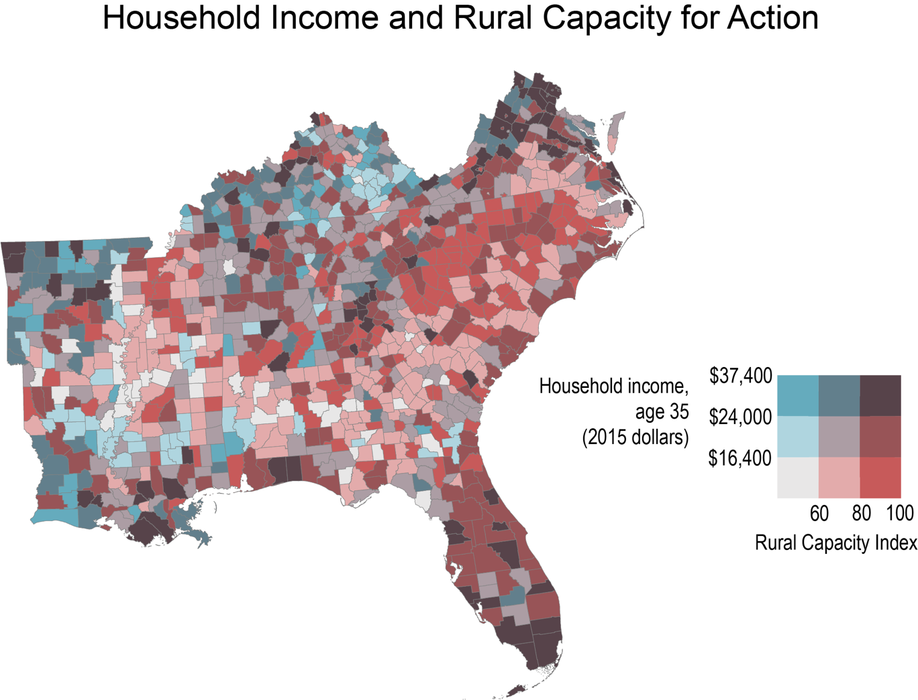
Figure 22.12. Counties where low-income households overlap with limited community capacity (shown in light gray) highlight rural climate risk challenges.
Notes:
CAPTION: In the Southeast, children born to parents who make the lowest incomes also tend to earn low incomes as adults (blue hues), especially within frontline communities. These pockets of limited generational upward mobility may also overlap with lower scores on the Rural Capacity Index (red hues), as measured by under-resourced governance structures and limited public participation in civic processes like voting.(Hernandez et al. 2022) This lack of resources may leave these communities more at risk from damage due to climate change. Figure credit: EPA, Groundwork USA, NOAA NCEI, and CISESS NC.

Slide 19
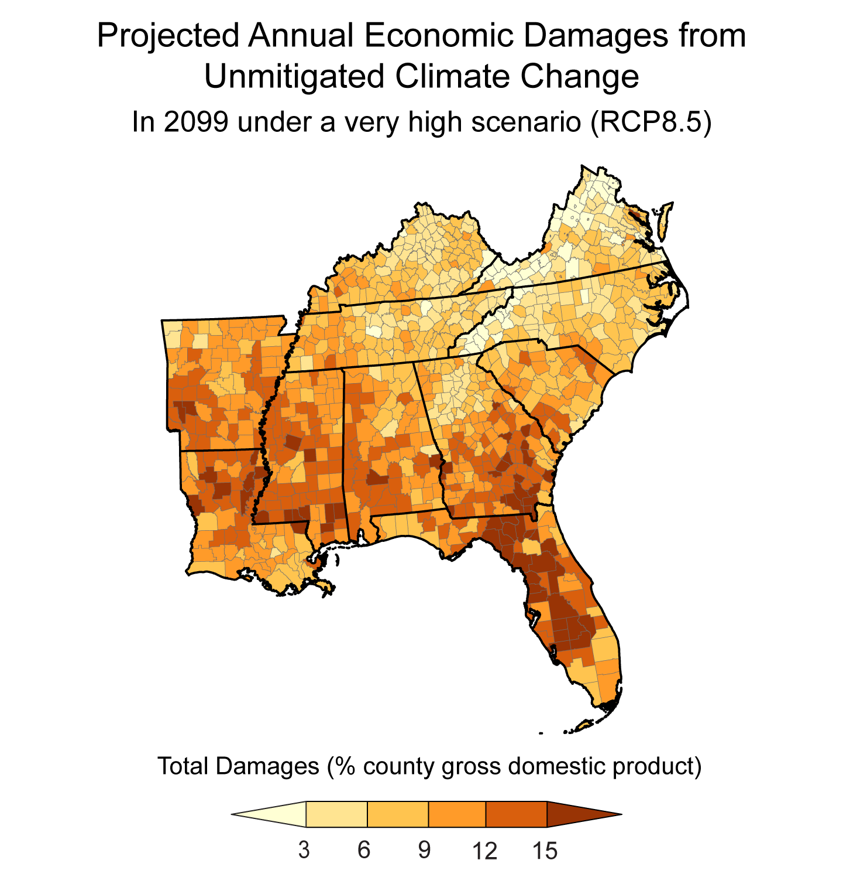
Figure 22.13. The Southeast region faces substantial economic risks from climate change impacts.
Notes:
CAPTION: Direct annual climate damages, as measured by the percent of county GDP, are projected to be especially large in the Southeast. The map shows damages under a very high scenario (RCP8.5) at the end of the century. Adapted from Hsiang et al. 2017.(Hsiang et al. 2017)

Slide 20
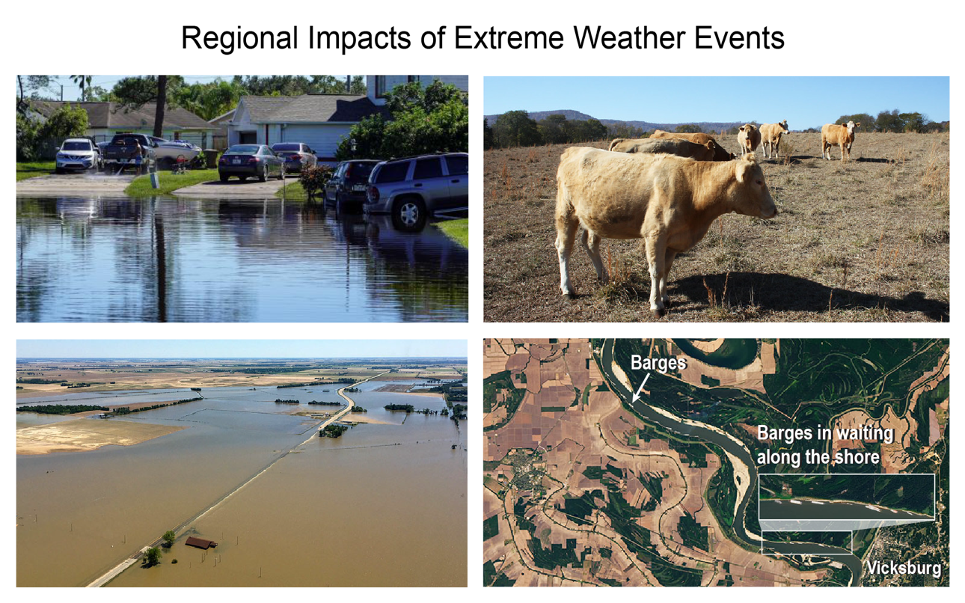
Figure 22.14. The Southeast is impacted by a wide variety of extreme weather events.
Notes:
CAPTION: The impacts of weather and climate extremes can be seen in photos from the Southeast (clockwise from top left): A flooded neighborhood in Kissimmee, Florida, is shown after Hurricane Ian (2022), which heavily impacted local livelihoods. Drought conditions in Alabama (2016) directly impacted farmers’ incomes and potentially increased prices for customers. Regional drought-induced low-flow conditions on the Mississippi River caused barges and towboats to become stranded for several days (2022). Flood damage in northeast Arkansas impacted transportation infrastructure and crops and may have impacted supply chains (2017). Image credits: (top left) Robert Kaufmann/FEMA, DHS; (top right) Bruce Dupree, Alabama Extension [CC0 1.0]; (bottom left) Sonny Perdue, USDA; (bottom right) adapted from NASA Earth Observatory.

Slide 21
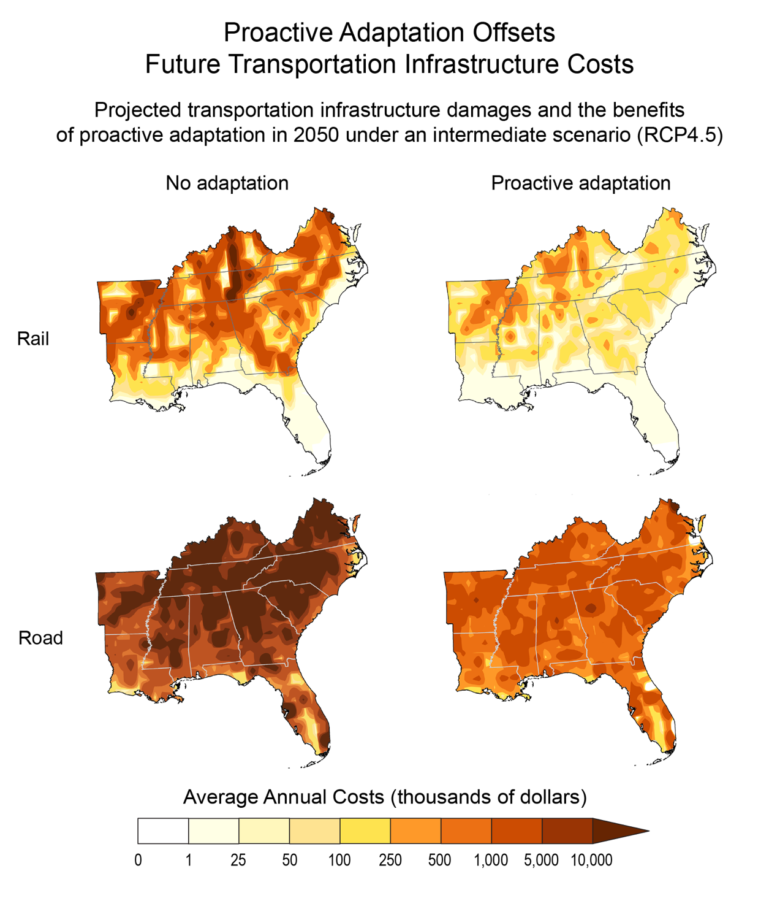
Figure 22.15. Proactive adaptation to climate change could save millions of dollars in future transportation infrastructure costs.
Notes:
CAPTION: Future climate change impacts (under RCP4.5) may cost US transportation infrastructure billions in damages by 2050, with especially high costs in the Southeast. The left panels show the additional annual average system costs (as compared to 1986–2005 in 2018 dollars) to rail infrastructure (top) and road networks (bottom) in 2050, assuming no adaptation. Proactive adaptation—anticipating climate risks and investing up front in strengthening these systems before damage occurs—could reduce significantly, but not eliminate, these costs (right panels). Proactive adaptation strategies include temperature sensors for railroad tracks and working to reduce disruption times for roads undergoing repairs. Adapted from Neumann et al. 2021(Neumann et al. 2021) [CC BY 4.0].

Slide 22
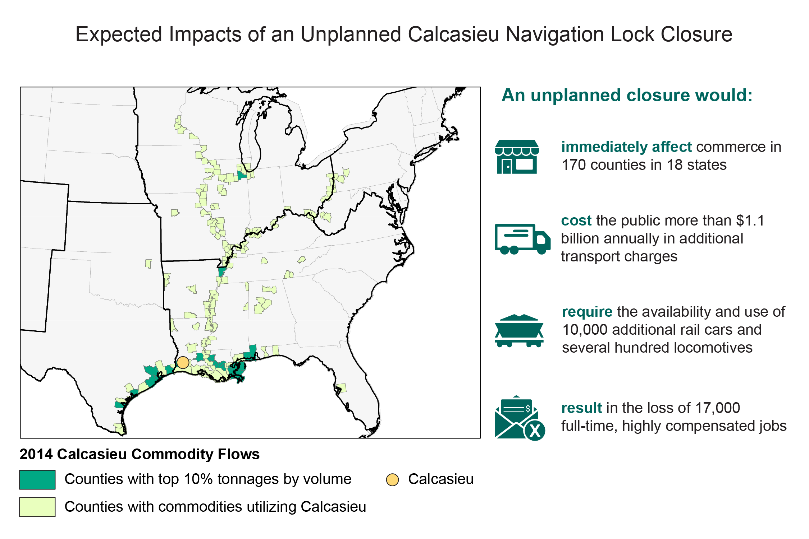
Figure 22.16. An unplanned closure of the Calcasieu Navigation Lock would have impacts that extend well beyond the Southeast.
Notes:
CAPTION: The commodity flow impacts associated with an unplanned shutdown of Calcasieu Lock extend well outside the Southeast, affecting 170 counties across 18 states. Weather and climate extremes such as regional drought and low-flow conditions on the Mississippi River can result in unplanned shutdowns of the Calcasieu Lock. Adapted with permission from ©Janey Camp, Vanderbilt University.

Slide 23
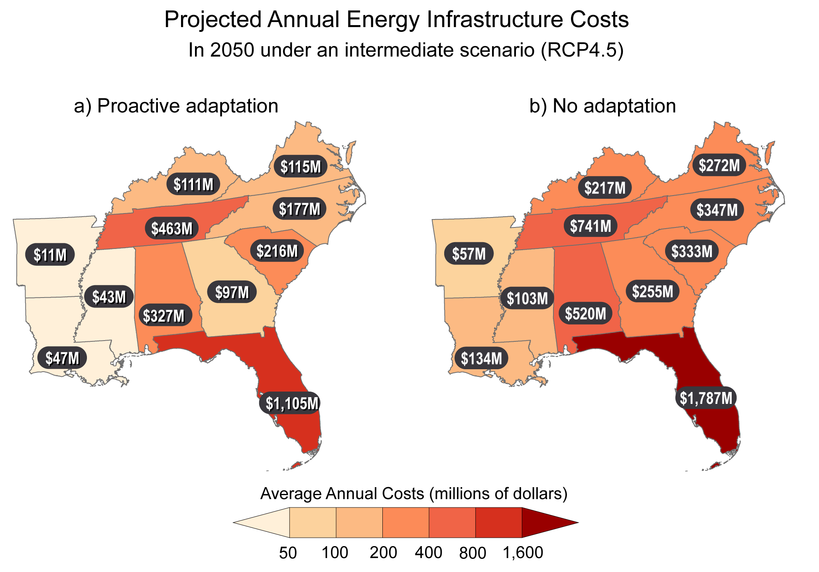
Figure 22.17. Proactively investing in strengthening our electrical infrastructure offsets significant future costs due to climate change damage.
Notes:
CAPTION: The Southeast faces some of the highest economic risks related to energy infrastructure damage without proactive adaptation measures in place—such as energy utilities and policymakers’ anticipating climate risks to electrical grid infrastructure and investing upfront in strengthening these systems in advance of any damages. As shown in the maps, in 2050 under an intermediate scenario (RCP4.5), proactive adaptation (a) could save as much as twice the total costs (in 2017 dollars) of no adaptation (b). These costs could be passed onto consumers. Adapted from Fant et al. 2020(Fant et al. 2020) [CC BY 4.0].

Slide 24
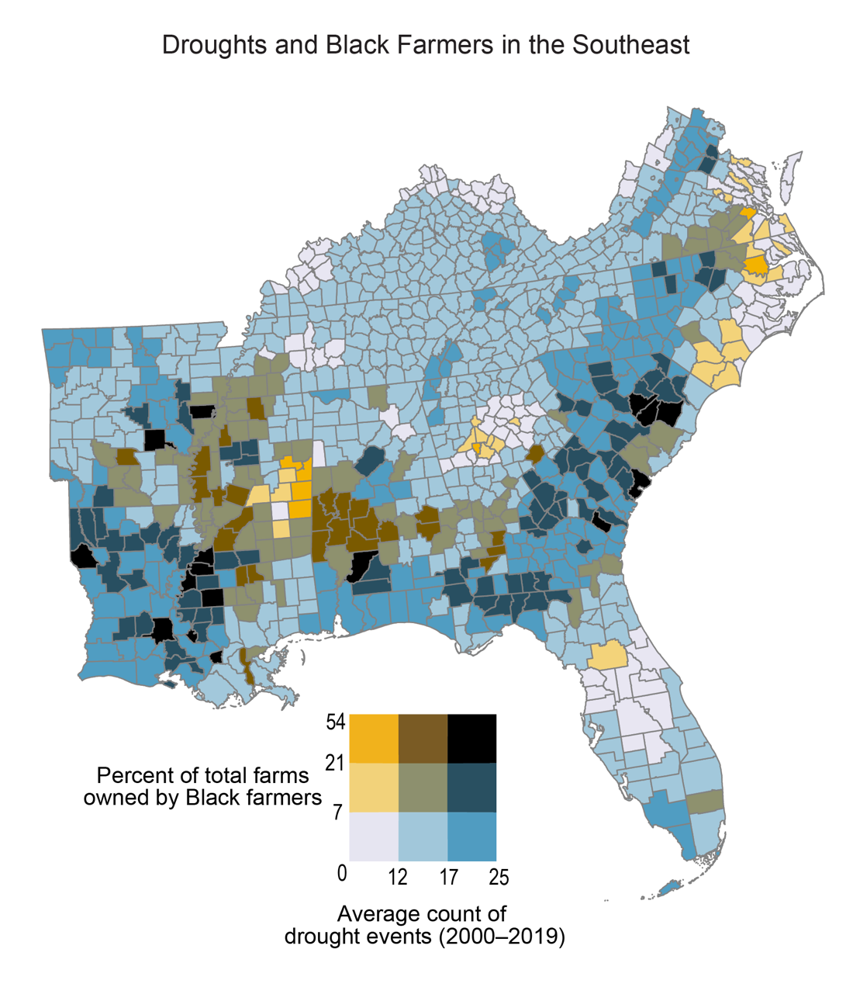
Figure 22.18. The Southeast’s Black farmers face disproportionate weather and climate risks.
Notes:
CAPTION: In the Southeast, areas with a higher number of drought events from 2000 through 2019 often overlapped with counties that are home to relatively higher proportions of Black producers, as identified in the 2017 USDA Census of Agriculture. The Southeast has the highest proportion of Black producers when compared to any other National Climate Assessment region, highlighting how disparities in climate risks require innovation and equitable adaptation, especially for those producers who have smaller operations and fewer resources to adopt new technologies. Figure credit: Groundwork USA, University of Georgia, NOAA NCEI, and CISESS NC.

Slide 25
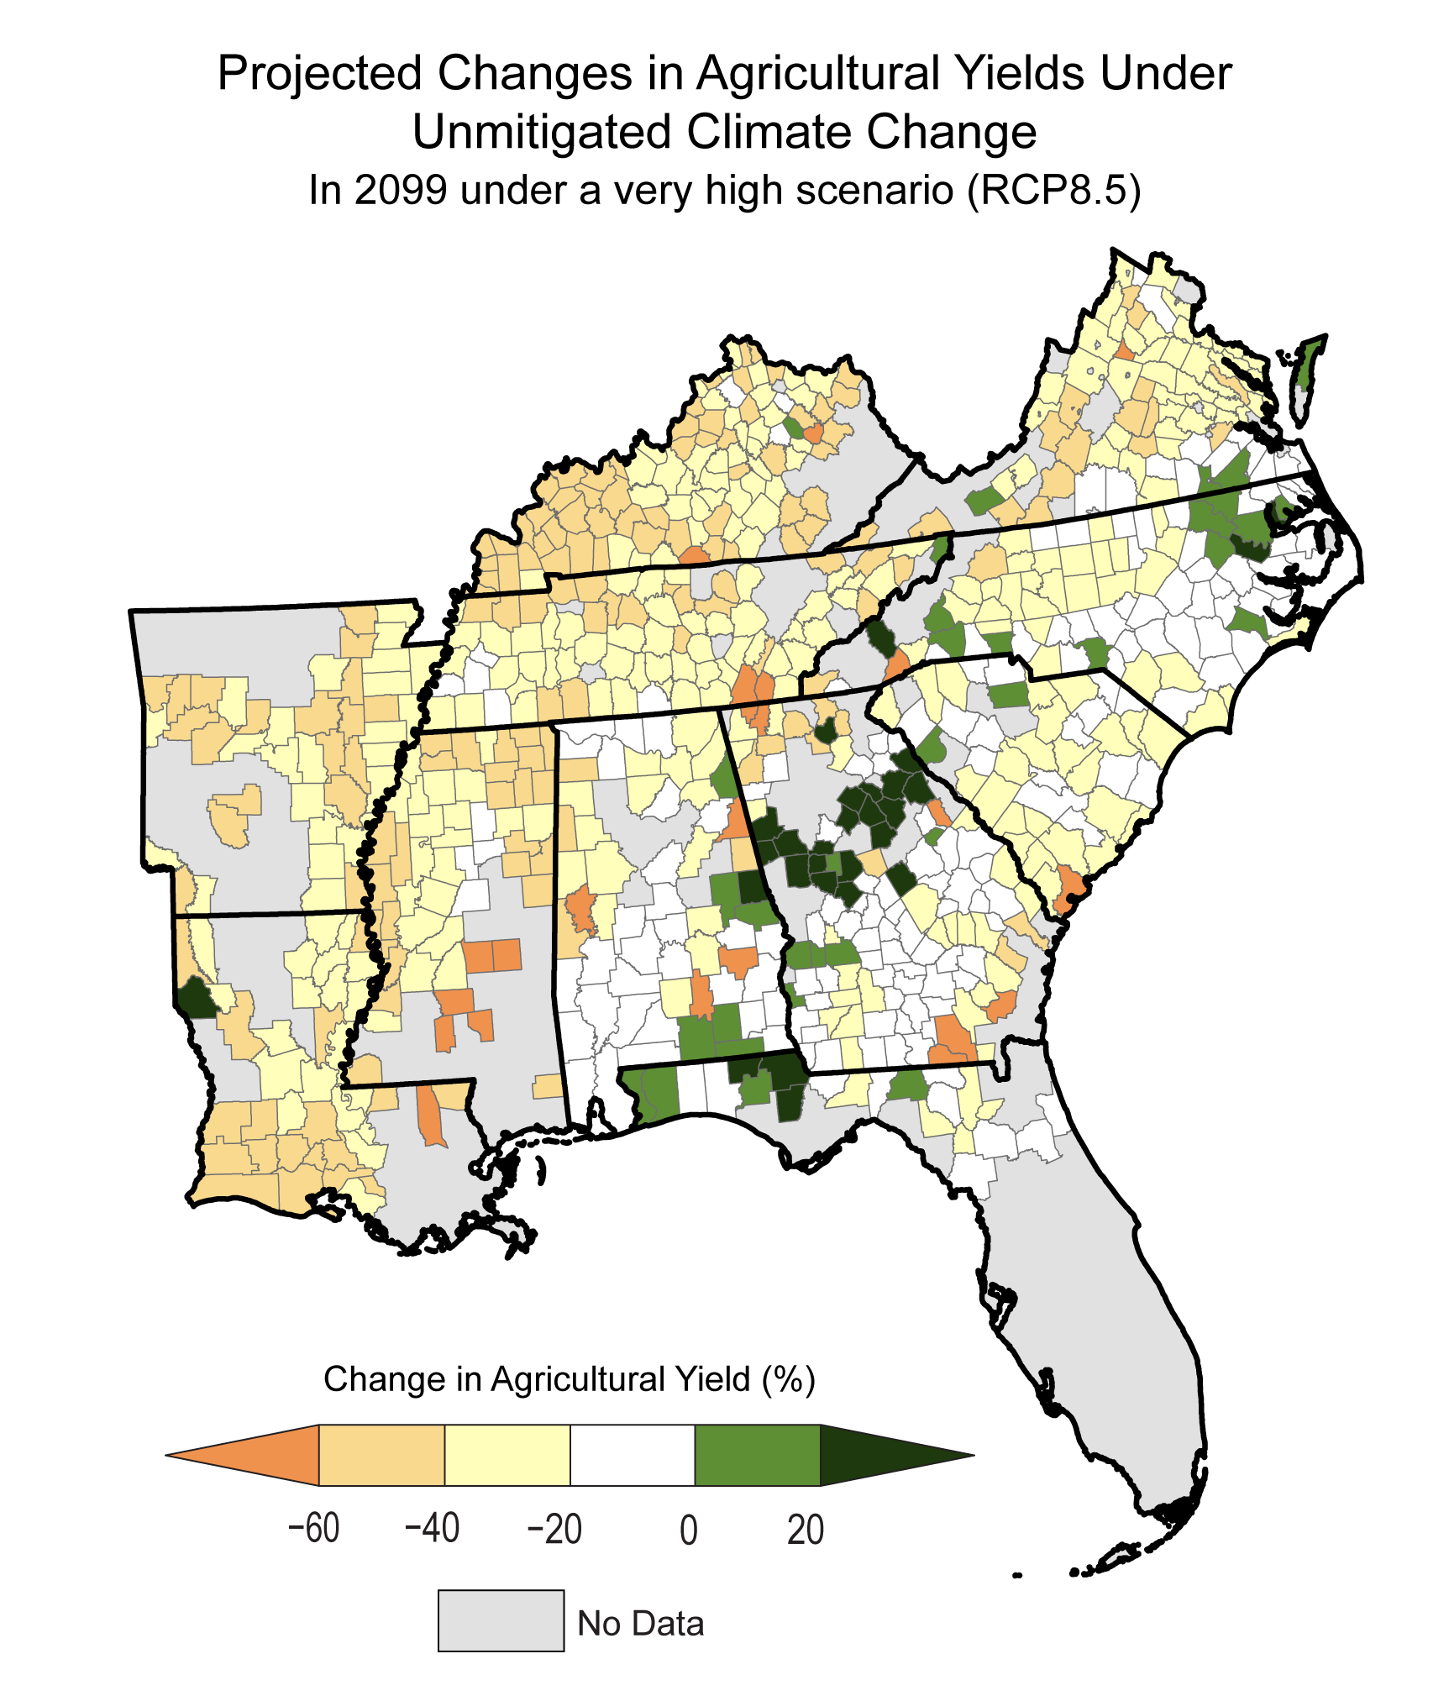
Figure 22.19. Agricultural yields are expected to decrease under very high warming.
Notes:
CAPTION: Agricultural yields (area-weighted average for corn, wheat, soybeans, and cotton) in the Southeast are expected to decrease due to the warmer climate in the future by 2099 under a very high scenario (RCP8.5). Some areas, however, may see yield increases due to less severe climate changes in these places, as well as limited impacts due to sea level rise and tropical storm damage. Decreases in crop yield are expected to negatively impact regional and national food supplies while threatening agricultural lifestyles and traditions. Adapted from Hsiang et al. 2017.(Hsiang et al. 2017)

Slide 26
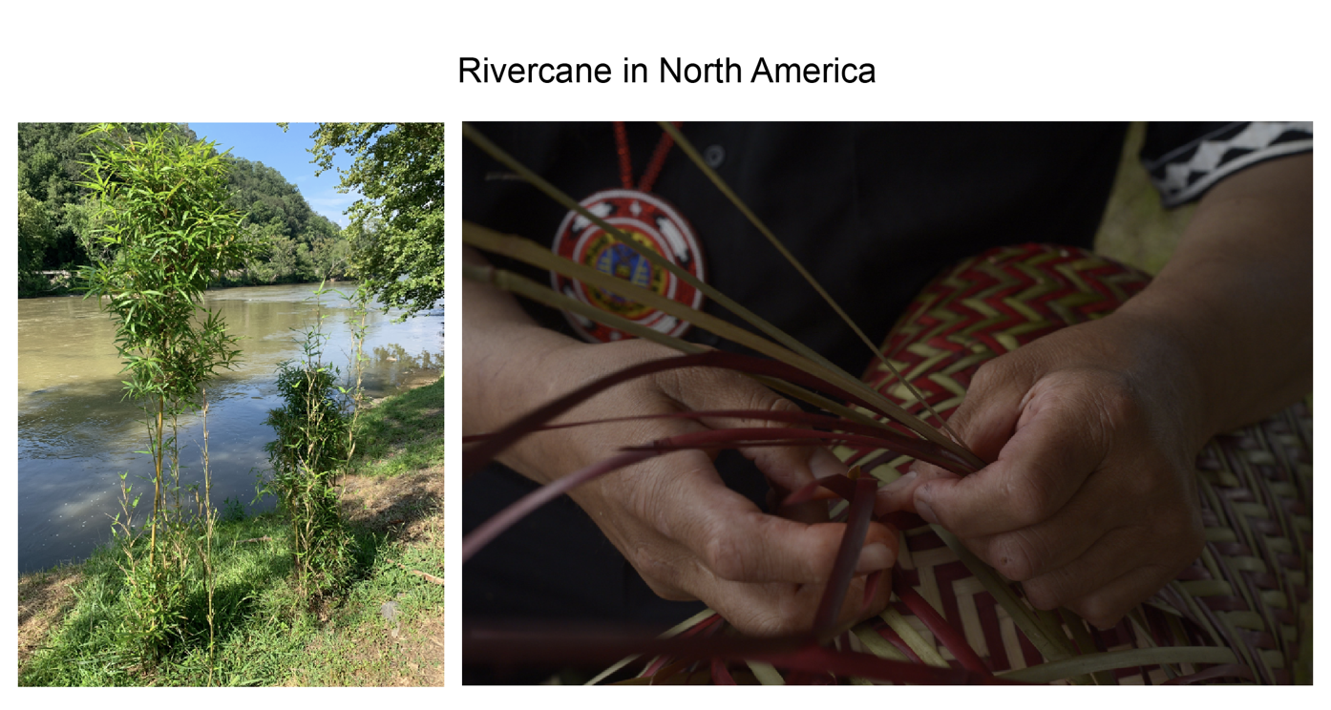
Figure 22.20. Rivercane, a native bamboo, is culturally important to many Tribes in the Southeast.
Notes:
CAPTION: (left) Rivercane grows by the French Broad River in Buncombe County, North Carolina. (right) Basket weaver Ramses King (Mississippi Band of Choctaw Indians) creates a “double-weave” basket (2014). The significantly reduced range of rivercane, largely due to land cover changes and agriculture, is now further threatened by invasive species that are thriving under climate change. Photo credits: (left) © Adam Griffith, Revitalization of Traditional Cherokee Artisan Resources; (right) Lance Cheung, USDA.

Slide 27
Federal Coordinating Lead Author
Steven G. McNulty, USDA Forest Service
Chapter Lead
Jeremy S. Hoffman, Groundwork USA
Chapter Authors
Claudia Brown, Centers for Disease Control and Prevention
Kathie D. Dello, North Carolina State University, State Climate Office of North Carolina
Pamela N. Knox, University of Georgia
Aranzazu Lascurain, National Oceanic and Atmospheric Administration
Carl Mickalonis, Federal Emergency Management Agency
Gary T. Mitchum, University of South Florida, College of Marine Science
Louie Rivers III, US Environmental Protection Agency
Marie Schaefer, US Geological Survey, Southeast Climate Adaptation Science Center
Gavin P. Smith, North Carolina State University
Janey Smith Camp, Vanderbilt University
Kimberly M. Wood, Mississippi State University
Technical Contributors
William D. Bryan, Southeast Energy Efficiency Alliance
Ryan E. Emanuel, Duke University
Adam D. Griffith, North Carolina State University
Dionne L. Hoskins-Brown, NOAA Fisheries, Southeast Fisheries Science Center
Solomon Hsiang, University of California, Berkeley
Evan Mallen, Georgia Institute of Technology, Urban Climate Lab
Megan McLaughlin, Oak Ridge Institute for Science and Education
William Sweet, NOAA National Ocean Service
Peter E. Thornton, Oak Ridge National Laboratory
Aaron van Donkelaar, Washington University in St. Louis
Review Editor
Tisha Joseph Holmes, Florida State University
USGCRP Coordinators
Allyza R. Lustig, US Global Change Research Program / ICF
Joshua Hernandez, US Global Change Research Program / ICF

Slide 28
Hoffman, J.S., S.G. McNulty, C. Brown, K.D. Dello, P.N. Knox, A. Lascurain, C. Mickalonis, G.T. Mitchum, L. Rivers III, M. Schaefer, G.P. Smith, J.S. Camp, and K.M. Wood, 2023: Ch. 22. Southeast. In: Fifth National Climate Assessment. Crimmins, A.R., C.W. Avery, D.R. Easterling, K.E. Kunkel, B.C. Stewart, and T.K. Maycock, Eds. U.S. Global Change Research Program, Washington, DC, USA. https://doi.org/10.7930/NCA5.2023.CH22
https://nca2023.globalchange.gov/chapter/22

