Slide 1
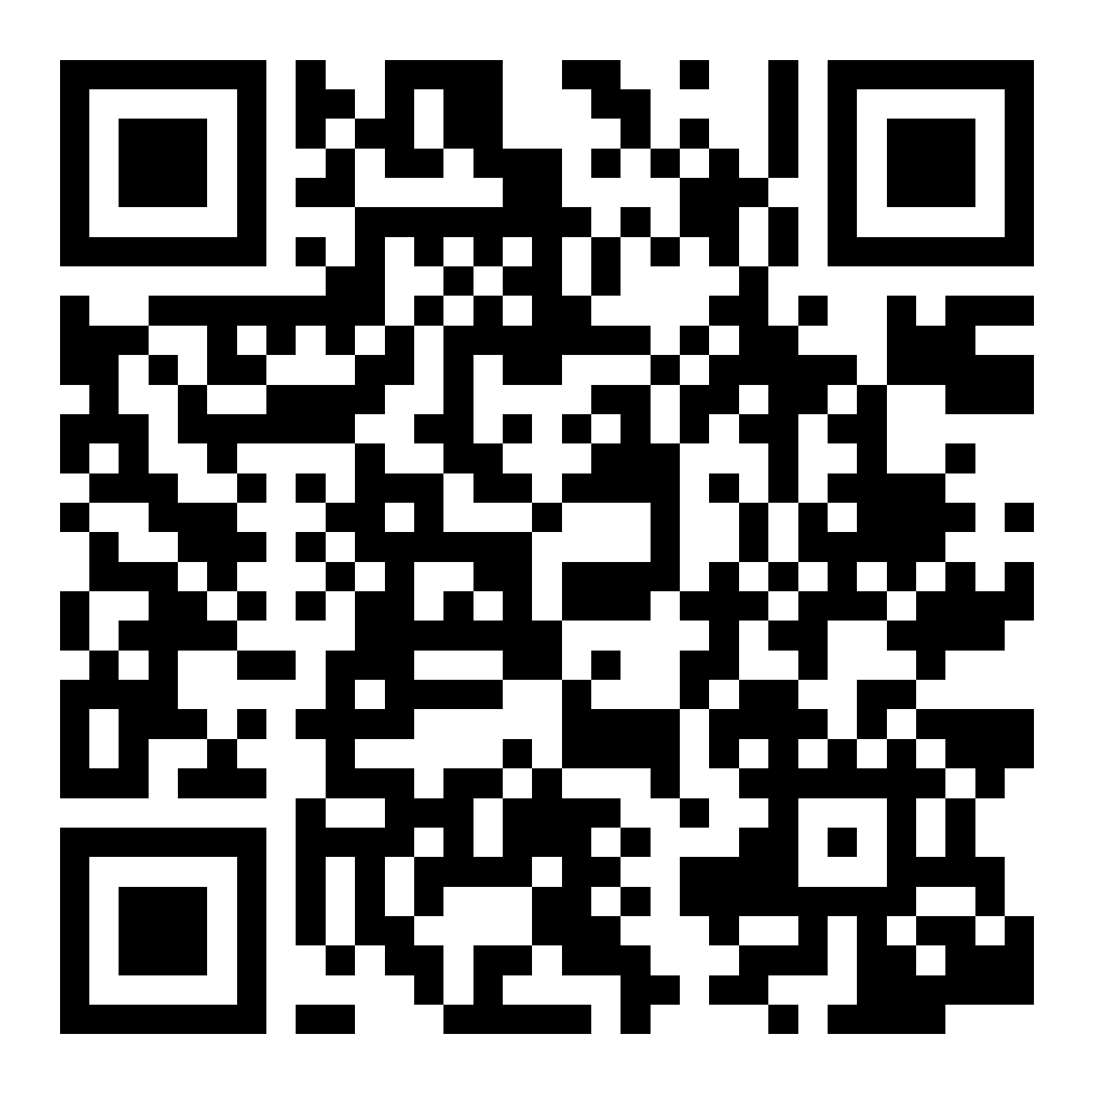
NCA5 Website: https://nca2023.globalchange.gov
Chapter Website: https://nca2023.globalchange.gov/chapter/26
NCA5 Atlas: https://atlas.globalchange.gov
Figure captions can be found in the slide notes of this deck
Social media: @usgcrp, #NCA5

Slide 2
Chapter 26 | Southern Great Plains

Slide 3
1
How We Live: Climate Change Is Degrading Lands, Waters, Culture, and Health
Climate change is beginning to alter how we live in the Southern Great Plains, putting us at risk from climate hazards that degrade our lands and waters, quality of life, health and well-being, and cultural interconnectedness (high confidence). Many climate hazards are expected to become more frequent, intense, or prolonged; to broaden in spatial extent; and to result in more people experiencing costly, deadly, or stressful climate-related conditions (very likely, high confidence). To address the growing risk, effective climate-resilient actions include implementing nature-based solutions; valuing Indigenous, traditional, and local knowledges; and infusing climate change solutions into community planning (medium confidence).

Slide 4
2
How We Work: Climate Changes Are Creating Economic Challenges and Opportunities
As climate conditions change, businesses and industries across the Southern Great Plains are experiencing disruptions and losses in productivity and profits—but also new economic opportunities (high confidence). In coming decades, warmer temperatures, more erratic precipitation, and sea level rise are expected to force widespread and costly changes in how we work (very likely, high confidence). Businesses and industries have opportunities to harness their diverse knowledge, resources, and workers to develop products and services in climate mitigation technologies, adaptation strategies, and resilient design that will enhance the region’s economy (medium confidence).

Slide 5
3
How We Play: Climate Extremes Are Endangering Sports, Recreation, and Leisure
Extreme climate-related events are negatively influencing how we play and participate in outdoor sport, recreation, and physical activities in the Southern Great Plains (very high confidence). Climate change is expected to increase heat-related illness and death, reduce outdoor physical activity, and decrease athletic performance (very likely, high confidence). Individuals, communities, and sports organizations can adapt to these hazards through strategies such as modifying the timing, location, intensity, or monitoring of activities (high confidence).

Slide 6
4
How We Heal: Climate Change Is Exacerbating Existing Social and Environmental Disparities
Some neighborhoods and communities in the Southern Great Plains are suffering disproportionately from climate-related hazards because of long-standing marginalization, discrimination, and governmental policies (very high confidence). As a result, climate change will compound existing social and environmental burdens on the people, neighborhoods, and communities with the fewest resources to prepare and adapt (very high confidence). Our institutions and governments can play a role in improving outcomes for these people and places by adopting climate adaptation and hazard-mitigation practices and policies that prioritize social equity and justice, aim to reduce community risks, build resilience, and repair past injustices (medium confidence).

Slide 7
5
How We Serve: Climate Change Is Straining Public Infrastructure and Services
The institutions that serve our communities have been challenged to respond and adapt to more frequent and intense weather events (medium confidence). Without significant adaptation, climate change is expected to strain water supplies, transportation infrastructure, and emergency services across the Southern Great Plains (high confidence). Actions that can enhance our community resilience include substantially reducing greenhouse gas emissions, installing or retrofitting climate-resilient infrastructure, educating students and the public on climate change, and cultivating the capacity of faith- and volunteer-based aid organizations to assist hazard planning, response, and recovery (medium confidence).

Slide 8
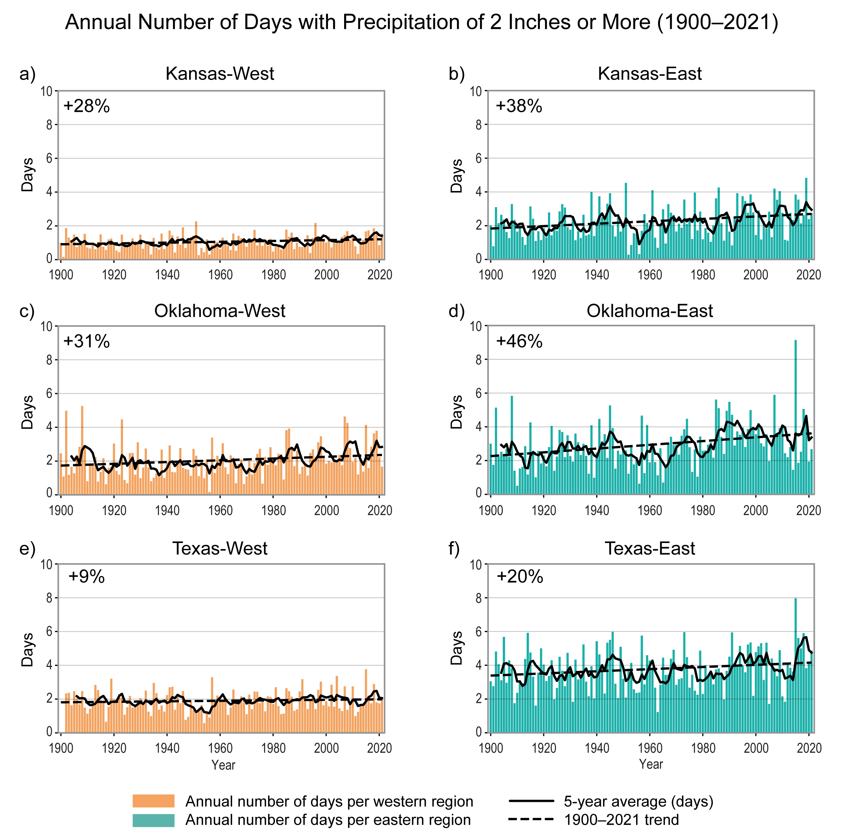
Figure 26.1. The frequency of days with precipitation of 2 inches or more has increased across the Southern Great Plains.
Notes:
CAPTION: These graphs show the annual number of days (colored bars) with daily precipitation of 2 inches or more from 1900 to 2021 in (a) western Kansas (28% increase for the long-term, linear trend), (b) eastern Kansas (38% increase), (c) western Oklahoma (31% increase), (d) eastern Oklahoma (46% increase), (e) western Texas (9% increase), and (f) eastern Texas (20% increase). (Station data were unavailable for 1900 and 1901 in western Texas.) Solid black lines show five-year averages; dashed black lines denote the 1900–2021 trend. The number of days has been highly variable from year to year, with fewer 2-inch events in the west (gold bars) on average than in the east (green bars; divided at 97.5° west, near Wichita, Oklahoma City, Fort Worth, and Corpus Christi). Days with precipitation of 2 inches or more have increased in all six regions. Figure credit: NOAA NCEI and CISESS NC.

Slide 9
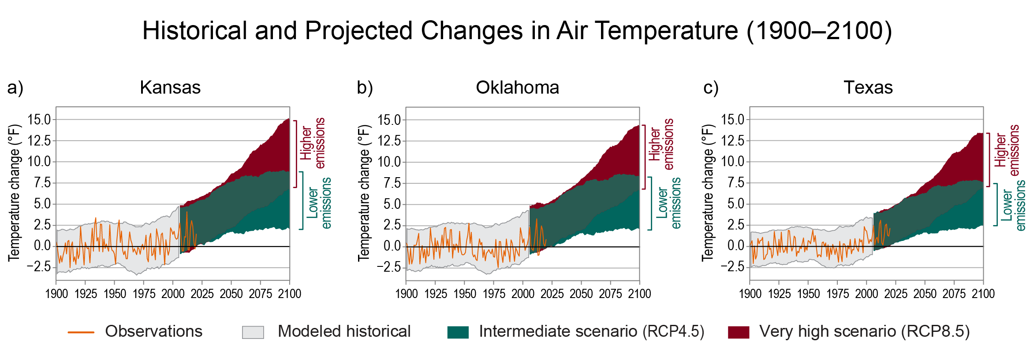
Figure 26.2. Air temperatures for Kansas, Oklahoma, and Texas are projected to be historically unprecedented by the end of the century.
Notes:
CAPTION: These graphs show observed and projected changes (compared to the 1901–1960 average; thick black line) in near-surface air temperature for (a) Kansas, (b) Oklahoma, and (c) Texas. Annual average temperature observations (orange line) are plotted with the range of temperatures from climate model output (light gray shading) for the historical period. The overlap of observed and modeled temperatures indicates that the models represent the region’s climate reasonably well. Climate projections out to 2100 use an intermediate scenario (RCP4.5; green shading) and a very high scenario (RCP8.5; red shading), showing a range of possible future temperatures. Results from both scenarios indicate substantial warming in Kansas, Oklahoma, and Texas by midcentury and historically unprecedented warming by the end of the century. (a, b) Adapted from Frankson et al. 2022(Frankson et al. 2022) and Frankson et al. 2022;(Frankson et al. 2022) (c) adapted from Runkle et al. 2022.(Runkle et al. 2022)

Slide 10
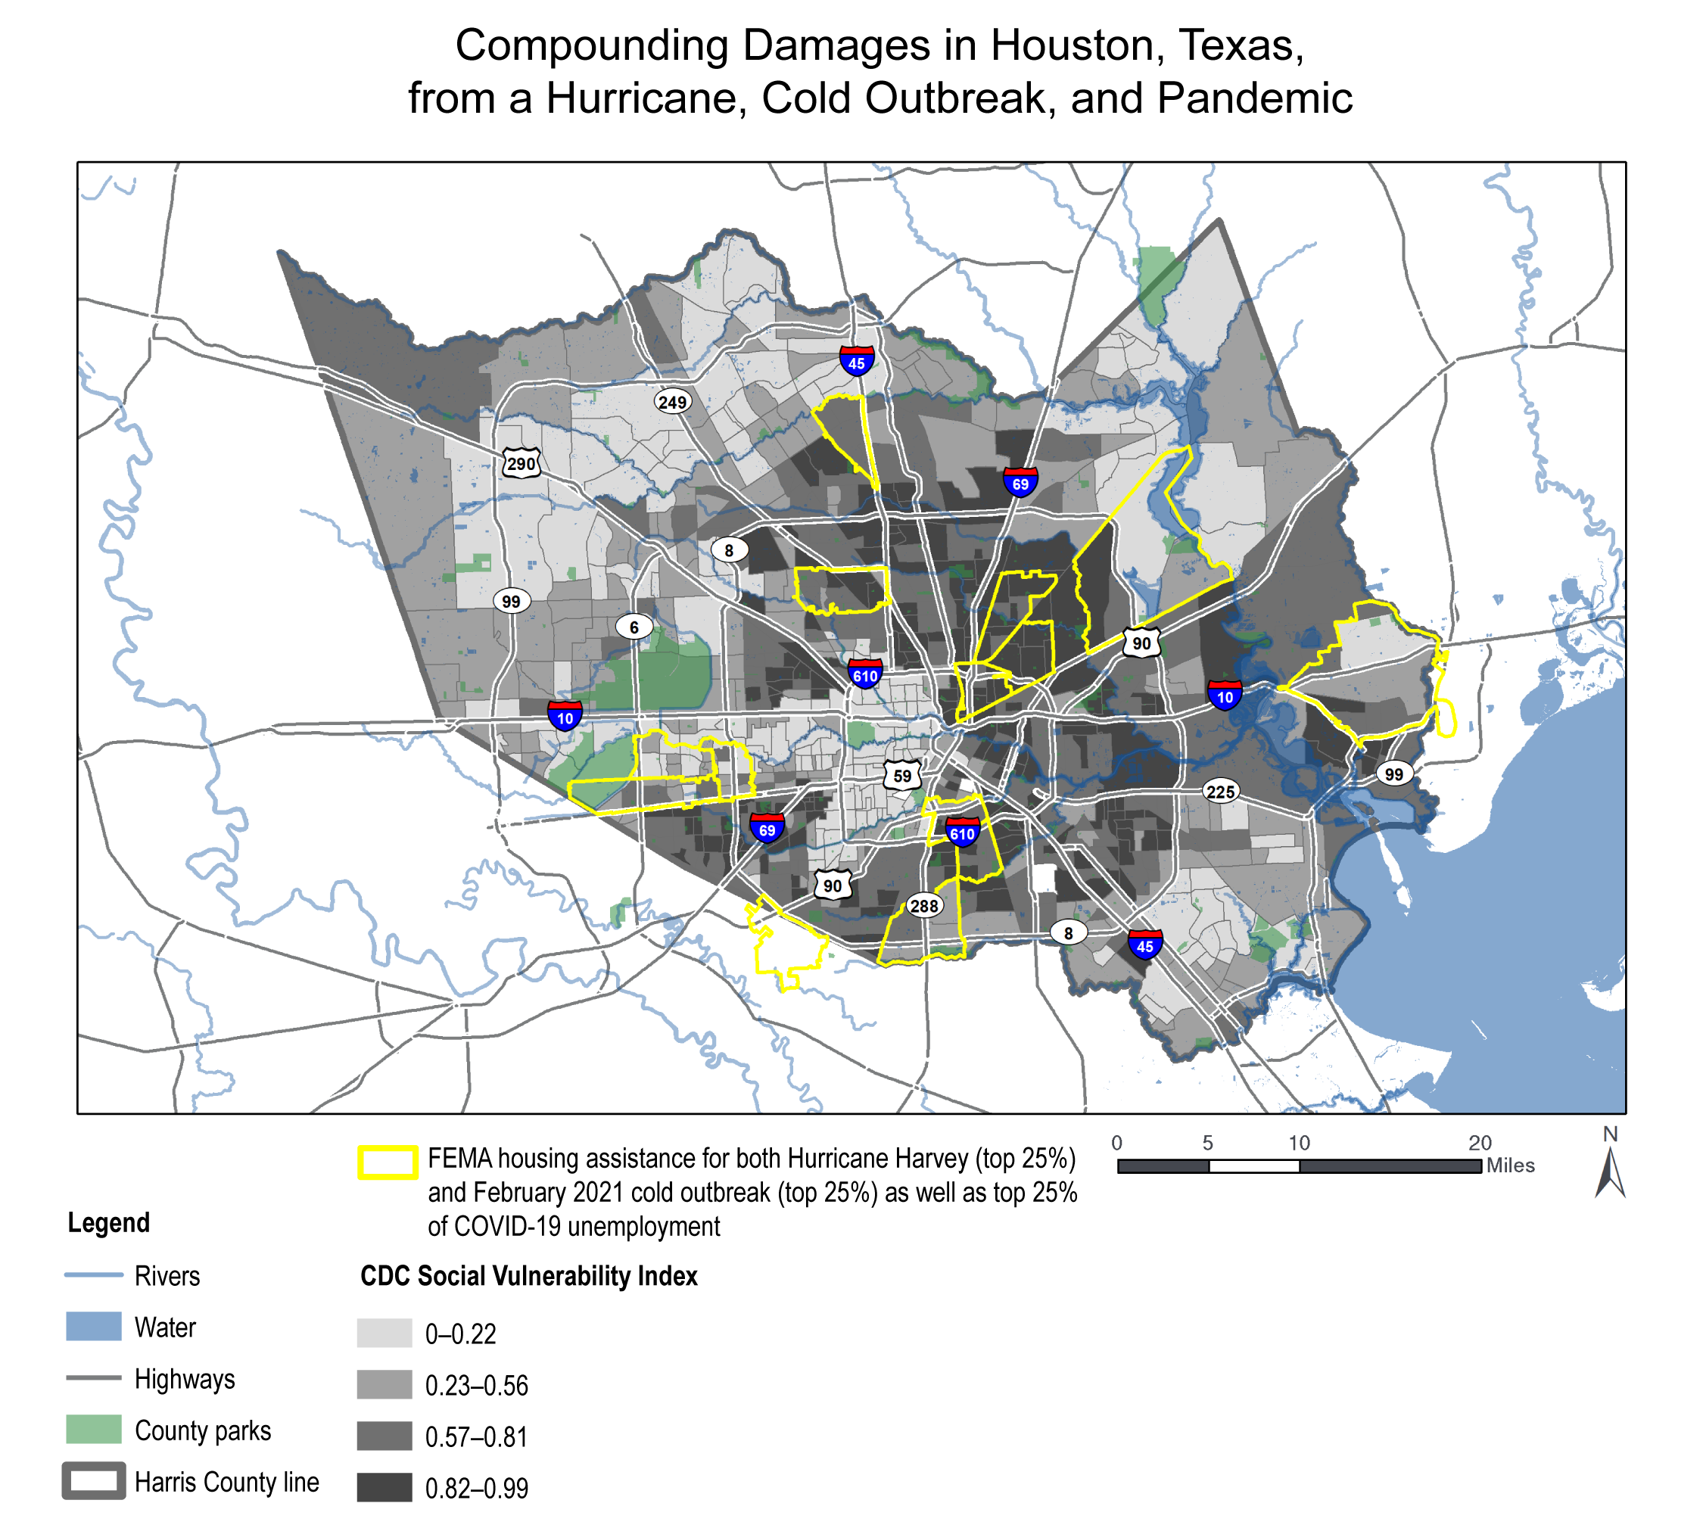
Figure 26.3. Damages from compounding events—a hurricane, cold outbreak, and pandemic—disproportionately impacted socially vulnerable populations in Houston, Texas.
Notes:
CAPTION: Several areas in Houston (yellow outlines) that were most affected by Hurricane Harvey, the February 2021 cold outbreak (unofficially named “Uri”), and COVID-19 unemployment coincided with census blocks with high scores on the Social Vulnerability Index (SVI) from the CDC (darker gray shading). (The SVI measures 16 social factors that describe socioeconomic status, household characteristics, racial and ethnic status, housing type, and transportation access.) For the weather events, zip codes were ranked by number of valid registrants to FEMA’s Individual and Households Program for financial assistance; for COVID-19, zip codes were ranked by percentage of population claiming unemployment insurance due to COVID-19, according to Texas Workforce Commission data from May 2020 to June 2021. The zip codes in the top 25% by those metrics are outlined in yellow. Adapted from Map 5 of Rice University’s Kinder Institute for Urban Research 2022.(Rice University Kinder Institute for Urban Research 2022)

Slide 11
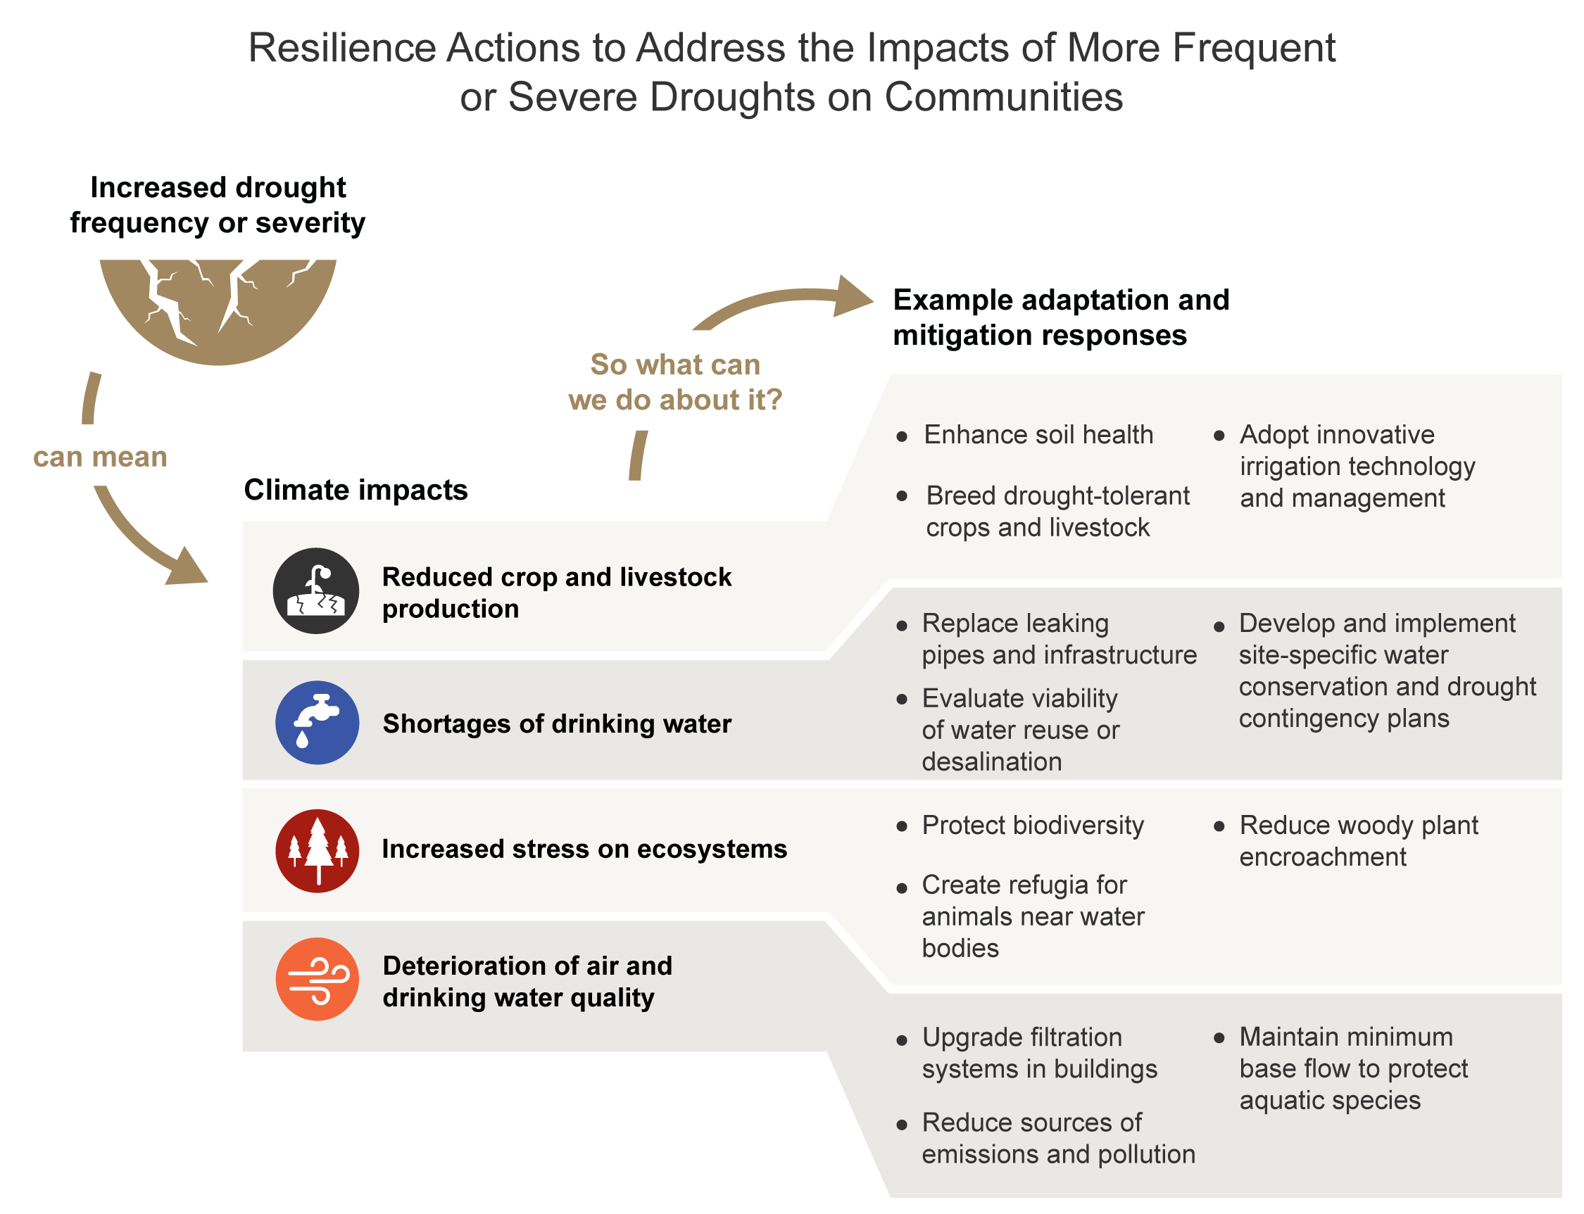
Figure 26.4. Resilience actions can help alleviate harmful consequences to communities of more frequent or severe drought.
Notes:
CAPTION: The increasing frequency or severity of drought has negative impacts on lands and waters across the Southern Great Plains, including reduced crop and livestock production, shortages of drinking water, increased stress on ecosystems, and deterioration of air and drinking water quality. The example adaptation and mitigation actions can increase resilience and reduce negative impacts. Figure credit: See figure metadata for contributors.

Slide 12
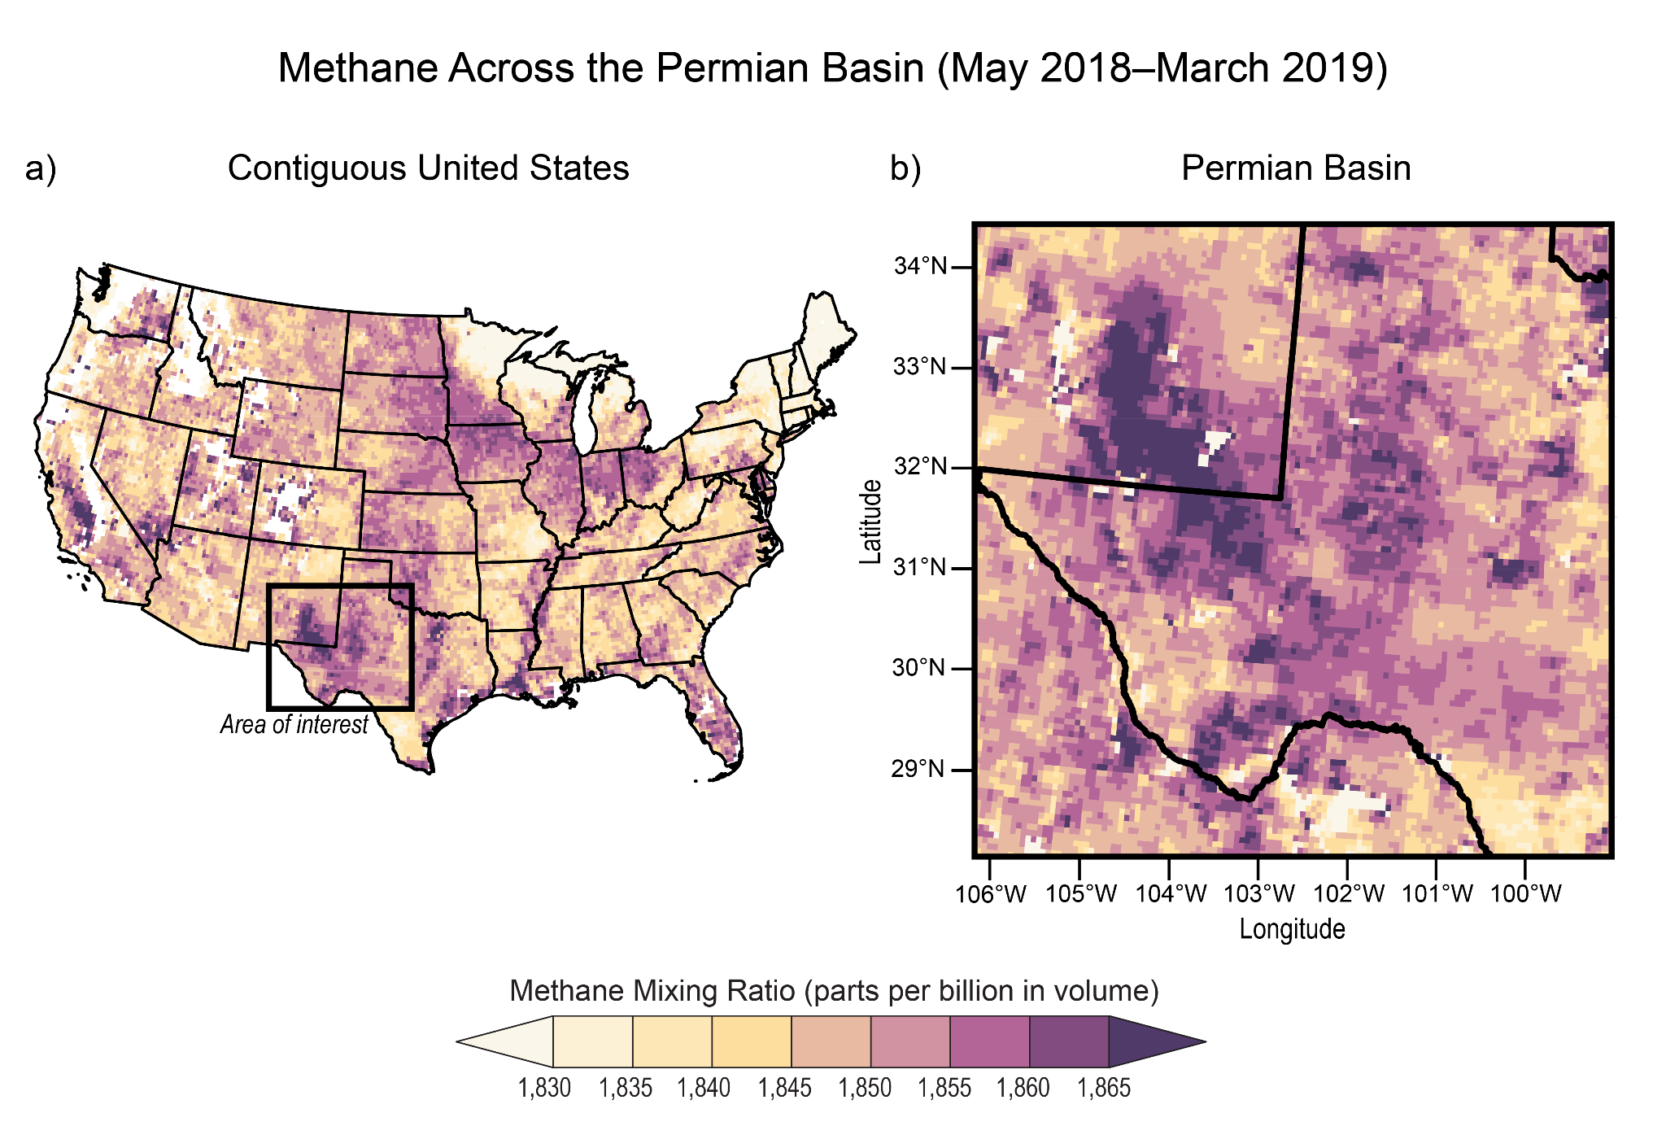
Figure 26.5. Natural gas operations in the Permian Basin leak large amounts of methane.
Notes:
CAPTION: The maps show satellite-estimated methane mixing ratio (in parts per billion by volume [ppbv]) across (a) the contiguous United States and (b) the Permian Basin (black box and inset map), averaged from May 2018 to March 2019. Mixing ratio is a measure of the concentration of a gas such as methane in the air. Darker shading represents higher methane mixing ratios; missing data are shaded white. Accounting for atmospheric transport, the spatial pattern of methane mixing ratio across the basin is closely associated with gross (before processing) natural gas production and, to a lesser extent, with oil production. (The original published source did not include data for Alaska, Hawaiʻi and the US-Affiliated Pacific Islands, and the US Caribbean.) Natural gas operations in the Permian Basin leak a large volume of methane, contributing to atmospheric warming. Adapted from Zhang et al. 2020 [CC BY-NC 4.0].

Slide 13
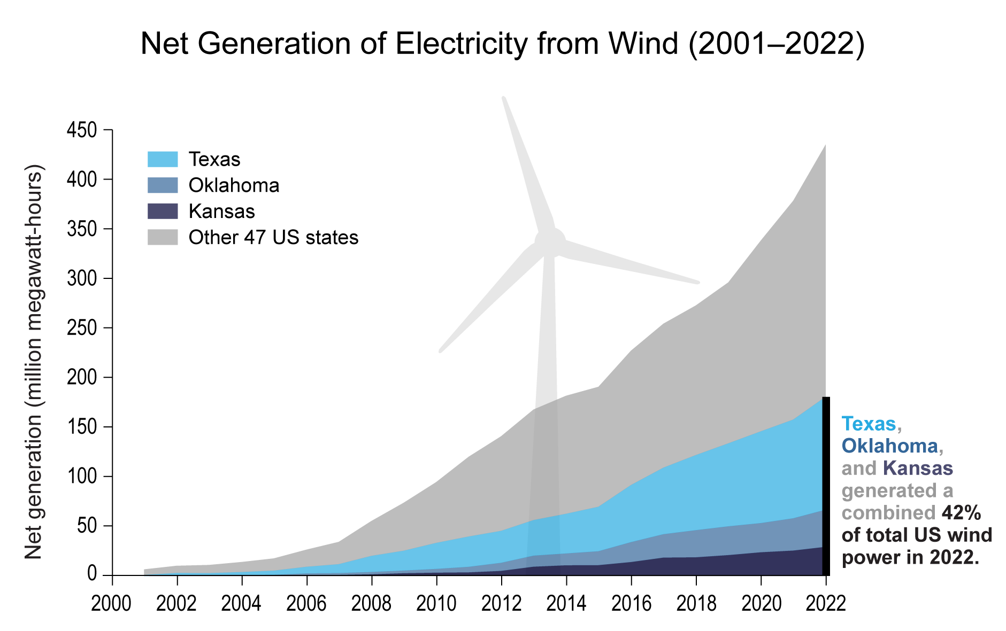
Figure 26.6. The Southern Great Plains contributes a large share to total US wind-generated electricity.
Notes:
CAPTION: US producers in the 50 states generated 435 million megawatt-hours of electricity from wind power in 2022. Together, Texas, Oklahoma, and Kansas contributed 159 million megawatt-hours, or 42% of total US production. Data were not available for the US-Affiliated Pacific Islands or the US Caribbean. Figure credit: See figure metadata for contributors.

Slide 14
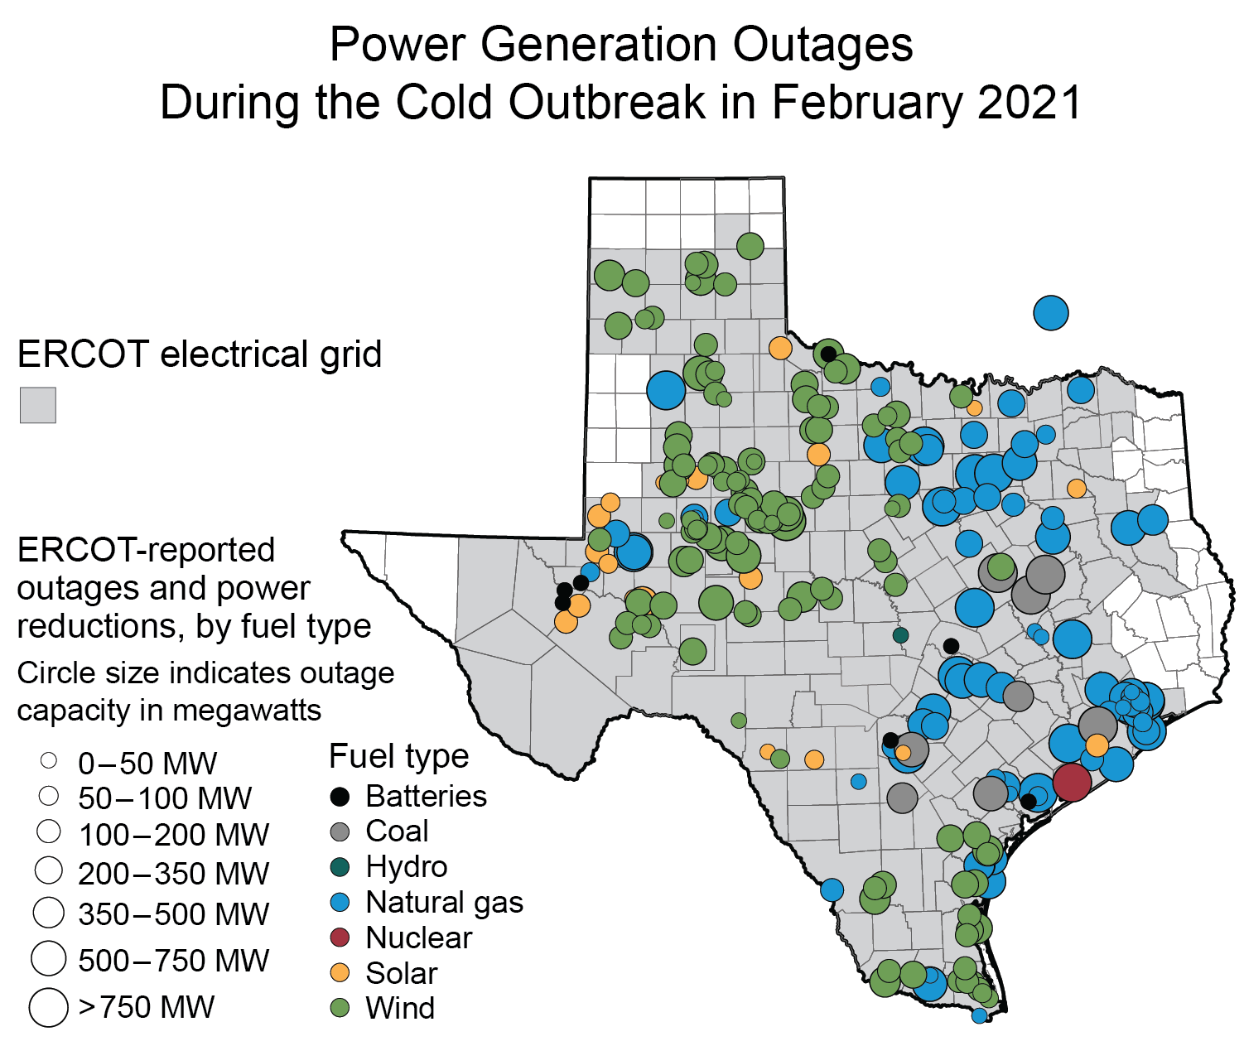
Figure 26.7. A severe cold outbreak in February 2021 led to extensive outages for electricity generation plants serving the Electric Reliability Council of Texas (ERCOT).
Notes:
CAPTION: The map shows the maximum outage or power reduction (in megawatts, MW) by location and fuel type for electricity generation facilities serving ERCOT during February 10–24, 2021, amid the cold outbreak across portions of the south-central US. Circles are colored by fuel type; larger circles represent larger values of maximum outage or power reduction. One generation facility is in Oklahoma. Shaded counties denote the ERCOT service area. In Texas alone, loss of generation capacity caused more than 4.5 million customers to be without power at some time during the cold outbreak.(FERC 2021) Figure credit: See figure metadata for contributors.

Slide 15
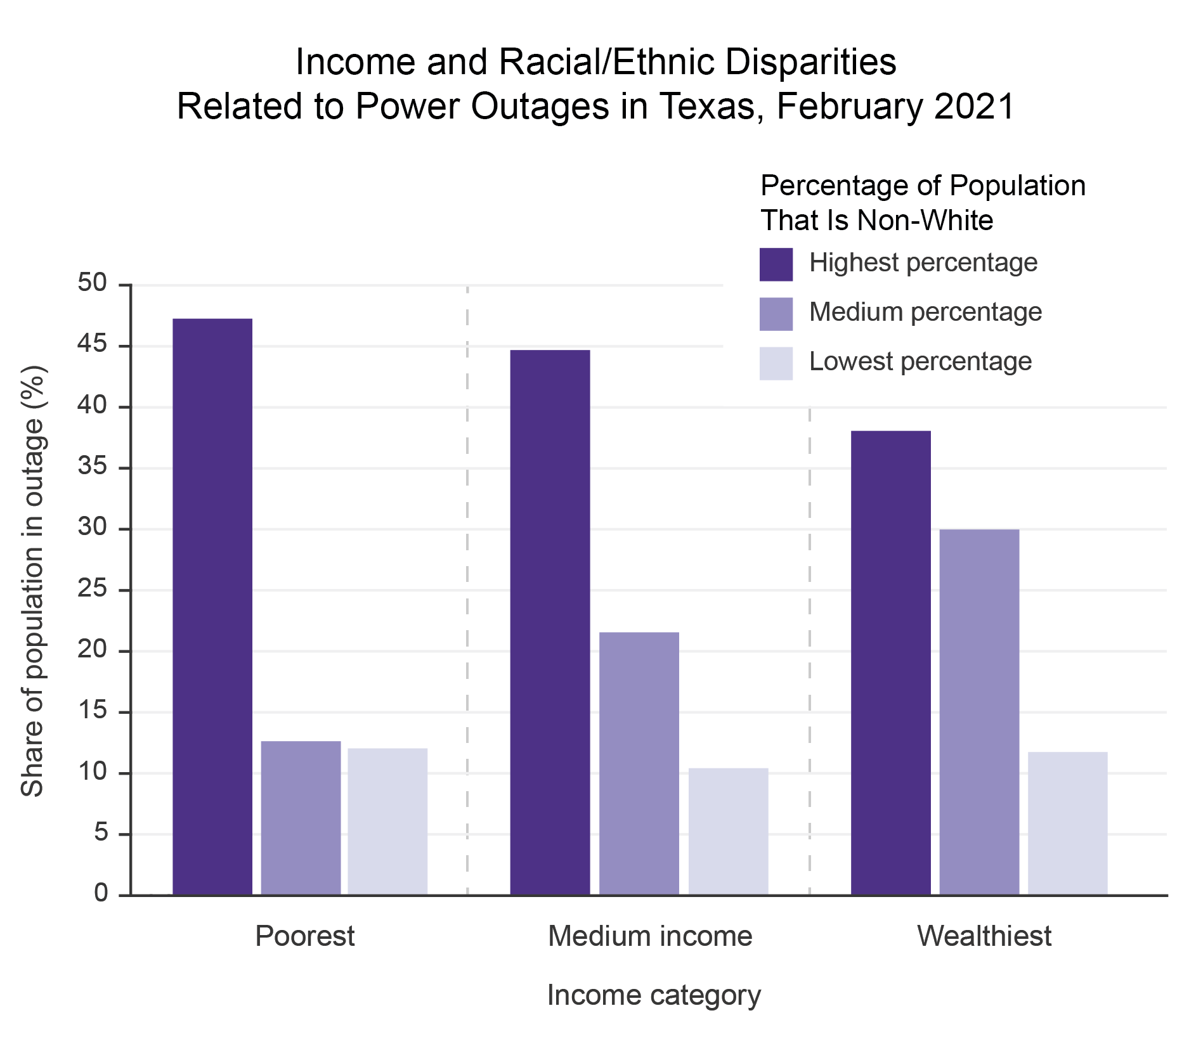
Figure 26.8. Regardless of income level, non-White populations experienced a disproportionate share of outages during the February 2021 cold outbreak.
Notes:
CAPTION: This graph shows the percentage of the Texas population that experienced power outages during the February 2021 cold outbreak based on income level (poorest, medium income, and wealthiest) and race/ethnicity (lowest, medium, and highest percentage of non-White people in the population) by census block group. Non-White people are those individuals whose race was listed as other than White alone or who list their ethnicity as Hispanic or Latino. Regardless of wealth status, data indicate that areas with the highest populations of non-White people were the most likely to be impacted by power outages due to long-standing marginalization. Adapted with permission from Carvallo et al. 2021.(Carvallo et al. 2021)

Slide 16
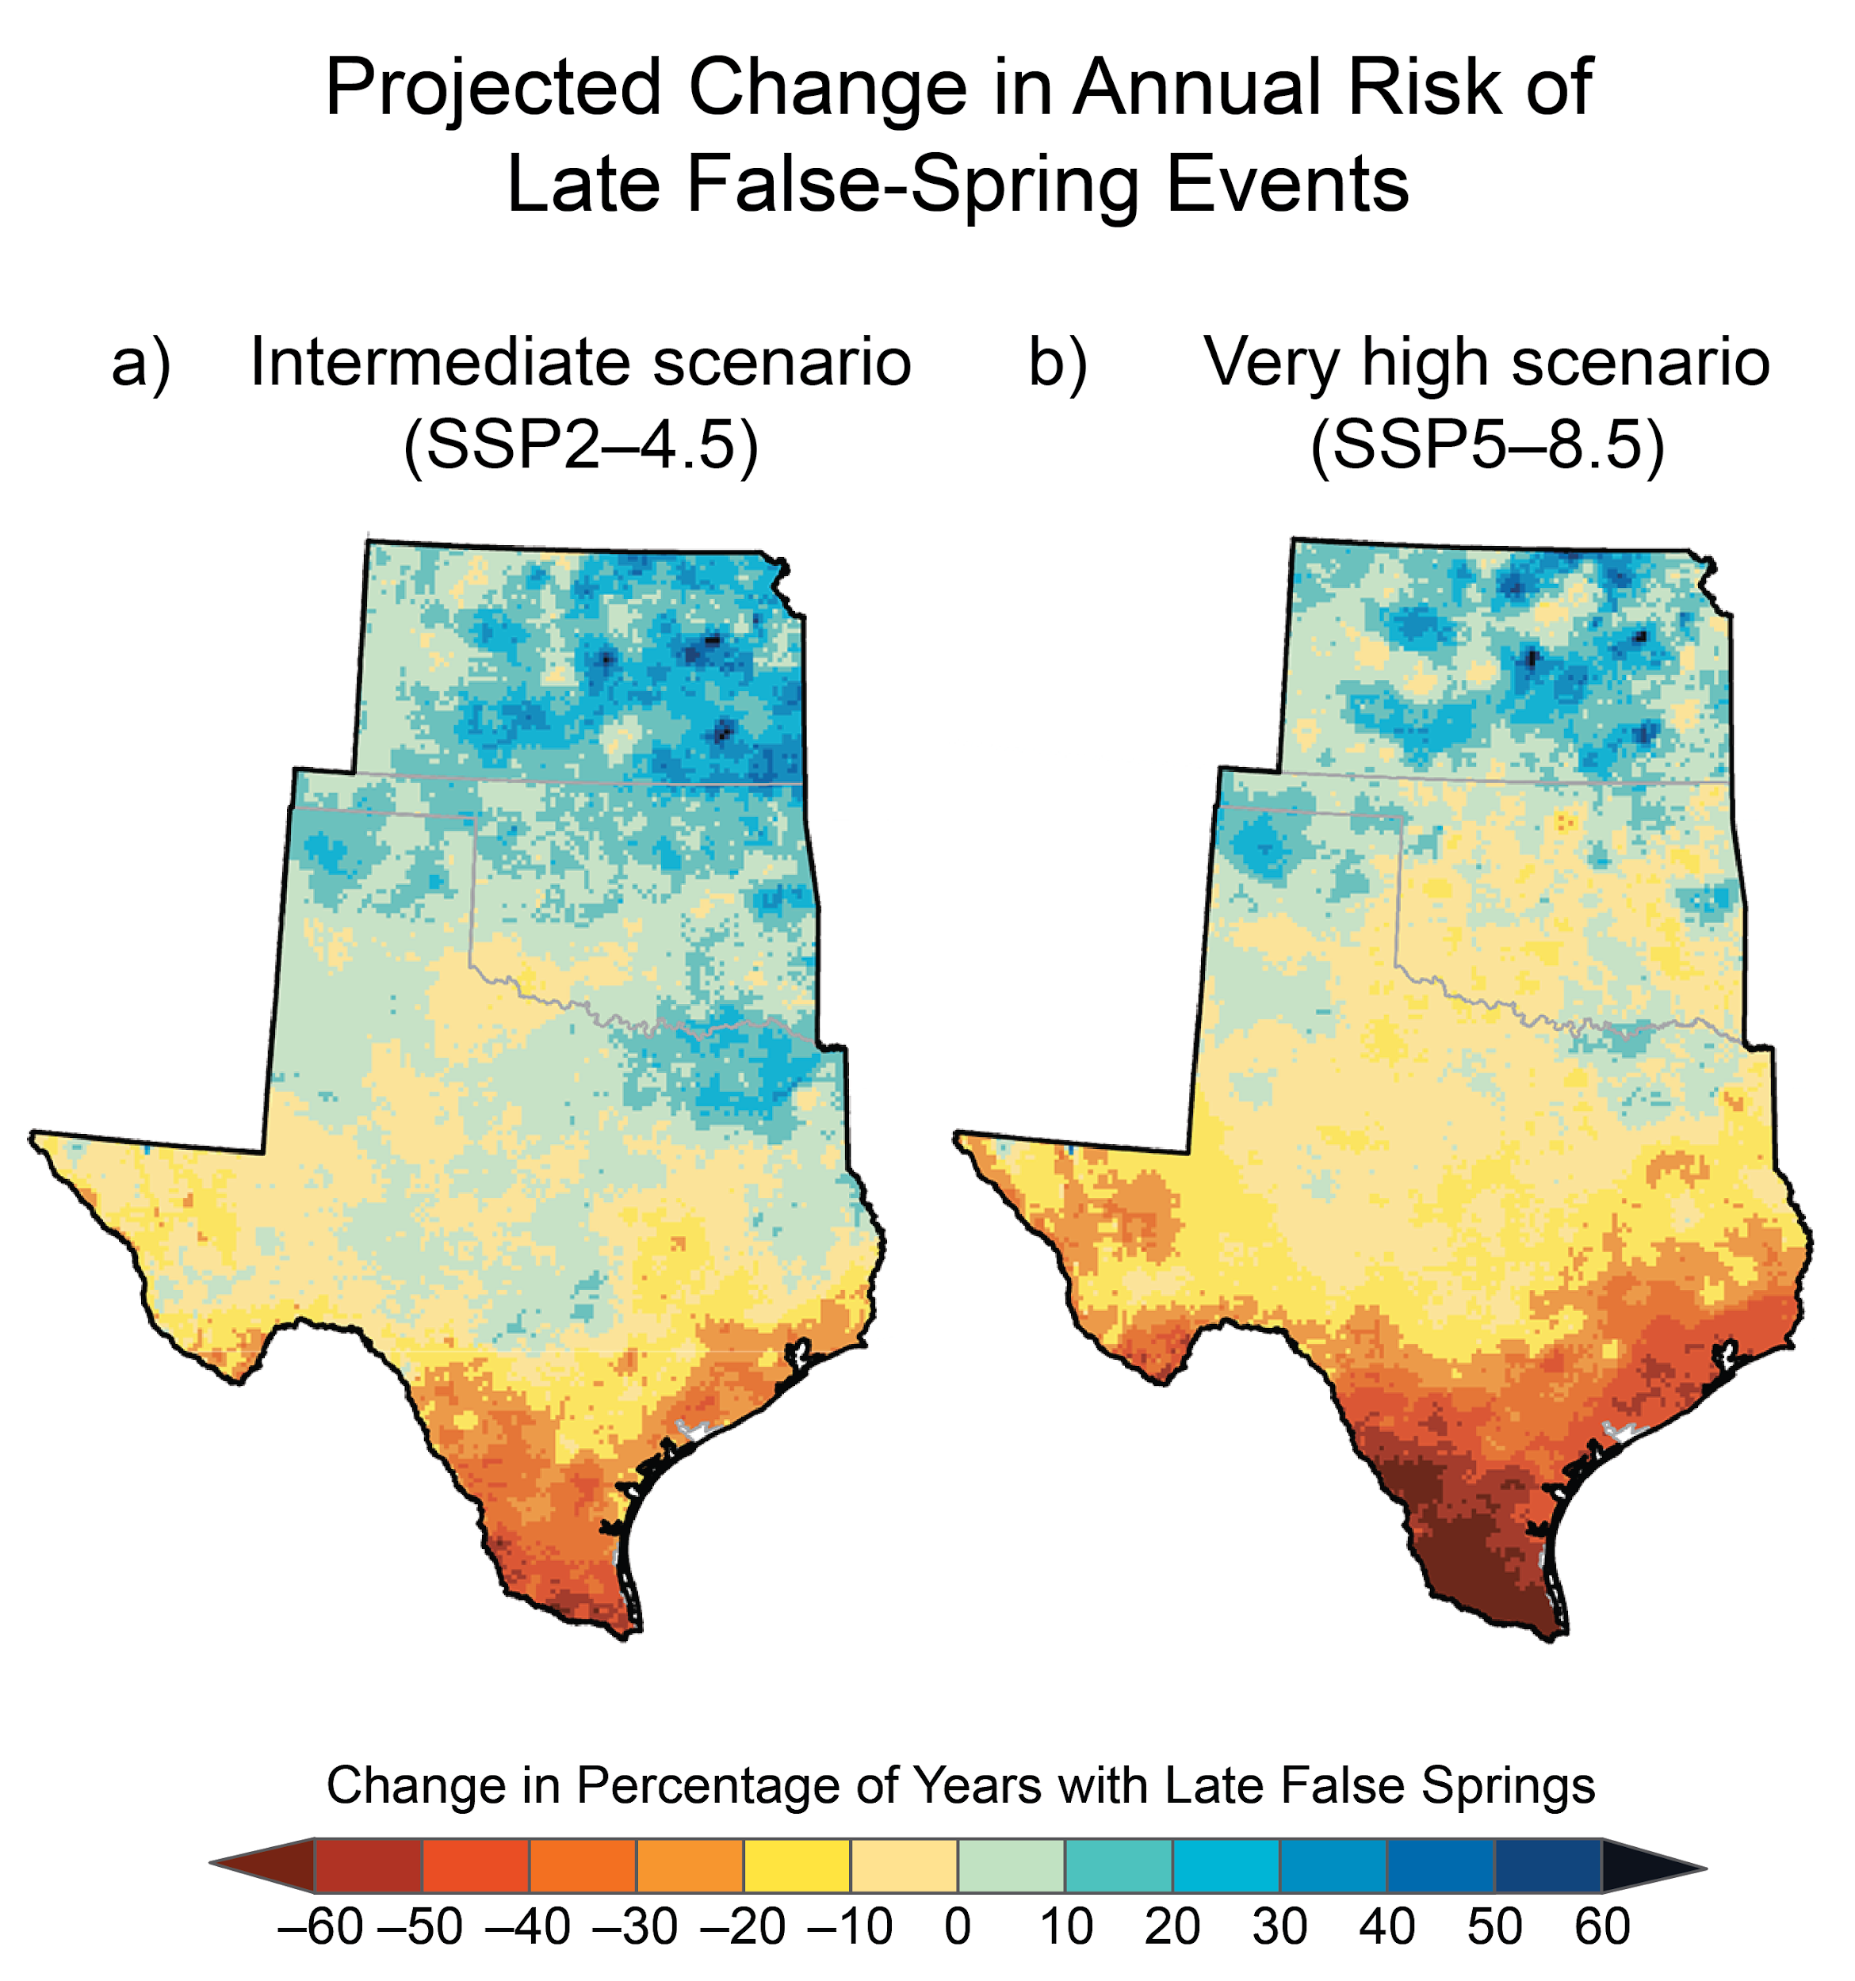
Figure 26.9. The risk of plant bud burst before the last freeze is projected to increase for the northern portion of the Southern Great Plains. The risk decreases for the southern portion of the region.
Notes:
CAPTION: Freezing temperatures after plants begin growth in spring (late false spring) can damage crops and nursery plants. Risk of a late false spring is projected to increase in northern parts of the Southern Great Plains by the end of the century (2071–2100) as compared to the 1991–2020 average. The risk of late false springs increases by up to 20% across most of Kansas, Oklahoma, and northern Texas under an intermediate scenario (SSP2-4.5; panel a) and across most of Kansas, the Texas Panhandle, and parts of Oklahoma under a very high scenario (SSP5-8.5; panel b). Risk decreases for the remainder of the region, especially in southern and far western Texas under a very high scenario. Figure credit: See figure metadata for contributors.

Slide 17
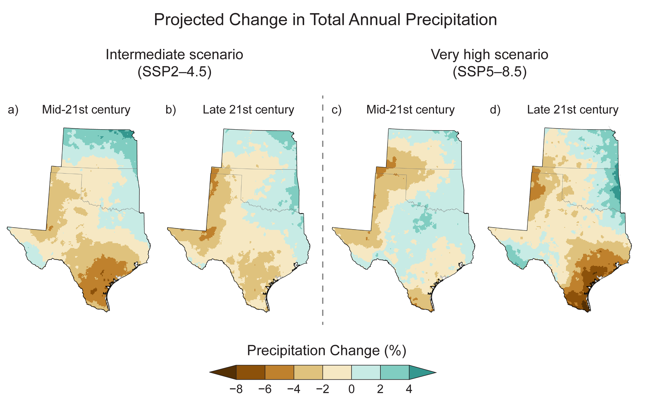
Figure 26.10. Slightly drier conditions are projected for much of the western and southern portions of the region by the end of the century.
Notes:
CAPTION: In the future, drier conditions threaten agriculture and water supplies in parts of the Southern Great Plains (brown), while more precipitation is projected near the northern and eastern boundaries of the region (green). Under an intermediate scenario (SSP2-4.5), total annual precipitation is projected to decrease by 4% or more (as compared to the 1991–2020 average) in southern Texas by midcentury (a), with smaller differences expected by century’s end (b). Under a very high scenario (SSP5-8.5), annual precipitation is projected to decline slightly in western portions of the region by midcentury (c) and by 4% or more in southeast and far northwest Texas by the century’s end (d). Figure credit: See figure metadata for contributors.

Slide 18
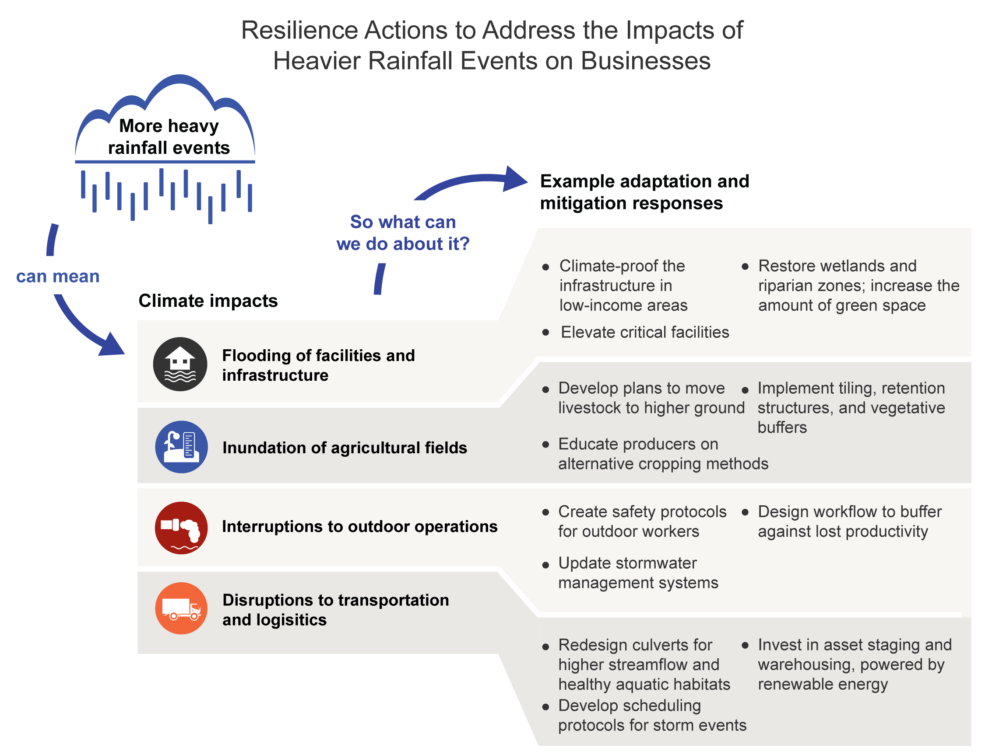
Figure 26.11. Resilience actions can help businesses and industries reduce the negative consequences of more heavy rainfall events.
Notes:
CAPTION: An increased number of heavy rainfall events affects business and industry across the Southern Great Plains through flooding of facilities and infrastructure, inundation of agricultural fields, interruptions to outdoor operations, and disruptions to transportation and logistics. The example adaptation and mitigation actions can increase resilience and reduce negative impacts. Figure credit: See figure metadata for contributors.

Slide 19
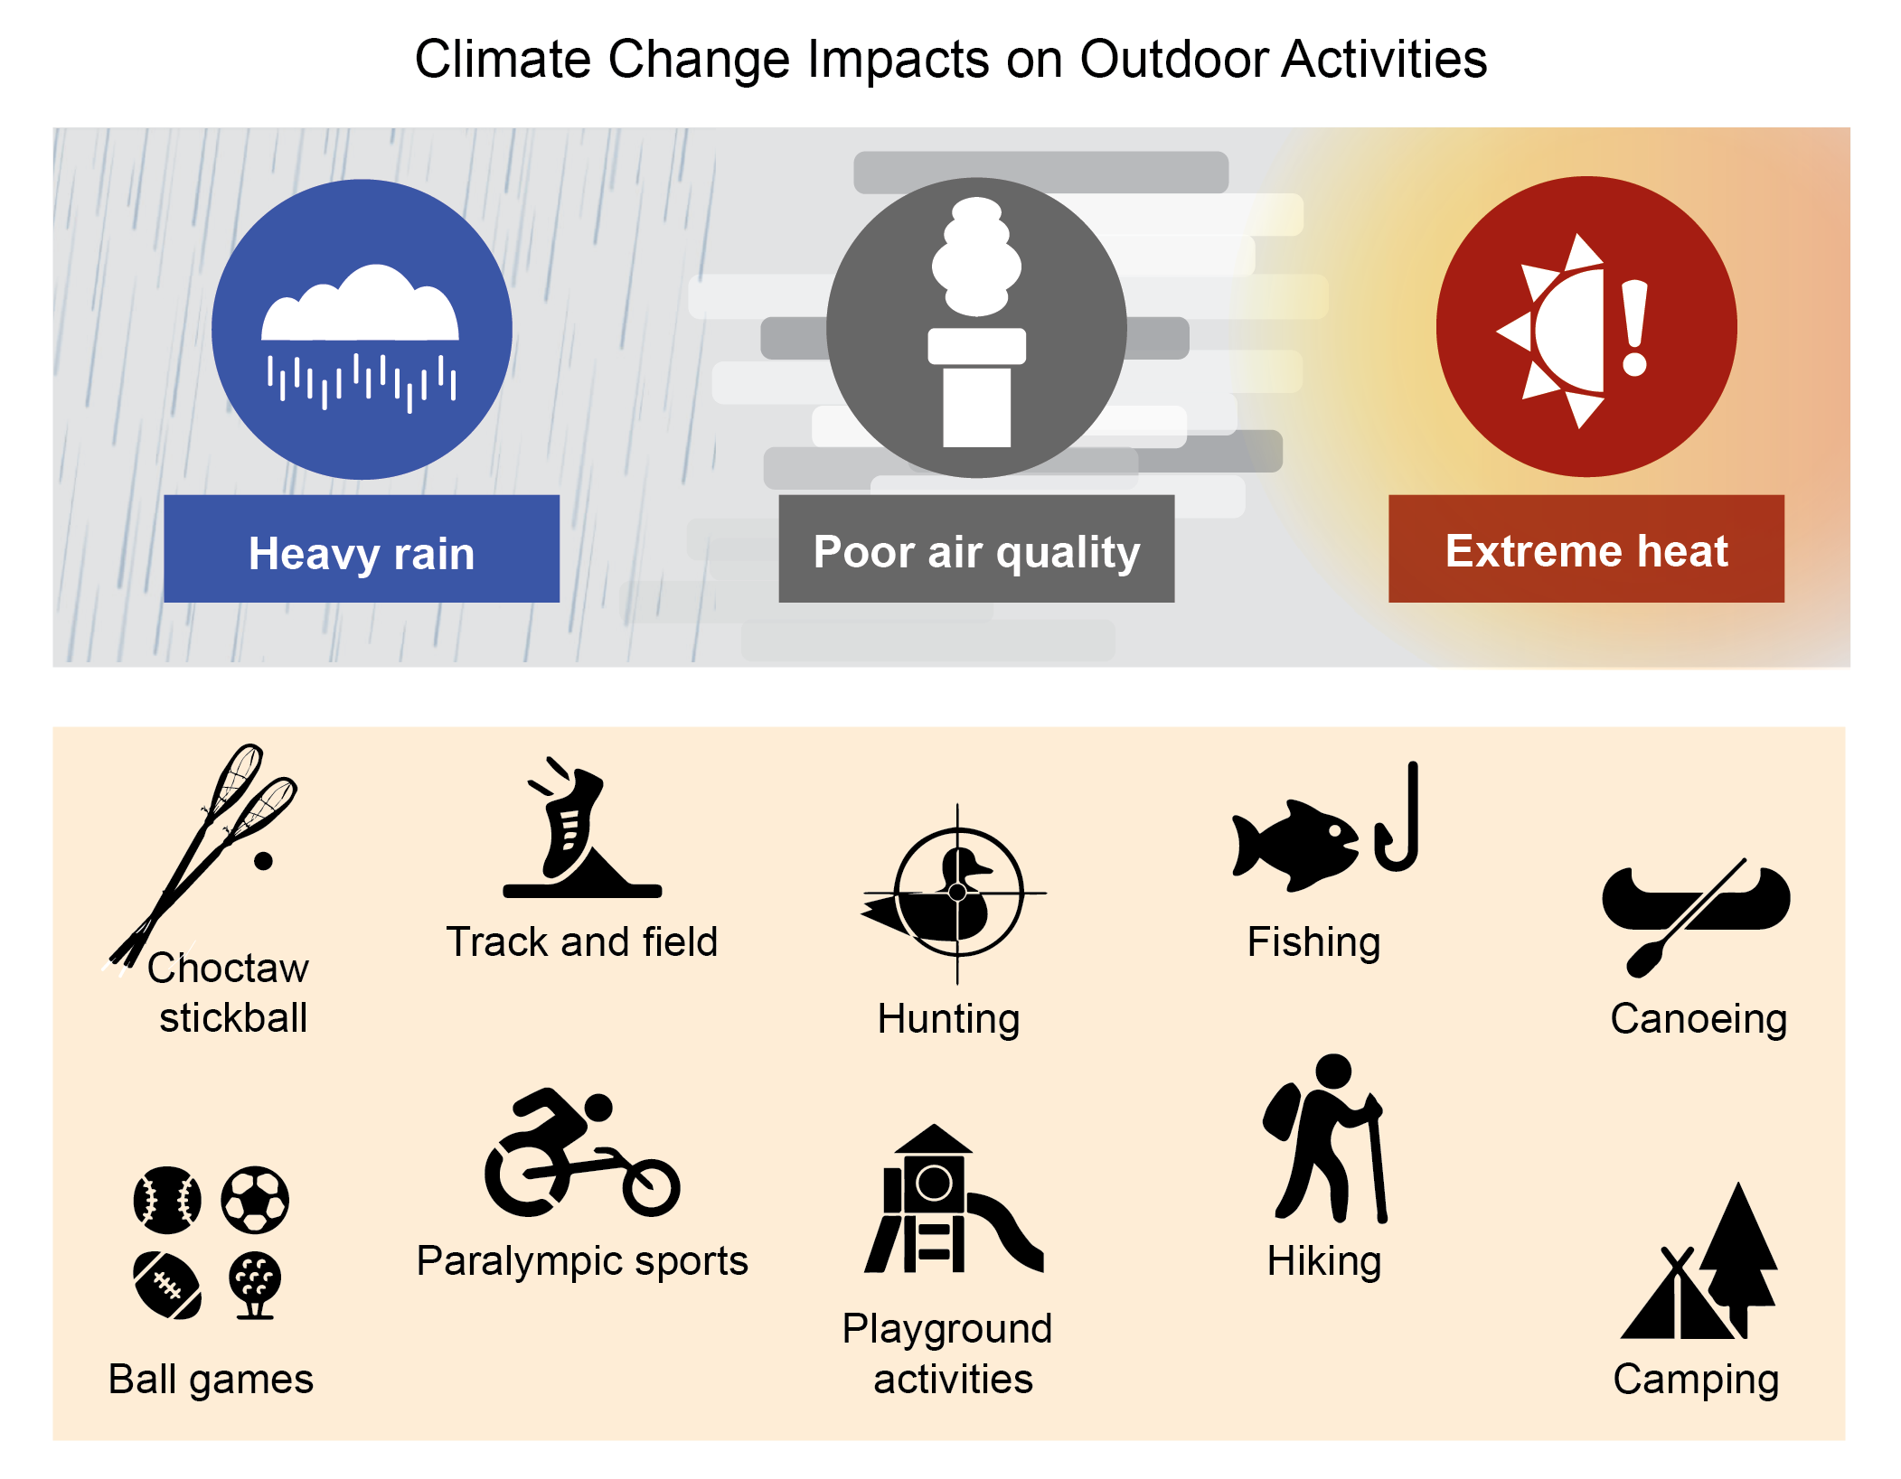
Figure 26.12. Climate change is expected to affect many outdoor sports, recreational, and leisure activities.
Notes:
CAPTION: Outdoor sports, recreational, and leisure activities for people of all ages are being affected by climate extremes. Heavy rainfall, poor air quality, and extreme heat are expected to increase with climate change. These stressors impair athletic performance, damage sports facilities, and alter landscapes for recreation and tourism. Figure credit: See figure metadata for contributors.

Slide 20
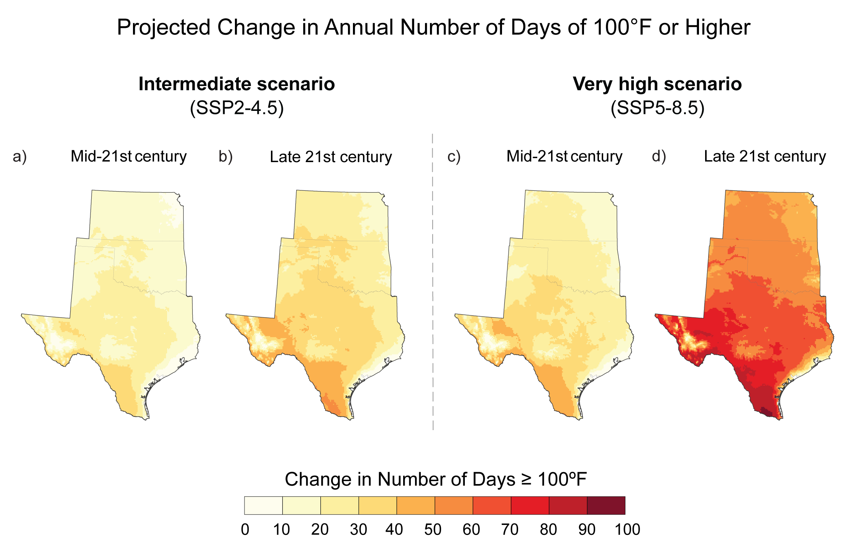
Figure 26.13. The number of extreme-heat days is projected to increase.
Notes:
CAPTION: Outdoor physical activity becomes more dangerous in extremely hot temperatures. By midcentury, the number of days per year with temperatures at or above 100°F across the Southern Great Plains is projected to increase (a) by 10–40 days under an intermediate scenario (SSP2-4.5) and (c) by 10–60 days under a very high scenario (SSP5-8.5) above the 1991–2020 average. By late century, projections indicate that the number of these extreme-heat days would increase (b) by 10–60 days (SSP2-4.5) or (d) by 30–90 days (SSP5-8.5), depending on scenario. The historical average ranges from fewer than 10 days per year in Kansas to fewer than 20 days across most of Oklahoma and Texas, with 40–60 days along the Mexican border. Figure credit: See figure metadata for contributors.

Slide 21
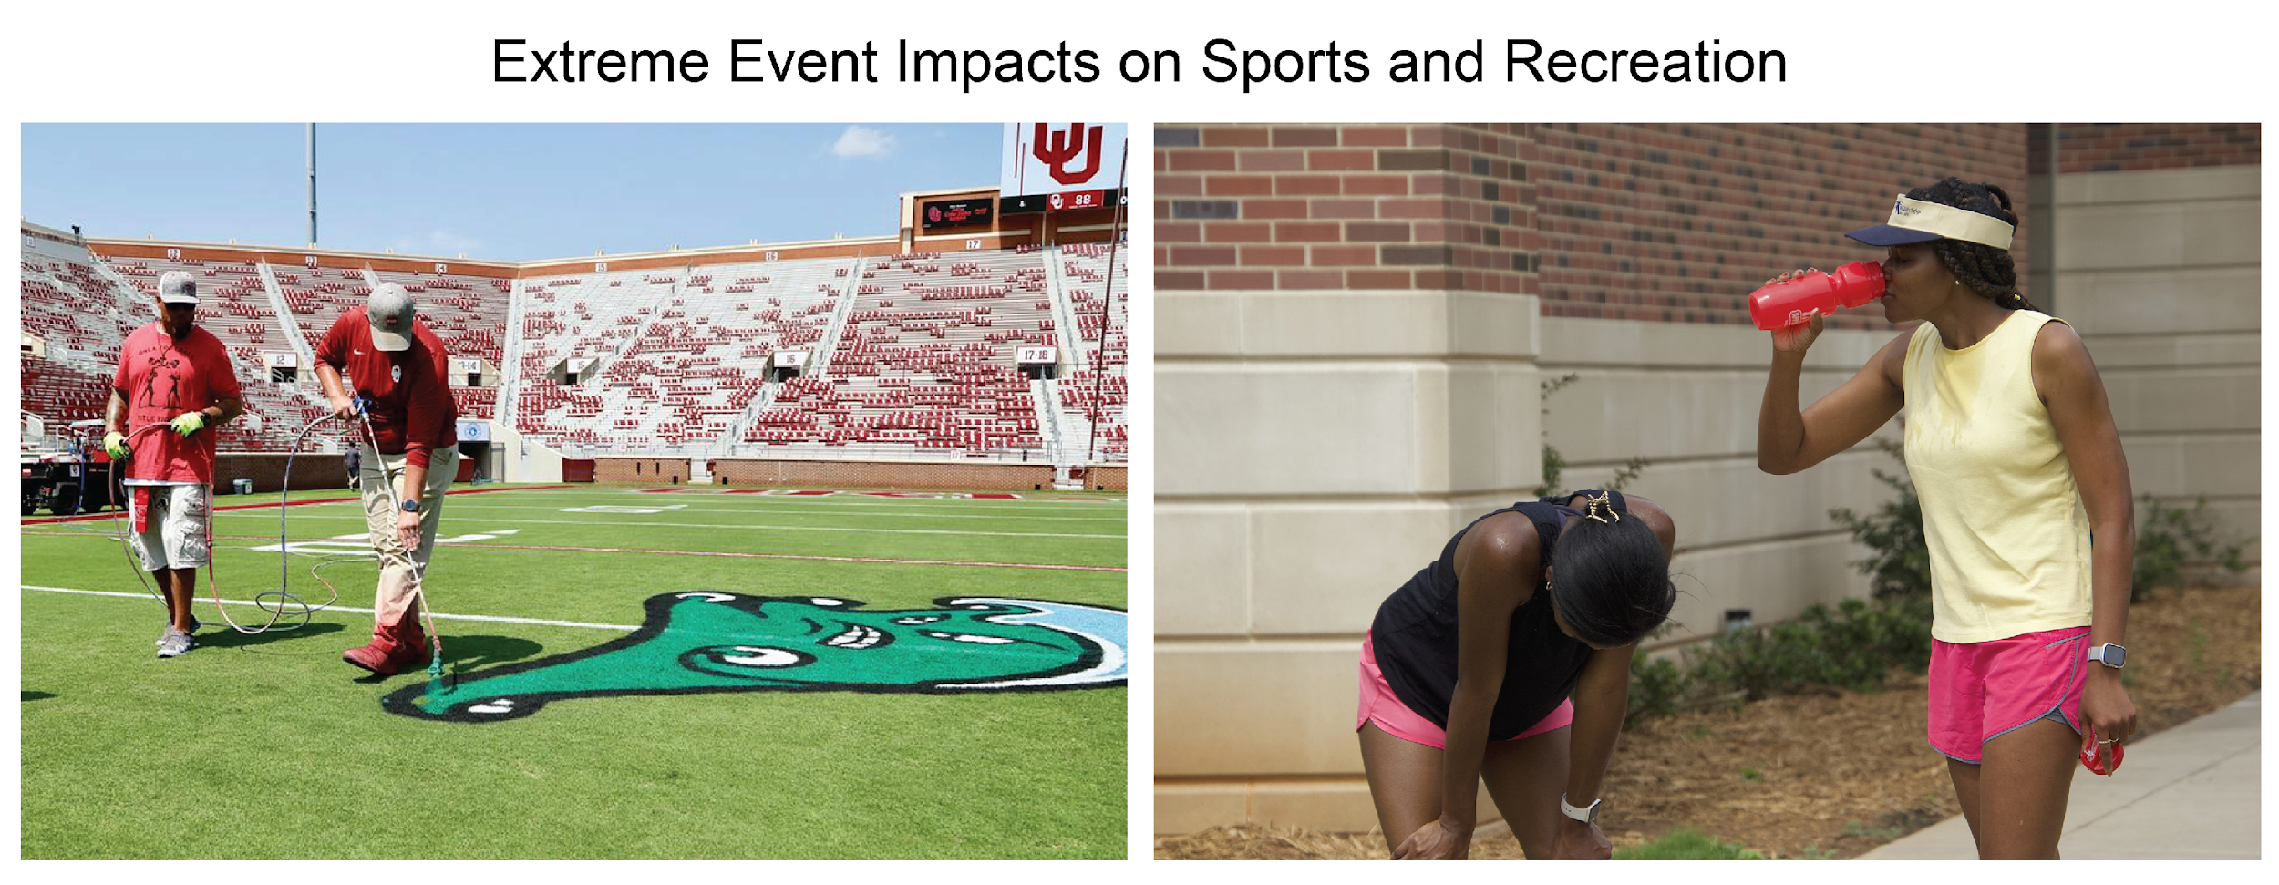
Figure 26.14. Outdoor sports and recreation of all kinds are challenged by extreme events.
Notes:
CAPTION: (left) University of Oklahoma staff paint the Green Wave of Tulane University on their football field for a September 4, 2021, matchup. The game was relocated after Hurricane Ida left Tulane’s stadium powerless and damaged. (right) As people enjoy the outdoors as part of a healthy lifestyle, warmer temperatures are expected to cause them to adapt by drinking cool liquids, reducing strenuous exercise, or exercising during cooler times of the day. Photo credits: (left) ©University of Oklahoma Athletics; (right) ©Emma Kuster.

Slide 22
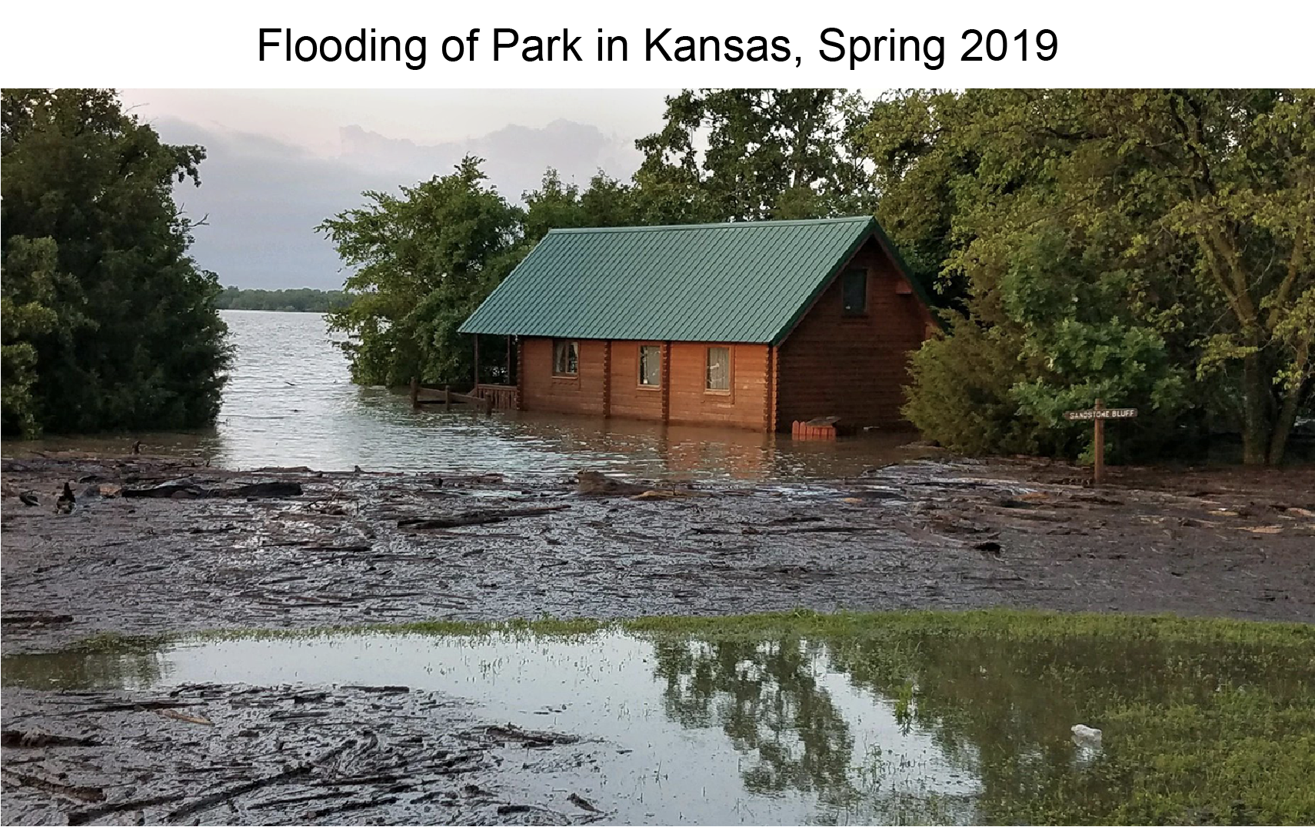
Figure 26.15. Historic spring flooding in 2019 closed parks and recreational areas in southeastern Kansas.
Notes:
CAPTION: Sandstone Bluff Cabin along Toronto Lake in Cross Timbers State Park was flooded from spring 2019 storms, as the lake level exceeded prior historic records. The extreme rainfall closed parks and created an estimated $12.5 million (in 2022 dollars) in damages. Photo credit: ©Kansas Department of Wildlife and Parks.

Slide 23
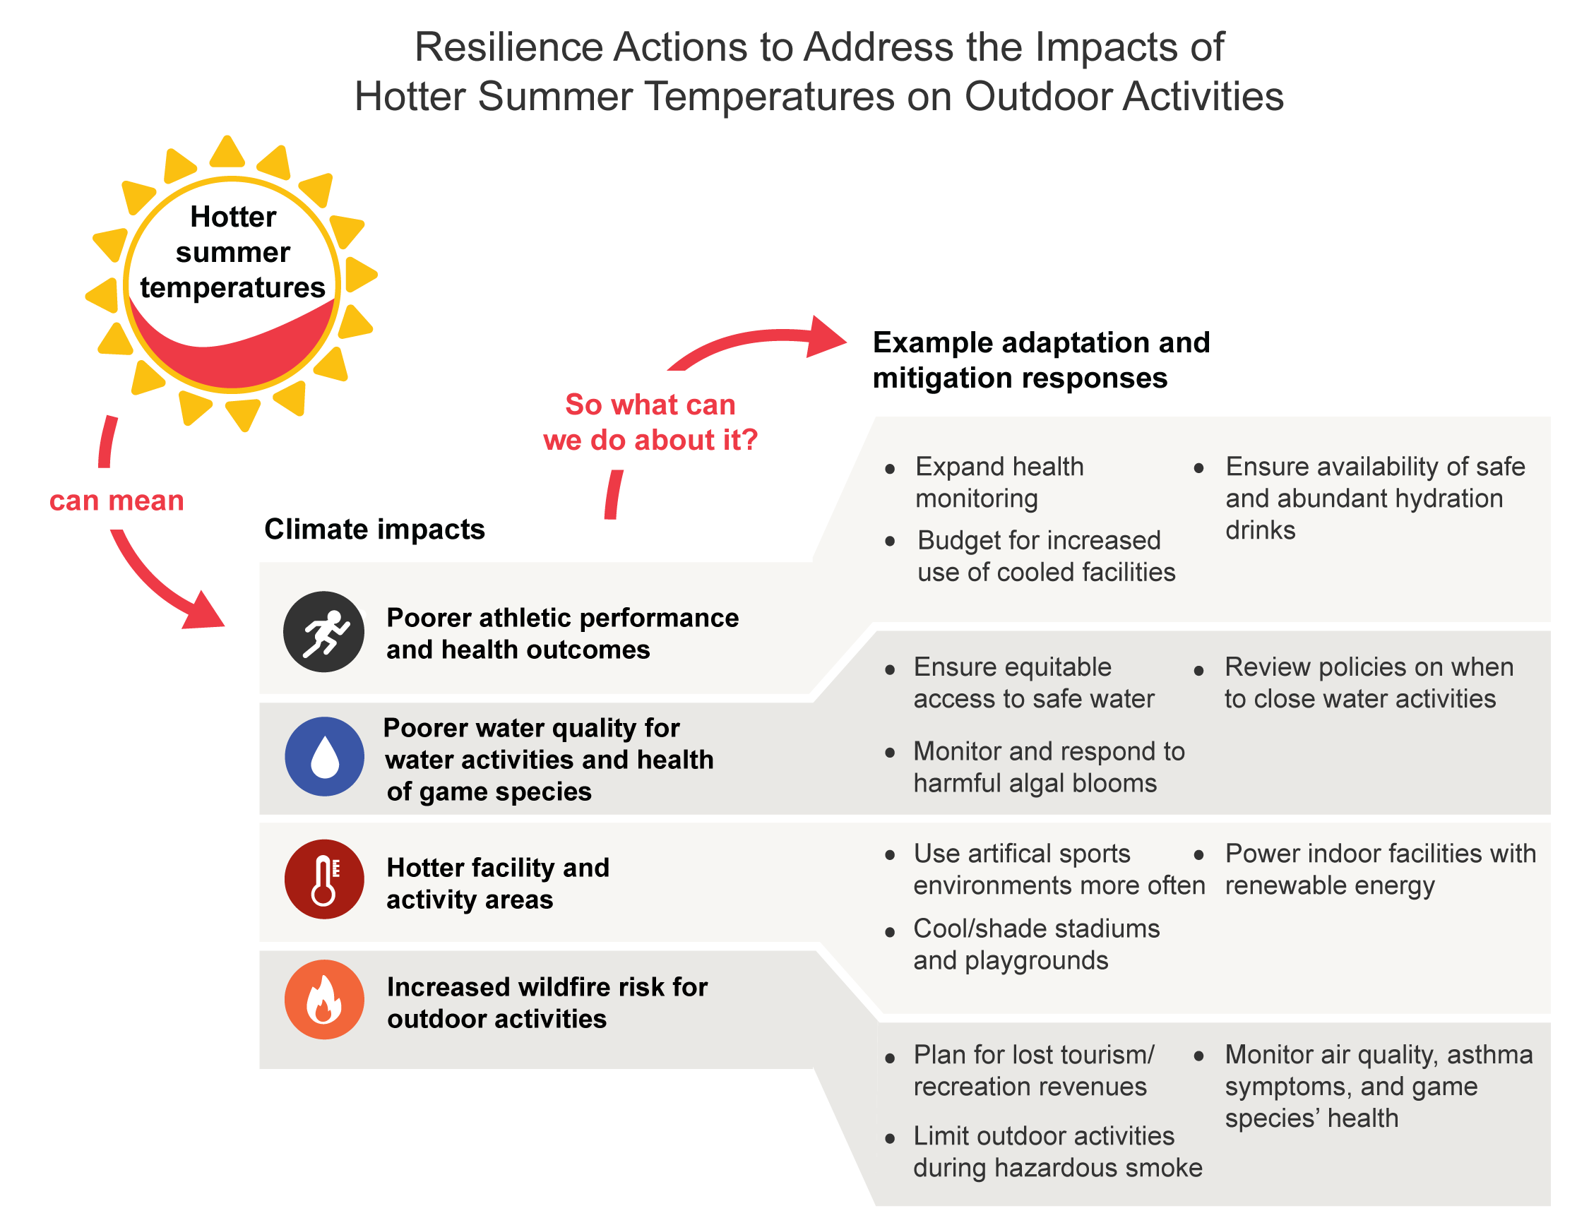
Figure 26.16. Resilience actions can alleviate the effects of hotter temperatures on outdoor activities.
Notes:
CAPTION: Hotter temperatures affect athletic, recreational, and leisure activities outdoors across the Southern Great Plains, leading to poorer athletic performance and health outcomes, poorer water quality, hotter facilities and activity areas, and increased wildfire risk. The example adaptation and mitigation actions can increase resilience and reduce negative impacts. Figure credit: See figure metadata for contributors.

Slide 24
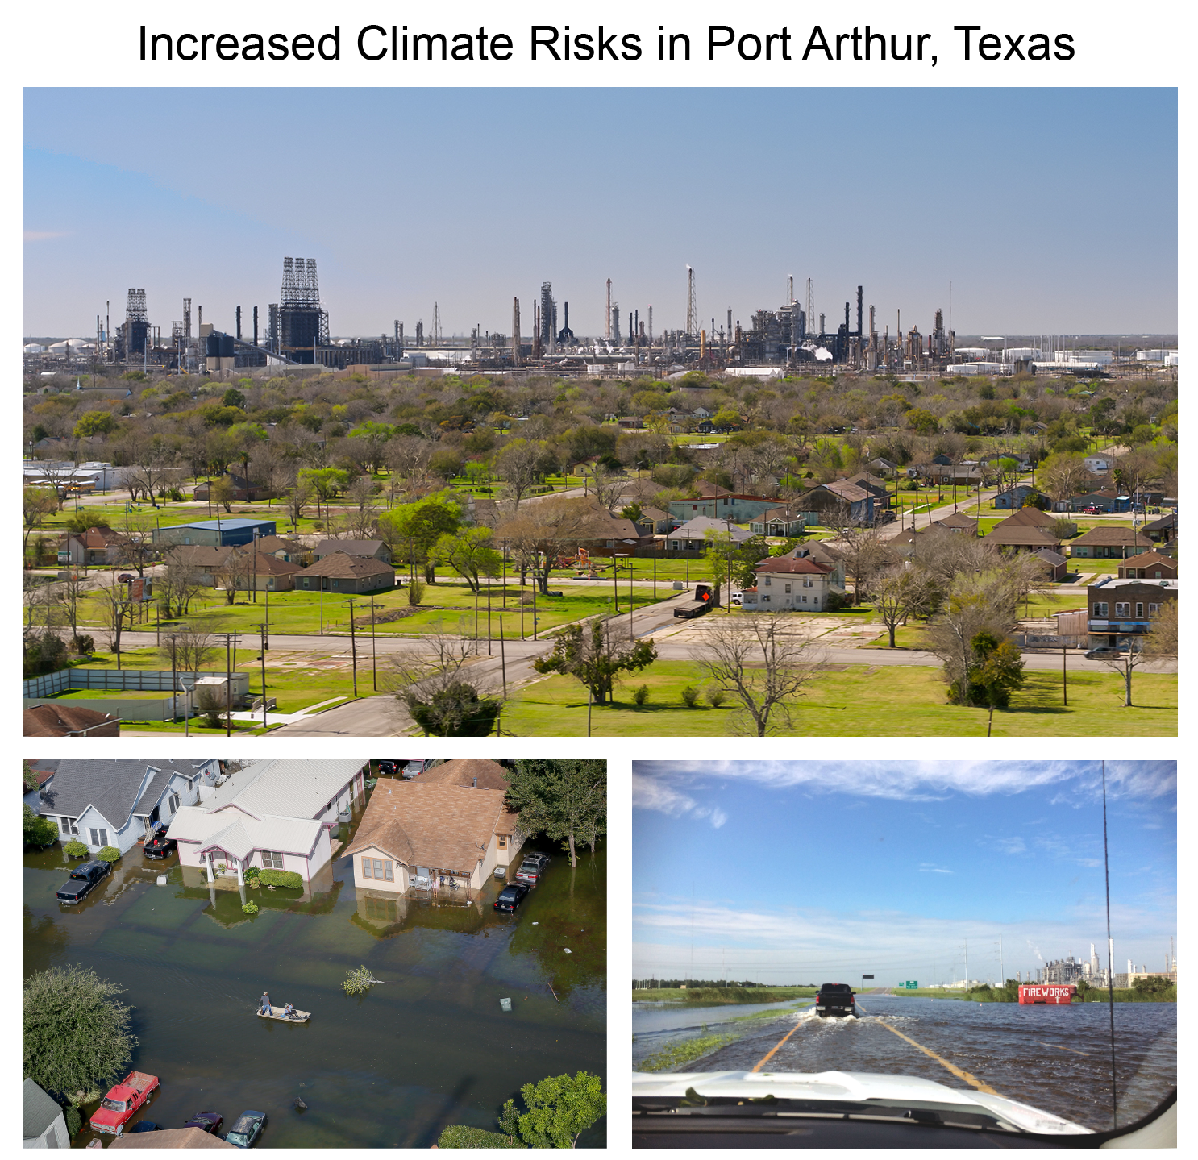
Figure 26.17. Historically underserved communities near chemical facilities face increased risks from weather hazards associated with climate change.
Notes:
CAPTION: These scenes from Port Arthur, Texas, reveal (top) a low-lying landscape of petrochemical facilities and residential neighborhoods, representative of many communities along the Texas Gulf Coast. After Hurricane Harvey (2017) made landfall near Port Aransas, Texas, neighborhoods (bottom left) and transportation infrastructure and petrochemical facilities (bottom right) were flooded, exposing residents to contaminated waters spreading across the landscape. With climate change projected to intensify hurricanes and bring heavier rainfall, the risks to communities along the Gulf Coast are even higher when hazardous facilities, such as petrochemical plants, are nearby. Photo credits: (top) halbergman/iStock via Getty Images Plus; (bottom left) US Air National Guard Staff Sergeant Daniel J. Martinez; (bottom right) ©Alison A. Tarter.

Slide 25
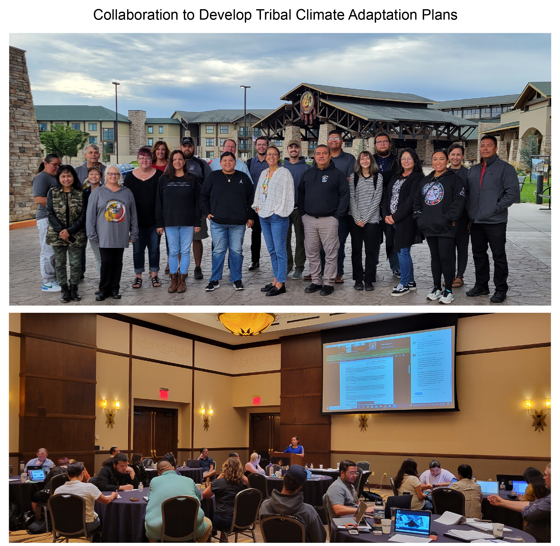
Figure 26.18. Nine Tribes of Kansas, Nebraska, and Iowa work together to create customized climate action plans for their individual communities
Notes:
CAPTION: (top) In 2022 Mayetta, Kansas, was the site of a climate resilience workshop for the nine Tribes of Kansas, Nebraska, and Iowa. (bottom) Technical teams worked together to create and present specific climate adaptation plans for each Tribe and to share their experiences with one another. Photo credit: ©Mark Junker.

Slide 26
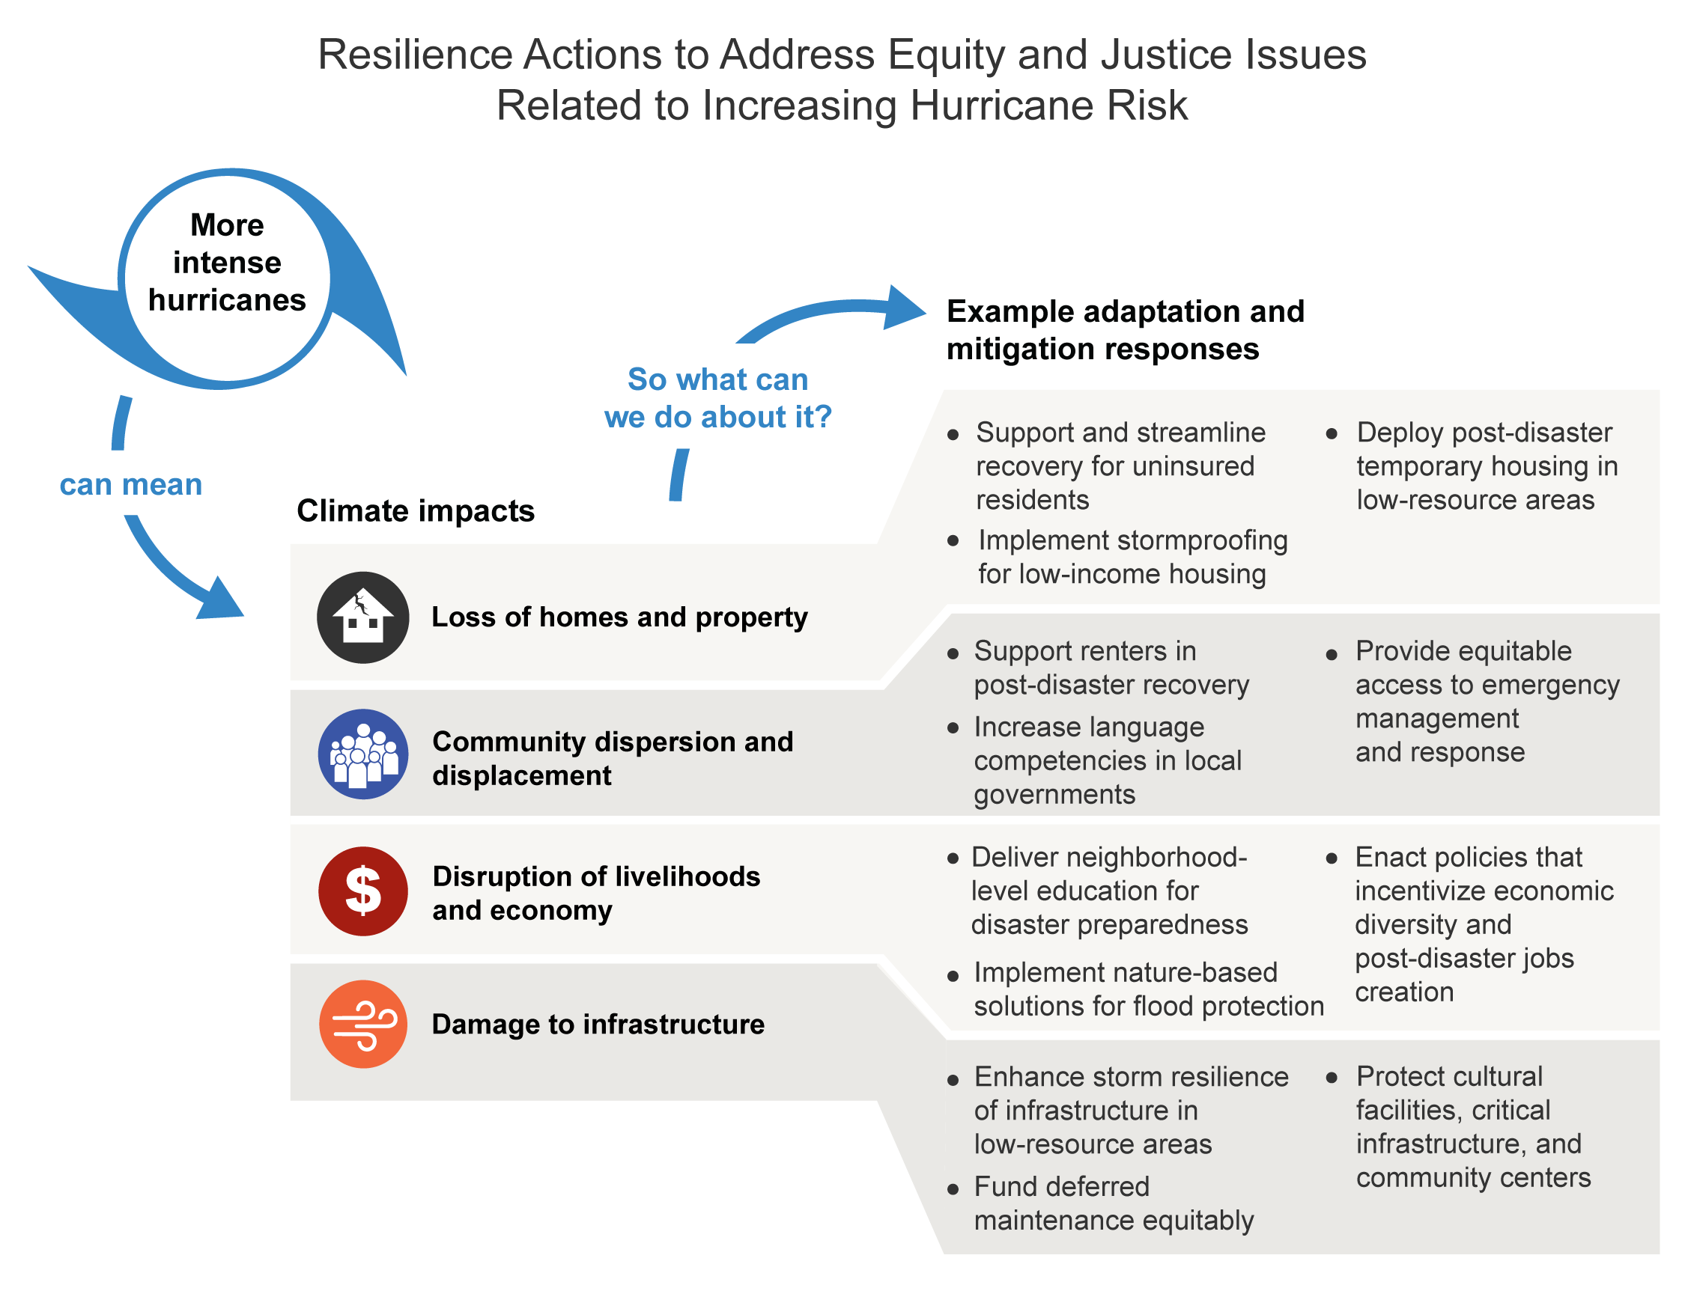
Figure 26.19. Resilience actions centered on justice and equity can help overburdened communities respond to increasing hurricane risks.
Notes:
CAPTION: More intense hurricanes increase challenges for justice and equity actions across the Southern Great Plains, including loss of homes and property, community dispersion and displacement, disruption of livelihoods and economy, and damage to infrastructure. The example adaptation and mitigation actions can align justice and equity work with climate resilience. Figure credit: See figure metadata for contributors.

Slide 27
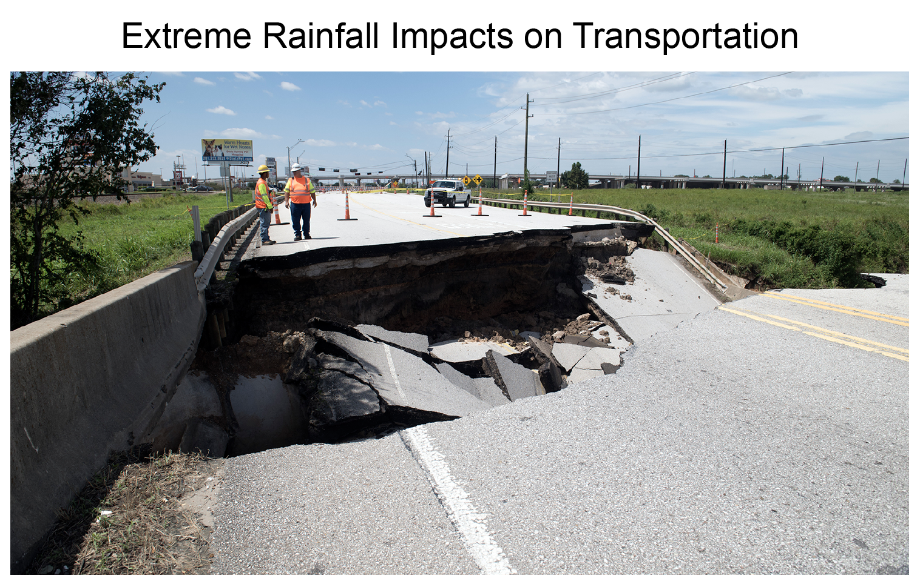
Figure 26.20. Heavy downpours associated with Hurricane Harvey (2017) caused bridge damage.
Notes:
CAPTION: Extreme events associated with climate change are expected to threaten transportation infrastructure, as demonstrated by past experiences. Here, widespread heavy rains associated with Hurricane Harvey (2017) caused the collapse of a section of Farm to Market Road 762 in Fort Bend County, Texas. Photo credit: Kevin Stillman, Texas Department of Transportation.

Slide 28
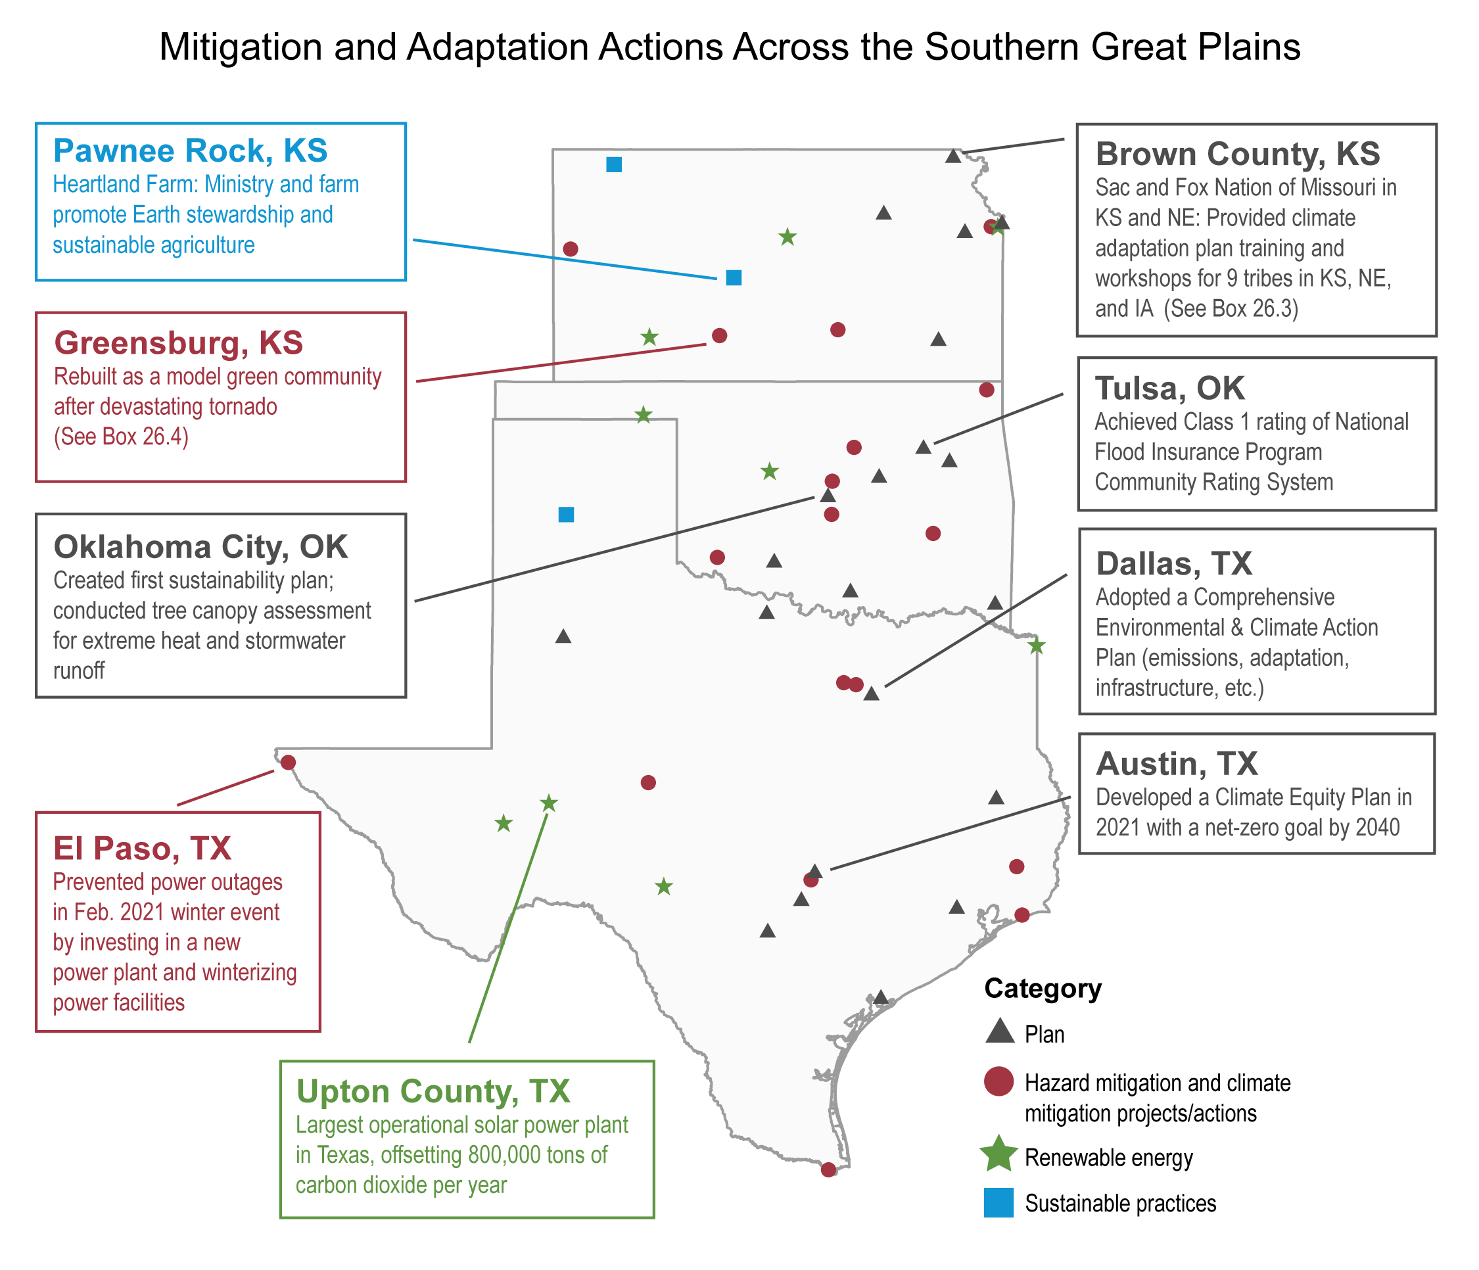
Figure 26.21. A wide array of actions are being conducted across the region to address the impacts of climate change.
Notes:
CAPTION: Communities and Tribes across the Southern Great Plains are acting in response to the challenges associated with climate variability and change. Actions include developing plans for hazard mitigation, climate action, and climate resilience (black triangles) or undertaking activities related to hazard mitigation (e.g., building resilient infrastructure) and climate mitigation (e.g., reducing energy usage; red circles). Renewable energy projects (green stars) and agricultural or environmental practices that support sustainability (blue squares) are also beginning. For actions under multiple categories, the main category was mapped. These actions aim to increase community resilience to hazards now and in the future. The mapped examples are representative of others occurring elsewhere across the region. See details at https://arcg.is/0yGjKm. Figure credit: See figure metadata for contributors.

Slide 29
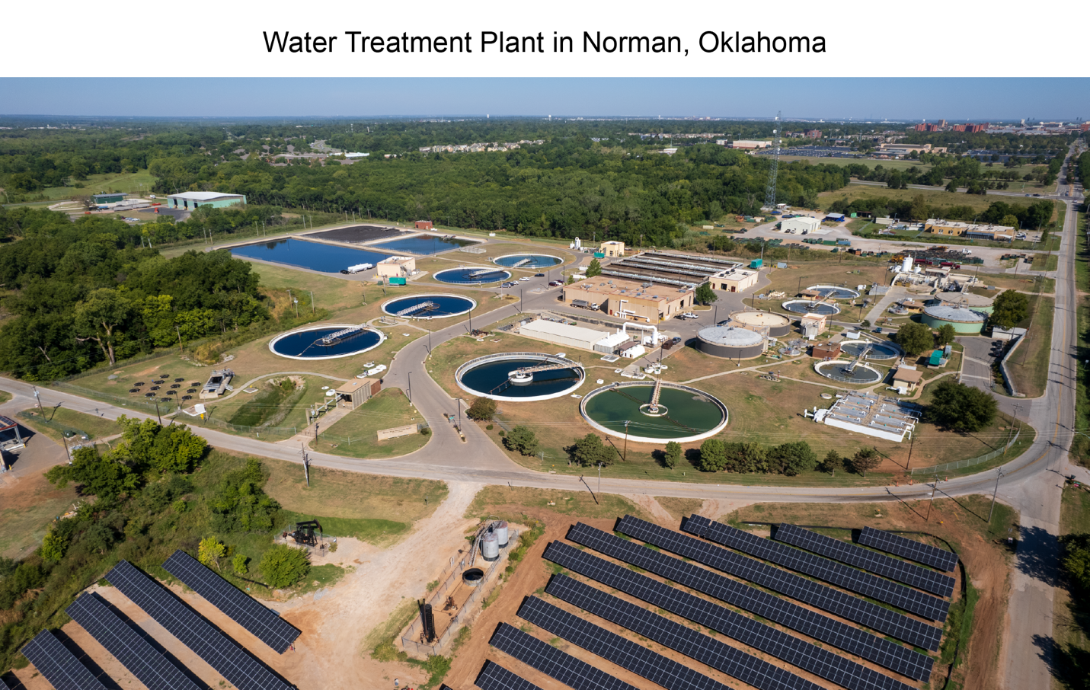
Figure 26.22. Wastewater treatment services in the region are addressing water resource challenges.
Notes:
CAPTION: The City of Norman’s wastewater treatment facility is testing how to supplement water during drought by returning highly treated water from its water reclamation facility to its nearby reservoir. Water reuse is a well-established adaptation method that is especially useful in semiarid climates. Photo credit: ©City of Norman, Oklahoma.

Slide 30
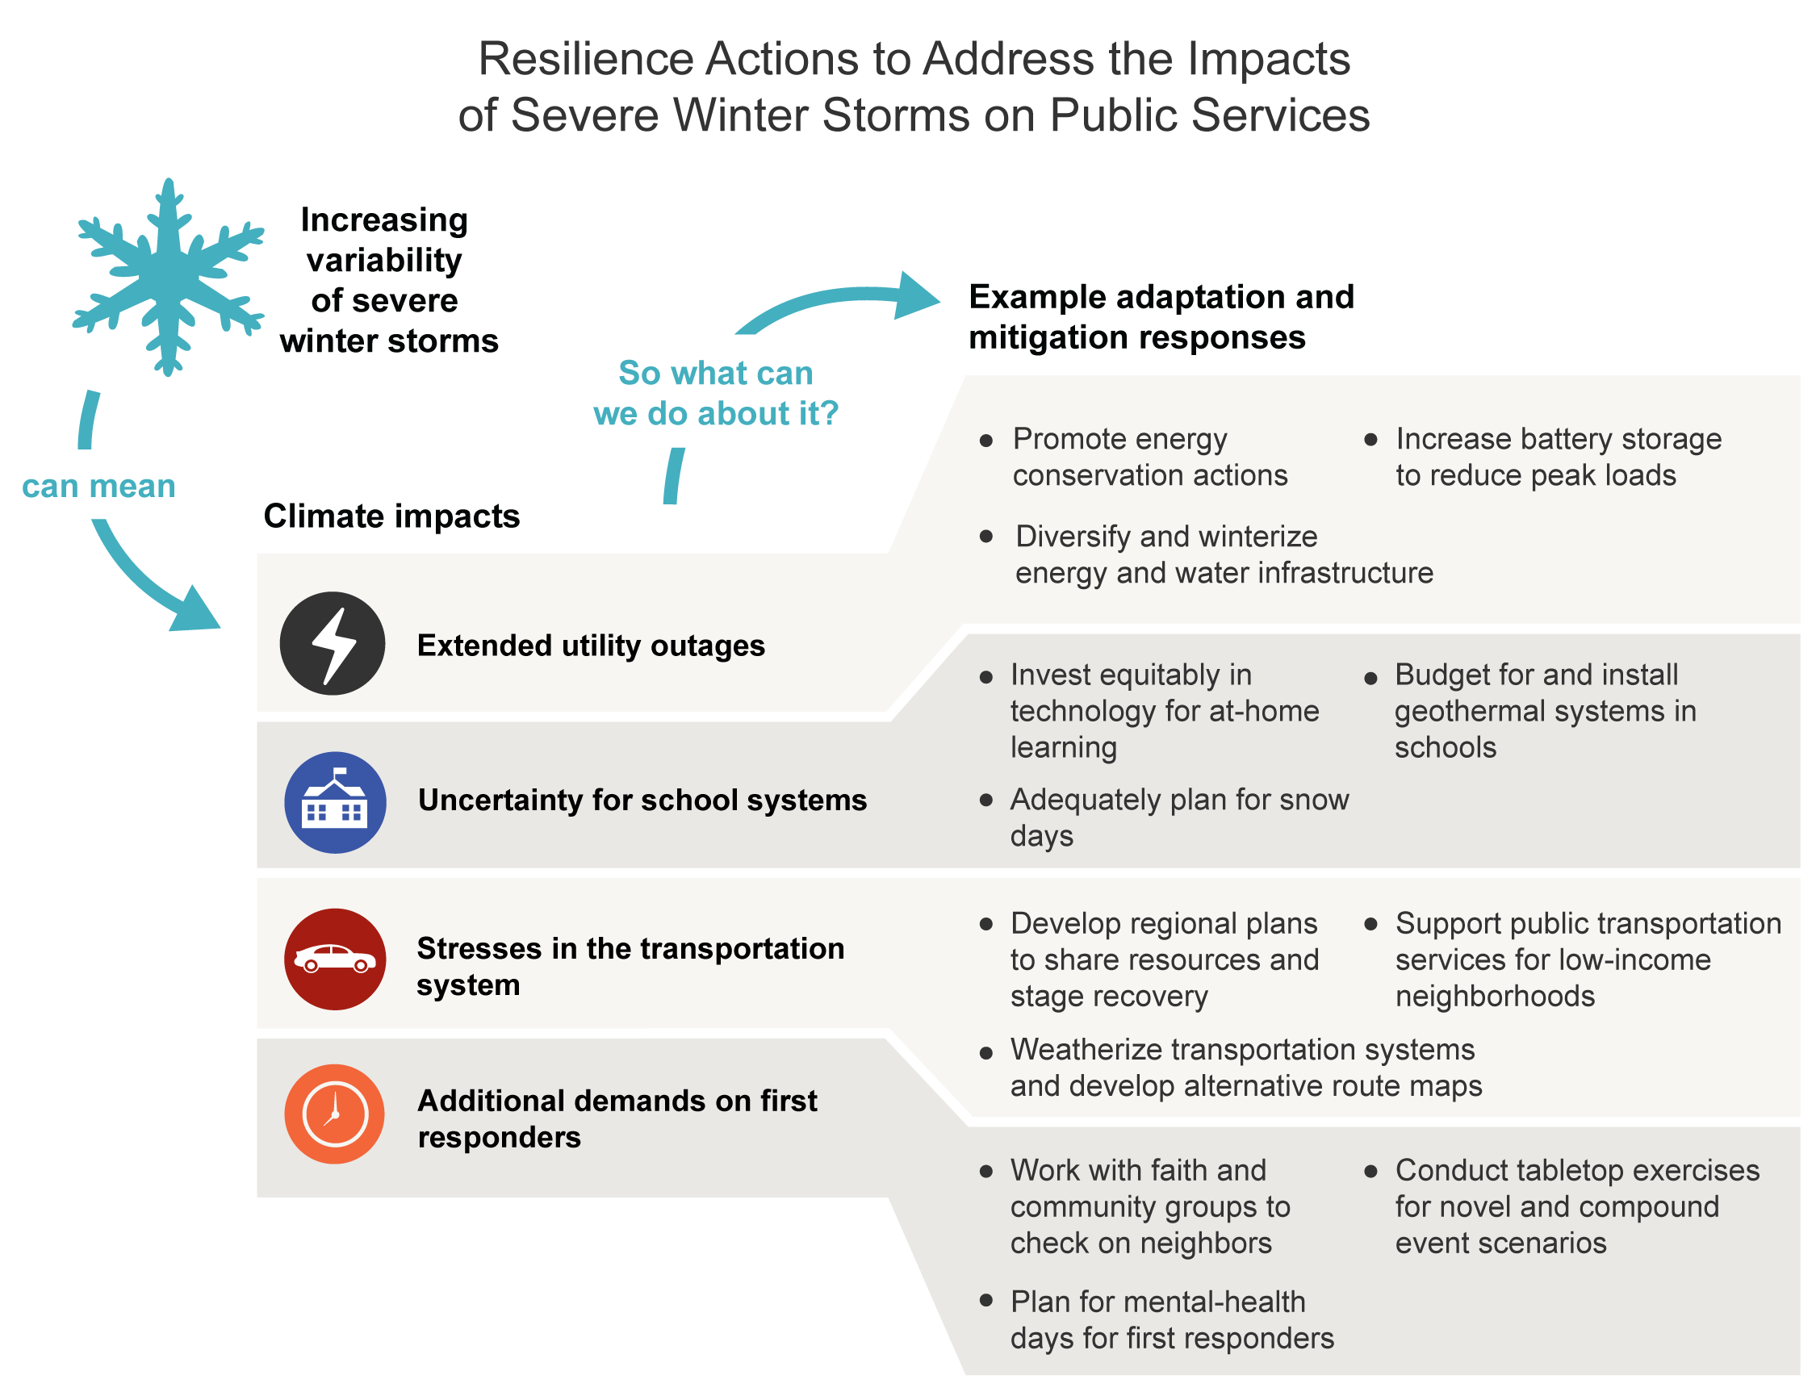
Figure 26.23. Resilience actions can reduce risks to public services caused by increasingly variable severe winter storms.
Notes:
CAPTION: The increasing variability of severe winter storms causes uncertainty and increases risk in public services and infrastructure across the Southern Great Plains, including extended utility outages, uncertainty for school systems, stresses in the transportation system, and additional demands on first responders. The example adaptation and mitigation actions can increase resilience and reduce negative impacts. Figure credit: See figure metadata for contributors.

Slide 31
Federal Coordinating Lead Author
Philip A. Fay, USDA Agricultural Research Service
Chapter Lead
Renee A. McPherson, University of Oklahoma, South Central Climate Adaptation Science Center
Chapter Authors
Susan G. Alvarez, City of Dallas, Texas
Darrian Bertrand, University of Oklahoma, Southern Climate Impacts Planning Program
Taylor L. Broadbent, South Central Climate Adaptation Science Center
Tianna Bruno, University of California, Berkeley
Ali Fares, Prairie View A&M University
Brian McCullough, Texas A&M University
Georgianne W. Moore, Georgia Southern University
Bee Moorhead, Texas Impact Foundation
Laura Patiño, City of Austin, Texas
Alexander "Sascha" Petersen, Adaptation International
Nicholas G. Smith, Texas Tech University
Jean L. Steiner, Kansas State University
April Taylor, Chickasaw Nation
Travis Warziniack, USDA Forest Service
Technical Contributors
Juan Pablo Carvallo, Lawrence Berkeley National Laboratory
Mark Junker, Sac and Fox Nation of Missouri in Kansas and Nebraska
Gary McManus, Oklahoma Climatological Survey
Lauren E. Mullenbach, University of Oklahoma
John W. Nielsen-Gammon, Texas A&M University
John A. Quinlan, NOAA Fisheries, Southeast Fisheries Science Center
Adrienne M. Wootten, University of Oklahoma
Review Editor
Mark Shafer, University of Oklahoma
USGCRP Coordinators
Reid A. Sherman, US Global Change Research Program / ICF
Joshua Hernandez, US Global Change Research Program / ICF
Drew Story, US Global Change Research Program / ICF

Slide 32
McPherson, R.A., P.A. Fay, S.G. Alvarez, D. Bertrand, T.L. Broadbent, T. Bruno, A. Fares, B. McCullough, G.W. Moore, B. Moorhead, L. Patiño, A. Petersen, N.G. Smith, J.L. Steiner, A. Taylor, and T. Warziniack, 2023: Ch. 26. Southern Great Plains. In: Fifth National Climate Assessment. Crimmins, A.R., C.W. Avery, D.R. Easterling, K.E. Kunkel, B.C. Stewart, and T.K. Maycock, Eds. U.S. Global Change Research Program, Washington, DC, USA. https://doi.org/10.7930/NCA5.2023.CH26
https://nca2023.globalchange.gov/chapter/26

