Slide 1

NCA5 Website: https://nca2023.globalchange.gov
Chapter Website: https://nca2023.globalchange.gov/chapter/27
NCA5 Atlas: https://atlas.globalchange.gov
Figure captions can be found in the slide notes of this deck
Social media: @usgcrp, #NCA5

Slide 2
Chapter 27 | Northwest

Slide 3
1
Frontline Communities Are Overburdened, and Prioritizing Social Equity Advances Regional Resilience
Ongoing systemic oppression disproportionately exposes frontline communities in the Northwest—including low-income urban communities of color; rural and natural resource–dependent communities; and Tribes and Indigenous communities—to the consequences of extreme heat, flooding, and wildfire smoke and other climate hazards (very high confidence). Frontline communities often have fewer resources to cope with and adapt to climate change but have been leaders in developing climate solutions within and outside their communities (high confidence). Actions to limit and adapt to climate change that prioritize climate justice and redirect investments to frontline communities can advance regional resilience (medium confidence).

Slide 4
2
Ecosystems Are Transitioning in Response to Extreme Events and Human Activity
Ecosystems are expected to change as the climate continues to change and as the magnitude and frequency of extreme events increases (very high confidence). Some historical and ongoing human activities reduce ecosystem resilience and the adaptive capacity of species (very high confidence). These human activities are expected to exacerbate many effects of climate change (very high confidence). Human efforts to enable ecological adaptation founded in ecological theory are expected to improve ecosystem functions and services and reduce exposure to climate-related hazards (medium confidence).

Slide 5
3
Impacts to Regional Economies Have Cascading Effects on Livelihoods and Well-Being
Climate change impacts to the Northwest’s natural resource- and outdoor-dependent economies will be variable, given the diversity of industries, land cover, and climatic zones (very high confidence). Impacts to these industries will have cascading effects on community livelihoods and well-being (high confidence). While some industries and resource-dependent communities are resilient to climate-related stresses, economic responses to climate change can benefit affected industries, workers, and livelihoods (medium confidence).

Slide 6
4
Infrastructure Systems Are Stressed by Climate Change but Can Enable Mitigation and Adaptation
Recent extreme events have stressed water systems and housing, transportation, and energy infrastructure across the Northwest (very high confidence). Extreme precipitation, droughts, and heatwaves will intensify due to climate change and continue to threaten these interrelated systems (very high confidence). Given the complexity of and interdependencies among infrastructure systems, an impact or a response within one sector can cascade to other sectors (very high confidence). Cross-sectoral planning, which can include redesigning aging infrastructure and incorporating climate considerations into land-use decisions, can increase resilience to future climate variability and extremes (high confidence).

Slide 7
5
Climate Change Amplifies Health Inequities
The Northwest’s climate has historically been temperate and relatively mild, but shifting weather patterns associated with climate change are adversely affecting physical, mental, and community health (very high confidence). The incidence of illnesses and death during extreme heat events and wildfire smoke days is increasing, and climate change is stressing health systems (high confidence). Climate-related health risks disproportionately affect certain individuals and groups (very high confidence). Climate resilience efforts can be leveraged to improve health, especially among the most vulnerable populations (high confidence).

Slide 8
6
Climate Change Affects Heritage and Sense of Place
Climate change has disrupted sense of place in the Northwest, affecting noneconomic values such as proximity and access to nature and residents’ feelings of security and stability (high confidence). Place-based communities, including Tribes, face additional challenges from climate change because of cultural and economic relationships with their locale (very high confidence). Leveraging local or Indigenous Knowledge and value systems can spur climate action to ensure that local heritage and sense of place persist for future generations (medium confidence).

Slide 9
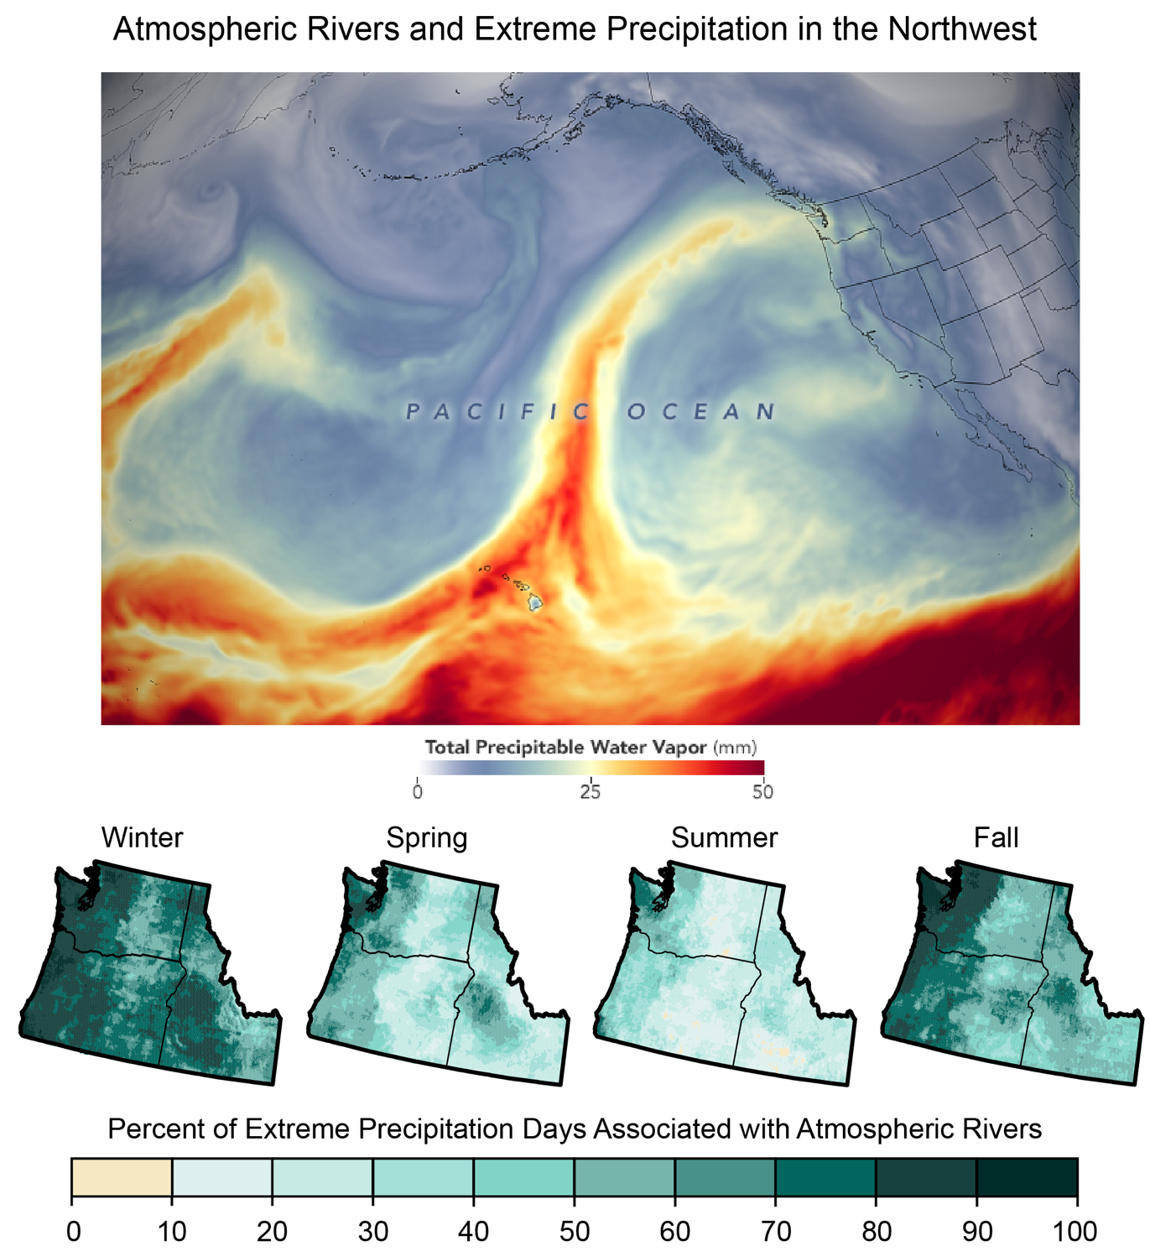
Figure 27.1. Extreme precipitation days are closely associated with atmospheric rivers, which are projected to be more frequent and intense and to reach farther inland.
Notes:
CAPTION: (top) Satellite imagery shows the total precipitable water vapor on February 6, 2020. Red areas indicate more precipitable water vapor, which appears in a narrow band known as an atmospheric river (AR) directed toward the Northwest. (bottom) ARs are closely associated with extreme precipitation events and vary across meteorological seasons, as seen by the percentage of extreme precipitation events during 1981–2016 associated with ARs: winter (December–February), spring (March–May), summer (June–August), and fall (September–November). Fall and winter months have a higher percentage of extreme precipitation days associated with ARs, particularly in coastal regions and regions west of the Cascades. (top) Satellite image: Joshua Stevens, NASA Earth Observatory; (bottom) adapted with permission from Slinskey et al. 2020.(Slinskey et al. 2020) ©American Meteorological Society.

Slide 10
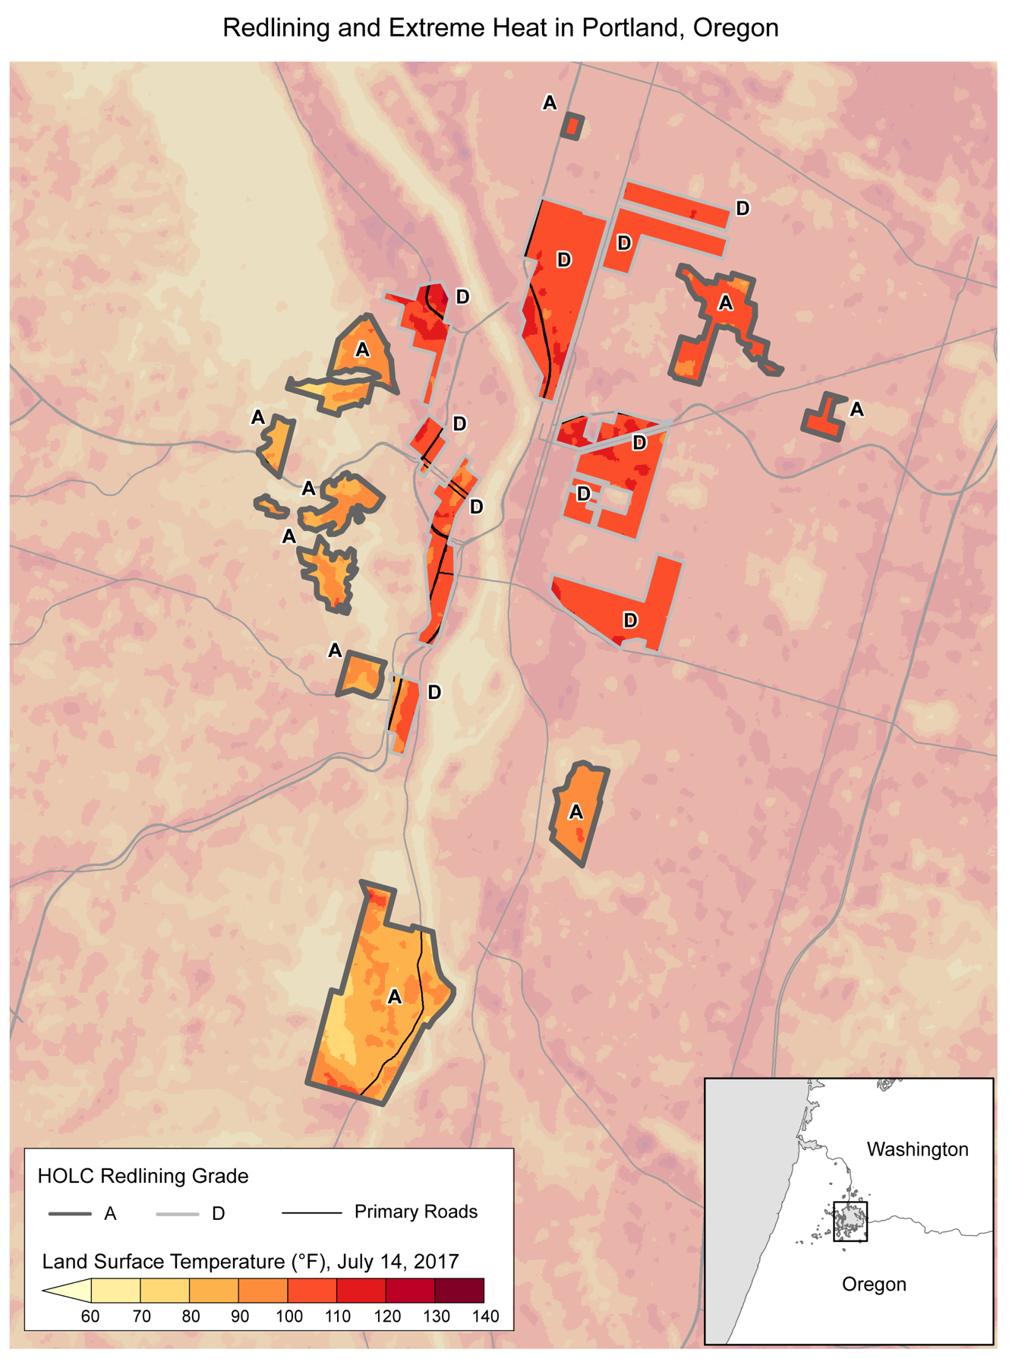
Figure 27.2. Economically and racially segregated urban communities are inequitably exposed to climate change impacts, including extreme heat.
Notes:
CAPTION: The map shows satellite-derived land surface temperature (in °F) for July 14, 2017. Areas in Portland, Oregon, that were historically redlined—that is, areas that received Home Owners’ Loan Corporation (HOLC) grades of D, or “hazardous”—experience more intense heat island effects than areas that received HOLC grades of A or B. Residents are disproportionately exposed to extreme heat in these areas, where surface temperatures are up to 13°F warmer than the city's average surface temperatures. Figure credit: Portland State University and NOAA NCEI.

Slide 11
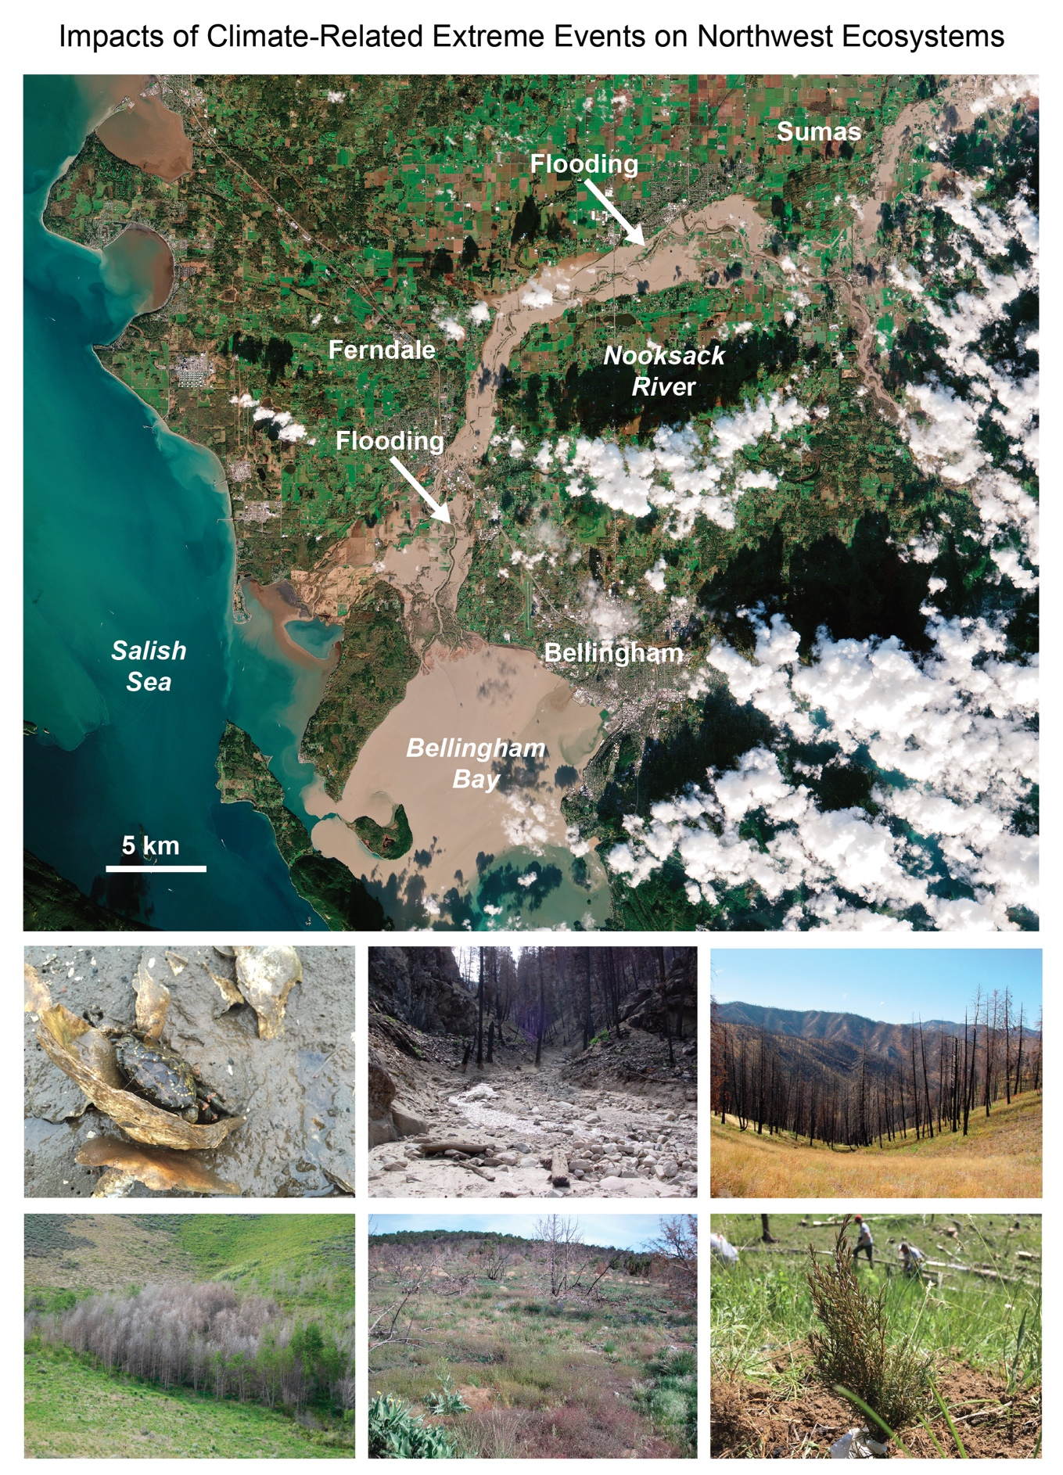
Figure 27.3. Long-term climate changes and extreme events threaten Northwest ecosystems.
Notes:
CAPTION: (top) Flooding on November 16, 2021, in the Nooksack River is shown. Flooding is expected to become more frequent and severe as a result of more intense rainfall and rain-on-snow events. (middle left) Non-native invasives such as the European green crab (Carcinus maenas) disrupt food webs as their distribution expands with warming coastal waters. (middle center) Postfire debris flows are expected to become more common with increased wildfire and precipitation intensity. (middle right) Large areas across the Northwest—such as in Idaho—are prone to increased risk of wildfires. (bottom left) Aspen is sensitive to high air temperature, leading to more dying aspen groves. (bottom center) Increases in the distribution and density of non-native invasive grasses, such as cheatgrass (Bromus tectorum), exacerbate wildfire risk. (bottom right) Seedlings are more sensitive than mature trees to heat stress and drought. Satellite image: (top) Lauren Dauphin and Joshua Stevens, NASA Earth Observatory. Photo credits: (middle left) ©Emily Grason; (middle center, middle right, bottom left) ©Charlie Luce; (bottom center) ©Erica Fleishman; and (bottom right) Colorado State Forest Service.

Slide 12
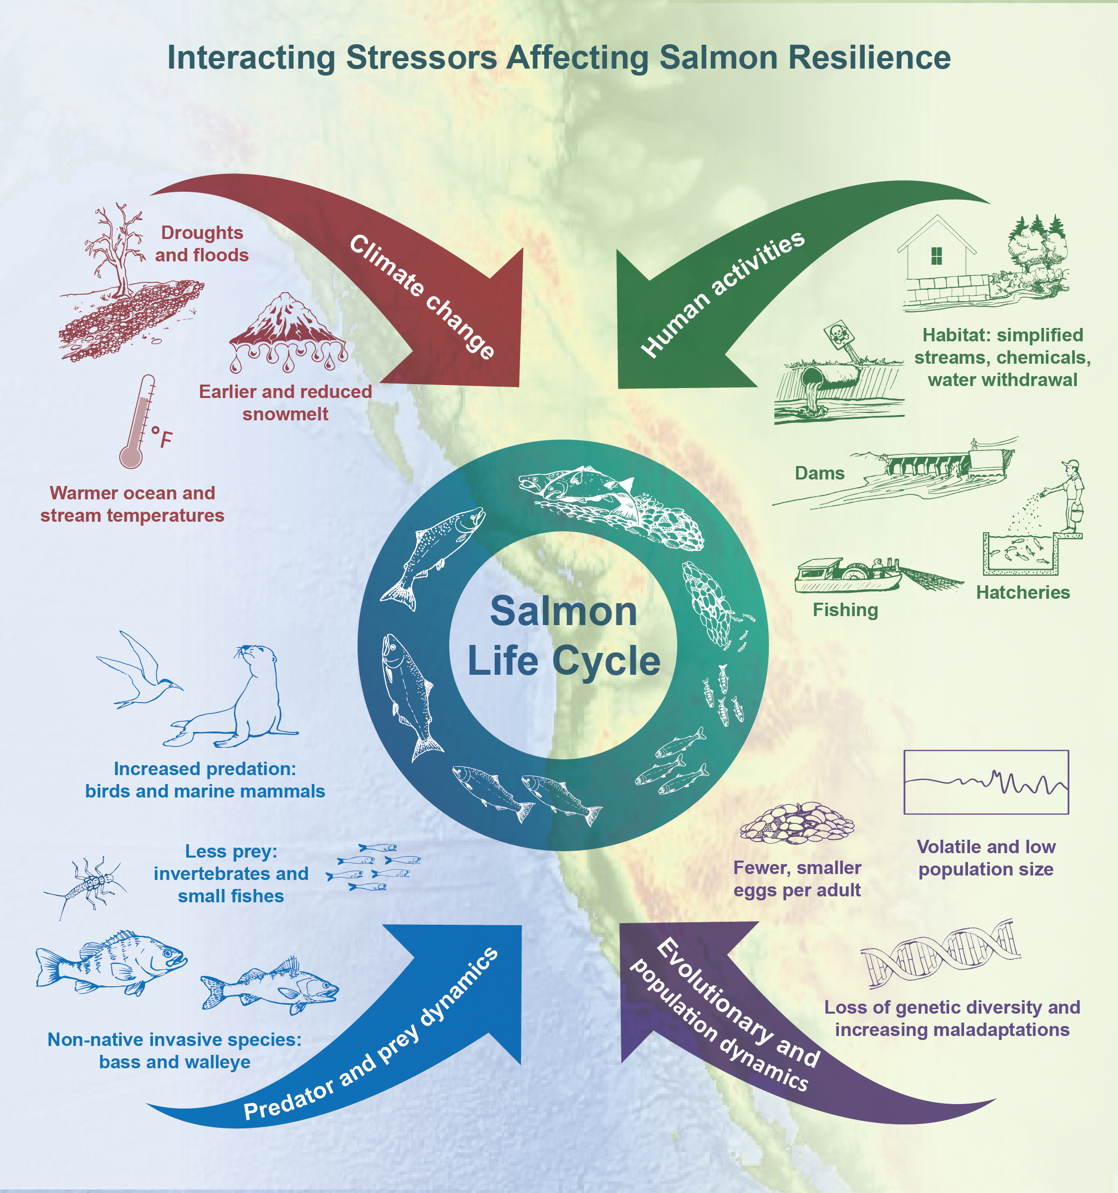
Figure 27.4. Stressors stemming from interactions between human activities and natural systems affect freshwater and marine ecosystems and reduce salmon resilience to climate change.
Notes:
CAPTION: Human activities and climate change alter the physical environment in concert, often amplifying their impacts through cumulative effects over the salmon life cycle. They also directly and indirectly alter freshwater and marine systems. Natural systems respond to changes in their environment through both evolutionary and ecological processes. The sum of these many different processes has led to declines in many populations of salmon over decades and reduced their ability to cope with future climate change. Figure credit: NOAA Fisheries.

Slide 13
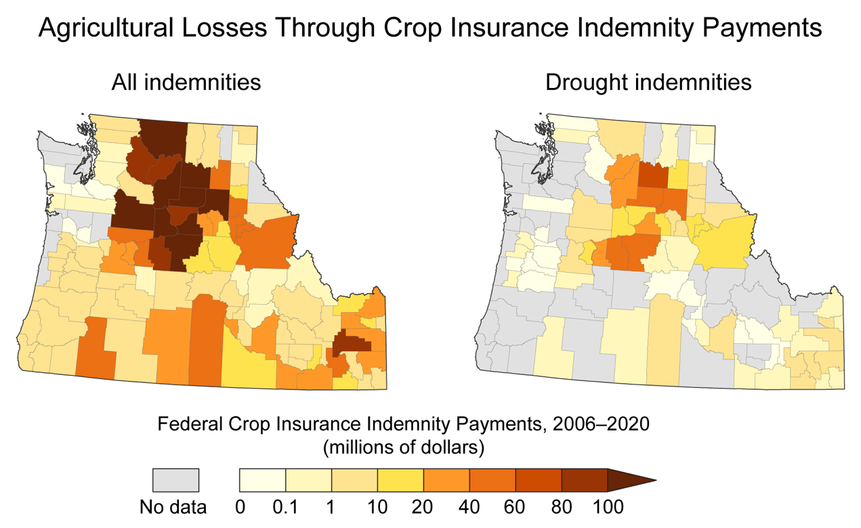
Figure 27.5. Increasing trends in crop insurance loss payments reflect the economic disruption of agricultural production due to extreme events including droughts.
Notes:
CAPTION: These county-level maps compare all crop insurance indemnity payments from the US Department of Agriculture Risk Management Agency (left) with those specifically due to drought, from 2006 through 2020 (right). All indemnity payments reflect both biophysical and socioeconomic impacts from weather- and climate-driven events, including major droughts, on important commodities such as wheat and potatoes. Figure credit: USDA. See figure metadata for additional contributors.

Slide 14
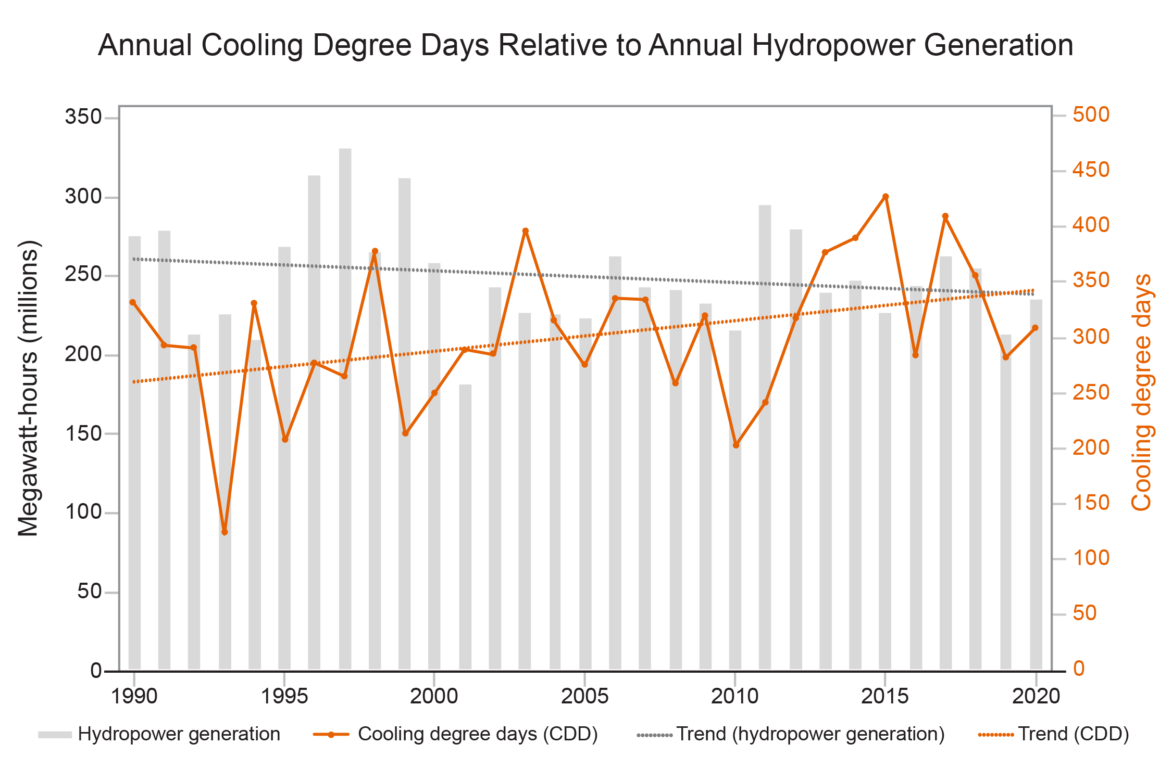
Figure 27.6. Hydropower generation is currently meeting the number of cooling degree days but might not continue to do so as temperatures and heatwaves increase in the future.
Notes:
CAPTION: Cooling degree days—the annual cumulative number of days on which the average temperature is greater than 65°F—are typically used to measure cooling energy demand. During 1990–2020, the annual number of cooling degree days (orange lines) increased, whereas annual hydropower generation (in millions of megawatt-hours, gray bars) decreased slightly. Hydropower generation may not meet projected future cooling demand, especially during summer. Figure credit: Boise State University and Cascadia Consulting Group.

Slide 15
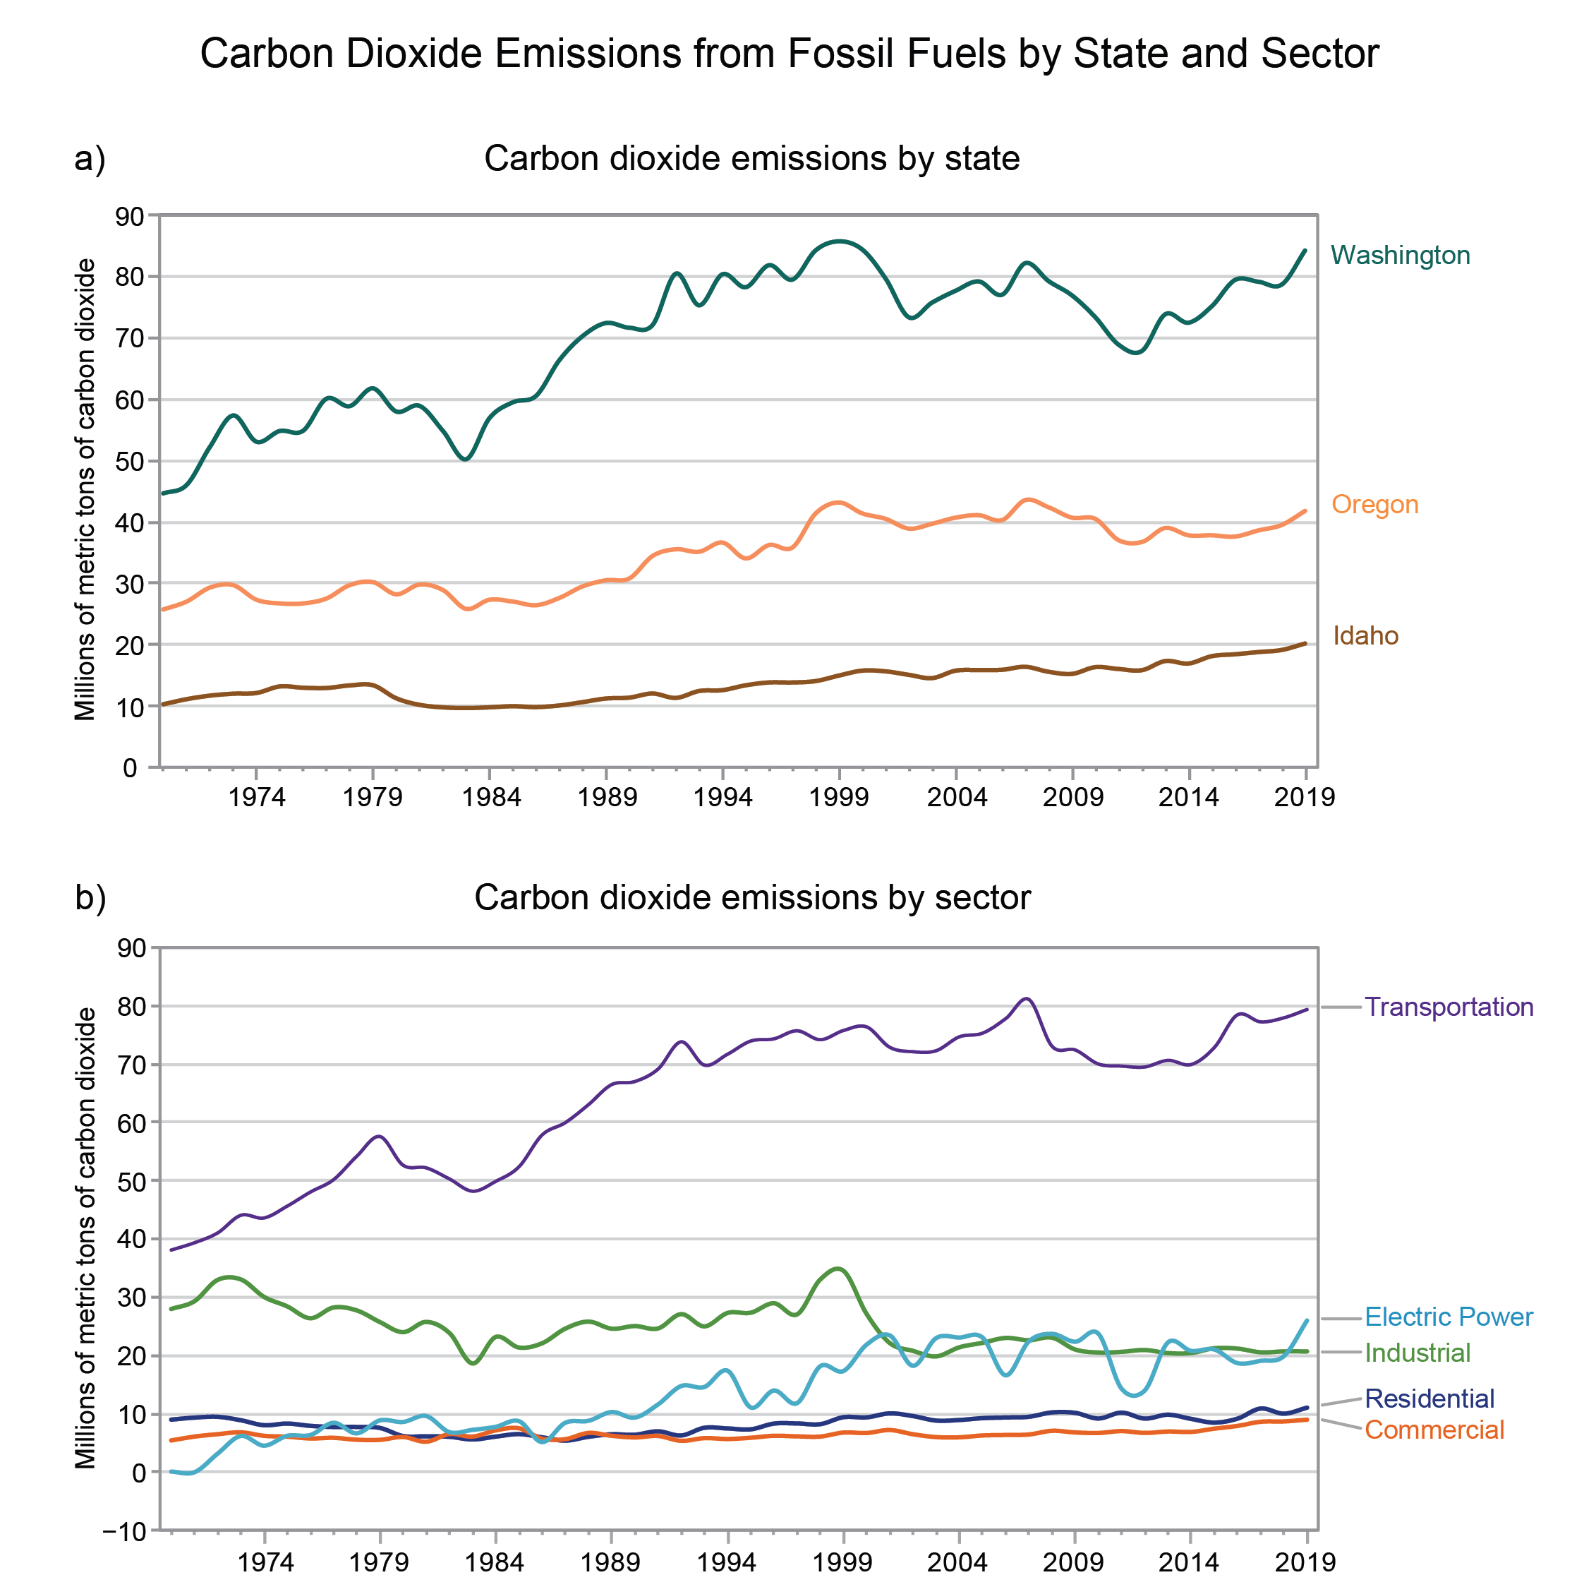
Figure 27.7. Carbon dioxide emissions from fossil fuel consumption vary widely by sector and state.
Notes:
CAPTION: These graphs show carbon dioxide (CO₂) emissions (in millions of metric tons) from fossil fuel consumption by state (top) and sector (bottom). Carbon dioxide emissions from fossil fuel consumption are greatest in Washington, followed by Oregon and Idaho. Transportation emits more CO₂ than other sectors across Idaho, Oregon, and Washington. Figure credit: Boise State University and Cascadia Consulting Group.

Slide 16
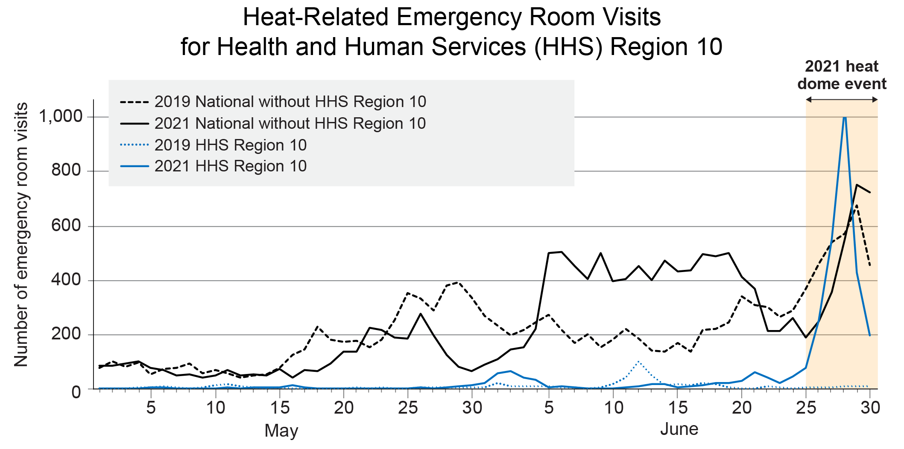
Figure 27.8. Heat-Related Emergency Room Visits for Health and Human Services (HHS) Region 10
Notes:
CAPTION: The graph shows the number of heat-related emergency department visits for US Department of Health and Human Services (HHS) Region 10 (which includes Alaska, Oregon, Idaho, and Washington), relative to the rest of the country, from May 1–June 30 in 2019 and 2021. There was a sharp increase in emergency department visits for heat-related illness during the 2021 heat dome event in HHS Region 10, relative to the heat-related emergency department visits for the region in 2019. HHS Region 10 also experienced relatively more heat-related emergency department visits during the 2021 heat dome event compared to the rest of the country over the same time period. Adapted from Schramm et al. 2021.(Schramm et al. 2021)

Slide 17
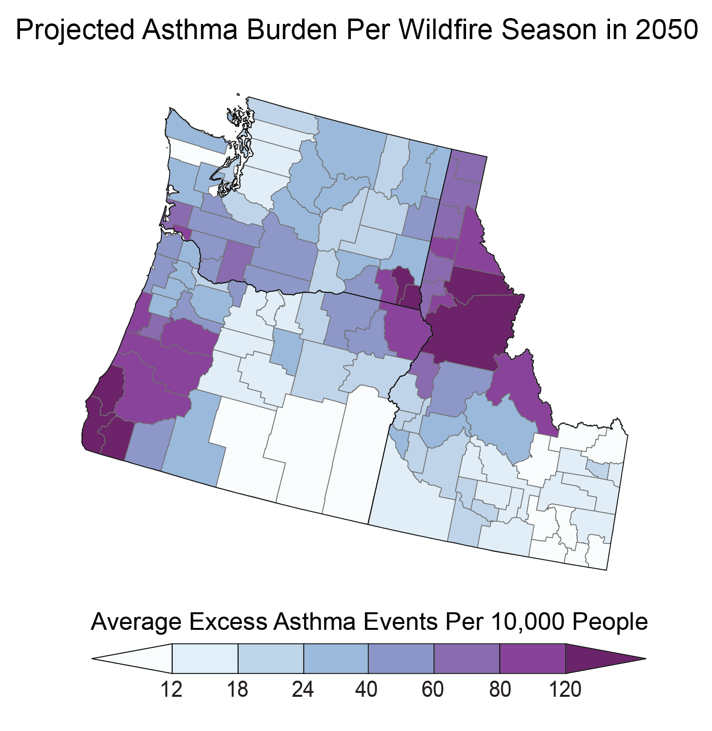
Figure 27.9. Excess asthma burden associated with wildfire smoke is expected to disproportionately affect the Northwest.
Notes:
CAPTION: Northern Idaho, coastal Oregon, and southwest Washington are expected to face some of the highest wildfire smoke–related asthma burden in the Northwest. Excess asthma incidences related to wildfire smoke are expected to increase across the Northwest. The figure shows the average expected total number of excess asthma events per 10,000 people per wildfire season by the 2050s under a very high scenario (RCP8.5). Adapted from Stowell et al. 2022(Stowell et al. 2022) [CC BY 4.0].

Slide 18
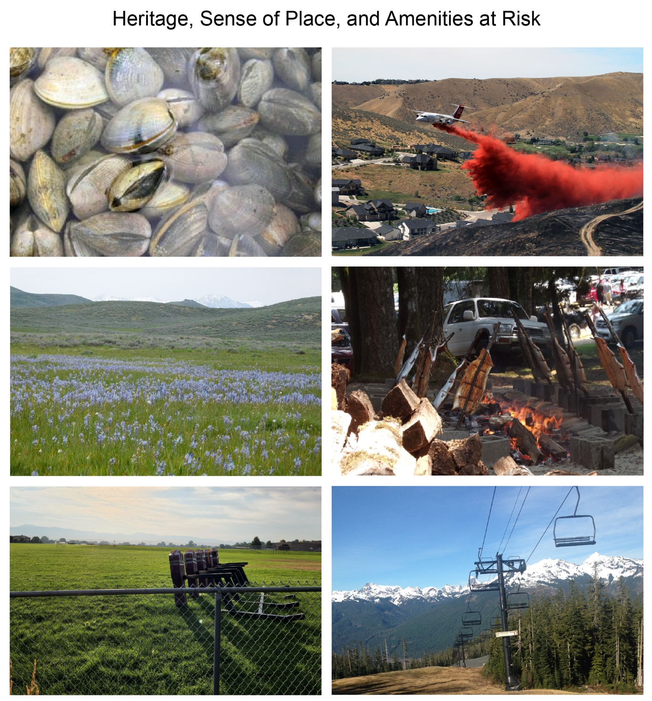
Figure 27.10. The heritage of the Northwest is intertwined with the diversity of landscapes, economies, and quality of life.
Notes:
CAPTION: These photos illustrate different heritages, cultural traditions, and amenities at risk from climate change. (top left) Coastal change is threatening beaches and shellfish habitat for the Swinomish Tribe, threatening cultural activities like the Swinomish Clam Bake. (top right) Fire retardant drops protect vulnerable homes in the wildland–urban interface. (center left) Culturally important foods, such as camas, will be affected by climate change. (center right) Climate change is affecting salmon, potentially affecting the ability of some Tribes to roast and smoke salmon. (bottom left) Wildfire smoke days are increasing, affecting school recreation opportunities. (bottom right) Warmer winters, such as the winter of 2015, will lead to less winter snow, affecting ski resorts such as Mount Baker Ski Resort, Washington, which had no snow on February 15, 2015, during the height of ski season. Photo credits: (top left) ©Richard A. Walker; (top right) National Interagency Fire Center; (center left and bottom left) ©Charles Luce; (center right) ©Samantha Chisholm Hatfield; (bottom right) ©Duncan Howat.

Slide 19
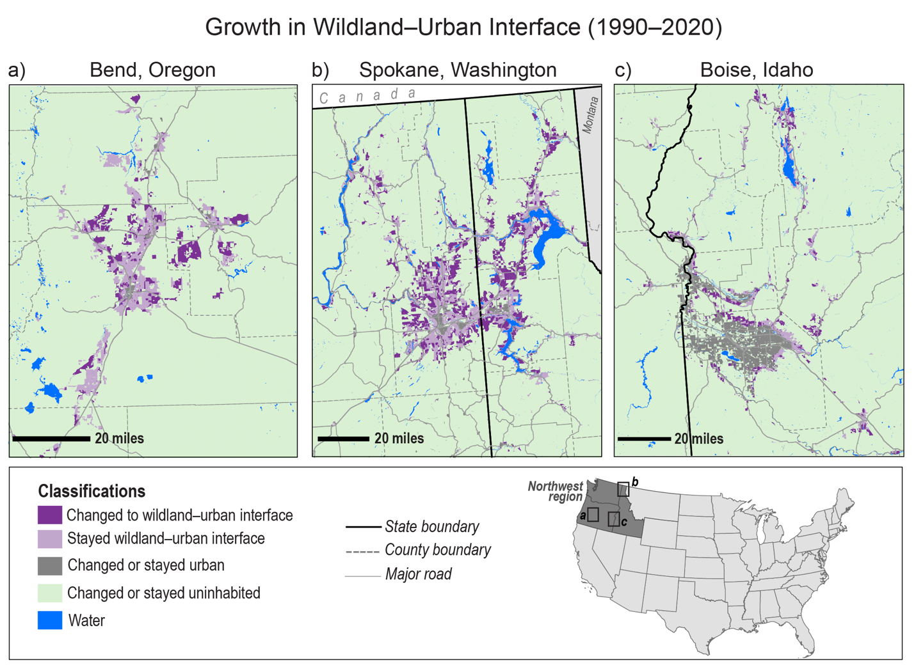
Figure 27.11. The growth of homes in the wildland–urban interface puts an increasing number of people at risk of wildfire and flooding.
Notes:
CAPTION: The maps show growth in the wildland–urban interface (WUI; dark purple) areas, which are associated with increased wildfire and flooding risks, between 1990 and 2020 near Bend, Oregon (a); Spokane, Washington (b); and Boise, Idaho (c). Bend and Spokane have experienced fast rates of development and population growth that have led to new areas being developed as WUI. Figure credit: USDA Forest Service, NOAA NCEI, and CISESS NC.

Slide 20
Federal Coordinating Lead Author
Li Erikson, US Geological Survey, Pacific Coastal and Marine Science Center
Chapter Lead
Michael Chang, Cascadia Consulting Group
Chapter Authors
Kathleen Araújo, Boise State University, CAES Energy Policy Institute
Erica N. Asinas, University of Washington, Climate Impacts Group
Samantha Chisholm Hatfield, Oregon State University
Lisa G. Crozier, NOAA Fisheries, Northwest Fisheries Science Center
Erica Fleishman, Oregon State University
Ciarra S. Greene, Sapóoq'is Wíit'as Consulting
Eric E. Grossman, US Geological Survey, Pacific Coastal and Marine Science Center
Charles Luce, USDA Forest Service
Jayash Paudel, University of Oklahoma
Kirti Rajagopalan, Washington State University, Department of Biological Systems Engineering
Elise Rasmussen, Washington State Department of Health
Crystal Raymond, University of Washington, Climate Impacts Group
Julian J. Reyes, US Department of Agriculture
Vivek Shandas, Portland State University
Technical Contributors
Blane L. Bellerud, NOAA Fisheries, West Coast Region
Su J. Kim, NOAA Fisheries, Northwest Fisheries Science Center
Angela Pietschmann, Cascadia Consulting Group
Review Editor
Kathryn McConnell, Brown University
USGCRP Coordinators
Aaron M. Grade, US Global Change Research Program / ICF
Christopher W. Avery, US Global Change Research Program / ICF
Samantha Basile, US Global Change Research Program / ICF

Slide 21
Chang, M., L. Erikson, K. Araújo, E.N. Asinas, S. Chisholm Hatfield, L.G. Crozier, E. Fleishman, C.S. Greene, E.E. Grossman, C. Luce, J. Paudel, K. Rajagopalan, E. Rasmussen, C. Raymond, J.J. Reyes, and V. Shandas, 2023: Ch. 27. Northwest. In: Fifth National Climate Assessment. Crimmins, A.R., C.W. Avery, D.R. Easterling, K.E. Kunkel, B.C. Stewart, and T.K. Maycock, Eds. U.S. Global Change Research Program, Washington, DC, USA. https://doi.org/10.7930/NCA5.2023.CH27
https://nca2023.globalchange.gov/chapter/27

