Slide 1

NCA5 Website: https://nca2023.globalchange.gov
Chapter Website: https://nca2023.globalchange.gov/chapter/2
NCA5 Atlas: https://atlas.globalchange.gov
Figure captions can be found in the slide notes of this deck
Social media: @usgcrp, #NCA5

Slide 2
Chapter 2 | Climate Trends

Slide 3
1
Climate Is Changing, and Scientists Understand Why
It is unequivocal that human activities have increased atmospheric levels of carbon dioxide and other greenhouse gases. It is also unequivocal that global average temperature has risen in response. Observed warming over the continental United States and Alaska is higher than the global average (virtually certain, very high confidence). Long-term changes have been observed in many other aspects of the climate system (very high confidence). The Earth system is complex and interconnected, which means changes in faraway regions are virtually certain to affect the United States (very high confidence).

Slide 4
2
Extreme Events Are Becoming More Frequent and Severe
Observations show an increase in the severity, extent, and/or frequency of multiple types of extreme events. Heatwaves have become more common and severe in the West since the 1980s (high confidence). Drought risk has been increasing in the Southwest over the past century (very high confidence), while at the same time rainfall has become more extreme in recent decades, especially east of the Rockies (very high confidence). Hurricanes have been intensifying more rapidly since the 1980s (high confidence) and causing heavier rainfall and higher storm surges (high confidence). More frequent and larger wildfires have been burning in the West in the past few decades due to a combination of climate factors, societal changes, and policies (very high confidence).

Slide 5
3
How Much the Climate Changes Depends on the Choices Made Now
The more the planet warms, the greater the impacts—and the greater the risk of unforeseen consequences (very high confidence). The impacts of climate change increase with warming, and warming is virtually certain to continue if emissions of carbon dioxide do not reach net zero (very high confidence). Rapidly reducing emissions would very likely limit future warming (very high confidence) and the associated increases in many risks (high confidence). While there are still uncertainties about how the planet will react to rapid warming and catastrophic future scenarios that cannot be ruled out, the future is largely in human hands.

Slide 6
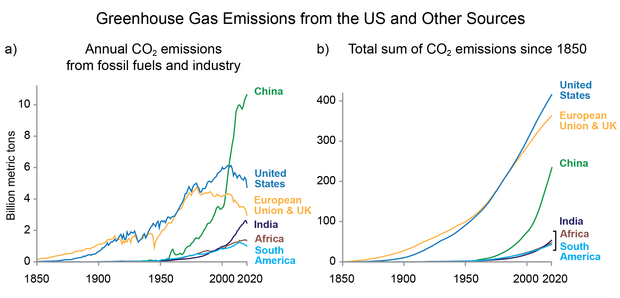
Figure 2.1. China is now the largest single-country emitter of carbon dioxide on an annual basis. The United States and Europe have emitted the majority of cumulative carbon dioxide.
Notes:
CAPTION: Panel (a) shows the annual total carbon dioxide (CO₂) emissions from fossil fuels and industry for selected world regions. China is currently the world’s largest emitter of CO₂. Emissions from the US and the European Union and UK are large and falling; India, Africa, and South America emit less CO₂ on an annual basis. Panel (b) shows the cumulative CO₂ emissions of the same world regions. Some CO₂ emitted decades ago remains in the atmosphere today, causing the climate changes now being experienced. Figure credit: Project Drawdown.

Slide 7
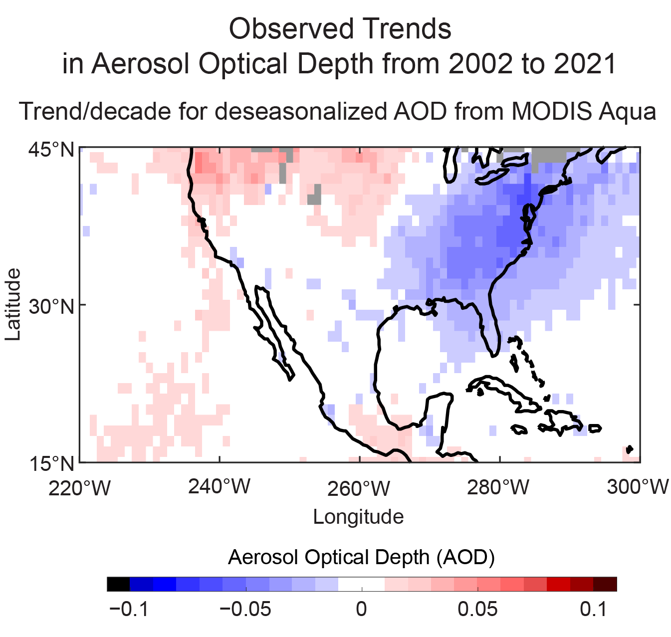
Figure 2.2. Trends in aerosol optical depth show decreases in aerosol pollution across the eastern United States.
Notes:
CAPTION: Aerosol pollution over and downwind of the eastern US has decreased significantly in recent decades, resulting in both improved air quality and reduced cooling effects. Aerosols are tiny particles in the air that are associated with respiratory disease. Reduction of these particles means less impact on human health. These particles also reflect sunlight back to space, thus cooling the Earth’s atmosphere. Reduction of these particles means less sunlight is reflected resulting in reduced cooling effects. This figure shows the trend from July 2002 to December 2021 in aerosol optical depth (AOD), a unitless measure of the total amount of aerosols in the atmosphere, as derived from satellite observations. The trend is calculated from deseasonalized AOD anomaly and is shown as change per decade. The trend over and downwind of the eastern US is significant at the 95% confidence level. Figure credit: NASA Langley Research Center.

Slide 8
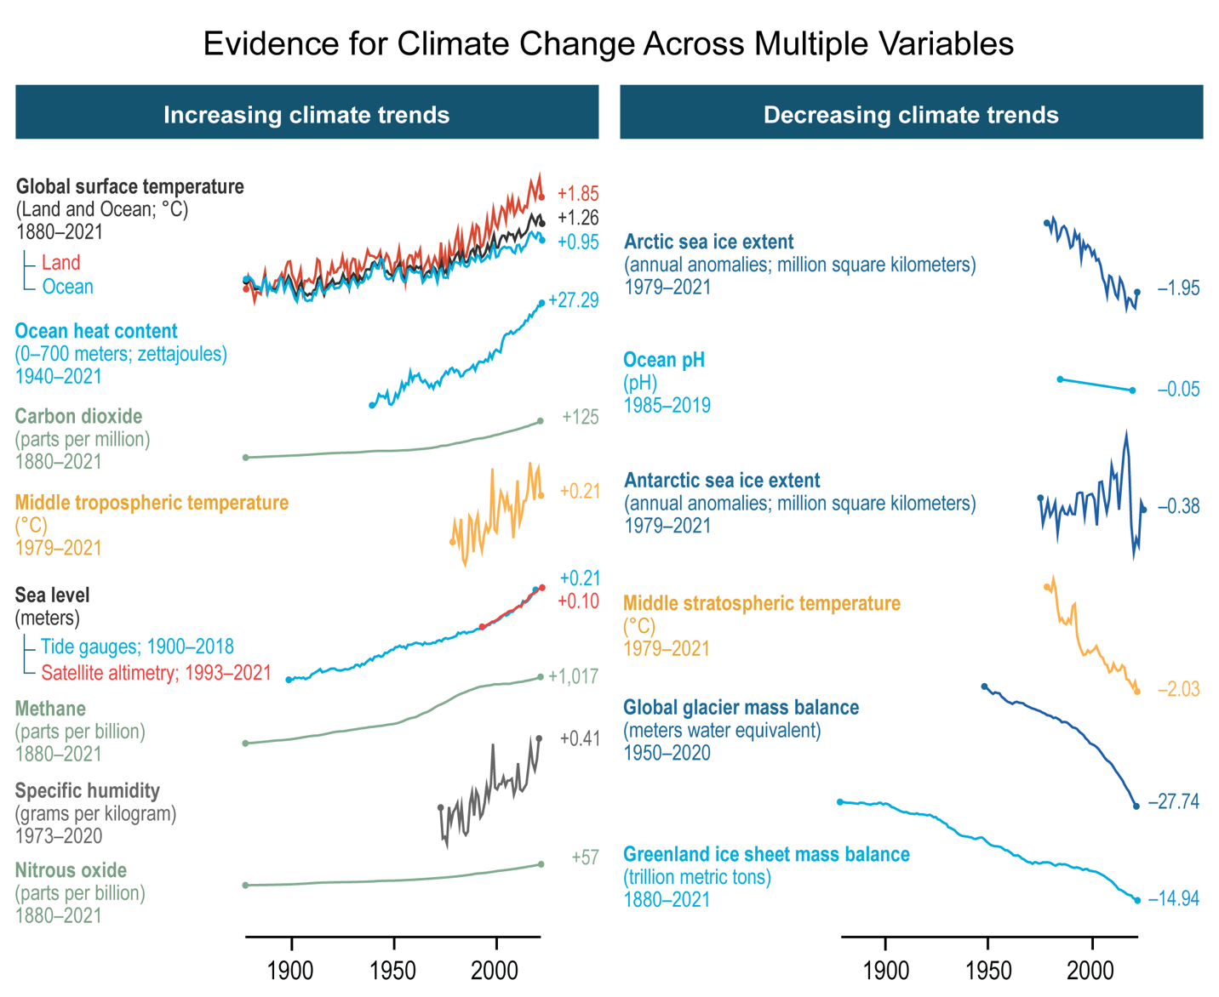
Figure 2.3. Changes across the Earth system reflect the influence of human activities on the climate.
Notes:
CAPTION: Climate change is apparent in many different aspects of the Earth system between 1880 and 2021. Many of these changes are evidence for a human fingerprint on the climate, reflecting the current scientific understanding of how the planet responds to external influences (Ch. 3). Global changes between the start and end of each time series are shown as numerical values to the right of each chart and are calculated by fitting each time series with a localized linear regression with a bandwidth of 30 years. Figure credit: Stripe Inc., NOAA NCEI, and CISESS NC.

Slide 9
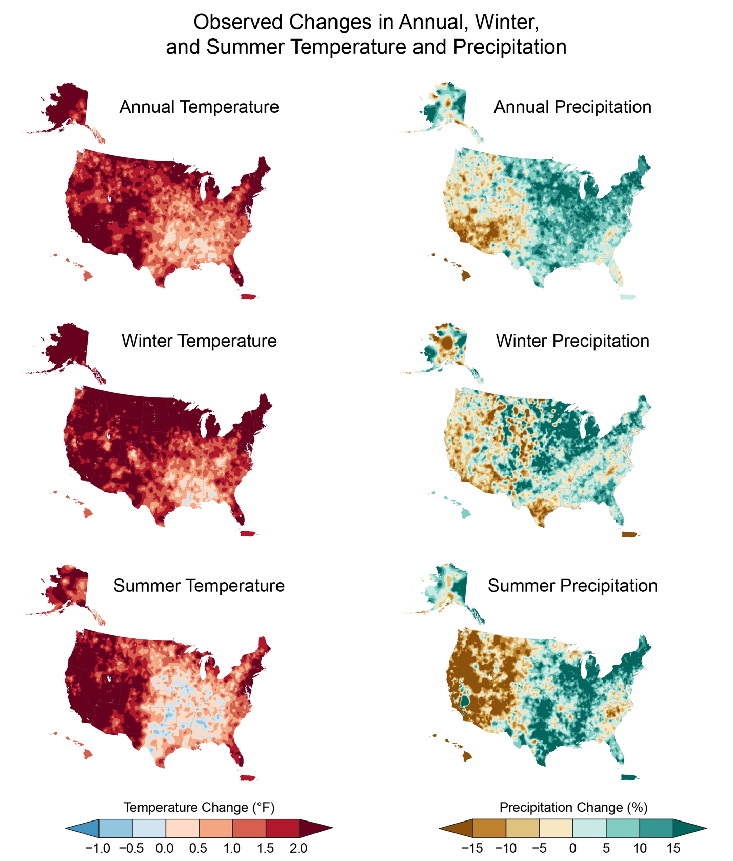
Figure 2.4. Temperature has increased and precipitation has changed over much of the United States.
Notes:
CAPTION: Changes shown are the difference between the annual average or seasonal temperatures (left column) and precipitation totals (right column) for the present day (2002–2021) compared to the average for the first half of the last century (1901–1960) for the contiguous United States (CONUS), Hawaiʻi, and Puerto Rico; and 1925–1960 for Alaska. Temperature and precipitation estimates for CONUS and Alaska are derived from the nClimGrid dataset.(Vose et al. 2014; Vose et al. 2017) For Hawaiʻi and Puerto Rico, temperature estimates are derived from NOAAGlobalTemp,(Vose et al. 2021) and precipitation estimates are derived from the Global Precipitation Climatology Center dataset.(Becker et al. 2013) Figure credit: NOAA NCEI and CISESS NC.

Slide 10
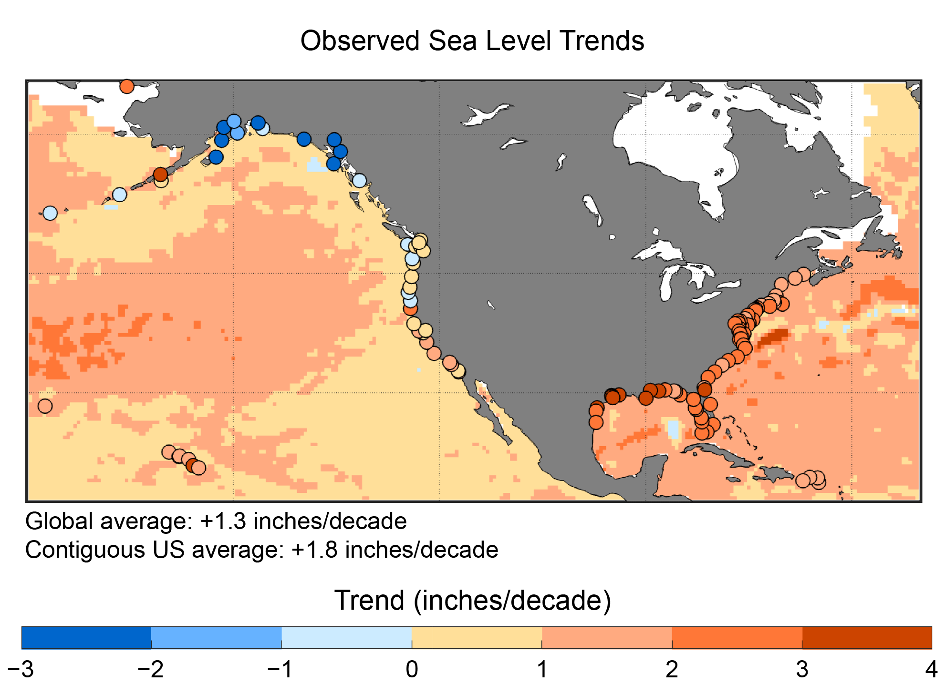
Figure 2.5. Sea levels are rising across most US coastal areas.
Notes:
CAPTION: Satellite and tide gauge data show trends in sea level rise during 1993–2020 that are, on average, greater than global trends. Sea levels are not rising uniformly across US coastlines. The highest rates of sea level rise have occurred along the Gulf Coast and Atlantic Coast, with lower rates on the Pacific Coast and sea level fall along parts of the Alaska Coast. Rates of sea level rise in Hawai‘i and Puerto Rico are closer to the global average. Adapted from Sweet et al. 2022.(Sweet et al. 2022)

Slide 11
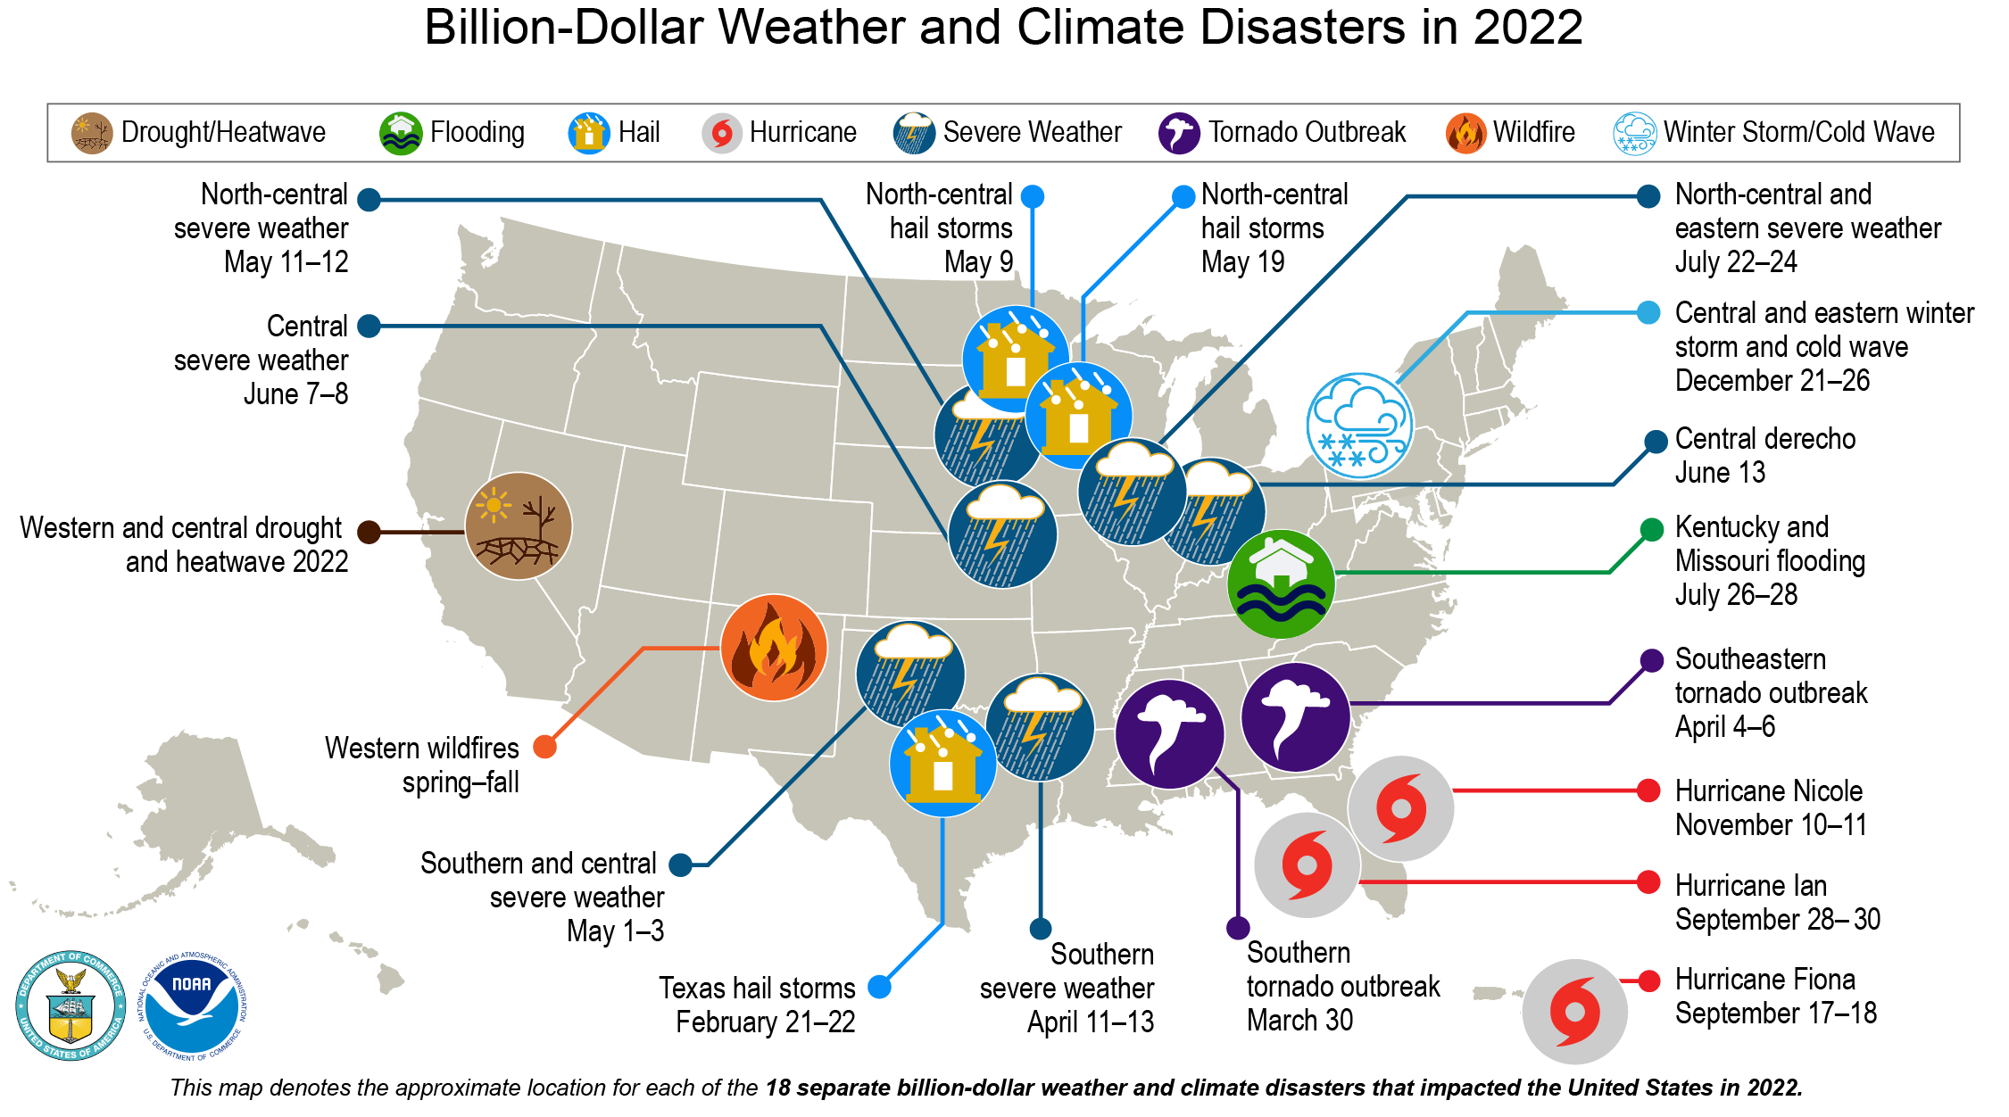
Figure 2.6. The US experienced 18 billion-dollar weather and climate disasters in 2022.
Notes:
CAPTION: In the 1980s, there was one weather/climate disaster event with losses exceeding $1 billion approximately every four months. By the 2010s, there was one every three weeks or less. In 2022, there were 18 such events that affected the United States. These events included 1 drought event, 1 flooding event, 11 severe storm events (including tornadoes, hail storms, and straight-line winds), 3 tropical cyclone events, 1 wildfire event, and 1 winter storm event. Overall, these events resulted in the deaths of 474 people and had significant economic effects on the areas impacted. Source: NCEI 2022.(NCEI 2022)

Slide 12
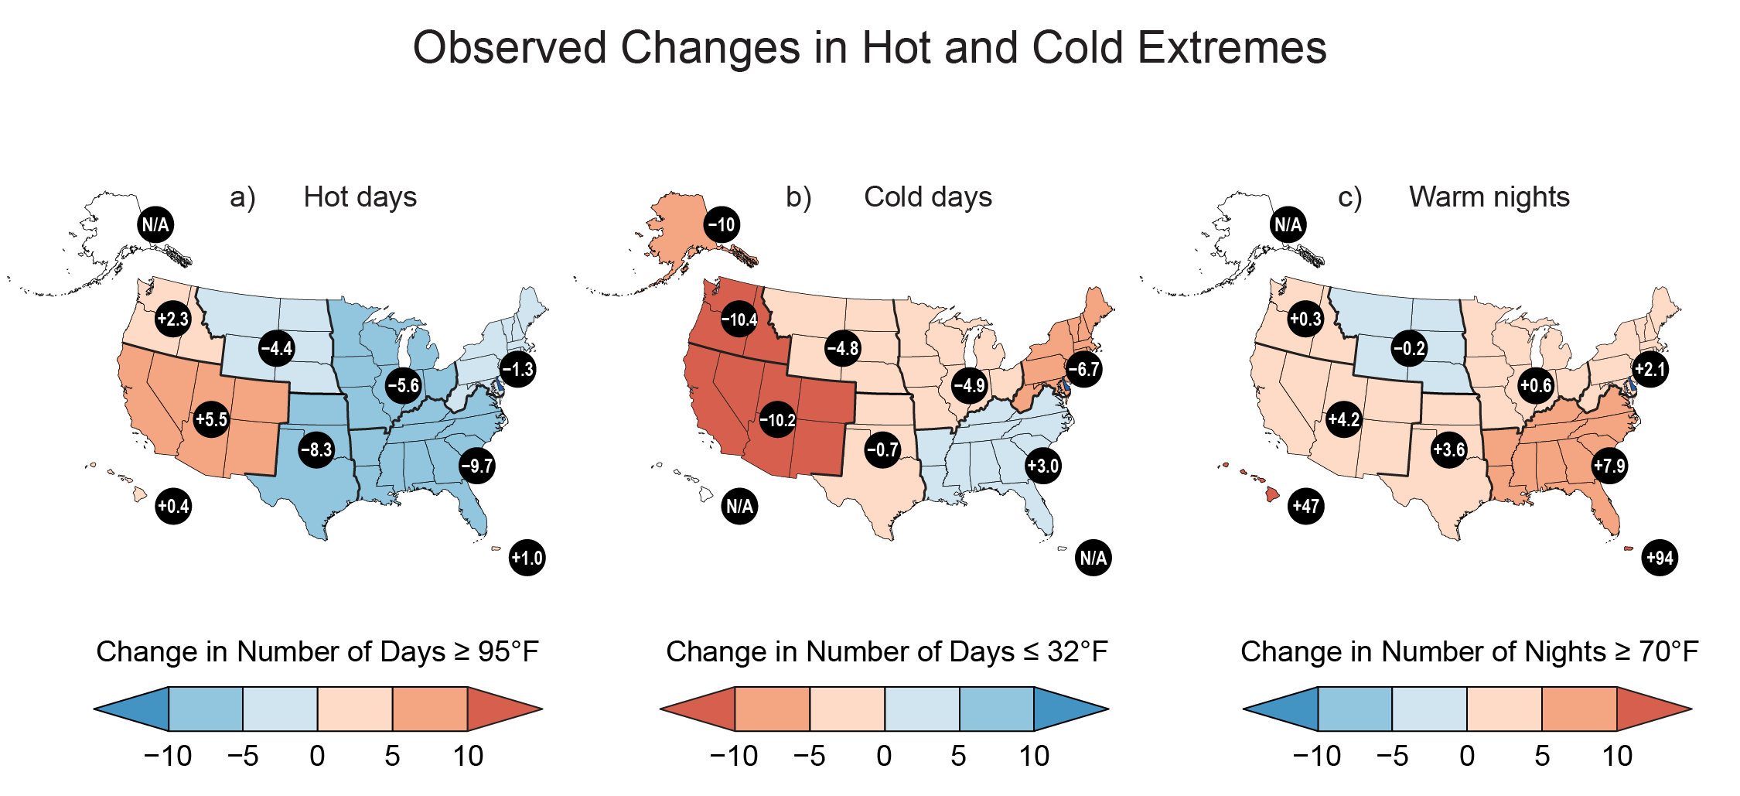
Figure 2.7. Hot days have increased in the West, hot nights have increased nearly everywhere, and cold days have decreased.
Notes:
CAPTION: Over much of the country, the risk of warm nights has increased while the risk of cold days has decreased. The risk of hot days has also increased across the western US. This figure shows the observed change in the number of (a) hot days (days at or above 95°F), (b) cold days (days at or below 32°F), and (c) warm nights (nights at or above 70°F) over the period 2002–2021 relative to 1901–1960 (1951–1980 for Alaska and Hawai‘i and 1956–1980 for Puerto Rico). Data were not available for the US-Affiliated Pacific Islands and the US Virgin Islands. Figure credit: Project Drawdown, Washington State University Vancouver, NOAA NCEI, and CISESS NC.

Slide 13
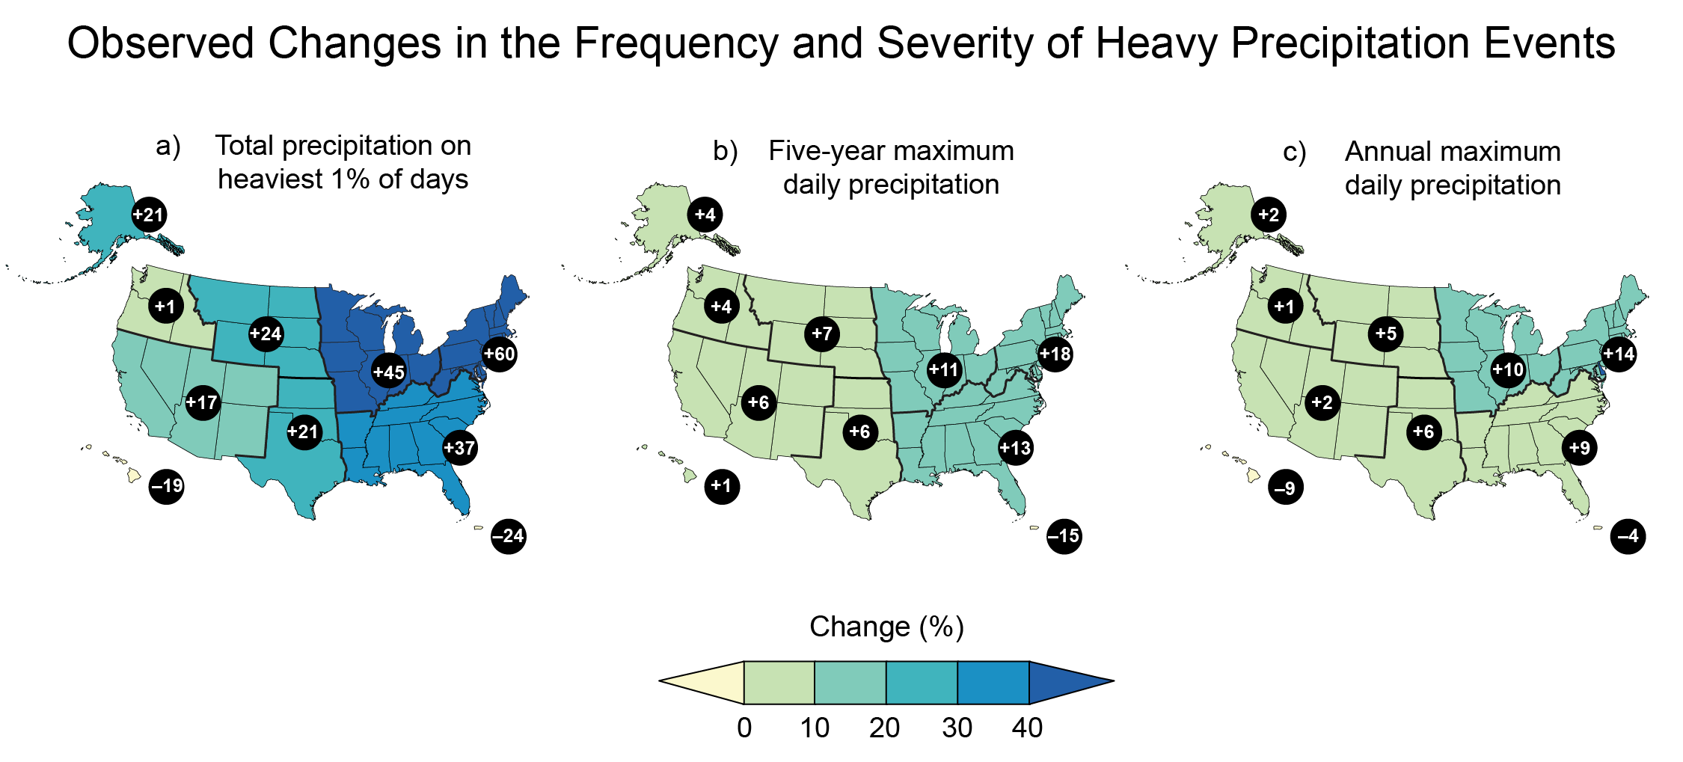
Figure 2.8. Heavy precipitation events are becoming more frequent and intense across much of the country.
Notes:
CAPTION: The frequency and intensity of heavy precipitation events have increased across much of the United States, particularly the eastern part of the continental US, with implications for flood risk and infrastructure planning. Maps show observed changes in three measures of extreme precipitation: (a) total precipitation falling on the heaviest 1% of days, (b) daily maximum precipitation in a 5-year period, and (c) the annual heaviest daily precipitation amount over 1958–2021. Numbers in black circles depict percent changes at the regional level. Data were not available for the US-Affiliated Pacific Islands and the US Virgin Islands. Figure credit: NOAA NCEI and CISESS NC.

Slide 14
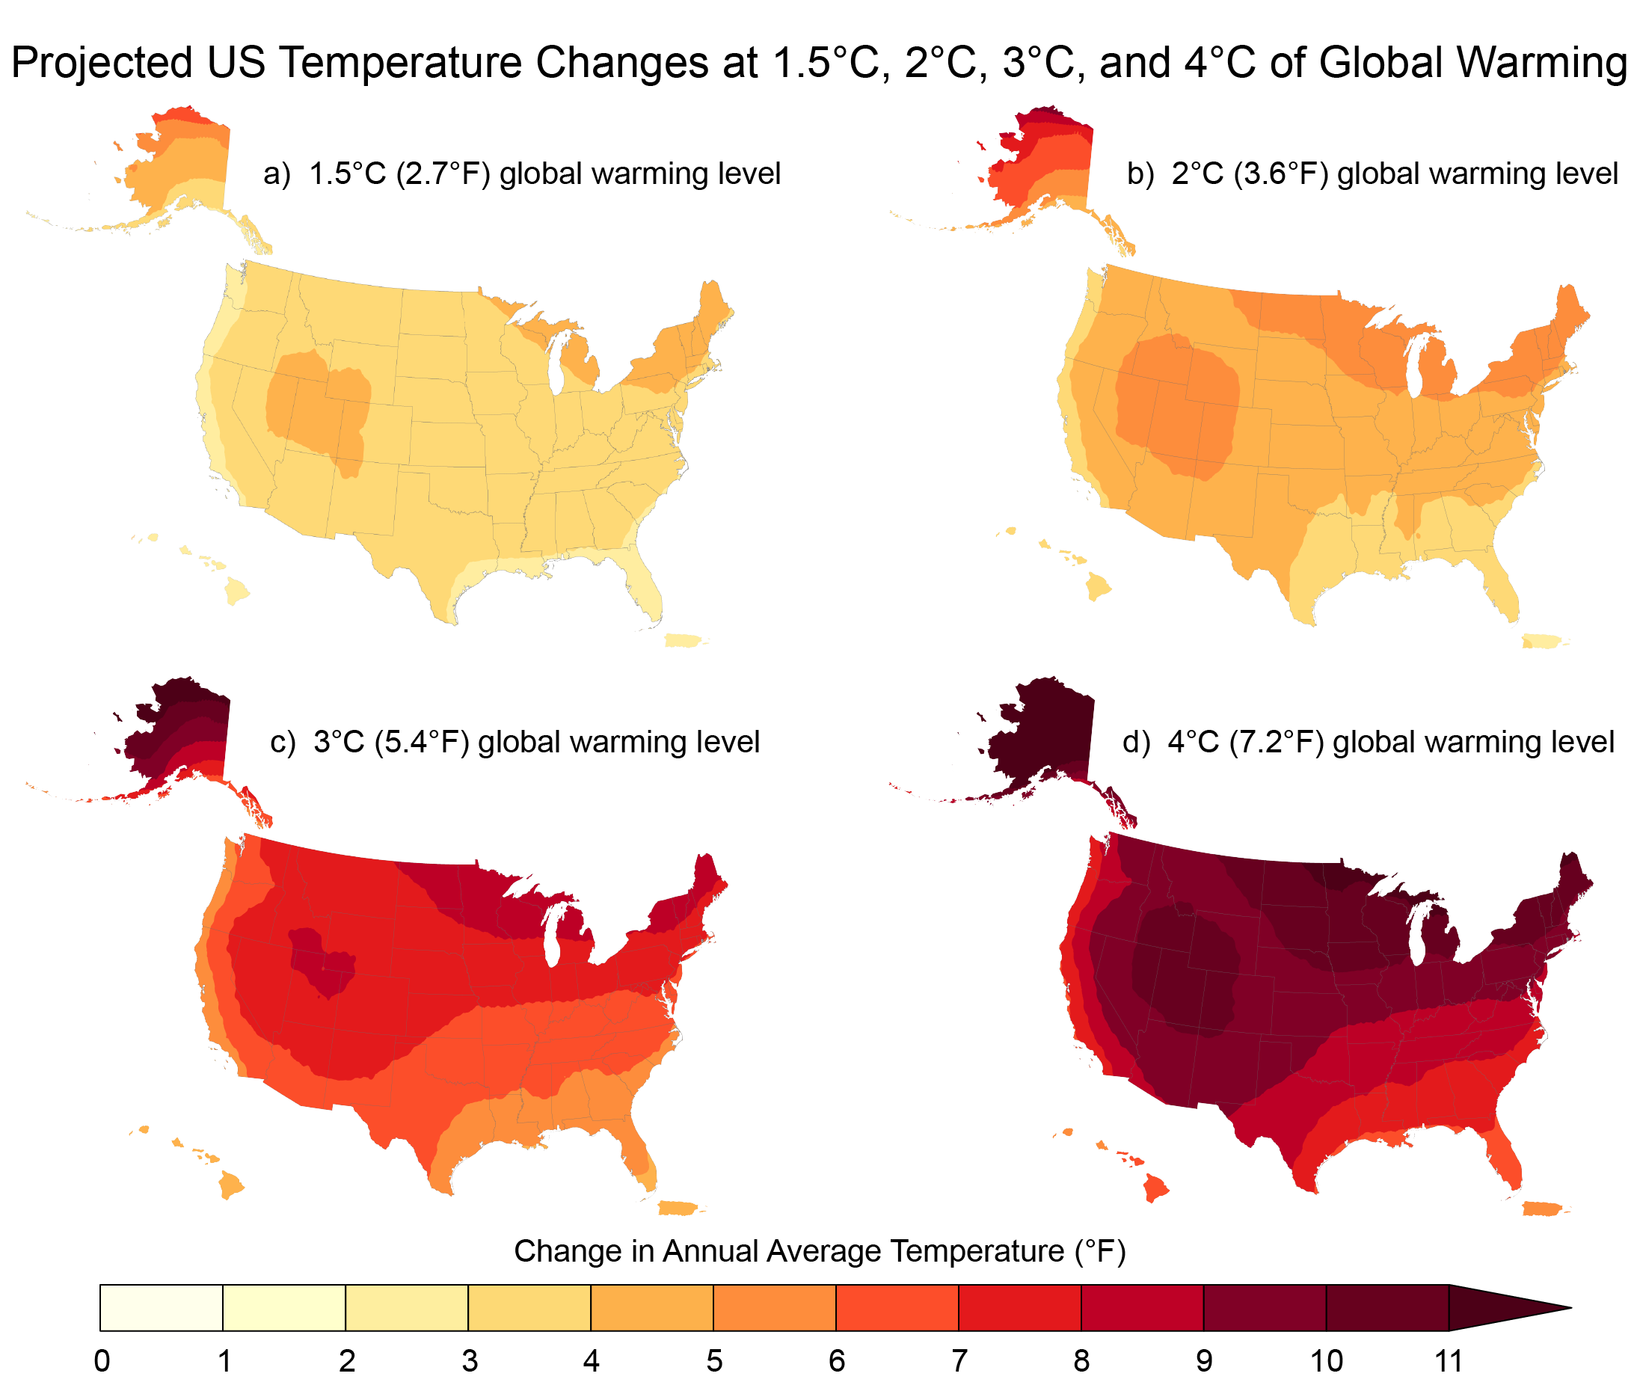
Figure 2.9. The United States is projected to warm faster than the global average.
Notes:
CAPTION: As the world warms, the US warms more. Projected temperature rises are larger in the northern and western portions of the country and are most severe in the Arctic. These maps show projected changes in annual average temperature (°F) for various global warming levels (1.5°, 2.0°, 3.0°, and 4.0°C). Changes are relative to the period 1851–1900. Based on CMIP6. Data were not available for the US-Affiliated Pacific Islands. Figure credit: NOAA NCEI and CISESS NC.

Slide 15
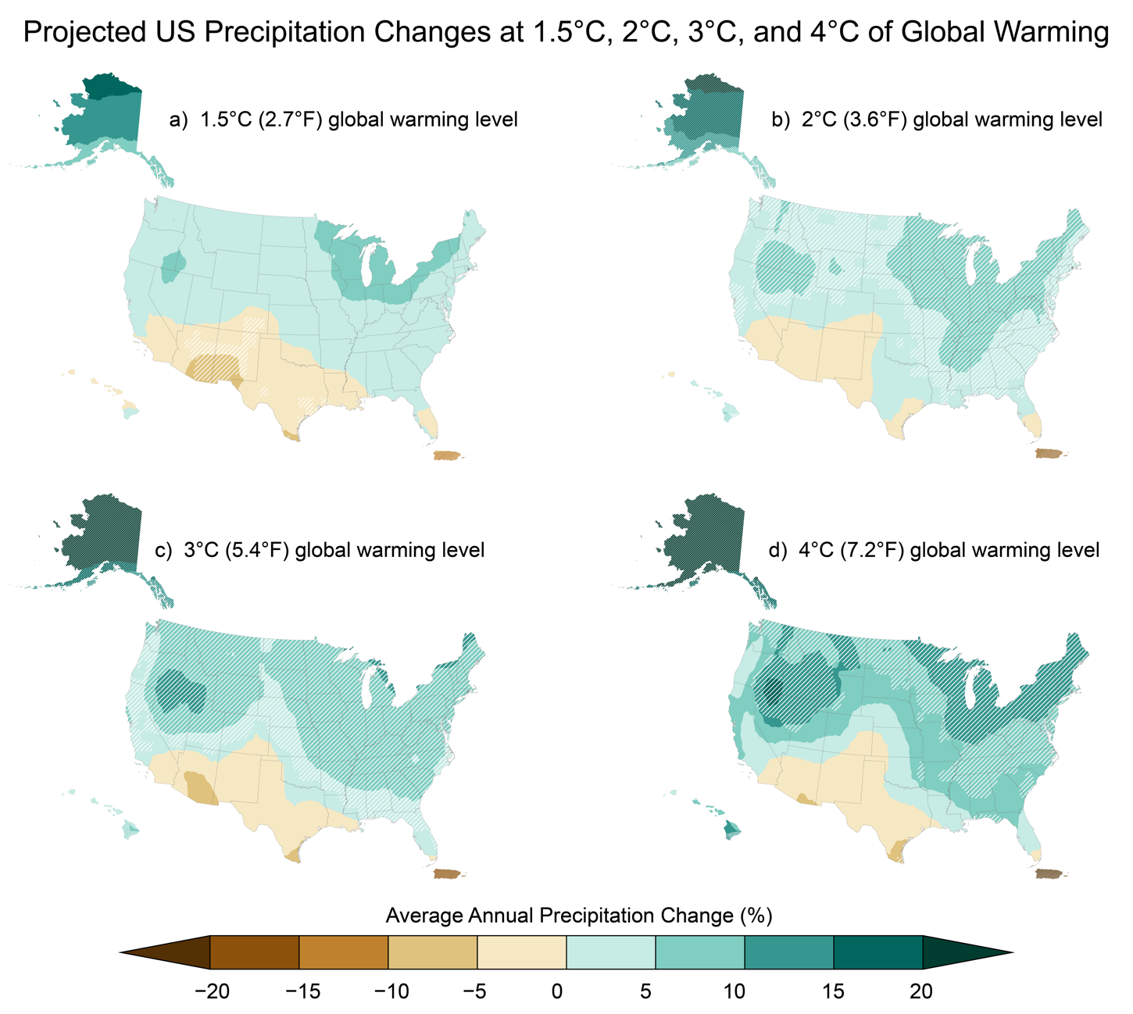
Figure 2.10. Precipitation changes are projected to be larger at higher levels of warming.
Notes:
CAPTION: These maps show projected changes in average annual precipitation (%) for various global warming levels (1.5°, 2.0°, 3.0°, and 4.0°C). Precipitation is projected to increase with warming in the North and East and to decrease in the Southwest and the Caribbean. Changes are relative to the period 1851–1900. Based on CMIP6. Data were not available for the US Affiliated Pacific Islands. Hatching indicates areas where 80% or more of the models agree on the sign of the change. Figure credit: Project Drawdown, Stripe Inc., NOAA NCEI, and CISESS NC.

Slide 16
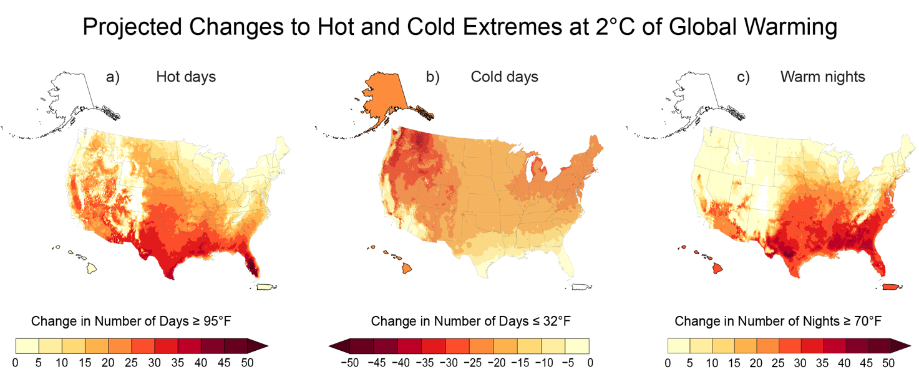
Figure 2.11. More hot days, even more warm nights, and fewer cold days are expected at a global warming level of 2°C.
Notes:
CAPTION: These maps show changes in the (a) projected number of hot days with a maximum temperature at or above 95°F, (b) cold days (minimum temperature at or below 32°F), and (c) warm nights (minimum temperature at or above 70°F) at a global warming level of 2.0°C. Changes are relative to the period 1991–2020. Based on LOCA2/STAR. Values for Alaska, Hawaiʻi, and Puerto Rico are averages from STAR downscaling of 44, 15, and 31 stations, respectively. The Hawai‘i value for cold days is for Mauna Loa, the only network station where freezing temperatures occur. Areas of no change (shown in white) generally will not experience temperatures exceeding those thresholds. Data were not available for the US-Affiliated Pacific Islands and the US Virgin Islands. Figure credit: NOAA NCEI and CISESS NC.

Slide 17
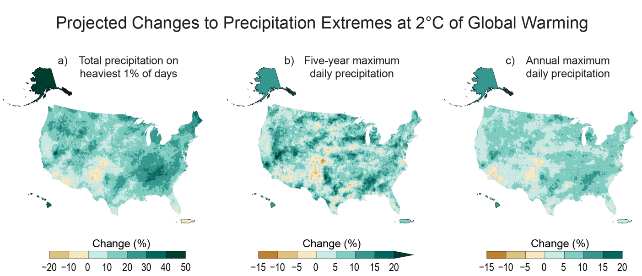
Figure 2.12. Increases in the frequency and severity of heavy precipitation are expected at a global warming level of 2°C.
Notes:
CAPTION: The maps show projected changes in three measures of extreme precipitation at a global warming level of 2°C: (a) total precipitation falling on the heaviest 1% of days, (b) daily maximum precipitation in a 5-year period, and (c) the annual heaviest daily precipitation amount. Changes are relative to the period 1991–2020. Based on LOCA2/STAR. Values for Alaska, Hawaiʻi, and Puerto Rico are averages from STAR downscaling of 45, 16, and 31 stations, respectively. Data were not available for the US-Affiliated Pacific Islands and the US Virgin Islands. Figure credit: NOAA NCEI and CISESS NC.

Slide 18
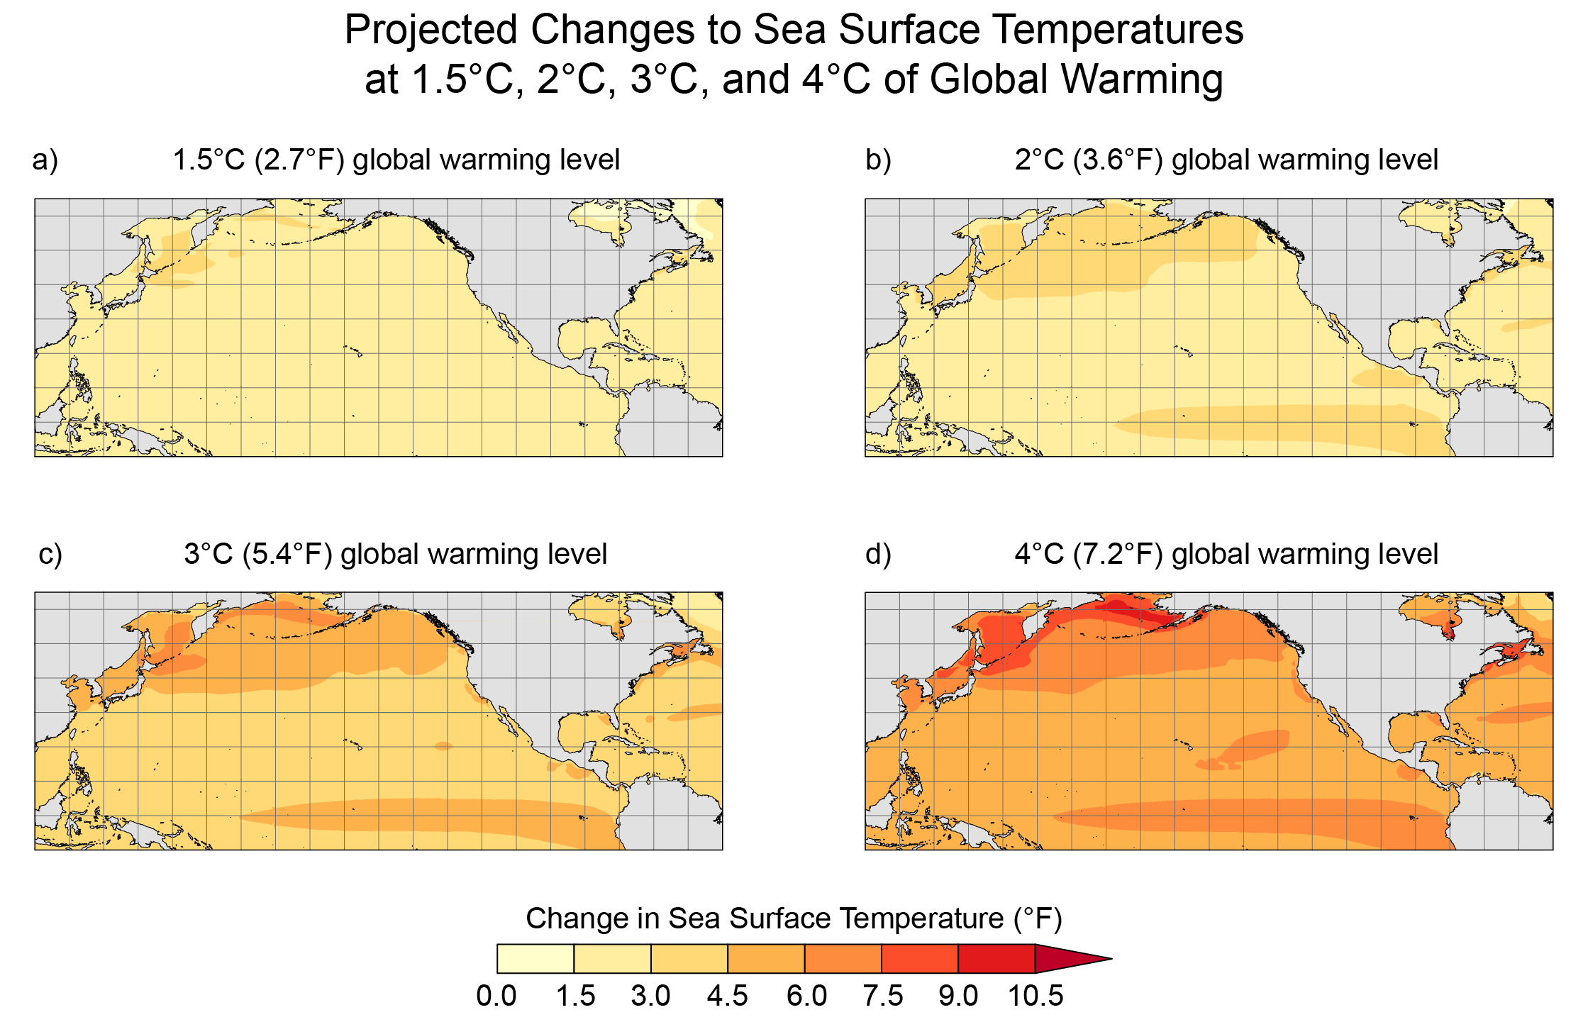
Figure 2.13. At higher global warming levels, sea surface temperatures are projected to change around the US coasts and open ocean, with implications for marine resources in those waters.
Notes:
CAPTION: These maps show projected changes in sea surface temperatures (°F) for various global warming levels (1.5°, 2.0°, 3.0°, and 4.0°C). Changes are relative to the period 1851–1900. Figure credit: NOAA, NOAA NCEI, and CISESS NC.

Slide 19
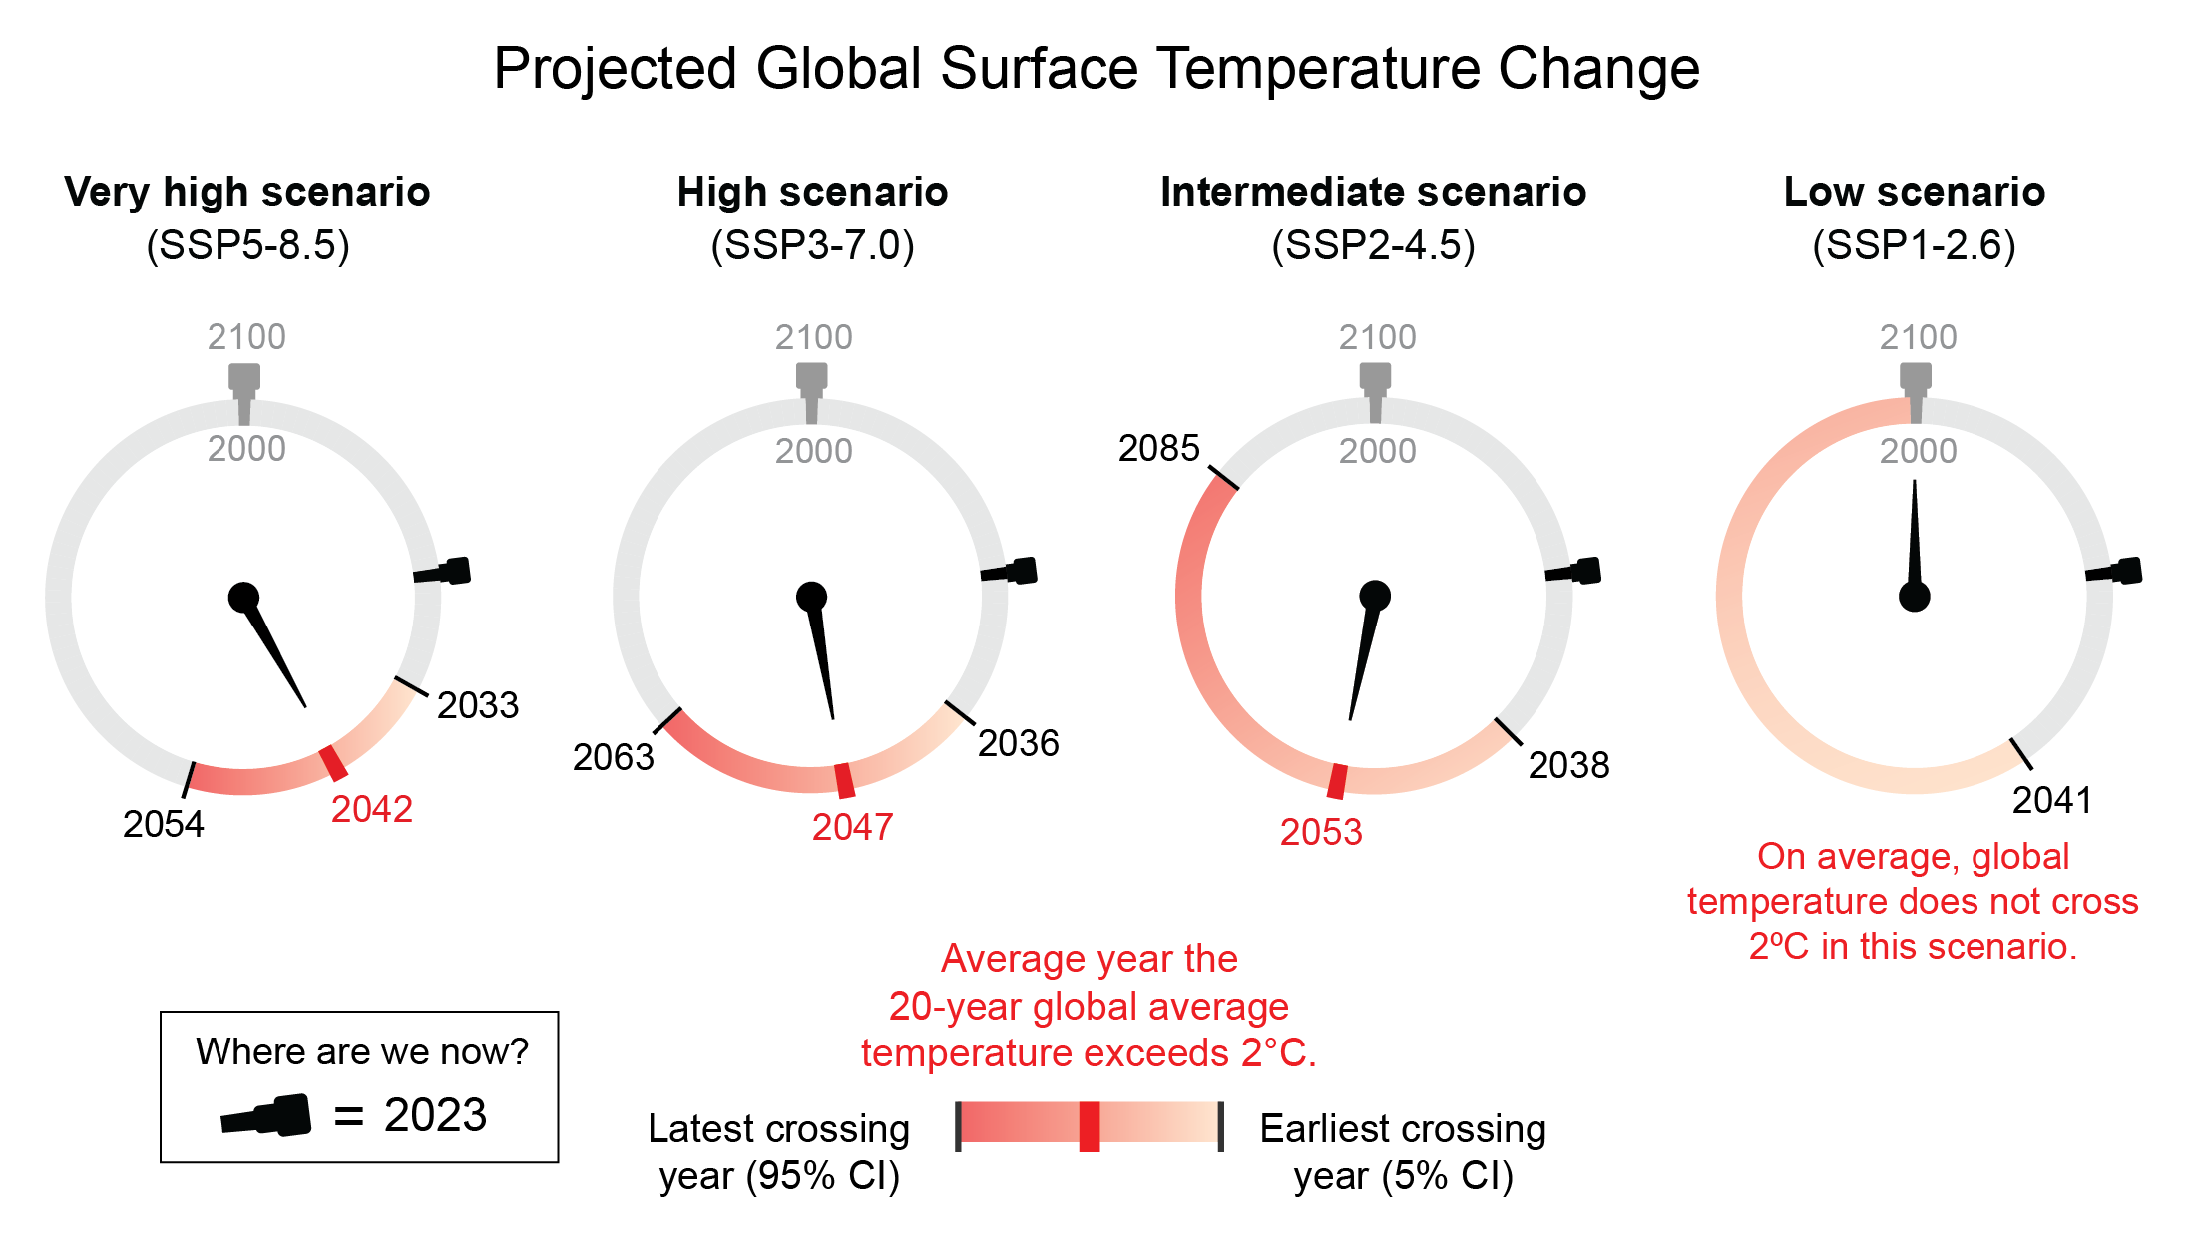
Figure 2.14. Future emissions of greenhouse gases determine whether and how quickly we reach 2°C of global warming.
Notes:
CAPTION: When (or if) the world reaches 2°C of global warming depends on future greenhouse gas emissions and the sensitivity of the climate system to those emissions. Shown are the IPCC AR6 assessed warming projections for four future scenarios, with projected years at which the 2°C (3.6°F) global warming level would be reached. For example, under a very high scenario (SSP5-8.5), models project reaching 2°C between 2033 and 2054, with an average estimate of 2042. Under a low scenario (SSP1-2.6), the 5% CI (confidence interval) range begins at 2041, but the average projection shows that warming would actually stay below 2°C. Figure credit: Project Drawdown, Stripe Inc., NOAA NCEI, and CISESS NC.

Slide 20
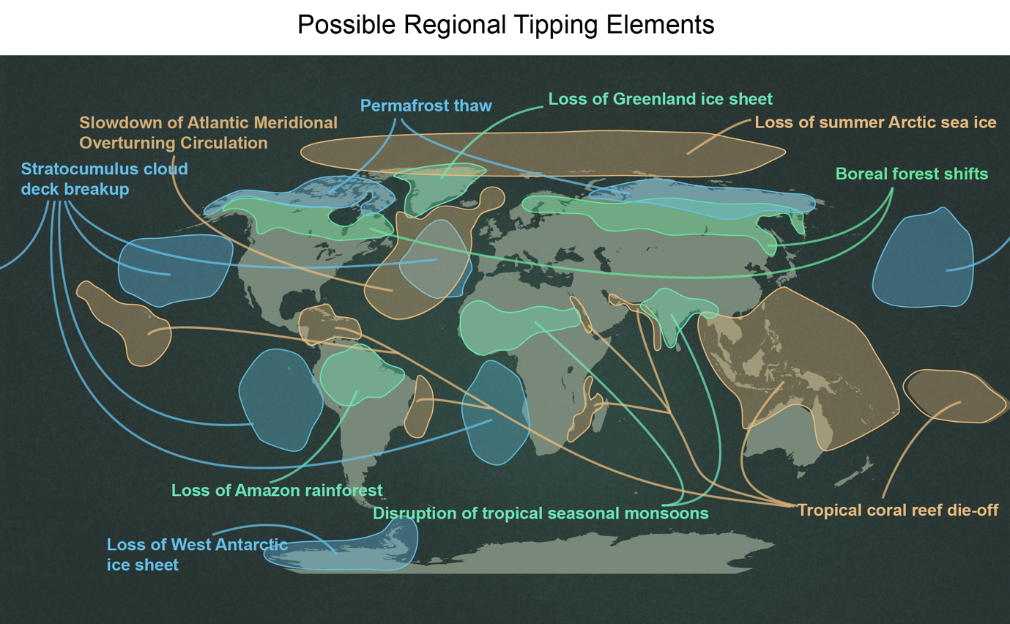
Figure 2.15. Continued warming could push some aspects of the Earth system past tipping points.
Notes:
CAPTION: The figure shows 10 potential tipping elements in the climate system. These include changes to tropical and boreal forests and coral reefs, the loss of Greenland or West Antarctic ice sheets, and changes to the circulation of the oceans and the monsoons. The spatial area affected by each tipping element is shown; colors are used for visual clarity. Adapted with permission from Figure 1 in Wang et al. 2023,(Wang et al. 2023) which was adapted from McSweeney 2020.(McSweeney 2020)

Slide 21
Federal Coordinating Lead Author
Wenying Su, NASA Langley Research Center
Chapter Lead
Kate Marvel, Project Drawdown
Agency Chapter Lead Author
Roberto Delgado, National Science Foundation
Chapter Authors
Sarah Aarons, University of California San Diego, Scripps Institution of Oceanography
Abhishek Chatterjee, NASA Jet Propulsion Laboratory, California Institute of Technology
Margaret E. Garcia, Arizona State University
Zeke Hausfather, Stripe Inc.
Katharine Hayhoe, Texas Tech University
Deanna A. Hence, University of Illinois at Urbana–Champaign
Elizabeth B. Jewett, National Oceanic and Atmospheric Administration
Alexander Robel, Georgia Institute of Technology
Deepti Singh, Washington State University Vancouver
Aradhna Tripati, University of California, Los Angeles
Russell S. Vose, NOAA National Centers for Environmental Information
Review Editor
Caroline P. Normile, Bipartisan Policy Center
USGCRP Coordinators
David J. Dokken, US Global Change Research Program / ICF
Fredric Lipschultz, US Global Change Research Program / USRA

Slide 22
Marvel, K., W. Su, R. Delgado, S. Aarons, A. Chatterjee, M.E. Garcia, Z. Hausfather, K. Hayhoe, D.A. Hence, E.B. Jewett, A. Robel, D. Singh, A. Tripati, and R.S. Vose, 2023: Ch. 2. Climate trends. In: Fifth National Climate Assessment. Crimmins, A.R., C.W. Avery, D.R. Easterling, K.E. Kunkel, B.C. Stewart, and T.K. Maycock, Eds. U.S. Global Change Research Program, Washington, DC, USA. https://doi.org/10.7930/NCA5.2023.CH2
https://nca2023.globalchange.gov/chapter/2

