Slide 1

NCA5 Website: https://nca2023.globalchange.gov
Chapter Website: https://nca2023.globalchange.gov/chapter/32
NCA5 Atlas: https://atlas.globalchange.gov
Figure captions can be found in the slide notes of this deck
Social media: @usgcrp, #NCA5

Slide 2
Chapter 32 | Mitigation

Slide 3
1
Successful Mitigation Means Reaching Net-Zero Emissions
Greenhouse gas emissions in the United States decreased by 12% between 2005 and 2019, mostly due to replacing coal-fired electricity generation with natural gas–fired and renewable generation (very high confidence). However, US net greenhouse gas emissions remain substantial and would have to decline by more than 6% per year on average, reaching net zero around midcentury, to meet current national climate targets and international temperature goals (very high confidence).

Slide 4
2
We Know How to Drastically Reduce Emissions
A US energy system with net-zero emissions would rely on widespread improvements in energy efficiency, substantial electricity generation from solar and wind energy, and widespread electrification of transportation and heating (high confidence). Low-carbon fuels would still be needed for some transport and industry applications that are difficult to electrify (high confidence). Land-related emissions in the US could be reduced by increasing the efficiency of food systems and improving agricultural practices and by protecting and restoring natural lands (high confidence). Across all sectors, many of these options are economically feasible now (high confidence).

Slide 5
3
To Reach Net-Zero Emissions, Additional Mitigation Options Need to Be Explored
Although many mitigation options are currently available and cost-effective, the level and types of energy technologies and carbon management in net-zero-emissions energy systems depend on still-uncertain technological progress, public acceptance, consumer choice, and future developments in institutions, markets, and policies (high confidence). Attractive targets for further research, development, and demonstration include carbon capture, utilization, and storage; long-duration energy storage; low-carbon fuels and feedstocks; demand management; next-generation electricity transmission; carbon dioxide removal; modern foods; and interventions to reduce industry and agricultural emissions (medium confidence).

Slide 6
4
Mitigation Can Be Sustainable, Healthy, and Fair
Large reductions in US greenhouse gas emissions could have substantial benefits for human health and well-being (high confidence). Mitigation is expected to affect pollution, the use of land and water resources, the labor force, and the affordability, reliability, and security of energy and food (high confidence). An equitable and sustainable transition to net-zero-emissions energy and food systems in the United States could help redress legacies of inequity, racism, and injustice while maximizing overall benefits to our economy and environment (high confidence).

Slide 7
5
Mitigation Can Be Sustainable, Healthy, and Fair
Mitigation efforts can be supported by a range of actors and actions, from choices made by individuals to decisions made by businesses and local, Tribal, state, and national governments (high confidence). Actions with significant near-term potential include sector-based policies accelerating deployment of low-carbon technologies, city-level efforts to promote public transportation and improve building efficiency, and individual behavioral changes to reduce energy demand and meat consumption (high confidence).

Slide 8
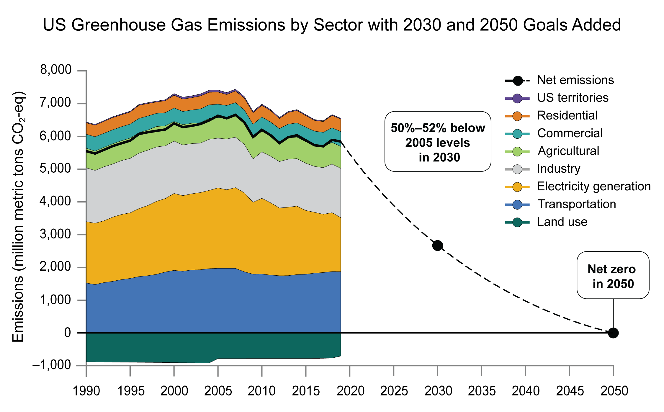
Figure 32.1. US emissions will need to decrease rapidly to reach levels consistent with international climate targets.
Notes:
CAPTION: Figure shows US annual greenhouse gas emissions and sinks from 2005 to 2019, as well as future targets for achieving the US nationally determined contribution under the Paris Agreement. US territories—including American Sāmoa, Commonwealth of the Northern Mariana Islands, Federated States of Micronesia, Guam, Republic of the Marshall Islands, and Republic of Palau—contribute minor emissions (not visible) that are not broken down by sector. CO₂-eq = carbon dioxide equivalent. Adapted from DOS and EOP 2021.(DOS and EOP 2021)

Slide 9
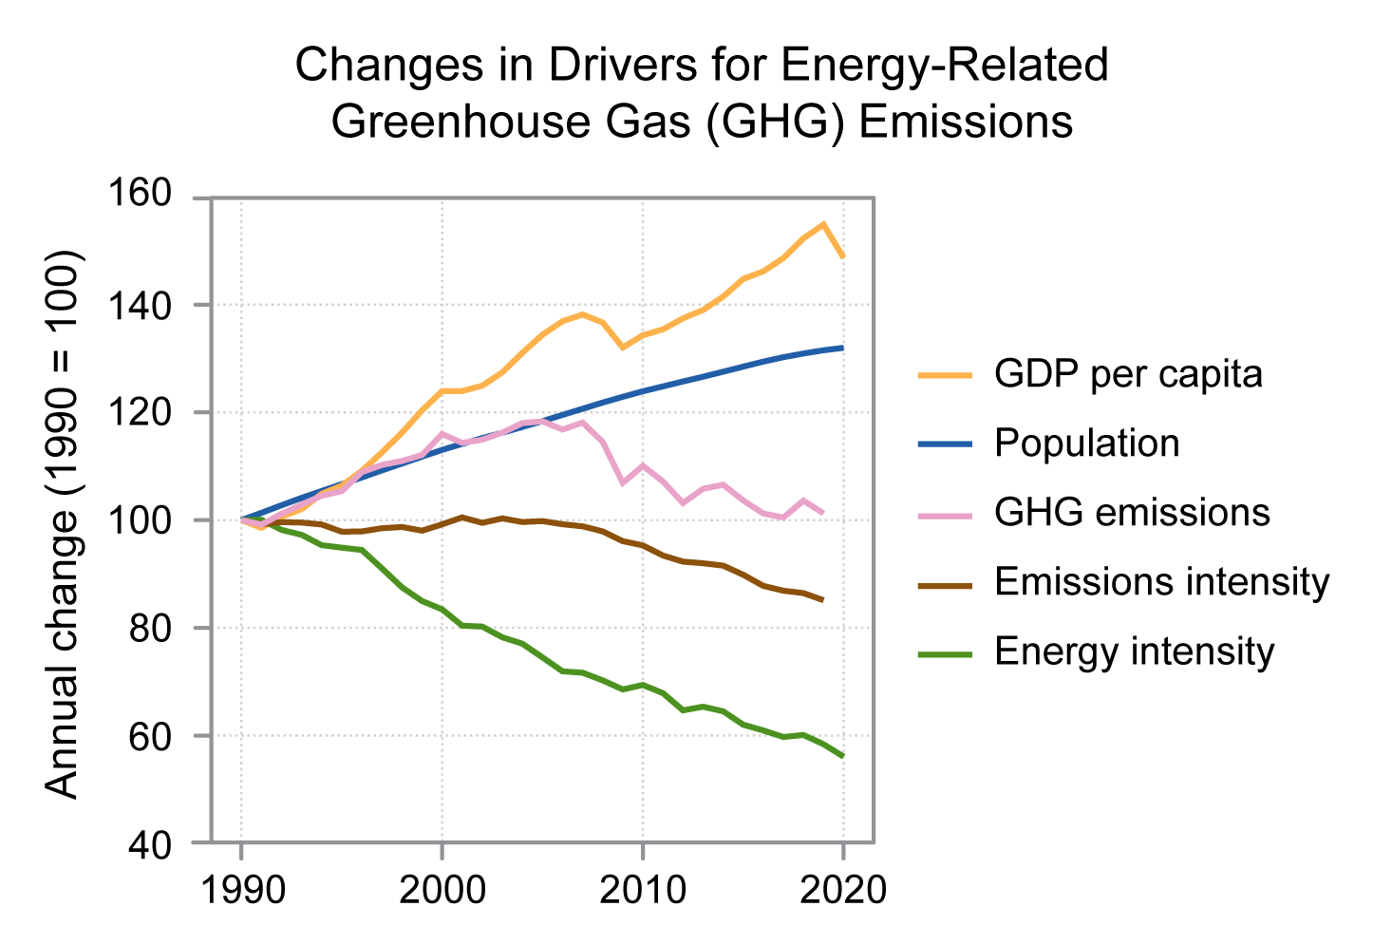
Figure 32.2. US greenhouse gas emissions have dropped even as population and economic activity (as measured by GDP) have climbed.
Notes:
CAPTION: Energy-related greenhouse gas (GHG) emissions in the United States have declined since 2007 (pink) despite rising population (blue) and economic activity measured by the GDP (orange). Behind the decreasing trend are gradual reductions in energy use per dollar of GDP (energy intensity, green) and large decreases in GHG emissions per unit of energy produced (emissions intensity, brown). Figure credit: Stanford University.

Slide 10
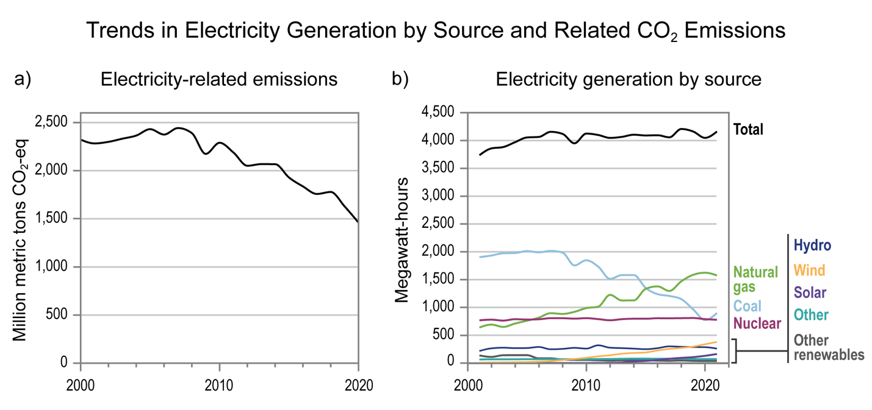
Figure 32.3. Carbon dioxide (CO2) emissions from electricity generation decreased by almost 40% between 2005 and 2020.
Notes:
CAPTION: The decrease in electricity-related emissions between 2000 and 2020 (a) can be explained by the decline in high-emitting coal generation and the growth in generation from lower-emitting (natural gas) and non-emitting (wind and solar) sources (b). CO₂-eq = carbon dioxide equivalent. Adapted from Scott Institute for Energy Innovation 2017(Scott Institute for Energy Innovation 2017) [CC BY-SA 4.0].

Slide 11
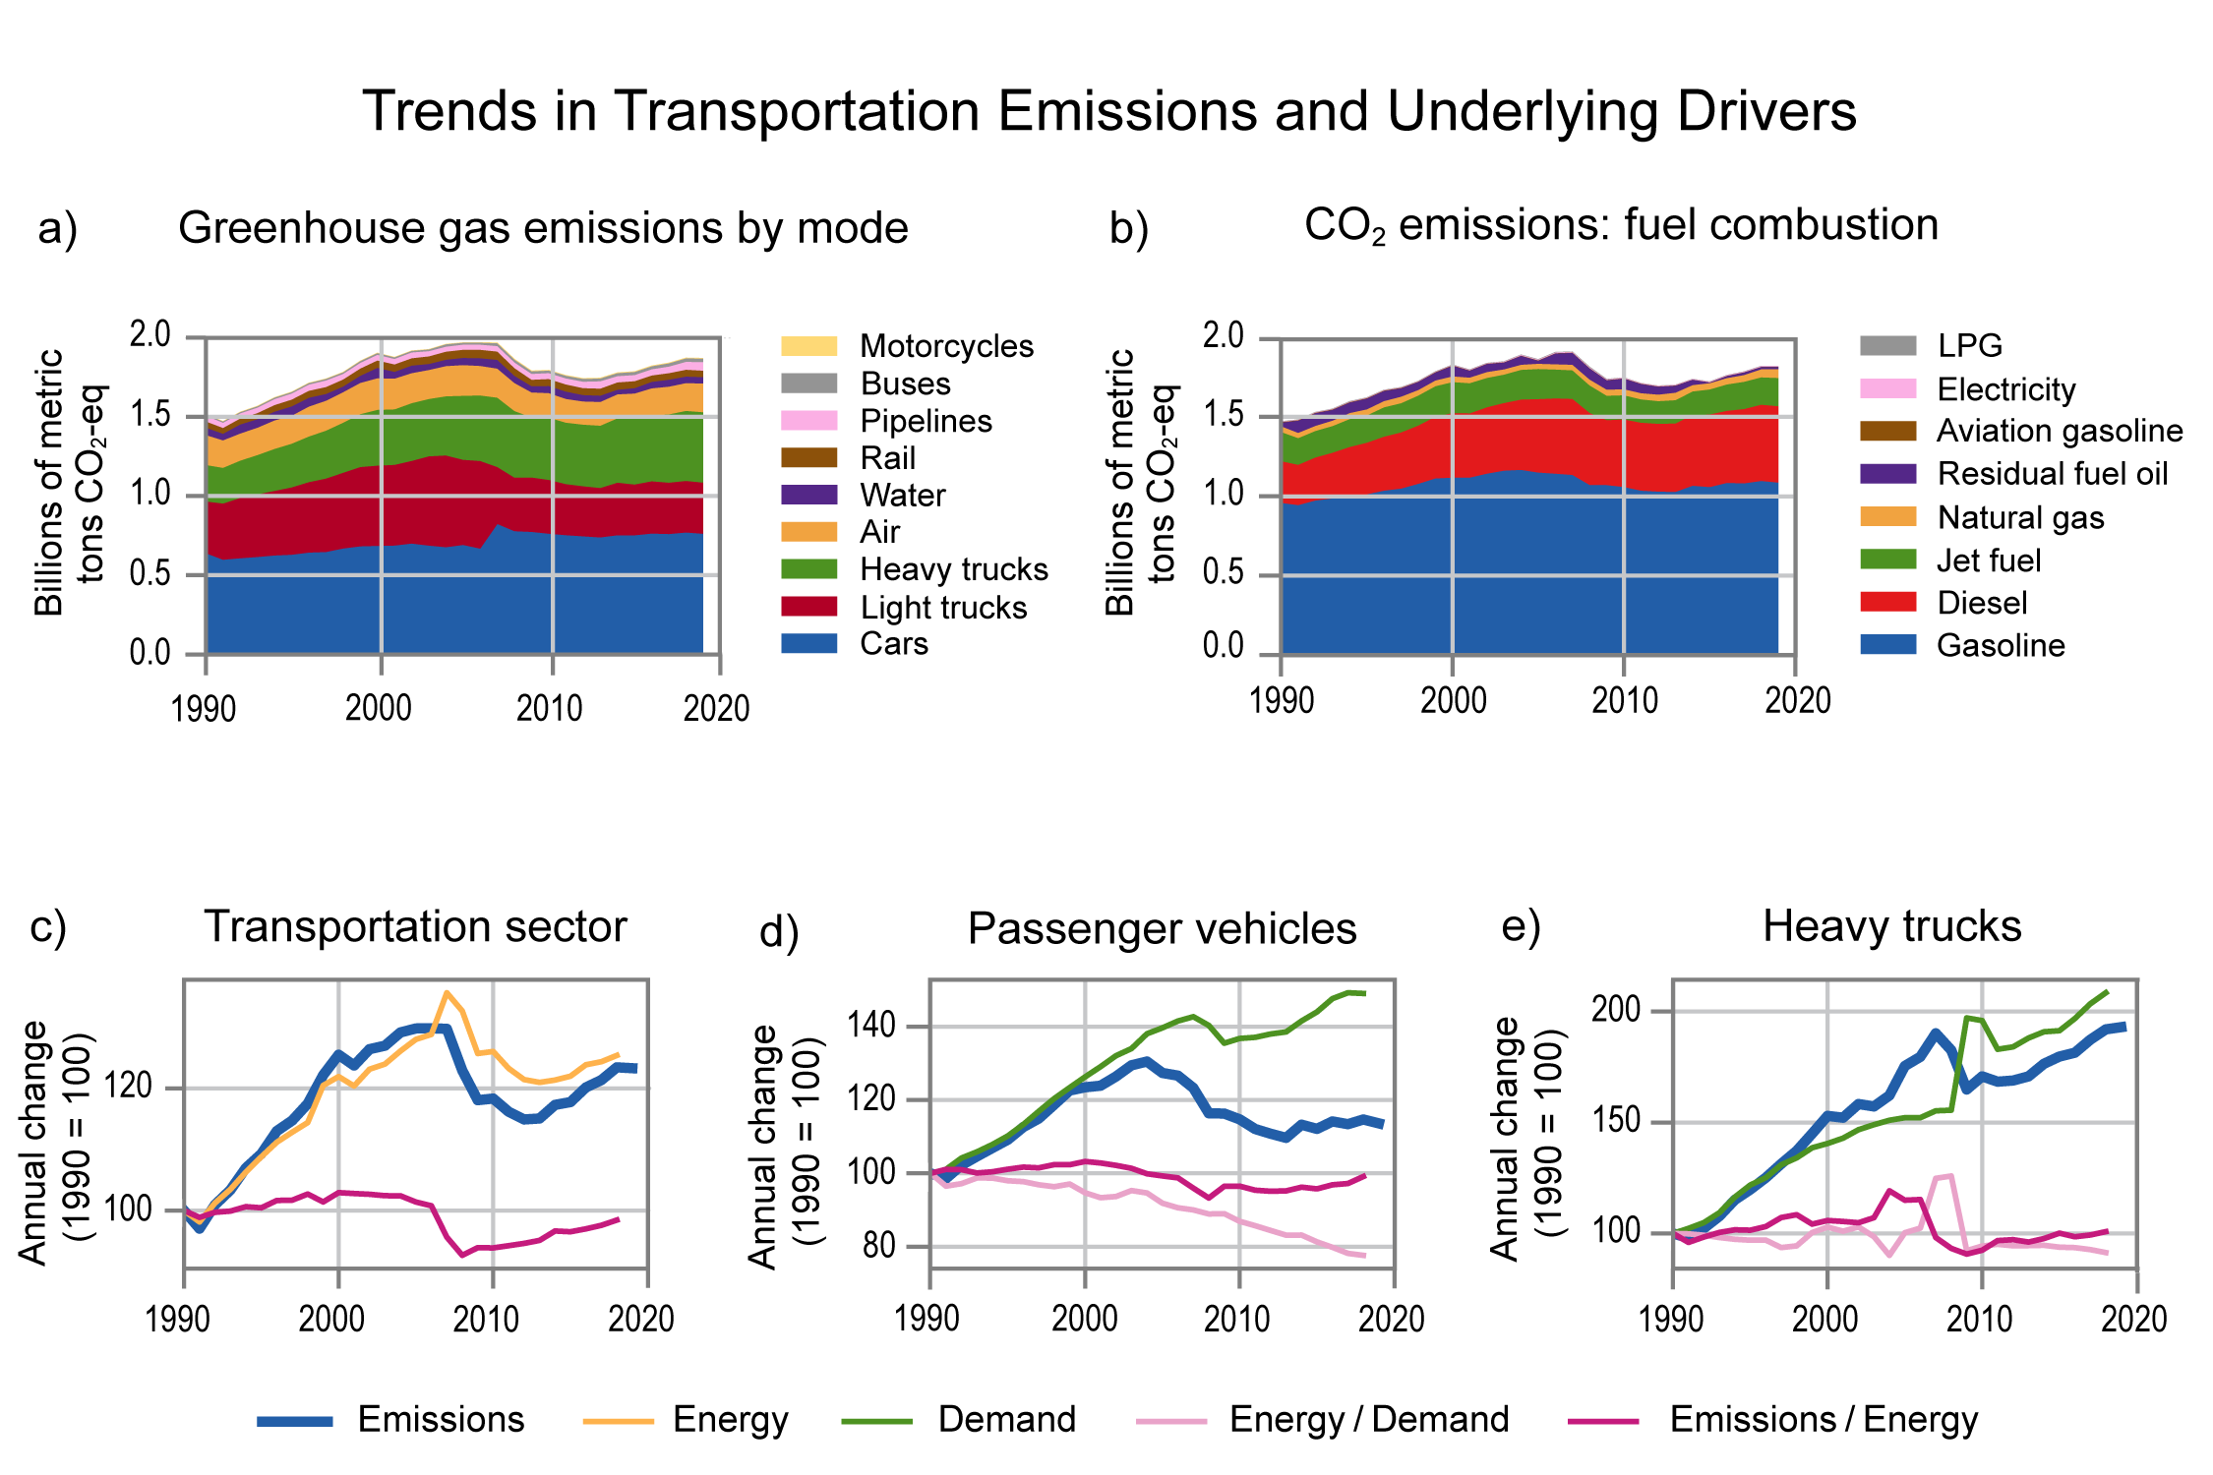
Figure 32.4. Transportations emissions fell from 2007–2012 but have climbed since then.
Notes:
CAPTION: The figure shows US greenhouse gas emissions by transportation mode. Emissions from transportation decreased starting in 2007 (a), reflecting decreases in carbon dioxide (CO₂) emissions from fuel combustion (b), but both have increased again since 2012. The trend was consistent across different types of vehicles, driven by a drop in demand during a period of recession and high fuel prices (c, d, e). Passenger vehicles include cars, light trucks, and buses. LPG refers to liquified petroleum gas or propane; CO₂-eq = carbon dioxide equivalent. Figure credit: Stanford University.

Slide 12
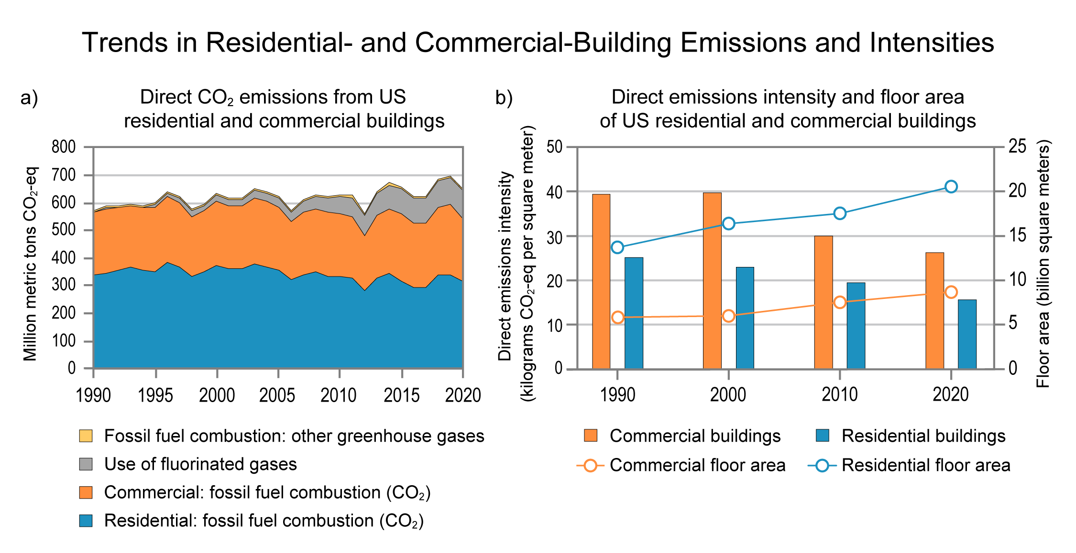
Figure 32.5. Overall greenhouse gas emissions from buildings have climbed despite small declines in CO2 emissions from onsite combustion of fossil fuels.
Notes:
CAPTION: Carbon dioxide (CO₂) emissions from onsite fuel combustion in US buildings have decreased modestly since 2005 (a), driven by decreasing fuel-related emissions per building floor area (b), but overall related greenhouse gas emissions from buildings have increased over the same period due to both growth in the size of floor area (lines in panel b) and increasing levels of fluorinated gases escaping from building cooling systems (gray area in panel a). CO₂-eq = carbon dioxide equivalent. Figure credit: University of California, Santa Barbara.

Slide 13
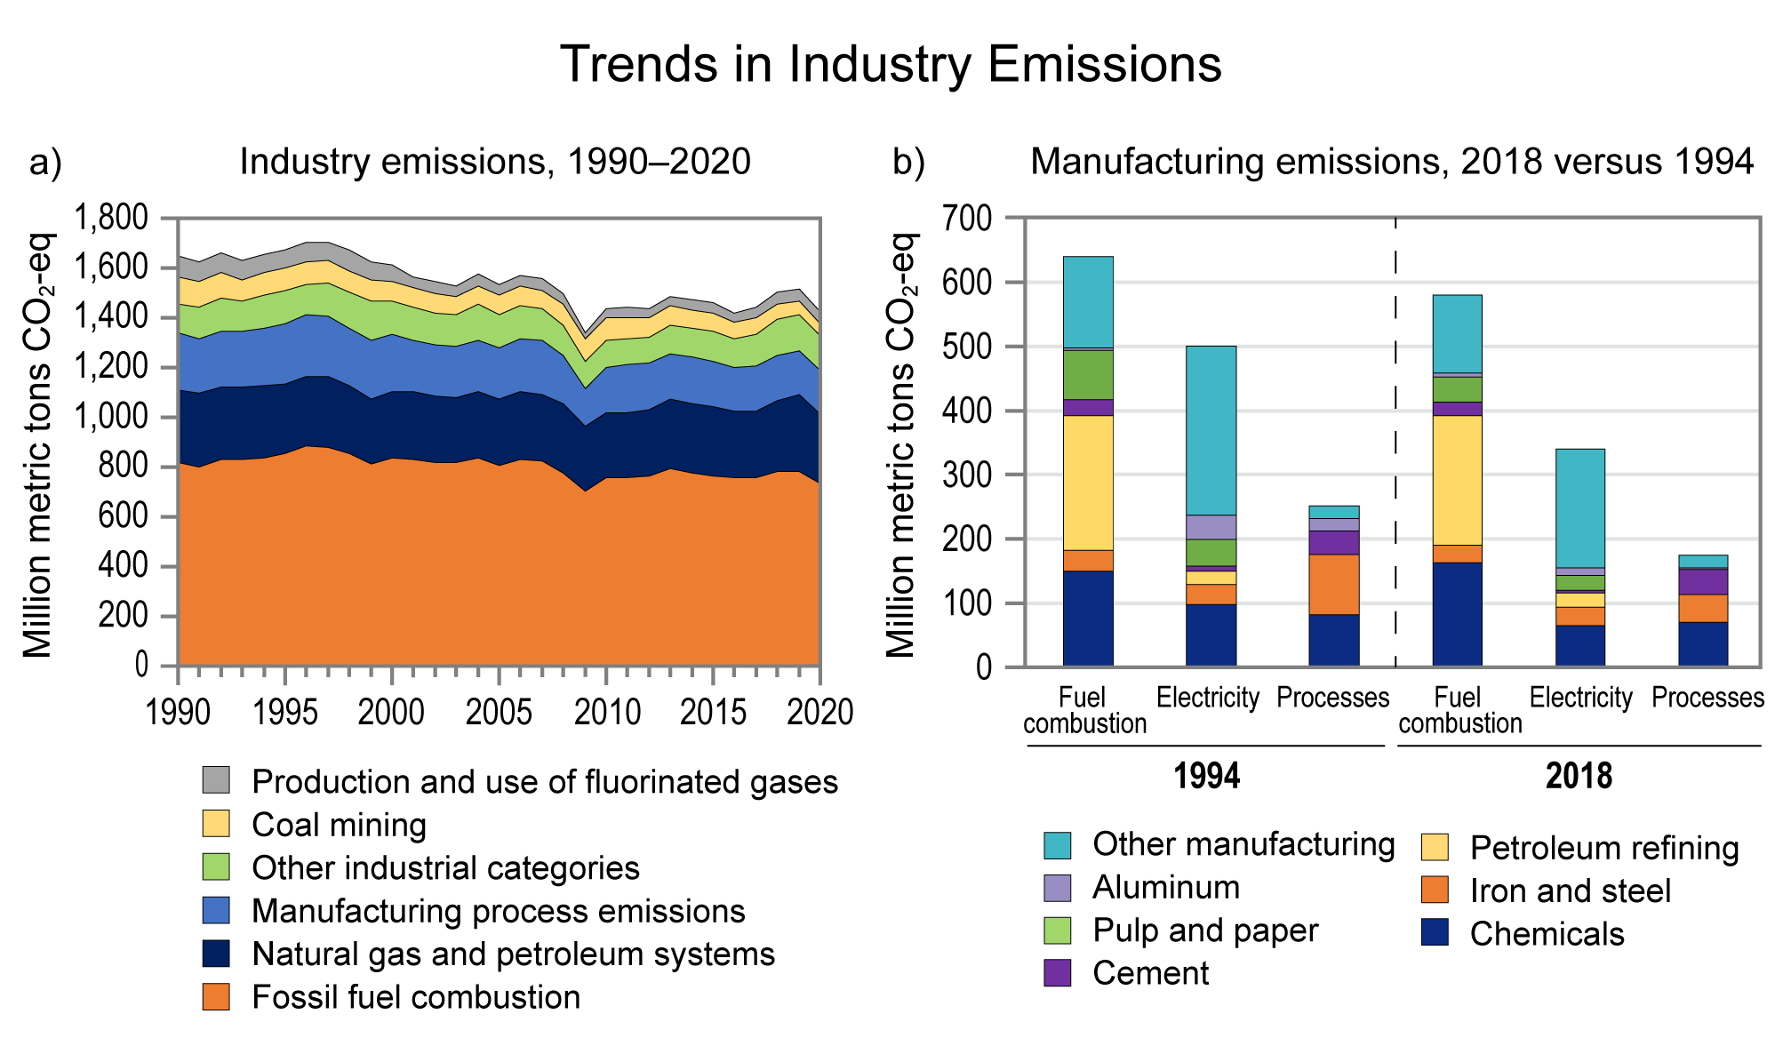
Figure 32.6. Greenhouse gas emissions from US industry, including manufacturing, have declined in recent decades.
Notes:
CAPTION: Greenhouse gas emissions from US industry have declined modestly since 2005 across all sources (a). Panel b shows the breakdown of industry emissions in 1994 and 2018 by key manufacturing subsectors such as chemicals, iron and steel, pulp and paper, and aluminum. Data on intensity of industry emissions over time are not available. CO₂-eq = carbon dioxide equivalent. Figure credit: University of California, Santa Barbara.

Slide 14
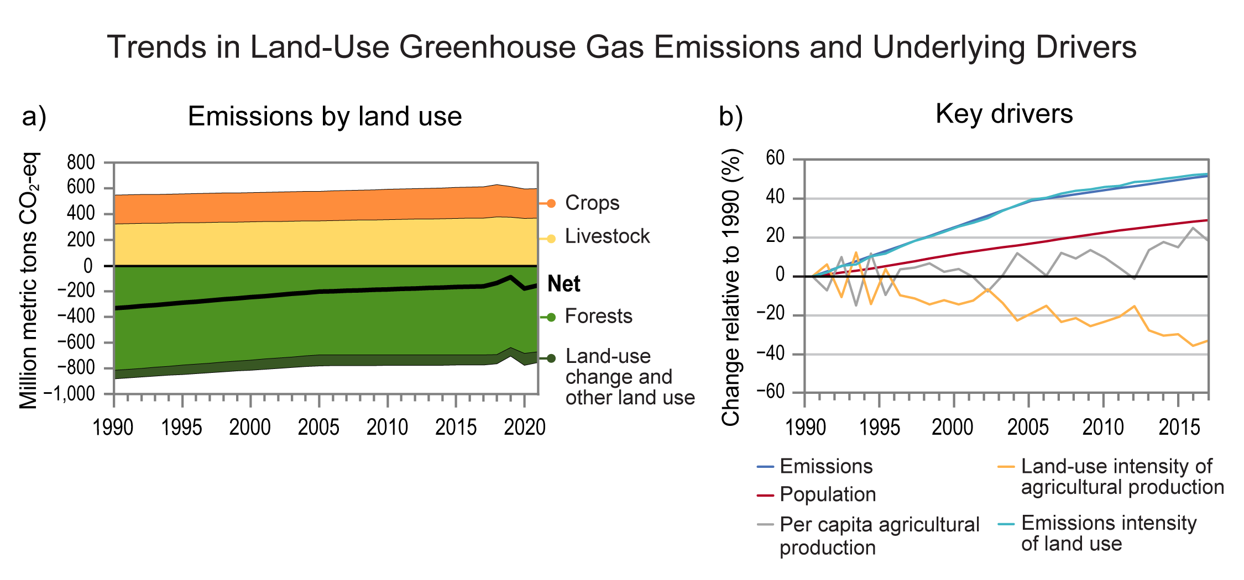
Figure 32.7. US forests sequester more carbon than is emitted by agriculture, but the forest sink has weakened in recent decades.
Notes:
CAPTION: Net greenhouse gas emissions from US land use are negative, meaning the carbon taken up by forests is greater than agricultural emissions (a). However, this net sink has weakened since 2005, driven by increases in the emissions intensity of land use (light blue curve in panel b) and despite decreases in the land-use intensity of agricultural production (yellow curve in panel b). CO₂-eq = carbon dioxide equivalent. Figure credit: University of California, Irvine.

Slide 15
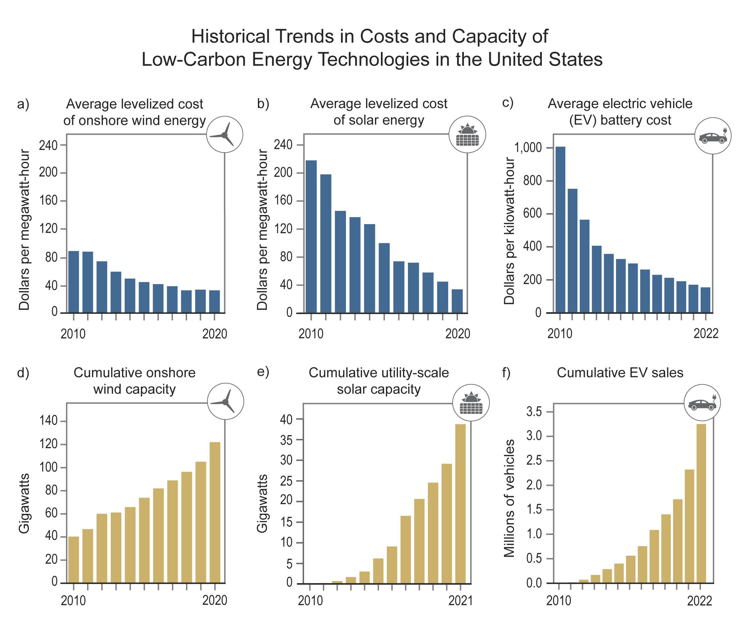
Figure 32.8. Costs of renewable energy sources and electric vehicle batteries have declined as their cumulative deployment has increased.
Notes:
CAPTION: Costs of onshore wind (a), solar photovoltaics (b), and electric vehicle (EV) batteries (c) have decreased sharply since 2000 (data shown here start in 2010), as the cumulative capacities of wind and solar generation (d, e) and the cumulative number of EVs sold (f) have increased. Figure credit: Electric Power Research Institute, National Renewable Energy Laboratory, NOAA NCEI, and CISESS NC.

Slide 16
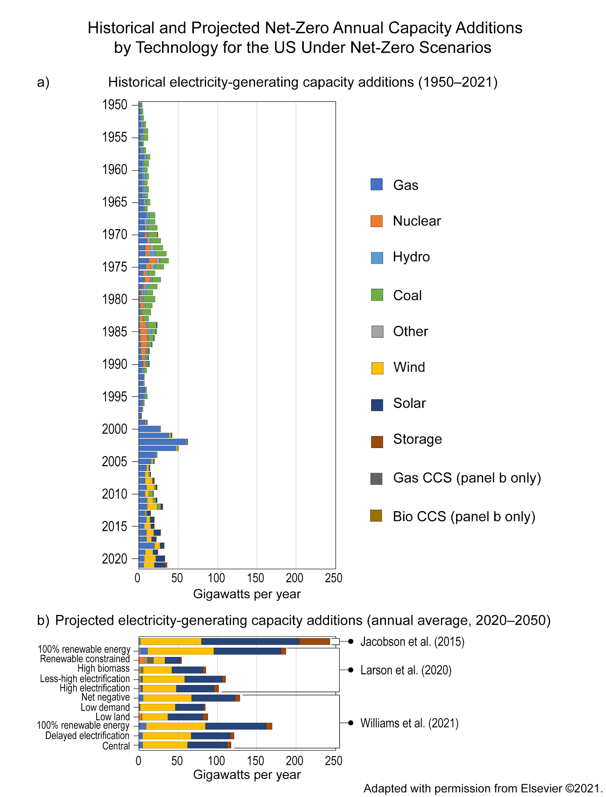
Figure 32.9. To reach net zero, the US will need to add more electricity-generating capacity in each of the next 30 years than we have added historically.
Notes:
CAPTION: Since 1950, increases in US electricity-generating capacity have exceeded 50 gigawatts (GW) in only one year, 2002 (a). In comparison, scenarios of net-zero-emissions energy systems produced by models project average increases in electricity-generating capacity of more than 50 GW per year every year between 2020 and 2050 (b). CCS refers to carbon capture and storage. See Jacobson et al. 2015; Larson et al. 2020; and Williams et al. 2021.(Jacobson et al. 2015; Larson et al. 2021; Williams et al. 2021) Adapted from Bistline 2021(Bistline 2021) with permission from Elsevier (https://www.sciencedirect.com/journal/joule).

Slide 17
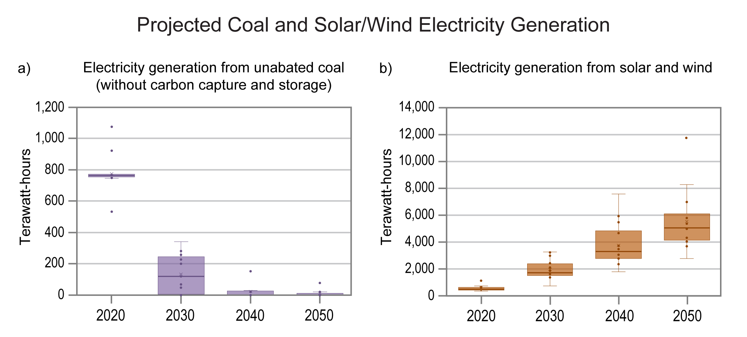
Figure 32.10. Models project a steep decline in coal-generated electricity and increases in renewables.
Notes:
CAPTION: Across net-zero scenarios produced by models, median US coal electricity generation (thick horizontal lines) is expected to decrease sharply between 2020 and 2030 (a). Meanwhile, in the same scenarios, median solar and wind generation would increase steadily between 2020 and 2050 (b). Plots show individual scenarios as points, the 25th–75th percentile ranges as rectangles, and the 10th–90th percentile ranges as thin vertical lines. The mean of each set of scenarios is represented by an X. Figure credit: University of California, Irvine, and Electric Power Research Institute.

Slide 18
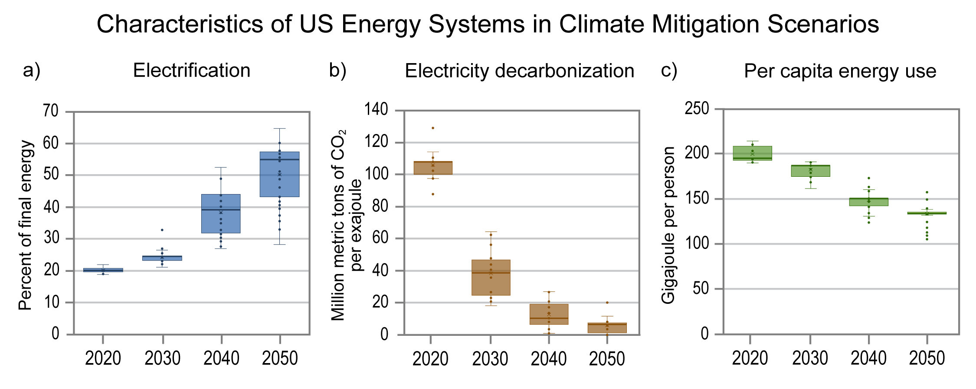
Figure 32.11. Net-zero model scenarios show large increases in electrical energy, accompanied by decarbonization of electricity sources and modest decreases in overall energy use per person.
Notes:
CAPTION: Across net-zero model scenarios, between 2020 and 2050 the median share of all energy used (thick horizontal lines) by end consumers that is electricity increases (a), the median carbon intensity of electricity decreases (b), and the median energy per capita decreases modestly (c). Plots show individual scenarios as points, the 25th–75th percentile ranges as rectangles, and the 10th–90th percentile ranges as thin vertical lines. The mean of each set of scenarios is represented by an X. CO₂ = carbon dioxide. Figure credit: University of California, Irvine; Electric Power Research Institute; and Evolved Energy Research.

Slide 19
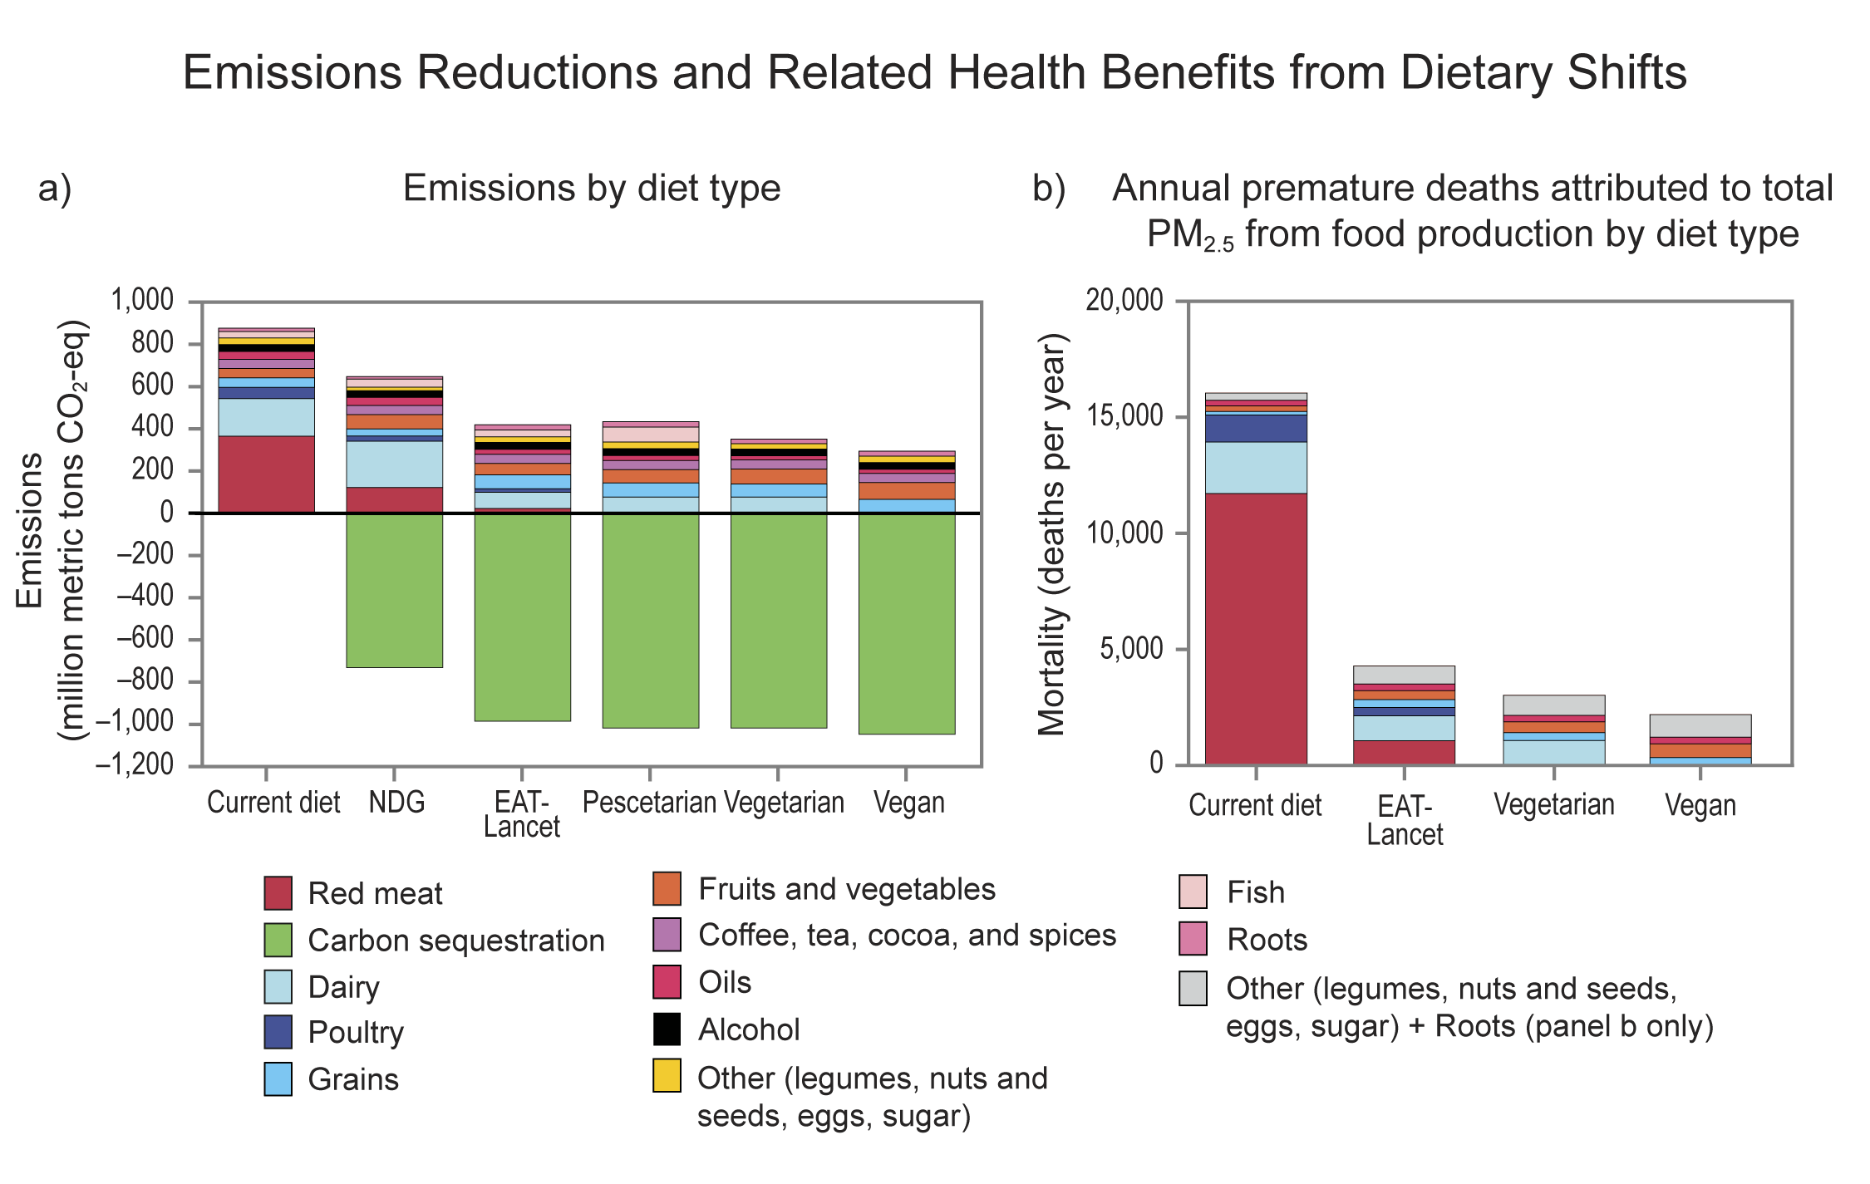
Figure 32.12. Changes in American diets could decrease US land-use greenhouse gas emissions, increase carbon sequestration, and reduce air pollution.
Notes:
CAPTION: Studies have estimated potential reductions in greenhouse gas (GHG) emissions (a) and air pollution-related deaths (b) if the shares of foods in Americans’ current (average) diet were to shift. Although the specific changes in diet vary across studies, all would reduce GHG and pollution emissions as well as enhance carbon sequestration relative to the current diet. EAT-Lancet refers to a “flexitarian” diet that is mostly plant-based but includes modest amounts of fish, meat, and dairy foods. NDG refers to government-endorsed national dietary guidelines. PM_{2.5} refers to particulate matter 2.5 micrometers or smaller in diameter. CO₂-eq = carbon dioxide equivalent. Figure credits: (a) University of Minnesota, NOAA NCEI, and CISESS NC; (b) adapted from Domingo et al. 2021(Domingo et al. 2021) [CC BY-NC-ND 4.0].

Slide 20
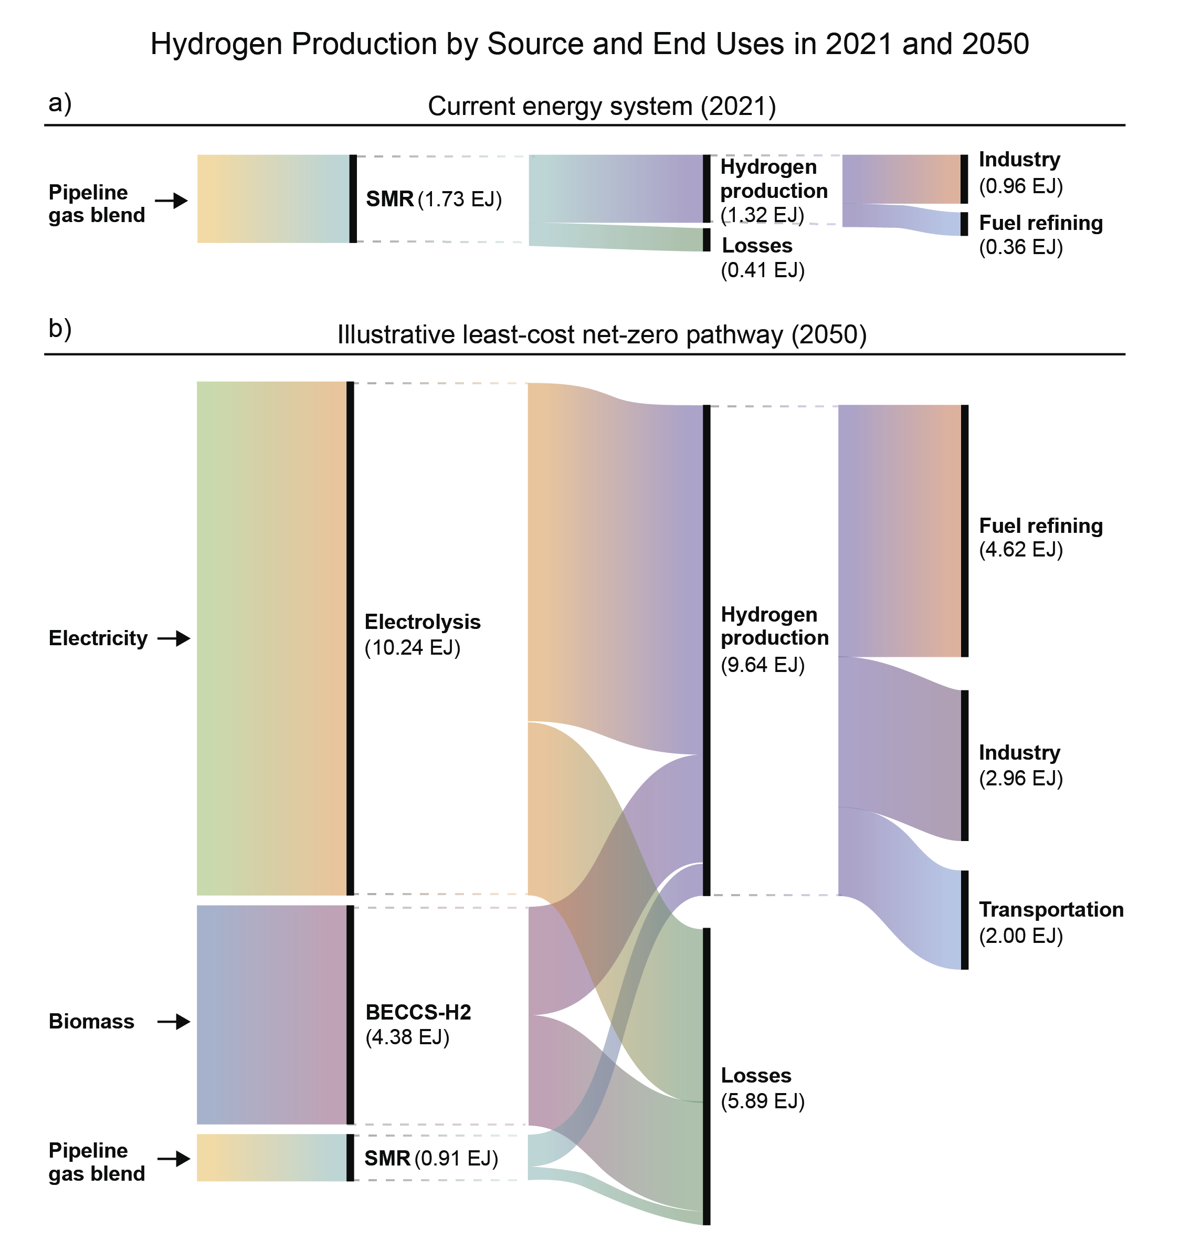
Figure 32.13. Energy model scenarios show that the magnitude, sources, and uses of hydrogen will change substantially by 2050.
Notes:
CAPTION: Curves in the figure show how hydrogen is produced (left), lost to waste (middle) and used (right) currently (a) and in an illustrative 2050 scenario (b). The thickness of the curves represents the amount of hydrogen in each category. Today, most hydrogen is produced by steam reforming of natural gas (SMR) and used by the chemical industry (especially for making fertilizer). In the depicted net-zero emissions scenario, by 2050 the largest source has become electricity, and fuel refining has become the largest use. BECCS-H2 refers to hydrogen produced from biomass feedstocks with carbon capture and storage; EJ = exajoule. Adapted with permission from Haley et al. 2022.(Haley et al. 2022)

Slide 21
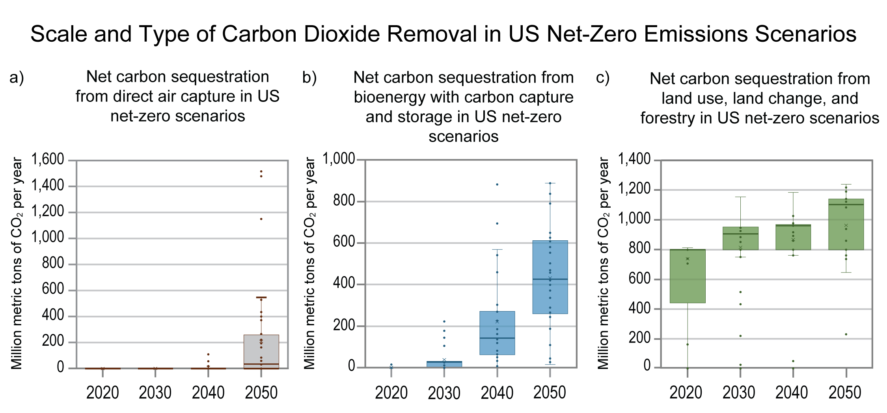
Figure 32.14. Net-zero emissions scenarios project substantial carbon dioxide removal by 2050, although the type and quantities used in the scenarios vary considerably.
Notes:
CAPTION: Annual carbon dioxide (CO₂) removals increase between 2020 and 2050 in scenarios that reach net zero by 2050, including nature-based sequestration on land (c), bioenergy with carbon capture and storage (b), and—after 2040—direct air capture (a). Median sequestration (thick horizontal lines) by land use, land-use change, and forestry increases less dramatically in scenarios. Plots show individual scenarios as points, the 25th–75th percentile ranges as rectangles, and the 10th–90th percentile ranges as thin vertical lines. The mean of each set of scenarios is represented by an X. Figure credit: University of California, Irvine.

Slide 22
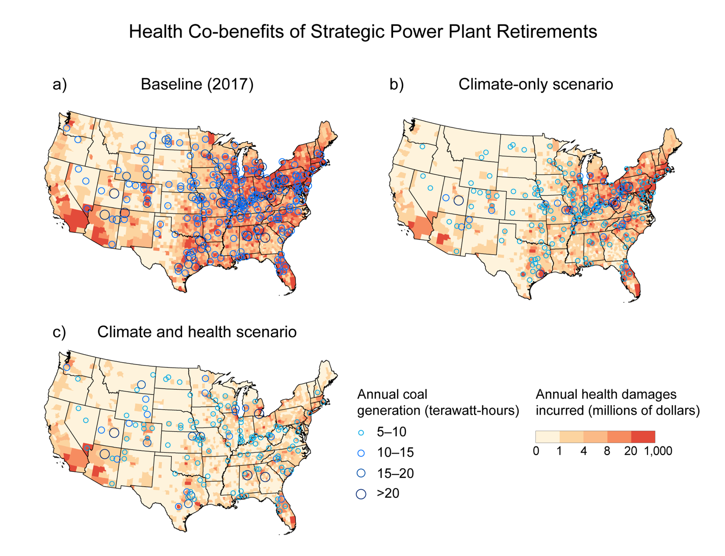
Figure 32.15. Shutting down coal-fired power plants would produce both health and climate benefits.
Notes:
CAPTION: Blue circles show the location and size of US coal-fired power plants in 2017 (a) and in two scenarios: one in which the fewest plants are retired to reduce CO₂ emissions by a fixed amount (b) and one in which plants are retired not only to achieve the same CO₂ reduction but also to avoid health damages as much as possible (c). Not surprisingly, estimated health damages (red shading) are greatly reduced in the future scenario that prioritizes health. Annual generation from coal power plants (in terawatt-hours) and corresponding annualized health damages (in millions of dollars) from each scenario are both summarized by county. Baseline shows results based on 2017 continuous emissions monitoring systems data, while optimization results shown represent the climate-only and climate-plus-health scenarios. Health damages are shown by the county in which those damages occur; legend breaks are based on quintiles of the data. Although this analysis included only the continental US, its conclusions are consistent with similar analyses in other regions: substantial health benefits would be expected from retiring coal electricity anywhere. Adapted with permission from Sergi et al. 2020.(Sergi et al. 2020)

Slide 23
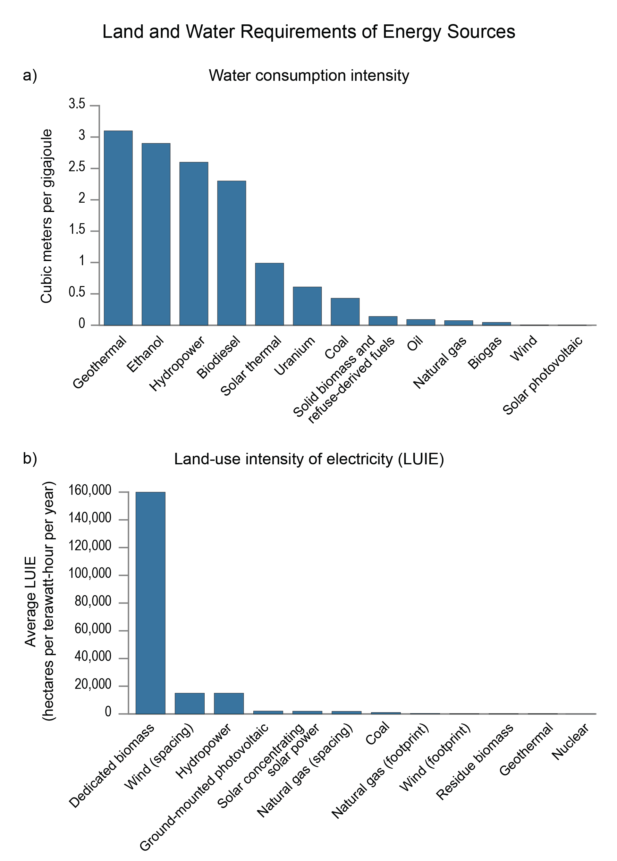
Figure 32.16. Different sources of energy entail more or less water and land use.
Notes:
CAPTION: Bars depict water-consumption intensity (a) and land-use intensity of electricity (LUIE) for the US in 2014 (b) related to different electricity sources. Wind and solar use less water than any of the other energy sources but more land area than nuclear, geothermal, or fossil sources. (a) Adapted with permission from Grubert and Sanders 2018;(Grubert and Sanders 2018) (b) adapted from Lovering et al. 2022(Lovering et al. 2022) [CC BY 4.0].

Slide 24
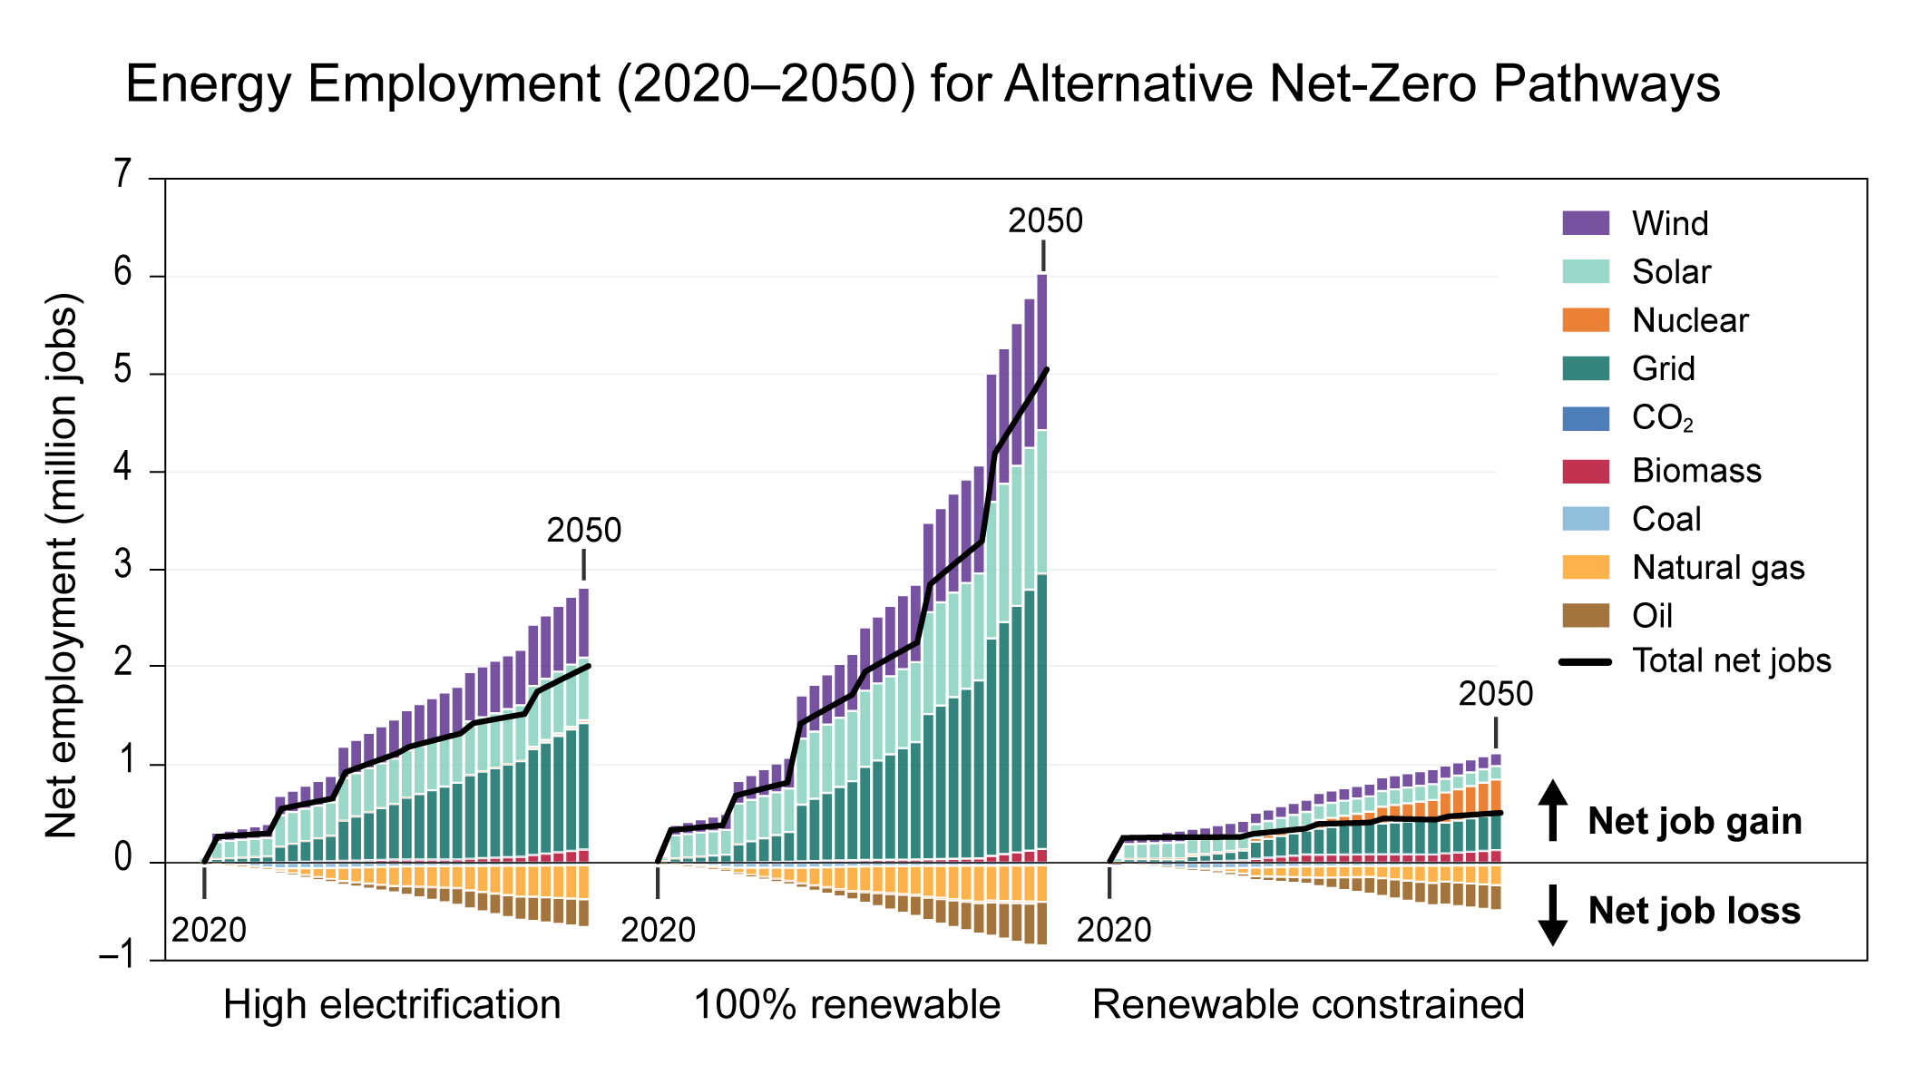
Figure 32.17. A shift toward renewables is projected to increase the total number of jobs in the energy sector.
Notes:
CAPTION: Despite decreases in the number of fossil fuel–related jobs, the overall number of energy jobs (specifically those involved in the supply of energy) is generally projected to increase in net-zero-emissions energy scenarios between 2020 and 2050, although by much more in some scenarios than in others. These particular scenarios are from Larson et al. 2021(Larson et al. 2021) and span a range of energy futures in which nearly all buildings and transport are electrified but there are no constraints (a), renewables produce 100% of energy (b), or renewables produce much less energy and nuclear and fossil energy with carbon capture and storage are prevalent (c). CO₂ = carbon dioxide. Adapted with permission from Jenkins et al. 2021.(Jenkins et al. 2021)

Slide 25
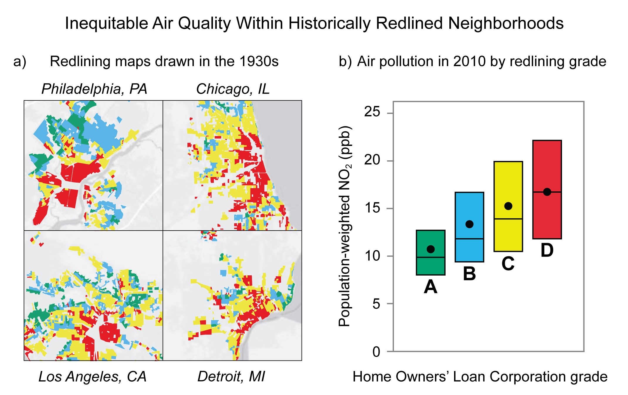
Figure 32.18. Communities redlined in the 1930s experience more air pollution today.
Notes:
CAPTION: The Home Owners’ Loan Corporation (HOLC) grades (A [“best”], B, C, and D [“hazardous,” i.e., redlined]) from the 1930s (which effectively denied Black and minority groups access to lending institutions) still corresponded to greater levels of air pollution in 2010. Panel (a) shows redlining maps of neighborhoods based on 1930s HOLC grade classifications for four US cities. Panel (b) shows the population-weighted distribution of nitrogen dioxide (NO₂) levels (measured as concentration in parts per billion [ppb]) for 2010 across 202 census tracts in the contiguous US. Horizontal lines indicate medians, points indicate averages, and bars indicate 25th to 75th percentiles. Adapted with permission from Lane et al. 2022.(Lane et al. 2022)

Slide 26
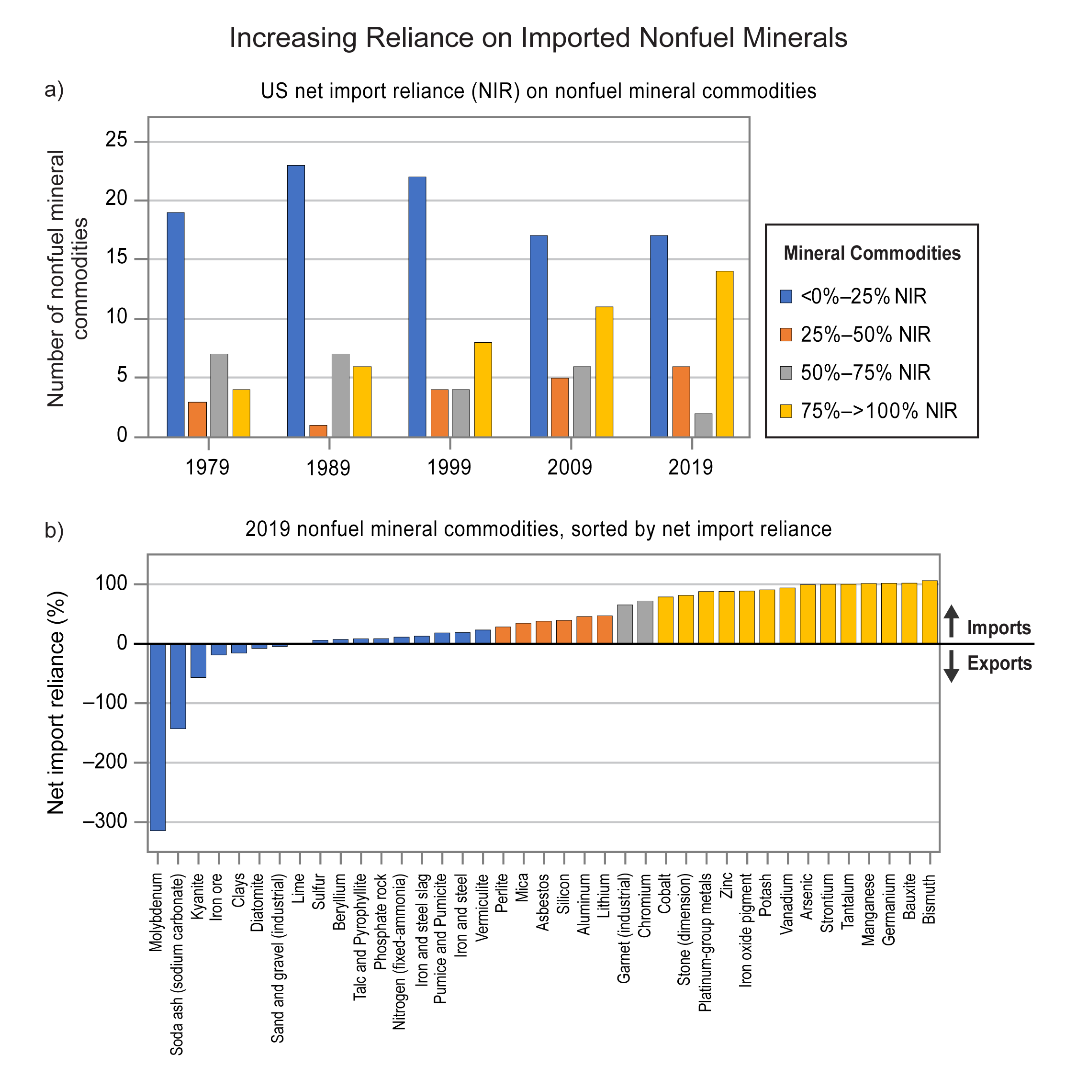
Figure 32.19. The US has grown increasingly dependent on imported minerals.
Notes:
CAPTION: Panel (a) shows that the US has become increasingly dependent on imports of 39 nonfuel mineral commodities since 1979; commodities of which 75%–100% is imported (yellow bars) are increasing in number, and commodities of which less than 25% is imported (blue bars) are decreasing in number. Panel (b) shows the specific commodities and the degree of import reliance for each in 2019. Figure credits: (a) adapted from Fortier et al. 2015;(Fortier et al. 2015) (b) University of California, Irvine.

Slide 27
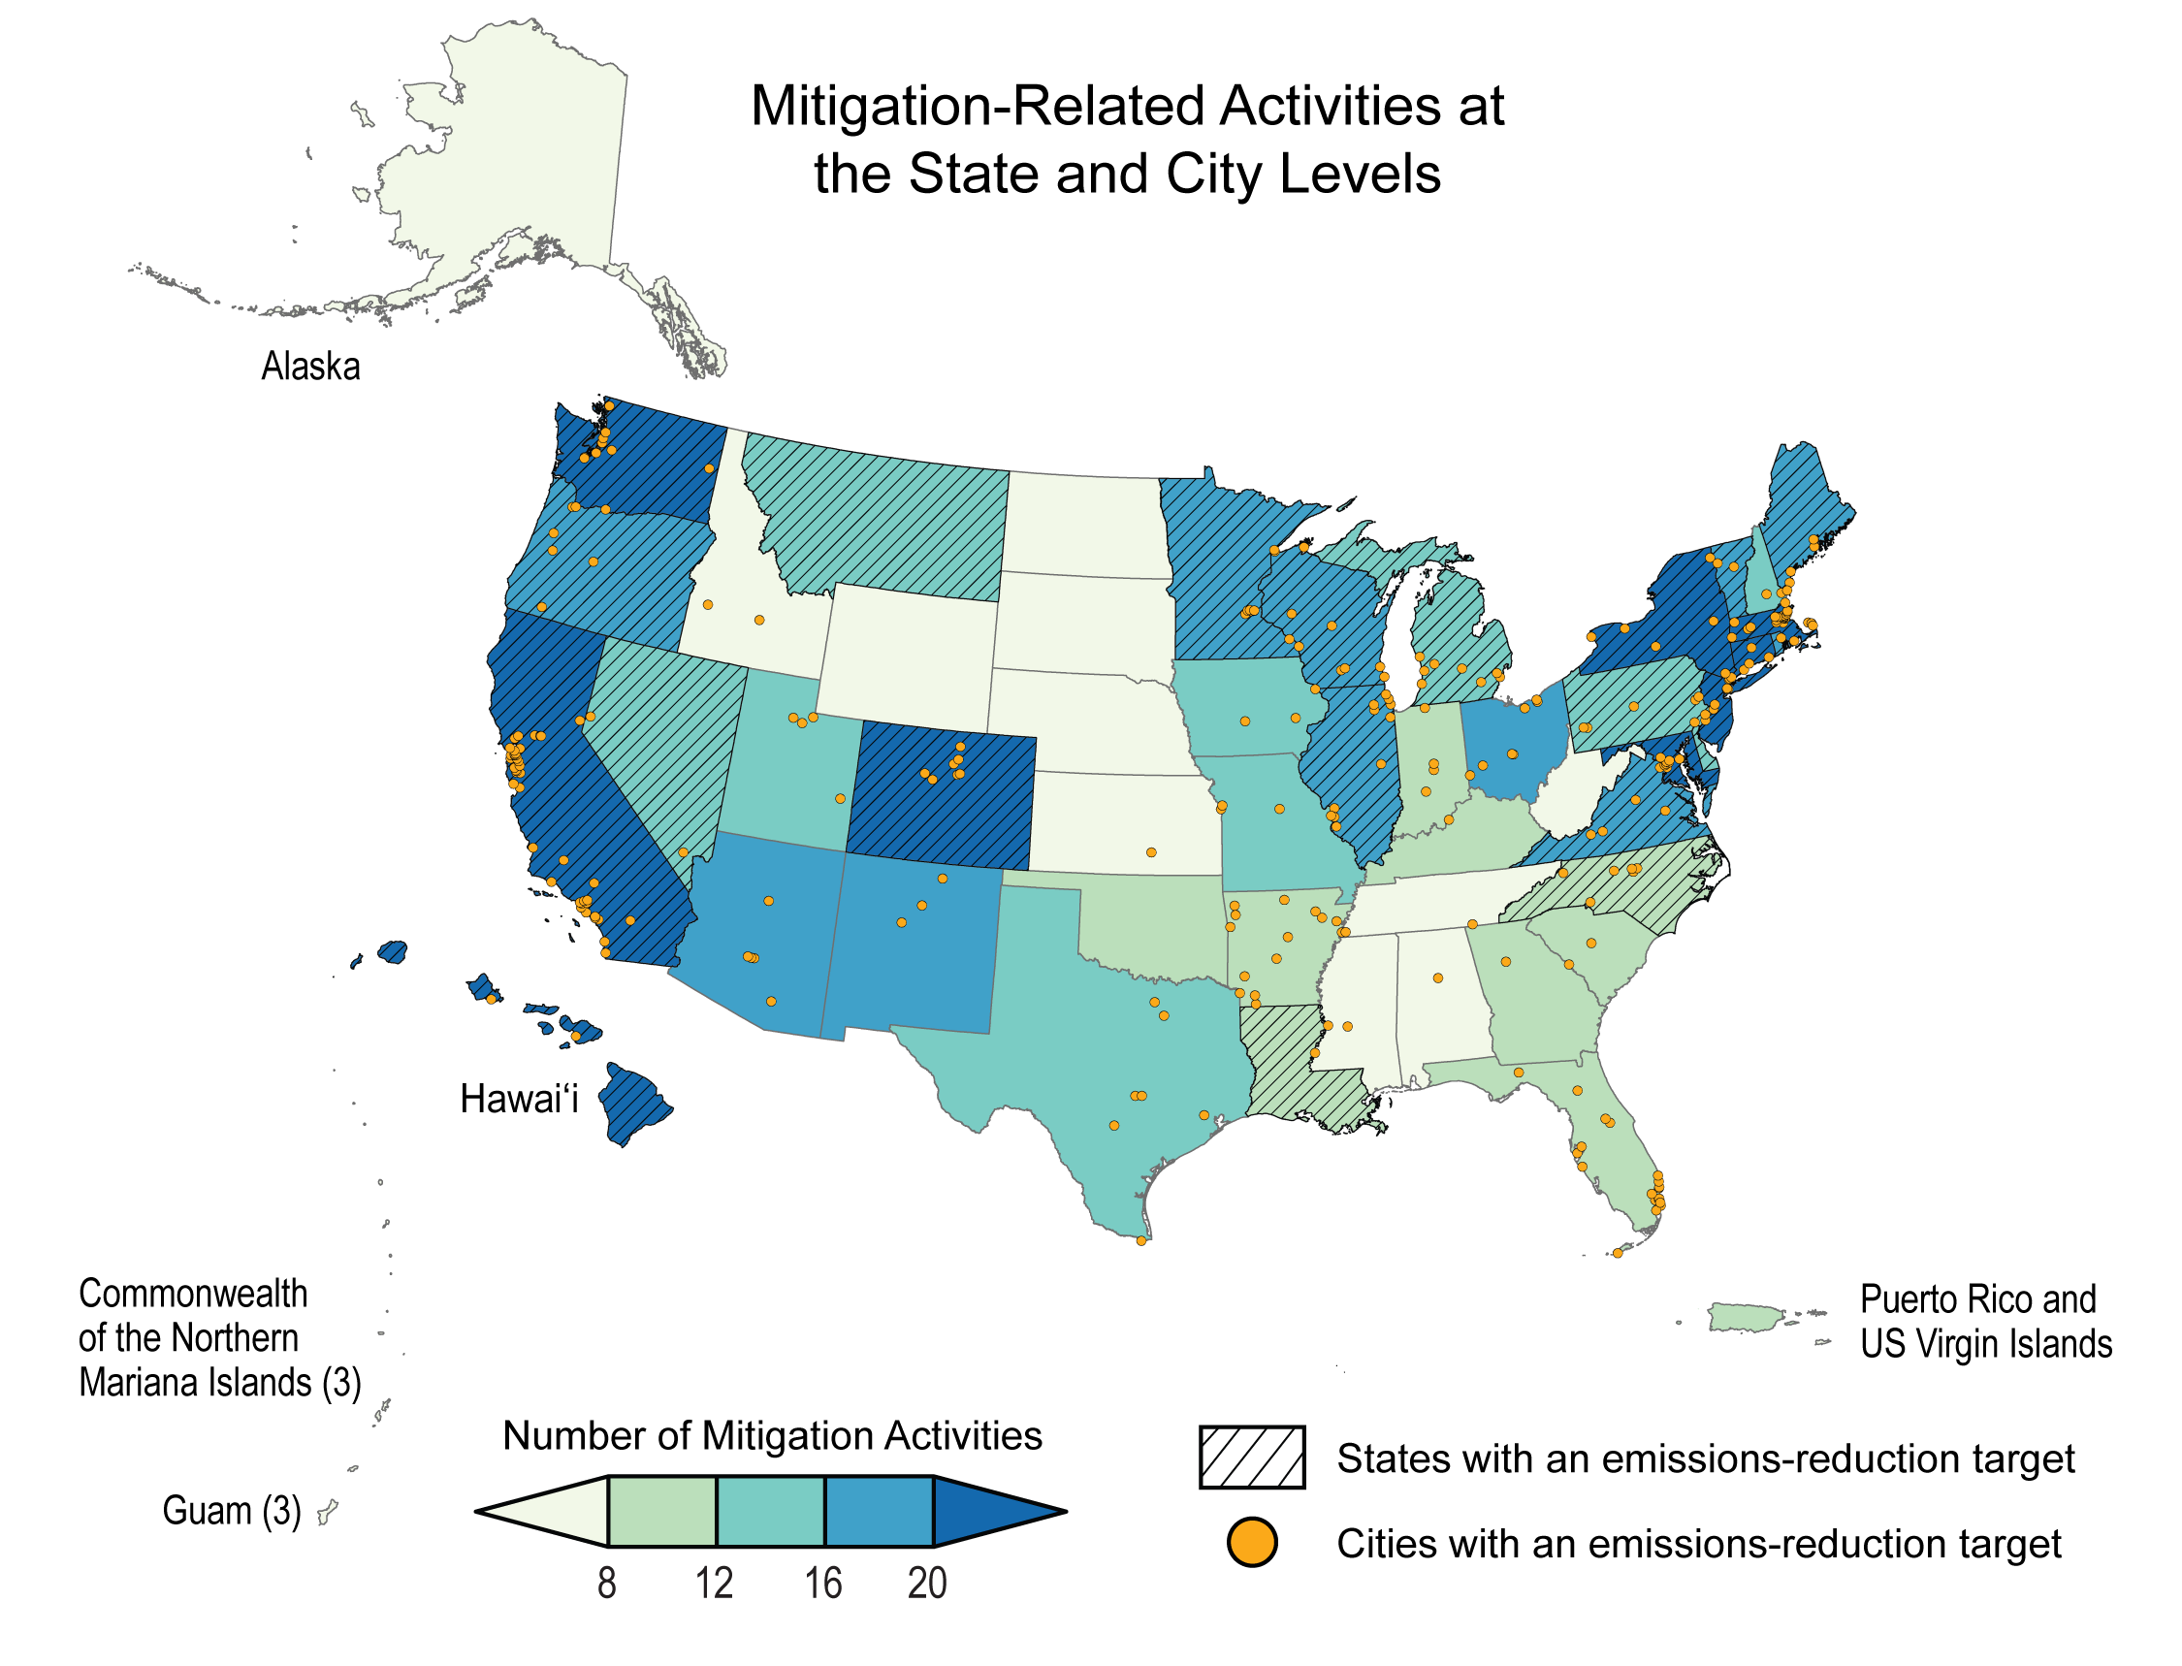
Figure 32.20. Many states and cities have taken action to reduce greenhouse gas emissions.
Notes:
CAPTION: Shading indicates the number of mitigation activities taken by each state, and orange circles indicate cities with emissions-reduction targets (as of April 2023). Almost every region has taken some action, with hotspots of activity in the Northeast, Southwest, Colorado, Hawaiʻi, and along the West Coast. See Figure 32.21 for examples of the types of actions taken. Figure credit: The Pennsylvania State University, NOAA NCEI, and CISESS NC.

Slide 28
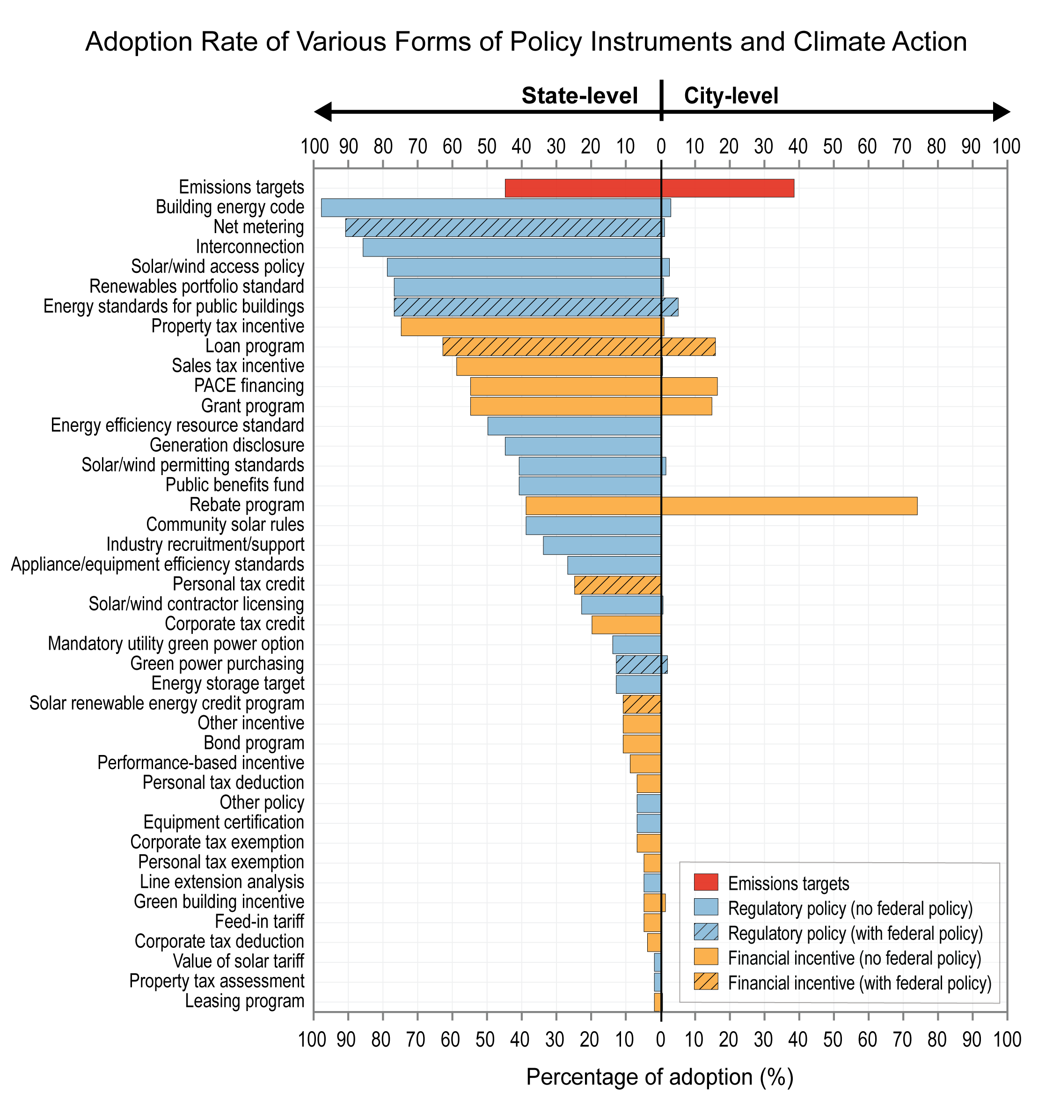
Figure 32.21. States and cities have adopted a range of climate actions and policies.
Notes:
CAPTION: Bars show the percentages of states (left) and cities (right) that have announced emissions targets (tracked by the United Nations Framework Convention on Climate Change Non-state Actor Zone for Climate Action dataset) or adopted the selected clean energy policies (tracked in North Carolina State University’s Database of State Incentives for Renewables & Efficiency dataset) as of April 2023. The color of the bars indicates the type of policy, and hashing denotes that the policy action is also being adopted or announced by the Federal Government. PACE stands for property assessed clean energy. Figure credit: The Pennsylvania State University, NOAA NCEI, and CISESS NC.

Slide 29
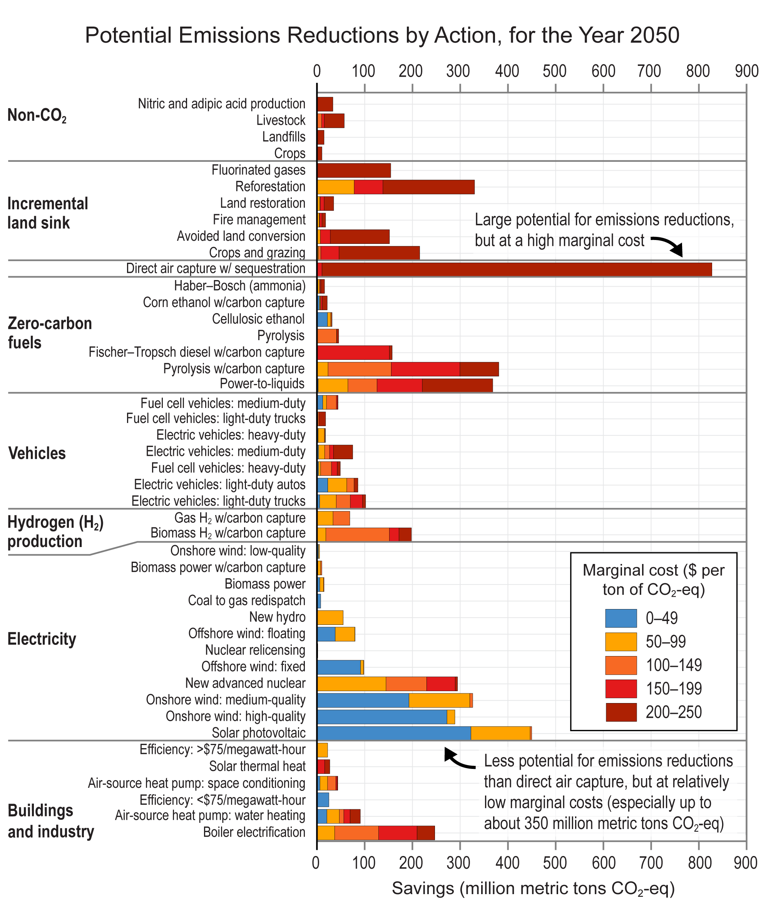
Figure 32.22. The size and cost of emissions reductions depend on available technologies and the source of related emissions.
Notes:
CAPTION: Energy system, land-sector, and non-CO₂ (carbon dioxide) mitigation options for the year 2050 are shown along with estimated marginal costs, excluding the impact of policy incentives. The sum of the mitigation options shown results in net-negative CO₂-eq (carbon dioxide equivalent) emissions in the United States, not only demonstrating the possibility of reaching net-zero emissions using a combination of these actions but also highlighting a large range of cost for such actions (costs as of 2021). Mitigation options from conservation and lifestyle change are not assessed due to the difficulty in assessing costs for these measures. H₂ = hydrogen. Adapted with permission from Farbes et al. 2021(Farbes et al. 2021) and Figure SPM.7 in IPCC 2022.(IPCC 2022)

Slide 30
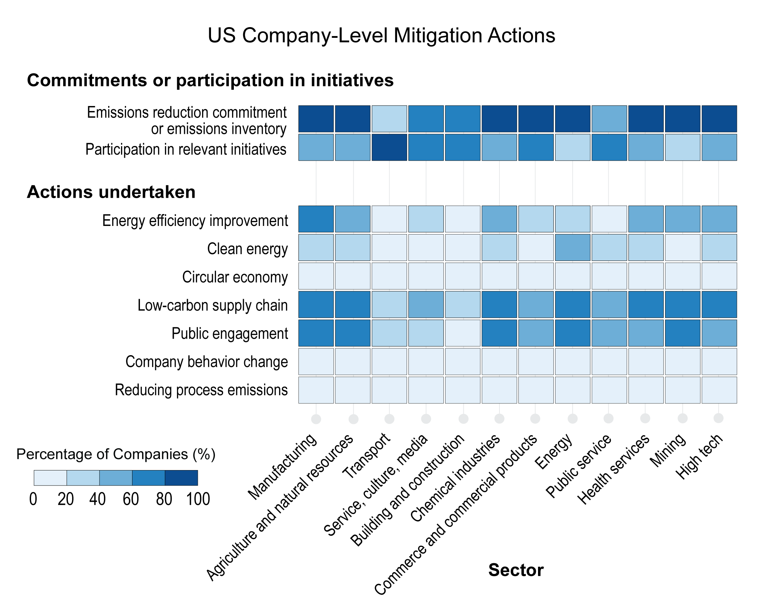
Figure 32.23. A majority of US companies have made mitigation commitments, inventoried emissions, or participated in initiatives, but fewer are taking action.
Notes:
CAPTION: As of April 2023, a majority of US companies across many sectors have committed to reducing emissions or conducted emissions inventories, and many have participated in mitigation initiatives (top). Percentages are smaller in terms of actions taken (bottom). For example, many companies are involved in energy efficiency improvements, efforts to reduce supply chain emissions, and public engagement efforts. But 20% or fewer across all sectors are reported as reducing process emissions or effecting company behavior changes. Figure credit: The Pennsylvania State University, NOAA NCEI, and CISESS NC.

Slide 31
Federal Coordinating Lead Author
Rebecca S. Dodder, US Environmental Protection Agency
Chapter Lead
Steven J. Davis, University of California, Irvine
Agency Chapter Lead Author
David D. Turner, NOAA Global Systems Laboratory
Chapter Authors
Ines M. L. Azevedo, Stanford University
Morgan Bazilian, Colorado School of Mines
John Bistline, Electric Power Research Institute
Sanya Carley, Indiana University
Christopher T. M. Clack, Vibrant Clean Energy LLC
Joseph E. Fargione, The Nature Conservancy
Emily Grubert, University of Notre Dame
Jason Hill, University of Minnesota
Adrienne L. Hollis, Hollis Environmental Consulting
Alan Jenn, University of California, Davis
Ryan A. Jones, Evolved Energy Research
Eric Masanet, University of California, Santa Barbara
Erin N. Mayfield, Dartmouth College
Matteo Muratori, National Renewable Energy Laboratory
Wei Peng, The Pennsylvania State University
Brittany C. Sellers, City of Orlando, Florida
Technical Contributors
Jacques de Chalendar, Stanford University
Julianne DeAngelo, University of California, Irvine
Huilin Luo, The Pennsylvania State University
Tyler H. Ruggles, Carnegie Institution for Science
Jaxon Z. Stuhr, University of California, Santa Barbara
Review Editor
Michael Westphal, Pacific Northwest National Laboratory
USGCRP Coordinators
Christopher W. Avery, US Global Change Research Program / ICF
Reid Sherman, US Global Change Research Program / ICF

Slide 32
Davis, S.J., R.S. Dodder, D.D. Turner, I.M.L. Azevedo, M. Bazilian, J. Bistline, S. Carley, C.T.M. Clack, J.E. Fargione, E. Grubert, J. Hill, A.L. Hollis, A. Jenn, R.A. Jones, E. Masanet, E.N. Mayfield, M. Muratori, W. Peng, and B.C. Sellers, 2023: Ch. 32. Mitigation. In: Fifth National Climate Assessment. Crimmins, A.R., C.W. Avery, D.R. Easterling, K.E. Kunkel, B.C. Stewart, and T.K. Maycock, Eds. U.S. Global Change Research Program, Washington, DC, USA. https://doi.org/10.7930/NCA5.2023.CH32
https://nca2023.globalchange.gov/chapter/32

