Slide 1

NCA5 Website: https://nca2023.globalchange.gov
Chapter Website: https://nca2023.globalchange.gov/chapter/3
NCA5 Atlas: https://atlas.globalchange.gov
Figure captions can be found in the slide notes of this deck
Social media: @usgcrp, #NCA5

Slide 2
Chapter 3 | Earth Systems Processes

Slide 3
1
Human Activities Have Caused the Observed Global Warming
Human activities—primarily emissions of greenhouse gases from fossil fuel use—have unequivocally caused the global warming observed over the industrial era. Changes in natural climate drivers had globally small and regionally variable long-term effects over that period.

Slide 4
2
The Estimated Range of Climate Sensitivity Has Narrowed by 50%
Recent improvements in the understanding of how climate feedbacks vary across timescales have narrowed the estimated likely range of warming expected from a doubling of atmospheric carbon dioxide by 50% to between 4.5°F and 7.2°F (high confidence).

Slide 5
3
New Data and Analysis Methods Have Advanced Climate Science
A number of scientific developments have enabled deeper understanding of climate processes and their responses to human influence. Observational records have lengthened, and new observing systems have come online. New scenarios of socioeconomic development, and their associated emissions and land-use changes, drive updated climate projections from Earth system models. Large ensemble simulations from multiple models have enabled scientists to better distinguish anthropogenic climate change from natural climate variability. More targeted model evaluation techniques are using observations to narrow the estimated range of future climatic changes. Finally, advances in methods for extreme event attribution enabled scientists to estimate the contributions of human influence to some types of individual extreme events in near-real-time.

Slide 6
4
Humans Are Changing Earth System Processes
Human activities cause changes throughout the Earth system, including the land surface, cryosphere, ocean and atmosphere, and carbon and water cycles. The magnitude, and for some processes the direction, of these changes can vary across regions, including within the US. These changes also occur against a background of substantial natural climate variability.

Slide 7
5
Humans Are Changing Weather and Climate Extremes
Human activities are affecting climate system processes in ways that alter the intensity, frequency, and/or duration of many weather and climate extremes, including extreme heat, extreme precipitation and flooding, agricultural and hydrological drought, and wildfire (medium to high confidence).

Slide 8
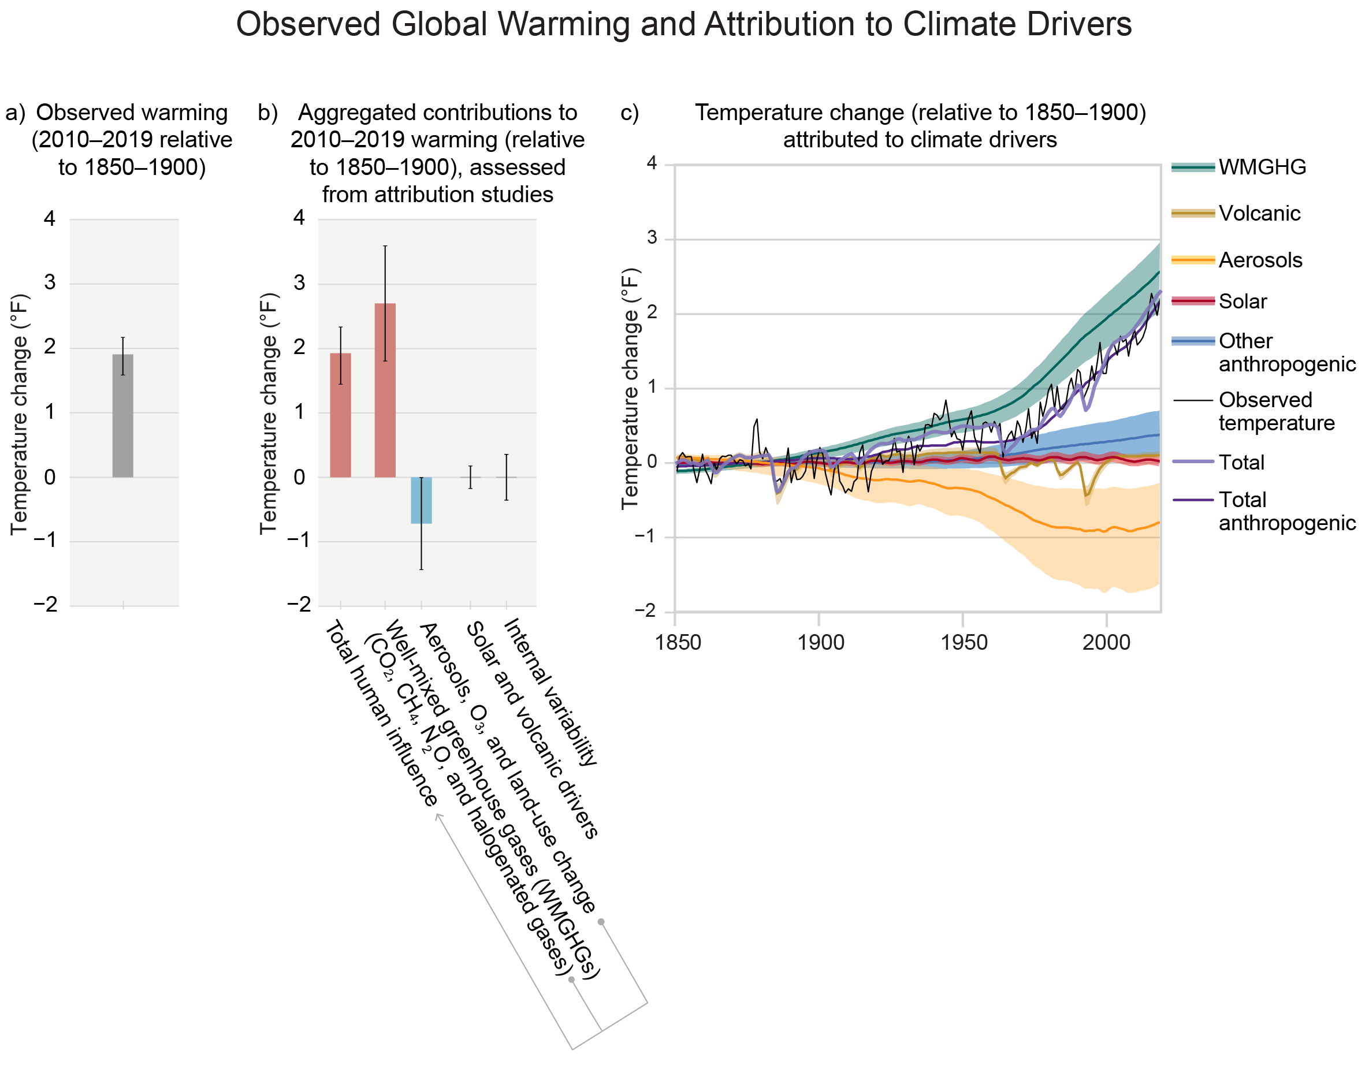
Figure 3.1. The warming observed over the industrial era was driven by emissions from human activities, with greenhouse gas warming partly masked by aerosol cooling.
Notes:
CAPTION: The figure shows (a) observed change in global average surface temperature in 2010–2019 relative to 1850–1900; (b) temperature change over the same period (also relative to 1850–1900) attributed to total human influence, including changes in well-mixed greenhouse gas concentrations (including carbon dioxide [CO₂], methane [CH₄], nitrous oxide [N₂O], and halogenated gases); combined changes in aerosols, ozone (O₃), and land use (land-use reflectance); and solar and volcanic drivers and natural climate variability; and (c) time evolution of observed temperature (2010–2019, relative to 1850–1900; black line) attributed to different climate drivers from 1850 to 2019, as well as total human influence (“Total anthropogenic”; purple line) and combined natural and human influence (“Total”; lavender line). Whiskers in (a) and (b) show the very likely range, while shaded uncertainty bands in (c) show very likely (5%–95%) ranges. Note that in (b), the warming effect of ozone is largely offset by the cooling effect of aerosols, resulting in a net cooling when the effects of aerosols, ozone, and land-use change are combined. (a, b) Adapted with permission from Figure SPM.2 in IPCC 2021;(IPCC 2021) (c) adapted with permission from Figure 7.8 in Forster et al. 2021(Forster et al. 2021) and Figure 2.11c in Gulev et al. 2021.(Gulev et al. 2021)

Slide 9
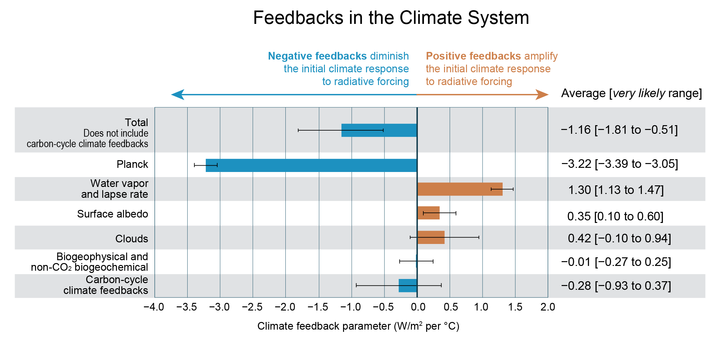
Figure 3.2. Multiple feedback processes in the climate system amplify or partially diminish the response to radiative forcing; quantifying their values is necessary to determine the climate response to human activities.
Notes:
CAPTION: The graph shows assessed values of feedbacks acting in the climate system. The total feedback is the feedback that contributes to the assessed value of climate sensitivity. Bars denote the average feedback values, and uncertainties denoted by whiskers represent very likely ranges. Negative feedbacks are denoted by blue bars and positive feedbacks by orange bars. The feedback values are estimated by climate models based on the equilibrium change in Earth’s energy balance in response to a doubling of carbon dioxide (CO₂) with and without the feedback processes. W/m² is watts per square meter. Adapted with permission from Figure TS.17 in Arias et al. 2021.(Arias et al. 2021)

Slide 10
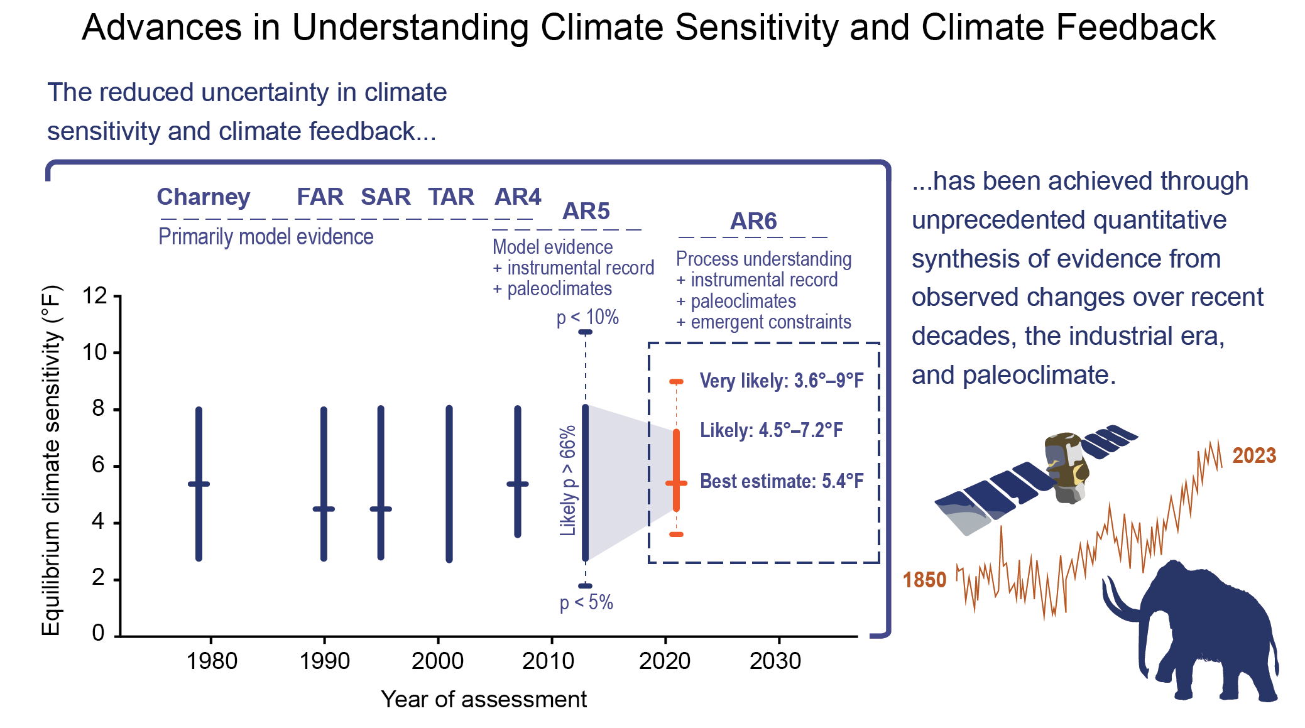
Figure 3.3. Uncertainties in climate sensitivity and feedbacks have been reduced by synthesizing multiple lines of evidence.
Notes:
CAPTION: The graph (left) shows estimates of equilibrium climate sensitivity (ECS; y-axis) and the considered lines of evidence as a function of the years (x-axis) in which various assessment reports were released. These assessments include the “Charney Report”—a study by an ad hoc US research group that was published in 1979—and the first through sixth assessment reports produced by the Intergovernmental Panel on Climate Change (IPCC), indicated here by the acronyms FAR, SAR, TAR, AR4, AR5, and AR6, respectively. NCA adopts the climate sensitivity values assessed by IPCC reports. Thick vertical bars indicate the likely range, and the horizontal tick marks on these bars, where present, indicate the best estimate (tick marks for the AR5 indicate a less than 5% probability of ECS being below 1.8°F and less than 10% probability of being greater than 10.8°F). The reduced estimated range of ECS in AR6 reflects advances in understanding of how climate feedbacks operate across timescales and an improved ability to combine physical constraints with observational data from recent decades, the industrial era, and paleoclimate records. The images of a satellite, the surface temperature time series, and a woolly mammoth (right) are emblematic of these three lines of evidence used to assess climate sensitivity. Adapted with permission from Figure TS.16a in Arias et al. 2021.(Arias et al. 2021)

Slide 11
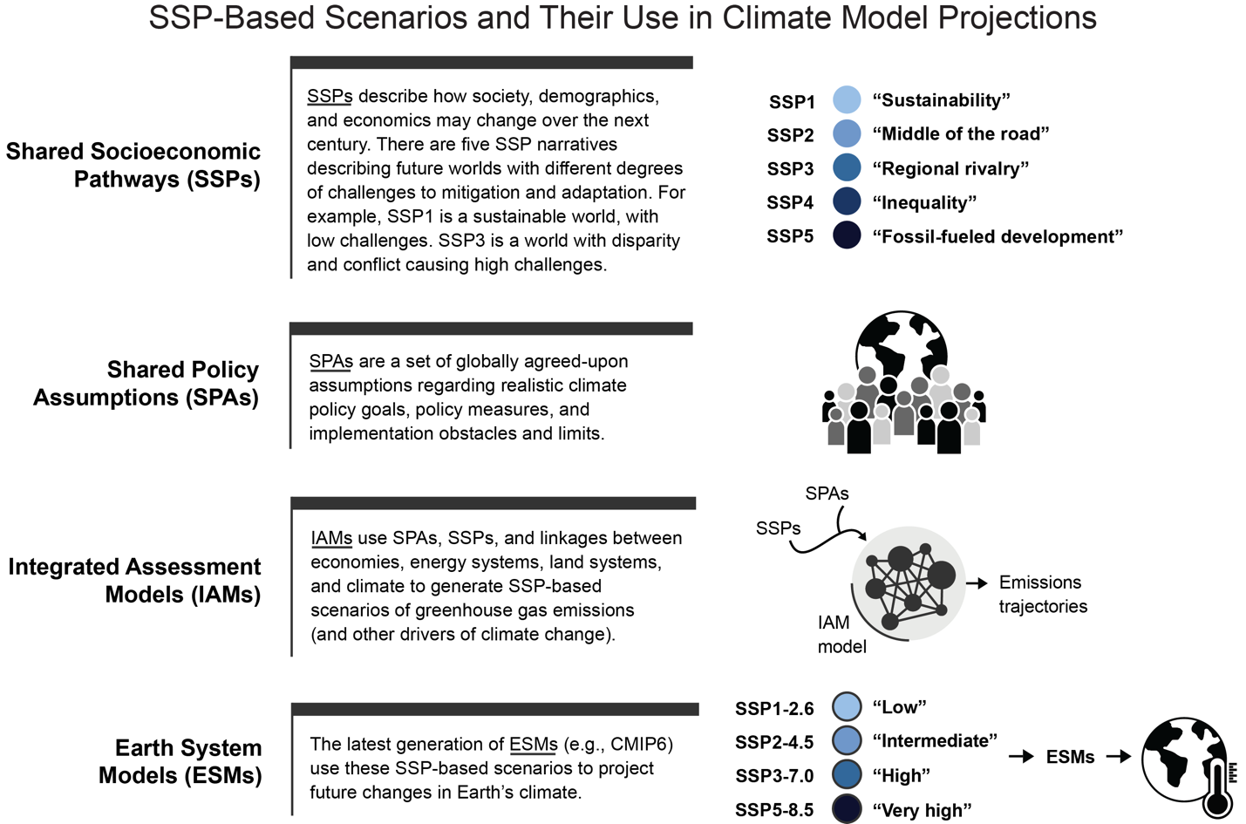
Figure 3.4. Projections of future climate involve a multistep process using scenarios about future socioeconomic developments, policy goals, and emissions to drive Earth system models.
Notes:
CAPTION: The graphic shows the chain of development leading to Earth system model experiments under CMIP6 ScenarioMIP, the most up-to-date 21st-century climate change projections. Five societal development pathways (the SSPs) were produced. Then, assumptions about climate mitigation policies that could be consistently applied to those socioeconomic futures were developed (the SPAs). Integrated assessment models took these baseline or mitigated pathways and produced alternative plausible trajectories of greenhouse gas emissions and land-use change. Earth system models used those emissions and land-use changes as inputs to produce the new CMIP6 scenarios of climate outcomes. Figure credit: Pacific Northwest National Laboratory, NOAA NCEI, and CISESS NC.

Slide 12
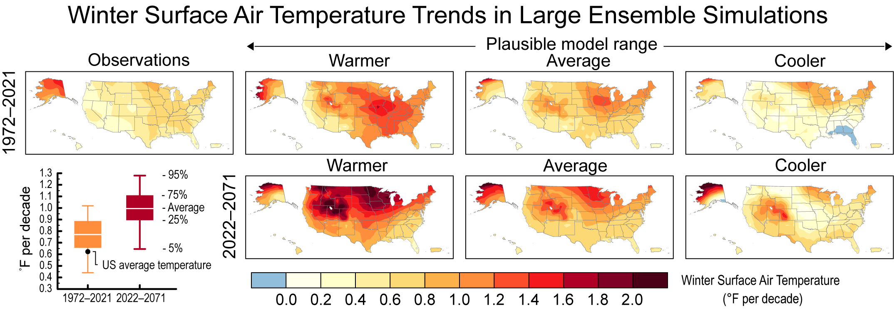
Figure 3.5. Large ensemble simulations provide a plausible range of trends in winter surface air temperature combining the human-caused climate change and natural variability. The observed trend falls within the range simulated by the large ensemble for the historical period.
Notes:
CAPTION: This figure shows past and projected future trends (in °F per decade) in winter (December–February) average air temperature over the United States and its territories (except the US-Affiliated Pacific Islands [USAPI]). The top row shows the observed trends during 1972–2021 (panel labeled “Observations”) and the plausible model range of trends simulated by the CESM2 100-member Large Ensemble during 1972–2021 (panels labeled “Warmer,” “Average,” and “Cooler”). Here, “warmer” means the ensemble member with the 5th largest US-average trend, “cooler” means the ensemble member with the 5th smallest US-average trend, and “average” means the average trend across all 100 ensemble members. Note that the model range results from the combined influences of simulated natural variability and human-caused climate change. The bottom row of maps shows the plausible model range of trends simulated by the Community Earth System Model 2 (CESM2) 100-member Large Ensemble projected for 2022–2071 under the SSP3-7.0 radiative forcing scenario (panels labeled “Warmer,” “Average,” and “Cooler”; see above for definitions). White areas on the maps are major lakes, including Great Salt Lake, Lake Okeechobee, and Lake Tahoe. Trend values in the USAPI (not shown) are very similar to those for the Hawaiian Islands. The box plot at the lower left shows the distribution of US-average trends simulated by the CESM2 100-member Large Ensemble for the period 1972–2021 (orange) and projected for the period 2022–2071 (red). The thin white line within each box denotes the average value, and the boundaries of the box show the 25th–75th percentile range. The black dot shows the observed US-average trend during 1972–2021, which lies within the plausible model range of trends. Figure credit: National Center for Atmospheric Research.

Slide 13
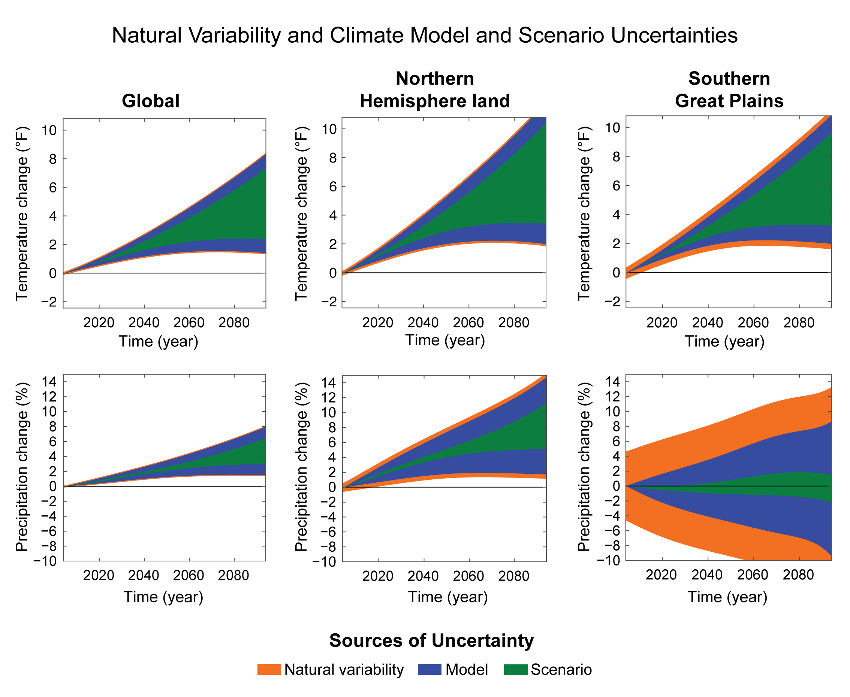
Figure 3.6. The sources of uncertainty in climate projections vary depending on timescale and geographical scale and for different aspects of the climate system.
Notes:
CAPTION: These charts show the relative importance of different sources of uncertainty (natural variability, model uncertainty, and scenario uncertainty) for projections of moving decadal average temperature (top row) and precipitation (bottom row) for the globe (first column), Northern Hemisphere land (second column), and the Southern Great Plains (third column) from 1999 to 2099 (decadal averages are plotted mid-decade; for example, the x-axis starts in 2004) relative to the reference period of 1995–2014, based on CMIP6 models. Model uncertainty is calculated as the variance across models’ forced response estimates. Scenario uncertainty is calculated as the variance across multimodel averages for different scenarios. The shadings are constructed as a symmetric 90% range around the multimodel, multiscenario average projection. Figure credit: Cornell University, National Center for Atmospheric Research, and Pacific Northwest National Laboratory.

Slide 14
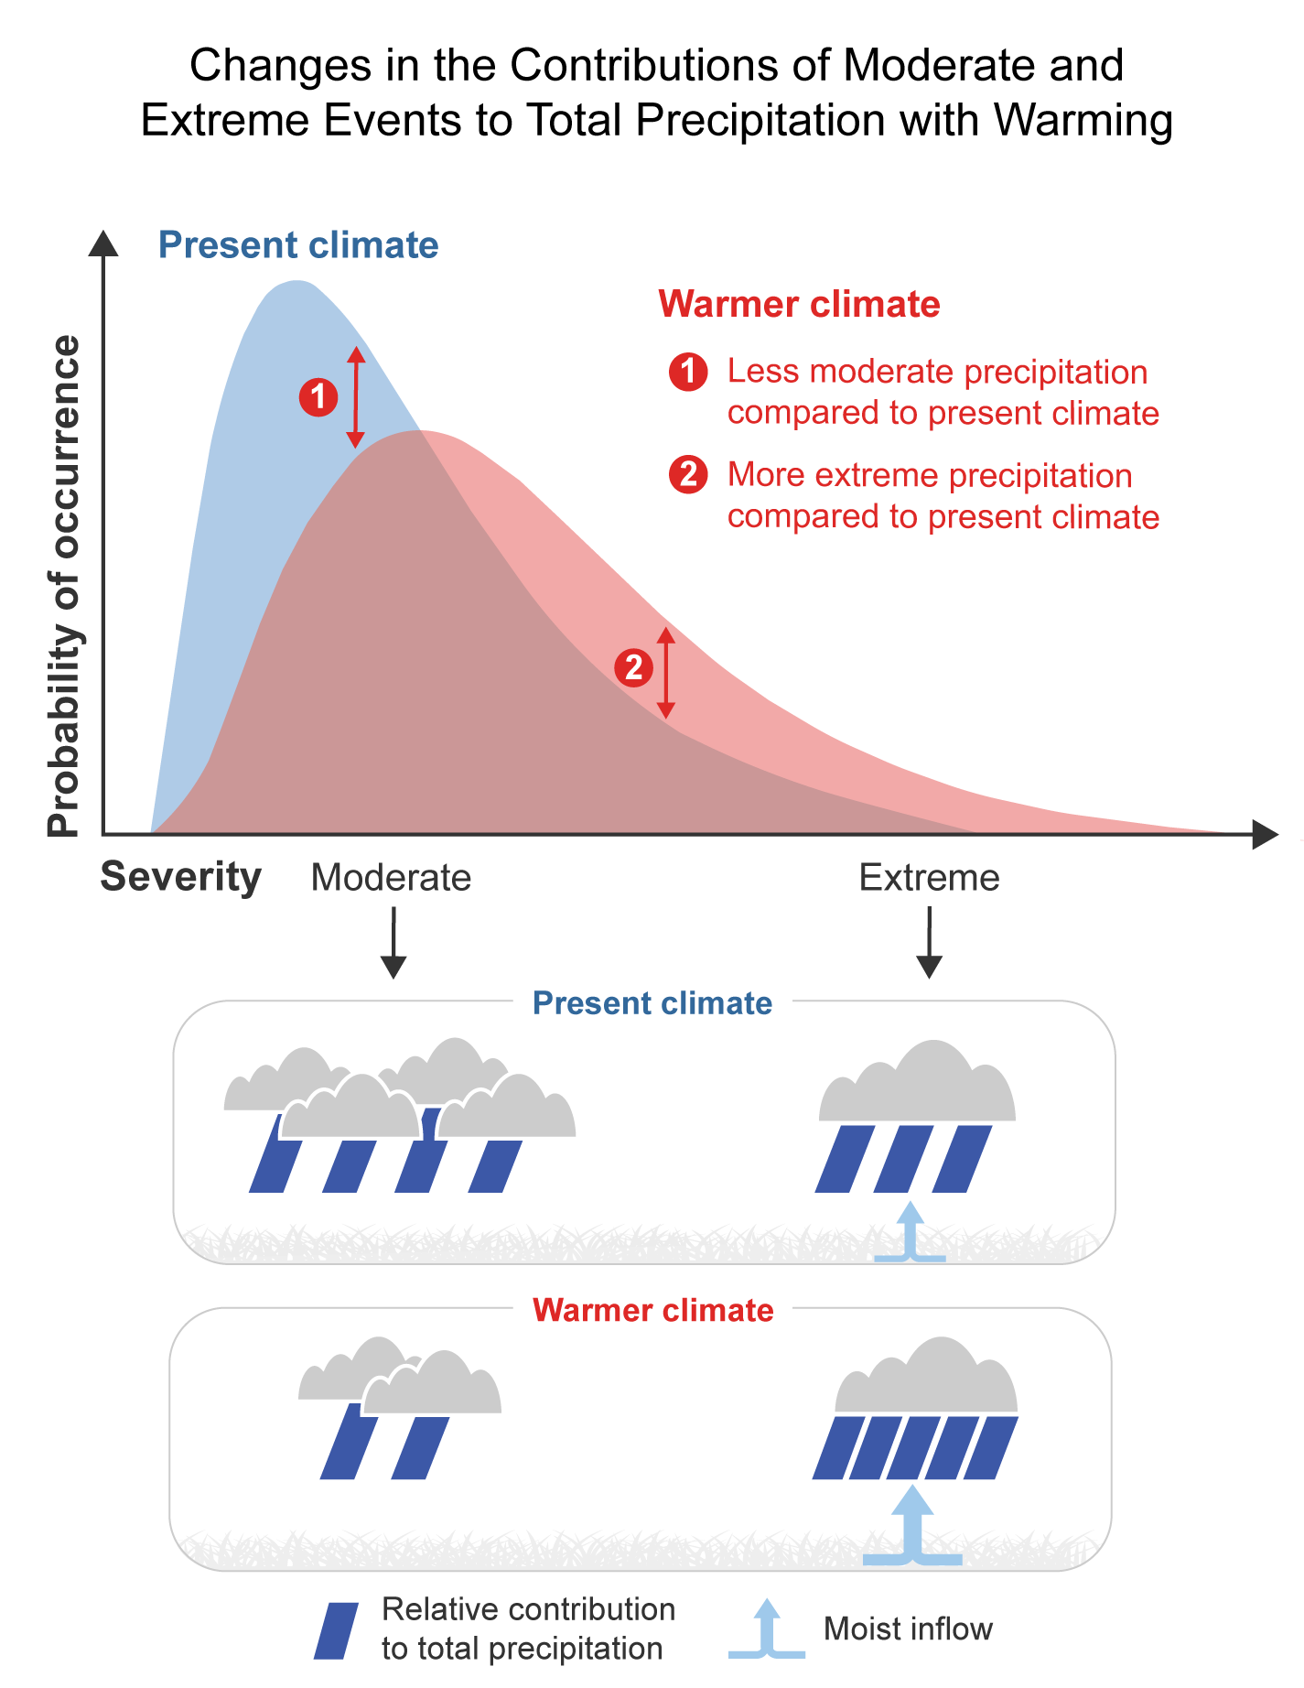
Figure 3.7. As the climate warms, extreme precipitation events become more intense and make up a larger fraction of total precipitation, while moderate events become less common.
Notes:
CAPTION: The graphic depicts example changes in the precipitation distribution at many locations as projected by climate models. (top) In general, warming shifts the distribution toward a greater probability of large events and a reduced probability of light to moderate events, with only a modest change in the average total precipitation over a season or year. (bottom) Greater levels of water vapor in the atmosphere in a warmer world drive more precipitation during storms, when moist air masses converge. The increased water vapor convergence, or moist inflow, in very stormy areas also transports more water vapor out of surrounding areas, reducing any light to moderate precipitation there. The changes in total precipitation are often modest, because they reflect this tug-of-war between opposing changes in heavy and light to moderate precipitation. Changes in circulation can also affect the changes in all parts of the precipitation distribution. Certainty in projected changes differs among the underlying processes: the increase in water vapor and associated increase in extremes is very certain, while the changes in circulation are less certain. Further discussion related to top panel can be found in Fischer and Knutti (2016).(Fischer and Knutti 2016) Figure credit: Cornell University and University of California, Los Angeles.

Slide 15
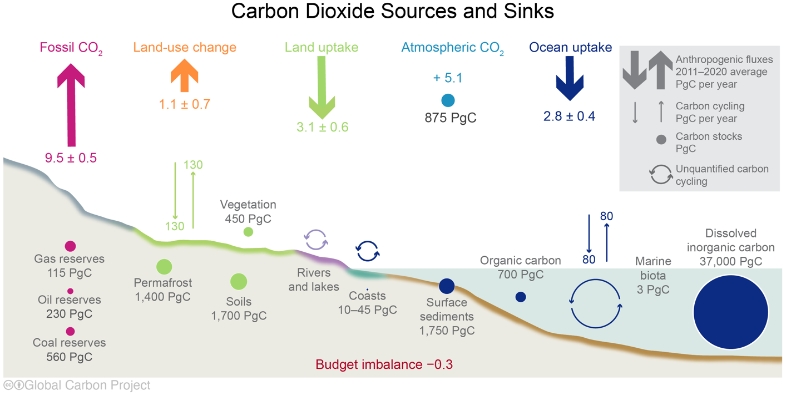
Figure 3.8. While the land and ocean take up some of the carbon dioxide from human activities, the rest continues to accumulate in the atmosphere every year.
Notes:
CAPTION: The primary sources of anthropogenic carbon are fossil fuel and land-use change emissions (upward thick arrows). While the land biosphere and ocean continue to take up the same proportion of anthropogenic carbon every decade (downward thick arrows), atmospheric carbon dioxide (CO₂) levels continue to rise as fossil fuel and land-use change emissions continue over time. Represented here is the budget of the global carbon cycle each year from estimates averaged globally for the decade 2011–2020, with flux estimates from Canadell et al. 2021.(Canadell et al. 2021) Values are in Petagrams of carbon (PgC). Adapted from Friedlingstein et al. 2022(Friedlingstein et al. 2022) [CC BY 4.0].

Slide 16
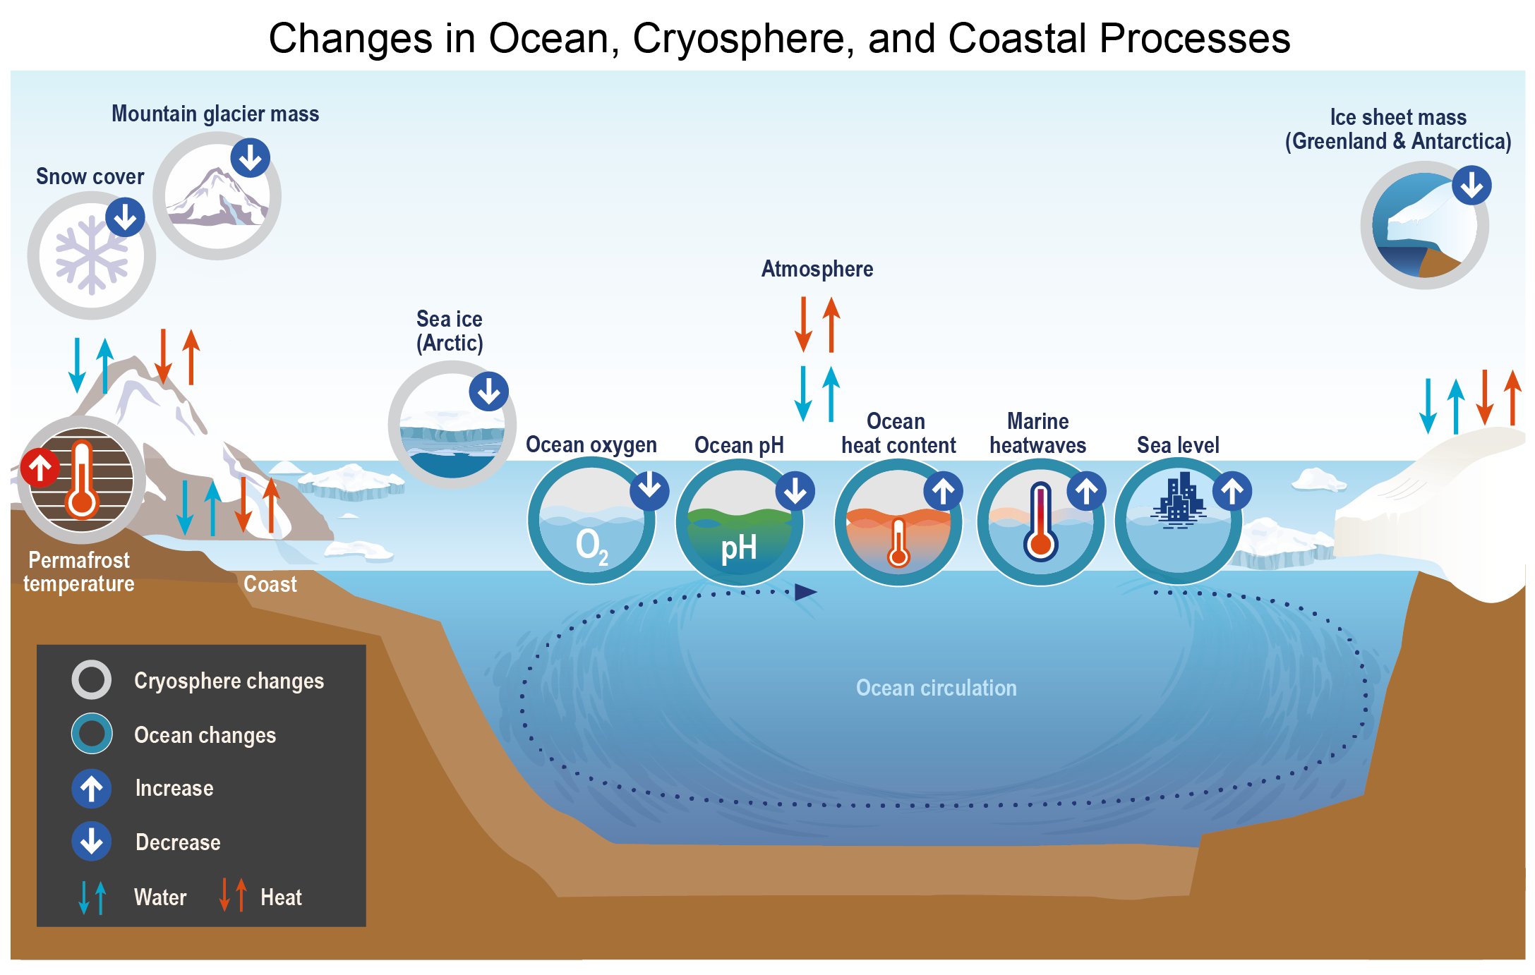
Figure 3.9. Climate change has multiple effects on the ocean, atmosphere, and cryosphere and their complex interactions.
Notes:
CAPTION: The figure shows important physical processes that play a role in the ocean and cryosphere, along with their linkages. Associated climate change–related effects, including sea level rise, increasing ocean heat content, ocean acidification, marine heatwaves, and ice mass loss, are also shown. The arrows indicate an exchange taking place between ice, ocean, and atmosphere. Adapted with permission from Figure TS.2 in IPCC 2019.(IPCC 2019)

Slide 17
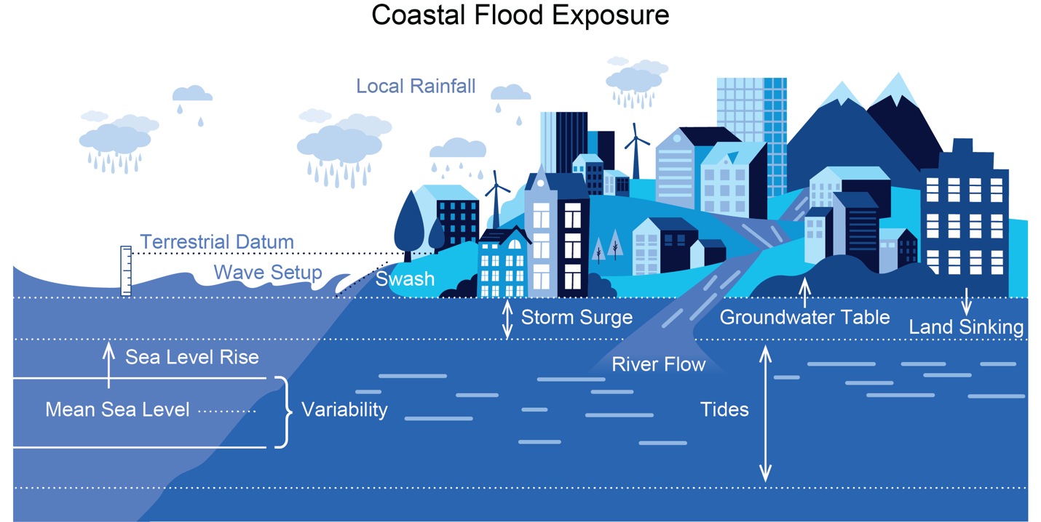
Figure 3.10. Sea level rise is increasing the probability of coastal flooding and associated impacts.
Notes:
CAPTION: The schematic shows the physical factors affecting coastal flood exposure. Nearshore processes like storm surge, wave setup (the increase in water level due to the presence of breaking waves), and swash (wave runup and wave rundown) combine with other large-scale processes to drive impacts. Due to the clear and strong relative sea level rise signal—that is, the combination of global increases in sea level and the fact that land is sinking in many US coastal areas—the probability of flooding and impacts is increasing along most US coastlines. Source: Sweet et al. 2022.(Sweet et al. 2022)

Slide 18
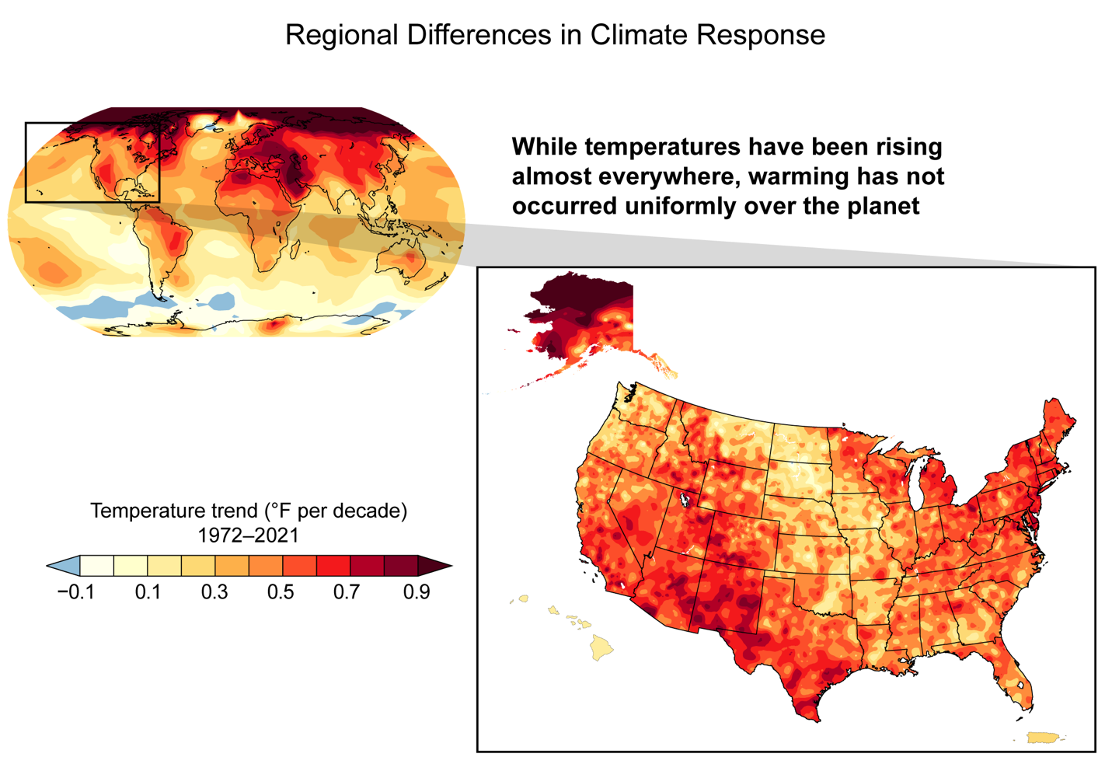
Figure 3.11. While temperatures have been rising almost everywhere, warming has not occurred uniformly over the planet.
Notes:
CAPTION: The maps show observed global (left) and overland US (right) trends (in °F per decade) in annual average near-surface temperature over the period 1972–2021. While temperatures have been increasing almost everywhere, warming has not occurred uniformly over either the planet or the US. Temperatures over land have been increasing faster than over the ocean, and the Arctic has been warming at more than twice the global average rate. Temperatures over the US have increased faster in Alaska, at high elevations, and in regions with significant seasonal snowpack. Figure credit: University of California, Los Angeles; University of California, Davis; NOAA NCEI; and CISESS NC.

Slide 19
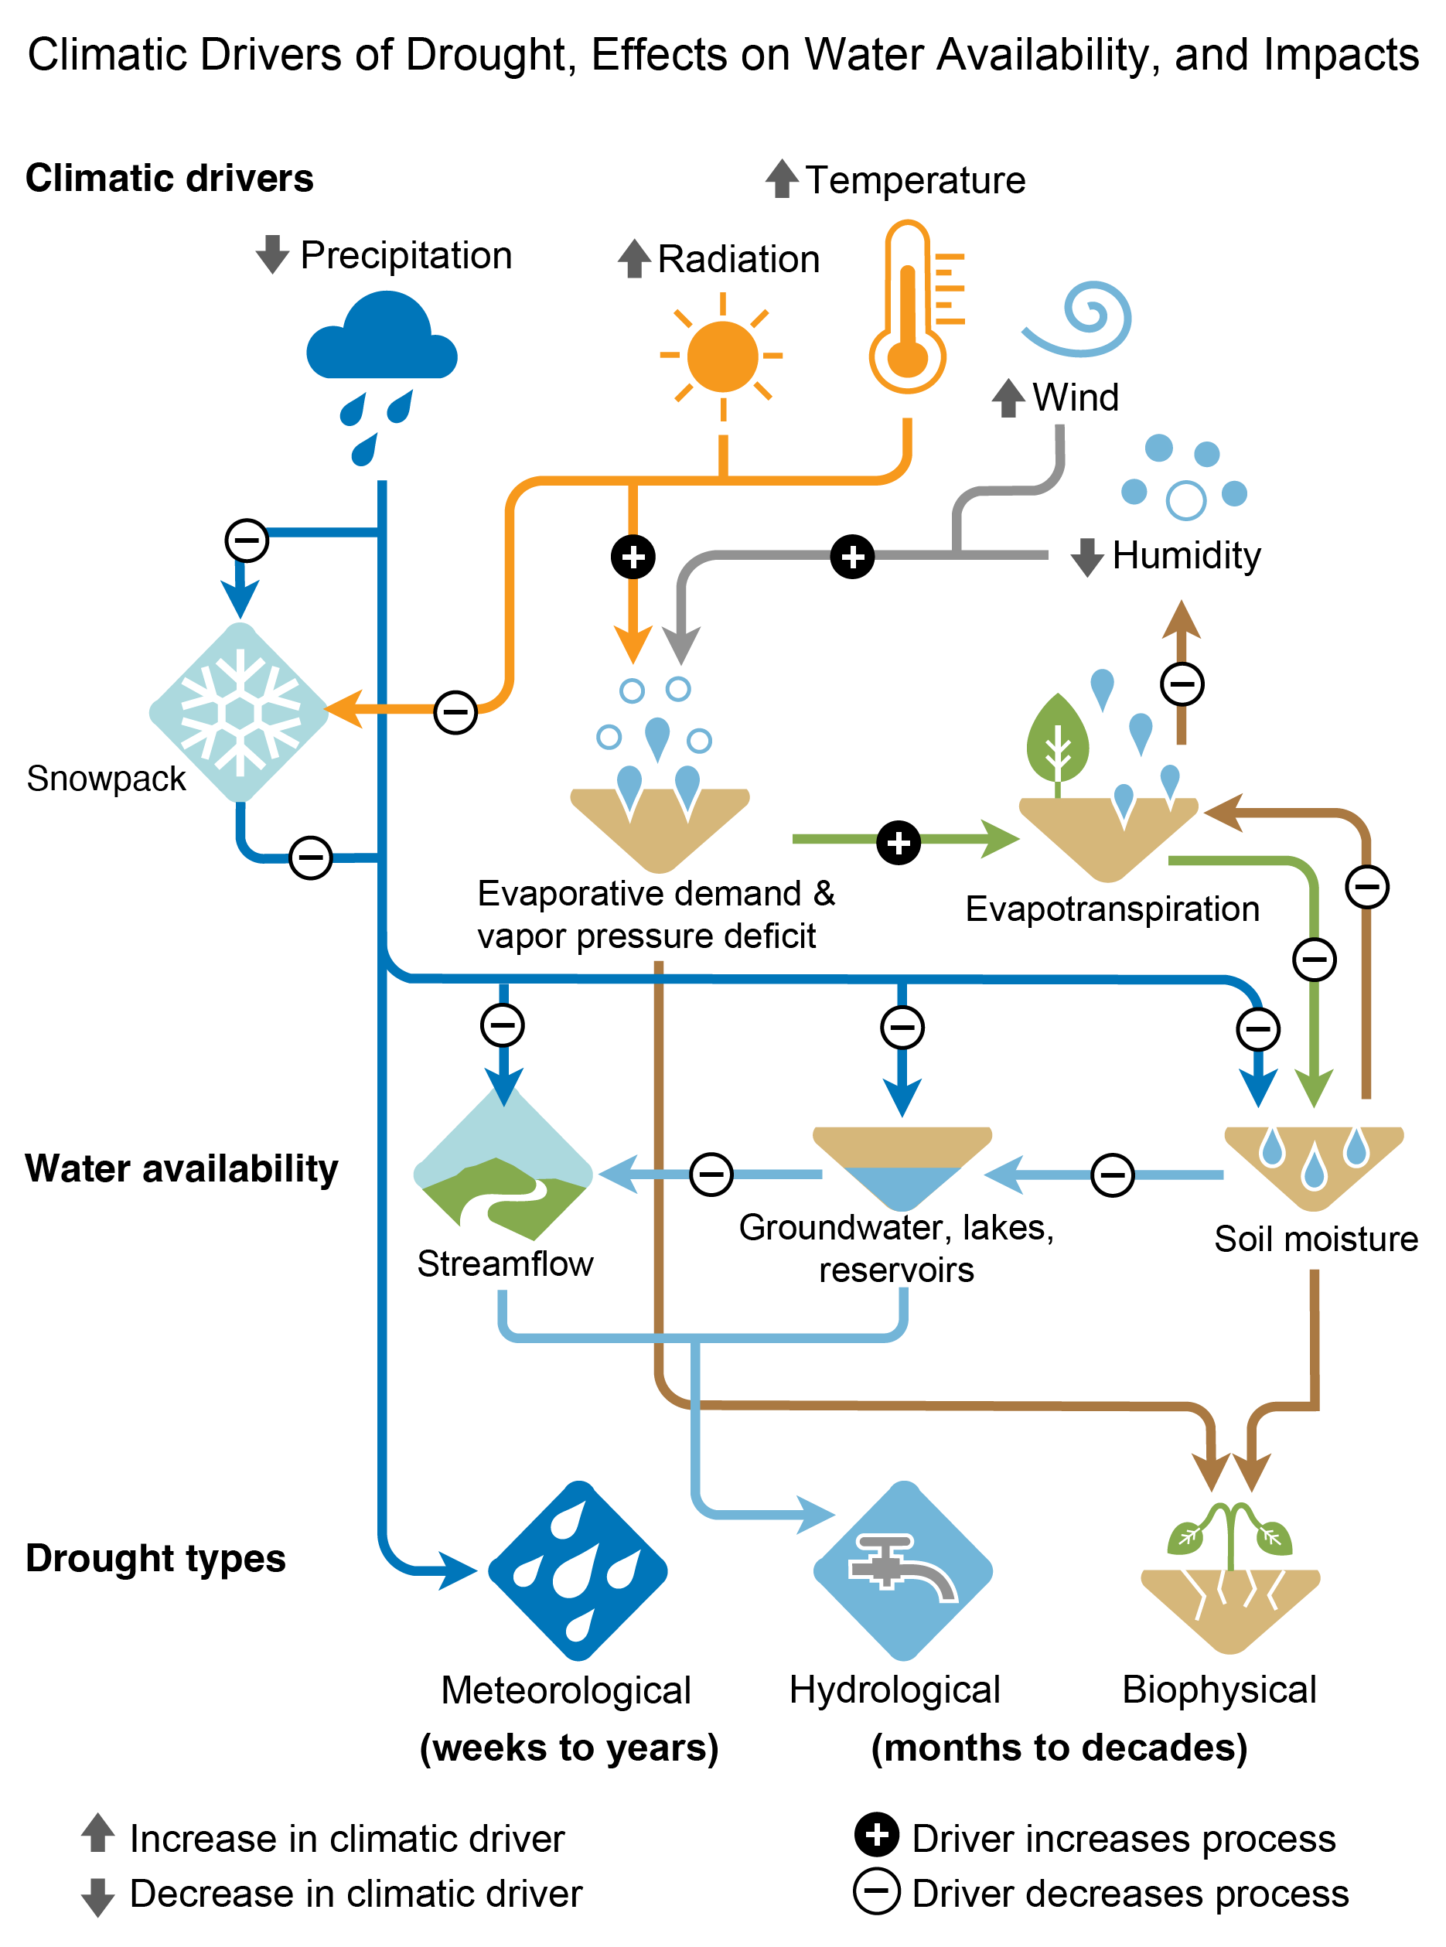
Figure 3.12. Climate change alters the hydrologic cycle and is expected to increase drought in some regions through various process pathways.
Notes:
CAPTION: Changes in climatic drivers (e.g., precipitation, temperature, wind, etc.) affect different aspects of the hydrologic cycle (e.g., evapotranspiration, snowpack, streamflow, soil moisture). In turn, these hydrologic shifts translate into changes in the severity, frequency, and risk of different drought types. Plus and minus signs denote the direction of change in the driver that would cause increases in drought. For example, where precipitation declines (down arrow), all drought types will increase because this reduces snowpack, streamflow, groundwater and reservoir storage, and soil moisture. Similarly, increasing temperatures (up arrow) are also expected to increase hydrological and biophysical drought by reducing snowpack and increasing evaporative losses from streams, surface reservoirs, and soils. Adapted with permission from Figure 8.6 in Douville et al. 2021.(Douville et al. 2021)

Slide 20
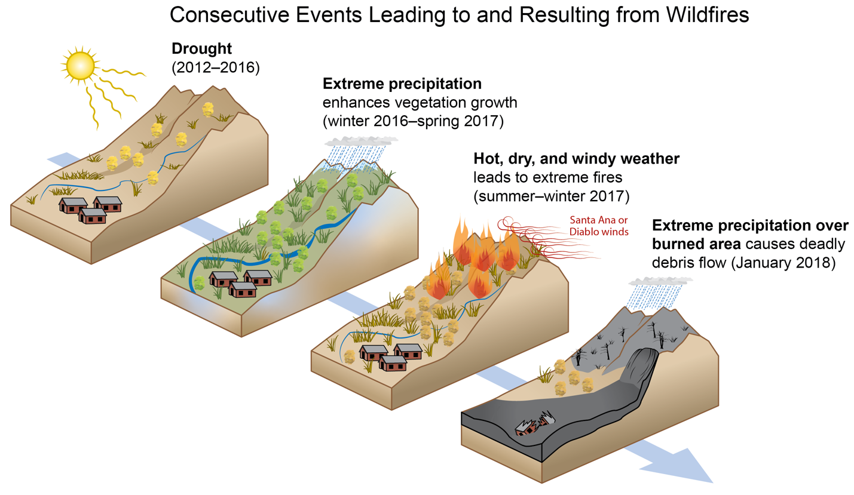
Figure 3.13. Consecutive events caused significant human health and economic impacts in Southern California from 2012 through 2018.
Notes:
CAPTION: A series of events in Southern California produced a cascade of impacts on human health and the economy. These include (from top left to bottom right): a prolonged drought from 2012 to 2016; above-average winter precipitation in 2017, enhancing growth of fuels; a dry, warm spring and summer, reducing moisture levels and drying existing vegetation; record-setting Santa Ana winds; fires occurring shortly thereafter; and rainfall over the burned area, leading to debris flow event in Montecito, CA. Adapted from AghaKouchak et al. 2020;(AghaKouchak et al. 2020) modified with permission from the Annual Review of Earth and Planetary Sciences, Volume 48 © 2020 by Annual Reviews, http://www.annualreviews.org.

Slide 21
Federal Coordinating Lead Author
Adam Terando, US Geological Survey
Chapter Lead
L. Ruby Leung, Pacific Northwest National Laboratory
Agency Chapter Lead Authors
Renu Joseph, US Department of Energy
George Tselioudis, NASA Goddard Institute for Space Studies
Chapter Authors
Lori M. Bruhwiler, NOAA Global Monitoring Laboratory
Benjamin Cook, NASA Goddard Institute for Space Studies
Clara Deser, National Center for Atmospheric Research
Alex Hall, University of California, Los Angeles
Benjamin D. Hamlington, NASA Jet Propulsion Laboratory
Andrew Hoell, NOAA Physical Sciences Laboratory
Forrest M. Hoffman, Oak Ridge National Laboratory
Stephen Klein, Lawrence Livermore National Laboratory
Vaishali Naik, NOAA Geophysical Fluid Dynamics Laboratory
Angeline G. Pendergrass, Cornell University
Claudia Tebaldi, Pacific Northwest National Laboratory
Paul A. Ullrich, University of California, Davis
Michael F. Wehner, Lawrence Berkeley National Laboratory
Technical Contributors
Flavio Lehner, Cornell University
Adam S. Phillips, National Center for Atmospheric Research
Review Editor
Gavin Schmidt, National Aeronautics and Space Administration
USGCRP Coordinators
David J. Dokken, US Global Change Research Program / ICF

Slide 22
Leung, L.R., A. Terando, R. Joseph, G. Tselioudis, L.M. Bruhwiler, B. Cook, C. Deser, A. Hall, B.D. Hamlington, A. Hoell, F.M. Hoffman, S. Klein, V. Naik, A.G. Pendergrass, C. Tebaldi, P.A. Ullrich, and M.F. Wehner, 2023: Ch. 3. Earth systems processes. In: Fifth National Climate Assessment. Crimmins, A.R., C.W. Avery, D.R. Easterling, K.E. Kunkel, B.C. Stewart, and T.K. Maycock, Eds. U.S. Global Change Research Program, Washington, DC, USA. https://doi.org/10.7930/NCA5.2023.CH3
https://nca2023.globalchange.gov/chapter/3

