Slide 1

NCA5 Website: https://nca2023.globalchange.gov
Chapter Website: https://nca2023.globalchange.gov/chapter/4
NCA5 Atlas: https://atlas.globalchange.gov
Figure captions can be found in the slide notes of this deck
Social media: @usgcrp, #NCA5

Slide 2
Chapter 4 | Water

Slide 3
1
Climate Change Will Continue to Cause Profound Changes in the Water Cycle
Changes to the water cycle pose risks to people and nature. Alaska and northern and eastern regions of the US are seeing and expect to see more precipitation on average, while the Caribbean, Hawai‘i, and southwestern regions of the US are seeing and expect to see less precipitation (medium confidence). Heavier rainfall events are expected to increase across the Nation (very likely, very high confidence), and warming will increase evaporation and plant water use where moisture is not a limiting factor (medium confidence). Groundwater supplies are also threatened by warming temperatures that are expected to increase demand (very likely, high confidence). Snow cover will decrease and melt earlier (very likely, high confidence). Increasing aridity, declining groundwater levels, declining snow cover, and drought threaten freshwater supplies (medium confidence).

Slide 4
2
Water Cycle Changes Will Affect All Communities, with Disproportionate Impacts for Some
Natural and human systems have evolved under the water cycle’s historical patterns, making rapid adaptation challenging. Heavier rainfall, combined with changes in land use and other factors such as soil moisture and snow, is leading to increasing flood damage (likely, high confidence). Drought impacts are also increasing (medium confidence), as are flood- and drought-related water quality impacts (medium confidence). All communities will be affected, but in particular those on the frontline of climate change—including many Black, Hispanic, Tribal, Indigenous, and socioeconomically disadvantaged communities—face growing risks from changes to water quantity and quality due to the proximity of their homes and workplaces to hazards and limited access to resources and infrastructure (very likely, high confidence).

Slide 5
3
Progress Toward Adaptation Has Been Uneven
The ability of water managers to adapt to changes has improved with better data, advances in decision-making, and steps toward cooperation. However, infrastructure standards and water allocation institutions have been slow to adapt to a changing climate (high confidence), and efforts are confounded by wet and dry cycles driven by natural climate variability (very likely, high confidence). Frontline, Tribal, and Indigenous communities are heavily impacted but lack resources to adapt effectively, and they are not fully represented in decision-making (high confidence).

Slide 6
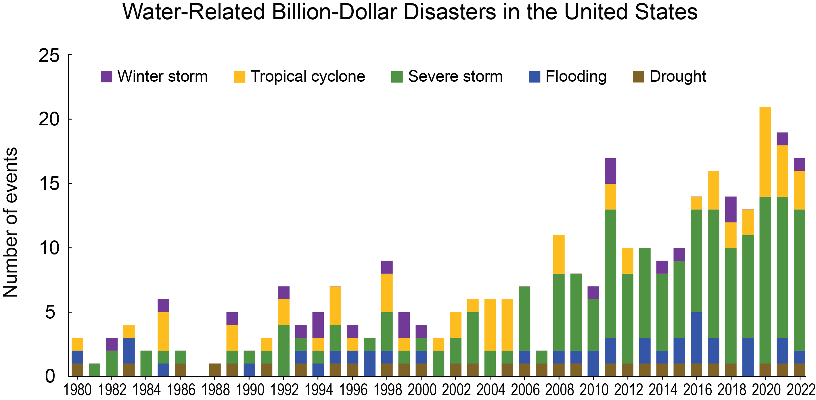
Figure 4.1. Water-related billion-dollar disasters are increasing in the United States.
Notes:
CAPTION: Across the US, the number of water-related disasters with damages exceeding $1 billion (adjusted for inflation) during 1980–2022 rose due to increases in exposure, or assets at risk; vulnerability, or how much damage a hazard of a given intensity causes; and climate change-driven increases in the frequency of extremes. Adapted from NCEI 2023.(NCEI 2023)

Slide 7
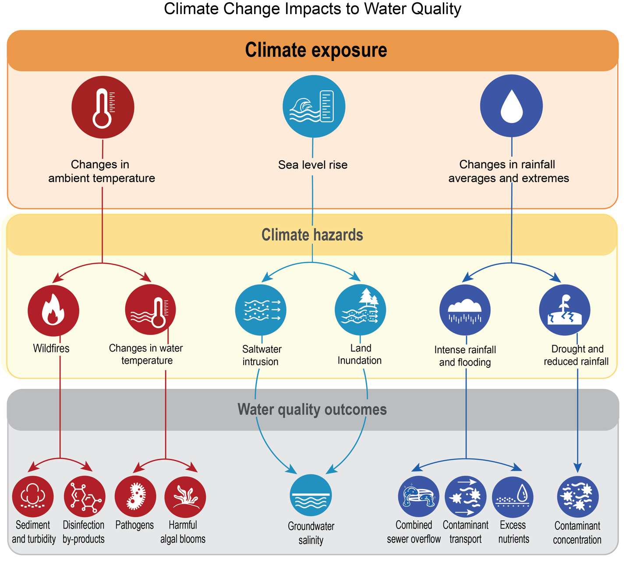
Figure 4.2. Climate change threatens the quality of freshwater supplies.
Notes:
CAPTION: Changes in ambient temperature, sea level, and rainfall (top) can create climate-related hazards, such as changes in water temperature and saltwater intrusion (middle) that can have negative impacts on water quality (bottom). Saltwater intrusion is an imminent threat to coastal and island communities dependent on groundwater for drinking water (KMs 30.1, 9.2); agricultural areas face risks to water supplies when fertilizers and pesticides are mobilized by flooding;(Shukla et al. 2023) higher temperatures are putting many areas at risk of exposure to harmful algal blooms (e.g., KM 22.2) and increases in fecal coliform bacteria;(Nijhawan and Howard 2022) and treatment plants are challenged by sediments and debris from wildfires in their source waters (KM 6.1).(Chow et al. 2019; Robinne et al. 2021) Adapted from Nijhawan and Howard 2022(Nijhawan and Howard 2022) [CC BY 4.0].

Slide 8
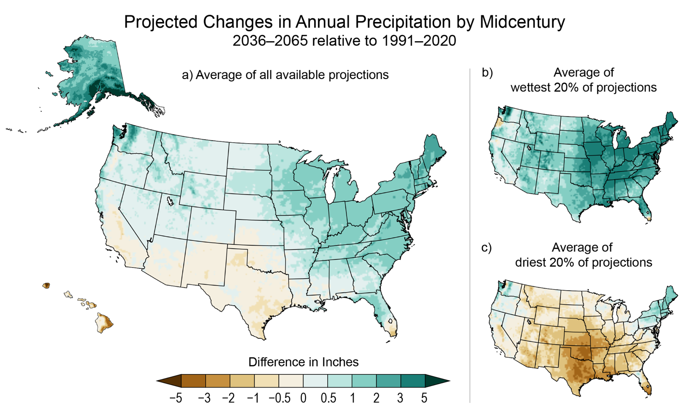
Figure 4.3. Annual precipitation projections show large regional differences.
Notes:
CAPTION: Under an intermediate (RCP4.5) scenario, annual precipitation is projected to increase for much of the US (a), except for the Southwest, Hawai‘i, and the US Caribbean (not shown; see Figure 23.2, which shows rainfall reductions of about 10% by midcentury, and increases in dry days during the wet season, for Puerto Rico). The wettest and driest 20% of projections (b, c) illustrate the range of uncertainty in annual precipitation projections. This figure shows projected changes in inches. In the Southwest, a half-inch change in annual precipitation has more influence on the region’s hydrology than does a half-inch change in the Northeast (see Figure 2.10 for percent changes under different warming levels). Projections are not available for the US-Affiliated Pacific Islands. Figure credit: University of Colorado Boulder, NOAA NCEI, and CISESS NC.

Slide 9
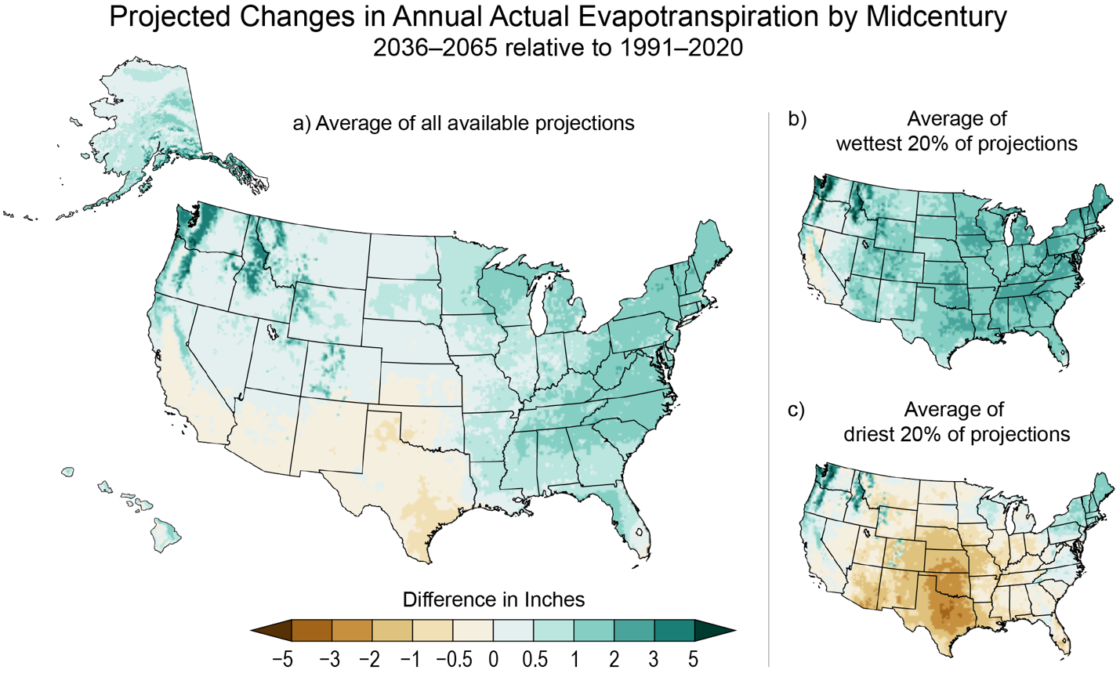
Figure 4.4. Actual evapotranspiration is projected to increase across most of the Nation but decrease in the Southern Great Plains and Southwest.
Notes:
CAPTION: Actual evapotranspiration is the water that evaporates from soil and surface water or transpires from plants. Higher rates of evapotranspiration can reduce overall water availability even if precipitation does not change; conversely, low water availability can limit actual evapotranspiration. Under an intermediate scenario (RCP 4.5), actual evapotranspiration is expected to decrease in regions with decreasing or unchanging precipitation (a), such as the US Southwest, the Southern Great Plains, and the Caribbean (not shown; Box 23.2). Wetter regions, including the Northwest, Alaska, Hawai‘i, and the eastern half of the US, will see higher actual evapotranspiration. The wettest and driest projections (b, c) illustrate the range of uncertainty. Projections are not available for the US-Affiliated Pacific Islands. Figure credit: University of Colorado Boulder, NOAA NCEI, and CISESS NC.

Slide 10
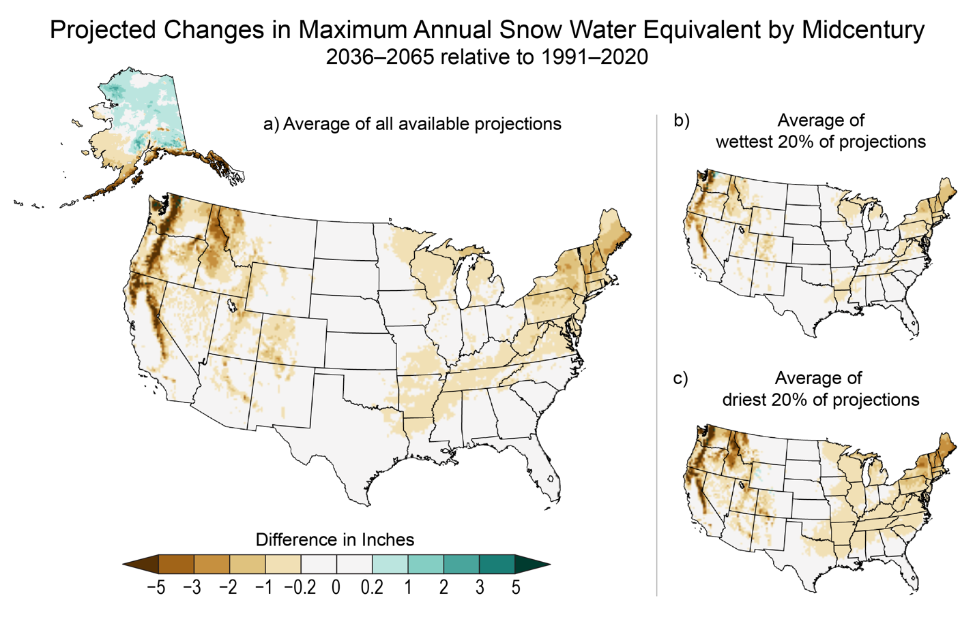
Figure 4.5. Continued decreases in snowpack water content are projected across much of the US.
Notes:
CAPTION: Snow water equivalent (SWE), the quantity of water stored in the snowpack, is key to regional water supplies. Under an intermediate scenario (RCP 4.5), peak SWE is projected to decline across much of the country except for some high-elevation interior locations in the contiguous United States and parts of Alaska (a). The largest snowpack declines are expected in warmer snow climates like coastal southern Alaska and the mountain ranges of California and the Northwest. The wettest (b) and driest (c) projections both show decreases in SWE, reflecting the influence of warming on future snowpack. Snow on the highest Hawaiian mountain peaks has important cultural and ecological significance, but projections at this resolution are not available. Figure credit: University of Colorado Boulder, NOAA NCEI, and CISESS NC.

Slide 11

Figure 4.6. Projected decreases in summer soil moisture will have important implications for agriculture and ecosystems.
Notes:
CAPTION: Summer soil moisture supports dryland agriculture and ecosystem functions and reduces irrigation demand and wildfire risk. Under an intermediate scenario (RCP 4.5), soil moisture is projected to decrease during the summer months (June, July, and August) for most of the country (a), with the West seeing decreases even under the wettest projections. Exceptions include portions of the Upper Midwest and Alaska. The range between the wettest (b) and driest (c) projections illustrate the uncertainty in summer soil projections. Projections are not available for the US Caribbean or US-Affiliated Pacific Islands. Figure credit: University of Colorado Boulder, NOAA NCEI, and CISESS NC.

Slide 12
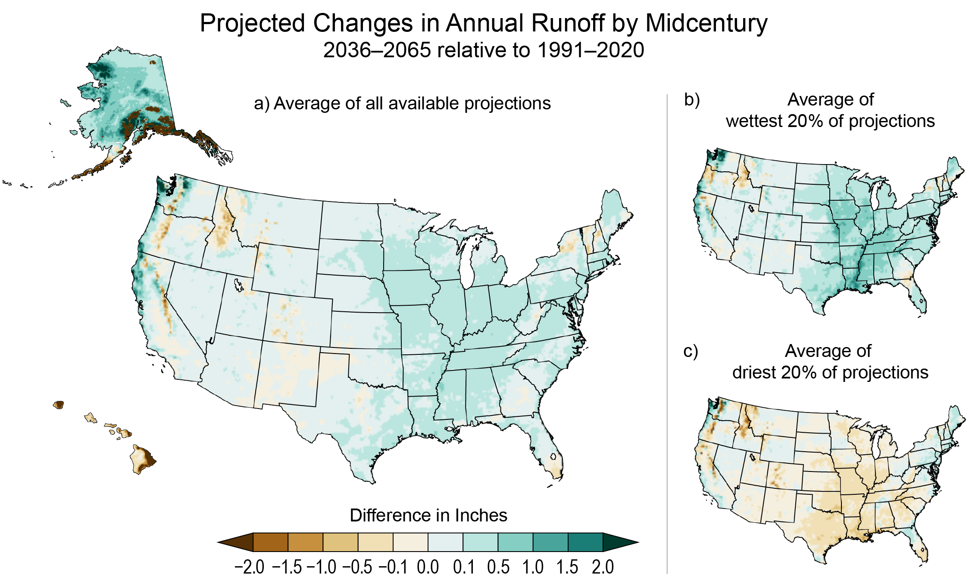
Figure 4.7. Projected changes in runoff vary across the Nation due to projected changes in multiple aspects of the water cycle.
Notes:
CAPTION: Rivers and streams aggregate runoff across watersheds, and runoff integrates climate change impacts to the water cycle (Figures 4.3, 4.4, 4.5, 4.6); as a result, impacts to runoff over a watershed are commonly used as surrogates for impacts to streamflow. Under an intermediate scenario (RCP4.5), projections of annual runoff vary geographically depending on relative changes to precipitation, evapotranspiration, snow and ice, groundwater, and soil moisture. Decreases are projected in Hawai‘i and parts of the Nation supplied by snow (a). Projections are not available for US-Affiliated Pacific Islands or the US Caribbean; however, given projected decreases in precipitation and increases in temperature in the Caribbean, annual runoff is expected to decrease. The range between the wettest (b) and driest (c) projections illustrate the uncertainty in runoff projections. Figure credit: University of Colorado Boulder, NOAA NCEI, and CISESS NC.

Slide 13
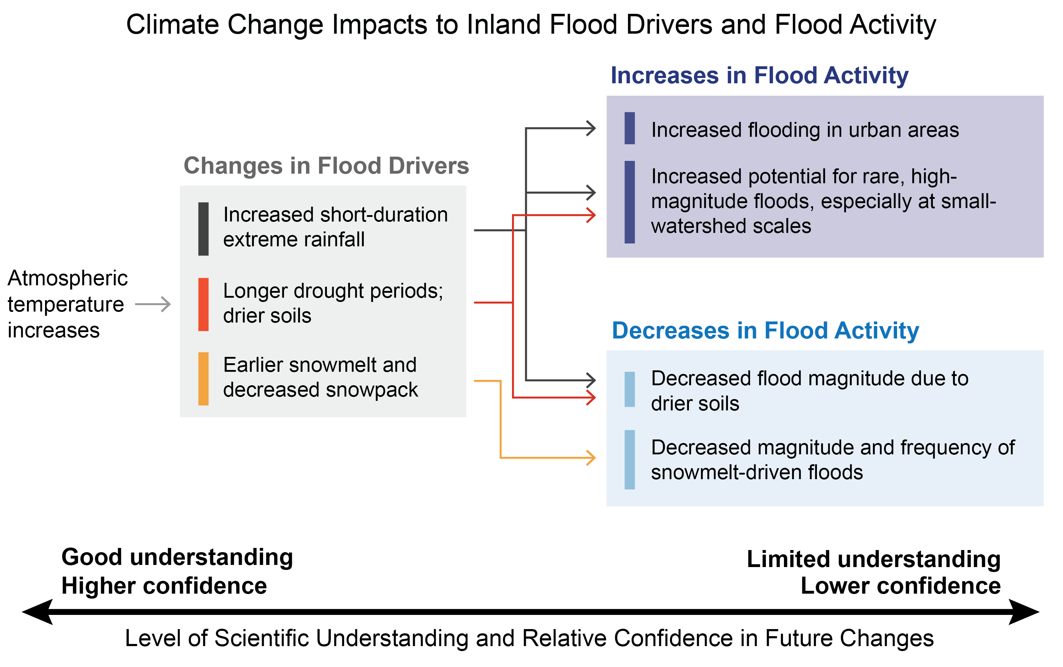
Figure 4.8. Climate change may cause both increases and decreases in inland flooding, depending on the location and time of year.
Notes:
CAPTION: Inland floods result from combinations of factors, primarily extreme rainfall, soil moisture, and snowpack and snowmelt conditions. Each of these are subject to substantial variability and change across a wide range of timescales, from daily to decadal, in a warming climate. Scientific confidence in how the climate drivers of flooding will change is higher than in how those drivers will combine to affect floods in particular locations and seasons. Adapted from Yu et al. 2020(Yu et al. 2020) [CC BY-NC 4.0].

Slide 14
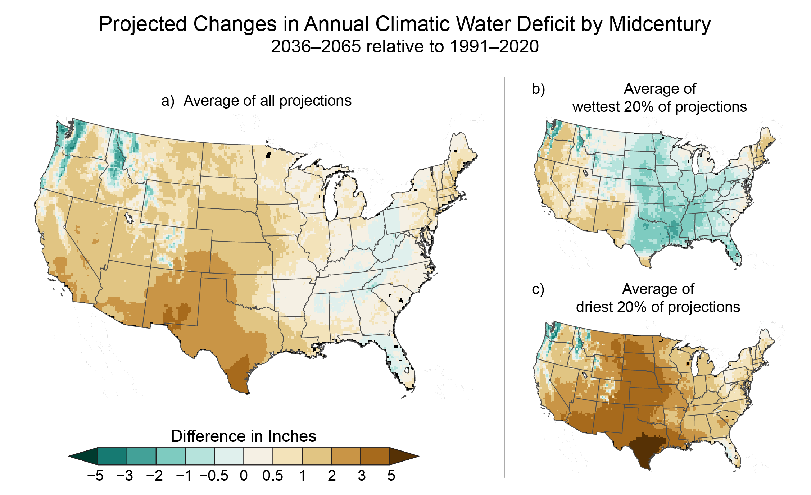
Figure 4.9. Water shortages to vegetation will increase across most of the Nation.
Notes:
CAPTION: Climatic water deficit (CWD) is the shortfall of water necessary to fully supply vegetation requirements—CWD is zero if those needs are met, and a higher number indicates drier conditions. Vegetation water needs will increase with increases in temperature; as a result, in the absence of compensating increases in precipitation, CWD is projected to increase. Under an intermediate scenario (RCP4.5), CWD is expected to rise across much of the Nation, with the Great Plains and Southwest seeing the greatest increase (a, c). Even the wettest projections show increases in CWD in the West (b). Projections are not available for the US Caribbean, Alaska, Hawai‘i, or US-Affiliated Pacific Islands; however, given expected temperature increases and annual precipitation decreases in Hawai‘i and the US Caribbean, CWD is expected to increase in those regions, while Alaska is expected to see both increases and decreases similar to the pattern seen in the Northwest. Figure credit: University of Colorado Boulder.

Slide 15
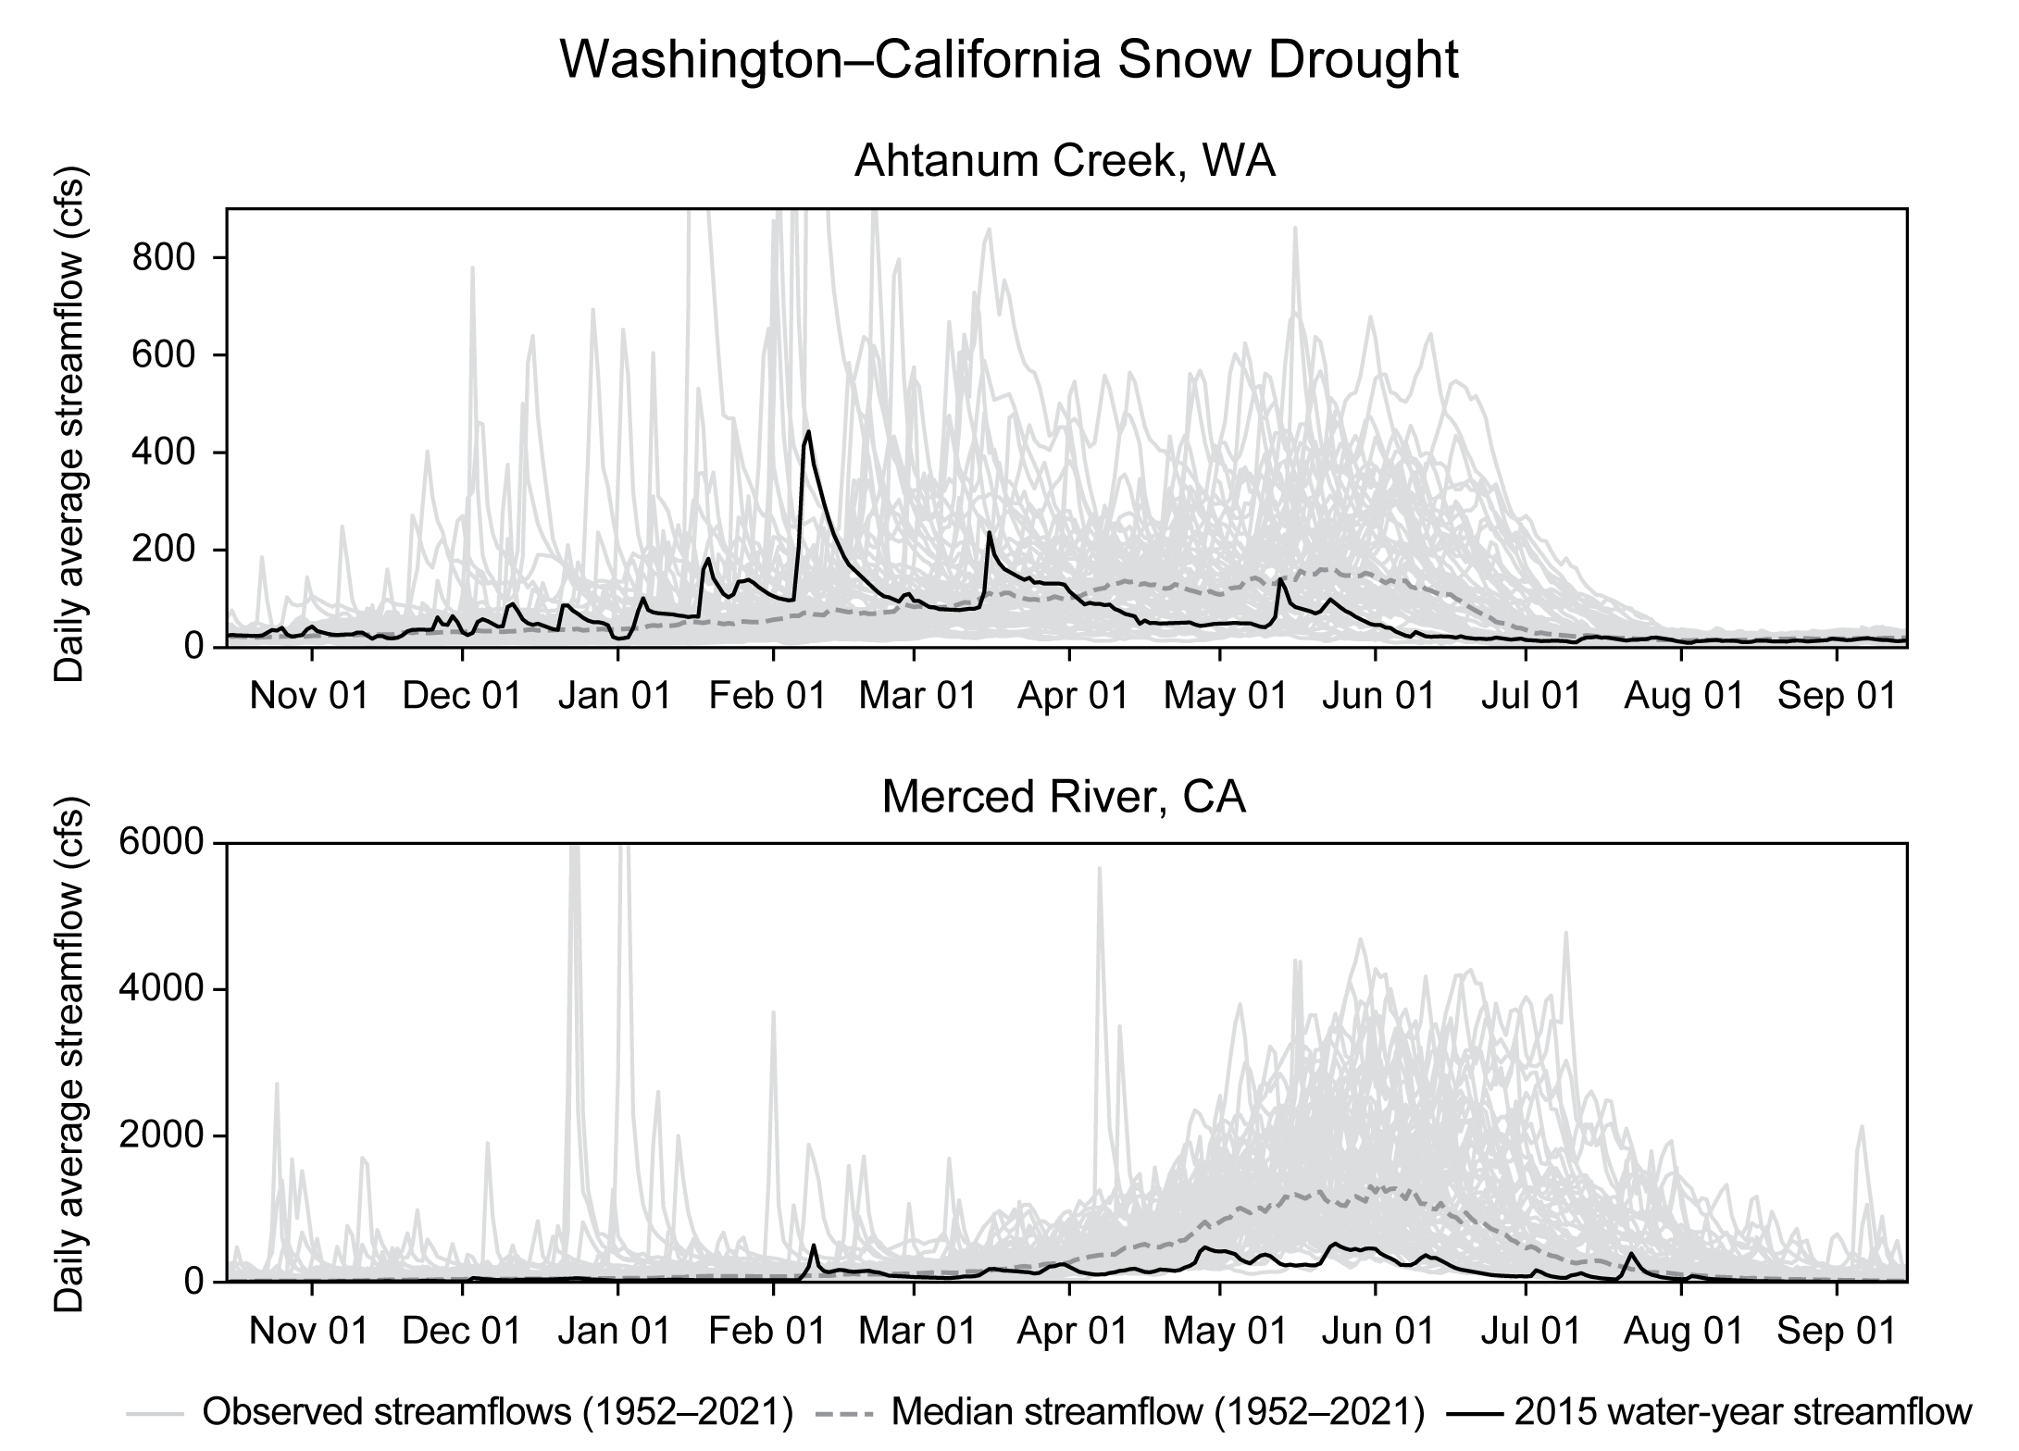
Figure 4.10. In 2015, parts of Oregon and Washington experienced a warm snow drought while the California Sierra Nevada experienced a dry snow drought.
Notes:
CAPTION: The timelines compare the 70-year (1952–2021) median streamflow (dashed line) with the 2015 water-year (October 2014–September 2015) streamflow (black line). Annual observed streamflows are also shown for 1952–2021 (gray lines). Values are daily average streamflows in cubic feet per second. Streamflow in summer 2015 was abnormally low, resulting from reduced snowpack during a warm snow drought (Ahtanum Creek) and a dry snow drought (Merced River). Daily streamflow is in cubic feet per second for each of the years 1952–2021 (gray lines). Merced River flows are lower year-round because of low total precipitation and little snowfall; Ahtanum Creek flows are shifted from summer to winter in 2014/15 because it was too warm for snow accumulation. Figure credit: University of Maryland, College Park and Lynker.

Slide 16
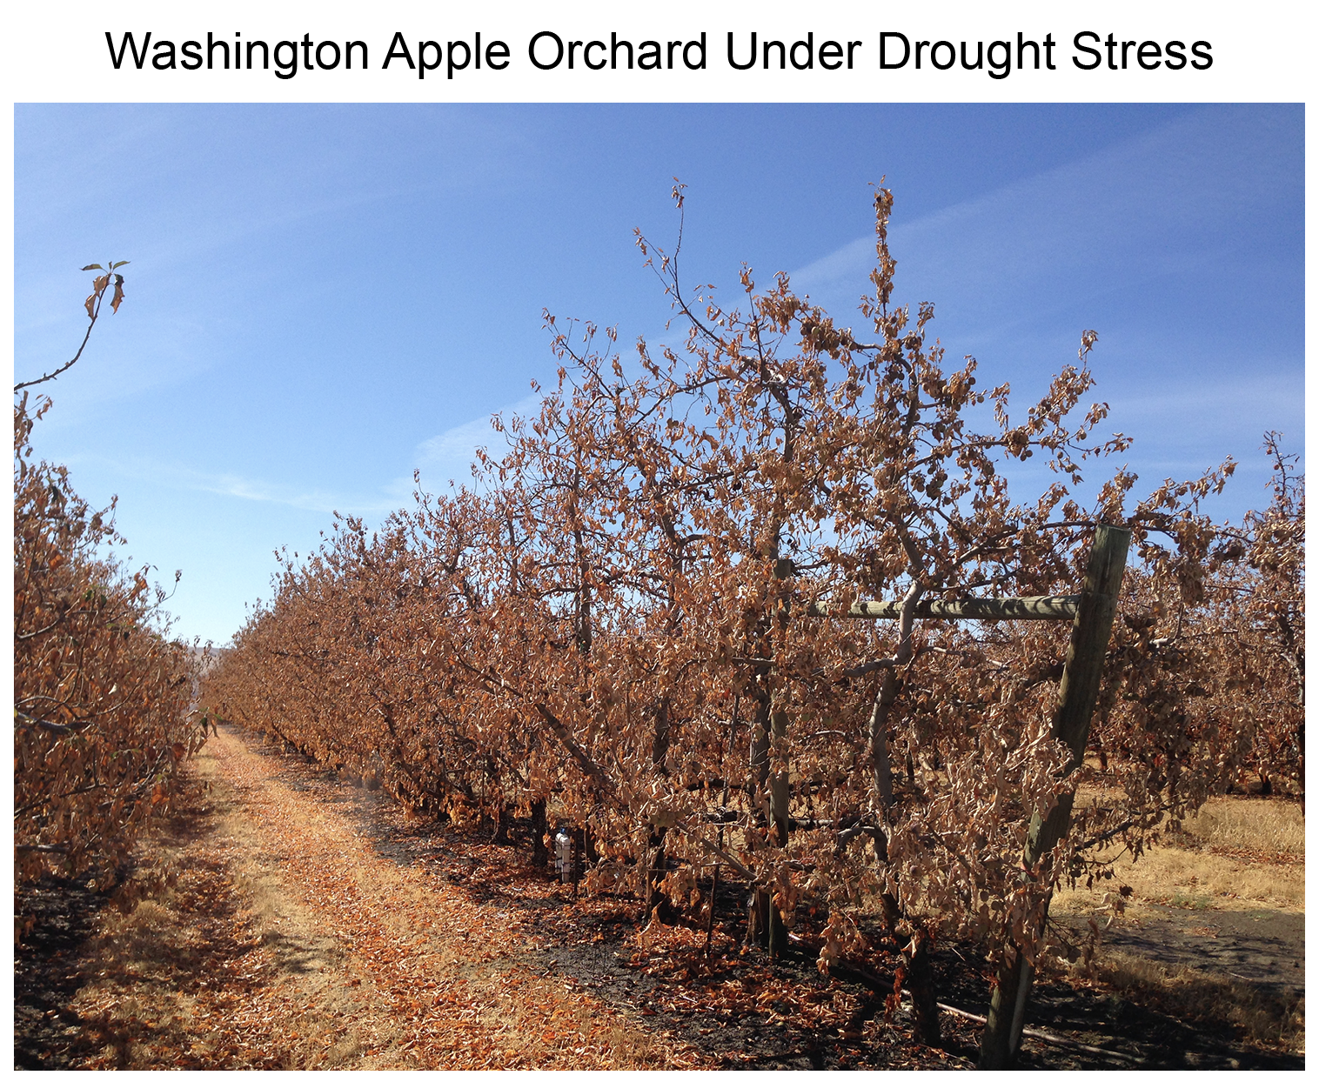
Figure 4.11. An apple orchard in the Roza Irrigation District in Washington shows extreme drought stress in September 2015.
Notes:
CAPTION: This apple orchard suffered the effects of a warm snow drought the previous winter. The warm winter temperatures caused much of the precipitation to fall as rain instead of snow, producing a reduced snowpack, and led to early snowmelt, resulting in low streamflows during irrigation season. Photo credit: © Sonia A. Hall.

Slide 17
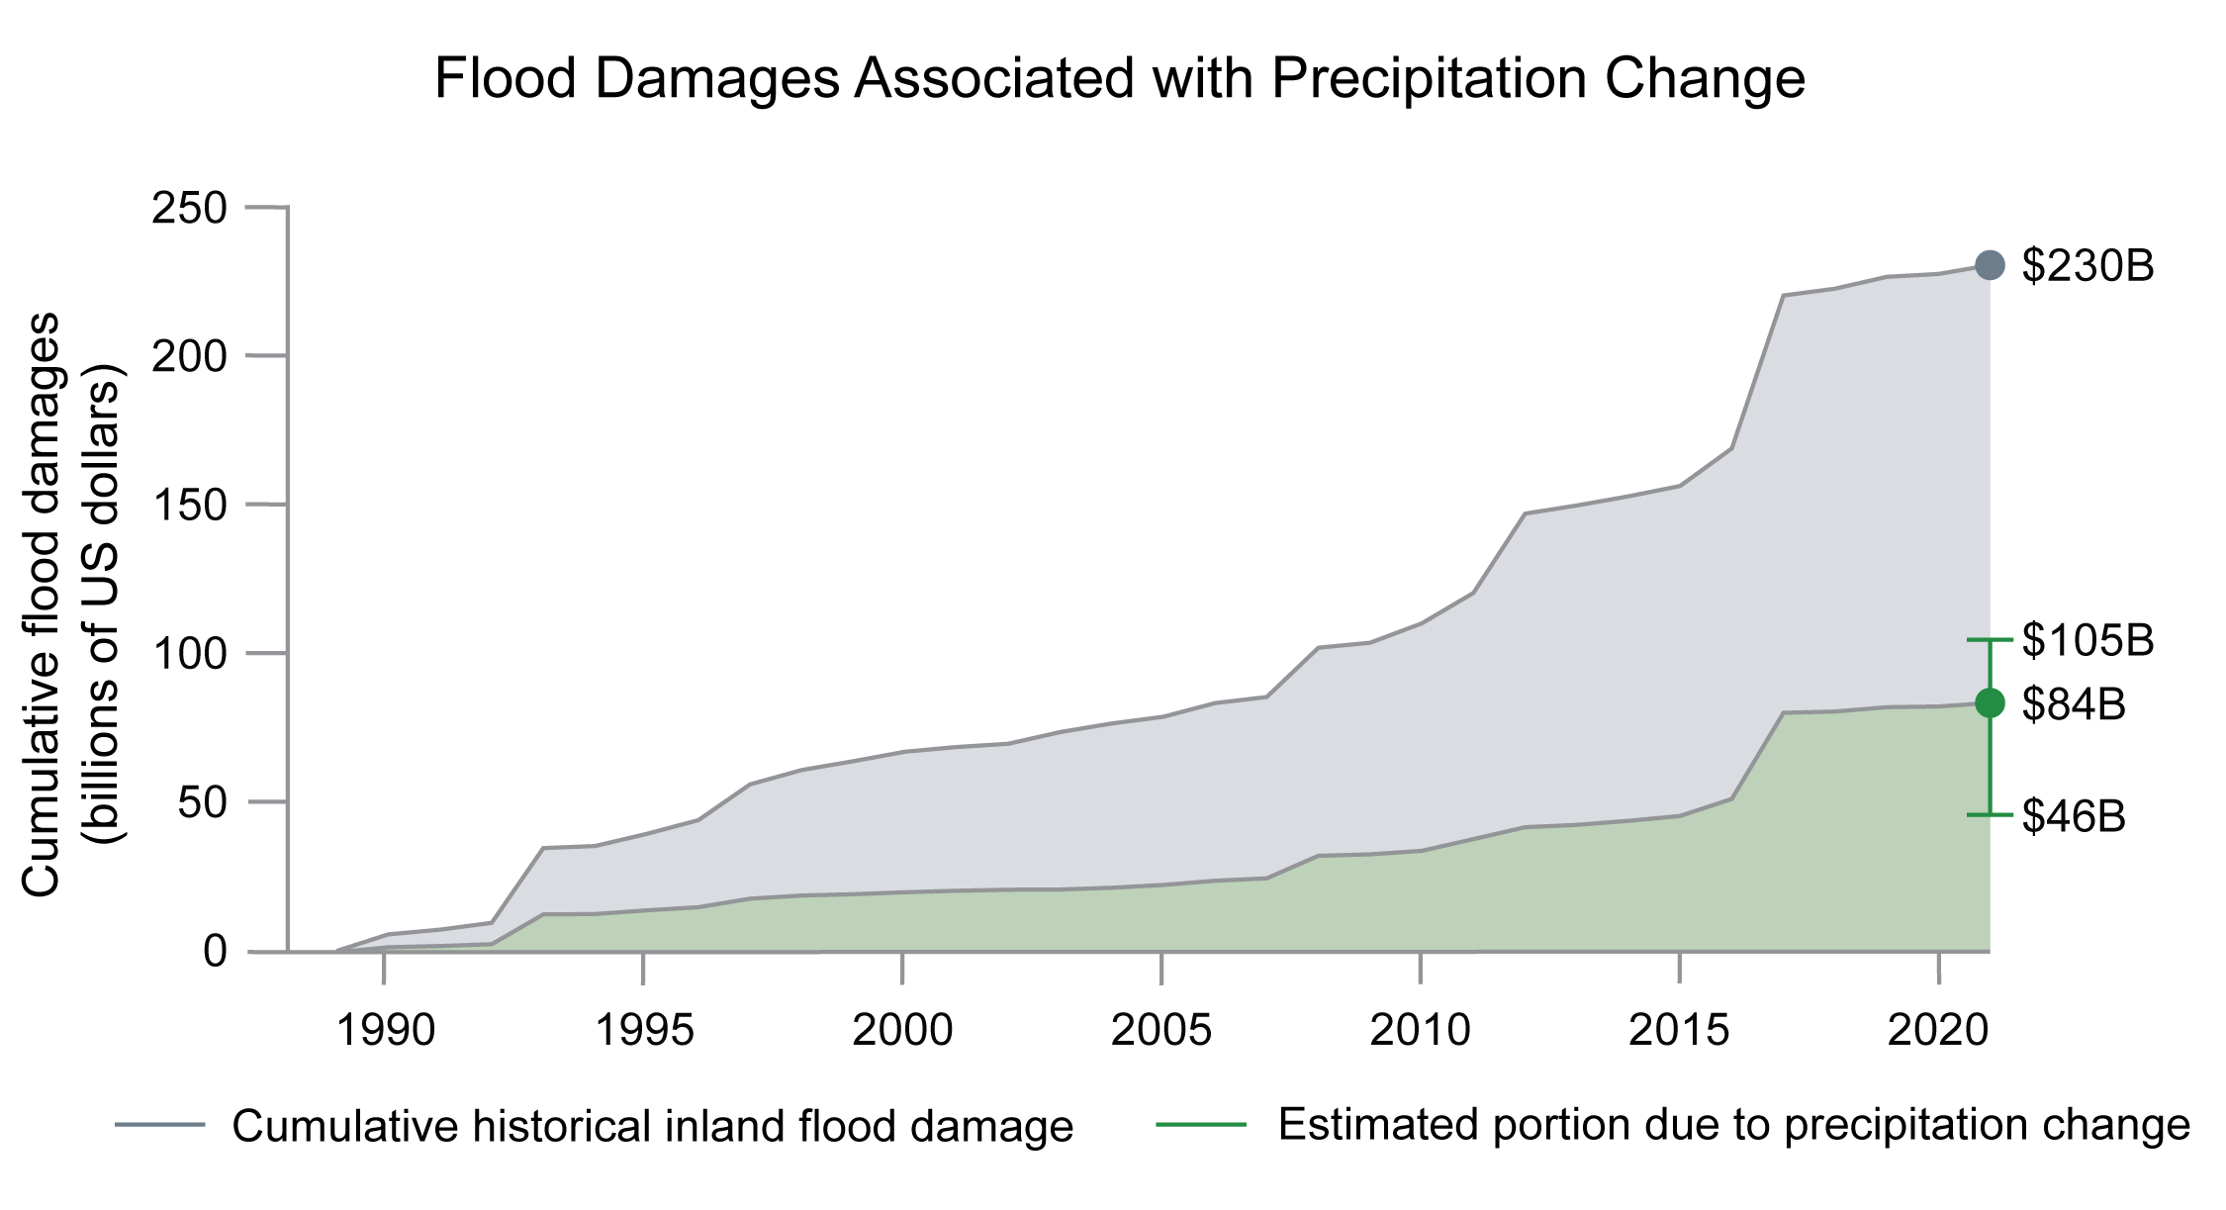
Figure 4.12. A portion of observed increases in inland flood damages can be attributed to changes in precipitation.
Notes:
CAPTION: Cumulative inland flood damages (in 2021 dollars) across the contiguous US (gray) and estimated portion due to changes in precipitation (green) are shown for 1988–2021. Over this period, heavy precipitation has increased over most of the US due to climate change (see Figure 2.8 for heavy precipitation changes over the 1958–2021 period). Error bars (in green) show the plausible range of cumulative damages in 2021, calculated using a 95% confidence level. Roughly 20%–46% of increases in observed flood damages can be attributed to increasing precipitation (assuming the same historical development patterns over the period 1988–2021). Other important contributors to flood damage include urbanization and land-use change, which can exacerbate runoff, and growth in the number and value of flood-affected buildings and other assets. Adapted from Davenport et al. 2021.(Davenport et al. 2021)

Slide 18
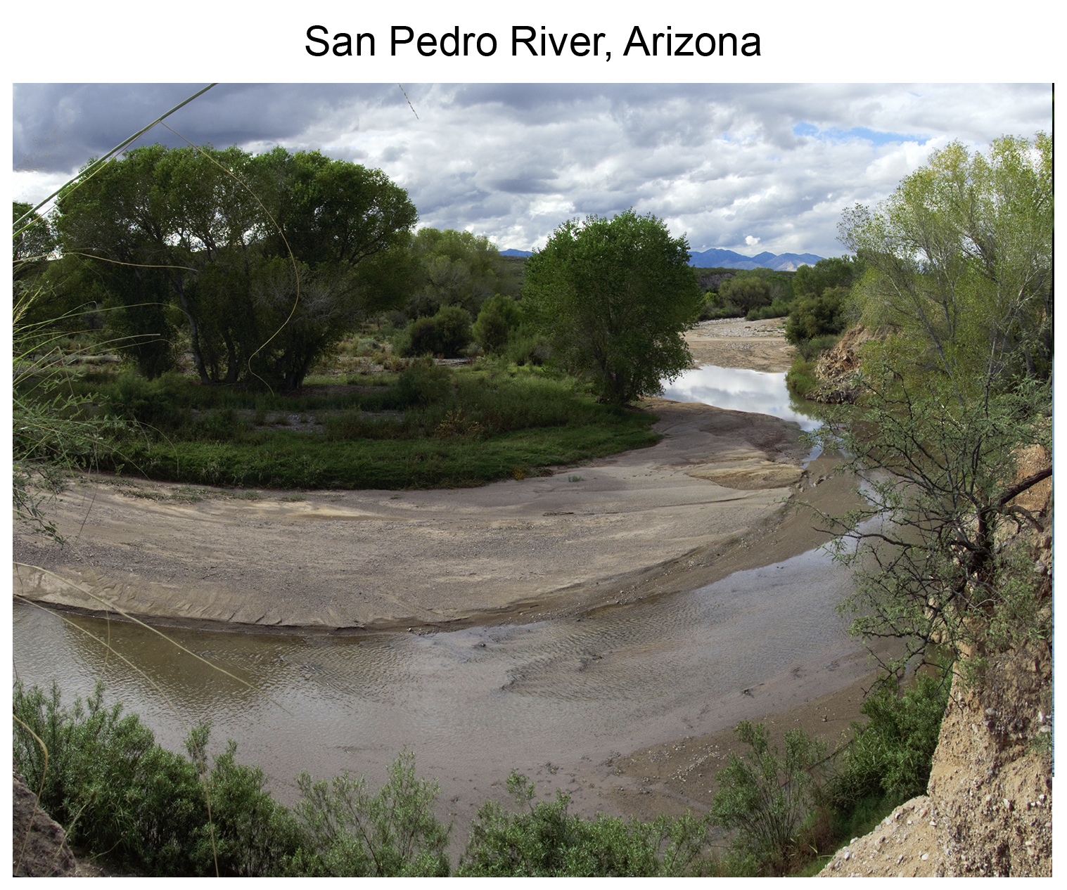
Figure 4.13. The San Pedro River in Arizona has been depleted by groundwater pumping, drying up wetlands and wildlife habitat.
Notes:
CAPTION: Groundwater pumping can reduce surface water supplies. One example is the San Pedro River in Arizona, where pumping that began in the 1940s has deprived wetlands and wildlife habitat of fresh water.(Borunda 2019) Photo credit: CochiseVista/iStock via Getty Images.

Slide 19
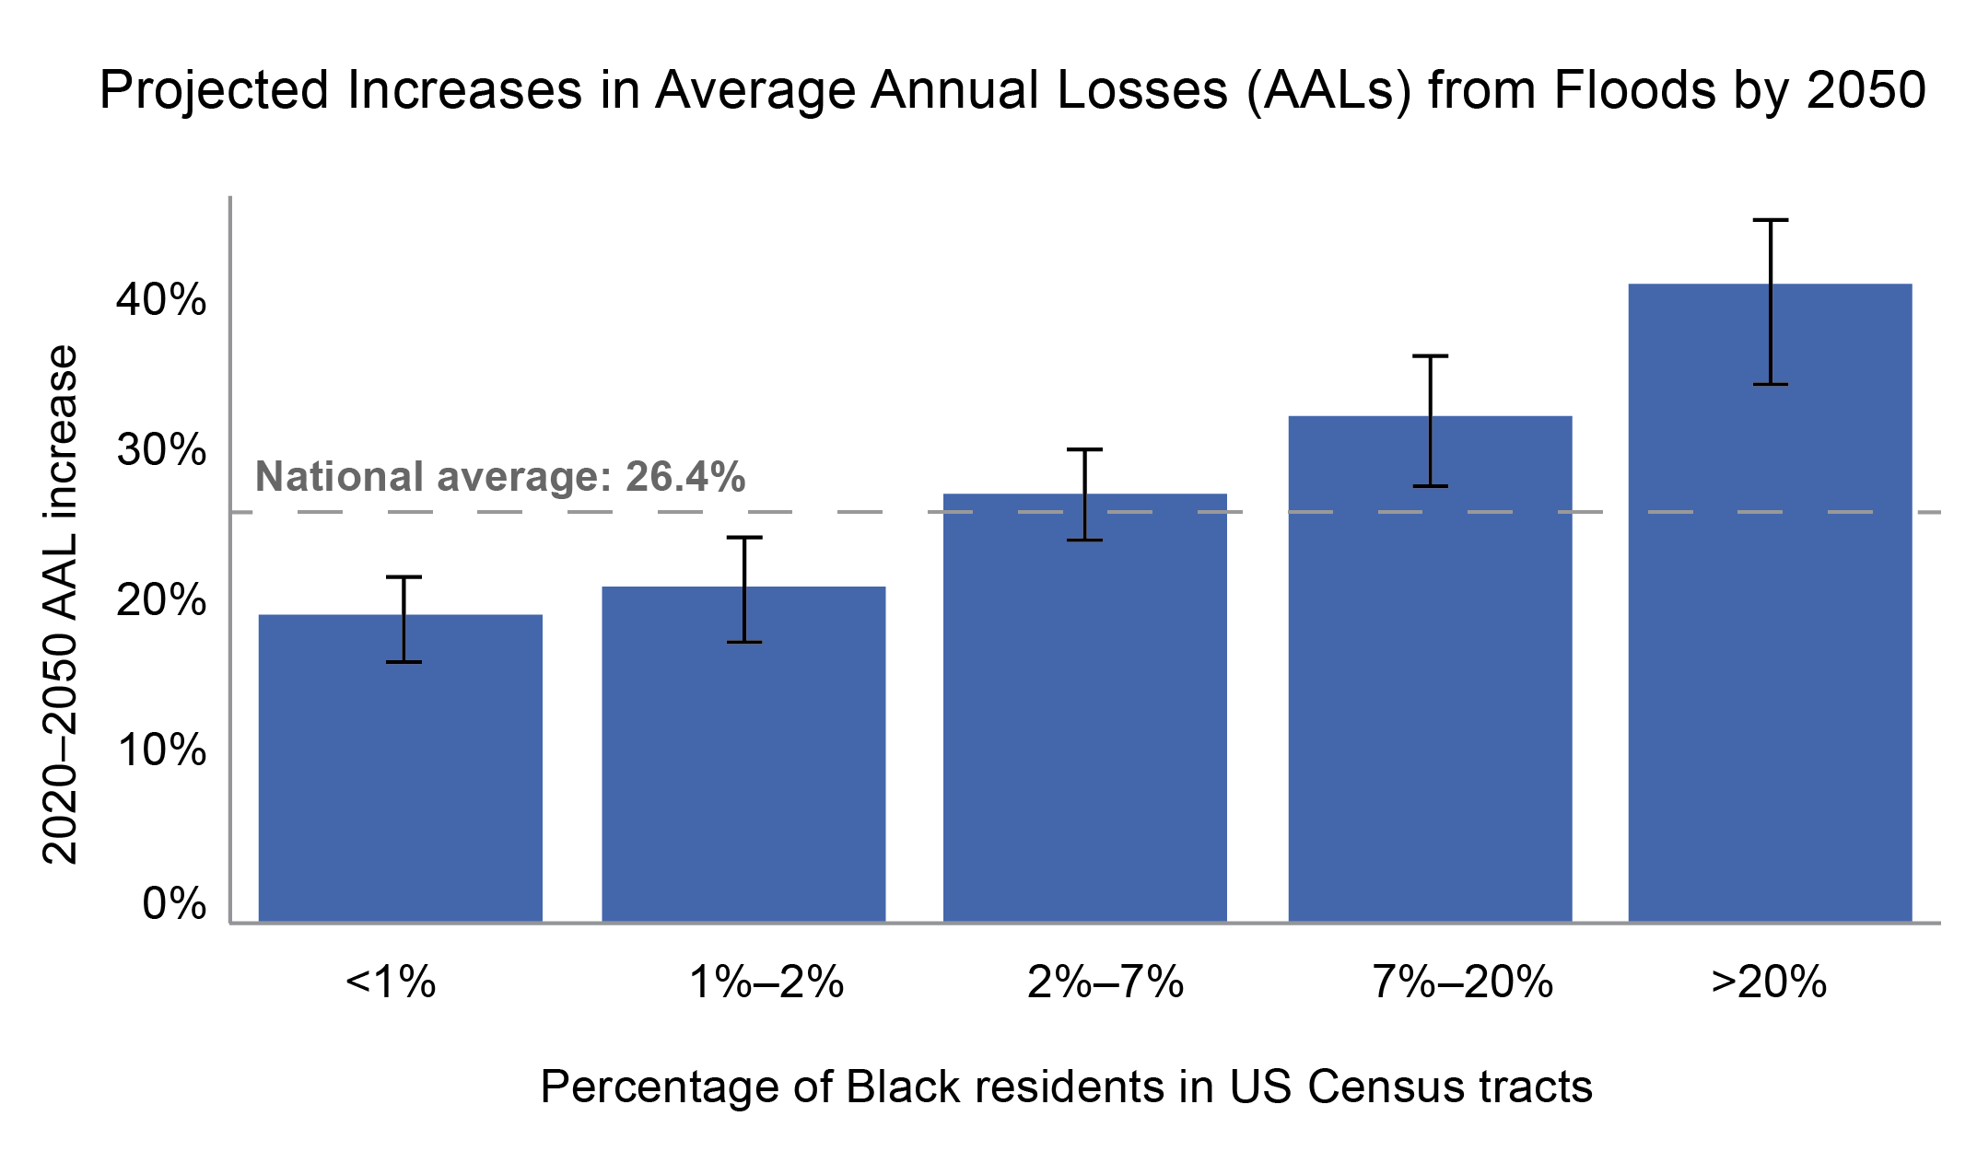
Figure 4.14. Losses due to floods are projected to increase disproportionately in US Census tracts with higher percentages of Black residents.
Notes:
CAPTION: Average annual losses—economic damages in a typical year—due to floods in census tracts with a Black population of at least 20% are projected to increase at roughly twice the rate of that in tracts where Black residents make up less than 1% of the population. Black bars represent 95% confidence intervals. Adapted from Wing et al. 2022 [CC BY 4.0].

Slide 20
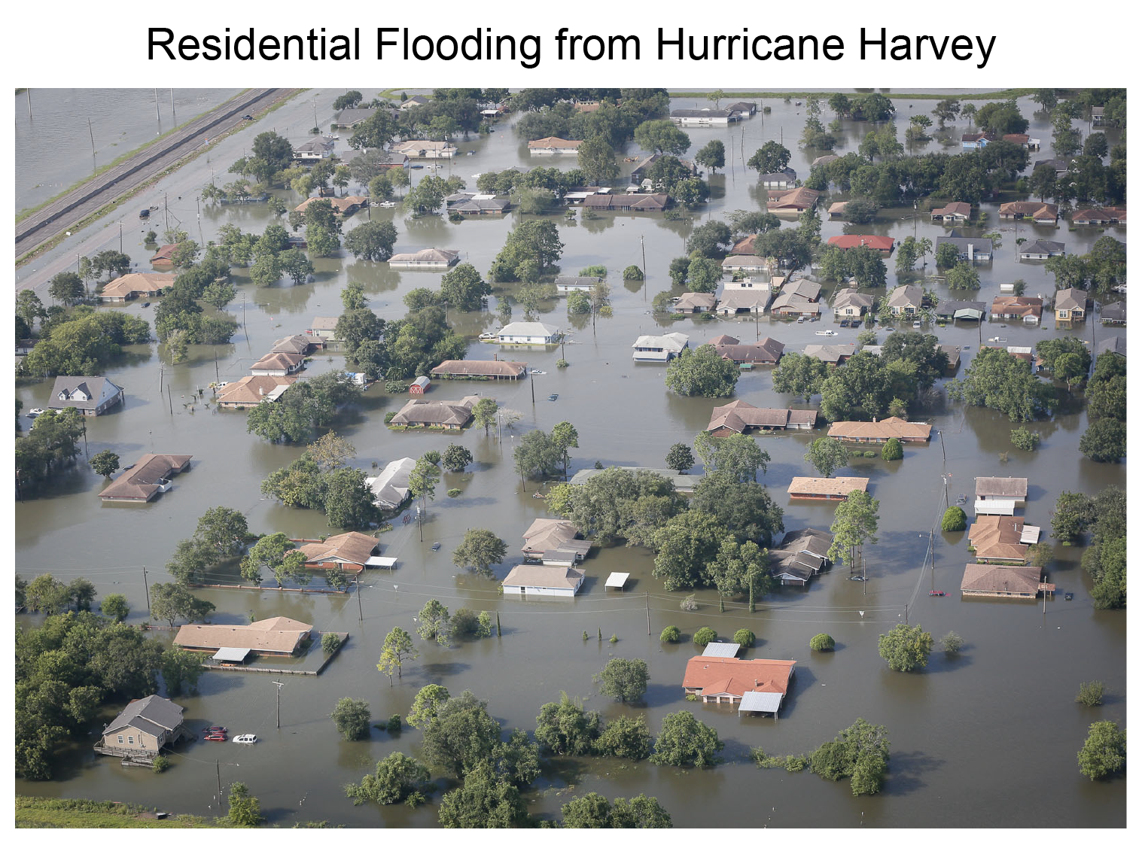
Figure 4.15. Flooding from Hurricane Harvey inundated residential neighborhoods in Port Arthur, Texas.
Notes:
CAPTION: Photo credit: Staff Sgt. Daniel J. Martinez, US Air National Guard.

Slide 21
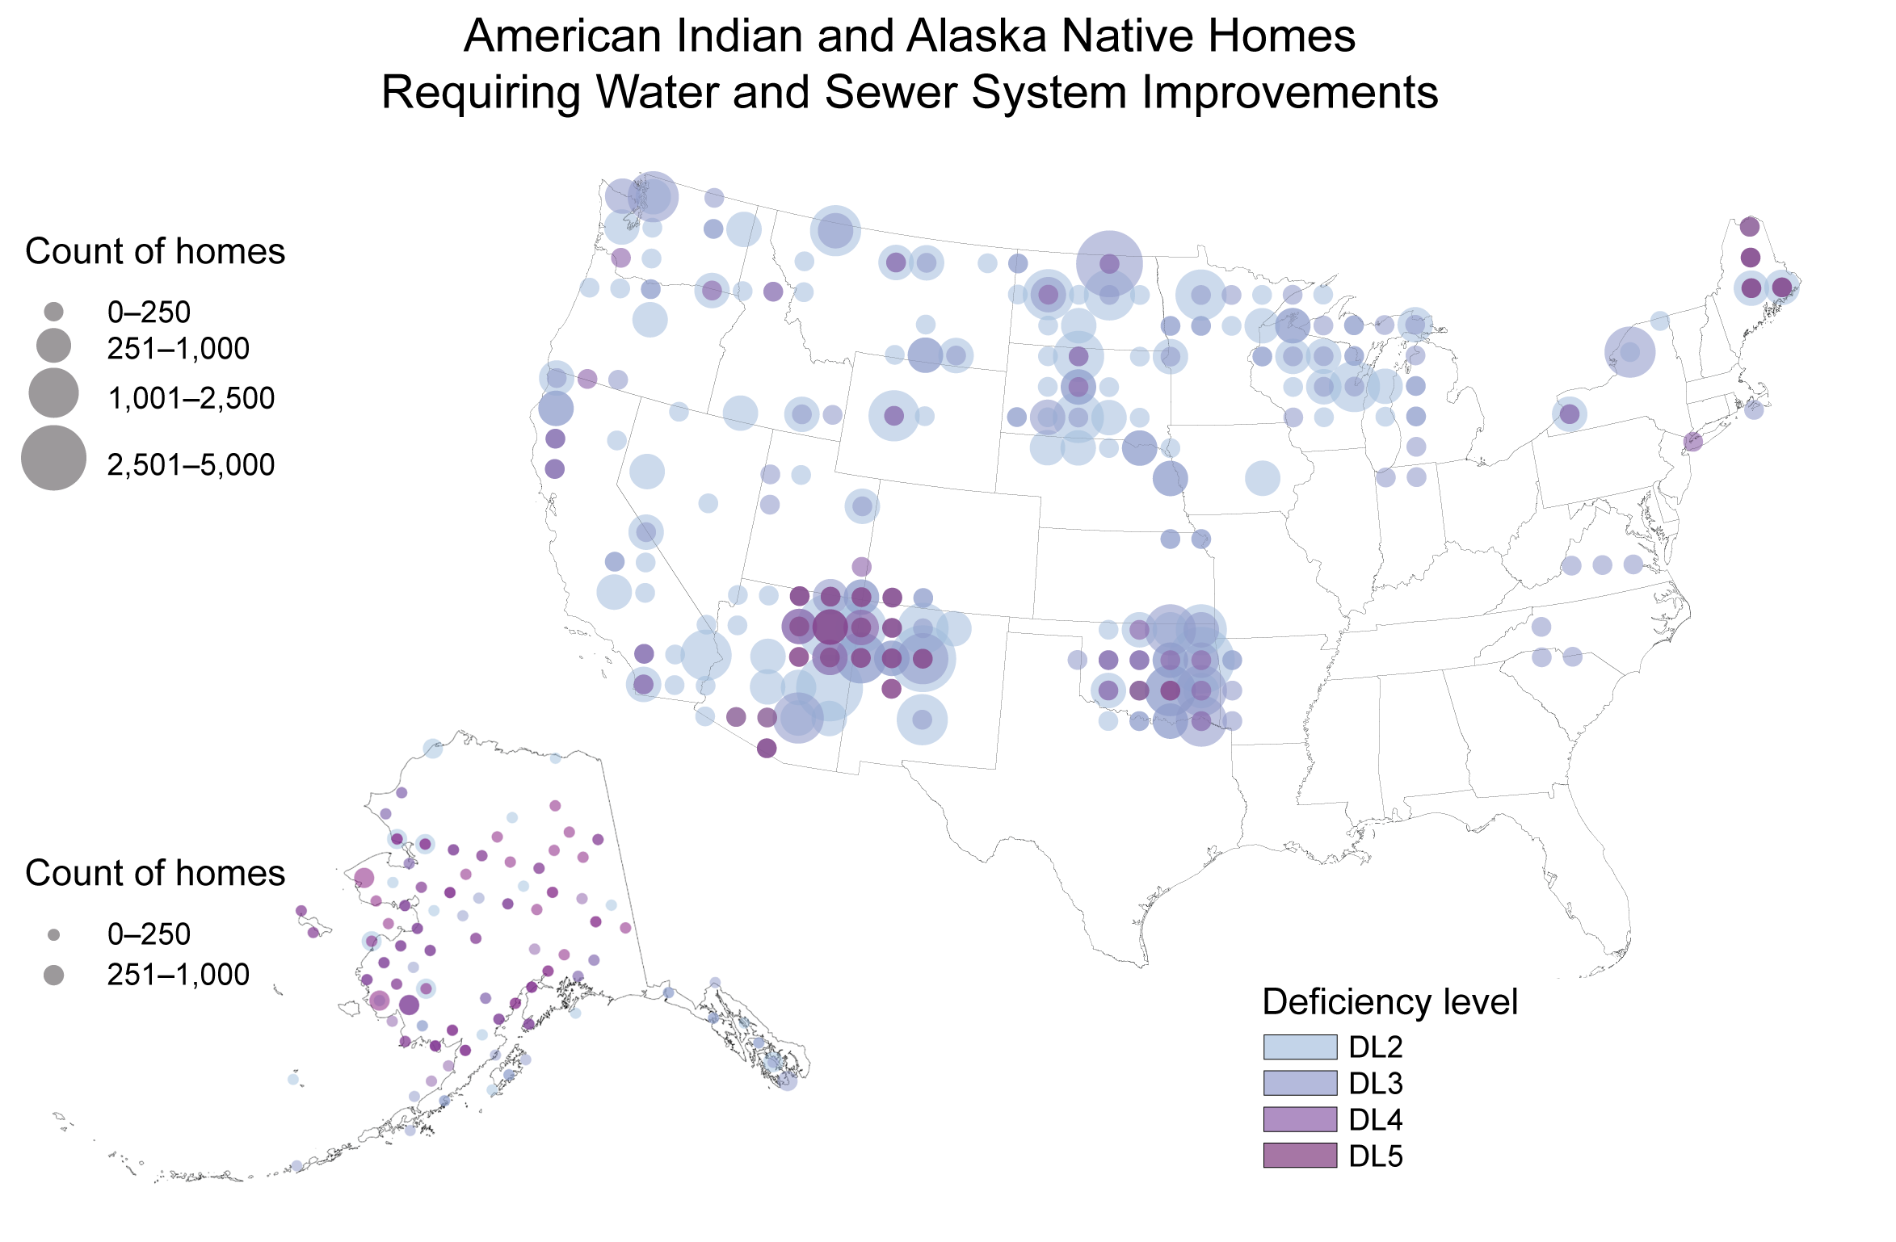
Figure 4.16. Water infrastructure supporting Tribal and Indigenous Peoples is particularly ill-equipped to handle increases in flooding and drought.
Notes:
CAPTION: The Indian Health Service (IHS) maintains a database of American Indian and Alaska Native (AI/AN) homes requiring sanitation facility improvements within IHS service areas. The figure shows sanitation deficiency levels in AI/AN homes across the country ranging from level 2 (capital improvements are necessary to meet domestic sanitation needs) to level 5 (lacks a safe water supply and a sewage disposal system). The IHS does not collect data for Hawai‘i, the US-Affiliated Pacific Islands, or the US Caribbean, but elevated rates of plumbing deficiencies are documented in those regions.(Mueller and Gasteyer 2021) Figure credit: Indian Health Service.

Slide 22
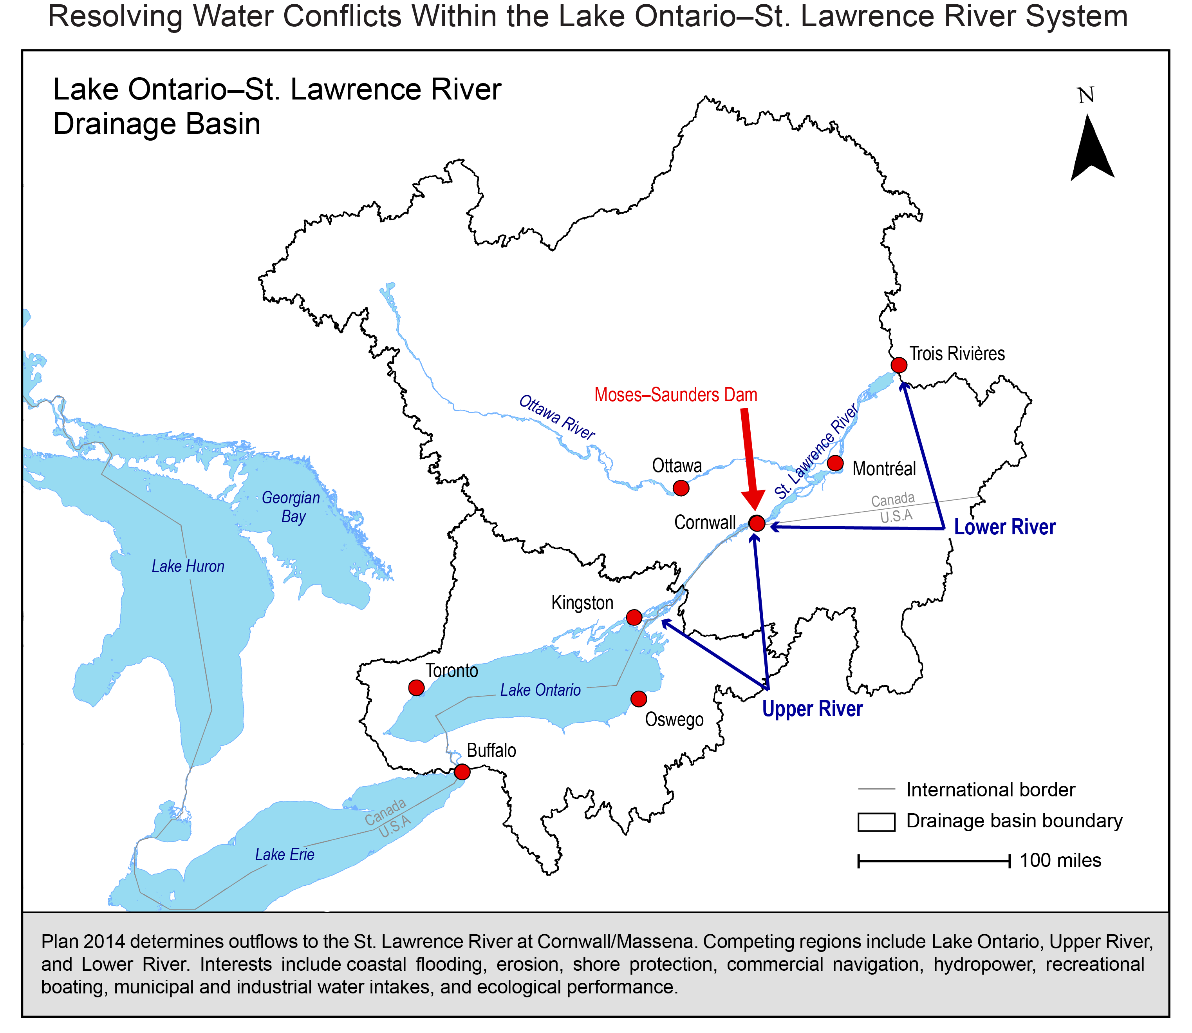
Figure 4.17. Plan 2014 was developed to manage Lake Ontario–St Lawrence River water levels, restore ecosystems, and account for climate change.
Notes:
CAPTION: The map shows the geographic setting for an international plan between the US and Canada to cooperatively manage Lake Ontario. The plan balances interests upstream of the Moses-Saunders Dam with downstream interests. The collaborative framework used to develop the plan serves as a model of a successful approach to resolving water conflicts. Adapted from International Joint Commission 2014.(International Joint Commission 2014)

Slide 23
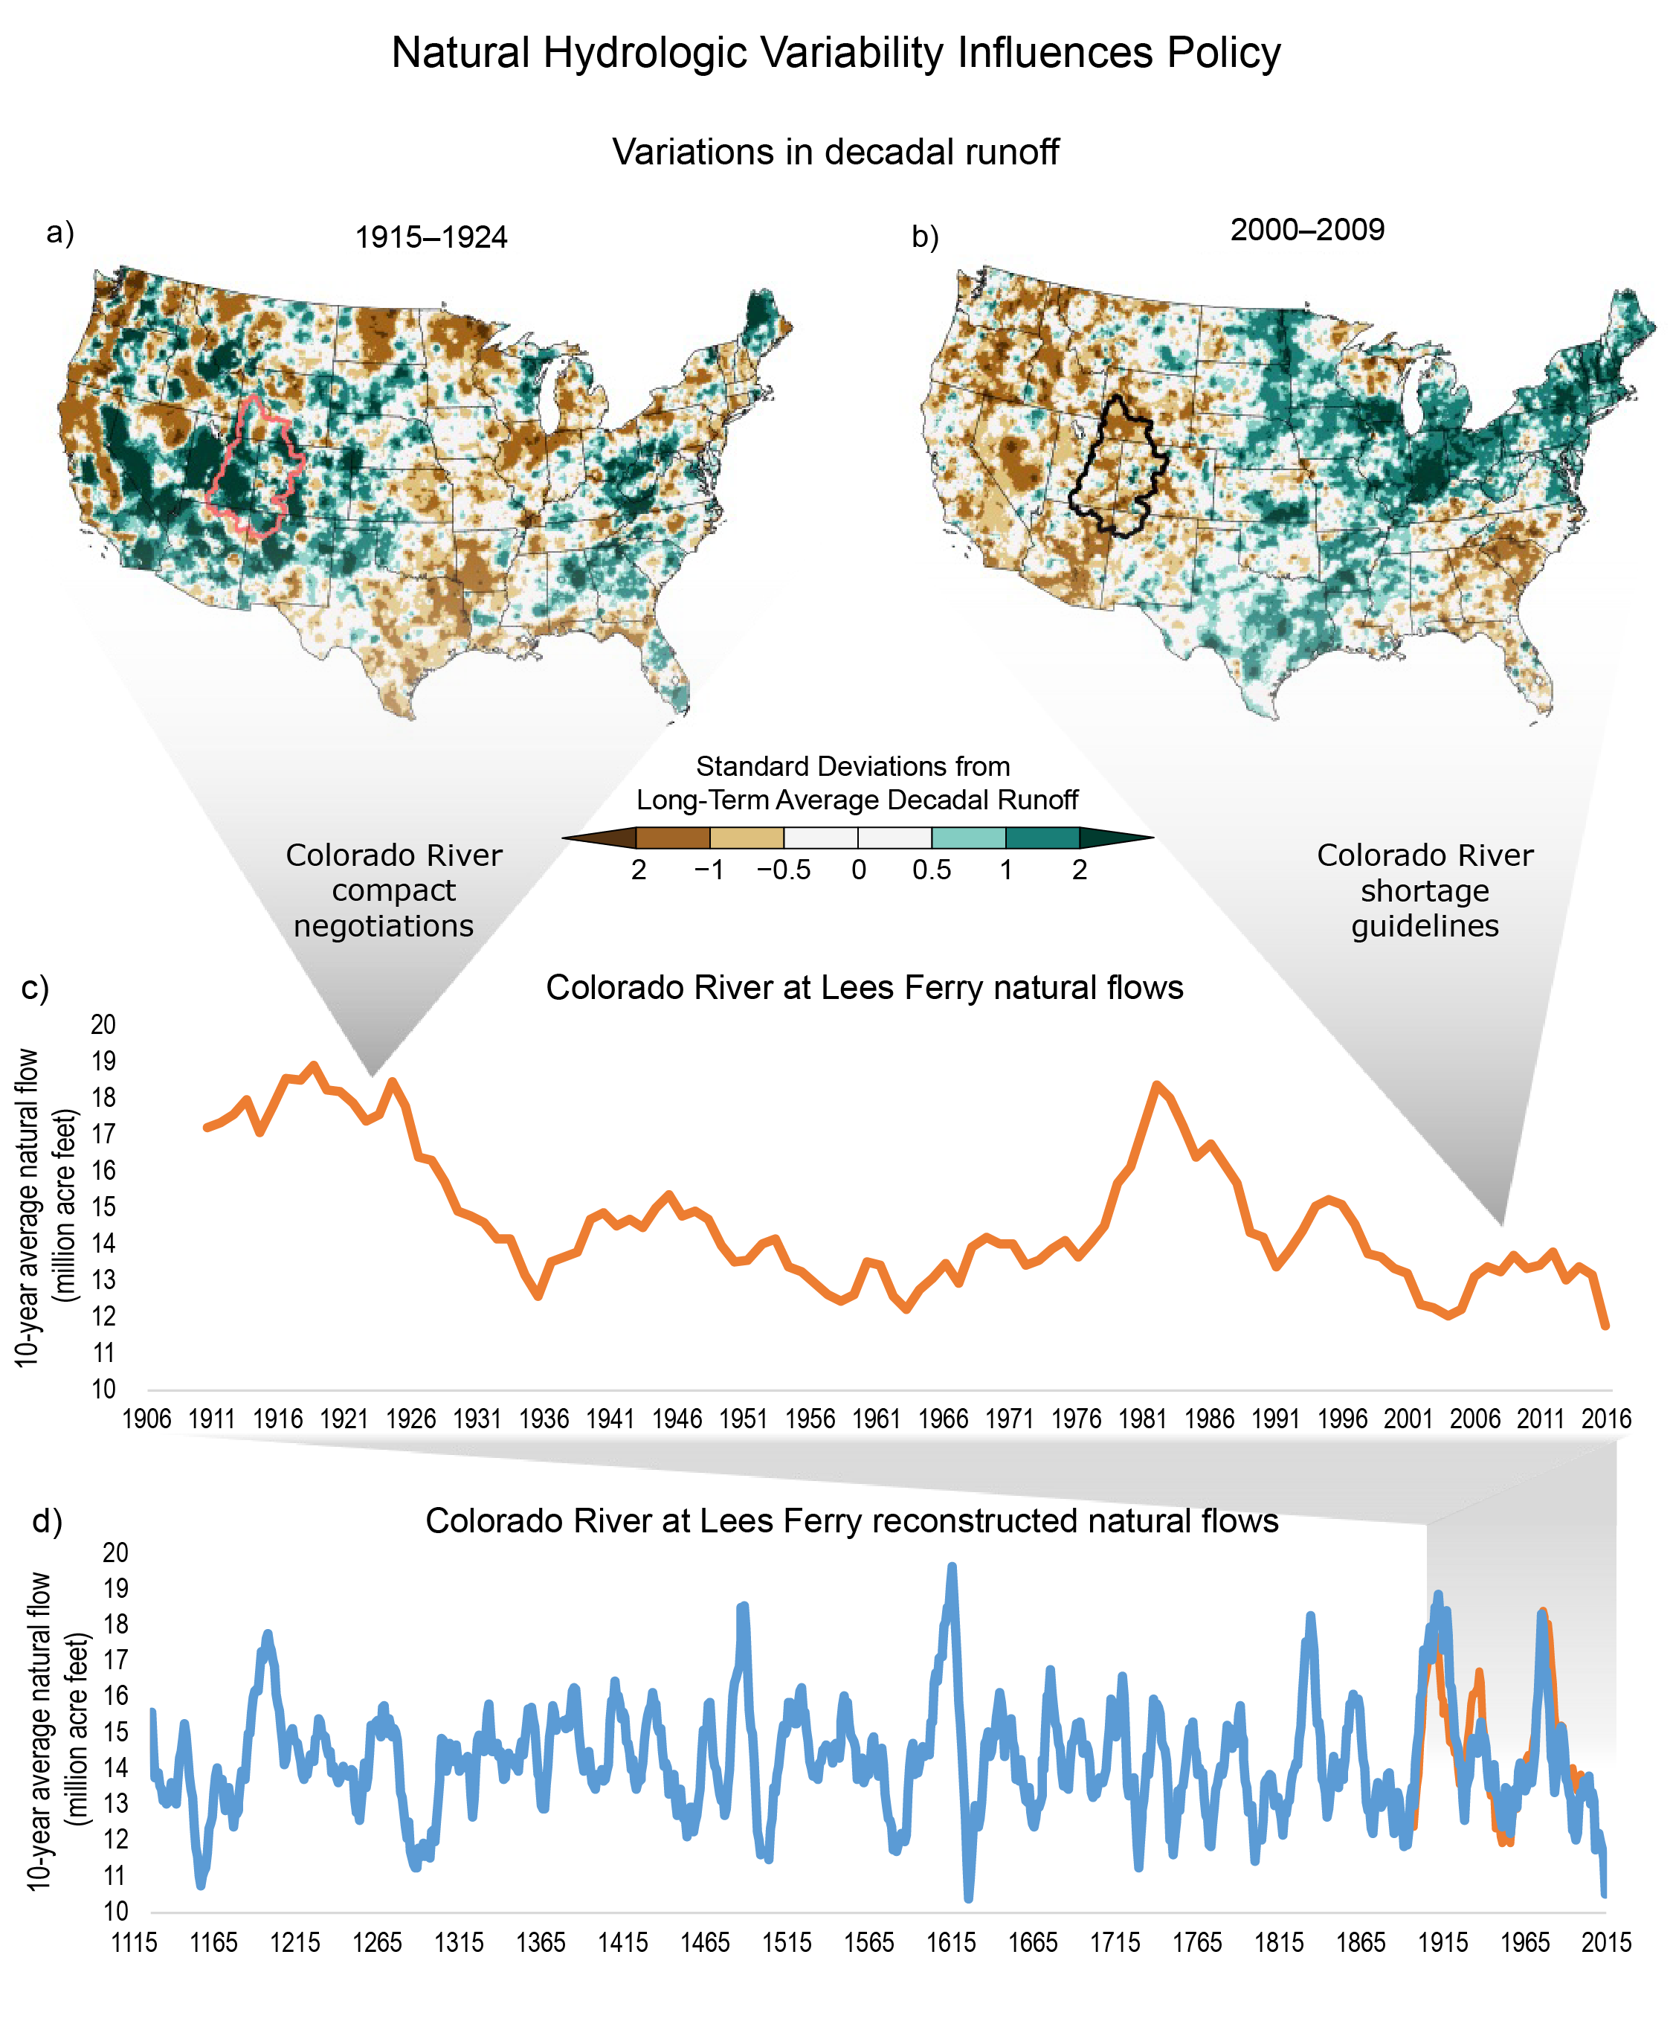
Figure 4.18. Natural hydrologic variability can promote urgency or complacency in long-term planning.
Notes:
CAPTION: The figure shows hydrologic variability in both space and time: (a, b) runoff variability (a surrogate for streamflow variability) across the country between two decades, with the boundary of Upper Colorado River Basin shown; and streamflow variability across time with (c) estimates of Colorado River flows from historical observations and (d) reconstructed flows from ancient tree rings (blue line), with data from (c) shown in orange. Wedges point to two negotiated policy events. Figure credit: Lynker and University of Colorado Boulder.

Slide 24
Federal Coordinating Lead Author
Ariane O. Pinson, US Army Corps of Engineers
Chapter Lead
Elizabeth A. Payton, University of Colorado Boulder, Western Water Assessment
Chapter Authors
Tirusew Asefa, Tampa Bay Water
Laura E. Condon, University of Arizona
Lesley-Ann L. Dupigny-Giroux, University of Vermont
Benjamin L. Harding, Lynker
Julie Kiang, US Geological Survey
Deborah H. Lee, NOAA Great Lakes Environmental Research Laboratory
Stephanie A. McAfee, University of Nevada, Reno
Justin M. Pflug, University of Maryland, College Park, Earth System Science Interdisciplinary Center
Imtiaz Rangwala, University of Colorado Boulder, North Central Climate Adaptation Science Center Heather J. Tanana, University of Utah, S.J. Quinney College of Law
Daniel B. Wright, University of Wisconsin–Madison
Technical Contributors
Frances V. Davenport, Colorado State University
Andrea L. Taylor, Indian Health Service
Review Editor
Beth M. Haley, Boston University, School of Public Health
USGCRP Coordinators
Katia Kontar, US Global Change Research Program / ICF
Yishen Li, US Global Change Research Program / ICF
Allyza R. Lustig, US Global Change Research Program / ICF
Drew Story, US Global Change Research Program / ICF

Slide 25
Payton, E.A., A.O. Pinson, T. Asefa, L.E. Condon, L.-A.L. Dupigny-Giroux,
B.L. Harding, J. Kiang, D.H. Lee, S.A. McAfee, J.M. Pflug, I. Rangwala, H.J.
Tanana, and D.B. Wright, 2023: Ch. 4. Water. In: Fifth National Climate
Assessment. Crimmins, A.R., C.W. Avery, D.R. Easterling, K.E. Kunkel, B.C.
Stewart, and T.K. Maycock, Eds. U.S. Global Change Research Program,
Washington, DC, USA. https://doi.org/10.7930/NCA5.2023.CH4
https://nca2023.globalchange.gov/chapter/4

