Slide 1

NCA5 Website: https://nca2023.globalchange.gov
Chapter Website: https://nca2023.globalchange.gov/chapter/5
NCA5 Atlas: https://atlas.globalchange.gov
Figure captions: Captions can be found in the slide notes of this deck
Social media: @usgcrp, #NCA5

Slide 2
Chapter 5 | Energy

Slide 3
1
Climate Change Threatens Energy Systems
Energy supply and delivery are at risk from climate-driven changes, which are also shifting demand (virtually certain, very high confidence). Climate change threats, including increases in extreme precipitation, extreme temperatures, sea level rise, and more intense storms, droughts, and wildfires, are damaging infrastructure and operations and affecting human lives and livelihoods (virtually certain, very high confidence). Impacts will vary over time and location (virtually certain, very high confidence). Without mitigation and adaptation, projected increases in the frequency, intensity, duration, and variability of extreme events will amplify effects on energy systems (virtually certain, very high confidence).

Slide 4
2
Compounding Factors Affect Energy-System and Community Vulnerabilities
Concurrent changes in technologies, policies, and markets, in addition to their interconnections, can reduce GHG emissions while also increasing vulnerabilities of energy systems and communities to climate change and extreme weather (very likely, very high confidence). Compound and cascading hazards related to energy systems and additional stressors, such as cyber and physical threats and pandemics, create risks for all but disproportionately affect overburdened communities (very likely, very high confidence).

Slide 5
3
Efforts to Enhance Energy System Resilience Are Underway
Federal, state, local, Tribal, and private-sector investments are being made to increase the resilience of the energy system to climate-related stressors, and opportunities exist to build upon this progress (very high confidence). Ongoing investments will need to include improvements in energy-efficient buildings; technology to decarbonize the energy system; advanced automation and communication and artificial intelligence technologies to optimize operations; climate modeling and planning methodologies under uncertainties; and efforts to increase equitable access to clean energy (very high confidence). An energy system transition emphasizing decarbonization and electrification would require efforts in new generation, transmission, distribution, and fuel delivery (very high confidence).

Slide 6
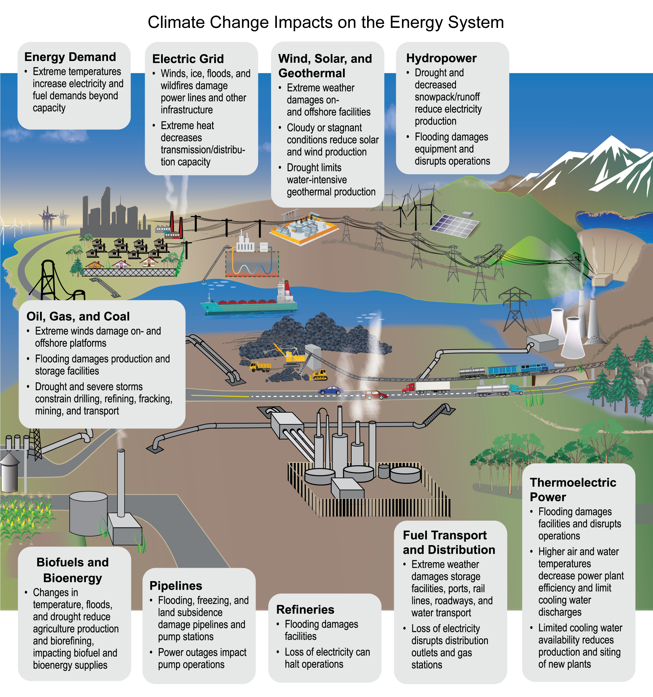
Figure 5.1. All aspects of the US energy system are vulnerable to the effects of climate change.
Notes:
CAPTION: Climate change impacts all components of the Nation’s energy system—resource extraction and processing, energy transport and storage, electricity generation, and energy end use. Adapted from DOE 2013.(DOE 2013)

Slide 7
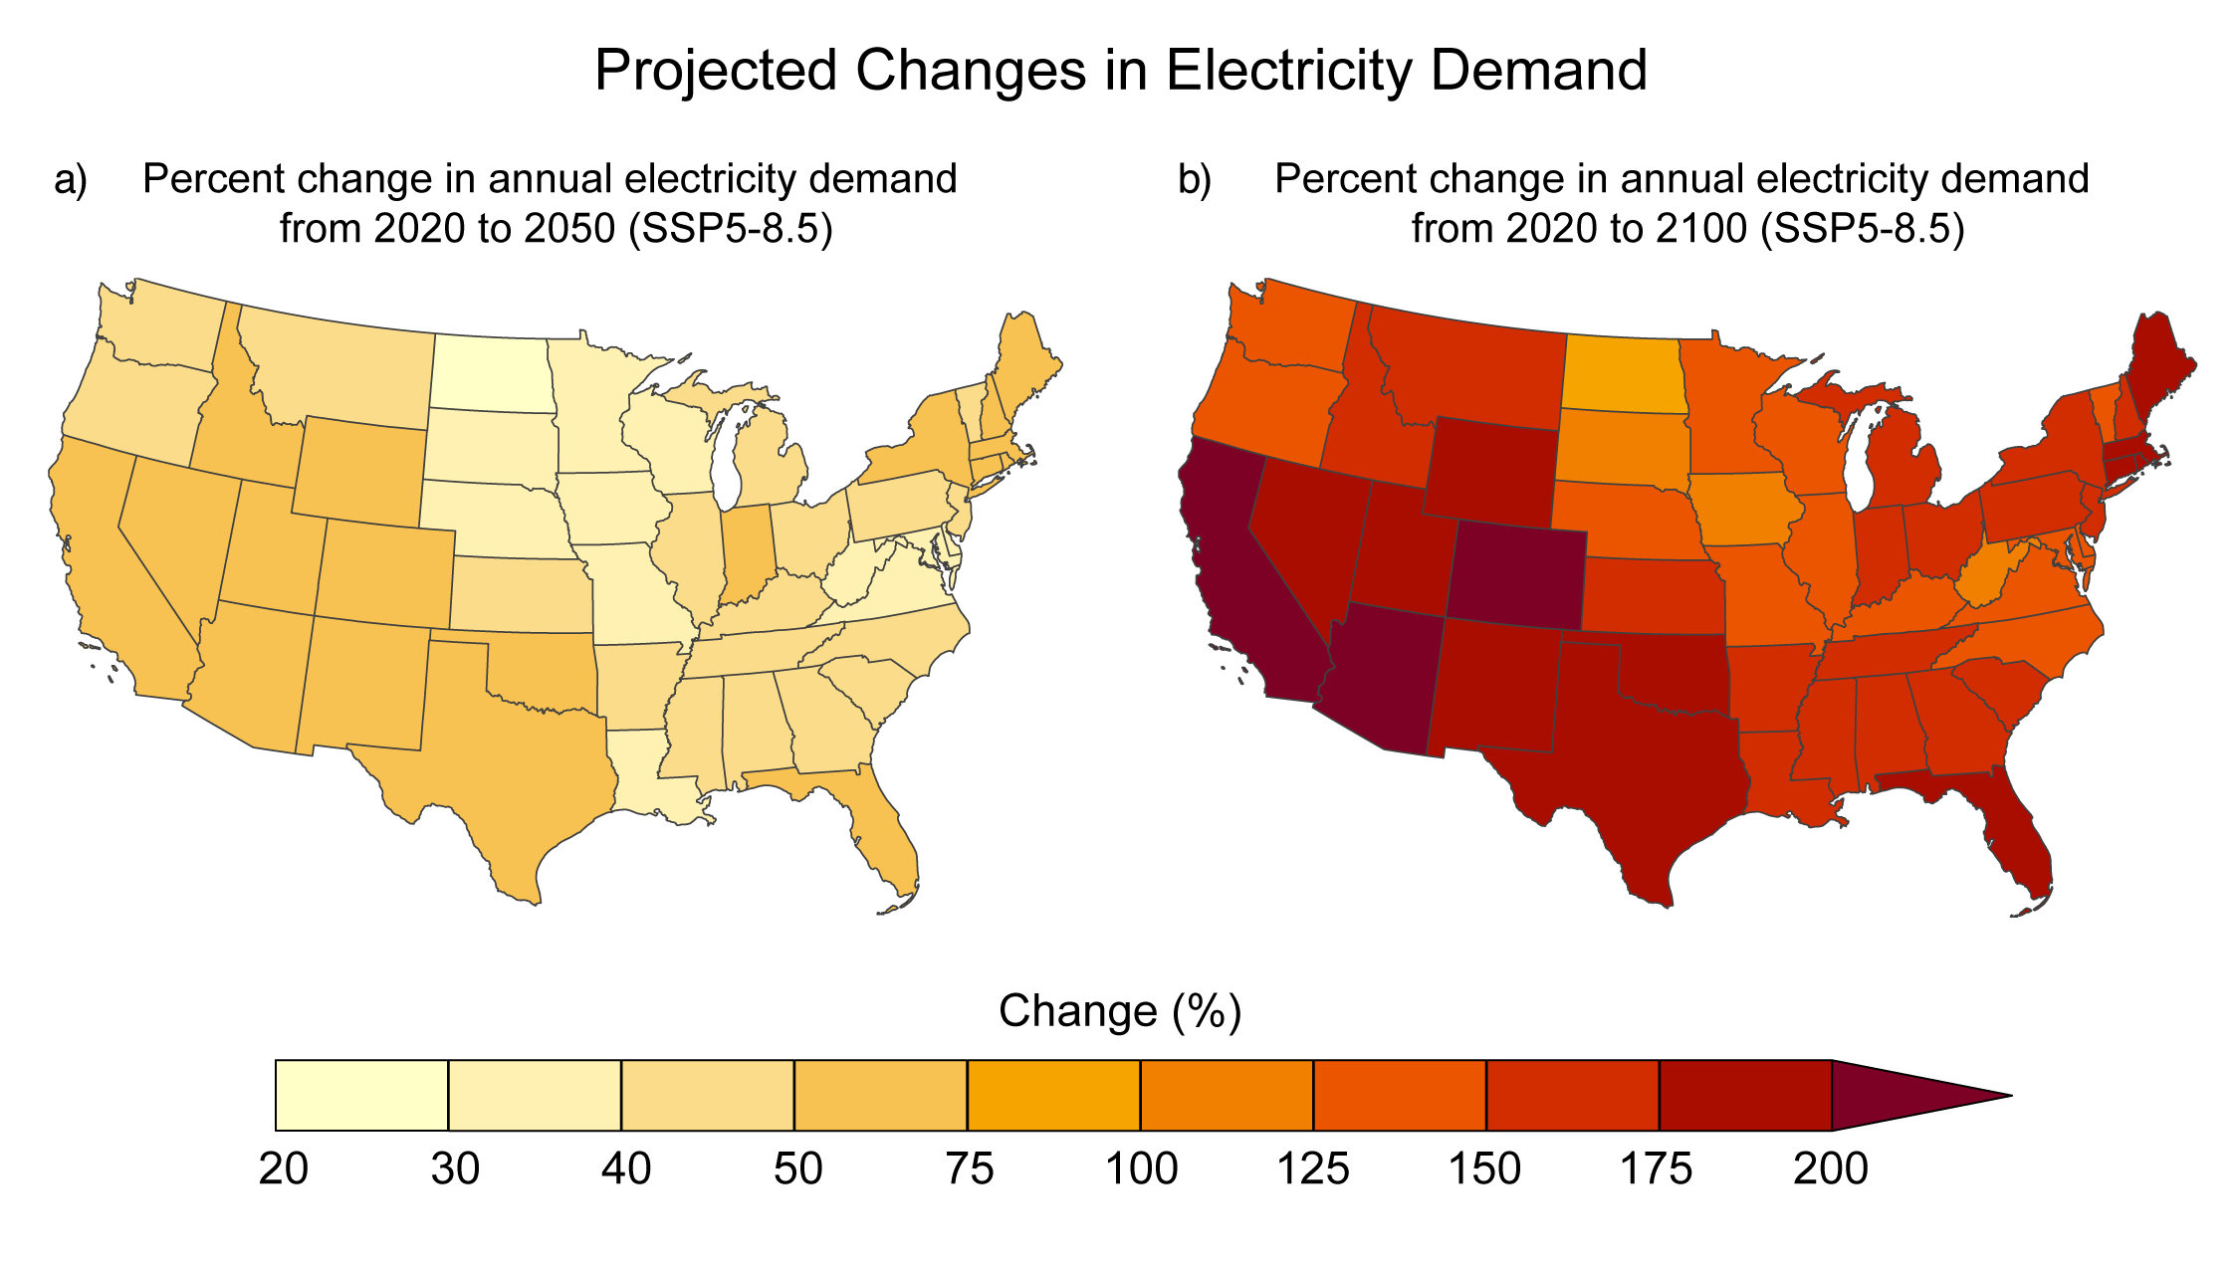
Figure 5.2. Due to climate change, electricity demand is projected to increase over this century.
Notes:
CAPTION: Global change intersectoral modeling forecasts(Khan et al. 2023) that do not reflect the provisions of the Inflation Reduction Act project a potential increase in annual electricity demand of 25% to 70% from 2020 to 2050 (a) and 96% to over 215% from 2020 to 2100 (b) across much of the country, driven in part by increased ambient temperatures. Alaska, Hawaiʻi and US-Affiliated Pacific Islands, and the US Caribbean are not included due to the lack of high-resolution climate data informing those projections, but similar trends are expected. Increasing electricity demand is expected based on socioeconomic scenarios and adaptation approaches for the grid (KM 23.4). Changes are based on a very high scenario (SSP5-8.5). Figure credit: Pacific Northwest National Laboratory.

Slide 8
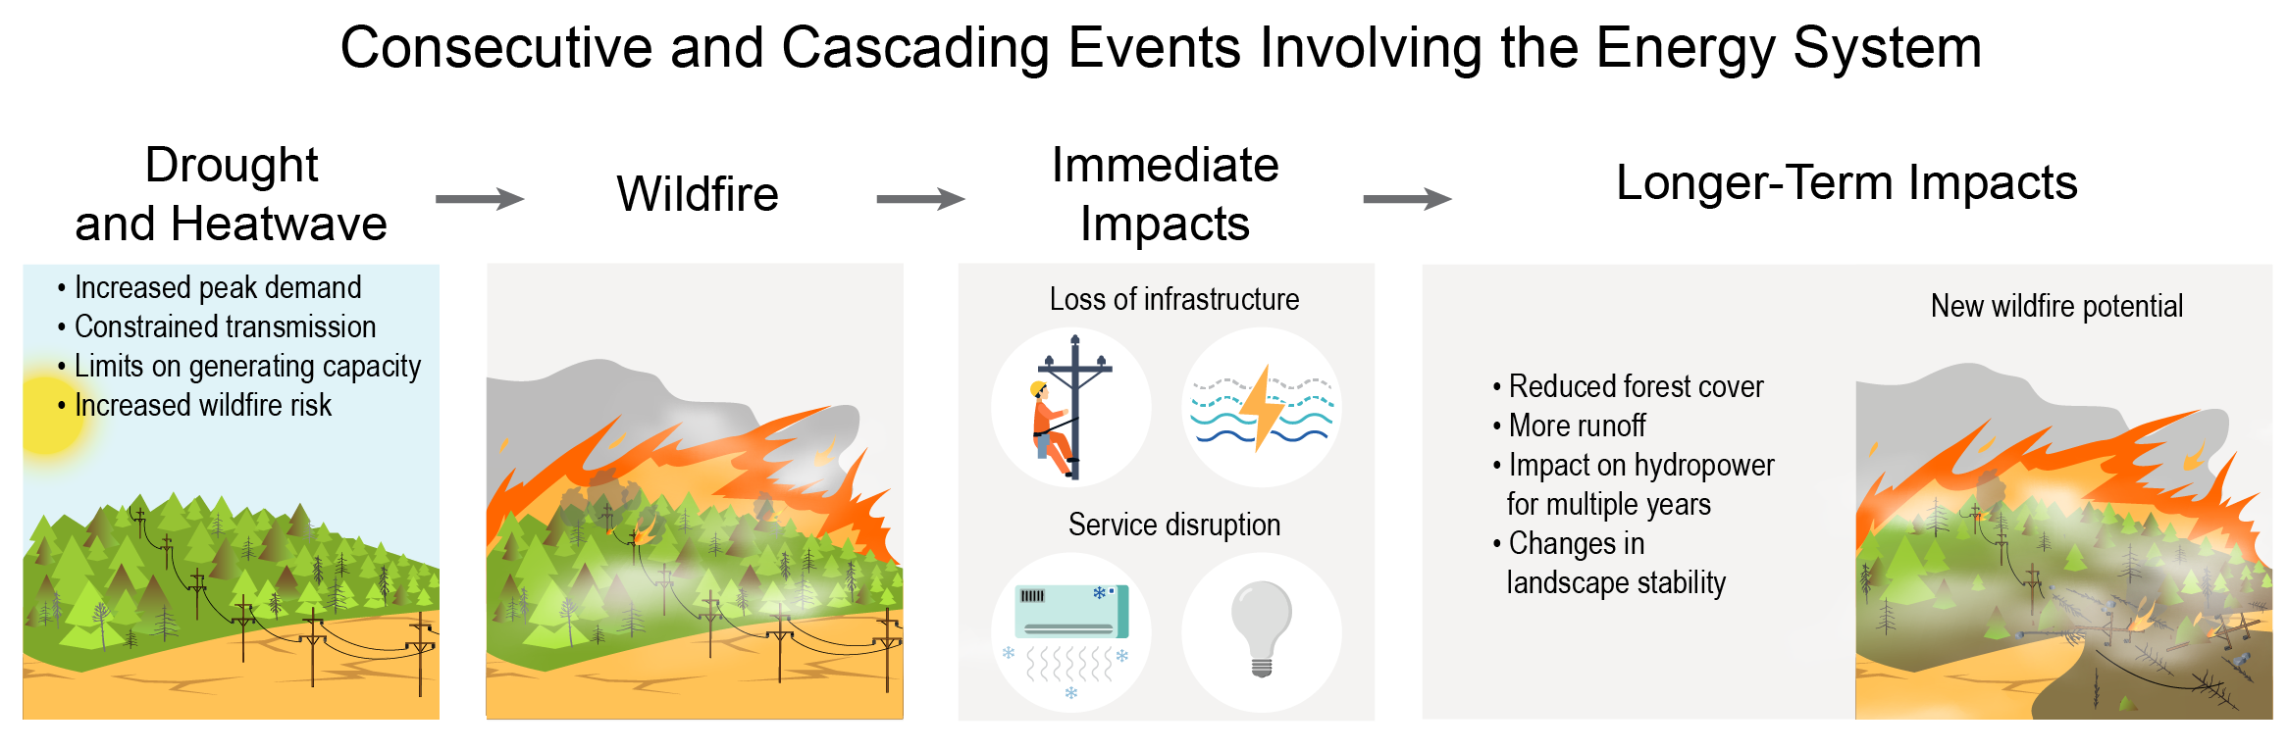
Figure 5.3. Sequential and concurrent climate impacts have near-term and long-term effects on electricity generation and distribution.
Notes:
CAPTION: Drought and heatwaves can reduce electricity generation and delivery through cascading mechanisms. Droughts reduce water availability and electricity generation. Stressed vegetation, including tree mortality following insect outbreaks, fuels wildfires. Concurrently, heatwaves increase electricity demand and reliance on transmission, which can also trigger wildfires. Wildfires damage electricity infrastructure, disrupting power and associated services. Reduced vegetation increases runoff, resulting in floods and landslides and increased risk of wildfires. The cycle of events can accelerate, as new vegetation is more sensitive to droughts and heatwaves. Figure credit: Oak Ridge National Laboratory, National Renewable Energy Laboratory, and Pacific Northwest National Laboratory.

Slide 9
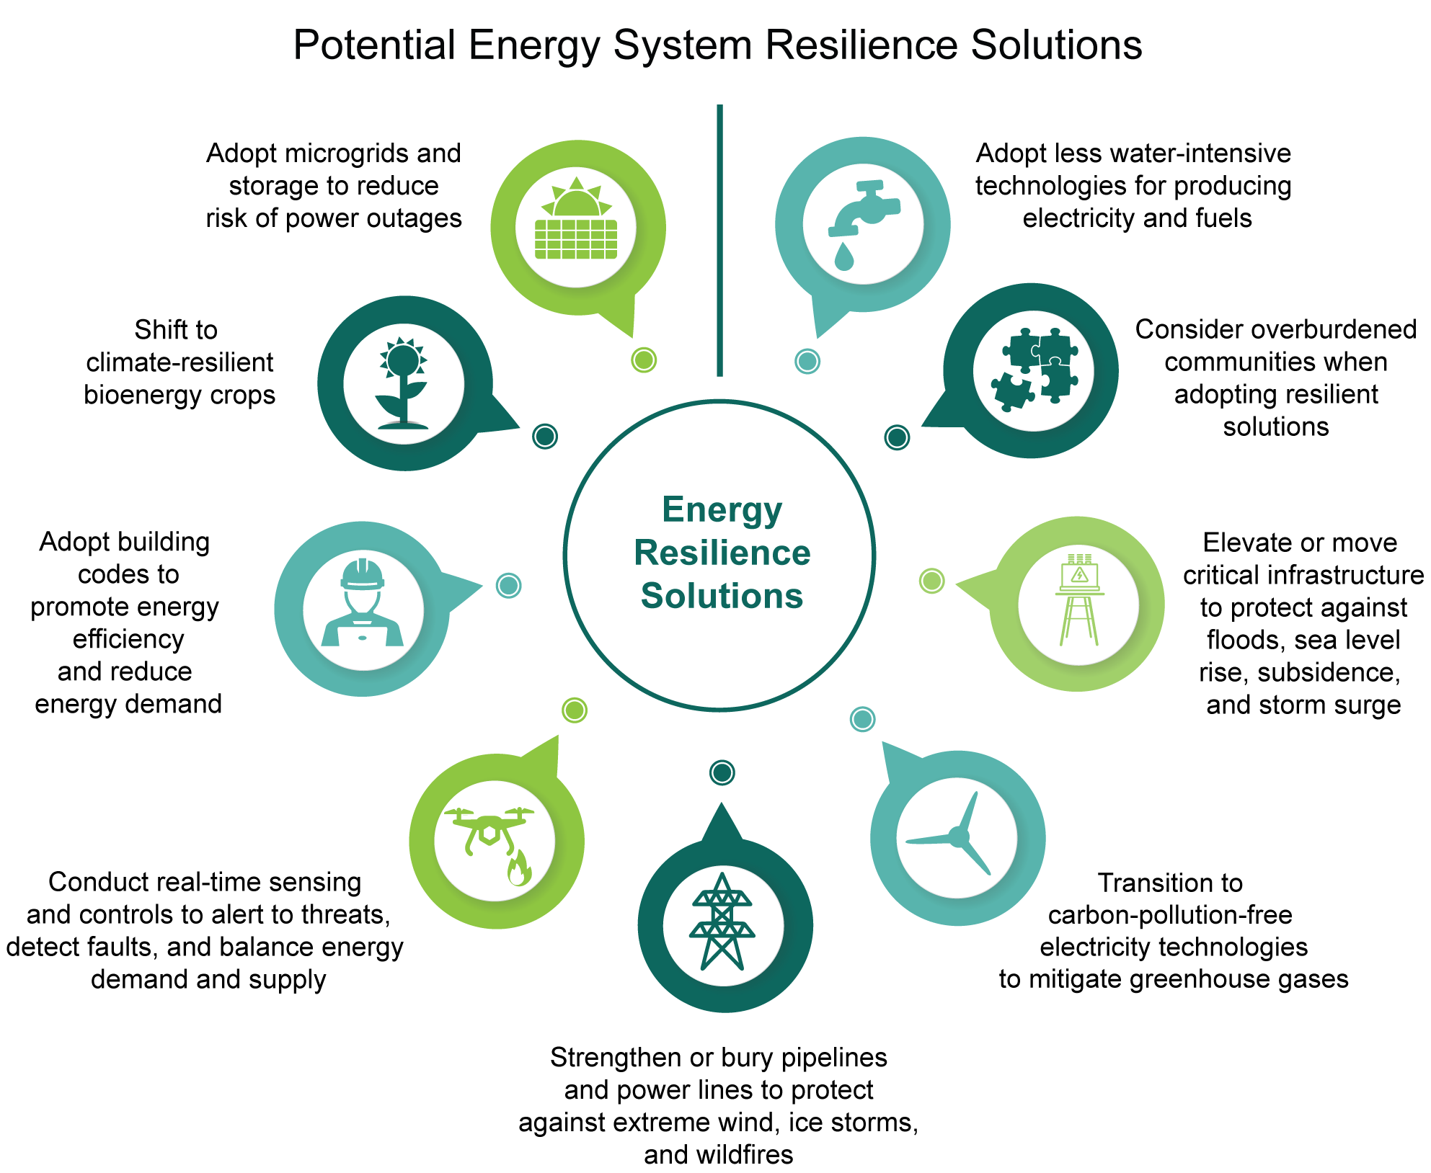
Figure 5.4. Many strategies are available to increase energy system resilience to climate change.
Notes:
CAPTION: While climate change results in risks to the energy system, many approaches for enhancing energy system resilience are available. Resilience options include burying powerlines, elevating critical infrastructure, Introducing microgrids and distributed generation, and improved monitoring. Figure credit: EPA, FEMA, and DOE.

Slide 10
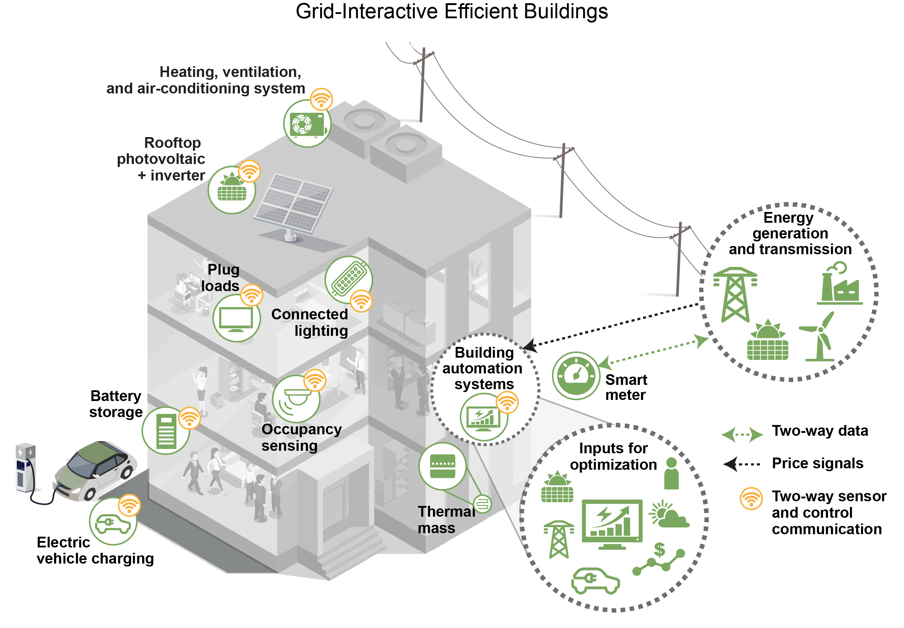
Figure 5.5. A reimagination of building design and operation is being driven by decarbonization goals.
Notes:
CAPTION: Grid-interactive efficient buildings (GEBs) integrate energy efficiency technologies (HVAC, plug loads, lighting), on-site renewable energy (photovoltaics), electric vehicles, and electric storage with smart sensing (HVAC, lighting, and occupancy) and control optimization to enable demand flexibility and provide excess electricity to the power grid through the smart meter when demand exceeds supply or when supply from the grid is constrained. The building automation systems can import the grid electricity pricing and carbon-intensity factor in real time and communicate the potential to reduce demand to the grid through the two-way sensor and communication protocol. Adapted from Nubbe and Yamada 2019,(Nubbe and Yamada 2019) © 2019 Guidehouse Inc.

Slide 11
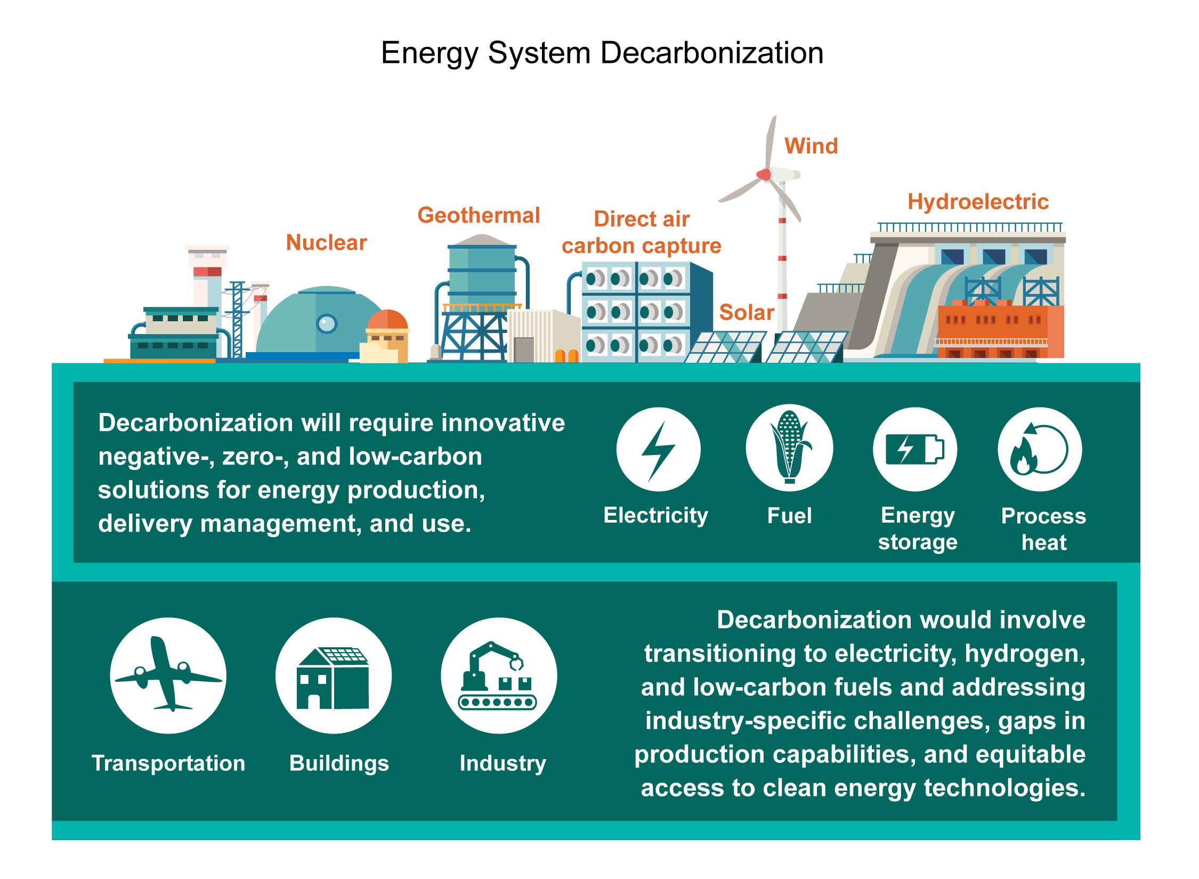
Figure 5.6. Decarbonization will require innovative solutions across multiple sectors.
Notes:
CAPTION: Energy system decarbonization will rely on increased innovation, deployment of clean energy technologies including carbon capture, small modular nuclear reactors, hydrogen, and further integration and electrification of residential and commercial buildings, industry, and transportation. Figure credit: DOE, Idaho National Laboratory, NOAA NCEI, and CISESS NC.

Slide 12
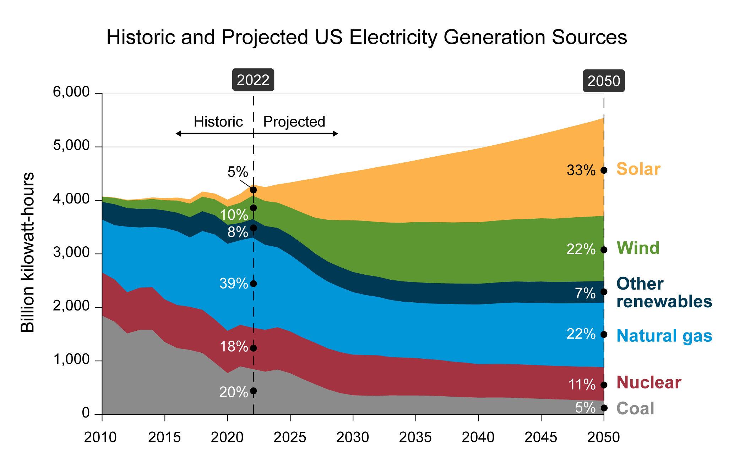
Figure 5.7. The Nation’s electricity grid continues to expand use of clean energy technologies.
Notes:
CAPTION: Most electricity generation projections see significant growth for renewable sources. Recently enacted legislation is anticipated to increase deployment rates for low-carbon technology. Adapted from EIA 2023.(EIA 2023)

Slide 13
Federal Coordinating Lead Author
Craig D. Zamuda, US Department of Energy
Chapter Lead
Craig D. Zamuda, US Department of Energy
Chapter Authors
Daniel E. Bilello, National Renewable Energy Laboratory
Jon Carmack, US Department of Energy
Xujing Jia Davis, US Department of Energy
Rebecca A. Efroymson, Oak Ridge National Laboratory
Kenneth M. Goff, Idaho National Laboratory
Tianzhen Hong, Lawrence Berkeley National Laboratory
Anhar Karimjee, US Department of Energy
Daniel H. Loughlin, US Environmental Protection Agency
Sara Upchurch, Federal Emergency Management Agency
Nathalie Voisin, Pacific Northwest National Laboratory
Technical Contributors
Laura West Fischer, Electric Power Research Institute
Zarrar Khan, Pacific Northwest National Laboratory
Review Editor
Ariel Miara, National Renewable Energy Laboratory
USGCRP Coordinators
Joshua Hernandez, US Global Change Research Program / ICF
Christopher W. Avery, US Global Change Research Program / ICF

Slide 14
Zamuda, C.D., D.E. Bilello, J. Carmack, X.J. Davis, R.A. Efroymson, K.M. Goff, T. Hong, A. Karimjee, D.H. Loughlin, S. Upchurch, and N. Voisin, 2023: Ch. 5. Energy supply, delivery, and demand. In: Fifth National Climate Assessment. Crimmins, A.R., C.W. Avery, D.R. Easterling, K.E. Kunkel, B.C. Stewart, and T.K. Maycock, Eds. U.S. Global Change Research Program, Washington, DC, USA. https://doi.org/10.7930/NCA5.2023.CH5 https://doi.org/10.7930/NCA5.2023.CH5
https://nca2023.globalchange.gov/chapter/5

